Slide 1

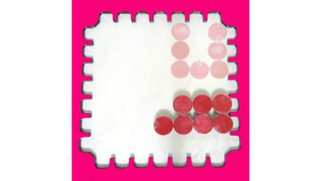

























ε
w_{b}
h_{b}
Build
zone
Robot
Goal
ε+2r
Move
h_{s}
Staging
zone
Drift Move
2ε
w_{s}
start
final
k=1
k=2
k=7

