Slide 1


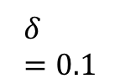
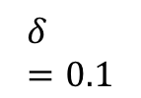

$$δ=0.1$$
$$δ=0.1$$
$$∆s$$
$$∆g$$
$∆$configuration space

