Slide 1
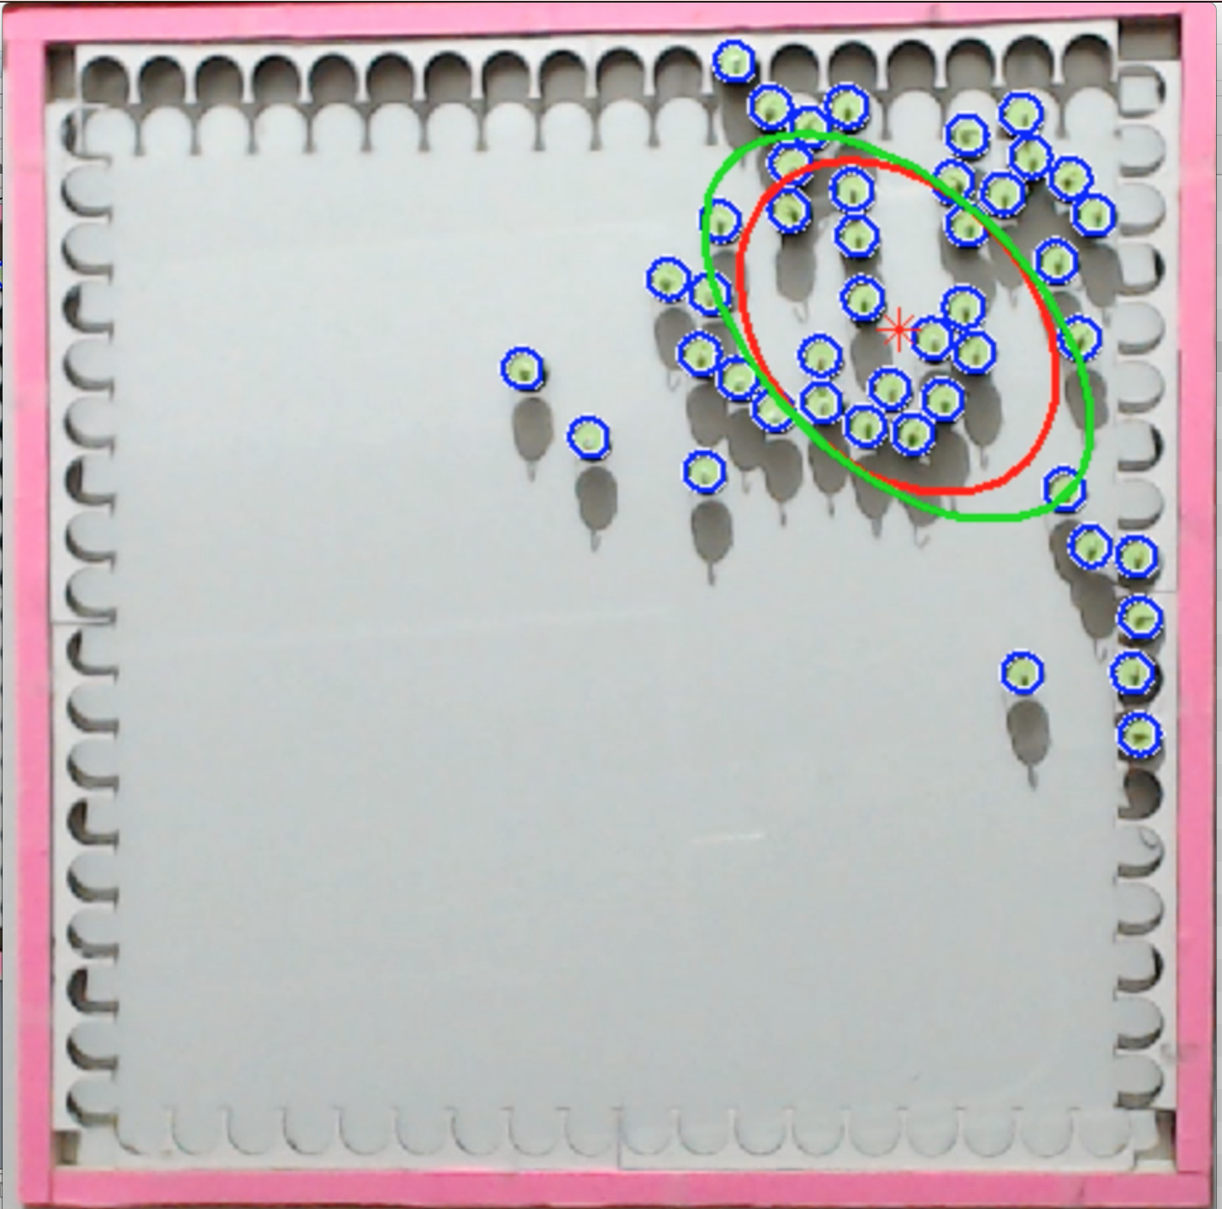
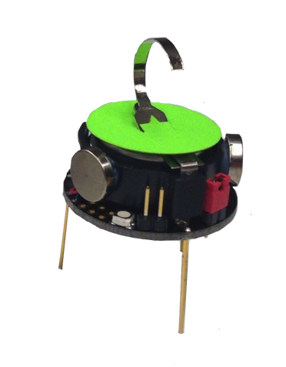
(global control input)
Distant light
sources
Kilobots with photophile behavior
3 cm

