Slide 1
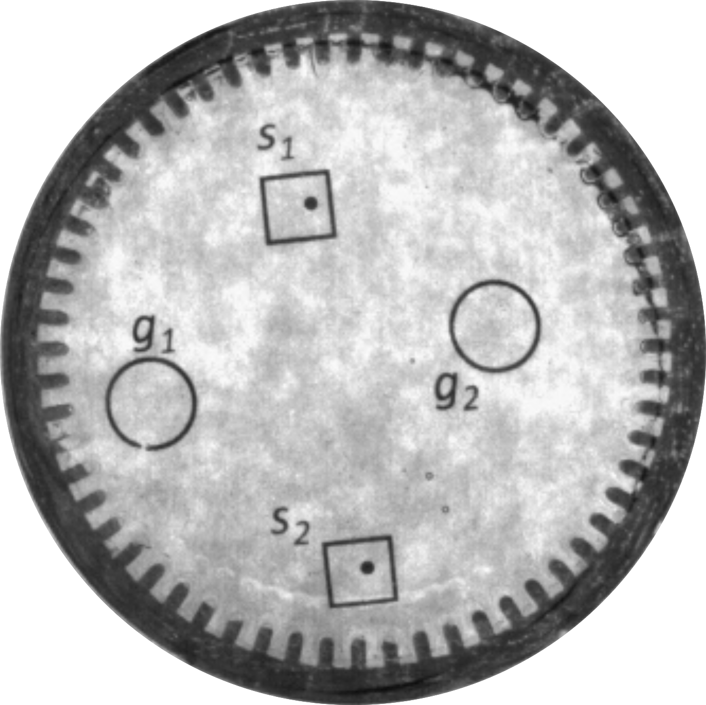
5 mm
1 mm
magnets

