Slide 1
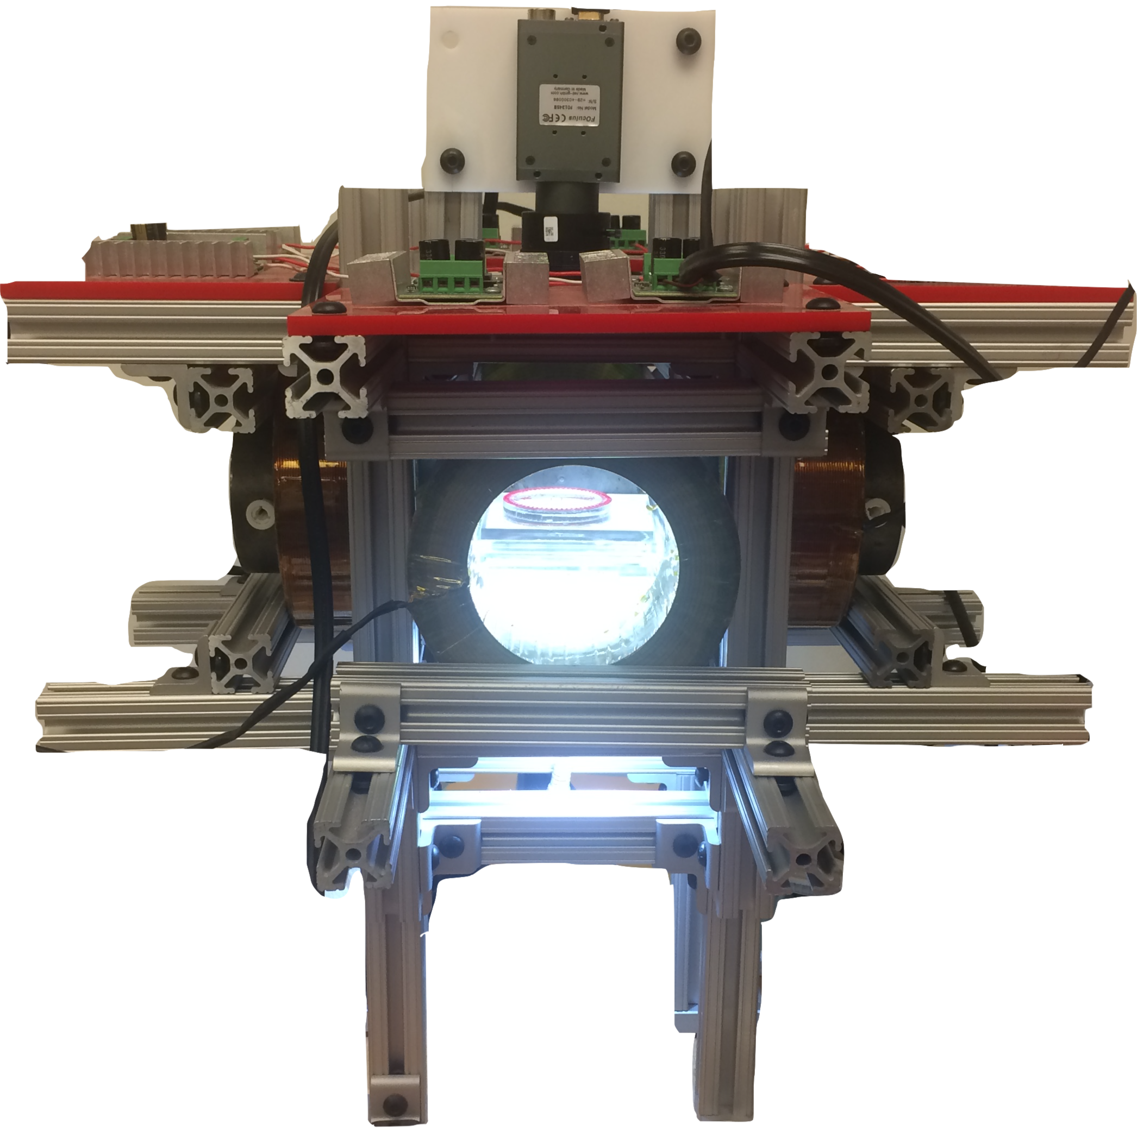
camera
coil
coil
workspace
LED

