Slide 1
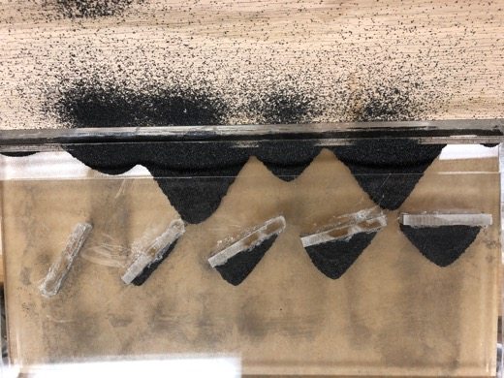
iron Closeup
Salt Closeup

