Slide 1
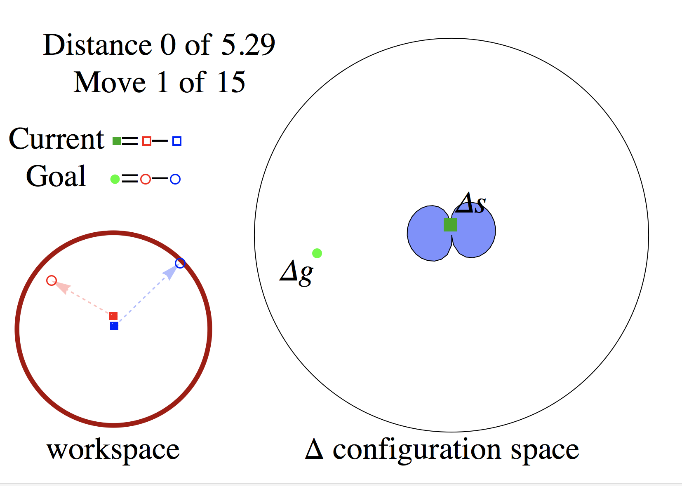
Shiva, start with a configuration like this, and compute what fraction of the Delta Space is reachable if the initial separation is ‘s’ distance.

Slide 2
Fraction of Delta config space reachable in 2 moves
.3
.2
.1
separation distance ‘s’ (distance between two robots in workspace)

Slide 3
Step 2: sample 20 points on boundary of 2-move reachable set, and do a RegionJoin[] of the 2-move reachable set for each of these.

Slide 4
Fraction of Delta config space reachable in 2 moves
.3
4-move reachable
.2
2-move reachable
.1
separation distance ‘s’ (distance between two robots in workspace)

Slide 5
Step 2: sample 20 points on boundary of 2-move reachable set, and do a RegionJoin[] of the 2-move reachable set for each of these.

Slide 6
6-move reachable
Fraction of Delta config space reachable in 2 moves
.3
4-move reachable
.2
2-move reachable
.1
separation distance ‘s’ (distance between two robots in workspace)

