Slide 1


Labelled data with labelled : : CHEAT SHEET
The labelled package provides a set of functions and methods to handle and to manipulate labelled data, as imported with haven package.
Basics
Value labels
Missing values
Labelled data is a common data structure in other statistical environment such as Stata, SAS or SPSS.
It consists of a set of additional attributes for numeric and character vectors (including columns of a data frame).
There are 3 types of attributes:
Variable labels (a short description of a variable)
Value labels (labels associated to specific values)
Missing values:
User-defined missing values (SPSS style)
Tagged NA (Stata and SAS style)
When value labels are attached to a numeric or character vector, the vector’s class becomes haven_labelled. A major difference with a factor is that values of the vector are not changed and it is not mandatory to attach a label to each value.
USER-DEFINED MISSING VALUES (SPSS STYLE)
Used to indicate that some values should be considered as missing. However, they will not be treated as NA as long as they are not converted to proper NA.
When missing values are attached to a numeric or character vector, the vector’s class becomes haven_labelled_spss.
When importing a SPSS file, use the option user_na = TRUE to keep defined missing values (otherwise, they will be converted to NA).
MANIPULATING A VECTOR
 | ³
 | ³
 | ³
val_label(x, value) or val_label(df$v1, value) Get the label attached to a specific value of a vector
val_label(x, value) <- "label" Set/Update the label attached to a specific value
val_label(x, value) <- NULL Remove the label attached to a specific value
val_labels(x) Get all value labels attached to a vector
val_labels(x) <- c(no = 0, yes = 1, maybe = 9) Set/Update all value labels attached to a vector
val_labels(x) <- NULL Remove all value labels attached to a vector
labelled(c("F", "F", "M"), c(Female = "F", Male = "M")) Create a labelled vector
sort_val_labels(x, according_to = "values") Sort value labels according to values (or labels)
drop_unused_value_labels(x) Remove value labels not observed in the data
na_values(x) Get individual missing values attached to a vector
na_values(x) <- c(8, 9, 10) df %>% set_na_values(v1 = c(8, 9, 10)) Set/Update individual missing values (NULL to remove)
na_range(x) Get a range of missing values attached to a vector
na_range(x) <- c(8, 10) df %>% set_na_range(v1 = c(8, 10)) Set/Update a range of missing values (NULL to remove)
user_na_to_na(x) or df %>% user_na_to_na() Convert user-defined missing values to NA
is.na(x) TRUE if NA or if a user-defined missing value
Variable labels
MANIPULATING A VECTOR
³
var_label(x) or var_label(df$v1) Get the variable label associated to a vector x
var_label(x) <- "variable description“ Add/modify a variable label to x
var_label(x) <- NULL Remove the variable label associated to x
MANIPULATING A DATA.FRAME
³ | ³ | ³
var_label(df) List all variable labels associated with columns of df
var_label(df) <- list(v1 = "variable 1", v2 = "variable 2") Update variable labels of some columns of df
df %>% set_variable_labels(v1 = "variable 1", v2 = "variable 2", v3 = NULL) Update variable labels using dplyr syntax
TAGGED NAs (STATA & SAS STYLE)
MANIPULATING A DATA.FRAME
“Tagged” missing values work exactly like regular R missing values except that they store one additional byte of information: a tag, which is usually a letter ("a" to "z").
 |  |  | ³
 |  |  | ³
 |  |  | ³
df %>% set_value_labels(v1 = c(Yes = 1, No = 2), v2 = c(Male = "M", Female = "F")) Define value labels of several variables
df %>% add_value_labels(v1 = c(Unknown = 9)) Add specific value labels to a variable (other already defined value labels remains unchanged)
df %>% remove_value_labels(v1 = 9) Remove specific value labels to a variable
df %>% set_value_labels(v1 = NULL) Remove all value labels attached to a variable
df %>% drop_unused_value_labels() Remove value labels not observed in the data
x <- c(1:5, tagged_na("a"), tagged_na("z"), NA) tagged_na("a") generates a NA with a tag
is.na(x) Tagged NAs work identically to regular NAs
is_tagged_na(x) Test if it is a tagged NA
na_tag(x) Display the tags associated to tagged NAs
format_tagged_na(x) Convert x to a character vector showing the tagged NAs
Searching variable / Dictionary
df %>% look_for() df %>% look_for(details = "full") Generate a data dictionnary
df %>% look_for("s") Search variables containing "s" in their name or label
df %>% look_for_and_select("s") Search variables and apply dplyr::select()
CC BY SA Joseph Larmarange • Learn more at http://larmarange.github.io/labelled • labelled version 2.9.0 • Updated: 2021-03

Slide 2
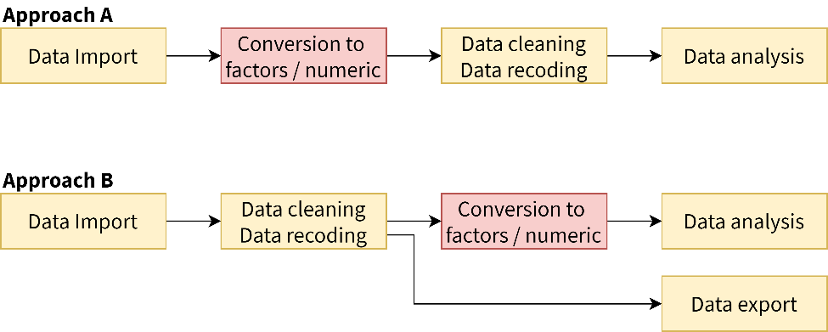
What is labelled data?
Conversion
haven_labelled and haven_labelled_spss classes introduced in haven package allow to add metadata (variable labels, value labels and SPSS-style missing values) to vectors / data frame columns and to properly import these metadata from SAS, Stata or SPSS.
Functions and methods provided by labelled package are designed for easy manipulation of such labelled data.
It should be noted that value labels doesn’t imply that your vectors should be considered as categorical or continuous. Therefore, value labels are not intended to be use for data analysis. For example, before performing modeling or plotting, you should convert vectors with value labels into factors or into classic numeric/character vectors.
Two main approaches could be considered:
OF LABELLED VECTORS
INTO LABELLED VECTORS
If all value labels and user-defined missing values are removed from a labelled vector, the haven_labelled class will be removed and the vector will be transformed into a basic numeric or character vector. Values of the vector will remain unchanged.
to_labelled(f) Convert a factor into a numeric labelled vector. Note that to_labelled(to_factor(x)) and x will not be identical (original coding will be lost).
to_labelled(df) If df was imported with the foreign package or if it is a data set created with memisc package, meta data (variable labels, value labels and user-defined missing values) will be converted into labelled format.
remove_val_labels(x) Remove value labels attached to a vector.
remove_user_na(x) Remove user-defined (na_values and na_range) from a vector
unclass(x) Remove the haven_labelled class. Therefore, the vector will be considered as a classical numeric or character vector. Value labels and user-defined missing values will still be visible as attributes attached to the vector.
If any value label or user-defined missing value is added to a numeric or a character vector, it will be automatically converted into a labelled vector.
Values of the vector will remain unchanged.
When converting a labelled vector into a factor or a character vector of the value labels, be aware that original values of the vector will be converted.
Miscellaneous
to_character(x) Convert into a character vector replacing values by their corresponding value label
to_factor(x) Convert into a character vector replacing values by their corresponding value label
to_factor(x, levels = "prefixed") Value labels will be prefixed with their original value
to_factor(x, strict = TRUE) Convert into a factor only if all observed values have a value label
df %>% to_factor() Convert all labelled vectors and only labelled vectors into factors
df %>% to_factor(labelled_only = FALSE) Convert all columns (including non labelled vectors) into factors
unlabelled(x) df %%>% unlabelled() Labelled vectors will be converted into factors only if all observed values have a value label. Otherwise, they will be unclassed. Similar to df %>% to_factor(labelled_only = T, strict = T, unclass = T)
to_factor(x, drop_unused_labels = TRUE) df %>% unlabelled(drop_unused_labels = TRUE) Unused value labels will be dropped before conversion into factors
nolabel_to_na(x) or df %>% nolabel_to_na() For labelled vectors, values without a value label will be converted into NA
val_labels_to_na(x) or df %>% val_labels_to_na() For labelled vectors, values with a value label will be converted into NA
df2 %>% copy_labels_from(df1) Copy labels and user-defined missing values from df1 to df2 based on shared columns names. Useful when attributes are lost after some data manipulation.
x %>% recode_if(condition, value) Recode only some values based on condition.
recode(x, `2` = 1, `3` =2) Apply dplyr::recode() to a labelled vector. Attached value labels will remain unchanged.
recode(x, `2` = 1, .combine_value_labels = TRUE) Will combine value labels of original values merged together to produce new value labels, to be checked. update_labelled(x) or df %>% update_labelled() If x/df was imported/created using an older version of haven or labelled, you may encounter some unexpected results. update_labelled() will update all labelled vectors to be consistent with the current implementation.
In approach A, labelled vectors are converted into factors or into numeric/character vectors just after data import, using unlabelled(), to_factor() or unclass(). Then, data cleaning, data recoding and analysis are performed using classic R vector types.
In approach B, labelled vectors are kept for data cleaning and recoding, allowing to preserve original coding, in particular if data should be reexported after that step. Functions provided by labelled will be useful for managing value labels.
However, as in approach A, labelled vectors will have to be converted into classic factors or numeric vectors before data analysis as this is the way categorical and continuous variables should be coded for analysis.
CC BY SA Joseph Larmarange • Learn more at http://larmarange.github.io/labelled • labelled version 2.9.0 • Updated: 2021-03

