Slide 1


Labelled data with labelled : : CHEAT SHEET
The labelled package provides a set of functions and methods to handle labelled data, as imported with haven package.
Basics
Value labels
Missing values
Labelled data is a common data structure in other statistical environment such as Stata, SAS or SPSS.
It consists of a set of additional attributes for vectors (including columns of a data frame).
There are 3 types of attributes:
Variable labels (a short description of a variable)
Value labels (labels associated to specific values)
Missing values:
User-defined missing values (SPSS style)
Tagged NA (Stata and SAS style)
When value labels are attached to a numeric or character vector, the vector’s class becomes haven_labelled. A major difference with a factor is that values of the vector are not changed and it is not mandatory to attach a label to each value.
USER-DEFINED MISSING VALUES (SPSS STYLE)
Used to indicate that some values should be considered as missing. However, they will not be treated as NA as long as they are not converted to proper NA.
When missing values are attached to a numeric or character vector, the vector’s class becomes haven_labelled_spss.
When importing a SPSS file, use the option user_na = TRUE to keep defined missing values (otherwise, they will be converted to NA).
MANIPULATING A VECTOR
 | ³
 | ³
 | ³
val_label(x, value) or val_label(df$v1, value) Get the label attached to a specific value of a vector
val_label(x, value) <- "label" Set/Update the label attached to a specific value
val_label(x, value) <- NULL Remove the label attached to a specific value
val_labels(x) Get all value labels attached to a vector
val_labels(x) <- c(no = 0, yes = 1, maybe = 9) Set/Update all value labels attached to a vector
val_labels(x) <- NULL Remove all value labels attached to a vector
labelled(c("F", "F", "M"), c(Female = "F", Male = "M")) Create a labelled vector
sort_val_labels(x, according_to = "values") Sort value labels according to values (or labels)
drop_unused_value_labels(x) Remove value labels not observed in the data
na_values(x) Get individual missing values attached to a vector
na_values(x) <- c(8, 9, 10) df %>% set_na_values(v1 = c(8, 9, 10)) Set/Update individual missing values (NULL to remove)
na_range(x) Get a range of missing values attached to a vector
na_range(x) <- c(8, 10) df %>% set_na_range(v1 = c(8, 10)) Set/Update a range of missing values (NULL to remove)
user_na_to_na(x) or df %>% user_na_to_na() Convert user-defined missing values to NA
is_na(x) TRUE if NA or if a user-defined missing value
Variable labels
MANIPULATING A VECTOR
³
var_label(x) or var_label(df$v1) Get the variable label associated to a vector x
var_label(x) <- "variable description“ Add/modify a variable label to x
var_label(x) <- NULL Remove the variable label associated to x
MANIPULATING A DATA.FRAME
TAGGED NAs (STATA & SAS STYLE)
³ | ³ | ³
var_label(df) List all variable labels associated with columns of df
var_label(df) <- list(v1 = "variable 1", v2 = "variable 2") Update variable labels of some columns of df
df %>% set_variable_labels(v1 = "variable 1", v2 = "variable 2", v3 = NULL) Update variable labels using dplyr syntax
look_for(df) or df %>% look_for() Return a data frame with all variable names and labels
look_for(df, "s") or df %>% look_for("s") Search variables containing "s" in their name or label
look_for(df, details = TRUE) Return additional details on each variable
“Tagged” missing values work exactly like regular R missing values except that they store one additional byte of information: a tag, which is usually a letter ("a" to "z").
MANIPULATING A DATA.FRAME
x <- c(1:5, tagged_na("a"), tagged_na("z"), NA) tagged_na("a") generates a NA with a tag
is.na(x) Tagged NAs work identically to regular NAs
is_tagged_na(x) Test if it is a tagged NA
na_tag(x) Display the tags associated to tagged NAs
format_tagged_na(x) Convert x to a character vector showing the tagged NAs
 |  |  | ³
 |  |  | ³
 |  |  | ³
df %>% set_value_labels(v1 = c(Yes = 1, No = 2), v2 = c(Male = "M", Female = "F")) Define value labels of several variables
df %>% add_value_labels(v1 = c(Unknown = 9)) Add specific value labels to a variable (other already defined value labels remains unchanged)
df %>% remove_value_labels(v1 = 9) Remove specific value labels to a variable
df %>% set_value_labels(v1 = NULL) Remove all value labels attached to a variable
CC BY SA Joseph Larmarange • Learn more at http://larmarange.github.io/labelled • labelled version 2.5.0 • Updated: 2020-06

Slide 2
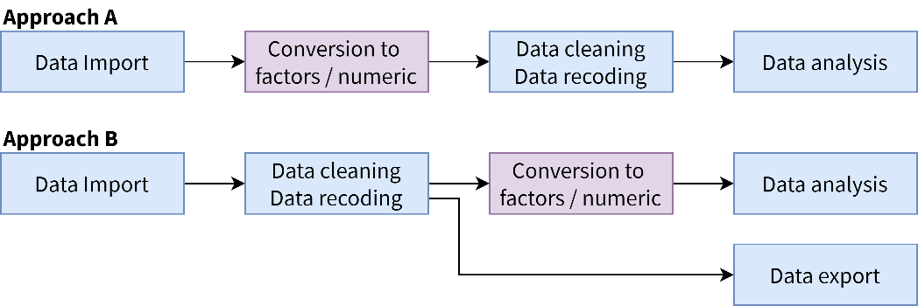
When using labelled data?
Conversion
Miscellaneous
haven_labelled and haven_labelled_spss classes introduced in haven package allow to add metadata (variable labels, value labels and SPSS-style missing values) to vectors / data frame columns and to properly import these metadata from SAS, Stata or SPSS.
It should be noted that value labels doesn’t imply that your vectors should be considered as categorical or continuous. Therefore, value labels are not intended to be use for data analysis. For example, before performing modeling or plotting, you should convert vectors with value labels into factors or into classic numeric/character vectors.
Two main approaches could be considered:
OF A LABELLED VECTOR
USER-DEFINED MISSING VALUES (SPSS STYLE)
val_label(x, value) or val_label(df$v1, value) Get the label attached to a specific value of a vector
val_label(x, value) <- "label" Set/Update the label attached to a specific value
val_label(x, value) <- NULL Remove the label attached to a specific value
val_labels(x) Get all value labels attached to a vector
val_labels(x) <- c(no = 0, yes = 1, maybe = 9) Set/Update all value labels attached to a vector
val_labels(x) <- NULL Remove all value labels attached to a vector
labelled(c("F", "F", "M"), c(Female = "F", Male = "M")) Create a labelled vector
sort_val_labels(x, according_to = "values") Sort value labels according to values (or labels)
nolabel_to_na(x) Values with no label are converted to NA values
val_labels_to_na(x) Values with a label are converted to NA values
Used to indicate that some values should be considered as missing. However, they will not be treated as NA as long as they are not converted to proper NA.
When missing values are attached to a numeric or character vector, the vector’s class becomes haven_labelled_spss.
When importing a SPSS file, use the option user_na = TRUE to keep defined missing values (otherwise, they will be converted to NA).
na_values(x) Get individual missing values attached to a vector
na_values(x) <- c(8, 9, 10) df %>% set_na_values(v1 = c(8, 9, 10)) Set/Update individual missing values (NULL to remove)
na_range(x) Get a range of missing values attached to a vector
na_range(x) <- c(8, 10) df %>% set_na_range(v1 = c(8, 10)) Set/Update a range of missing values (NULL to remove)
user_na_to_na(x) or df %>% user_na_to_na() Convert user-defined missing values to NA
is_na(x) TRUE if NA or if a user-defined missing value
In approach A, labelled vectors are converted into factors or into numeric/character vectors just after data import, using unlabelled(), to_factor() or unclass(). Then, data cleaning, data recoding and analysis are performed using classic R vector types.
In approach B, labelled vectors are kept for data cleaning and recoding, allowing to preserved original coding, in particular if data should be reexported after that step. Functions provided by labelled will be useful for managing value labels.
However, as in approach A, labelled vectors will have to be converted into classic factors or numeric vectors before data analysis as this is the way categorical and continuous variables should be coded for analysis.
TAGGED NAs (STATA & SAS STYLE)
“Tagged” missing values work exactly like regular R missing values except that they store one additional byte of information: a tag, which is usually a letter ("a" to "z").
INTO A LABELLED VECTOR
x <- c(1:5, tagged_na("a"), tagged_na("z"), NA) tagged_na("a") generates a NA with a tag
is.na(x) Tagged NAs work identically to regular NAs
is_tagged_na(x) Test if it is a tagged NA
na_tag(x) Display the tags associated to tagged NAs
format_tagged_na(x) Convert x to a character vector showing the tagged NAs
df %>% set_value_labels(v1 = c(Yes = 1, No = 2), v2 = c(Male = "M", Female = "F")) Define value labels of several variables
df %>% add_value_labels(v1 = c(Unknown = 9)) Add specific value labels to a variable (other already defined value labels remains unchanged)
df %>% remove_value_labels(v1 = 9) Remove specific value labels to a variable
df %>% set_value_labels(v1 = NULL) Remove all value labels attached to a variable
CC BY SA Joseph Larmarange • Learn more at http://larmarange.github.io/labelled • labelled version 2.5.0 • Updated: 2020-06

Slide 3

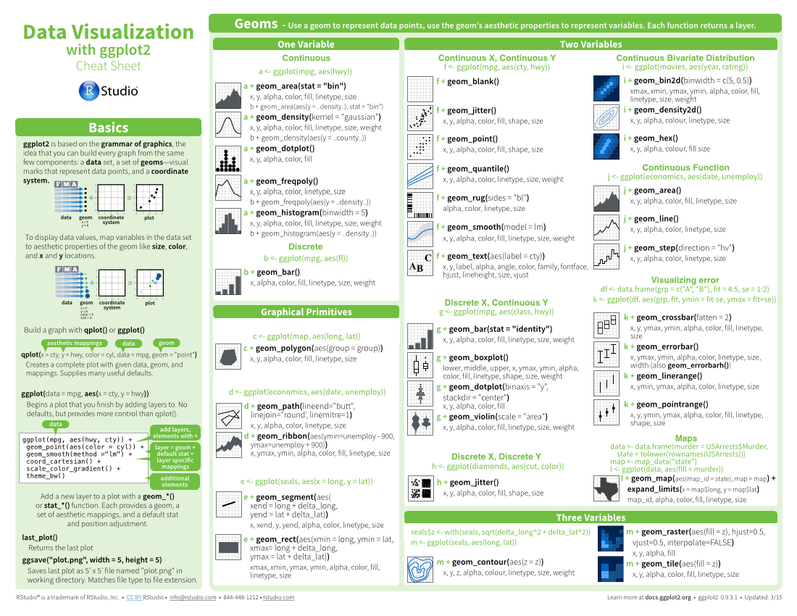




Four Column Layout : : CHEAT SHEET
Basics
Layout Suggestions
Useful Elements
Logistics
Thank you for making a new cheatsheet for R! These cheatsheets have an important job:
Use headers, colors, and/or backgrounds to separate or group together sections.
CODE
FONTS
Section 1
Section 2
Section 3
Where possible, use code that works when run.
This template uses several fonts: Helvetica Neue, Menlo, Source Sans pro, which you can acquire for free here, www.fontsquirrel.com/fonts/source-sans-pro, and Font Awesome, which you can acquire here, fortawesome.github.io/Font-Awesome/get-started/
Cheatsheets make it easy for R users
to look up useful information.
ggplot(mpg, aes(hwy, cty)) +
geom_point(aes(size = fl)) +
geom_smooth(method ="lm")
Remember that the best cheatsheets are visual—not written—documents. Whenever possible use visual elements to make it easier for readers to find the information they need.
Word balloons
can help explain
code
Create a visual hierarchy. Help users navigate the page with titles, subtitles, and subsubtitles
Title
To use a font awesome icon, copy and paste one from here fortawesome.github.io/Font-Awesome/cheatsheet/. Then set the text font to font awesome.
Use a layout that flows and makes it easy to zero in on specific topics.
ICONS
SUBTITLE
These are just font awesome characters
SUBSUBTITLE
☞    
Fit sections to content. Try several different layouts.
Use numbers or arrows to link sections if the order/flow is confusing.
Quickly identify content with a package hexsticker (if available)
MOCK TABLES
KEYNOTE
Use visualizations to explain concepts quickly and concisely.
I make my cheatsheets in Apple Keynote, and not latex or R Markdown, because presentation software makes it much easier to tweak the visual appearance of a document
summary function
Use visual elements to make the sheet scannable.
KEYNOTE TIPS
MOCK GRAPHS
Select multiple elements by holding down shift and then selecting each. Click on a selected element before letting go of shift to unselect it.
To group elements together. Select them all , then click Arrange > Group
To evenly space multiple objects, select them all then Right Click > Align objects or Right Click > Distribute objects
Click on a table, then visit Format >Table > Row and Column Size to make even width rows/columns.
i + geom_area() x, y, alpha, color, fill, linetype, size
i + geom_line() x, y, alpha, color, group, linetype, size
Copyright
Use visual emphasis (like color, size, and font weight) to make important information easy to find.
Each cheatsheet should be licensed under the creative commons license.
To license the sheet as creative commons, put CC'd by <your name> in the small print at the bottom of each page and link it to
http://creativecommons.org/licenses/by/4.0/
TABLES
sub-option | description
citation_package | The LaTeX package to process citations, natbib, biblatex or none
code_folding | Let readers to toggle the display of R code, "none", "hide", or "show"
colortheme | Beamer color theme to use
dplyr::lag() - Offset elements by 1
dplyr::lead() - Offset elements by -1
YOUR LOGO
(optional)
CC BY SA Joseph Larmarange • joseph@larmarange.net • http://larmarange.github.io/labelled/ • Learn more at webpage or vignette • package version 2.2.0 • Updated: 2019-05

Slide 4
Three Column Layout: : CHEAT SHEET
Basics
Layout Suggestions
Manipulate Variables
Thank you for making a new cheatsheet for R! These cheatsheets have an important job:
Use headers, colors, and/or backgrounds to separate or group together sections.
Create a visual hierarchy. Help users navigate the page with titles, subtitles, and subsubtitles
Quickly identify content with a package hexsticker (if available)
Fit sections to content. Try several different layouts.
Use numbers or arrows to link sections if the order/flow is confusing.
Cheatsheets make it easy for R users
to look up useful information.
Section 1
Section 2
Section 3
Title
Remember that the best cheatsheets are visual—not written—documents. Whenever possible use visual elements to make it easier for readers to find the information they need.
SUBTITLE
SUBSUBTITLE
Use a layout that flows and makes it easy to zero in on specific topics.
Logistics
Useful Elements
FONTS
CODE
This template uses several fonts: Helvetica Neue, Menlo, Source Sans pro, which you can acquire for free here, www.fontsquirrel.com/fonts/source-sans-pro, and Font Awesome, which you can acquire here, fortawesome.github.io/Font-Awesome/get-started/
Where possible, use code that works when run.
Word balloons
ggplot(mpg, aes(hwy, cty)) +
geom_point(aes(color = cyl)) +
geom_smooth(method ="lm")
can help explain
code
Use visualizations to explain concepts quickly and concisely.
summary function
To use a font awesome icon, copy and paste one from here fortawesome.github.io/Font-Awesome/cheatsheet/. Then set the text font to font awesome.
ICONS
☞ 
❑  
These are just font awesome characters
wind | wind | wind
Use visual elements to make the sheet scannable.
i + geom_area() x, y, alpha, color, fill, linetype, size
i + geom_line() x, y, alpha, color, group, linetype, size
KEYNOTE
MOCK TABLES
I make my cheatsheets in Apple Keynote, and not latex or R Markdown, because presentation software makes it much easier to tweak the visual appearance of a document
F | M | A
wind | wind | wind
wind | wind | wind
Use visual emphasis (like color, size, and font weight) to make important information easy to find.
KEYNOTE TIPS
Select multiple elements by holding down shift and then selecting each. Click on a selected element before letting go of shift to unselect it.
To group elements together. Select them all , then click Arrange > Group
To evenly space multiple objects, select them all then Right Click > Align objects or Right Click > Distribute objects
Click on a table, then visit Format >Table > Row and Column Size to make even width rows/columns.
MOCK GRAPHS
dplyr::lag() - Offset elements by 1
dplyr::lead() - Offset elements by -1
COPYRIGHT
Each cheatsheet should be licensed under the creative commons license.
To license the sheet as creative commons, put CC'd by <your name> in the small print at the bottom of each page and link it to http://creativecommons.org/licenses/by/4.0/
TABLES
sub-option | description
citation_package | The LaTeX package to process citations, natbib, biblatex or none
code_folding | Let readers to toggle the display of R code, "none", "hide", or "show"
colortheme | Beamer color theme to use
YOUR LOGO
(optional)
RStudio® is a trademark of RStudio, Inc. • CC BY SA Your Name • your@email.com • 844-448-1212 • your.website.com • Learn more at webpage or vignette • package version 0.5.0 • Updated: 2017-01

