Slide 1
Waterbirds Detection: Classifying a Minority
Lukáš Malík · Alejandro Macías del Pozo | ELE680 Deep Neural Networks · Group 3
Notes:
Open with the question, not the method. We were asked to maximise worst-group accuracy on Waterbirds and report the trade-off with average accuracy. Our angle: separate the effect of data rebalancing from the effect of the robust objective, on two different backbones.

Slide 2
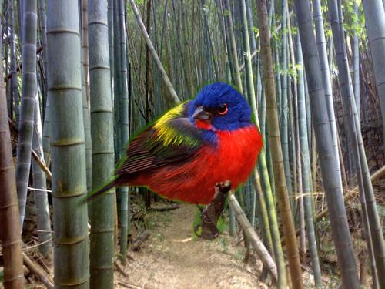
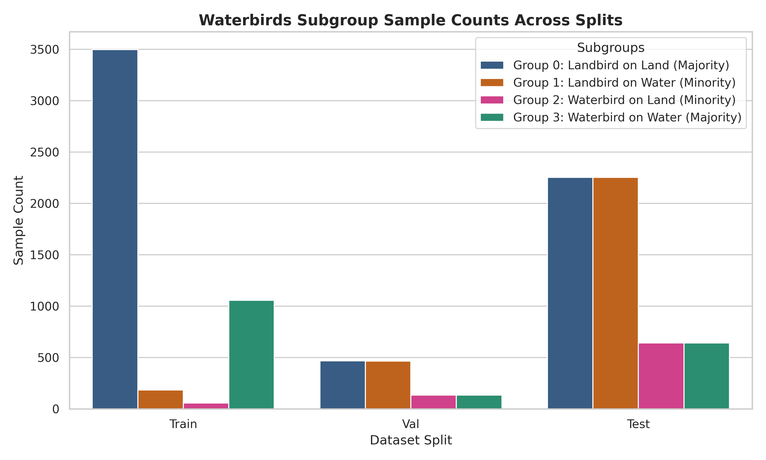
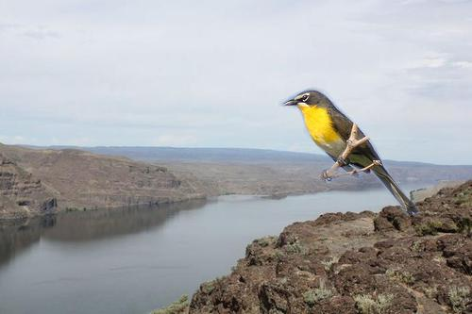
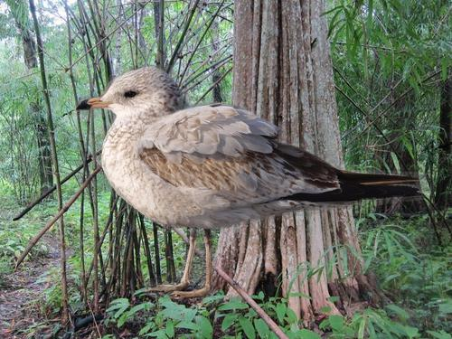

A model can be right for the wrong reason
G0 Landbird on land
3,498 train · majority
G1 Landbird on water
184 train · minority
G2 Waterbird on land
56 train · minority (hardest)
G3 Waterbird on water
1,057 train · majority
Notes:
95% of waterbirds are on water and 95% of landbirds on land in training. A model can score well on average by detecting water. Dataset, groups and the worst-group metric come from Sagawa et al. (2020); the framing of shortcut learning from Geirhos et al. (2020). Group 2 has only 56 training images.

Slide 3
A controlled design that separates data from loss
3 objectives
ERM (mean CE)
Group-reweighted CE, N / (4·n_g)
Group DRO
2 data loaders
Standard shuffling
Group-balanced sampler (1 / n_g)
2 backbones
ResNet-50 (CNN)
ViT-B/16 (Transformer)
Compared with Sagawa et al.
Paper: ResNet-50 only; we add a ViT-B/16
Paper reports methods; we cross every objective with every sampler, so the two effects can be separated
Includes the combination nobody recommends (reweight + balanced sampler) — and shows why
Every run ranked on validation, test touched once
×
×
12
28
1
main runs (Table 1)
Group DRO sweep runs (14 configs × 2 backbones)
rule for every choice: validation worst-group acc
Notes:
Key design idea: the balanced sampler and the reweighted loss both equalise group exposure, Group DRO adds an adaptive objective. By crossing them we can ask how much of the gain is just rebalancing. ERM + balanced sampler is the 'upweighting' baseline from the paper.

Slide 4
Our own Group DRO loss, step by step
1
Per-sample CE
reduction='none'
Given (Sagawa et al., Algorithm 1)
The update rule and the C/√n_g adjustment
Official code (kohpangwei/group_DRO)
2
Per-group mean loss ℓ_g
mask by group id; absent group → 0
Ours
Re-written from the paper in plain PyTorch (src/loss.py)
GroupLogger: per-group accuracy and loss for every epoch (src/utils.py)
Unified CLI for all methods, samplers and backbones, plus seeding
3
Update weights q
q_g ← q_g · exp(η (ℓ_g + C/√n_g)), renormalise, detached from autograd
4
Robust loss
Σ_g q_g ℓ_g → backward()
Notes:
Be ready to explain this in the oral exam. q is detached: it is updated by exponentiated gradient ascent, while the network does gradient descent on the q-weighted loss. A group missing from the mini-batch gets loss 0, so its weight is not increased in that step — this matters later.

Slide 5
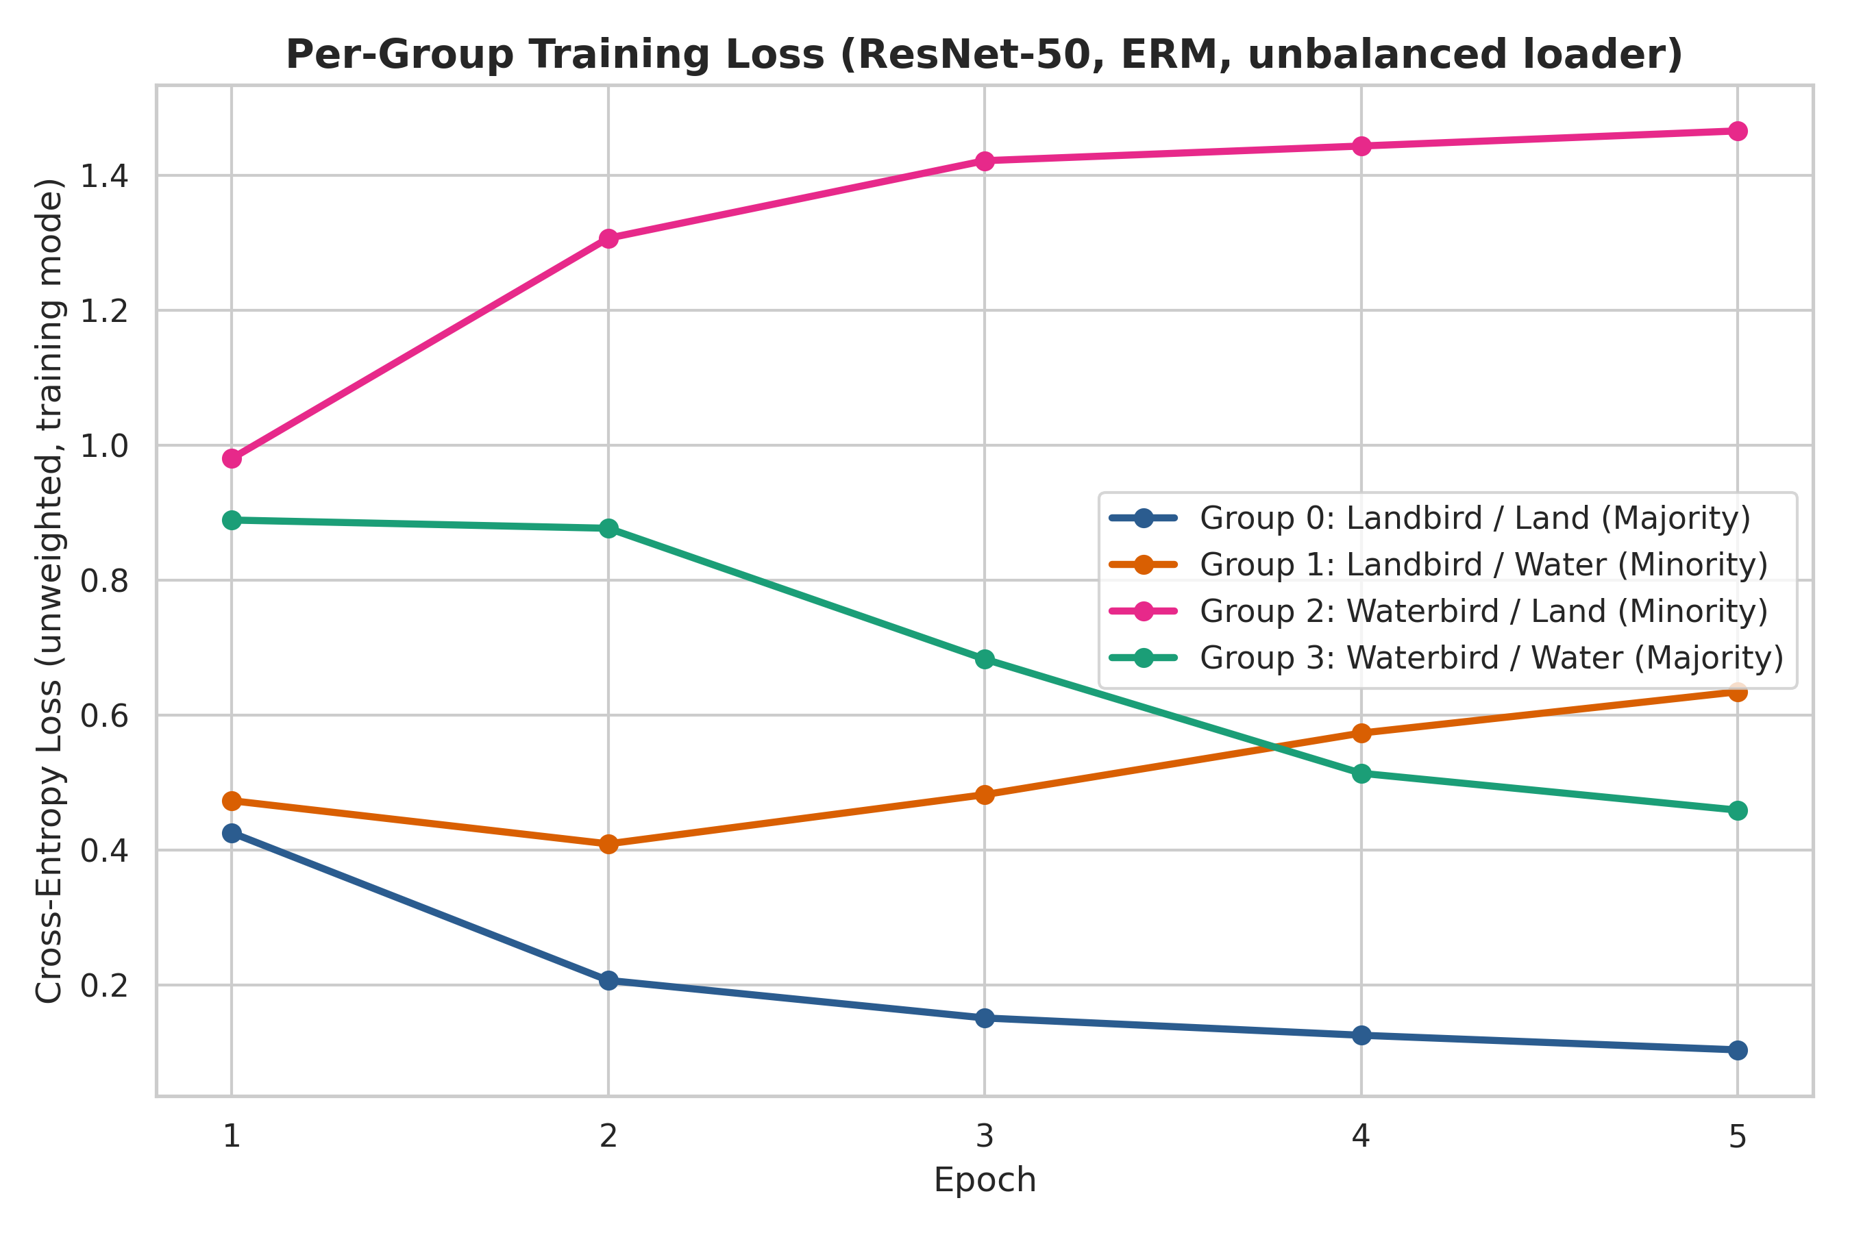
ERM learns the background, not the bird
99.7%
ResNet-50 ERM on G0 (landbird on land)
8.9%
same model on G2 (waterbird on land)
51.1%
ViT-B/16 ERM on G2 — better, still >40 pts behind
Notes:
Our per-group loss logging lets us see the shortcut forming during training, not only at test time: under ERM the minority groups' loss goes UP while the average loss goes down. G2 training accuracy is 8.9% at epoch 5 — the model never even fits the minority.

Slide 6
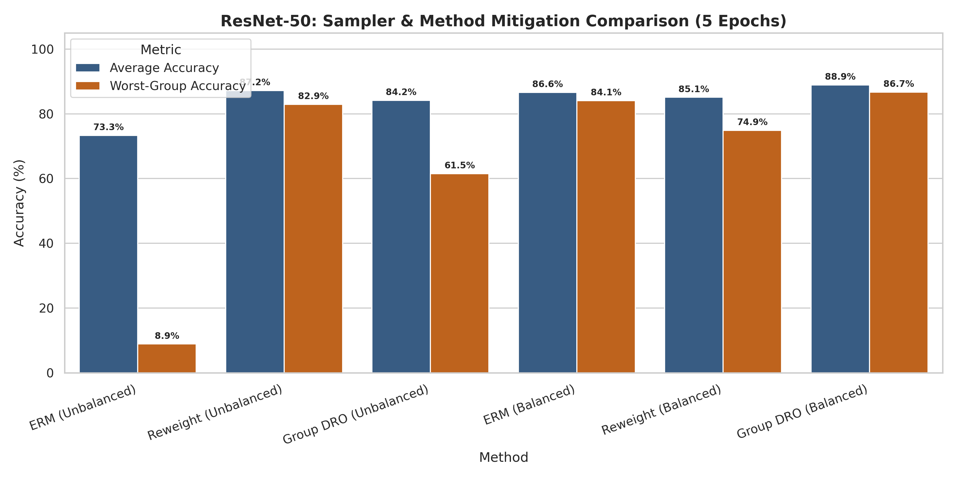
Rebalancing the data does most of the work
+75.2
pts worst-group from the balanced sampler alone (ERM 8.88 → 84.08, ResNet-50)
+2.7
pts extra from Group DRO on top (→ 86.74); ViT: +3.1
≈ 1.4 pts is the binomial standard error on 642 test images — the Group DRO gain is close to noise.
Notes:
This is our main answer to question (i). Plain upweighting via the sampler closes almost the whole gap. Consistent with Sagawa et al.: in the early-stopping regime importance weighting works, and Group DRO adds only a few points.

Slide 7
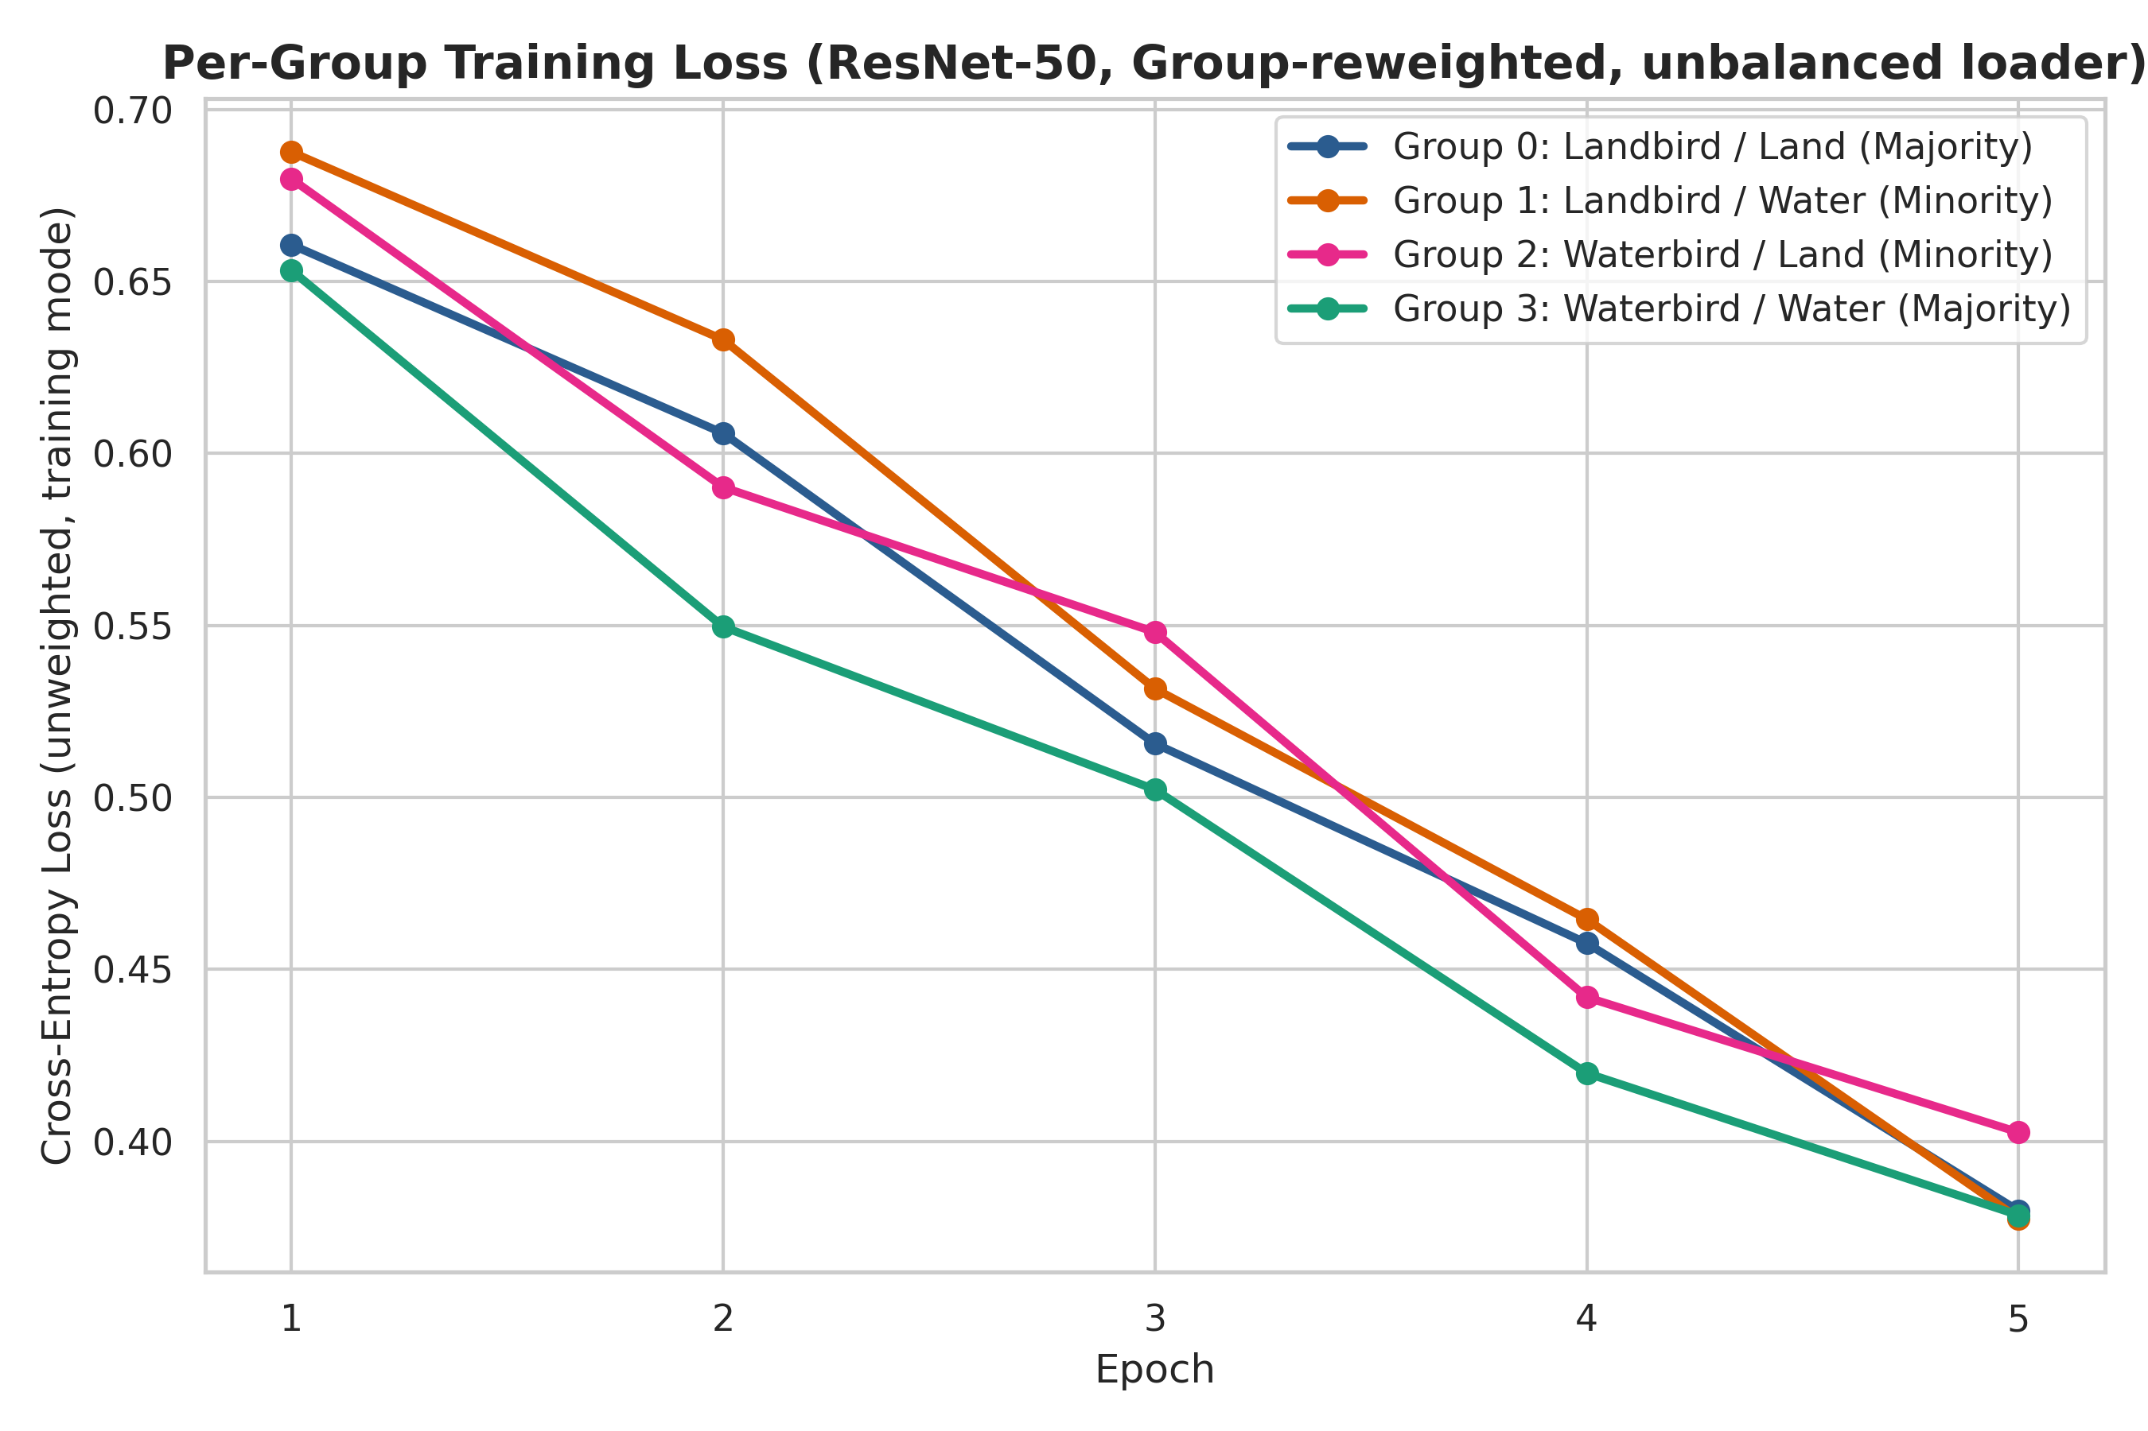
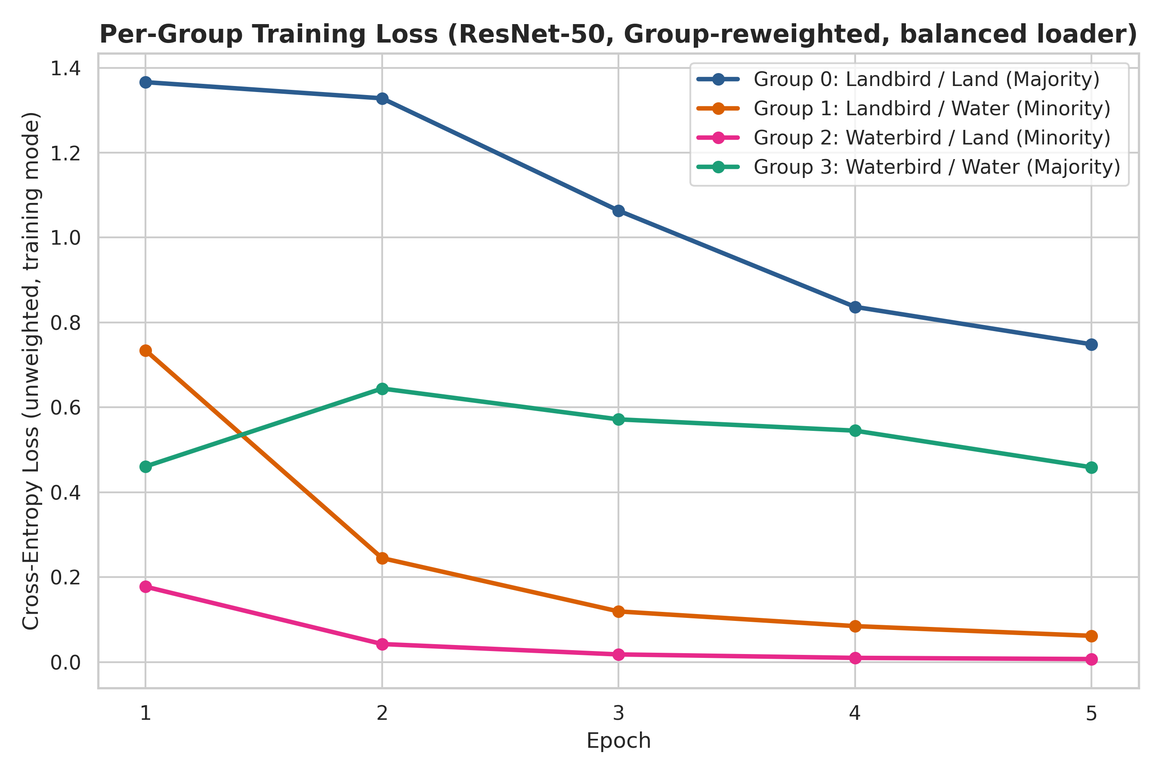
Correcting twice breaks the majority group
Inverse-frequency weighting applied in the sampler AND the loss = correction squared. ResNet-50: G1/G2 rise to 93.8 / 94.1%, but G0 drops to 74.9% → worst group flips to the majority. ViT-B/16 barely cares (88.6 vs 88.3%).
Notes:
New finding from our crossed design. The two rebalancing tools must not be stacked: the effective weight of G2 relative to G0 becomes (3498/56)² instead of 3498/56. Our code prints a warning when this combination is used.

Slide 8
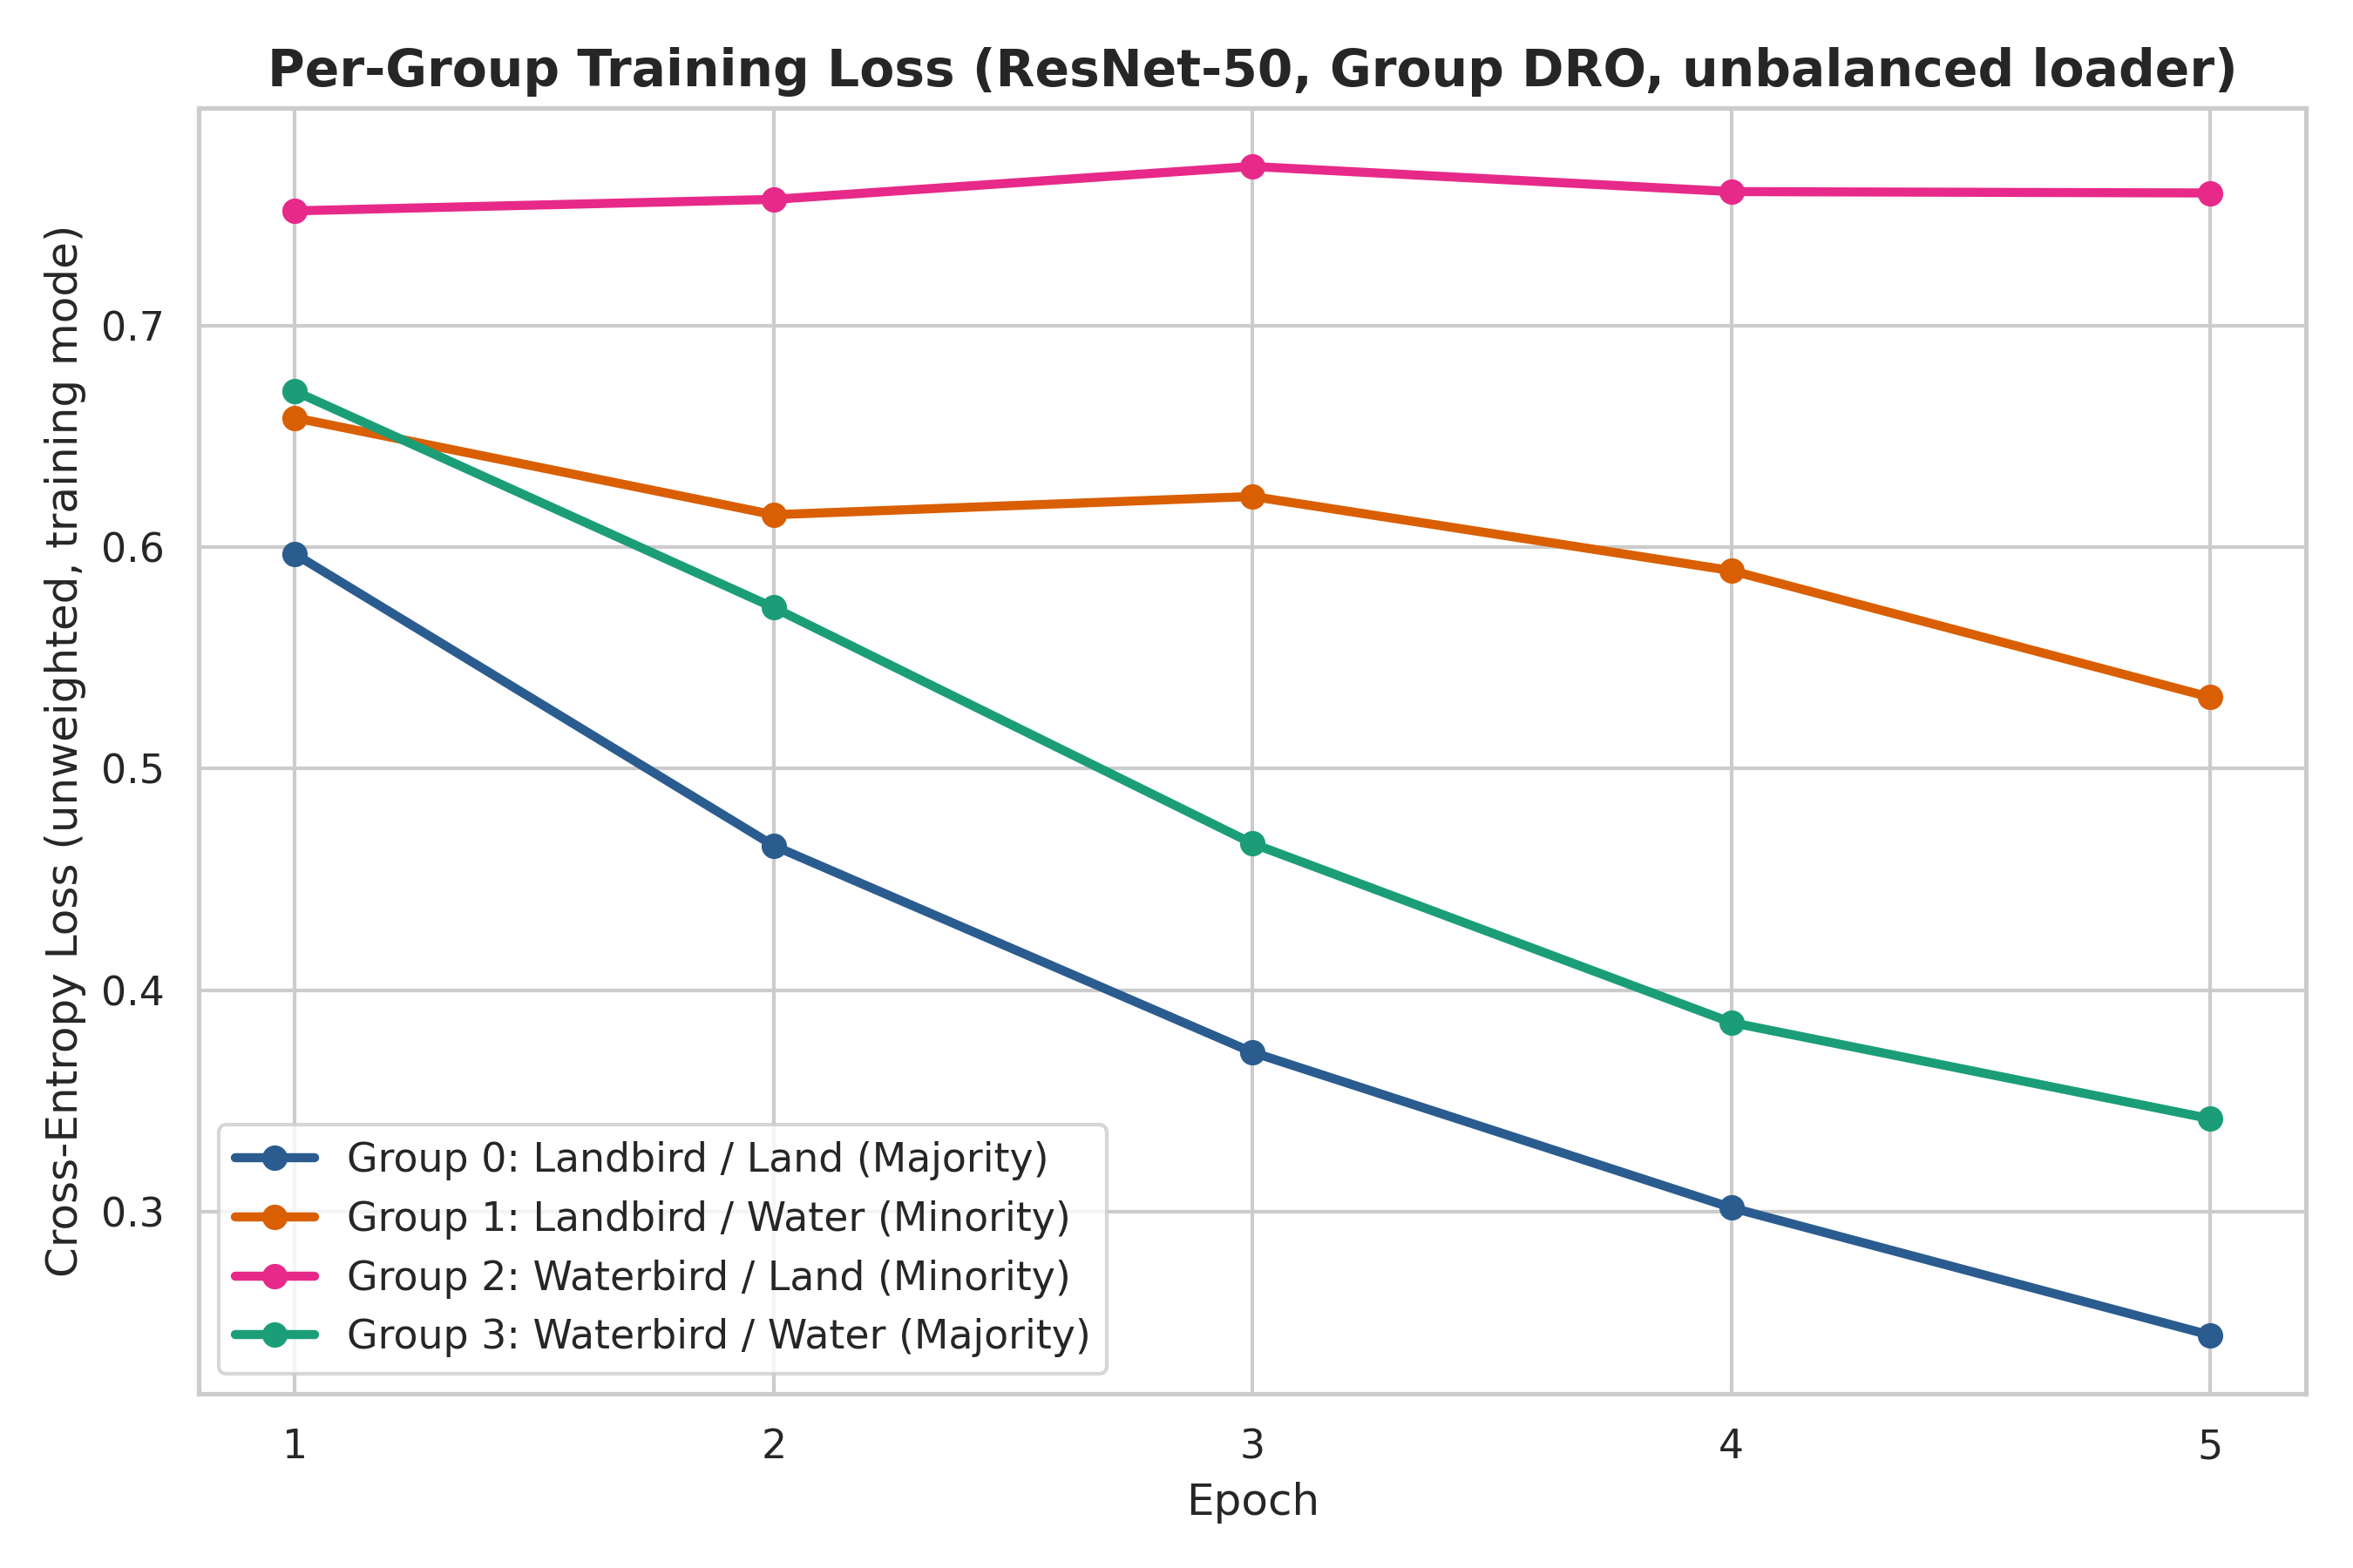
Why Group DRO needs the balanced sampler
69%
of size-32 batches contain no G2 image with standard shuffling: (1 − 56/4795)³² ≈ 0.69
When G2 is missing, ℓ₂ = 0 in that step, so its weight q₂ is not pushed up — the adversary systematically under-weights the group it should protect.
Notes:
Our explanation, not from the paper: the online q update only sees groups present in the batch. ResNet-50 drops 25 points without the sampler; ViT only 2 points, so it depends on it much less.

Slide 9
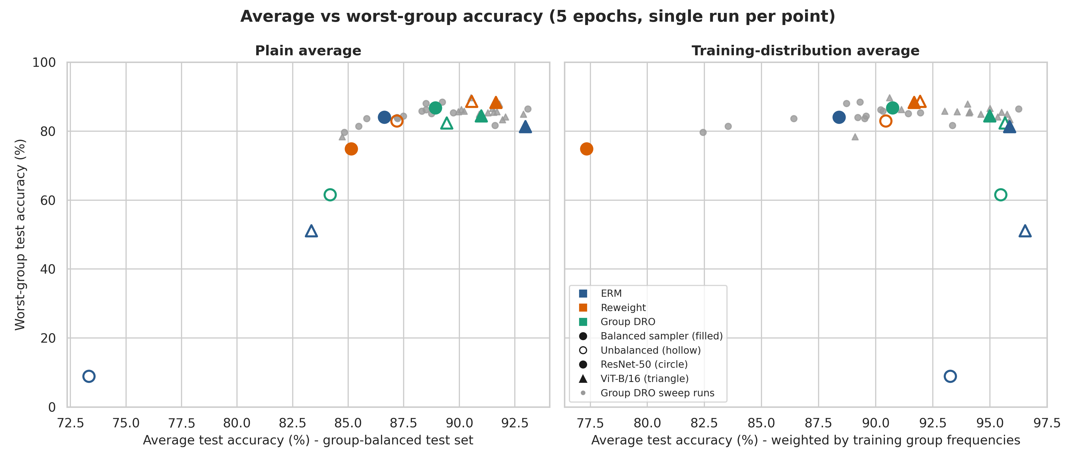
The cost of robustness depends on the average
Balanced test average
Robust methods win on both axes: ERM ResNet-50 reaches only 73.3% Avg.
Training-weighted average
ERM is best (93.3 / 96.6%). Robust methods give up 2.5–4.6 pts for +37.5 to +77.9 pts worst-group.
We report both averages on purpose: the 'cost' of robustness only appears under the skewed training distribution.
Notes:
This answers the professor's explicit request for the trade-off. The Waterbirds test set is group-balanced, so the plain test mean hides the trade-off. Re-weighting the per-group test accuracies by training proportions (how Sagawa et al. report it) reveals a small cost.

Slide 10
ViT-B/16 starts more robust and is less fragile
ERM: 51% vs 9% worst-group — ViT relies less on the background shortcut
Barely hurt by double weighting or missing groups
Best ViT result: Reweight, standard loader (88.6%)
Caveat: different pretraining recipes — architecture effect is indicative only
standard shuffling
balanced sampler
Notes:
Question (ii) of the report. Do not over-claim: the two torchvision checkpoints are trained differently, so we cannot attribute the difference purely to attention vs convolution.

Slide 11
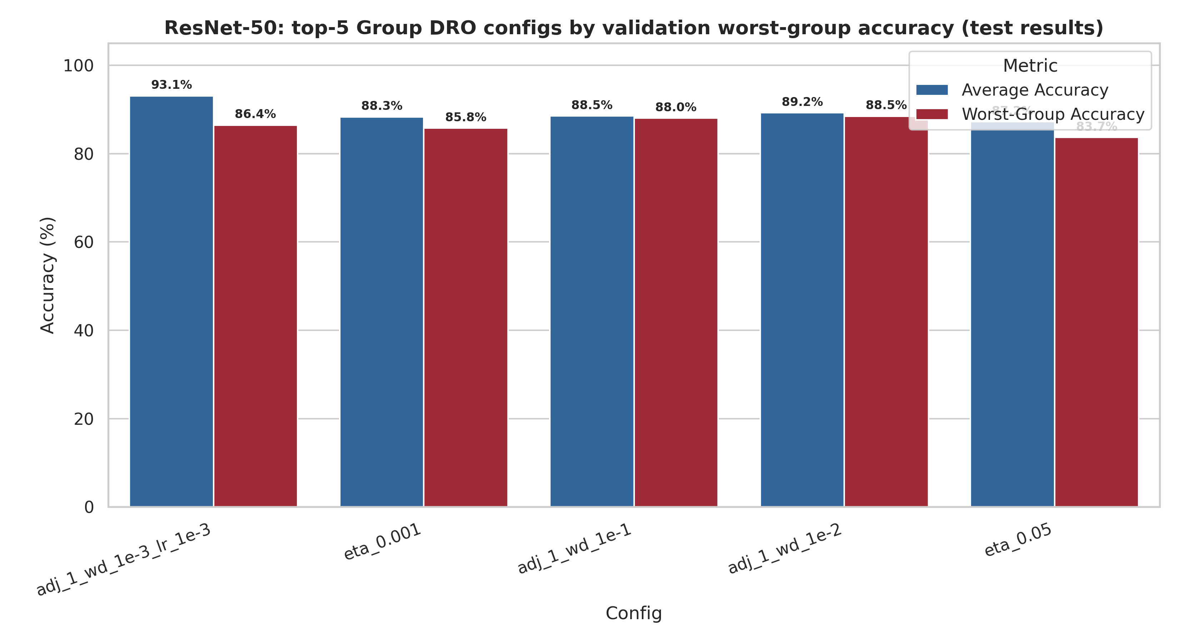
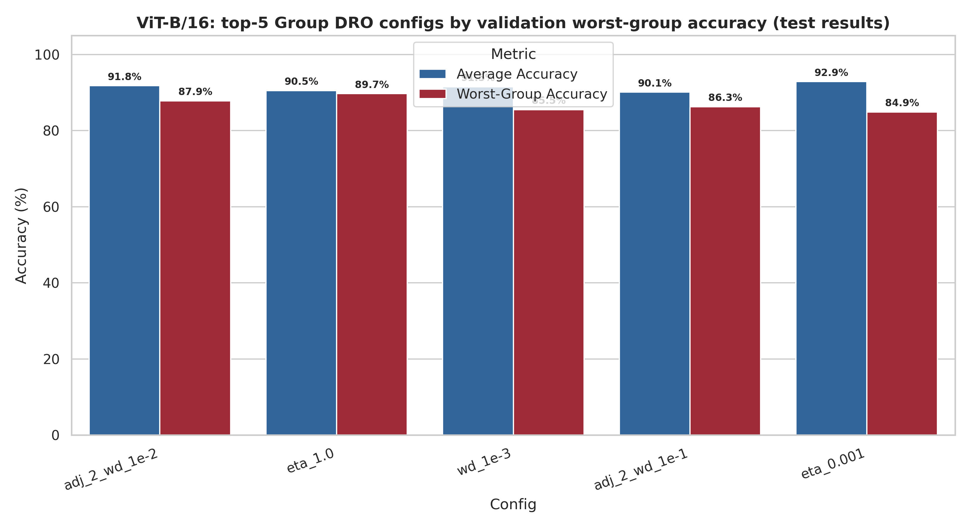
Hyperparameter sweep: small gains, big noise
Why noise matters
133 val images per minority group → 0.75 pt per image
SE ≈ 3.0 pts on val, 1.4 on test
Rankings among top methods are not stable
Test worst-group spans 79.7–88.5% (ResNet) and 78.4–89.7% (ViT)
Selected on val: ResNet C=1, lr 1e-3 → 86.5%; ViT C=2, wd 1e-2 → 87.9%
Neither beats Table 1 beyond noise
lr 1e-3: best ResNet, worst ViT (78.4%) → strong backbone–LR coupling
Notes:
Our critical point: with this little validation data, model selection is itself noisy. Example: η = 1.0 is 78.2% on ResNet validation but gives 89.7% on ViT test. C = 2 is best on ViT validation, as in the paper, but among the worst on ResNet.

Slide 12
How our results relate to Sagawa et al. (2020)
 | Sagawa et al. (given) | Our study (new)
Backbones | ResNet-50 (+ BERT for text) | ResNet-50 and ViT-B/16
Training regime | Standard, strong L2, early stopping; up to 300 epochs | Early-stopping regime only, 5 epochs
ERM → robust (ResNet-50) | Around 7 to 86 percent worst-group (early stopping) | 8.9% → 86.7% worst-group
DRO vs upweighting | DRO ahead by a few points | +2.7 (ResNet), +3.1 (ViT) — within noise
Sampler × objective crossing | Not reported | Full 3 × 2 grid; finds over-correction
Missing-group effect on q | Not discussed | 69% of batches lack G2 → explains DRO drop
We reproduce the paper's headline in a cheaper regime, then add evidence it does not contain.
Notes:
Our 5-epoch runs keep training CE around 0.36–0.40, never zero — that is the early-stopping regime in which Sagawa et al. and Byrd & Lipton (2019) say importance weighting still works. Check the paper numbers before the talk if you quote them.

Slide 13
Limitations we are aware of
Single seed per configuration
Differences of 2–3 pts are inside noise; a repeat run changed the ViT ranking (DRO 85.2 vs Reweight 84.7).
Only the 5-epoch regime
No converged 300-epoch training with strong weight decay, where Group DRO should matter more.
Partial sweep
Not a full grid; some trends (LR × backbone) are not explored in detail.
Backbone confound
ResNet-50 and ViT-B/16 come from different pretraining recipes.
Notes:
Show the critical approach the brief asks for. The infrastructure for more seeds already exists (--seeds, aggregate_seeds.py), so the first extension is cheap.

Slide 14
Balance group exposure — once
Rebalancing (sampler or loss) gives most of the worst-group gain: 8.9% → 84–87% on ResNet-50
Never stack both: it over-corrects and hurts the majority group
Group DRO adds 2–3 pts and needs balanced batches; on ViT its edge is negligible
Robustness costs only 2.5–4.6 pts of training-weighted accuracy
Notes:
Close with the one-line takeaway. Then: code and full reproduction instructions at github.com/AleMdP/waterbirds-shortcut-learning.

Slide 15
Thank you for your attention

