Slide 1
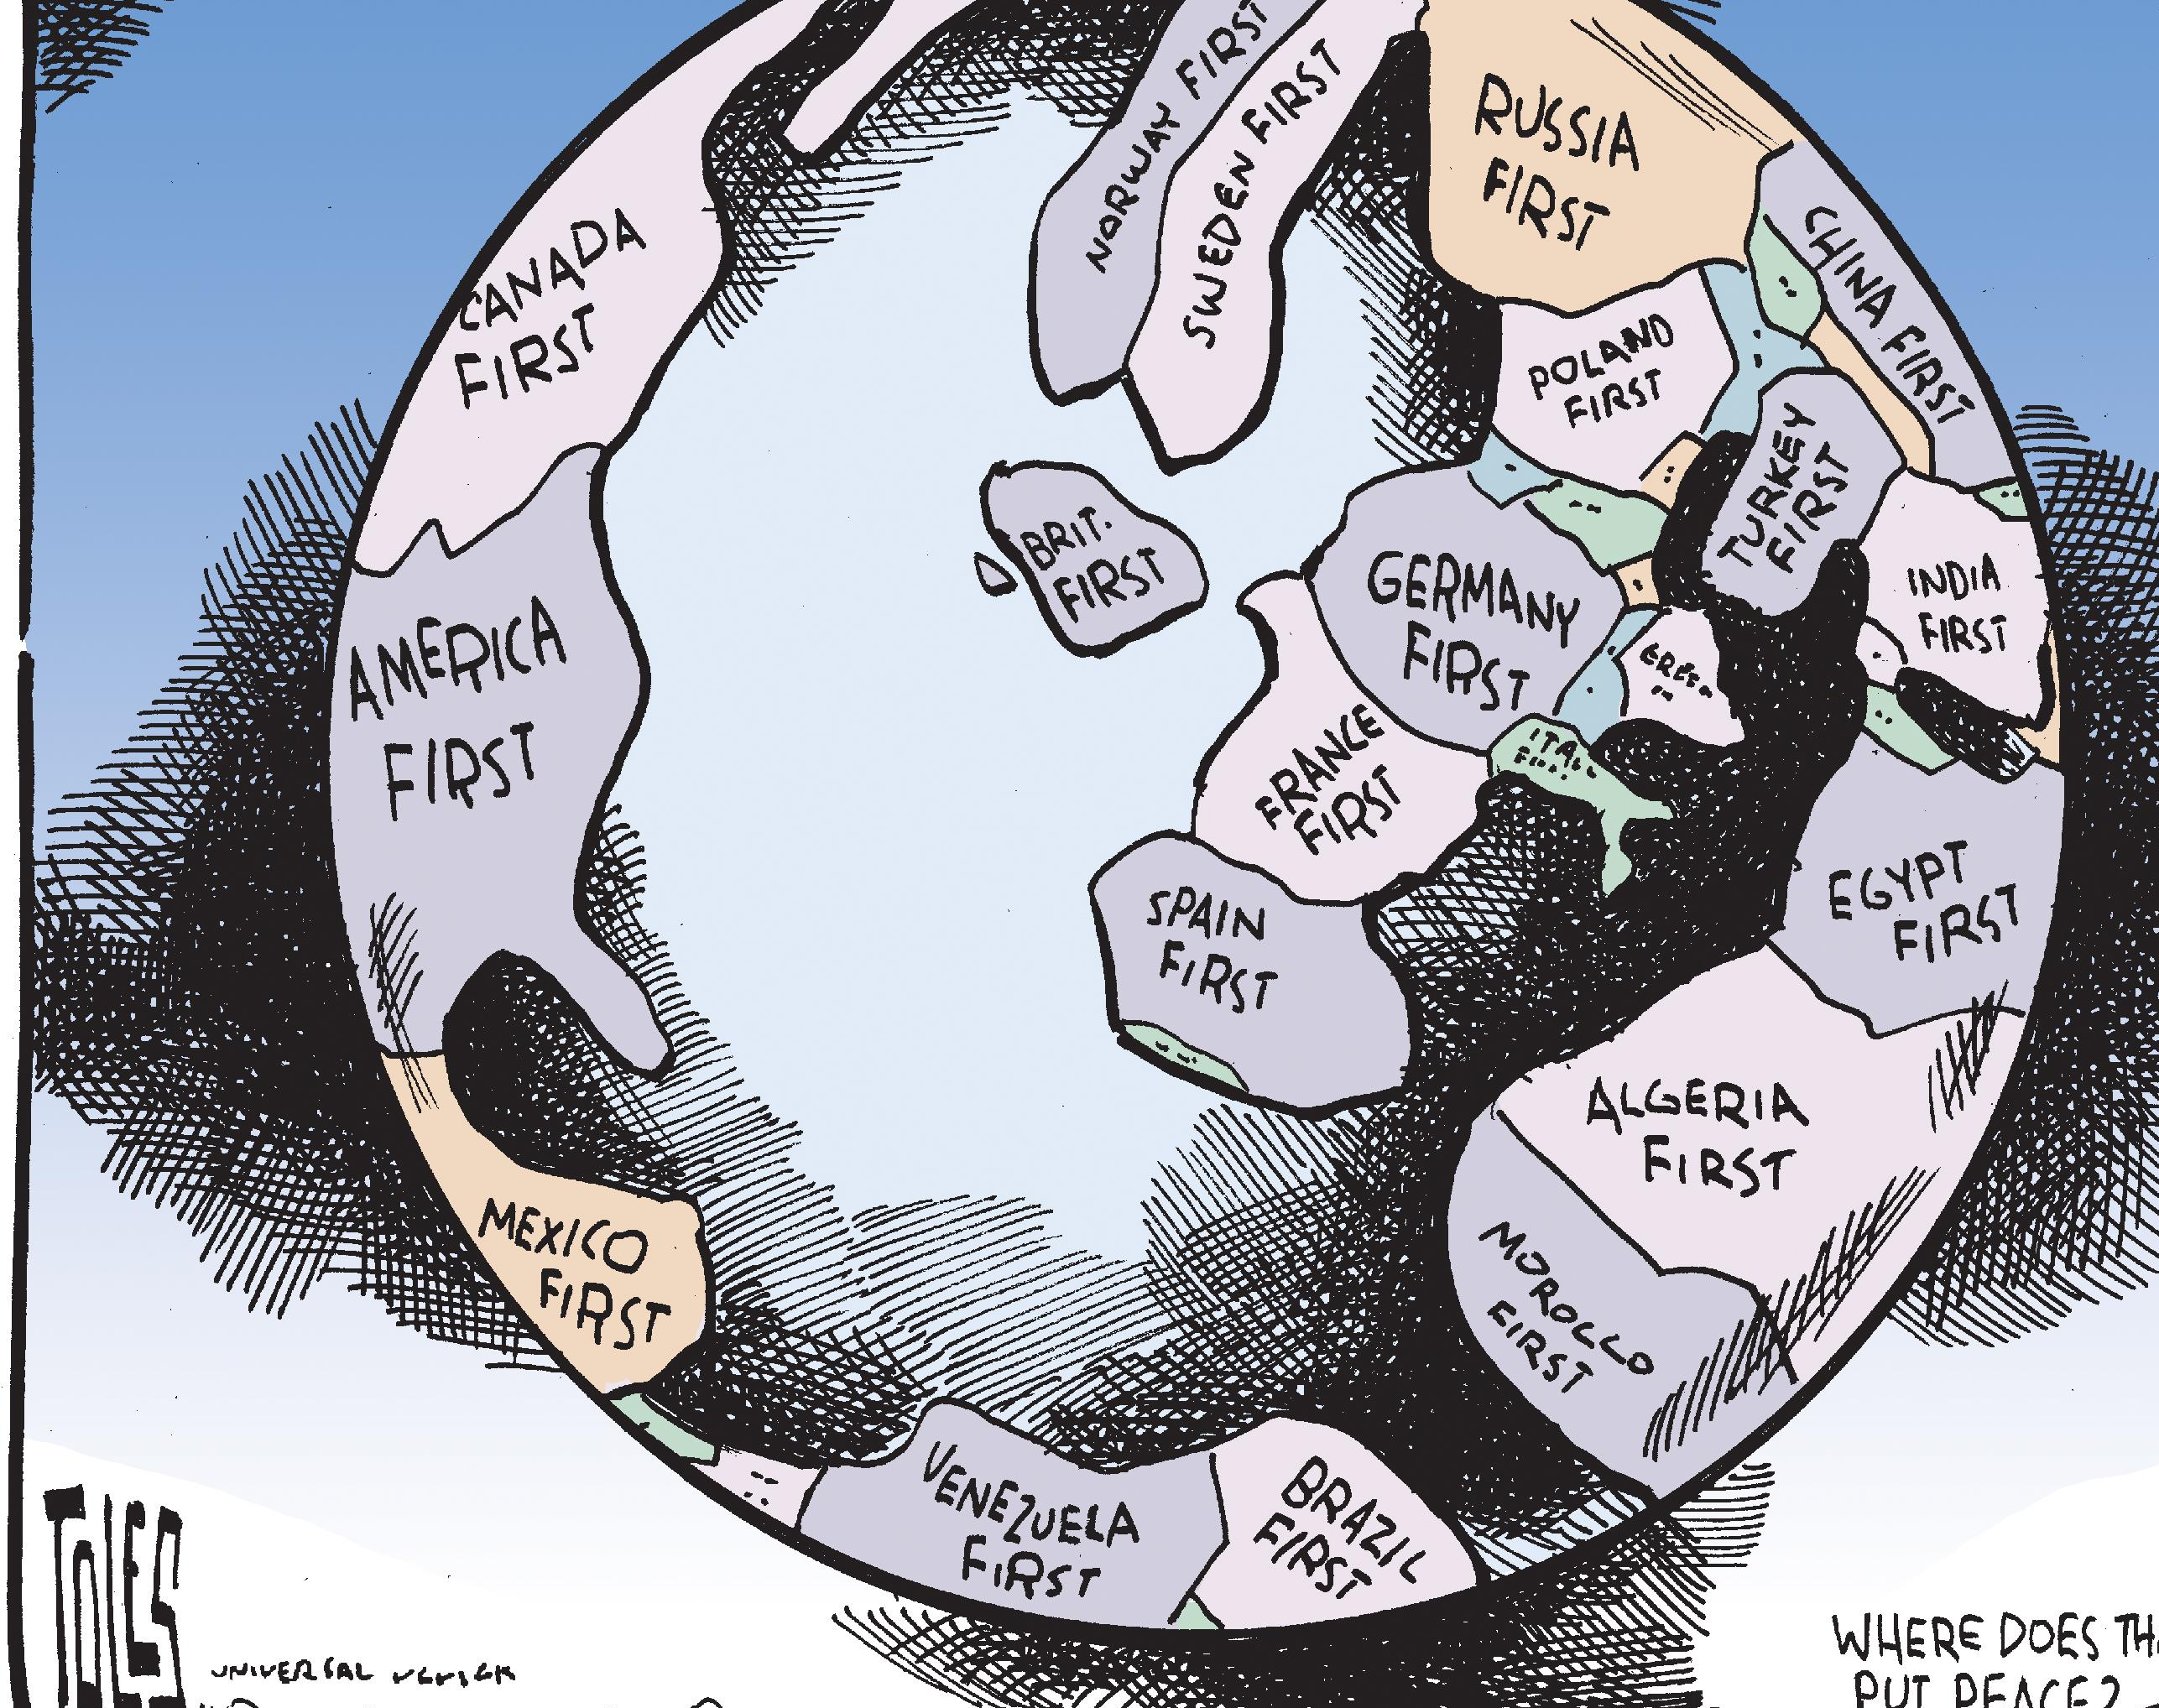
I social e il populismo
Alessandro Meloni, Alessandro Casanova
16/11/2023

Slide 2
Although frequently used by historians, social scientists, and political commentators, the term [populism] is exceptionally vague and refers in different contexts to a bewildering variety of phenomena.
Margaret Canovan
A thin-centred ideology that considers society to be ultimately separated into two homogenous and antagonistic camps, ”the pure people” versus ”the corrupt elite”, and which argues that politics should be an expression of the volonté générale (general will) of the people.
Mudde and Rovira Kaltwasser

Slide 3
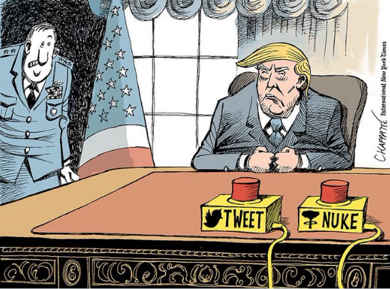
Il populismo
Nasce in America e in Russia.
Presenta idee agrarie, progressiste e il ”popolo” come virtuoso, ma schiavo delle autorità.
Propone idee ”semplici” e immediate per risolvere i problemi.
Crea l’immagine di un leader che guida, spesso utilizzando stereotipi sul suo carattere.
Immagina un mondo diviso tra ”noi” e ”loro”.

Slide 4
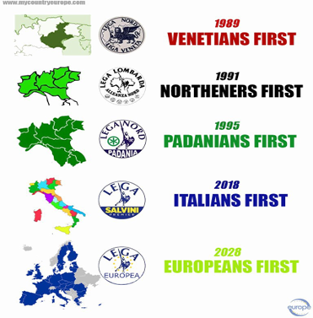
Come espresso dalla definizione di Gerbaudo, il populismo si afferma come il ”partito piglia tutto”: aggrega interessi indipendentemente dal loro grado di realizzabilità.
Populism here becomes a catch-all label to refer to all those political phenomena that are considered to be dangerous, irrational and demagogic; populism as a politics that appeals to the basest sentiments of the populace, makes demagogic promises and panders to imaginary fears.
Paolo Gerbaudo. Social media and populism: An elective affinity. Media Culture Society, pages 745–753, 2018.

Slide 5
Connessioni social populismo
opinion-building
movement-building
First, the design of social media as alternative media where ordinary people can express themselves has provided a suitable venue for populist movements to counter the perceived pro-establishment bias of mainstream news media, so that alternative media channels capable of intercepting popular anger have risen in importance.
Second, the aggregative functionalities of social media, embedded in their algorithmic architecture and their “filter bubble” tendencies, has allowed disgruntled individuals embracing ideas regarded as improper by liberal common sense to find each other and form online crowds, which have played a crucial role in providing militant support for anti-establishment candidates, as seen for example in the #Gamergate community support of Donald Trump's presidential campaign.

Slide 6
What makes social media such a propitious space for the rise of populist movements?
Social media as the People’s voice
Social media as the People’s rally

Slide 7
what is the new form of populism that emerges out of the encounter between social media and populism?

Slide 8
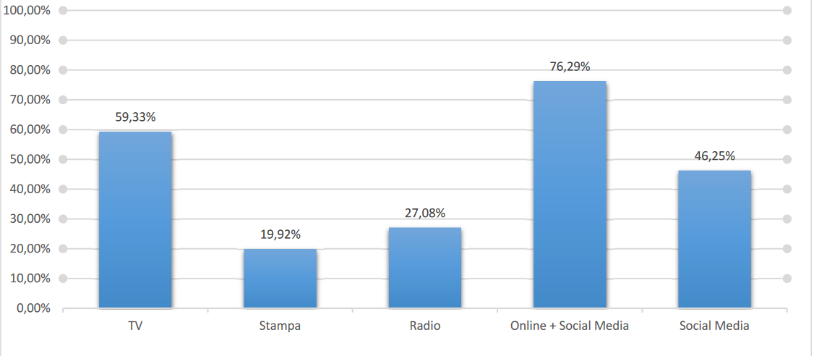
Grafico che aggrega i dati per «source of news» dei paesi Europei, presi da: https://reutersinstitute.politics.ox.ac.uk/digital-news-report/2023/interactive
Si rimanda al seguente link per vedere le percentuali di ogni Stato.

Slide 9
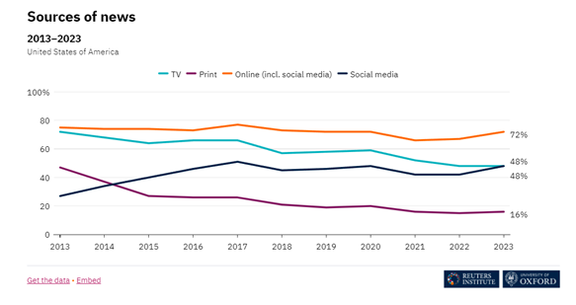
Grafico «source of news» negli USA
https://reutersinstitute.politics.ox.ac.uk/digital-news-report/2023/united-states

