Slide 1

MagiPark
The parking revolution
Preview
Architecture
Vision
Concept
by Alex, Simon And Lukas
Notes:
Find a parking spot. The easy way.

Slide 2


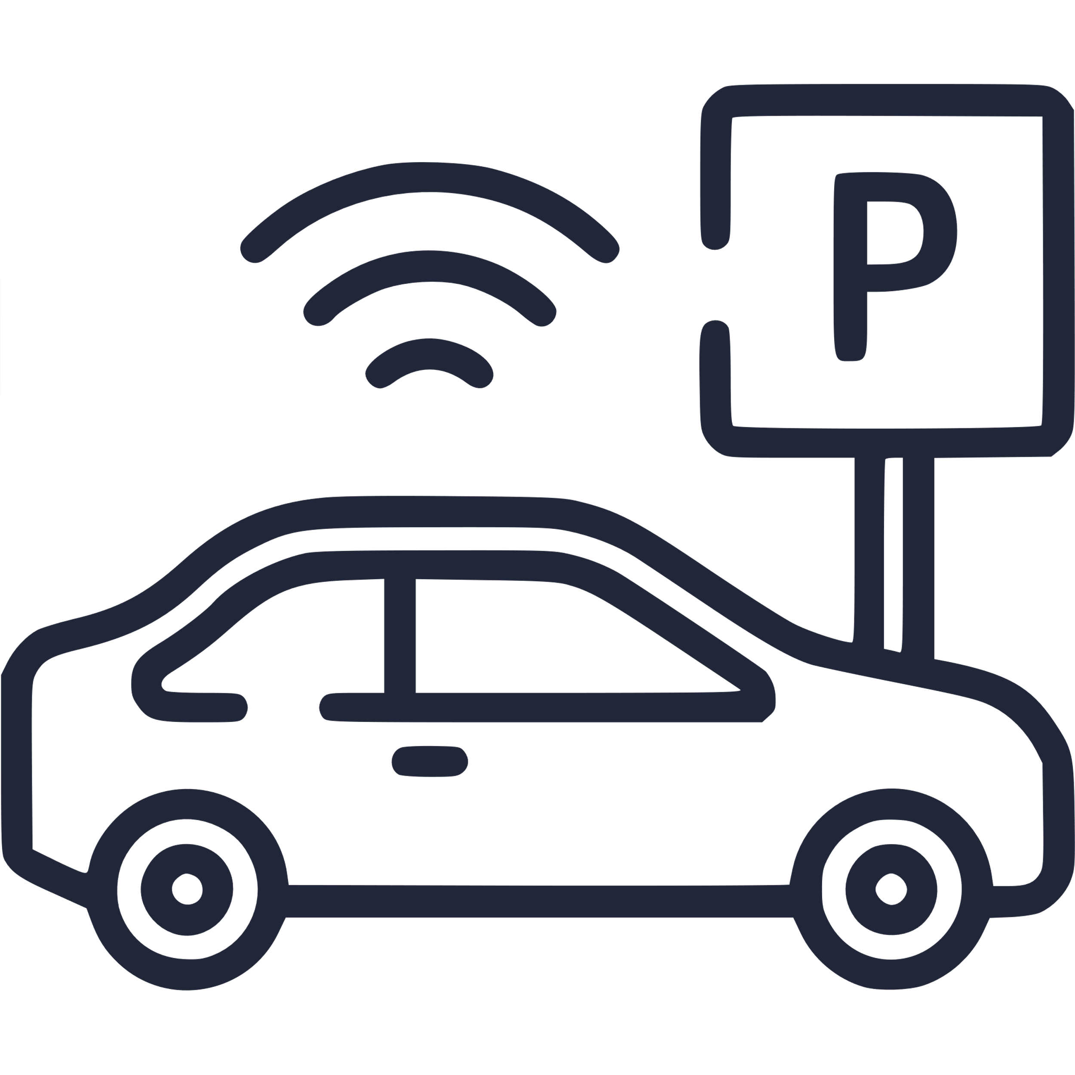

Preview
Architecture
Vision
Concept

Slide 3

Preview
Architecture
Vision
Concept
Notes:
Already equipped with Sensors

Slide 4
LIVE DEMO
Architecture
Preview
Vision
Concept
Notes:
Live demo:
Delete taken spot
Update automatically

Slide 5





Preview
Vision
Architecture
Concept
Notes:
Car Simulator for detection
Flask backend
React frontend

Slide 6


Preview
Architecture
Vision
Concept
Notes:
1) Park autonomous cars
2) Improve Sixt share experience
3) Use Standalone app like ours to share with others
4) Use fleet of increasingly „smart cars“ and connect them to the network
5) Use satellite imagery

