Slide 1
Resources on AWS
Notes:
Youtube on S3: https://www.youtube.com/watch?v=mDRoyPFJvlU

Slide 2
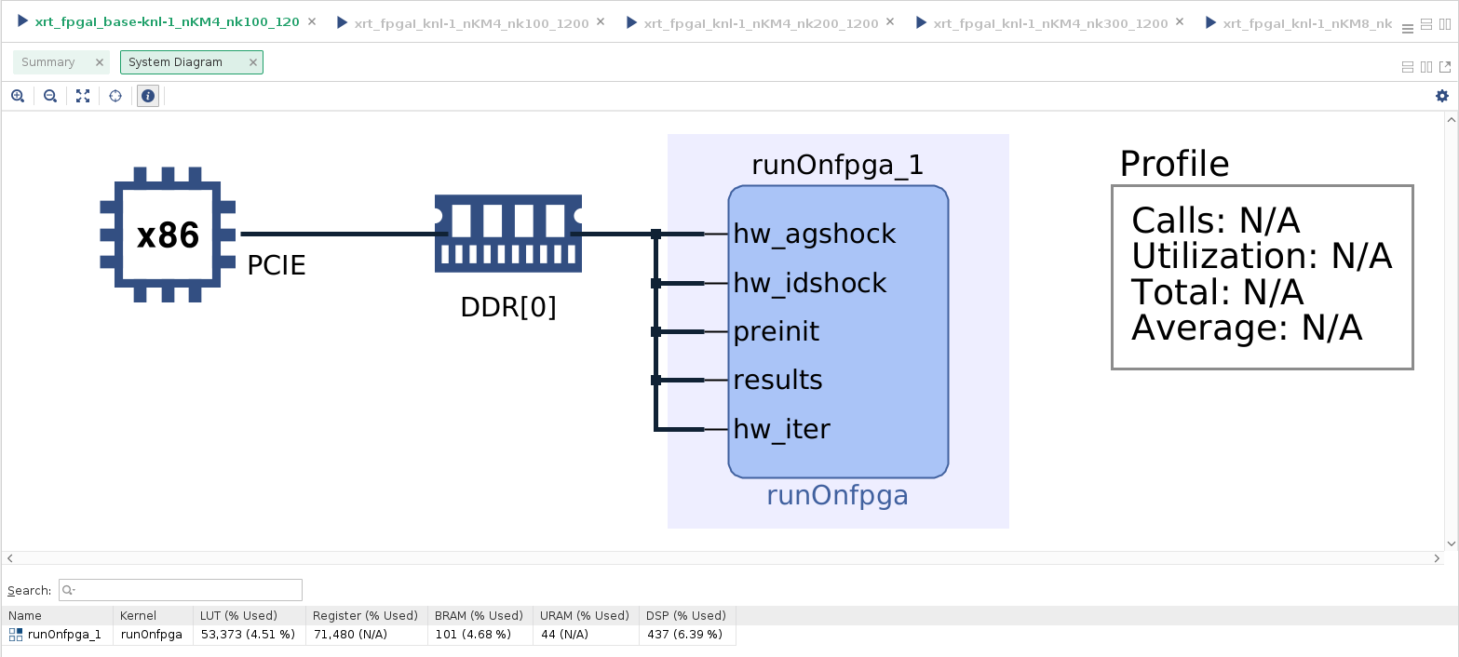
baseline

Slide 3
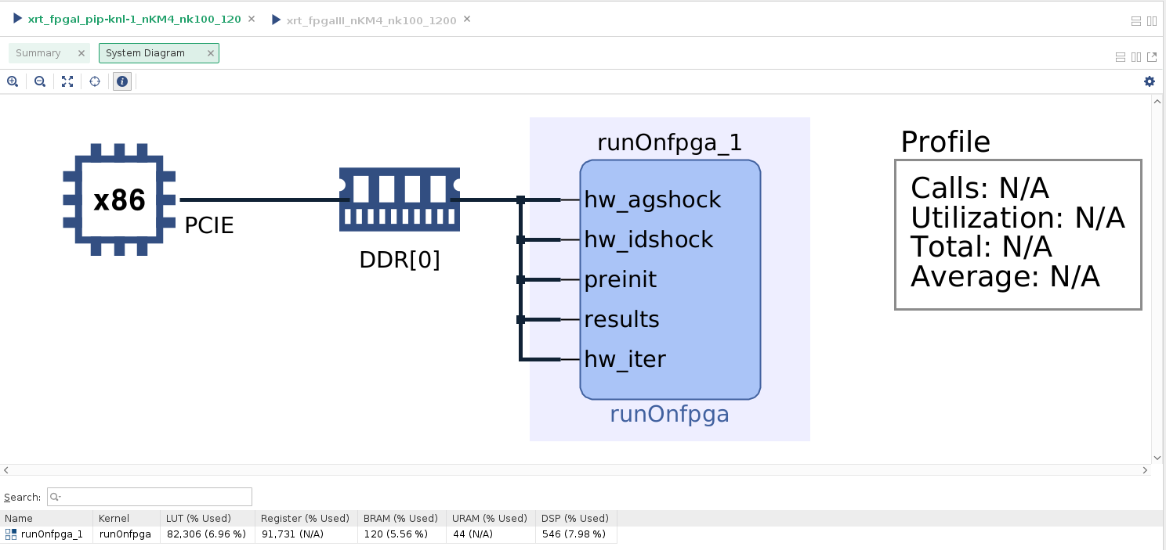
KnI-pipeline-100-4

Slide 4
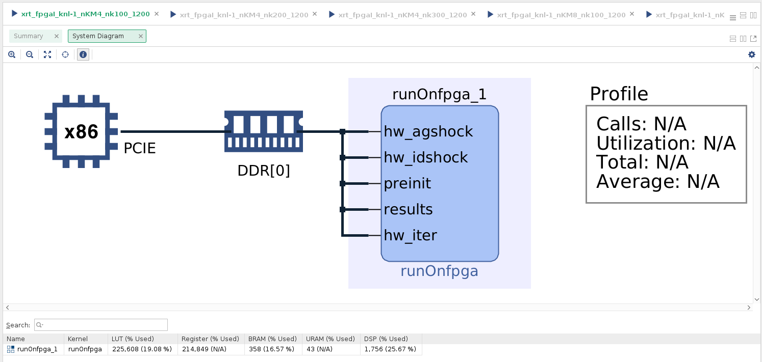
Kni-100-4

Slide 5
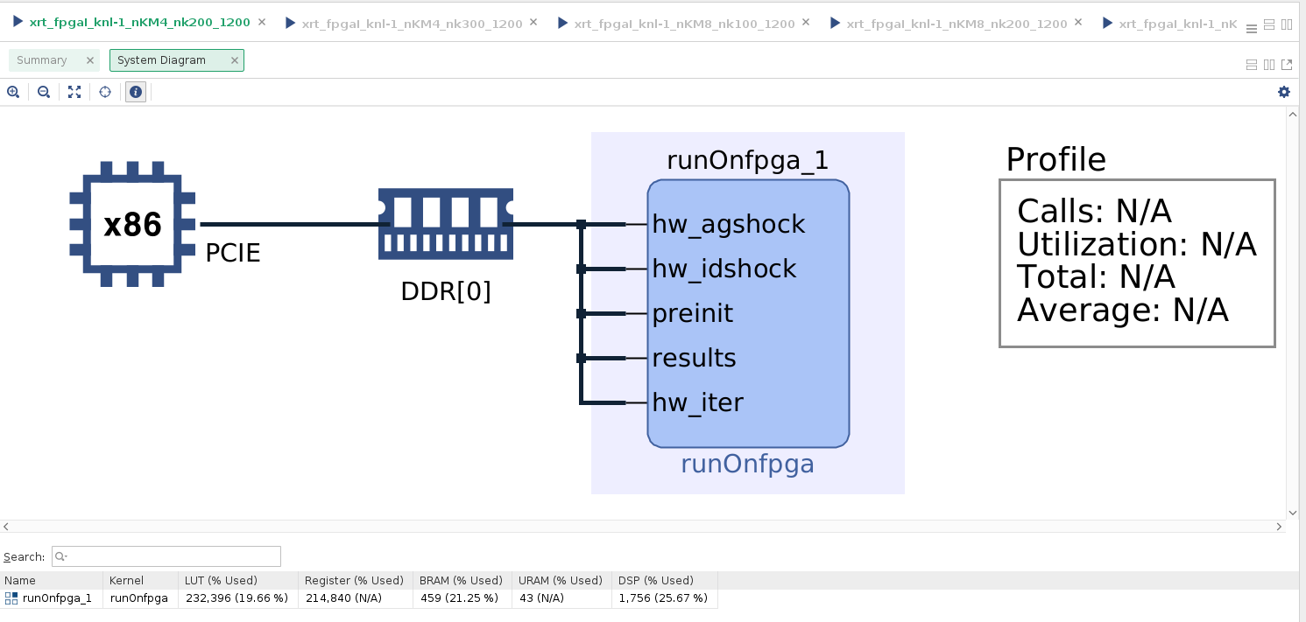
knI-200-4

Slide 6
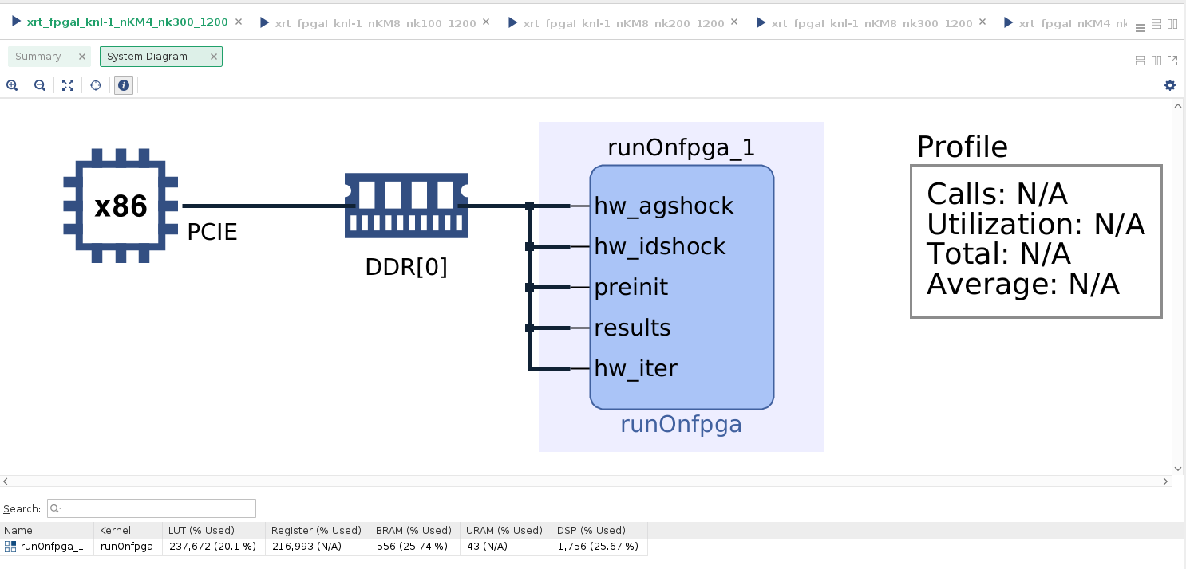
knI-300-4

Slide 7
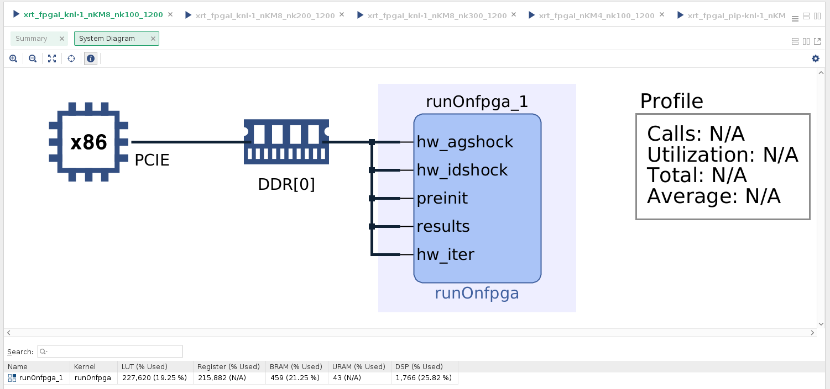
KnI-100-8

Slide 8
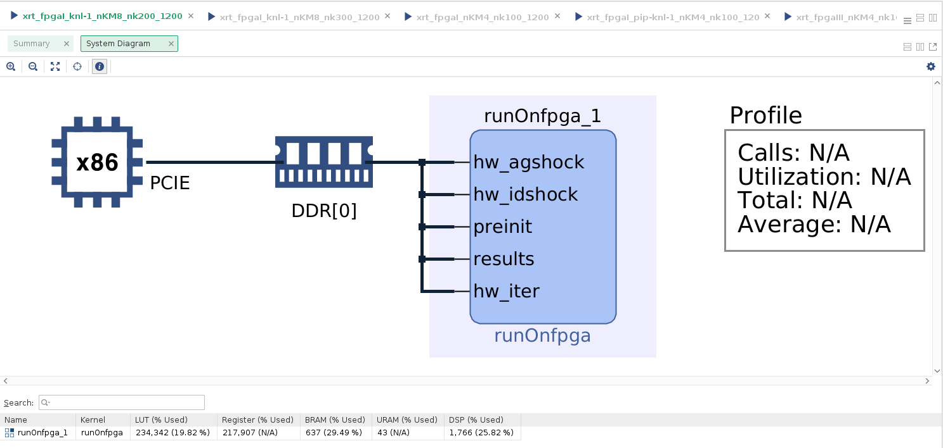
KnI-200-8

Slide 9
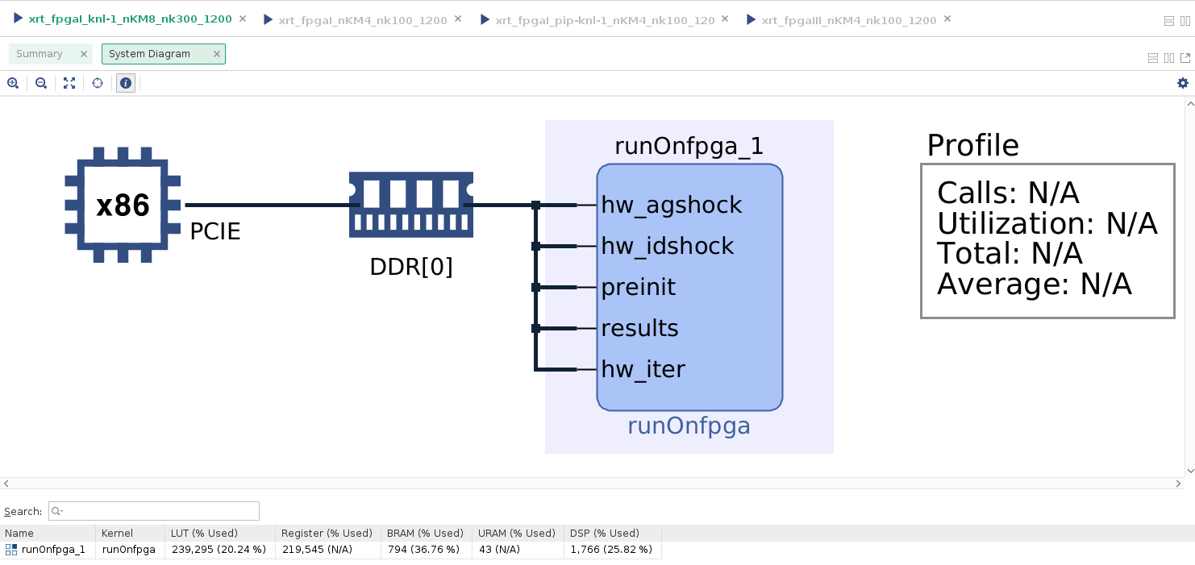
KnI-300-8

Slide 10
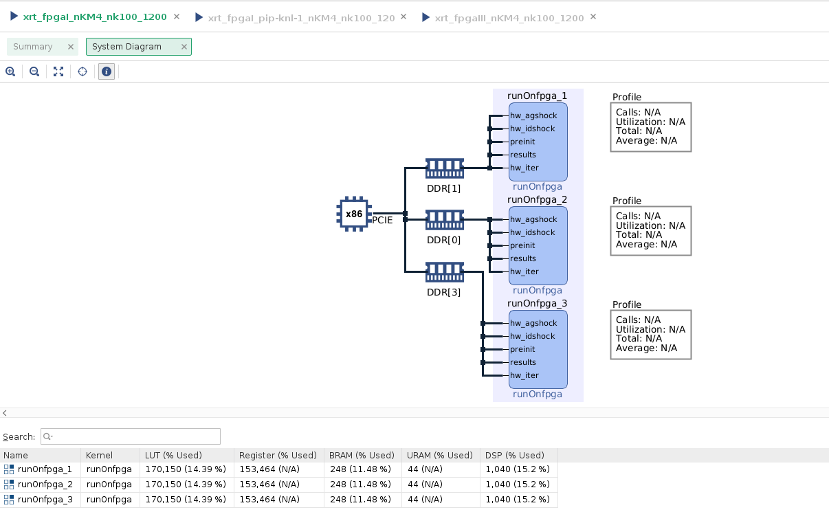
Kn3-100-4

