Slide 1
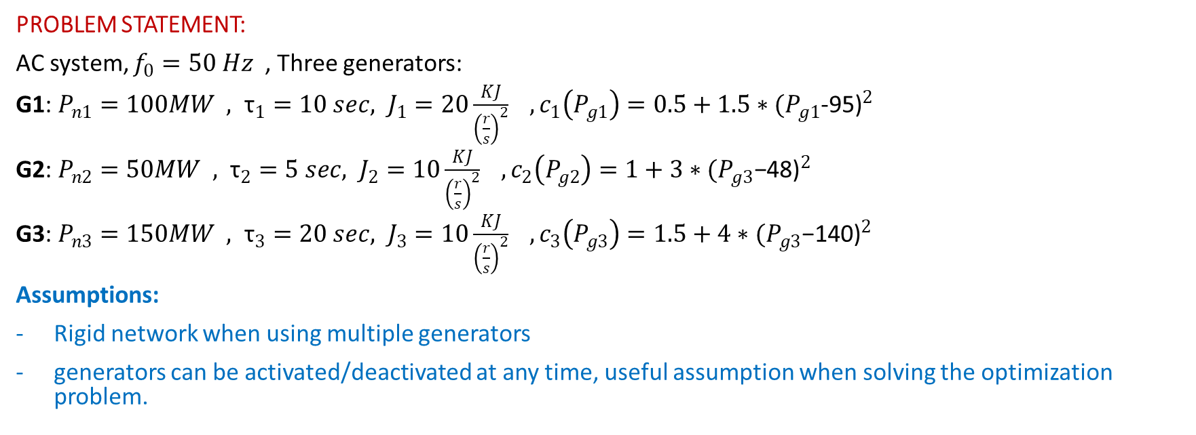
Automation of Energy Systems
Project for the academic year 2022/2023
Alessandro Puglisi, Nicolò Spinelli, Riccardo Mondin, Davide Pizzocheri
PROBLEM STATEMENT:
AC system, $f_{0}=50 Hz$ , Three generators:
G1: $P_{n1}=100MW , {\text{τ}}_{1}=10 sec, J_{1}=20\frac{KJ}{{\left(\frac{r}{s}\right)}^{2}} , c_{1}\left(P_{g1}\right)=0.5+1.5∗{(P_{g1}\text{−95)}}^{2}$
G2: $P_{n2}=50MW , {\text{τ}}_{2}=5 sec, J_{2}=10\frac{KJ}{{\left(\frac{r}{s}\right)}^{2}} , c_{2}\left(P_{g2}\right)=1+3∗{(P_{g3}\text{−}\text{48}\text{)}}^{2}$
G3: $P_{n3}=150MW , {\text{τ}}_{3}=20 sec, J_{3}=10\frac{KJ}{{\left(\frac{r}{s}\right)}^{2}} , c_{3}\left(P_{g3}\right)=1.5+4∗{(P_{g3}\text{−}\text{140}\text{)}}^{2}$
Assumptions:
Rigid network when using multiple generators
generators can be activated/deactivated at any time, useful assumption when solving the optimization problem.

Slide 2
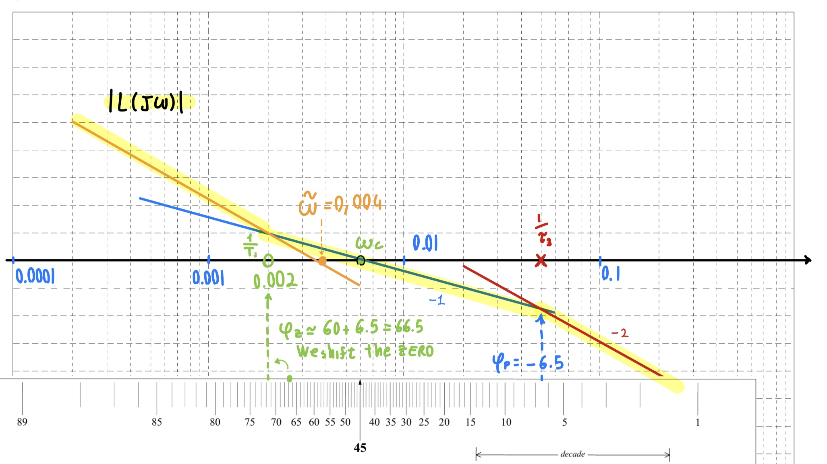

Configuration A, Control
G3 feeding L3+L4 (Islanded case):
from specification:
δPe ramp, 5MW over 10 sec
δω ≤ 0.05
t_{set} ≈ 15 min: 5/ω_{c} ≤ 900 → ω_{c} ≥ 0.006 rad/s
φ_{m} ≥ 60°: design choice, non oscillatory response .
T_{A}=$\frac{J_{3}∗ω_{0}^{2}}{P_{n,3}}$ = 6.573 sec , $g\left(s\right)=\frac{1}{1+20s}$
Loop shaping: C(s) = $\frac{1+500s}{500s}∗0.052$
Let’s simulate on Modelica:

Slide 3
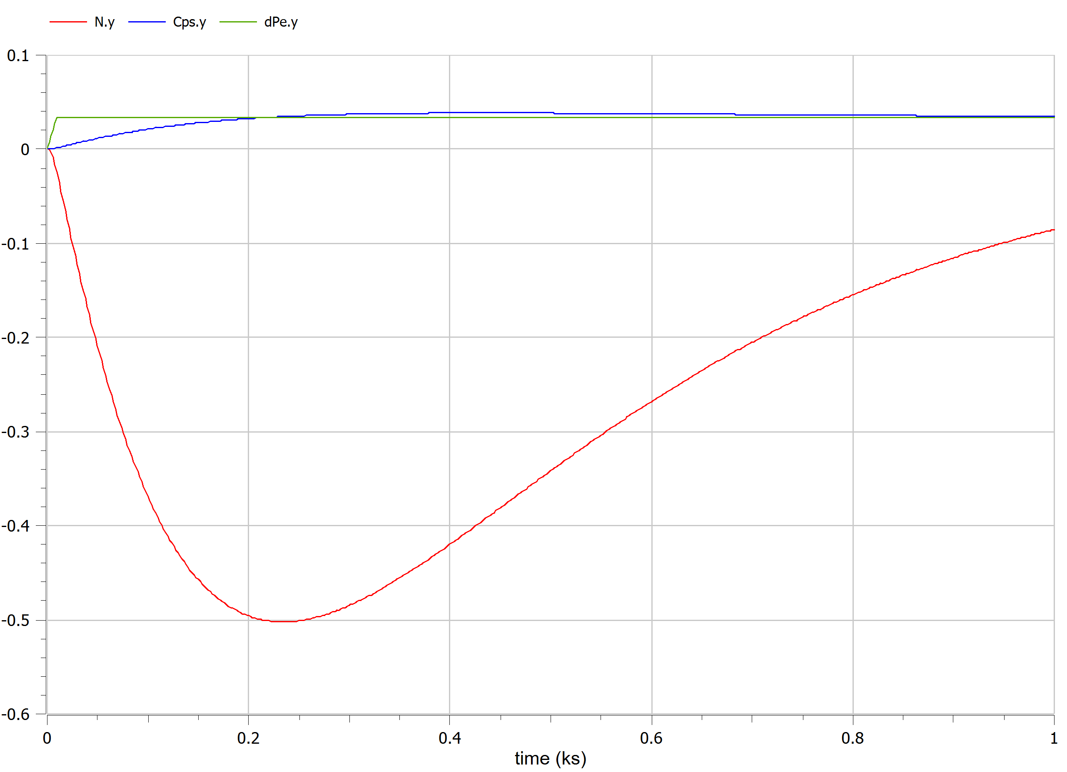
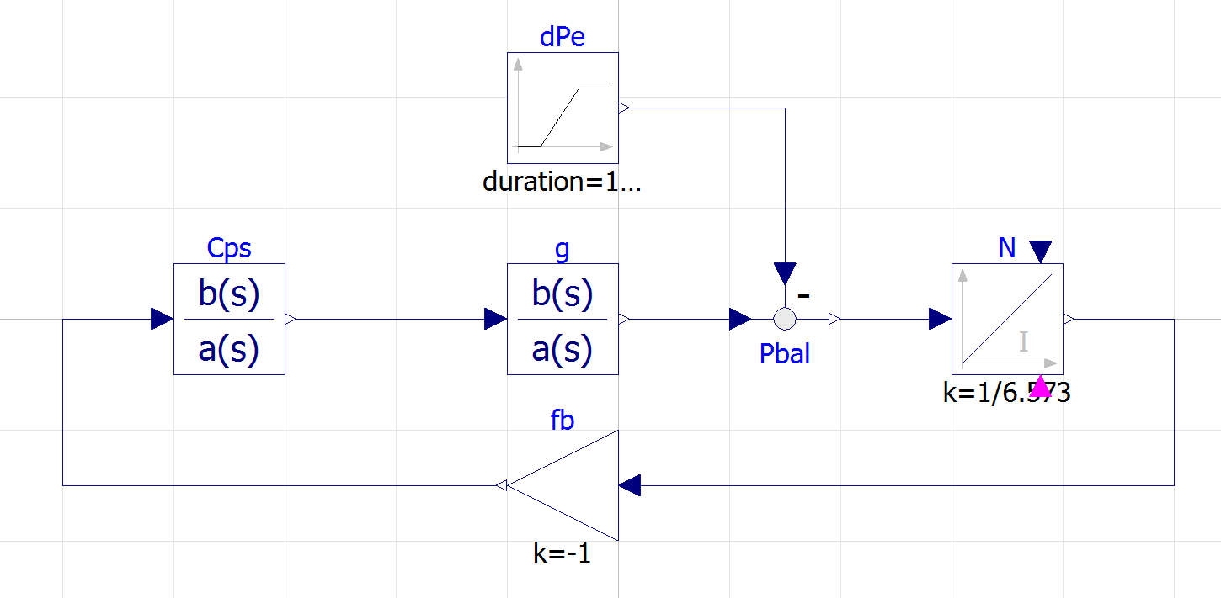
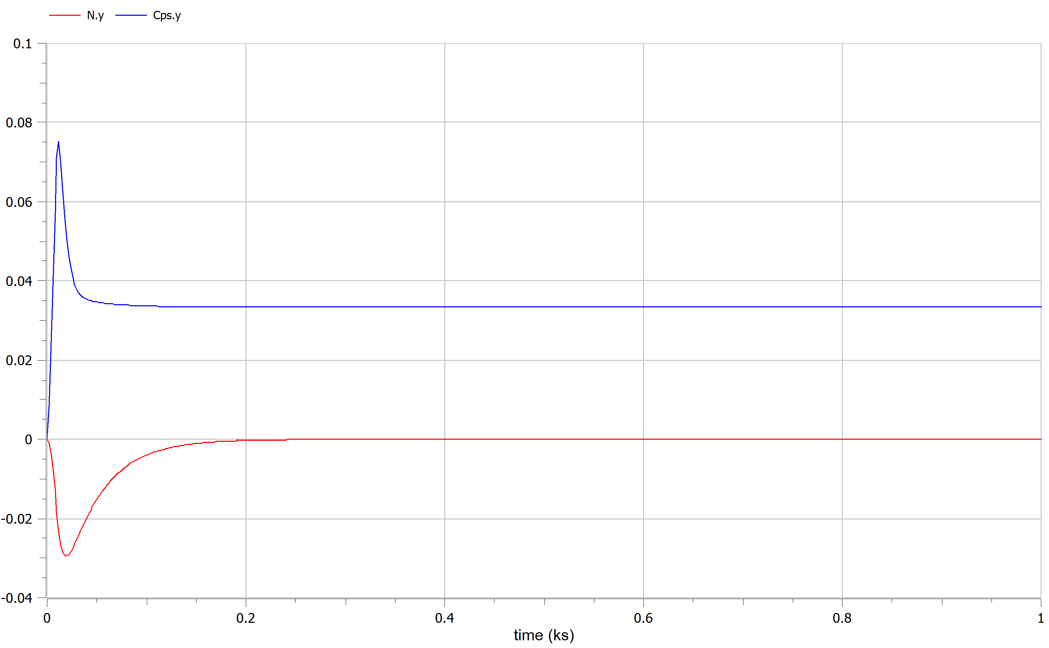

Modelica:
PID C(s): set up ω_{c} = 0.06 , one zero cancel gen pole, other zero in 0.022, pole in 0.6, than double the gain after some simulation, to get a better response without issue
C(s) =2*6.573*(0.04)² *$\frac{\left(1+45.45s\right)∗(1+20s)}{\left(1+1,67s\right)∗s}$
Neither settling time nor frequency error constraint guarantee!
Better to use a PID, to have a fast control, so less frequency loss

Slide 4
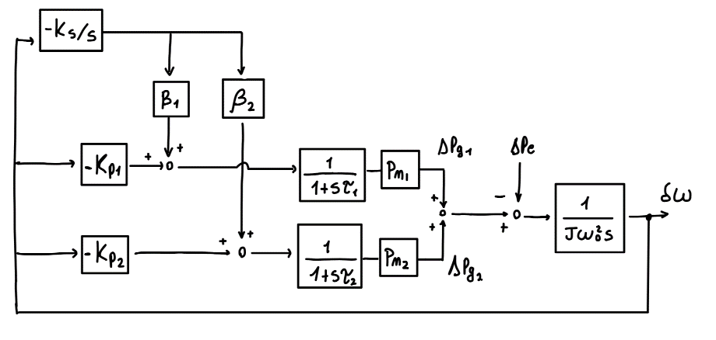
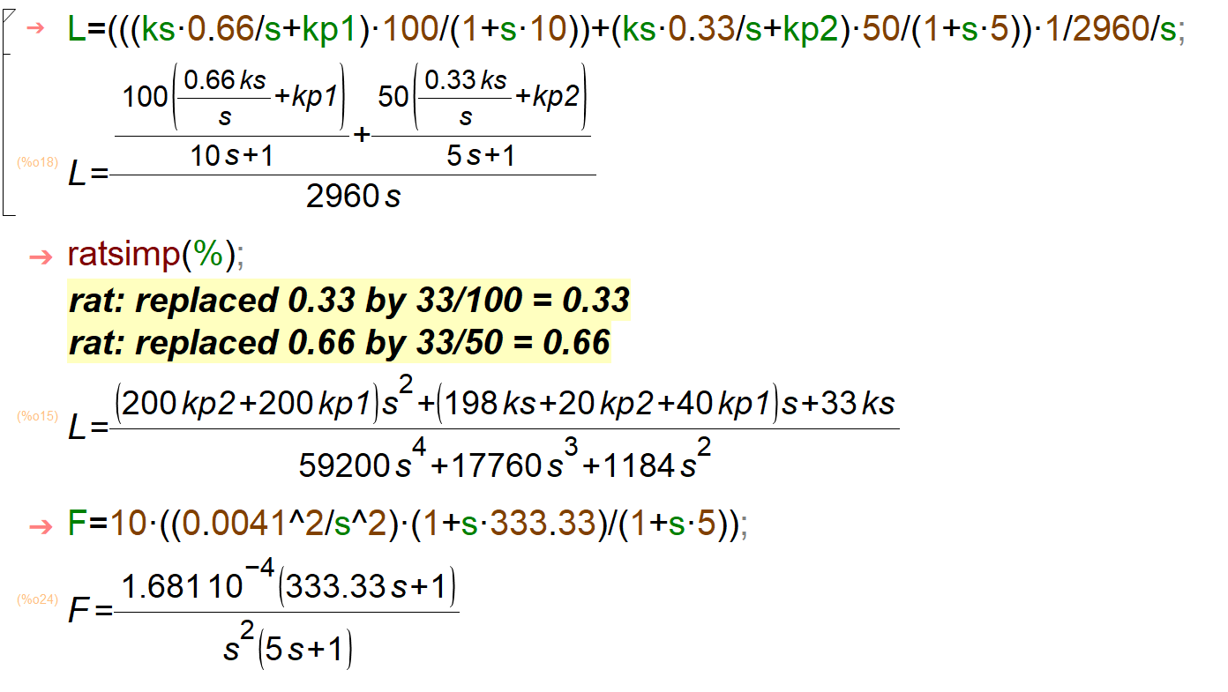
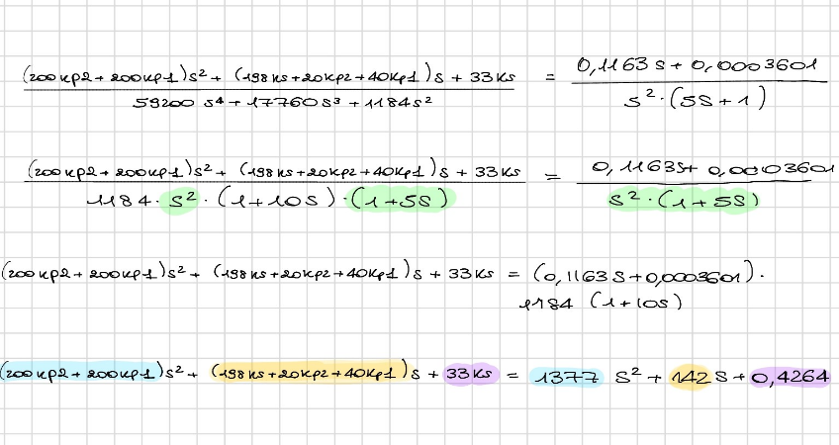
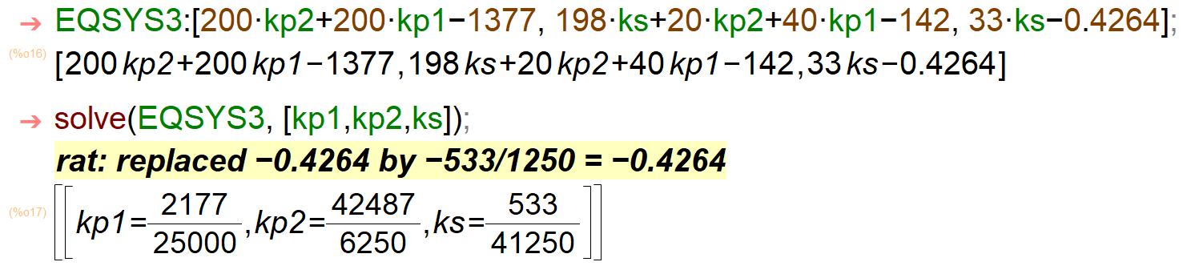

G1,G2 feeding L1+L2 (network generators)
$\frac{{10}^{6}}{{(J}_{1}+J_{2})∗ω_{0}^{2}}$ = $\frac{1}{2960.88}$ , (assuming overall inertia as the sum)
β₁=1/3 , β₂=2/3 (proportional to nominal Power)
Simulate on Modelica..
Guarantee same specification of islanded case, design a goal L(s) and find the equivalent C(s) PID reversing the dynamic.
Solve a system of equation with degrees of freedom primary and secondary gains.

Slide 5
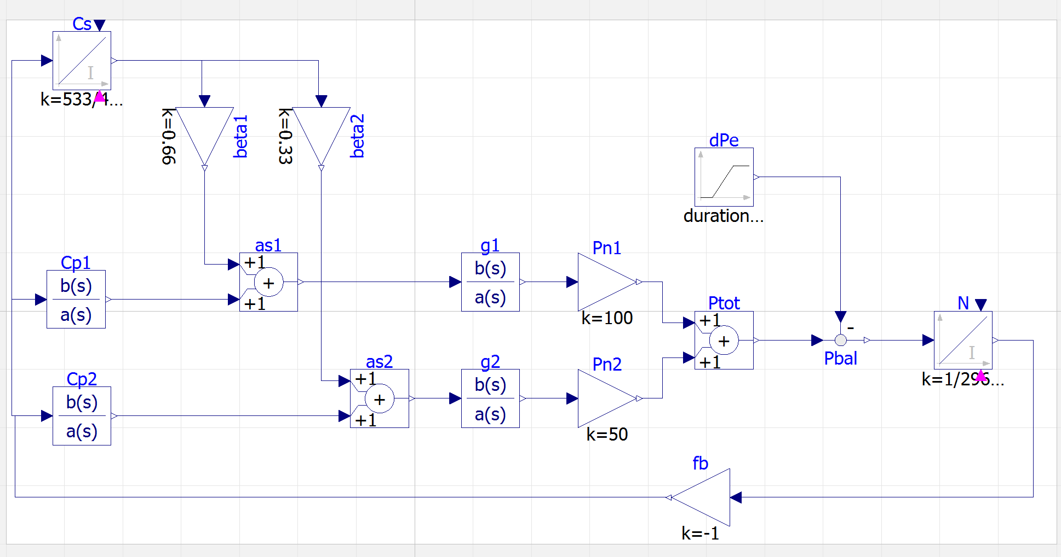
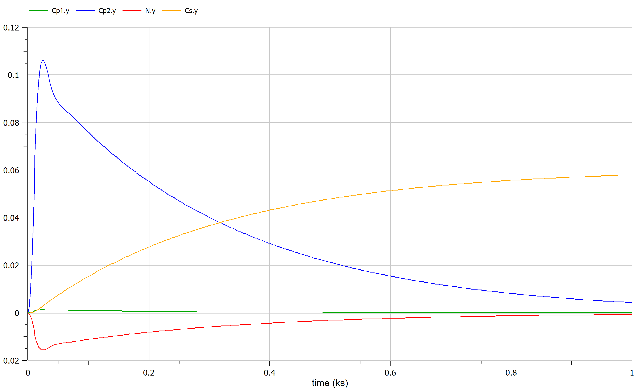
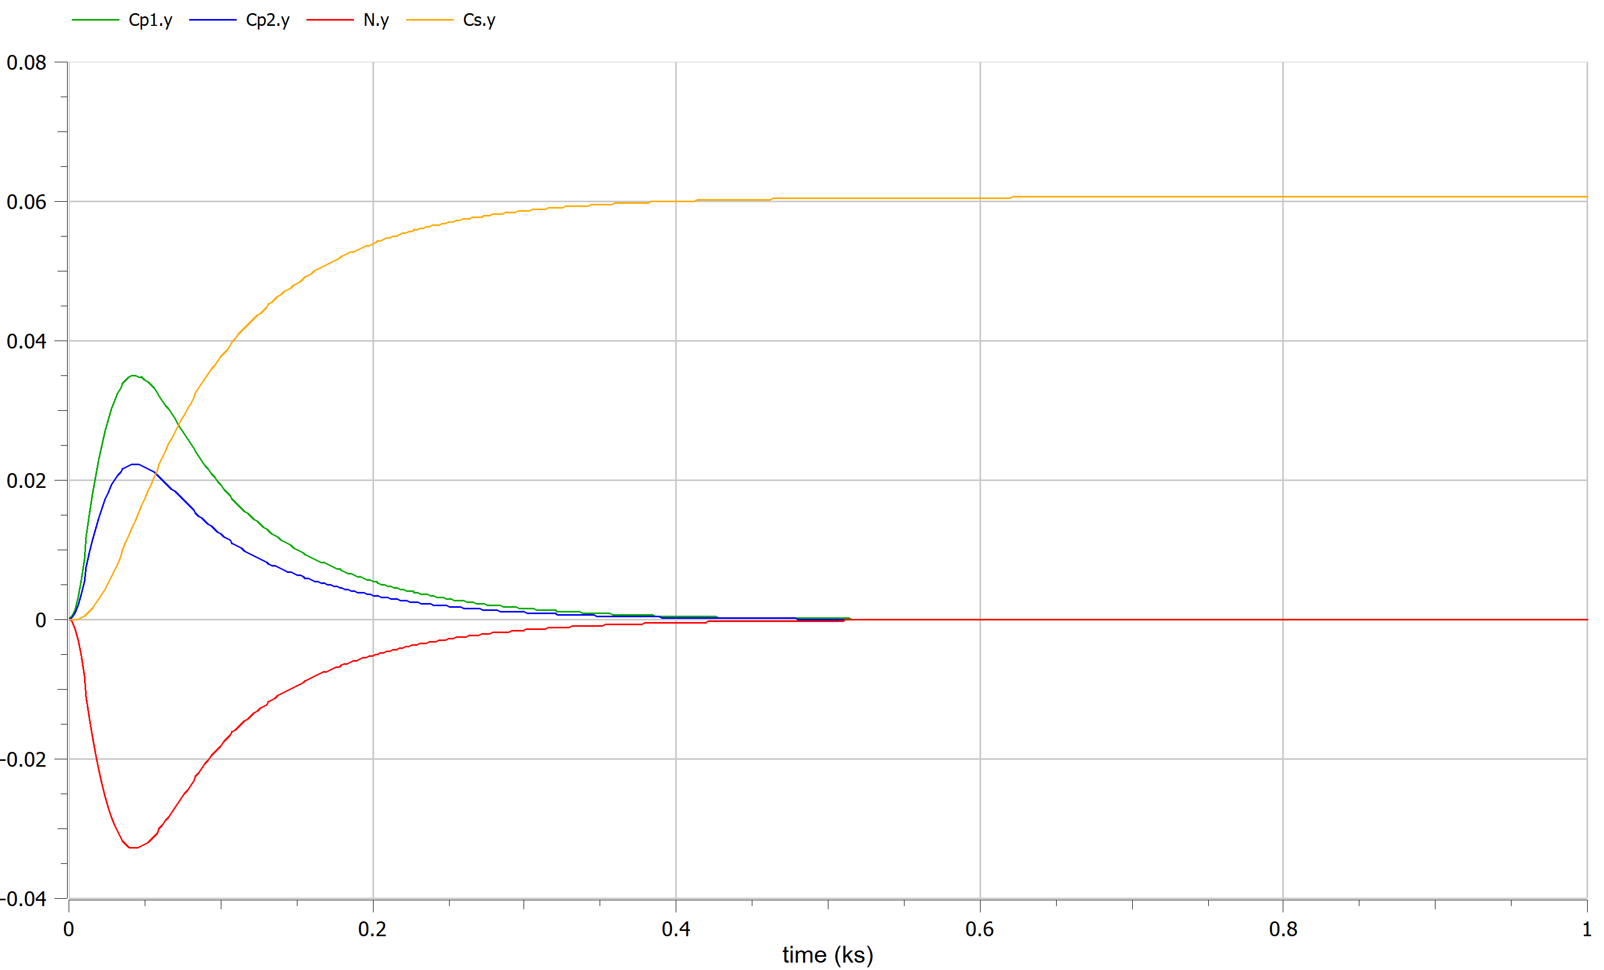
Modelica:
good freqency error. But controllers used in a very inefficent way! (during tuning we should also look inside the system, in particular the control action) To solve this, partition the effort proportionally to generator capability changing ks, kp1,2 .
Kp1 = 1.064
Kp2= 0.677327
Ks = 0.016

Slide 6
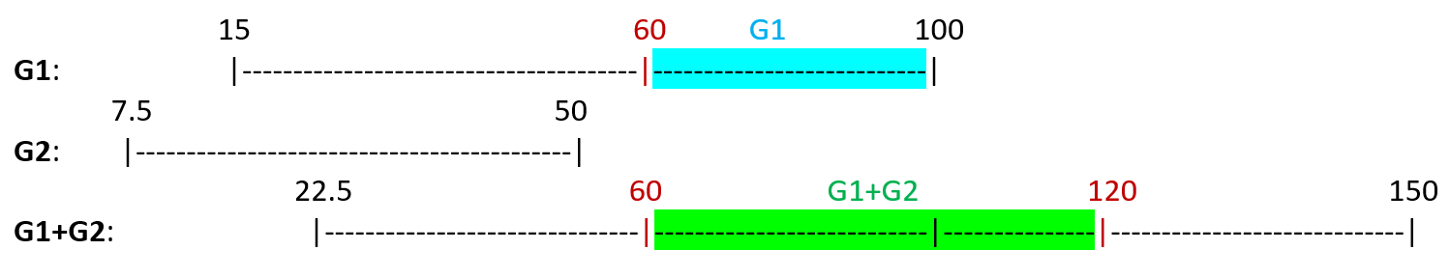

Configuration A, Optimization
(focus on G1,G2 feeding L1+L2)
G1: P_{g1,min} = 15MW P_{g1,max} = 100 MW
G2: P_{g2,min} = 7.5 MW P_{g2,max} = 50 MW
Optimization problem:
cost f: f(P_{g1},P_{g2}) = c₁(P_{g1})+c₂(P_{g2})
s.t: $\left\{\begin{aligned}P_{g1}+P_{g2}=P_{e} \\ P_{g1,min}≤P_{g1}≤P_{g1,max} \\ P_{g2,min}≤P_{g2}≤P_{g2,max}\end{aligned}\right.$ → as KKT formulation:
 | S1 | S2 | S3 | S4 | S5 | S6
Pe | 60 | 70 | 120 | 120 | 110 | 60
I₁: [60,100] -> (G1, G1+G2)
I₂: [100,120] -> (G1+G2)
f = 1.5 + 1.5*(P_{g1}-95)²+ 3*(P_{g2}-48)²
g = P_{g1} + P_{g2} – P_{e}
h₁=P_{g1} - P_{g1,min}
h₂=P_{g1,max} - P_{g1}
h₃=P_{g2} - P_{g2,min}
h₄=P_{g2,max} - P_{g2}
L= f + λ*g + μ*h (Lagrangian)

Slide 7
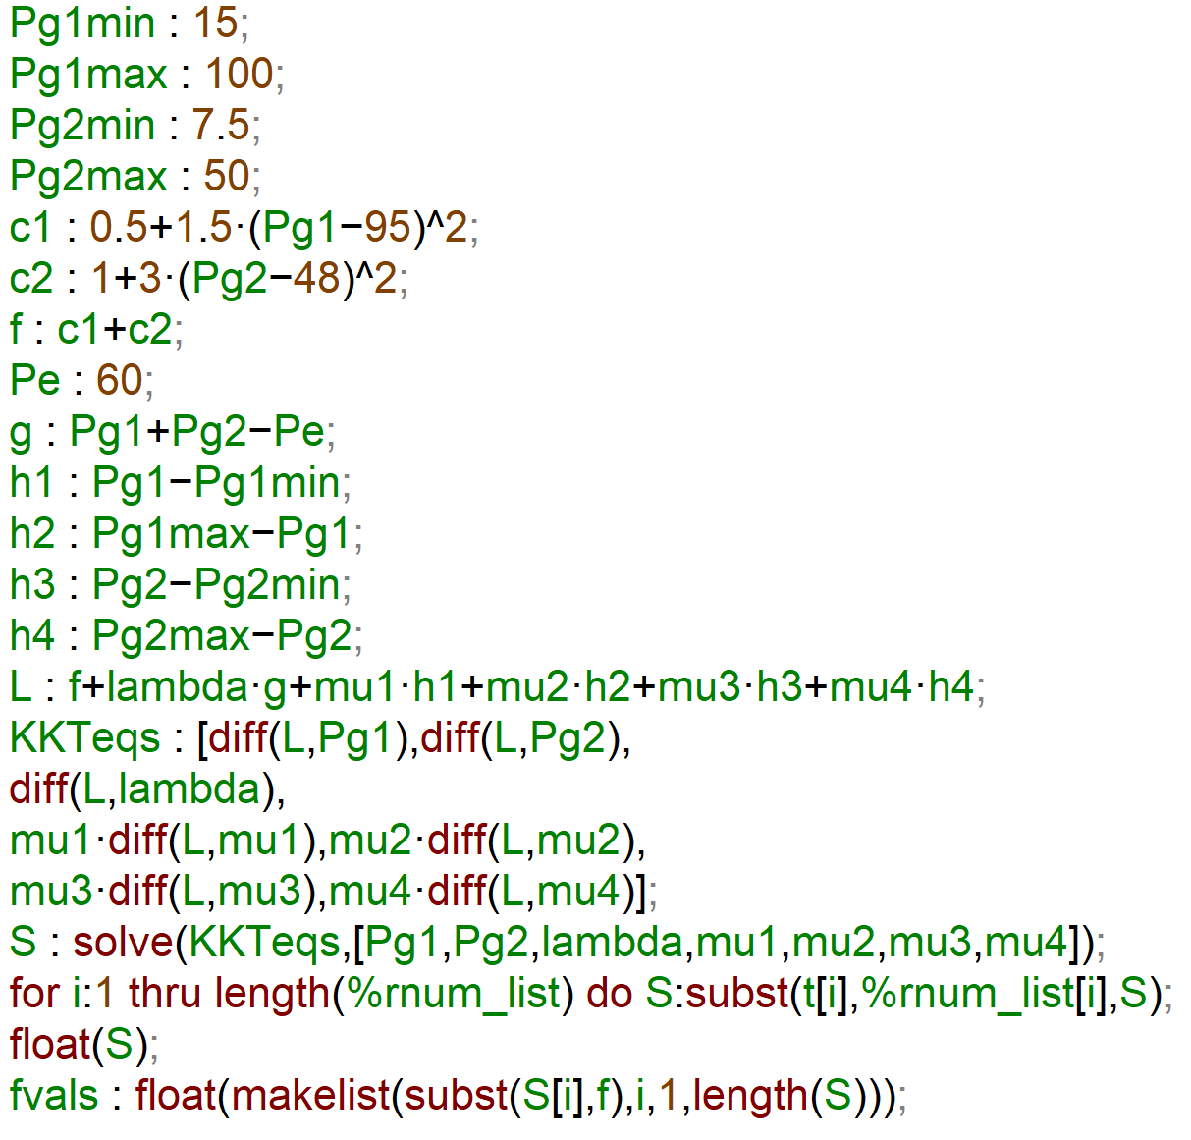
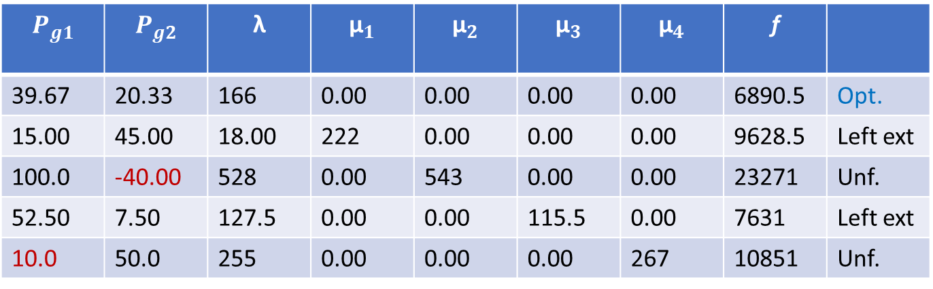
Compare the feasible combinations for each Pe:
Pe=60:
G1 Only:
P_{g1} = P_{e} = 60 , c₁= 0.5+1.5*(60-95)²=1838
G1+G2:
Maxima:
cost rate G1+G2 > cost rate G1 -> for Pe=60 optimal choice: Only G1!
$$P_{g1}$$ | $$P_{g2}$$ | λ | $${\text{μ}}_{1}$$ | $${\text{μ}}_{2}$$ | $${\text{μ}}_{3}$$ | $${\text{μ}}_{4}$$ | f
39.67 | 20.33 | 166 | 0.00 | 0.00 | 0.00 | 0.00 | 6890.5 | Opt.
15.00 | 45.00 | 18.00 | 222 | 0.00 | 0.00 | 0.00 | 9628.5 | Left ext
100.0 | -40.00 | 528 | 0.00 | 543 | 0.00 | 0.00 | 23271 | Unf.
52.50 | 7.50 | 127.5 | 0.00 | 0.00 | 115.5 | 0.00 | 7631 | Left ext
10.0 | 50.0 | 255 | 0.00 | 0.00 | 0.00 | 267 | 10851 | Unf.

Slide 8
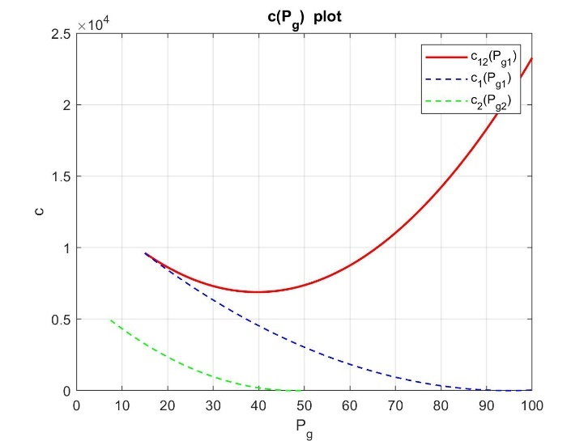
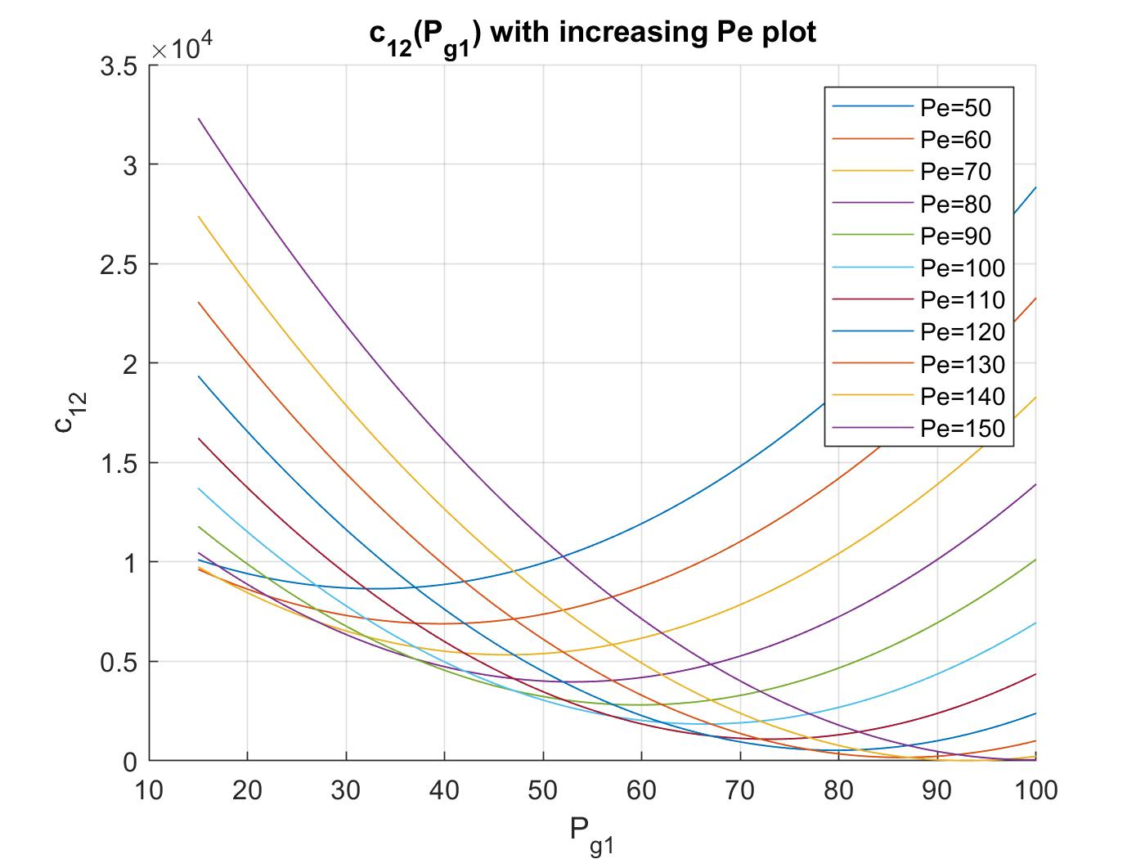
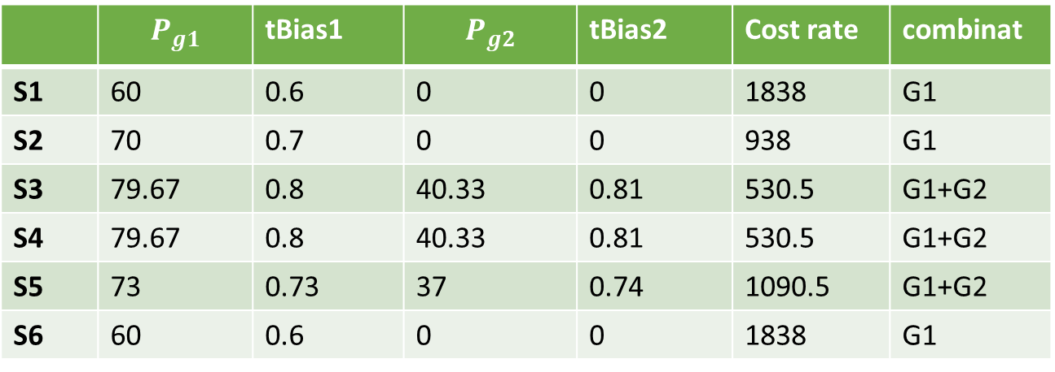
GRAPHICALLY: (for Pe=60) for Pe increasing, cost rate shift
Summing up all the results:
Let’s simulate on Modelica,
using same controllers:
 | $$P_{g1}$$ | tBias1 | $$P_{g2}$$ | tBias2 | Cost rate | combinat
S1 | 60 | 0.6 | 0 | 0 | 1838 | G1
S2 | 70 | 0.7 | 0 | 0 | 938 | G1
S3 | 79.67 | 0.8 | 40.33 | 0.81 | 530.5 | G1+G2
S4 | 79.67 | 0.8 | 40.33 | 0.81 | 530.5 | G1+G2
S5 | 73 | 0.73 | 37 | 0.74 | 1090.5 | G1+G2
S6 | 60 | 0.6 | 0 | 0 | 1838 | G1

Slide 9
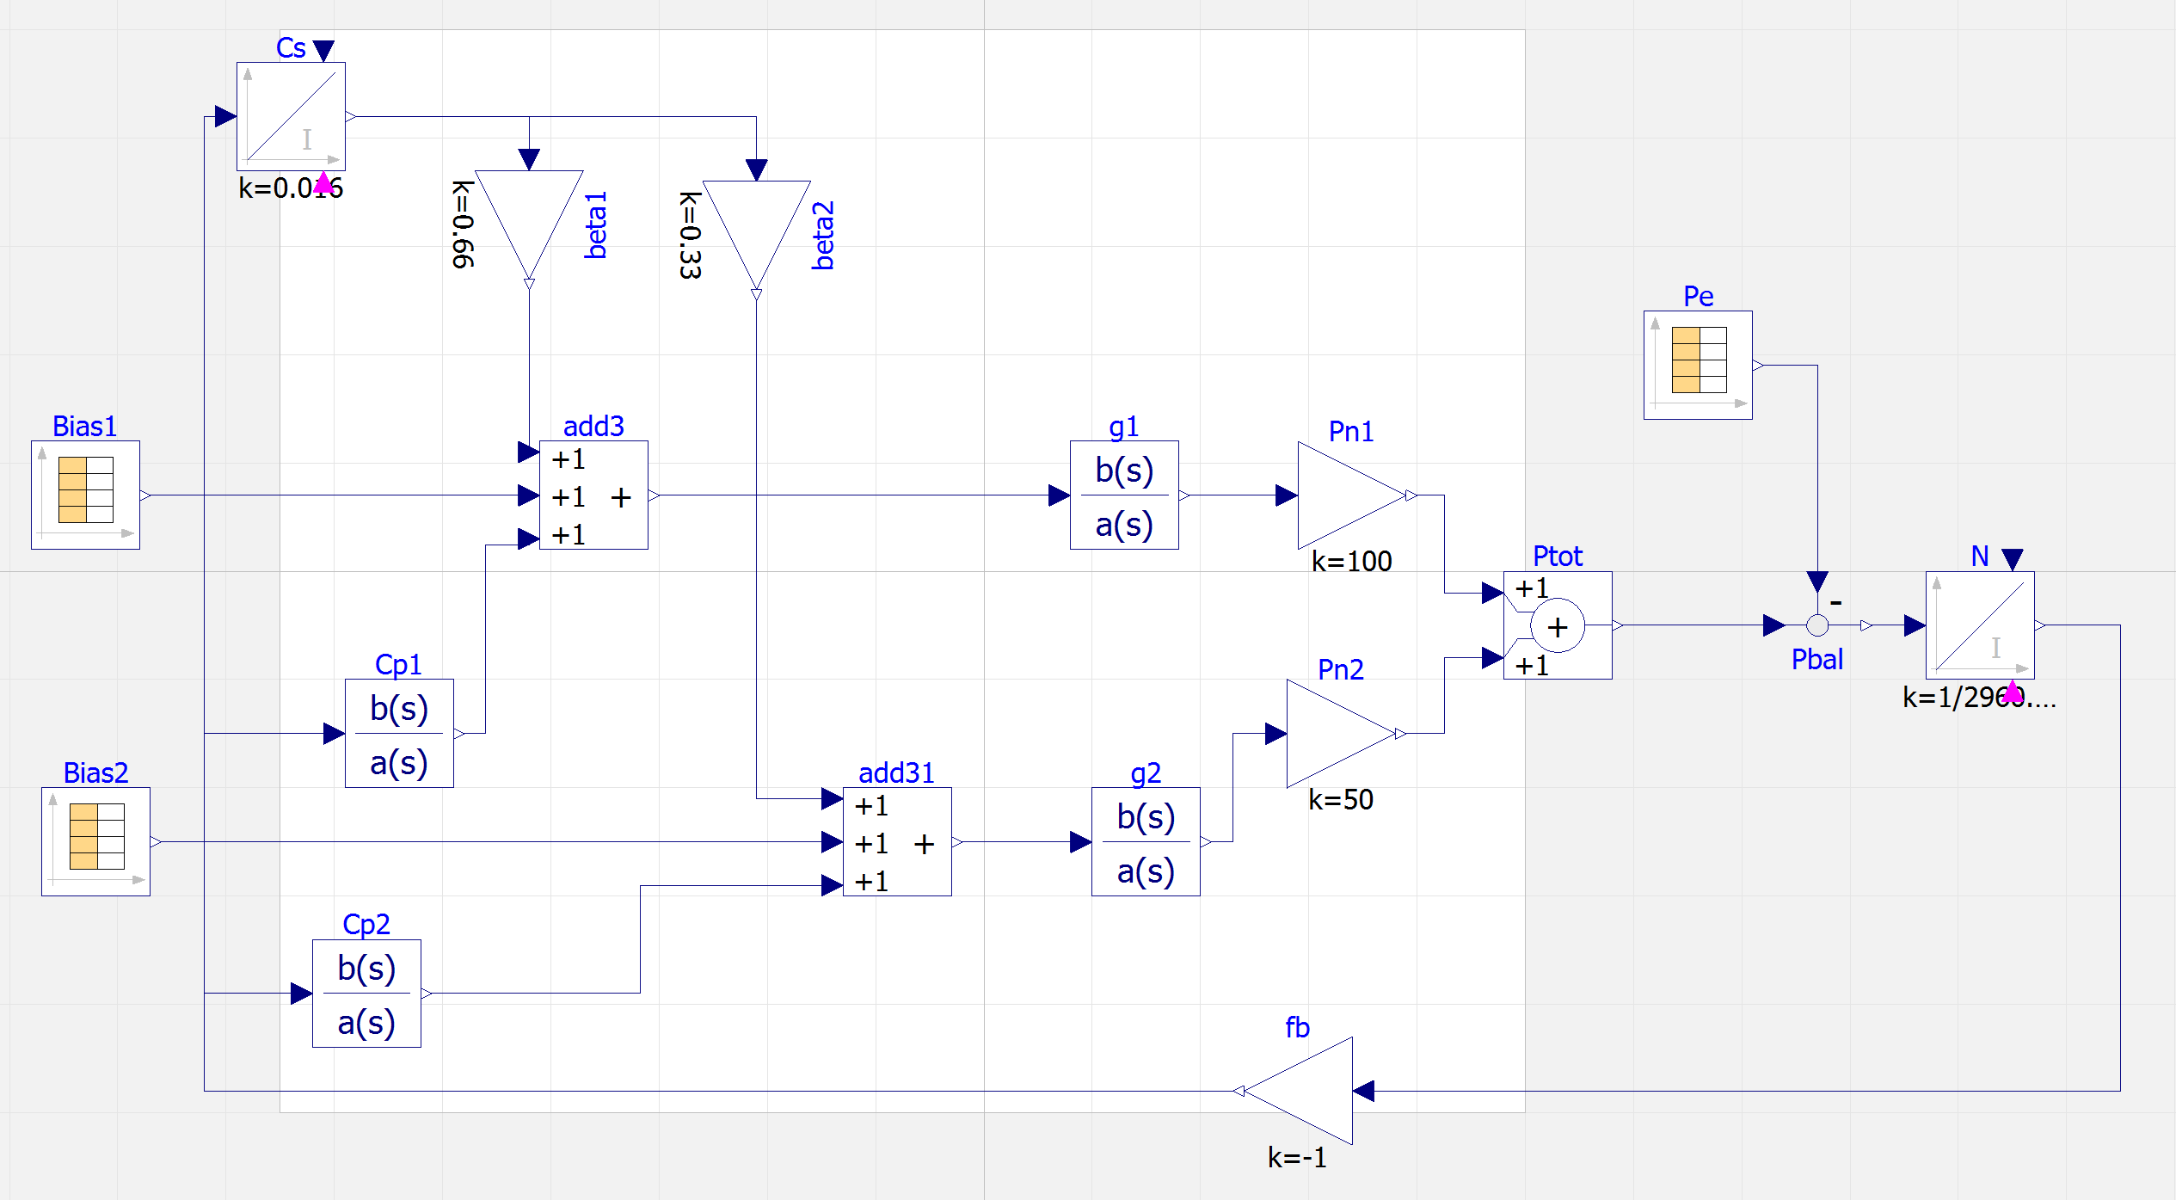
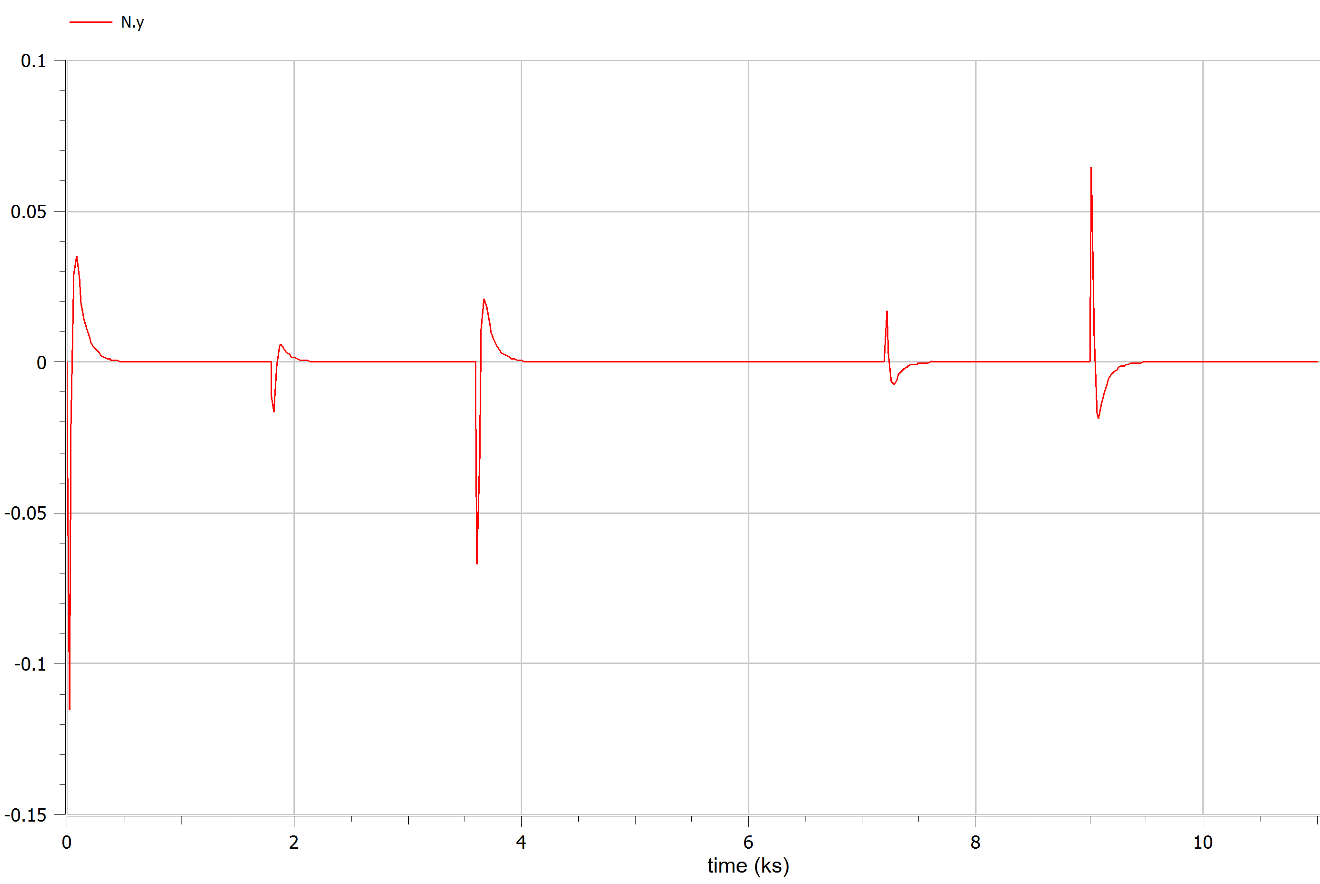
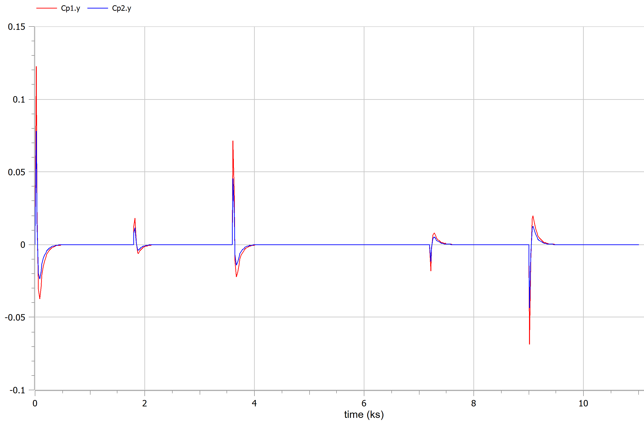
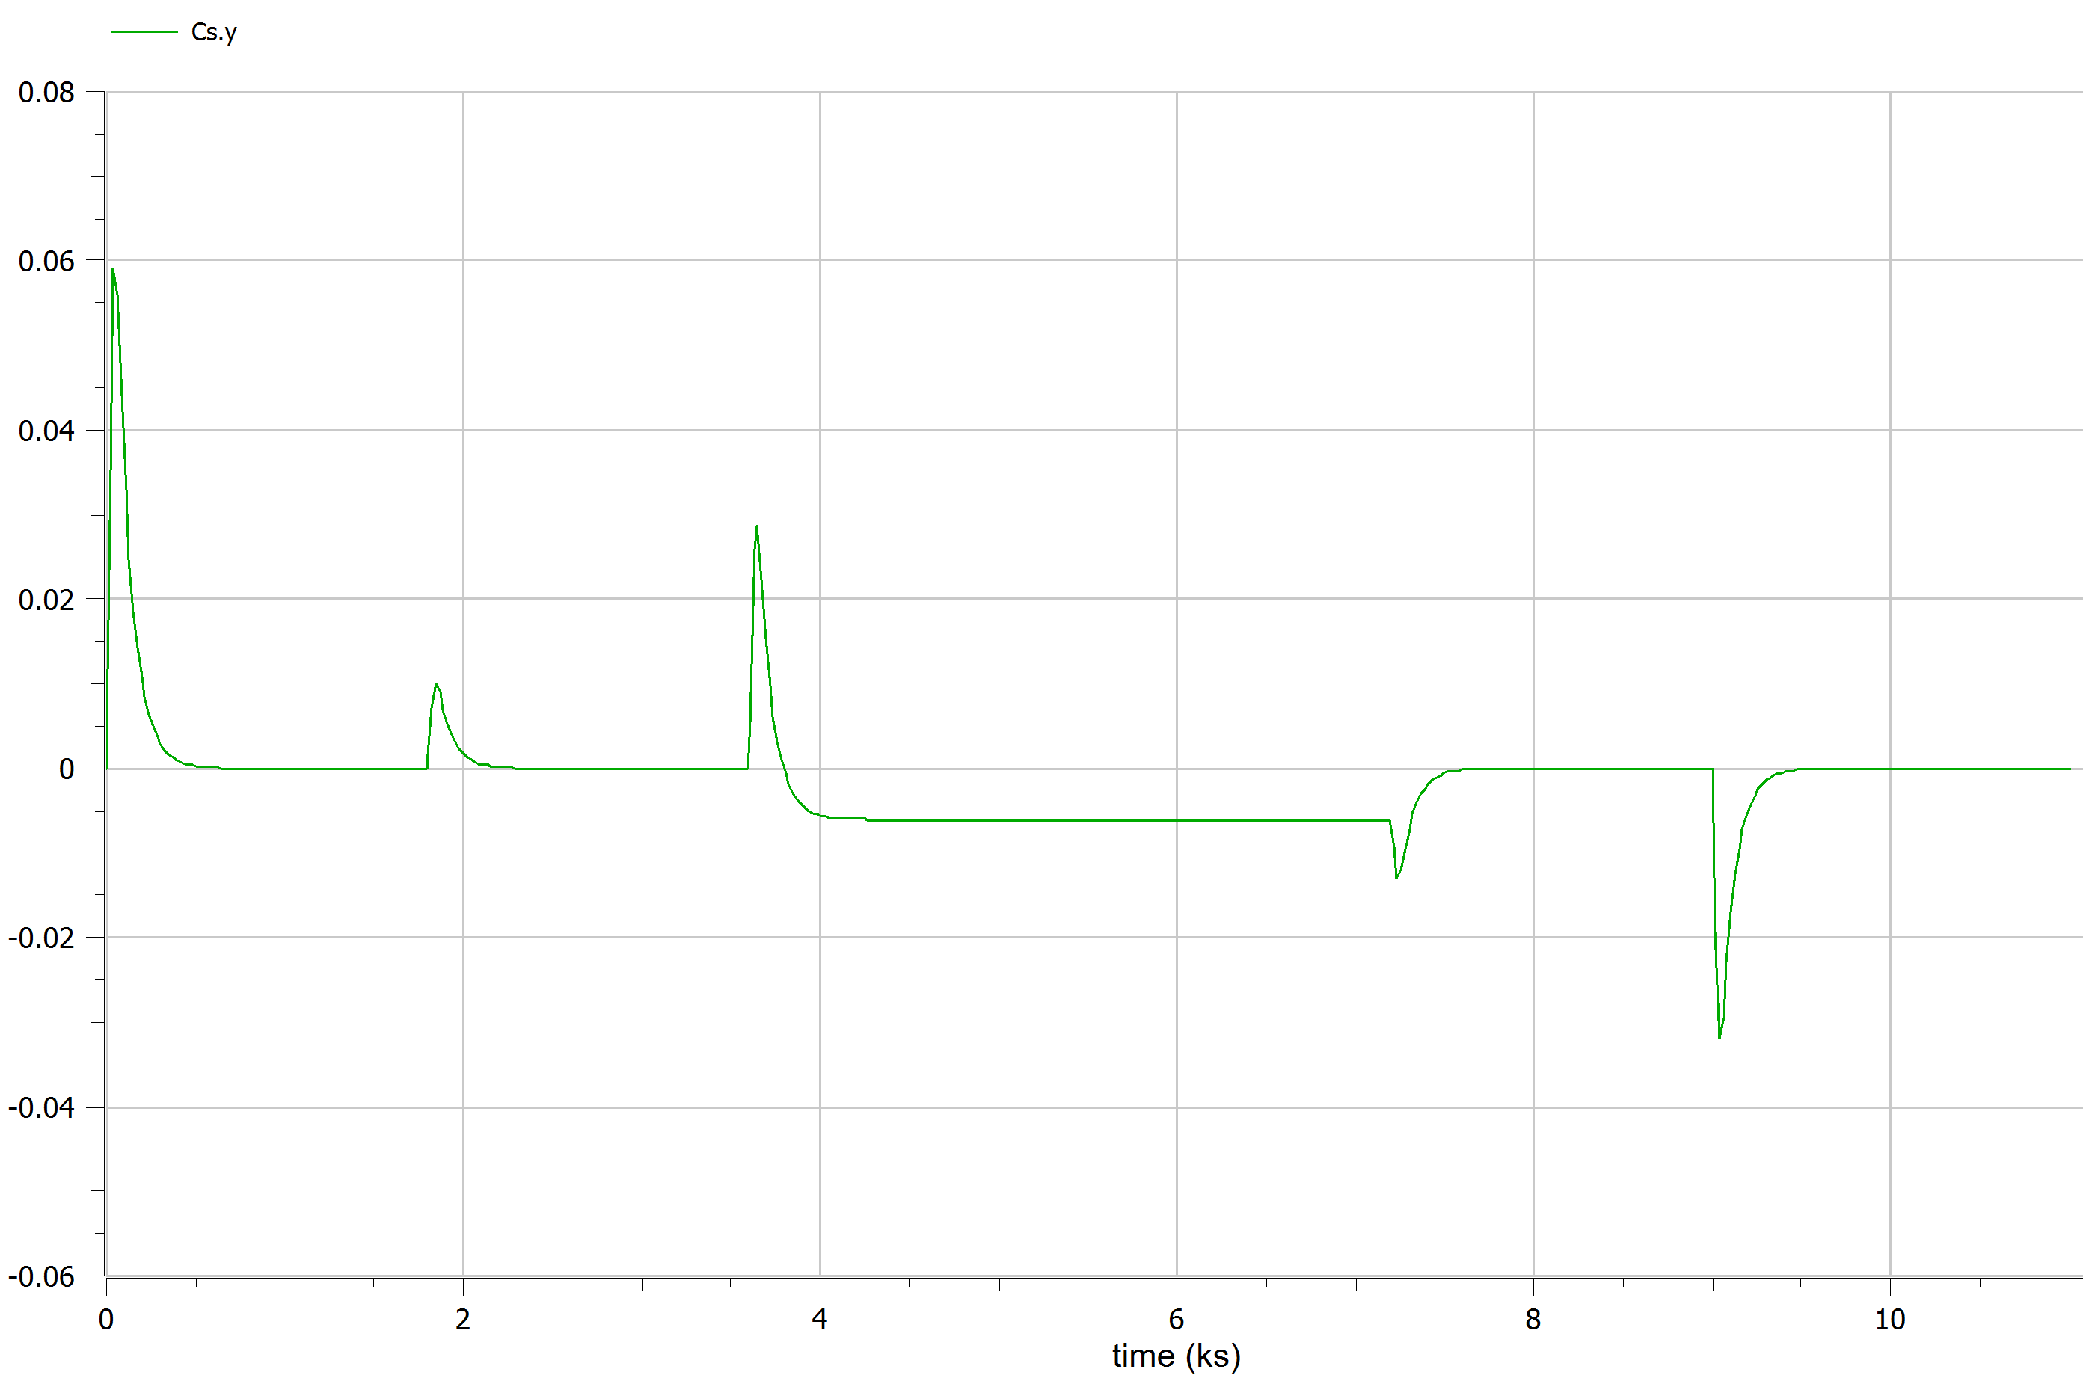
Frequency error
Some overdump due to intial set up dynamic and generators pool switching
Primary control
Secondary control

Slide 10
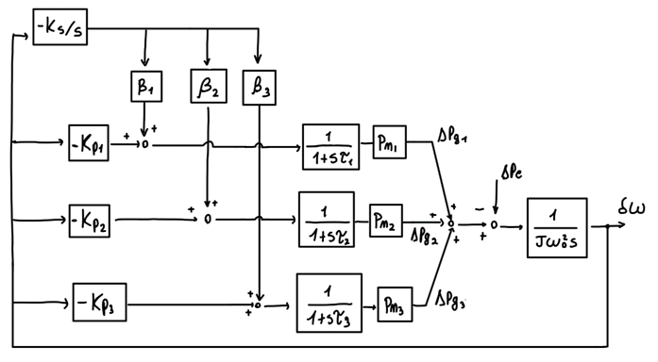
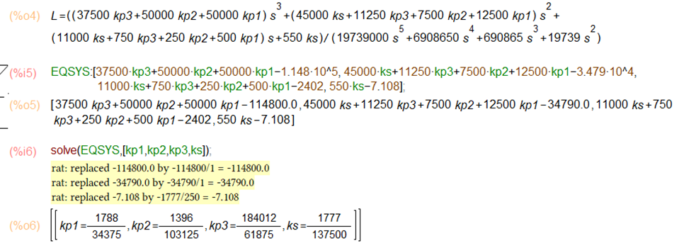
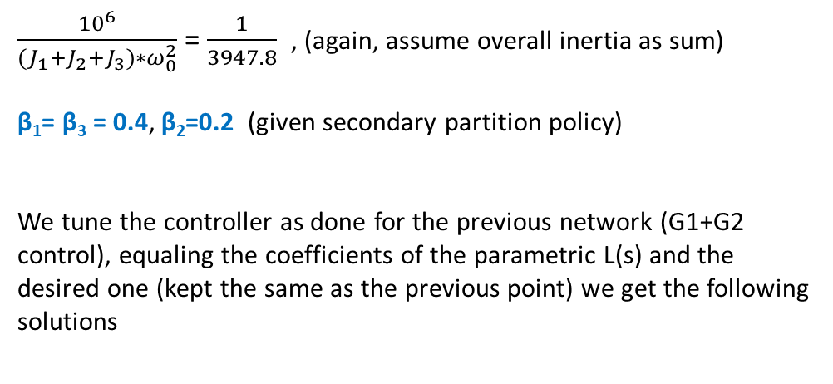
Configuration B, Control
$\frac{{10}^{6}}{{(J}_{1}+J_{2}+J_{3})∗ω_{0}^{2}}$ = $\frac{1}{3947.8}$ , (again, assume overall inertia as sum)
β₁= β₃ = 0.4, β₂=0.2 (given secondary partition policy)
We tune the controller as done for the previous network (G1+G2 control), equaling the coefficients of the parametric L(s) and the desired one (kept the same as the previous point) we get the following solutions
These solutions however produce once again an imbalanced response of the control variable,
Modify those gains by some magic and tons of errors.. to get a better-distributed stress in the network while still fulfilling the requirements
Kp1 = 0.520
Kp2 = 0.135
Kp3 = 0.595
Ks = 0.0129

Slide 11
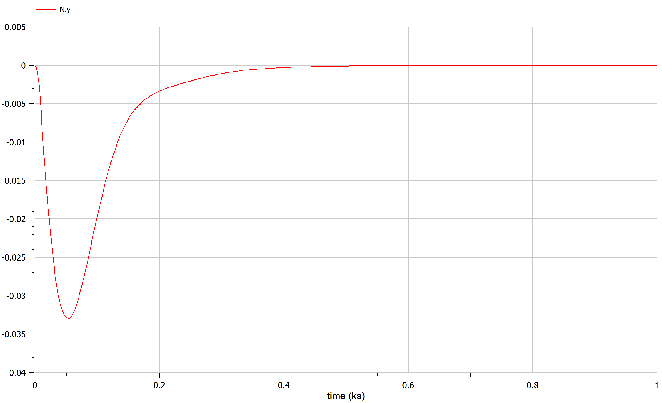
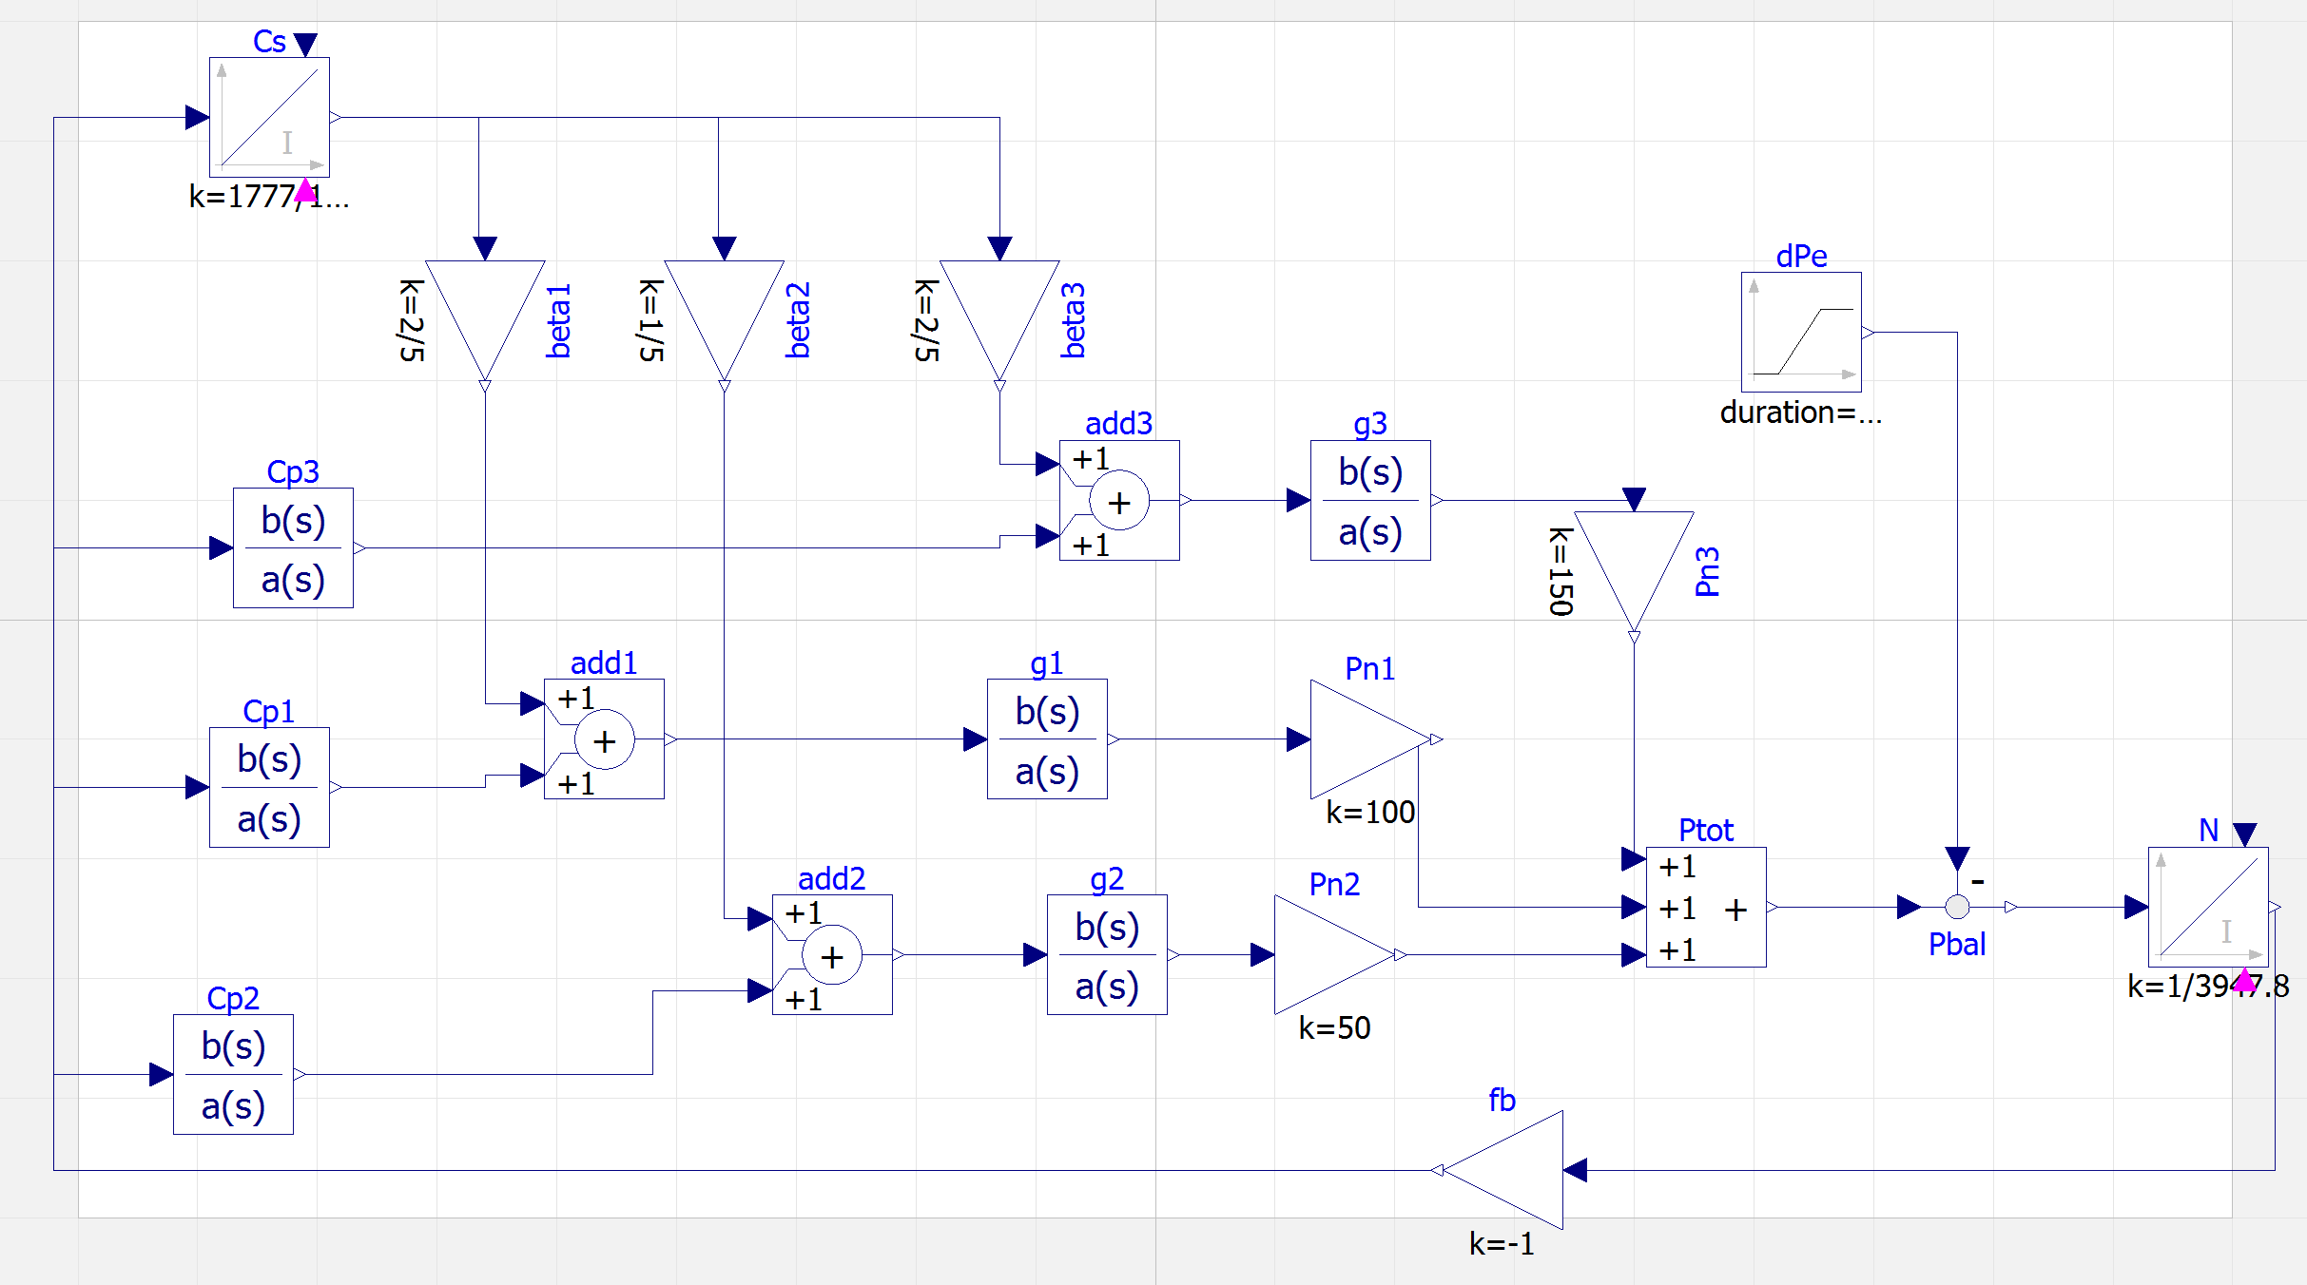
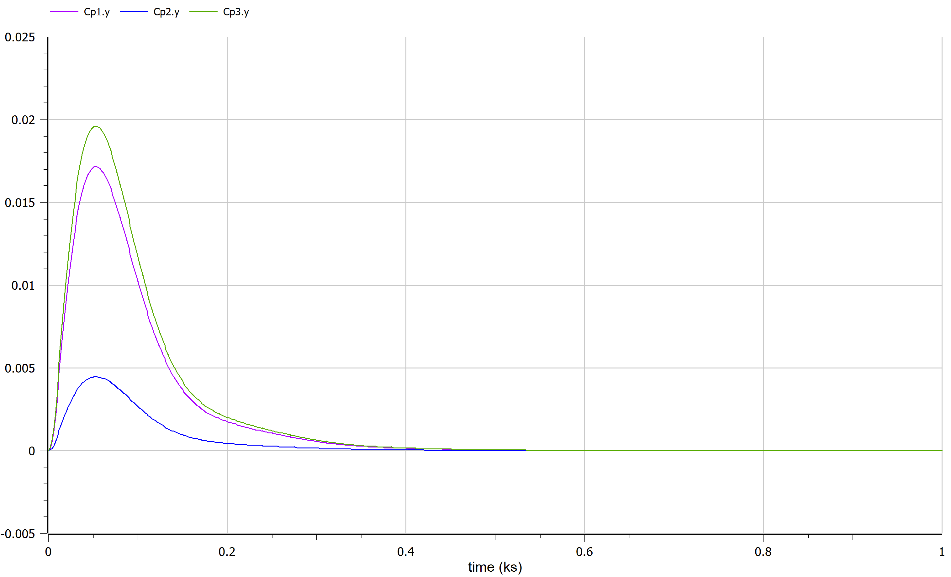
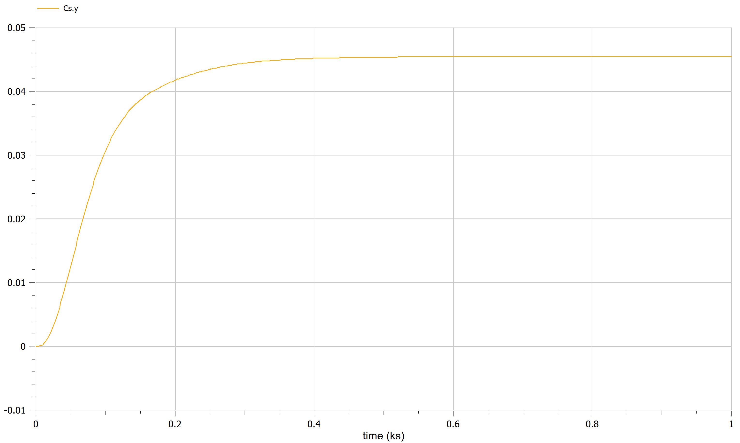
Frequency error
Primary control
Secondary control

Slide 12
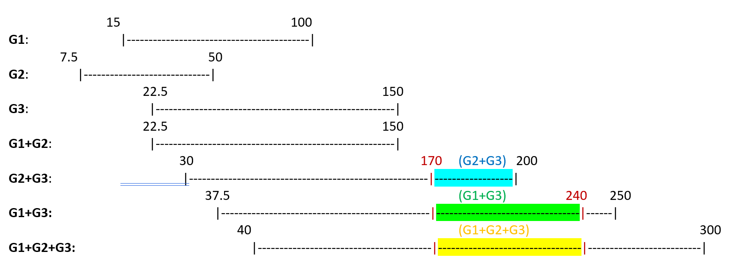
Configuration B, Optimization
(G1,G2,G3 feeding L1+L2*L3*L4)
G3: P_{g3,min} = 22.5 MW P_{g3,max} = 150 MW
 | S1 | S2 | S3 | S4 | S5 | S6
Pe | 170 | 180 | 230 | 210 | 240 | 190
I₁: [170,200] -> (G2+G3, G1+G3, G1+G2+G3) I₂: [200,240] -> (G1+G3, G1+G2+G3)
We cosider the point of view of a producer with expenditure only on G1 and G3, that can fix power given by G2 (given by another producer) without caring about its cost rate.

Slide 13
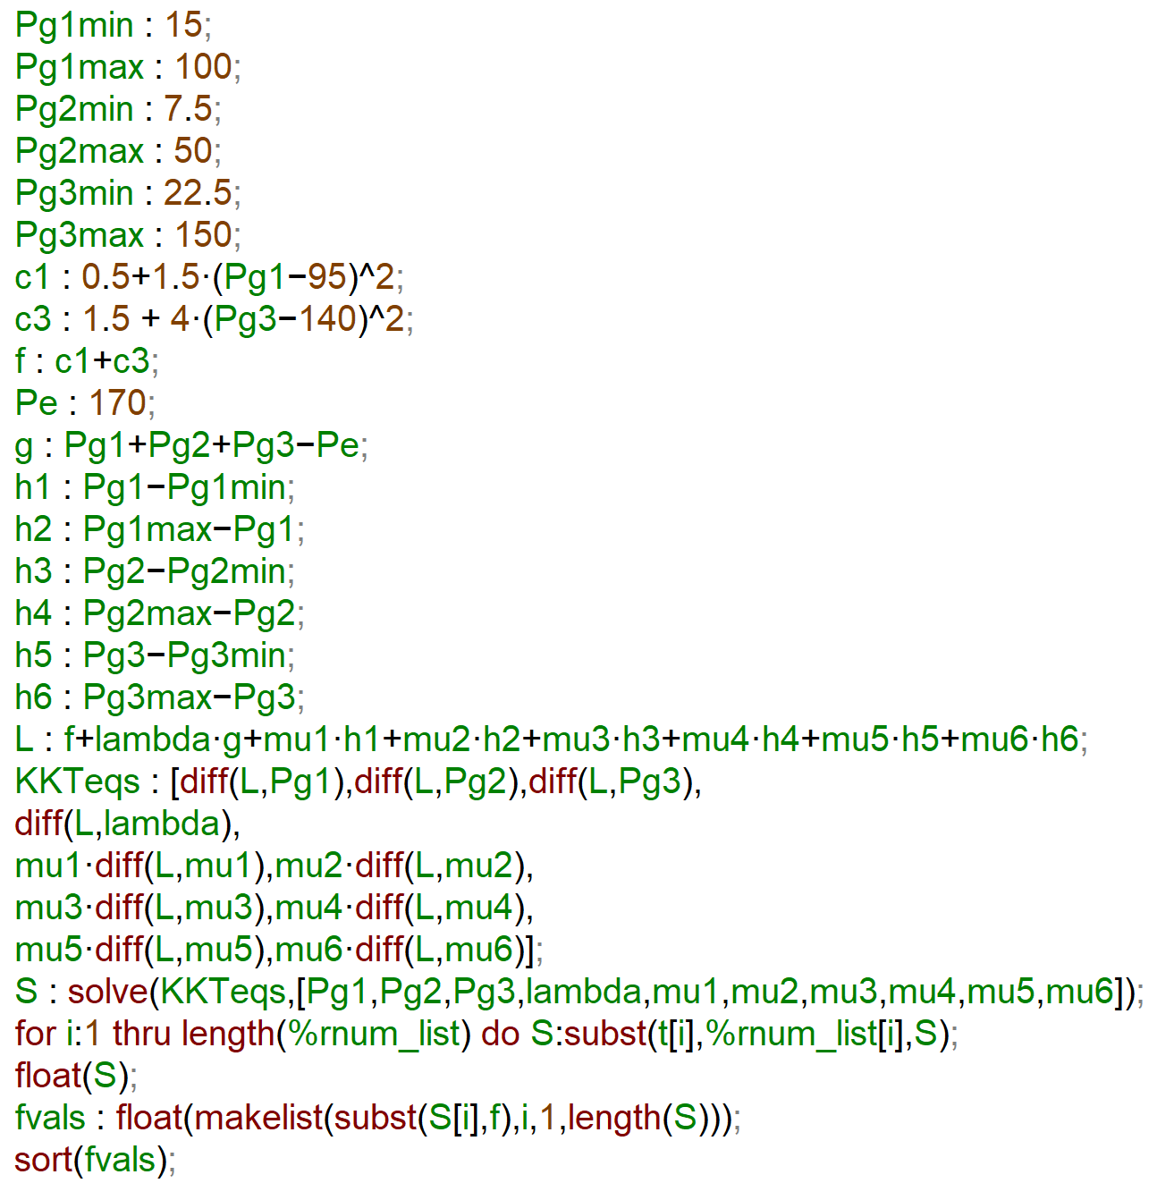
Optimzation problem (in KKT formulation)
f = 0.5 + 1.5*(P_{g1}-95)²+ 1.5 +4*(P_{g3}-140)² (neglect c₂ on the cost function, as we pointed out)
g = P_{g1} + P_{g2} + P_{g3} – P_{e}
h₁=P_{g1} - Pg1,min MAXIMA:
h₂=P_{g1,max} - P_{g1}
h₃=P_{g2} - P_{g2,min}
h₄=P_{g2,max} - P_{g2}
h₅=P_{g3} - P_{g3,min}
h₆=P_{g3,max} - P_{g3}
L= f + λ*g + μ*h (Lagrangian)
(blue parts only if G3 is active, green one when G1 is active)

Slide 14
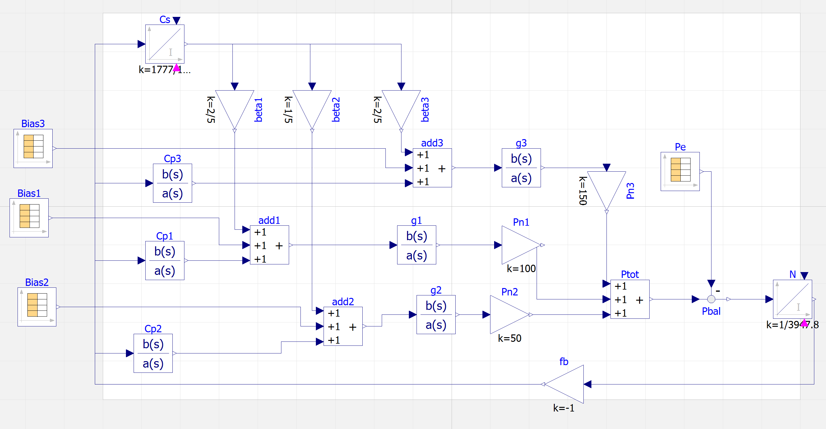
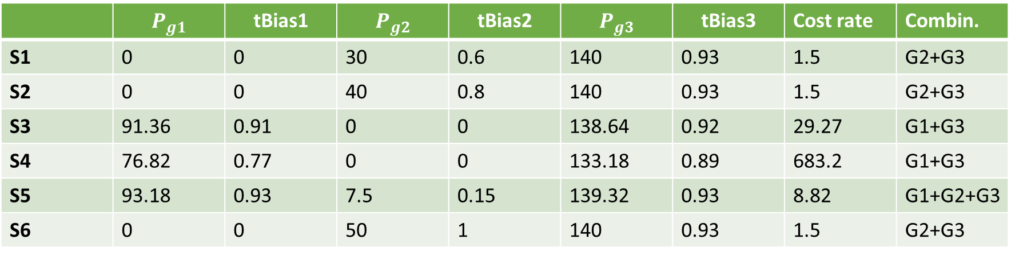
Summing up the optimization results:
 | $$P_{g1}$$ | $$\text{tBias}\text{1}$$ | $$P_{g2}$$ | $$\text{tBias}\text{2}$$ | $$P_{g3}$$ | $$\text{tBias}\text{3}$$ | Cost rate | Combin.
S1 | 0 | 0 | 30 | 0.6 | 140 | 0.93 | 1.5 | G2+G3
S2 | 0 | 0 | 40 | 0.8 | 140 | 0.93 | 1.5 | G2+G3
S3 | 91.36 | 0.91 | 0 | 0 | 138.64 | 0.92 | 29.27 | G1+G3
S4 | 76.82 | 0.77 | 0 | 0 | 133.18 | 0.89 | 683.2 | G1+G3
S5 | 93.18 | 0.93 | 7.5 | 0.15 | 139.32 | 0.93 | 8.82 | G1+G2+G3
S6 | 0 | 0 | 50 | 1 | 140 | 0.93 | 1.5 | G2+G3
Once computed the tertiary bias, using the control tuned previously, we can simulate our optimal tertiary bias as done before.

Slide 15
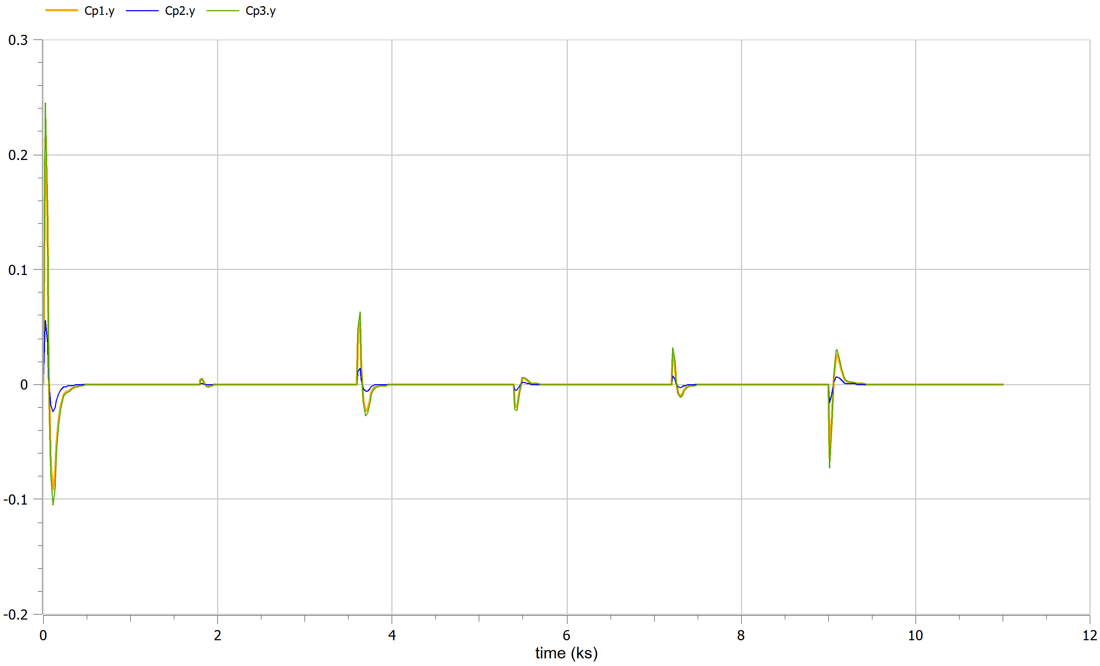
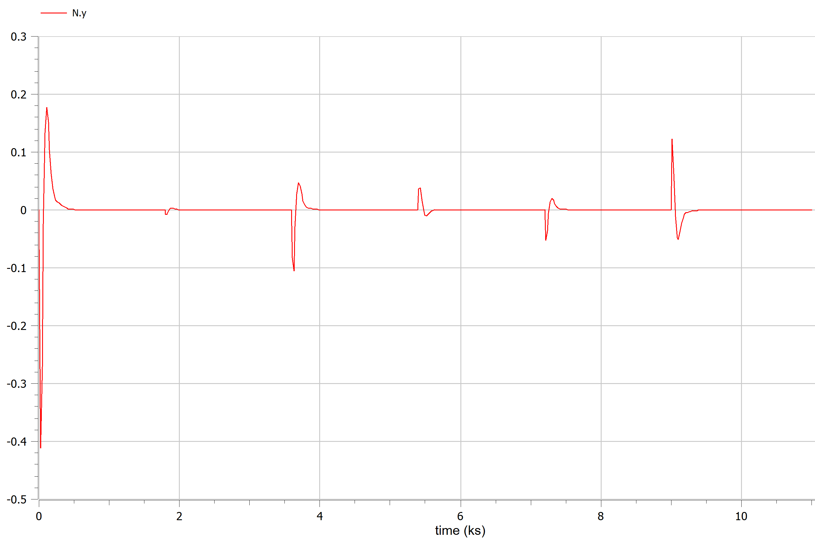
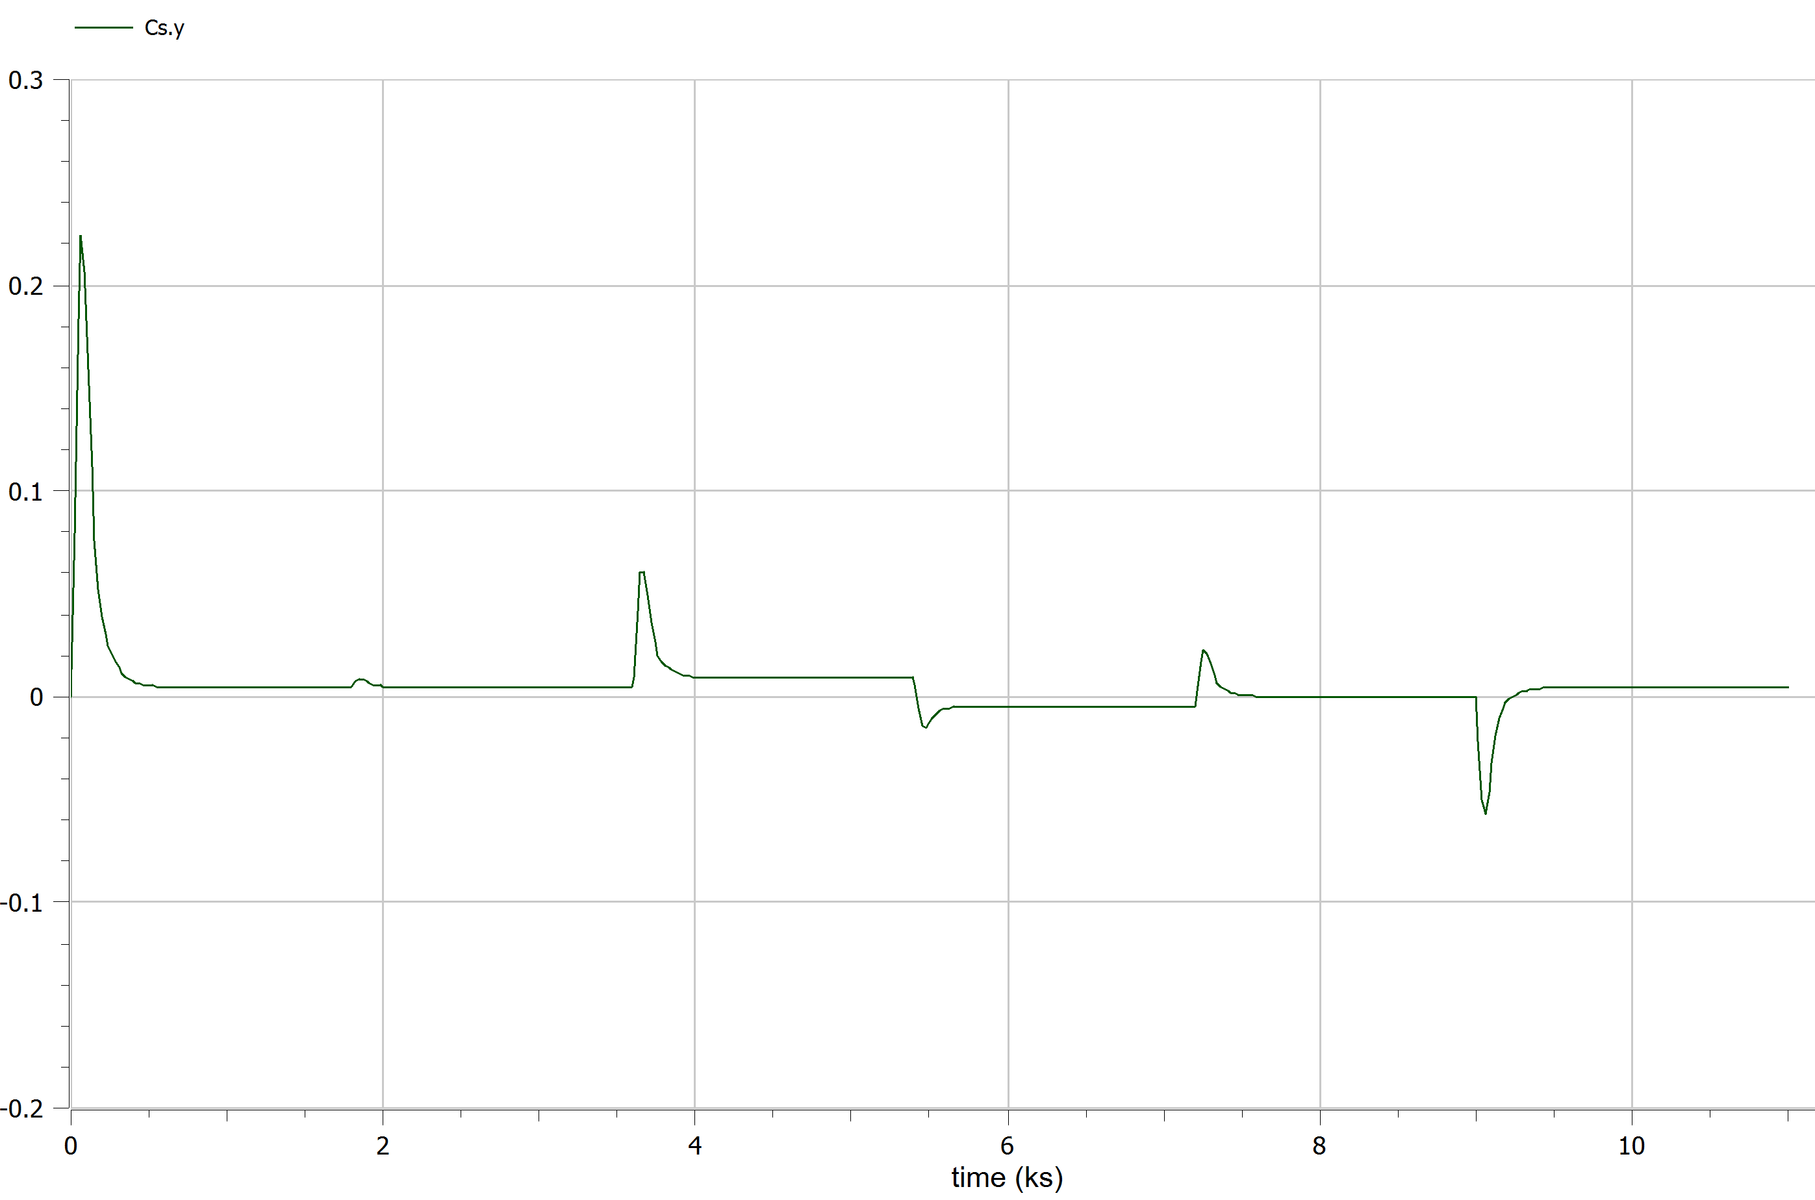
Primary control
Frequency error
Secondary control

