Slide 1
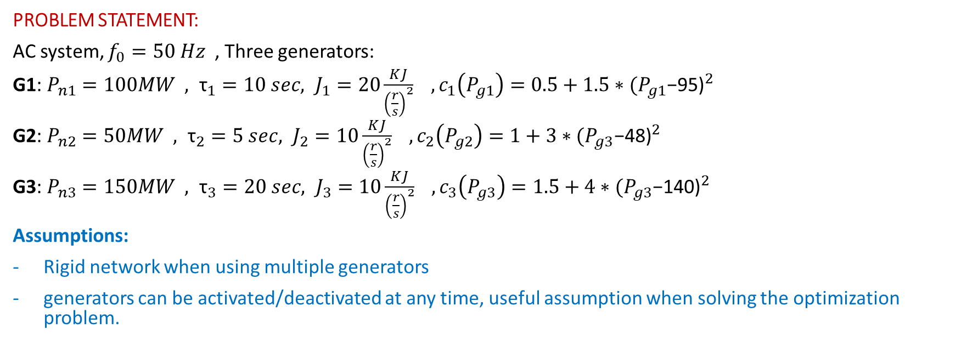
Automation of Energy Systems
Project for the academic year 2022/2023
Riccardo Mondin, Davide Pizzoccheri, Alessandro Puglisi, Nicolò Spinelli
PROBLEM STATEMENT:
AC system, $f_{0}=50 Hz$ , Three generators:
G1: $P_{n1}=100MW , {\text{τ}}_{1}=10 sec, J_{1}=20\frac{KJ}{{\left(\frac{r}{s}\right)}^{2}} , c_{1}\left(P_{g1}\right)=0.5+1.5∗{(P_{g1}\text{−95)}}^{2}$
G2: $P_{n2}=50MW , {\text{τ}}_{2}=5 sec, J_{2}=10\frac{KJ}{{\left(\frac{r}{s}\right)}^{2}} , c_{2}\left(P_{g2}\right)=1+3∗{(P_{g3}\text{−}\text{48}\text{)}}^{2}$
G3: $P_{n3}=150MW , {\text{τ}}_{3}=20 sec, J_{3}=10\frac{KJ}{{\left(\frac{r}{s}\right)}^{2}} , c_{3}\left(P_{g3}\right)=1.5+4∗{(P_{g3}\text{−}\text{140}\text{)}}^{2}$
Assumptions:
Rigid network when using multiple generators
generators can be activated/deactivated at any time, useful assumption when solving the optimization problem.

Slide 2
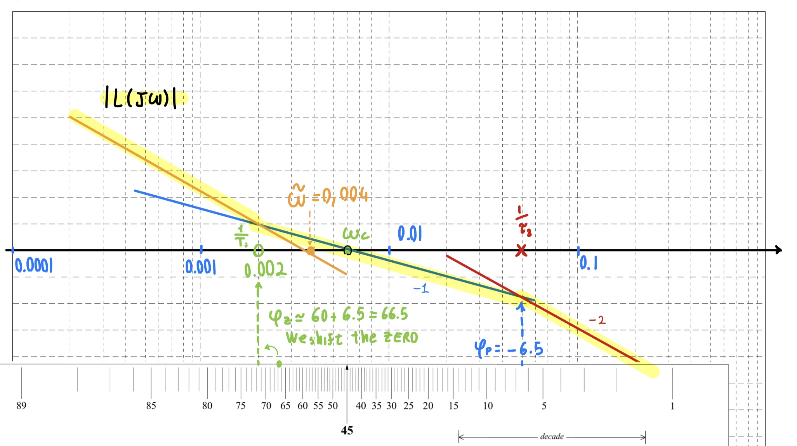
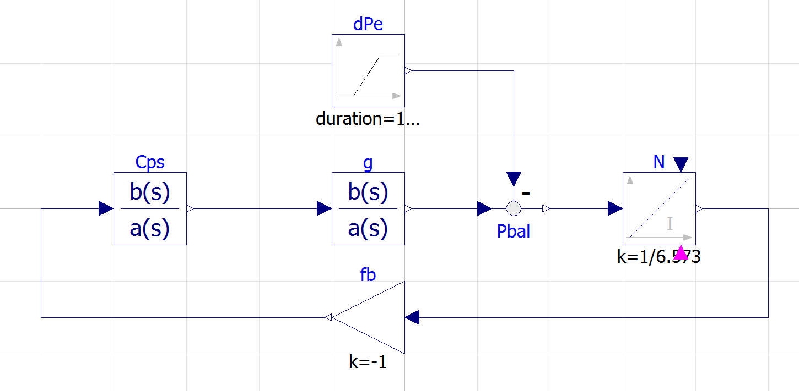

Configuration A, Control
G3 feeding L3+L4 (Islanded case):
from specification:
δPe ramp, 5MW over 10 sec
δω ≤ 0.05
t_{set} ≈ 15 min: 5/ω_{c} ≤ 900 → ω_{c} ≥ 0.006 rad/s
φ_{m} ≥ 60°: design choice, non oscillatory response .
T_{A}=$\frac{J_{3}∗ω_{0}^{2}}{P_{n,3}}$ = 6.573 sec , $g\left(s\right)=\frac{1}{1+20s}$
Loop shaping: C(s) = $\frac{1+500s}{500s}∗0.052$
Let’s simulate on Modelica:

Slide 3
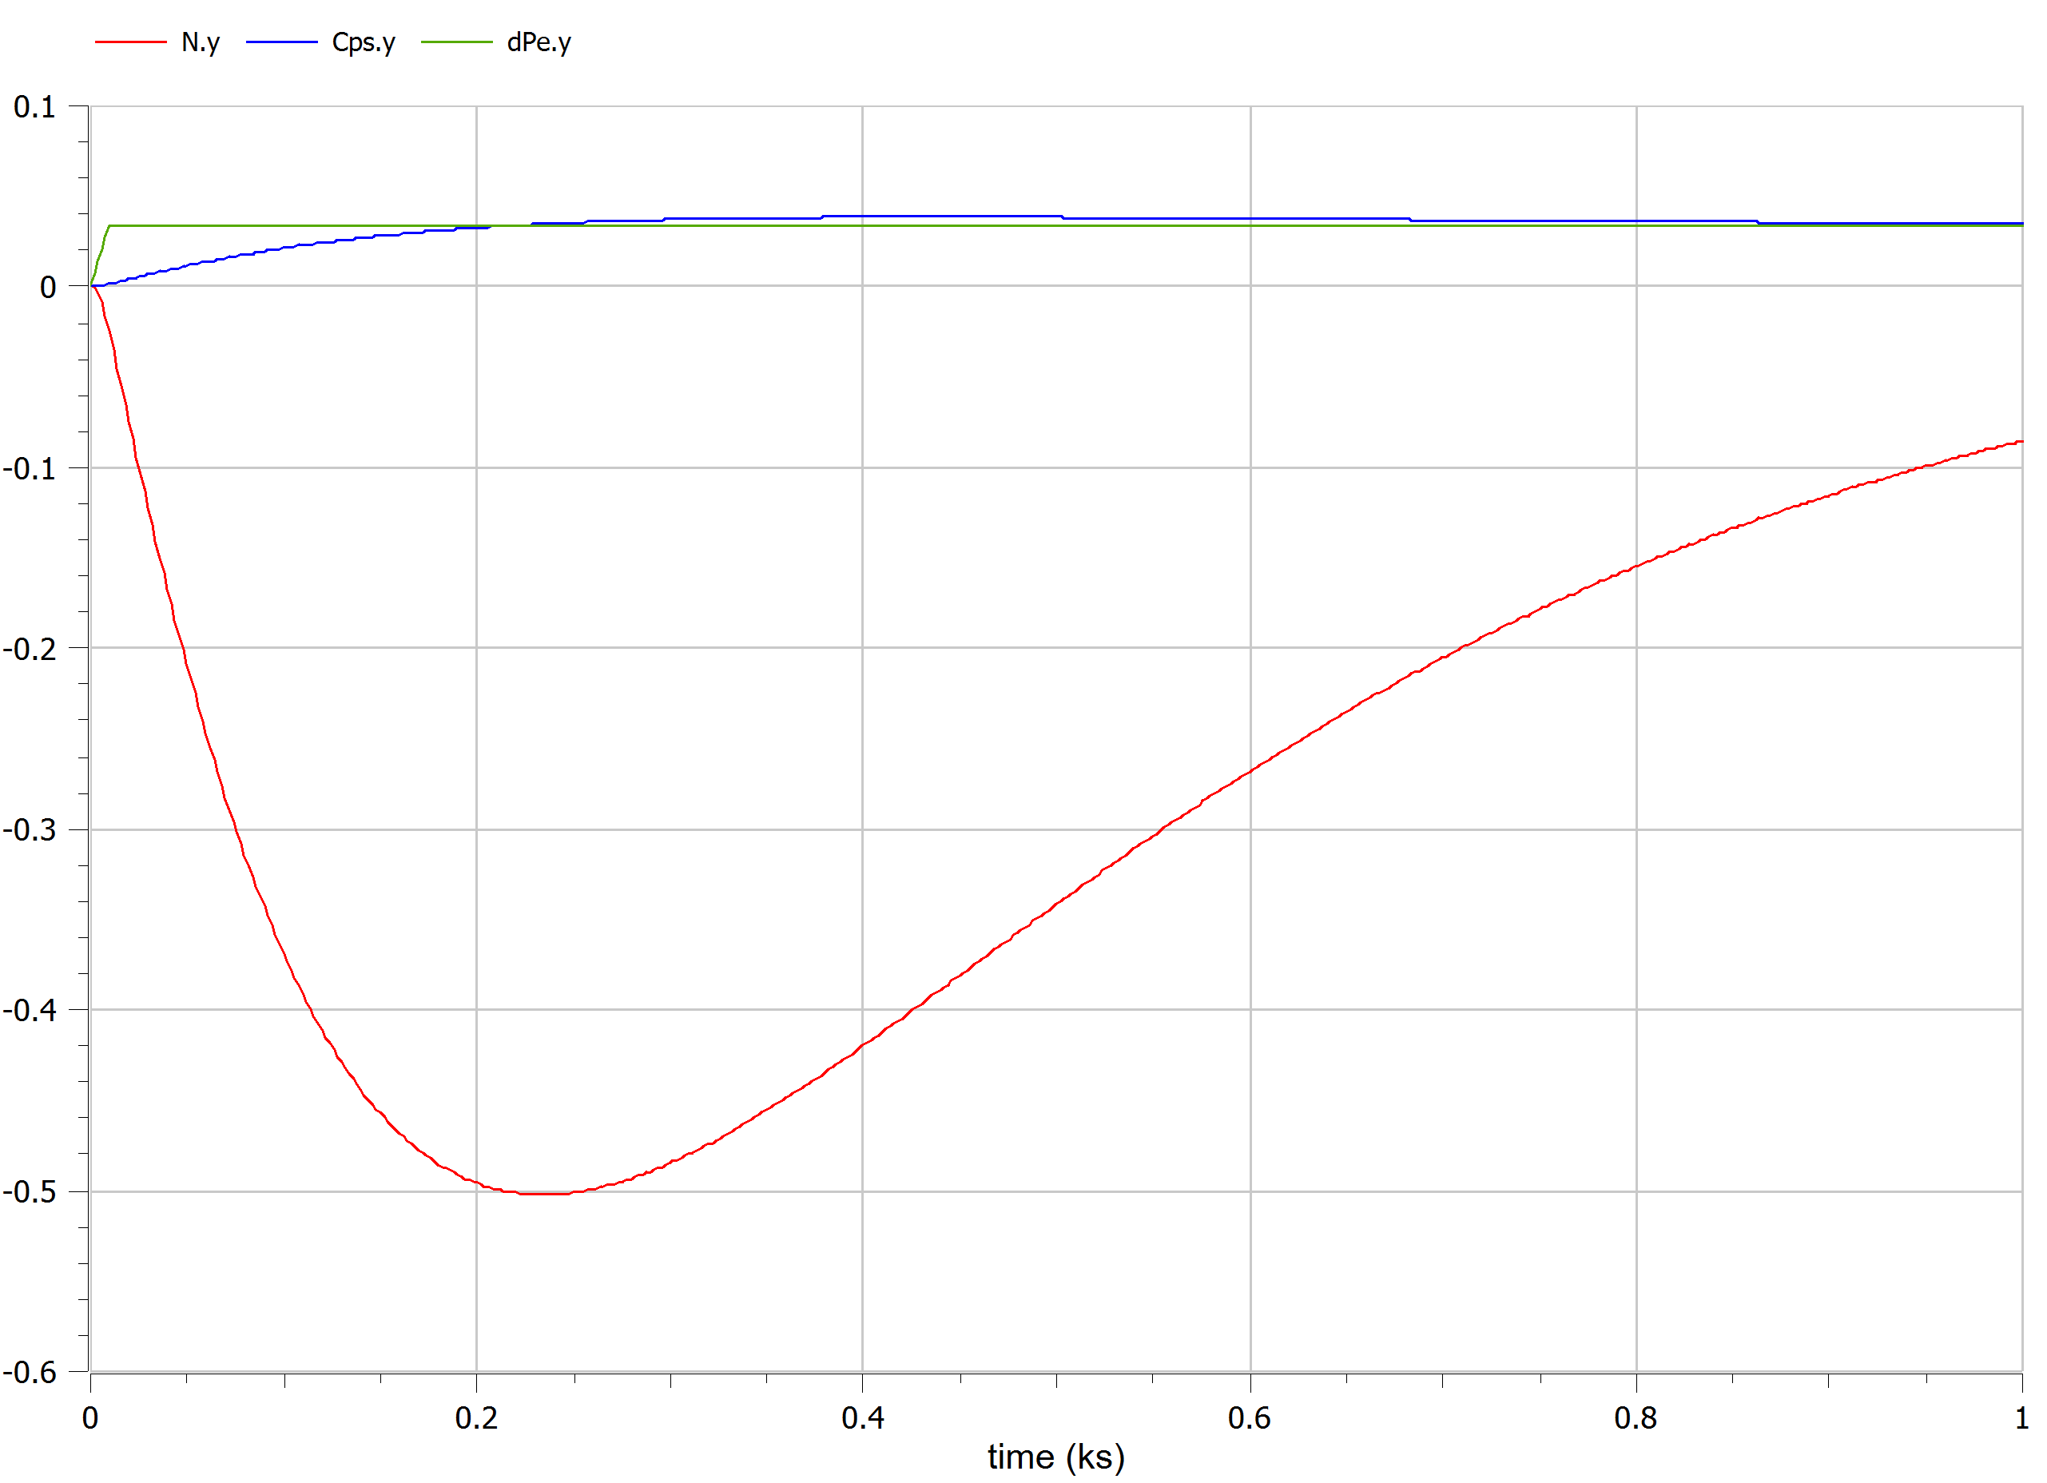
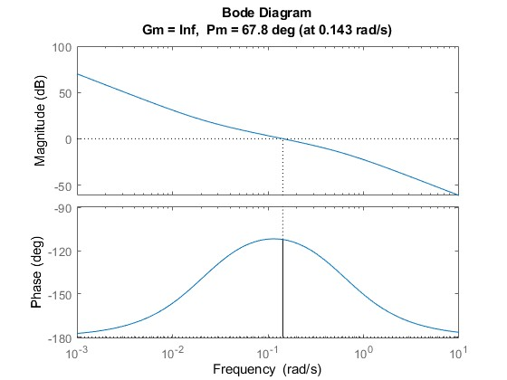
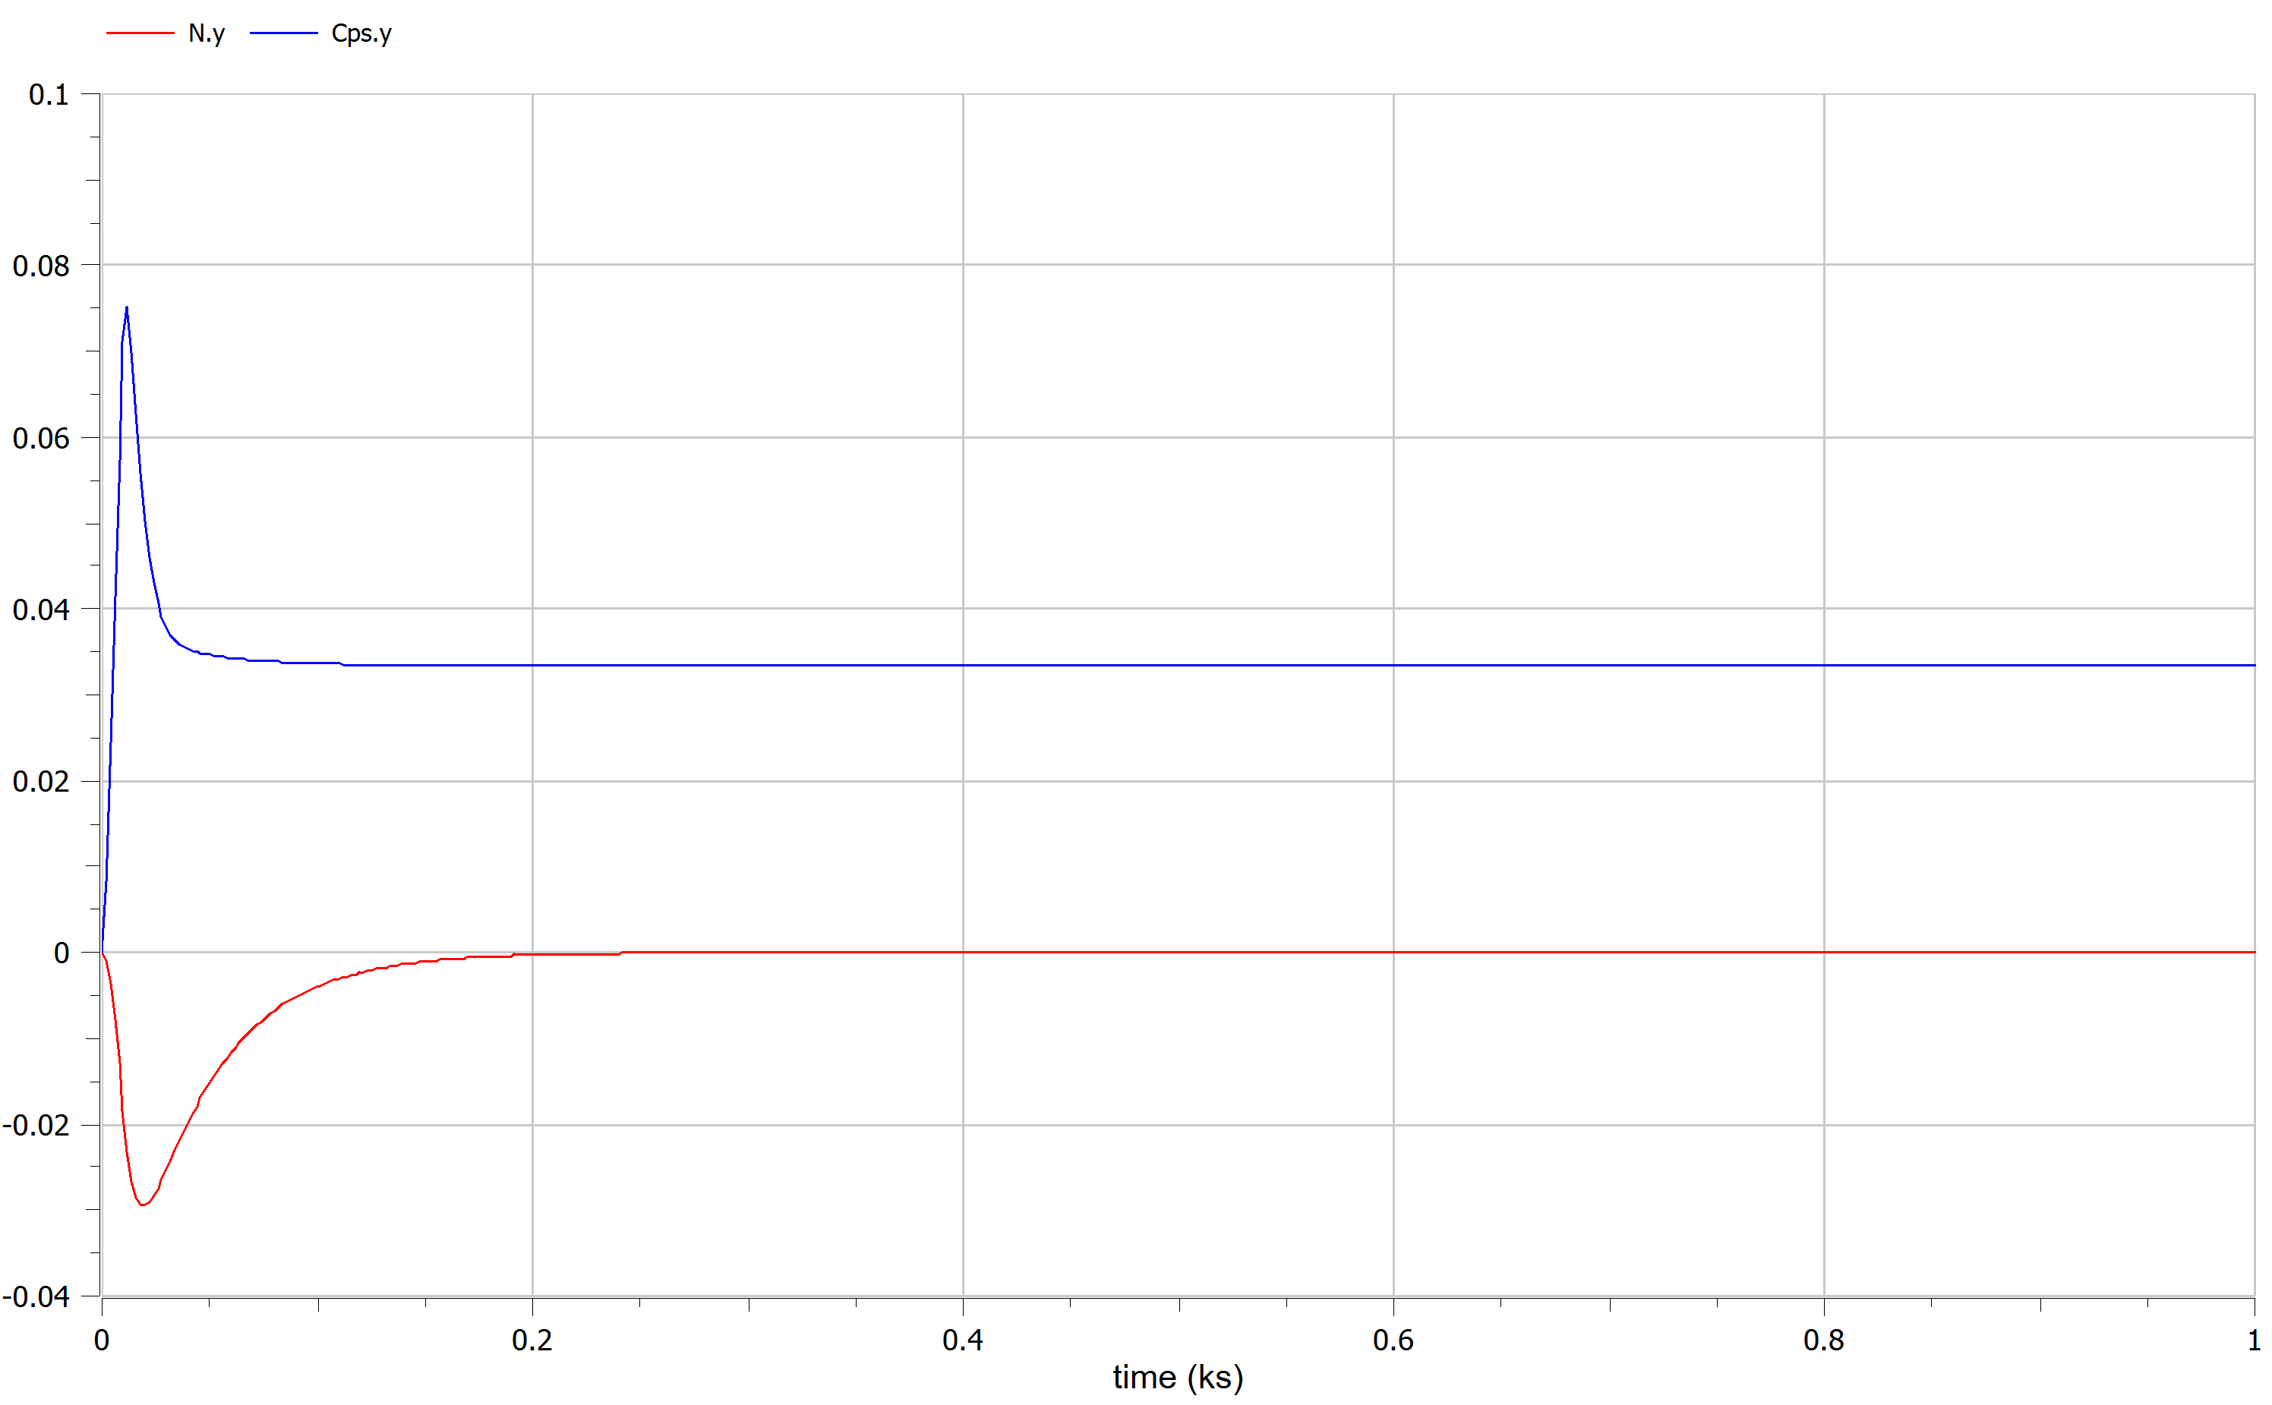

System’s response
Neither settling time nor frequency error constraint guarantee!
First guess: to increase the loop gain; from simulations on Matlab by a factor higher than 10 → Oscillatory response caused by a low phase margin.
Explore use of PID, to have a faster controller and less frequency error.
PID C(s): set up ω_{c} = 0.06 , one zero cancel gen pole, other zero in 0.022, pole in 0.6.
Response: slight violation of frequency boundary, phase margin acceptable but on the wrong side of the diagram.
Solution: double the gain.
C(s) =2*6.573*(0.04)² *$\frac{\left(1+45.45s\right)∗(1+20s)}{\left(1+1,67s\right)∗s}$

Slide 4
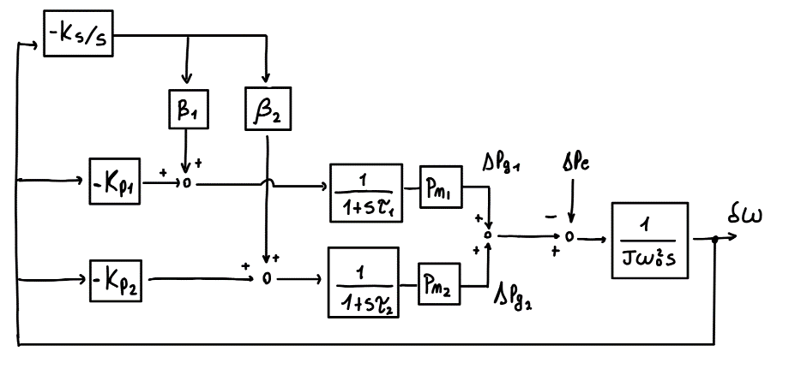
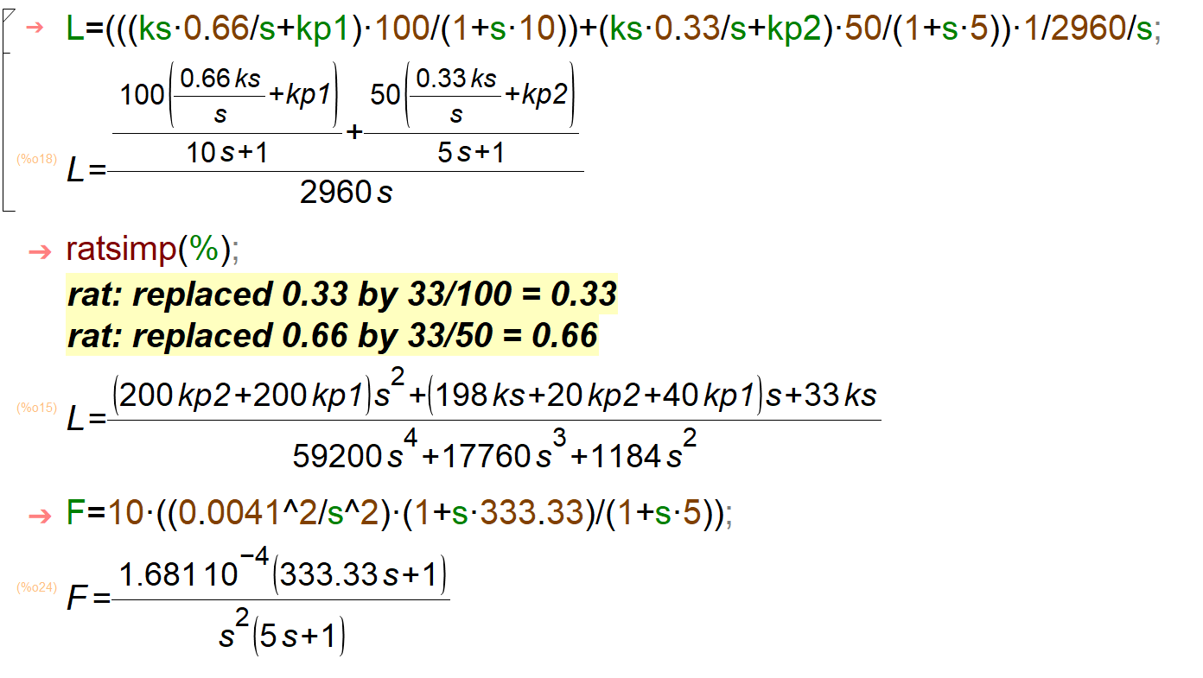
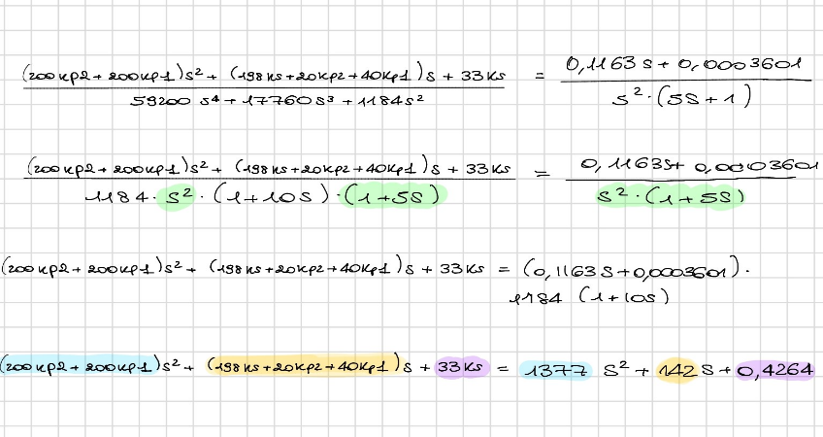
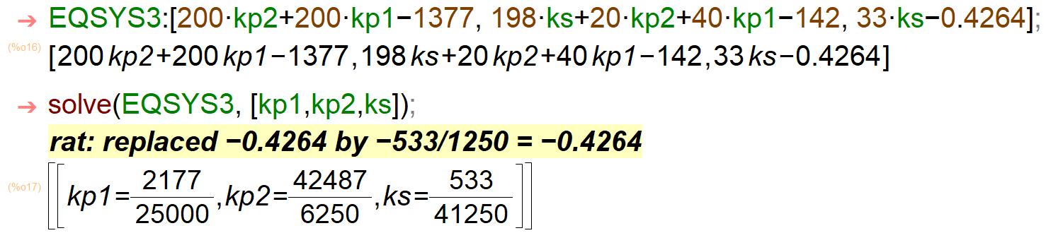

G1,G2 feeding L1+L2 (networked generators)
$\frac{{10}^{6}}{{(J}_{1}+J_{2})∗ω_{0}^{2}}$ = $\frac{1}{T_{A}}$ , T_{A} = 2960.88 sec (assuming overall inertia as the sum)
β₁=1/3 , β₂=2/3 (proportional to nominal Power)
Guarantee same specification of islanded case, design a goal L(s) and find the equivalent C(s) PID reversing the dynamic.
Solve a system of equations with 3 degrees of freedom (unknowns kp1, kp2 and ks)
Notes:
Network generators (G1,G2 feeding L1+L2) grid:
from our data:
$g_{1}\left(s\right)=\frac{1}{1+10s}$ P_{n,1}=100MW
$g_{2}\left(s\right)=\frac{1}{1+5s}$ P_{n,2} =50MW
We find the equivalent alternator dynamic from power to freq. error considering the overall inertia of parallel generators as the sum of the two inertia(s):
J₁=20 KJ/(r/s)² , J₂=10 KJ/(r/s)²
$\frac{{10}^{6}}{{(J}_{1}+J_{2})∗ω_{0}^{2}}$ = $\frac{1}{2960.88}$
(the constant is obtained consideringa 10⁶ factor since we are using data in MW)
We followed the instruction to set up the secondary contribution proportional to generator nominal powers, obtaining β₁=1/3 , β₂=2/3 Network generators (G1,G2 feeding L1+L2) grid:
Since we have to guarantee the same specification of the islanded case we proceeded by imposing a desired loop tf (called F in the Maxima script) whose response we verified on Matlab, and comparing it to the parametric loop transfer function – to mirror the desired behaviour- we obtained based on the block scheme. Imposing the equality of the coefficients of the polynomials in s we get a system of 3 equations in 3 unknowns K_{p1}, K_{p2} and K_{s}.
We then solved it in Maxima:

Slide 5
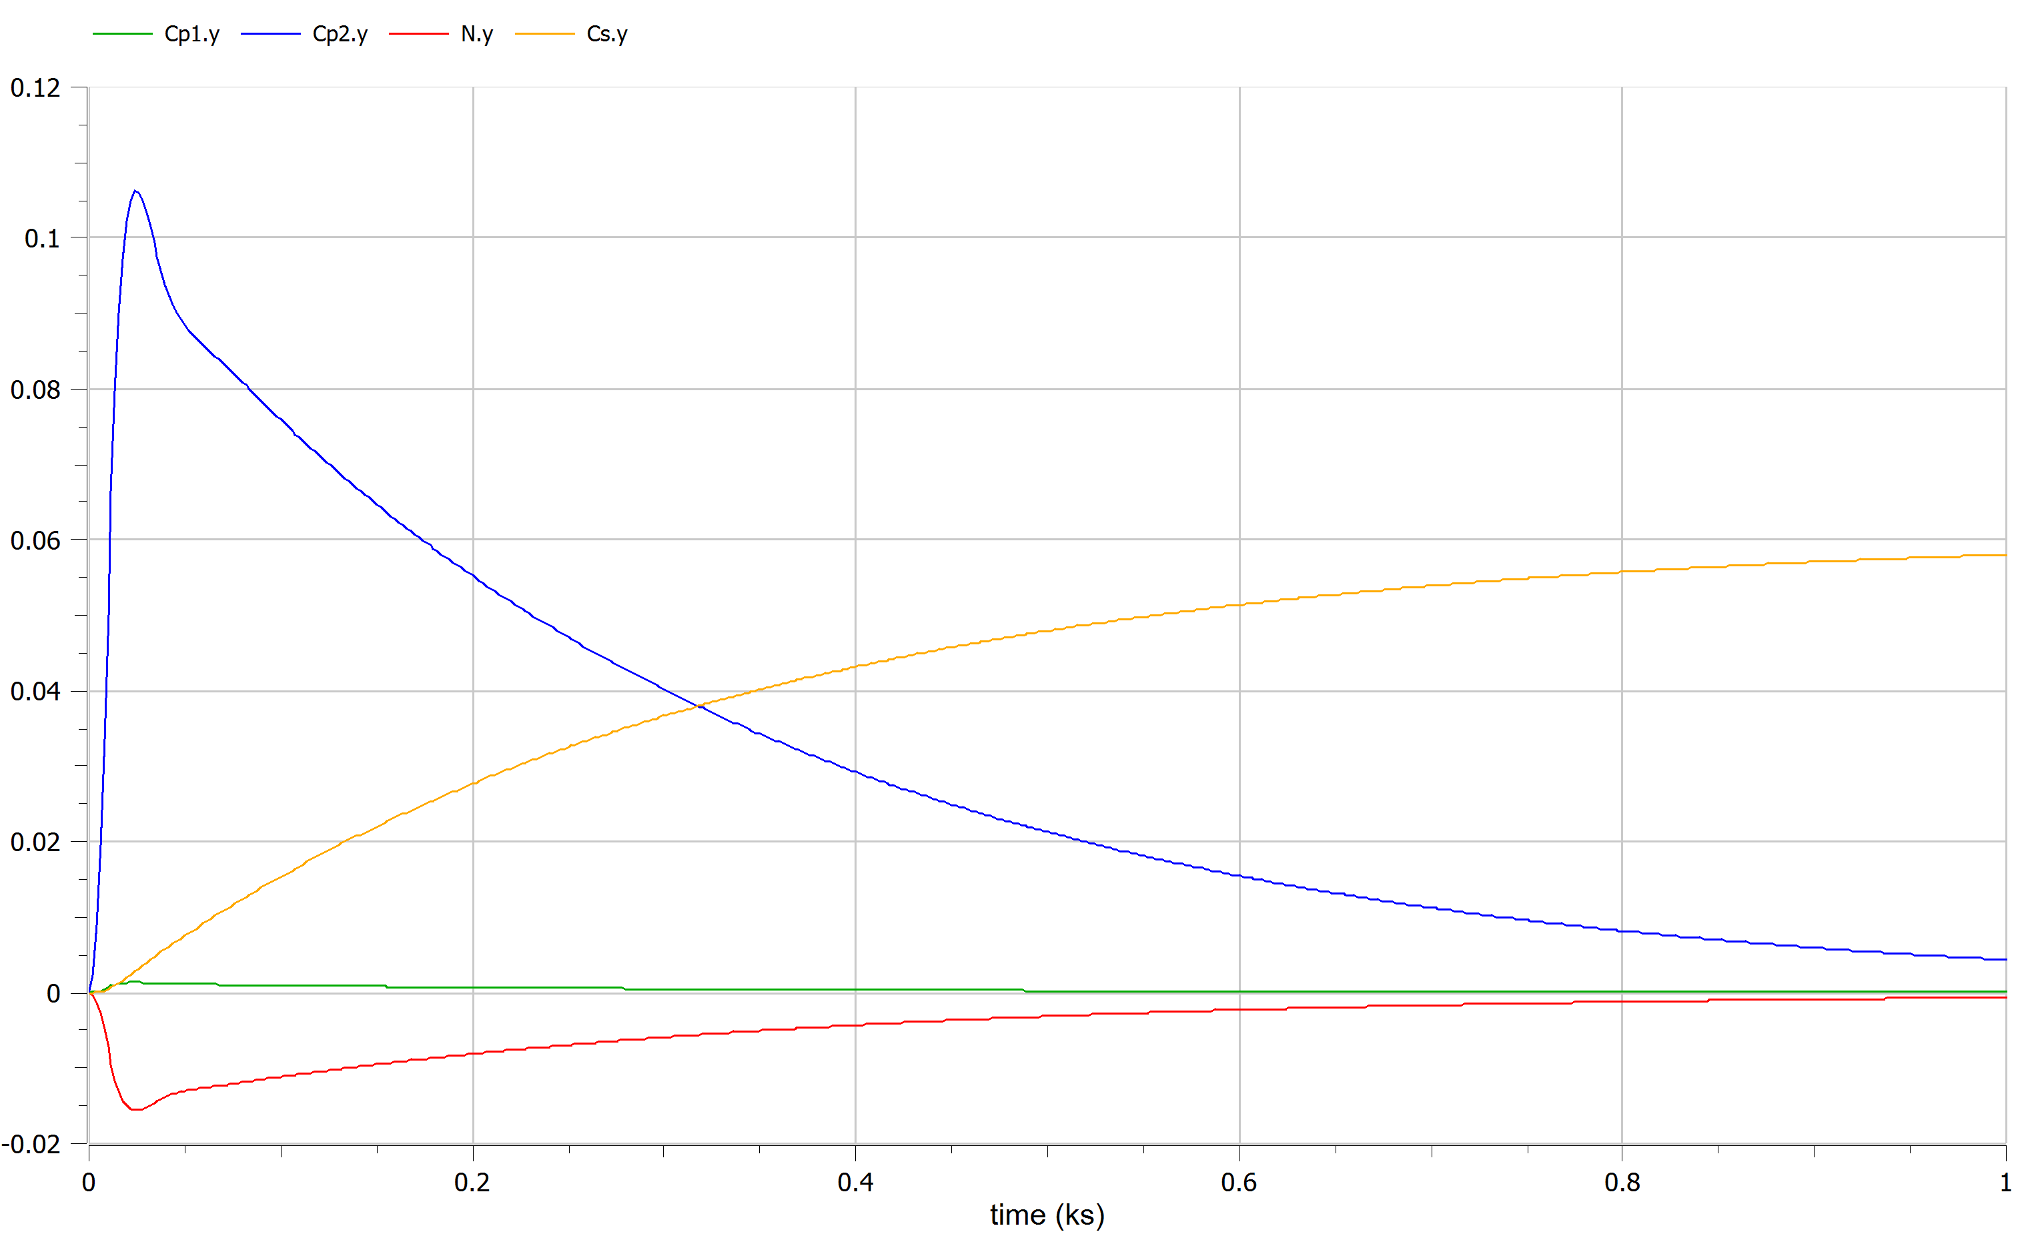
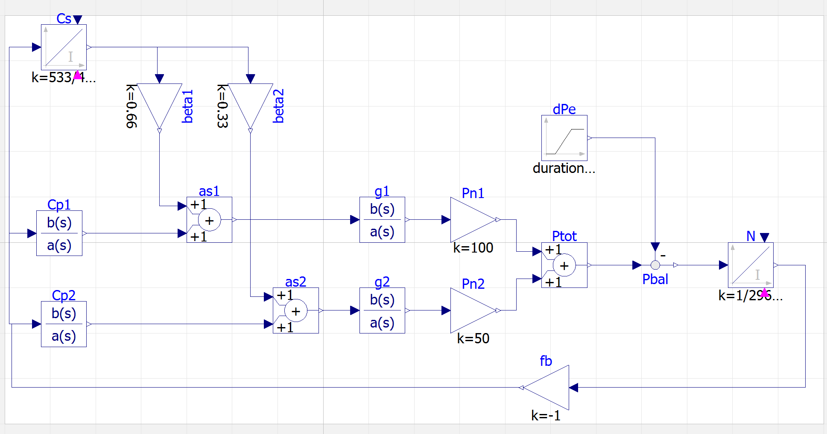
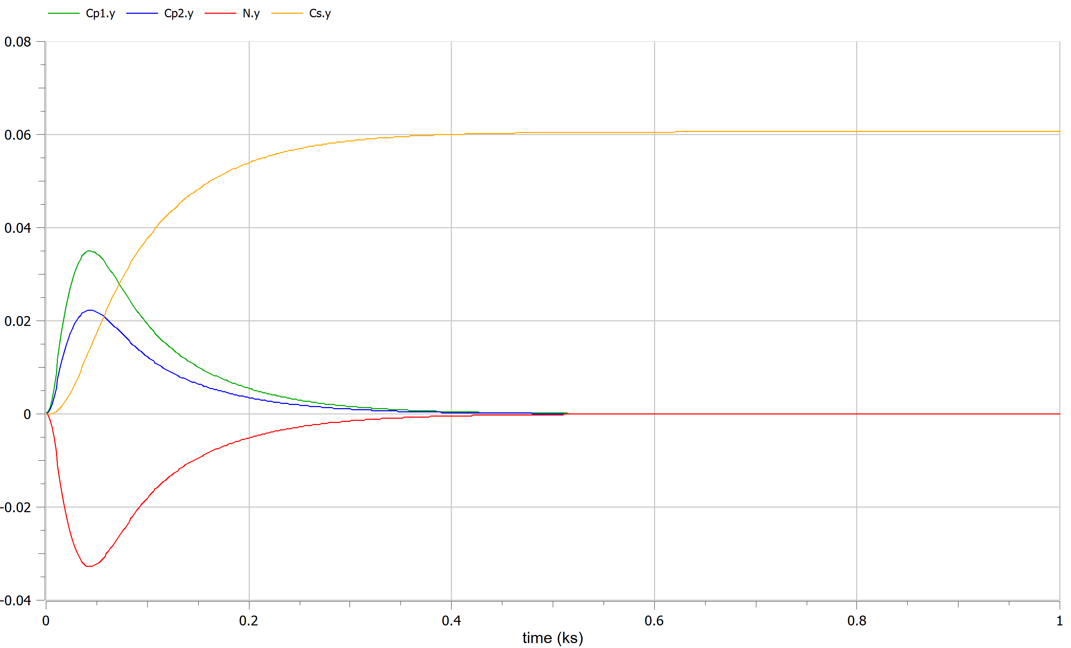
Modelica:
Frequency error ✓
Controller action heavily unbalanced ✗
→ During tuning we should also look inside the system, in particular the control action. Partition the effort proportionally to generator capability changing Ks, Kp1,2.
Kp1 = 1.064
Kp2= 0.677327
Ks = 0.016

Slide 6
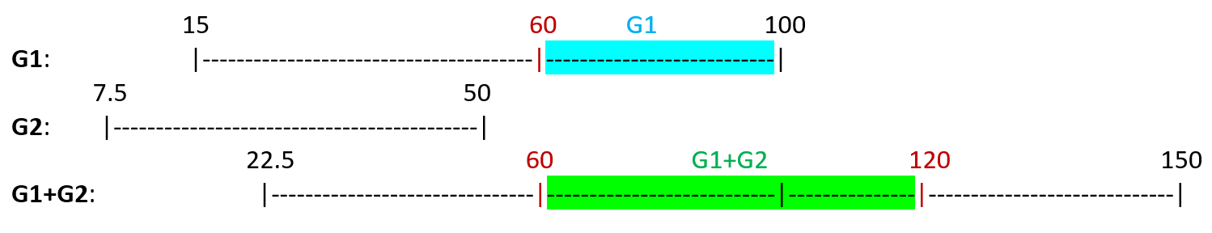

Configuration A, Optimization
(focus on G1,G2 feeding L1+L2)
G1: P_{g1,min} = 15MW P_{g1,max} = 100 MW
G2: P_{g2,min} = 7.5 MW P_{g2,max} = 50 MW
Optimization problem:
cost f: f(P_{g1},P_{g2}) = c₁(P_{g1})+c₂(P_{g2})
s.t: $\left\{\begin{aligned}P_{g1}+P_{g2}=P_{e} \\ P_{g1,min}≤P_{g1}≤P_{g1,max} \\ P_{g2,min}≤P_{g2}≤P_{g2,max}\end{aligned}\right.$ → as KKT formulation:
 | S1 | S2 | S3 | S4 | S5 | S6
Pe | 60 | 70 | 120 | 120 | 110 | 60
I₁: [60,100] -> (G1, G1+G2)
I₂: [100,120] -> (G1+G2)
f = 1.5 + 1.5*(P_{g1}-95)²+ 3*(P_{g2}-48)²
g = P_{g1} + P_{g2} – P_{e}
h₁=P_{g1} - P_{g1,min}
h₂=P_{g1,max} - P_{g1}
h₃=P_{g2} - P_{g2,min}
h₄=P_{g2,max} - P_{g2}
L= f + λ*g + μ*h (Lagrangian)

Slide 7
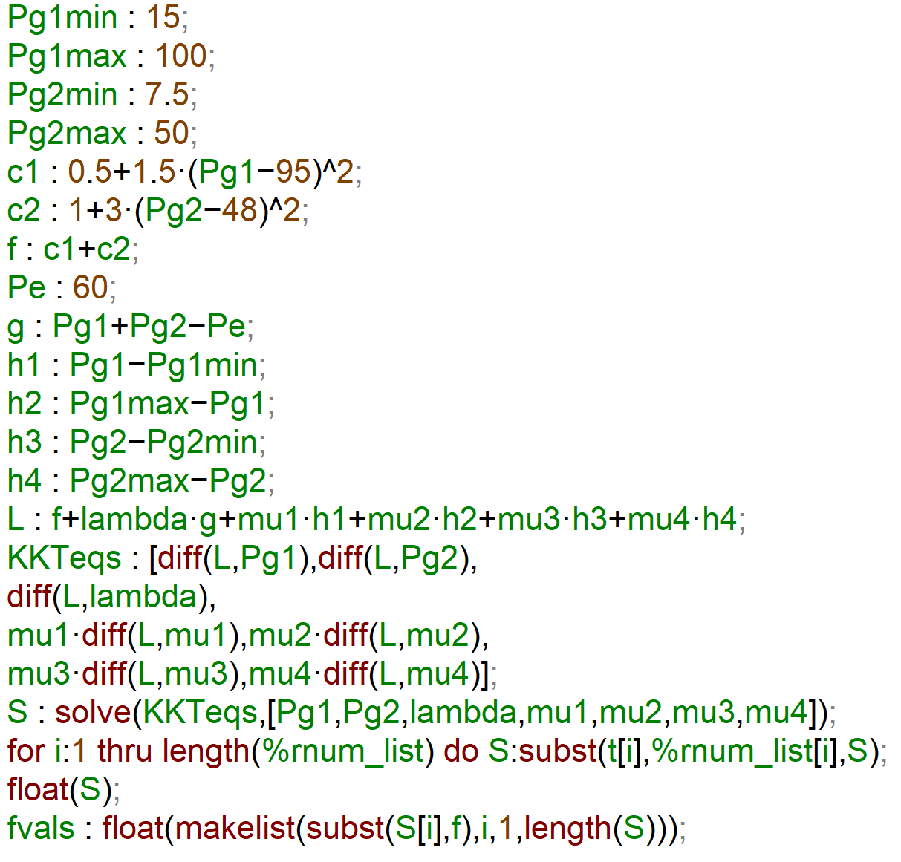
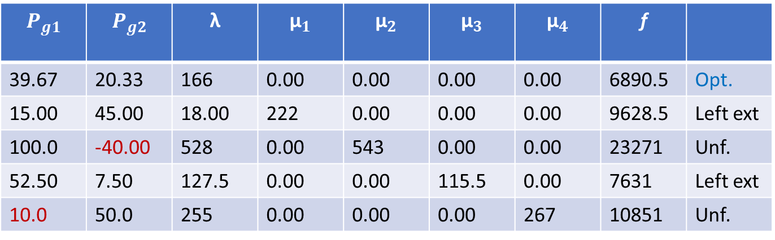
Compare the feasible combinations for each Pe:
Pe=60:
G1 Only:
P_{g1} = P_{e} = 60 , c₁= 0.5+1.5*(60-95)²=1838
G1+G2:
Maxima:
cost rate G1+G2 > cost rate G1 -> for Pe=60 optimal choice: Only G1!
$$P_{g1}$$ | $$P_{g2}$$ | λ | $${\text{μ}}_{1}$$ | $${\text{μ}}_{2}$$ | $${\text{μ}}_{3}$$ | $${\text{μ}}_{4}$$ | f
39.67 | 20.33 | 166 | 0.00 | 0.00 | 0.00 | 0.00 | 6890.5 | Opt.
15.00 | 45.00 | 18.00 | 222 | 0.00 | 0.00 | 0.00 | 9628.5 | Left ext
100.0 | -40.00 | 528 | 0.00 | 543 | 0.00 | 0.00 | 23271 | Unf.
52.50 | 7.50 | 127.5 | 0.00 | 0.00 | 115.5 | 0.00 | 7631 | Left ext
10.0 | 50.0 | 255 | 0.00 | 0.00 | 0.00 | 267 | 10851 | Unf.

Slide 8
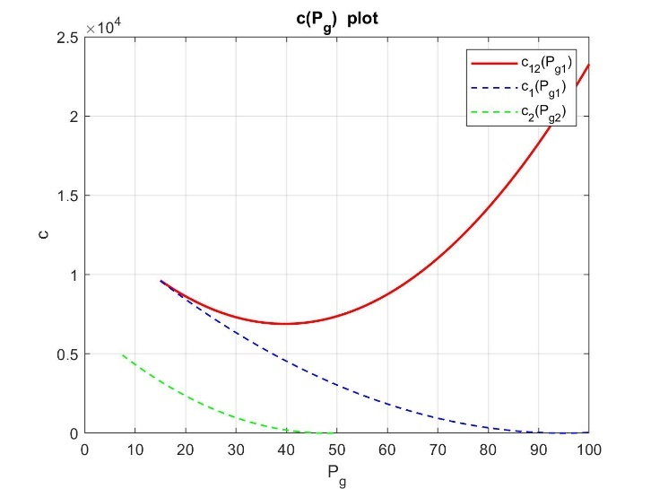
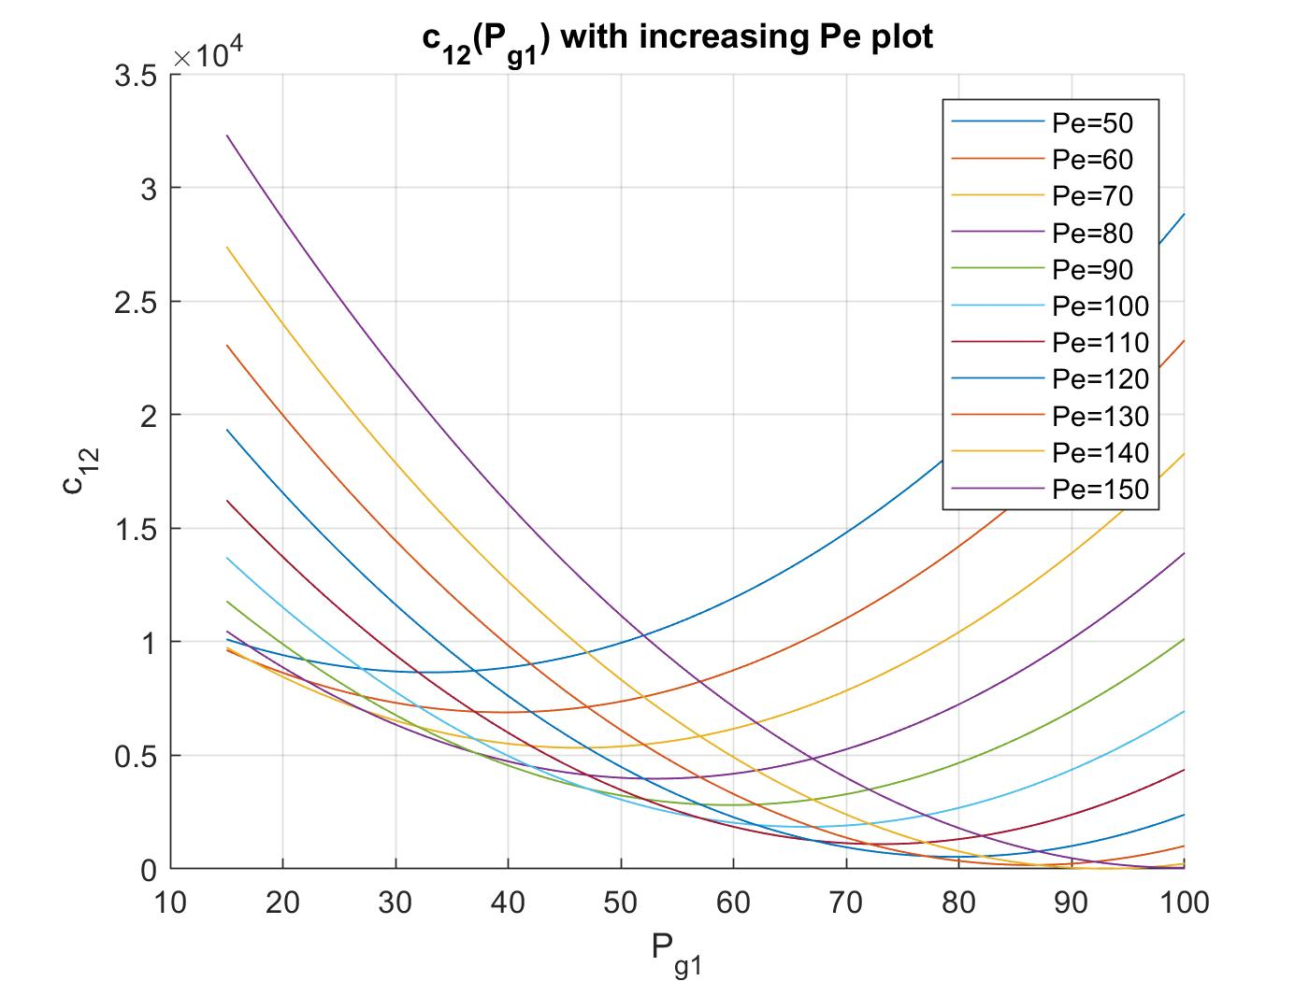
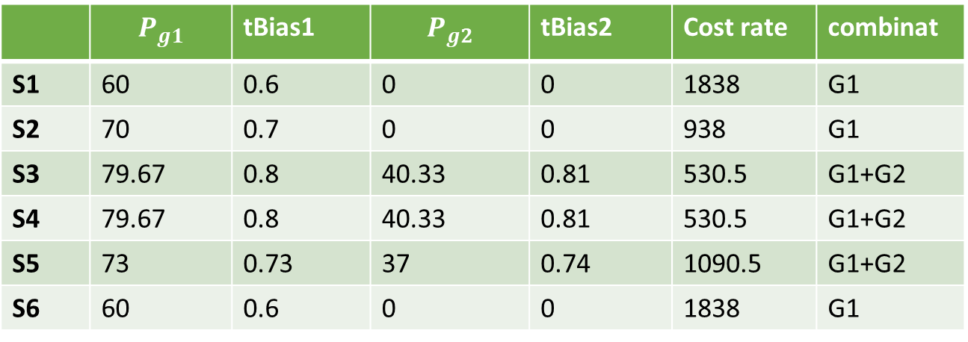
GRAPHICALLY: (for Pe=60) for Pe increasing, cost rate shift
Summing up all the results:
Let’s simulate on Modelica,
using same controllers:
 | $$P_{g1}$$ | tBias1 | $$P_{g2}$$ | tBias2 | Cost rate | combinat
S1 | 60 | 0.6 | 0 | 0 | 1838 | G1
S2 | 70 | 0.7 | 0 | 0 | 938 | G1
S3 | 79.67 | 0.8 | 40.33 | 0.81 | 530.5 | G1+G2
S4 | 79.67 | 0.8 | 40.33 | 0.81 | 530.5 | G1+G2
S5 | 73 | 0.73 | 37 | 0.74 | 1090.5 | G1+G2
S6 | 60 | 0.6 | 0 | 0 | 1838 | G1

Slide 9
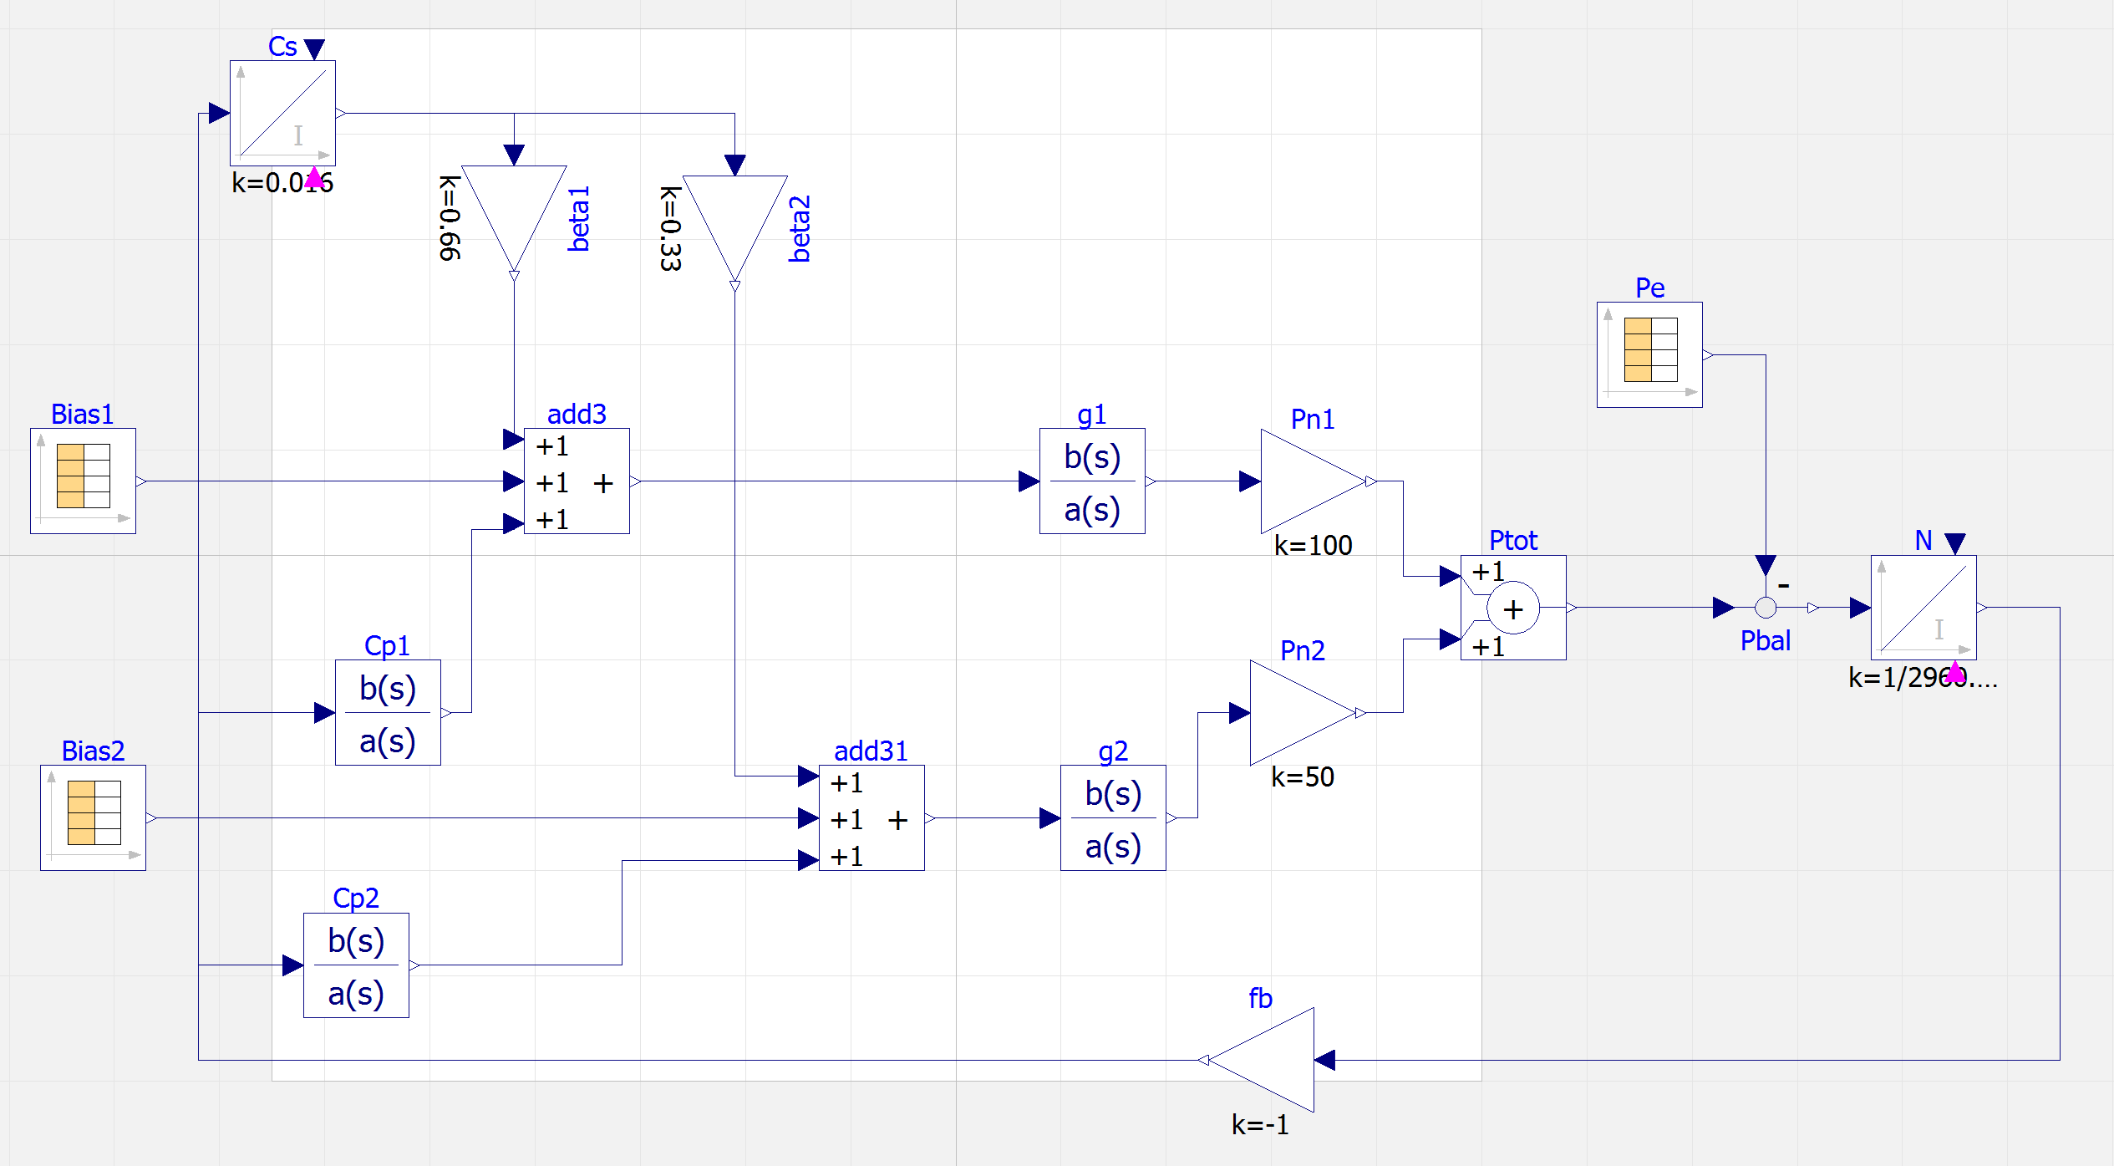
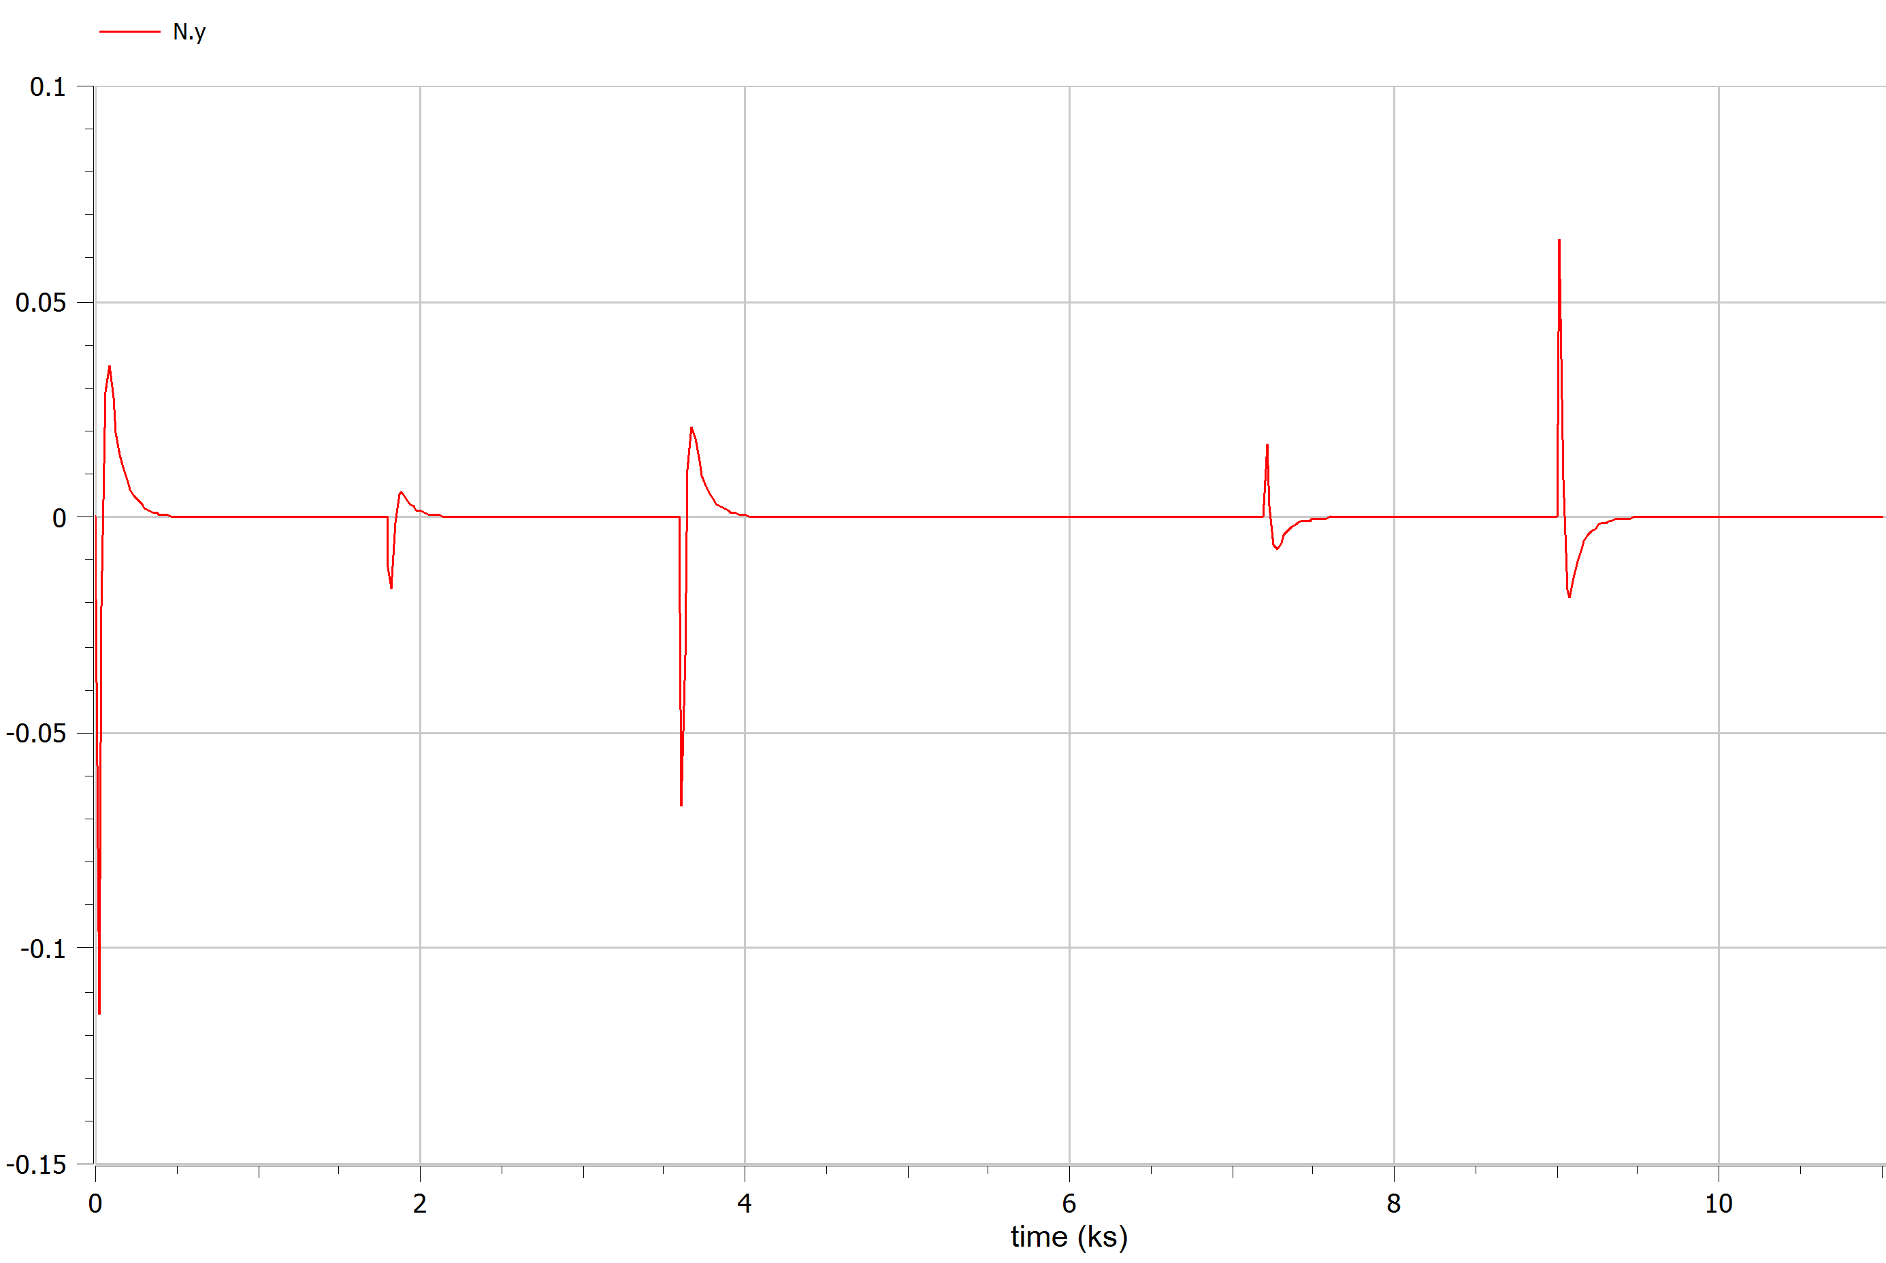
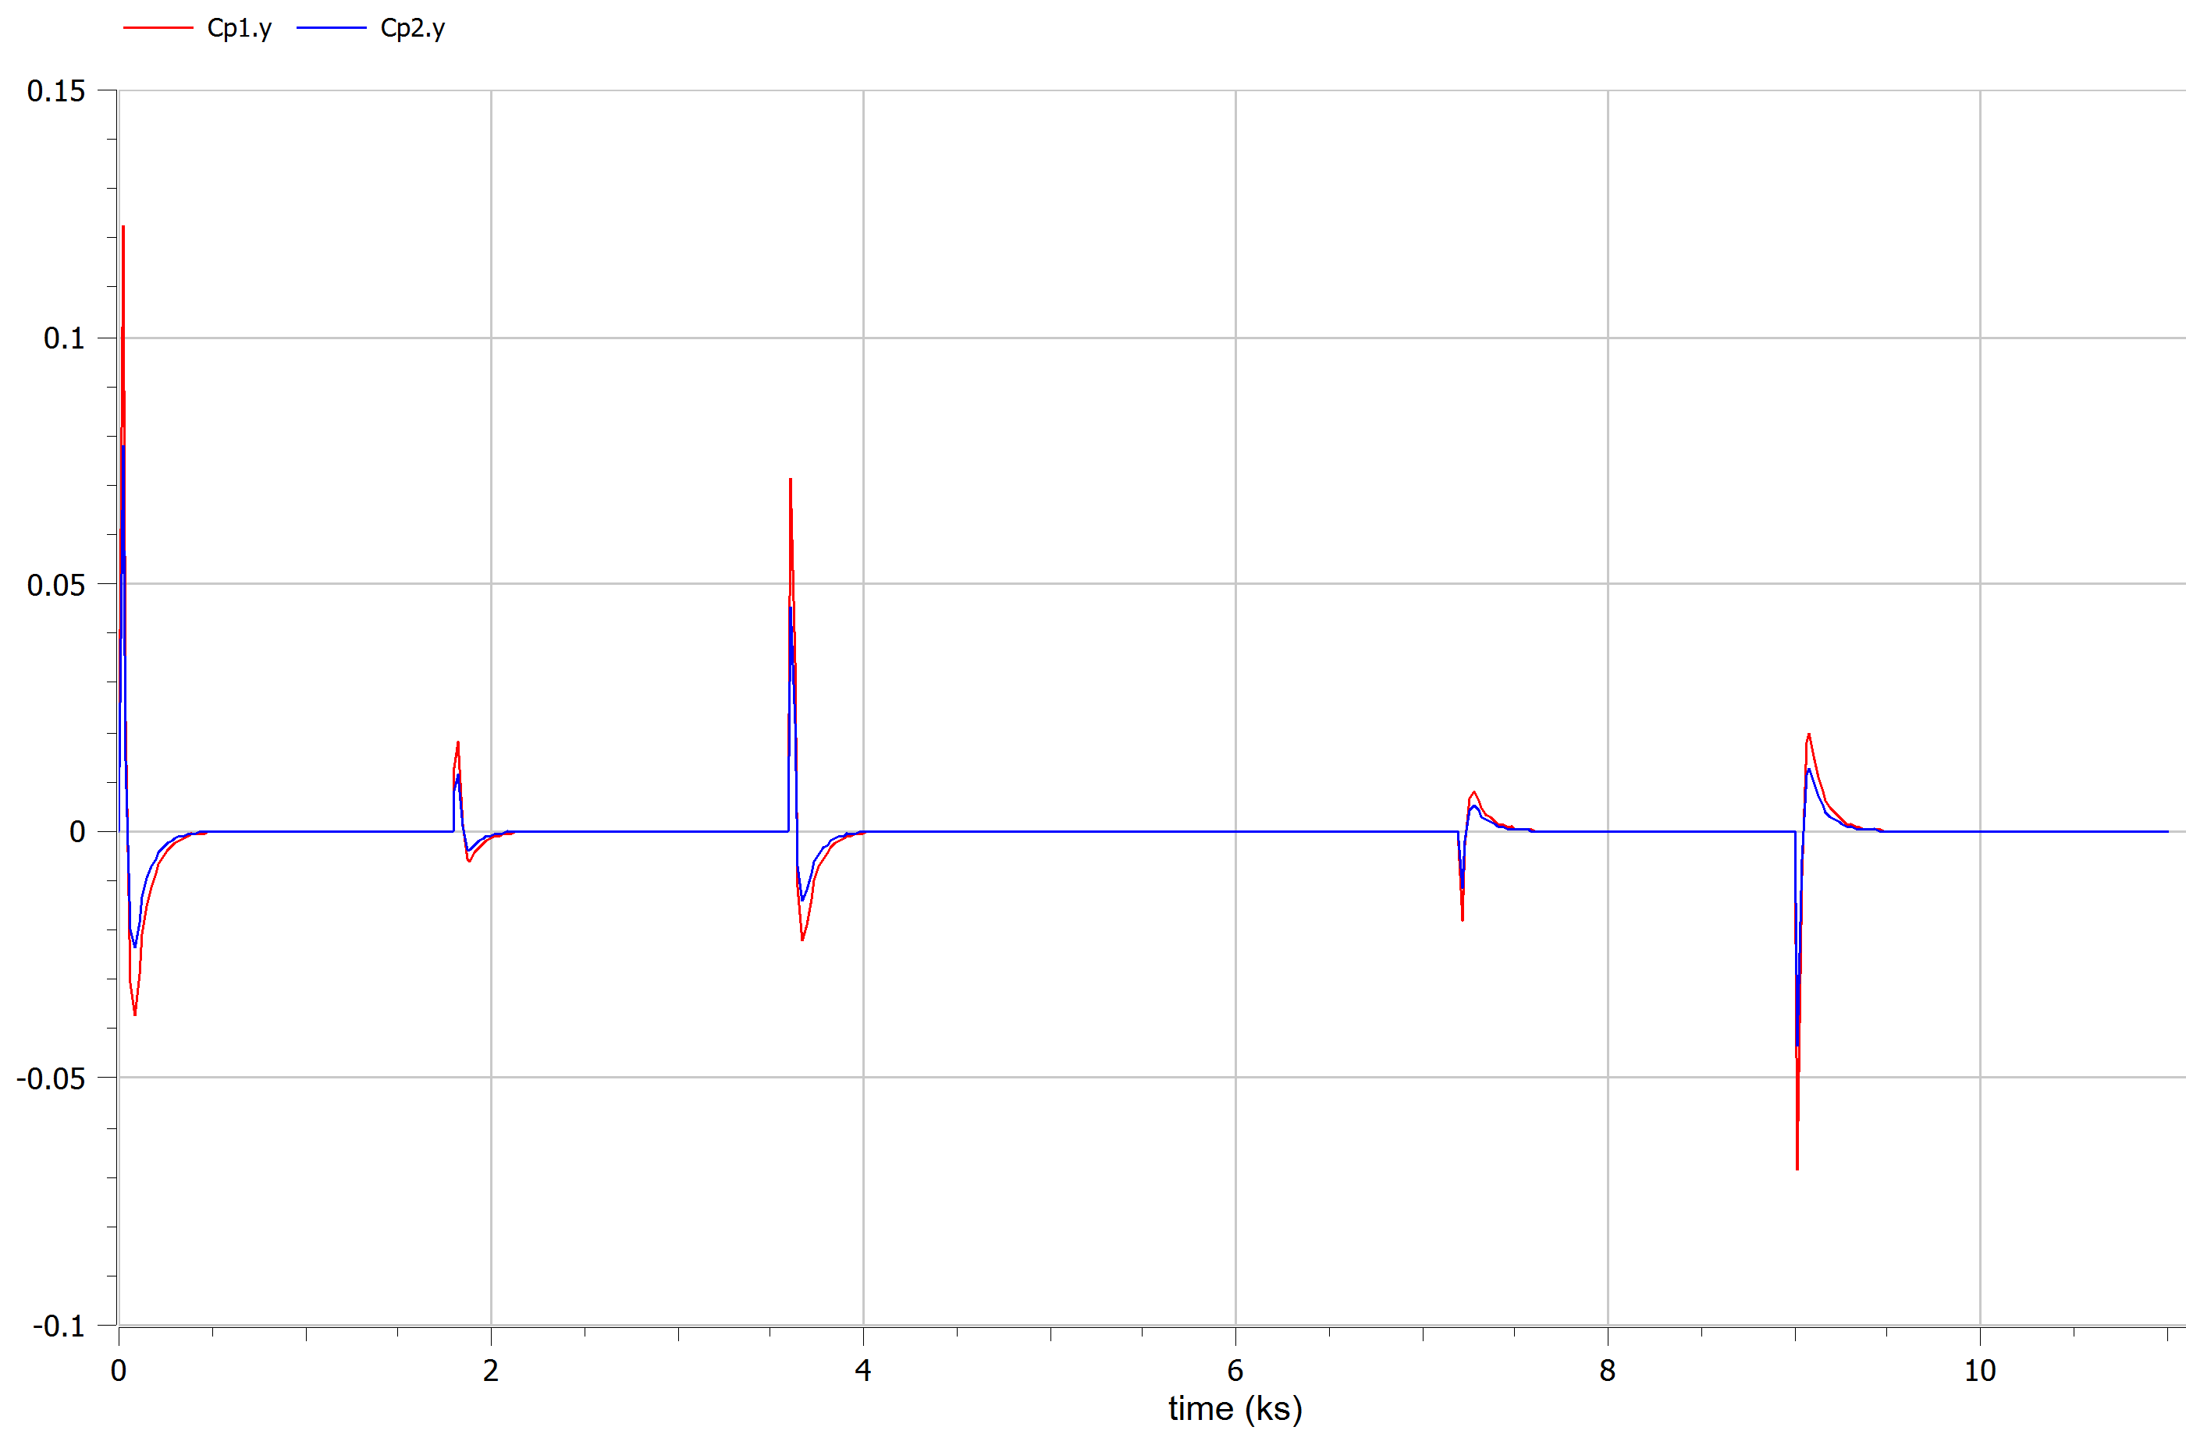
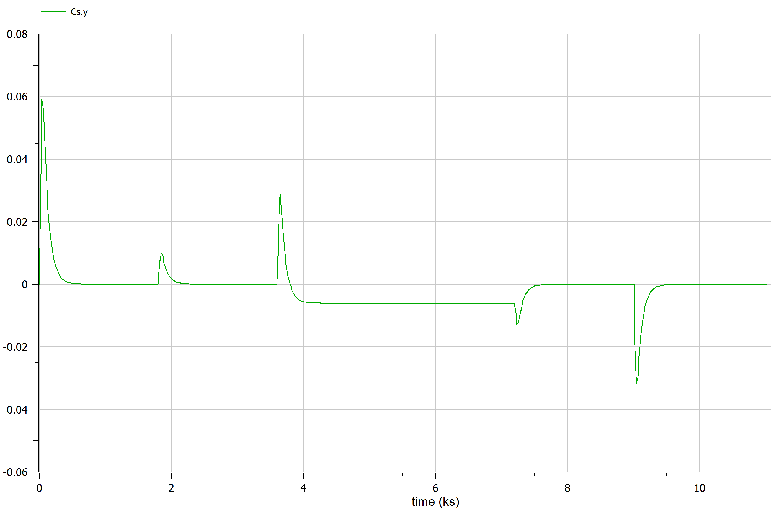
Frequency error
Some overdump due to intial set up dynamic and generators pool switching
Primary control
Secondary control

Slide 10
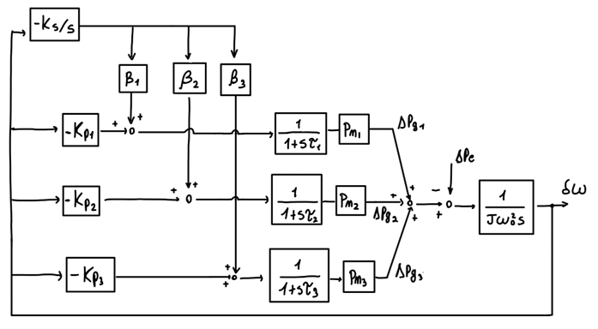
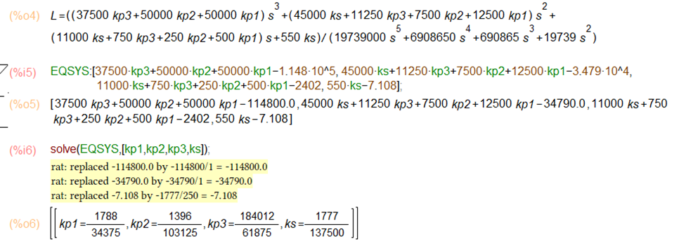
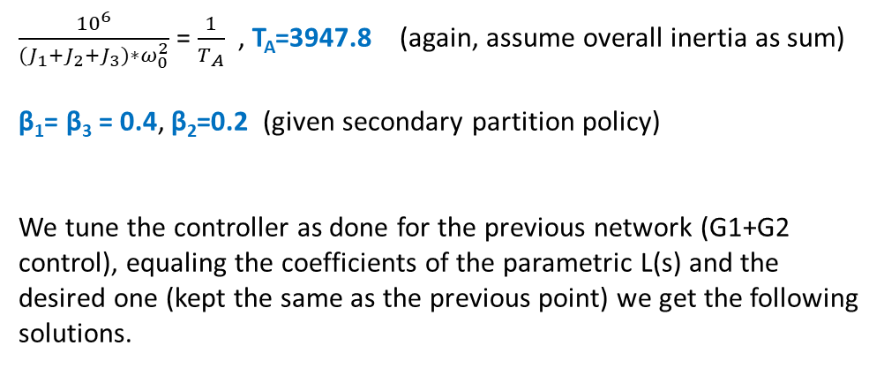
Configuration B, Control
$\frac{{10}^{6}}{{(J}_{1}+J_{2}+J_{3})∗ω_{0}^{2}}$ = $\frac{1}{T_{A}}$ , T_{A}=3947.8 (again, assume overall inertia as sum)
β₁= β₃ = 0.4, β₂=0.2 (given secondary partition policy)
We tune the controller as done for the previous network (G1+G2 control), equaling the coefficients of the parametric L(s) and the desired one (kept the same as the previous point) we get the following solutions.
These solutions however produce once again an imbalanced response of the control variable,
Modify those gains by some magic (and tons of errors) to get a better-distributed stress in the network while still fulfilling the requirements
Kp1 = 0.520
Kp2 = 0.135
Kp3 = 0.595
Ks = 0.0129

Slide 11
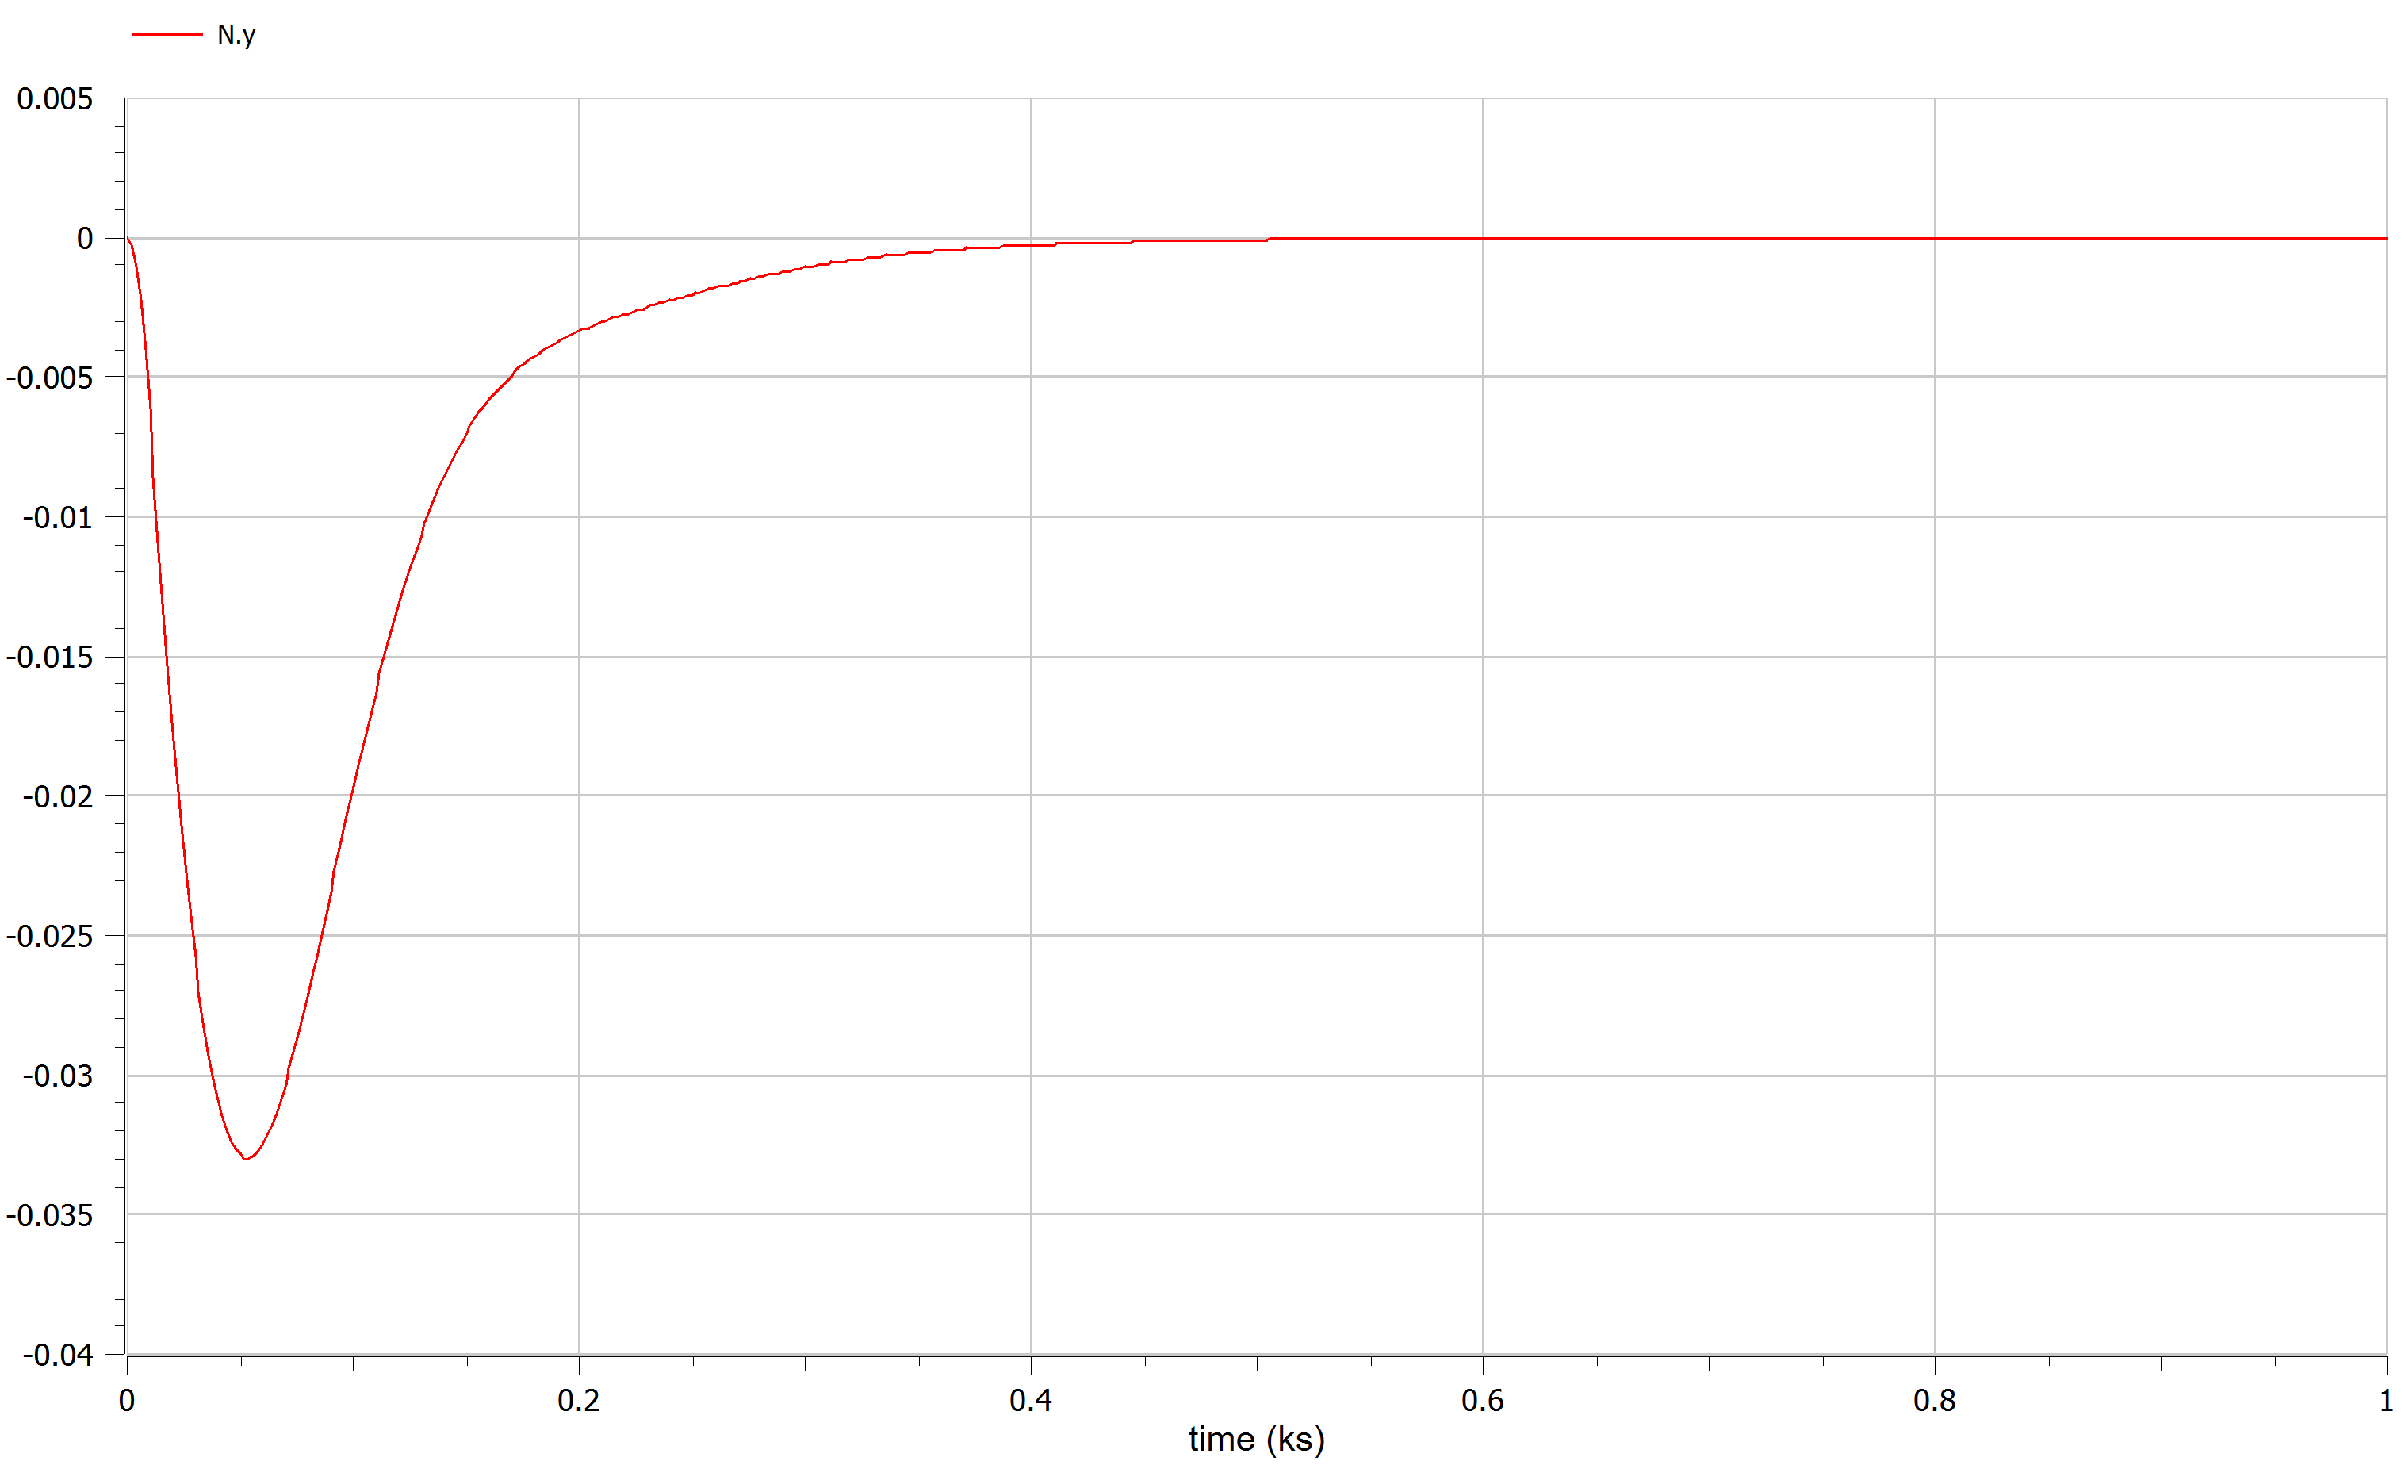
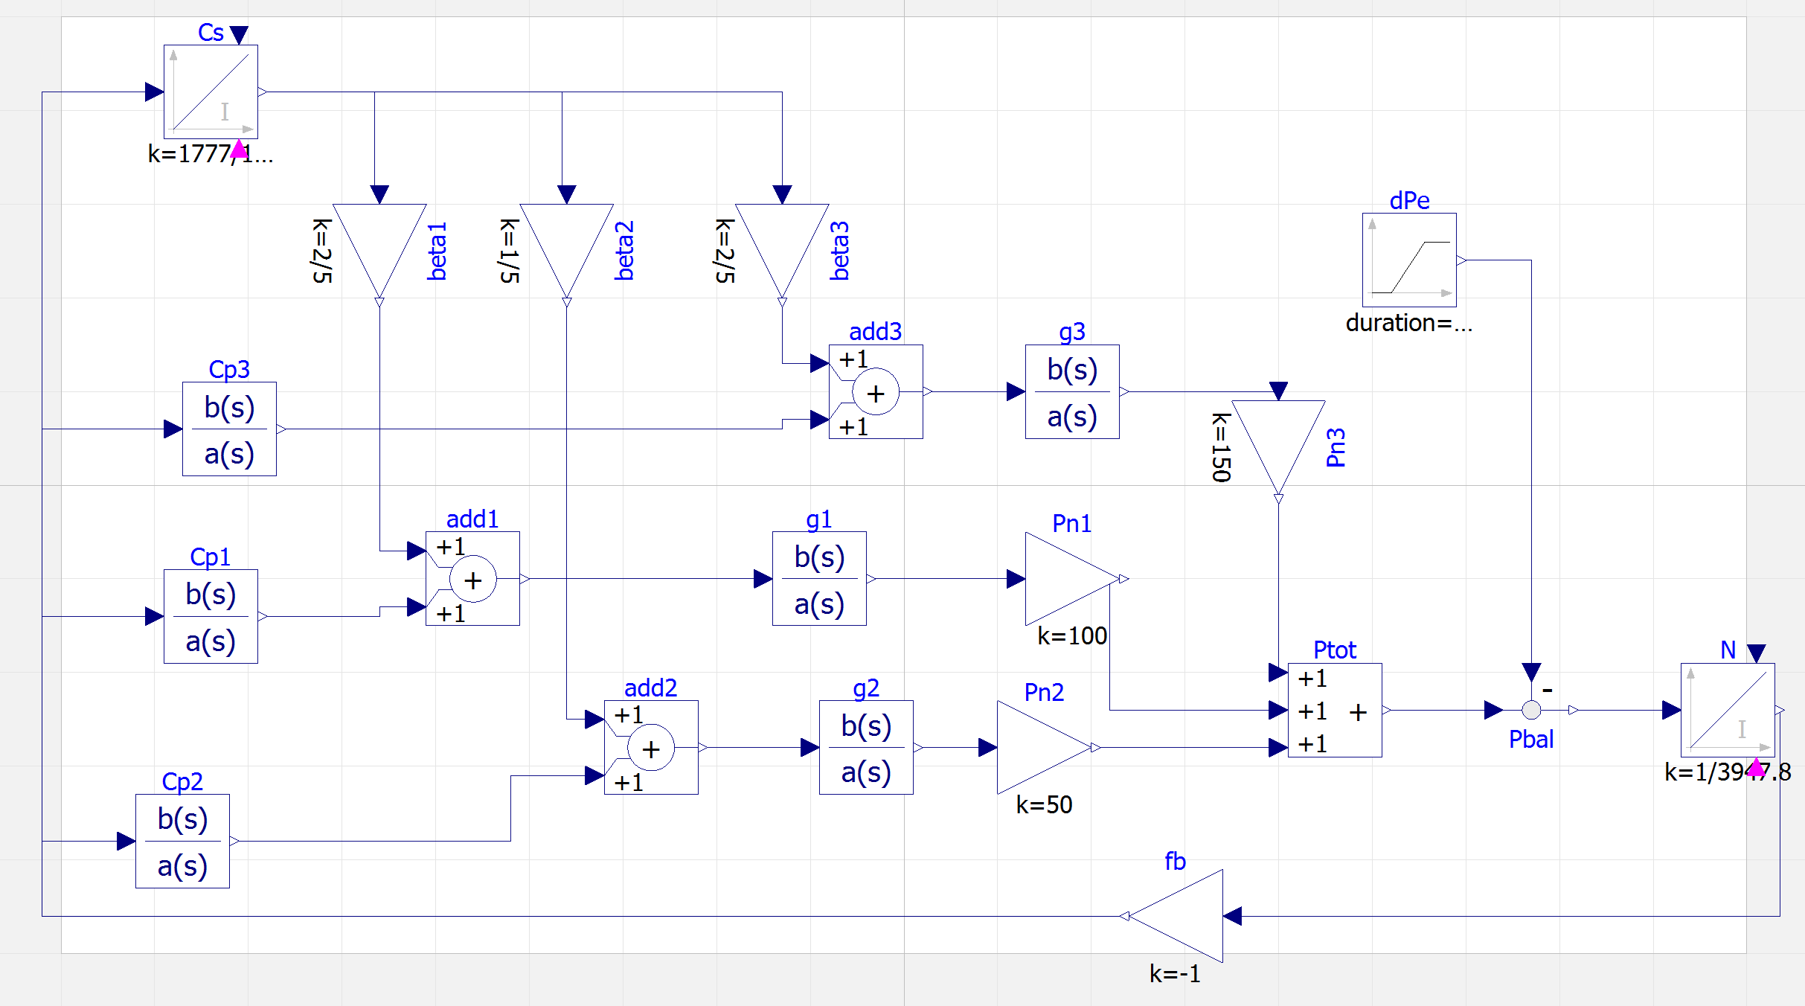
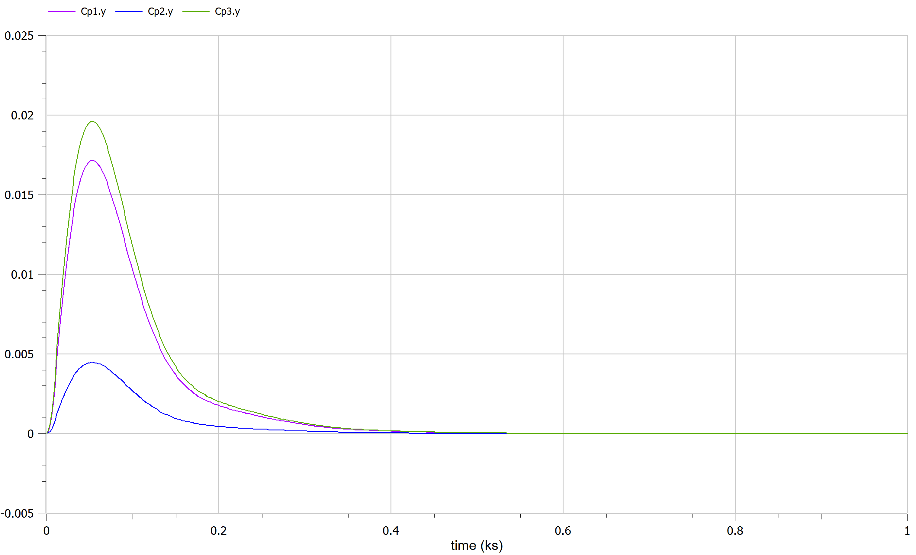
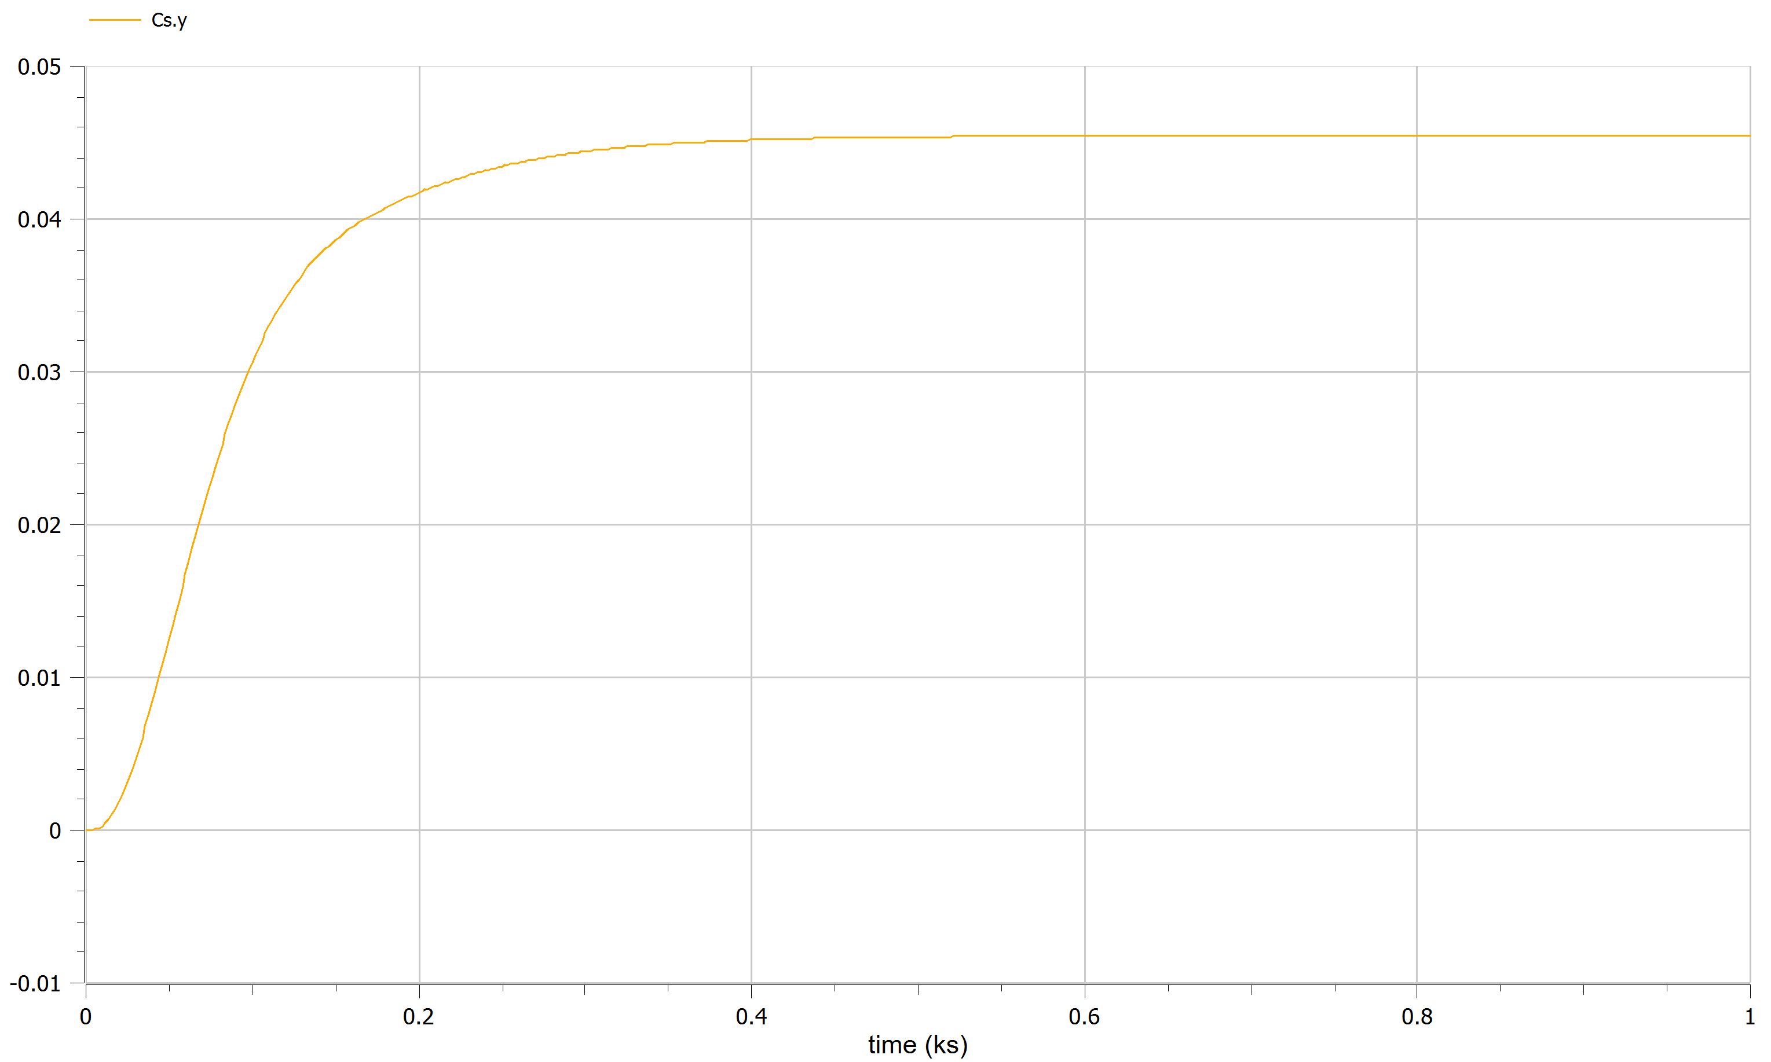
Frequency error
Primary control
Secondary control

Slide 12
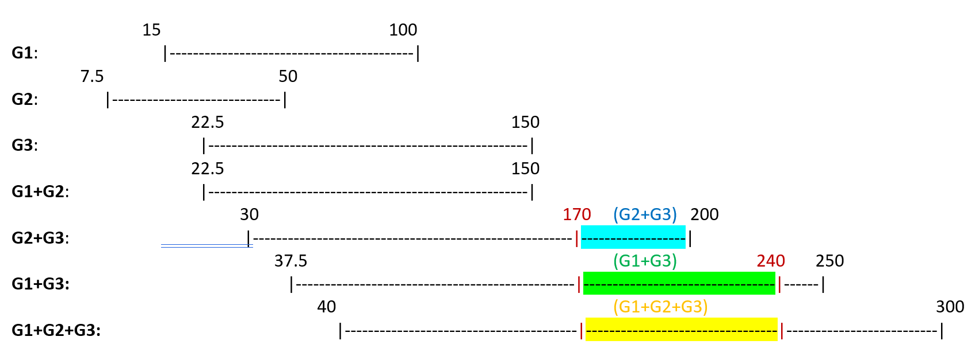
Configuration B, Optimization
(G1,G2,G3 feeding L1+L2*L3*L4)
G3: P_{g3,min} = 22.5 MW P_{g3,max} = 150 MW
 | S1 | S2 | S3 | S4 | S5 | S6
Pe | 170 | 180 | 230 | 210 | 240 | 190
I₁: [170,200] -> (G2+G3, G1+G3, G1+G2+G3) I₂: [200,240] -> (G1+G3, G1+G2+G3)
We cosider the point of view of a producer with expenditure only on G1 and G3, that can fix power given by G2 (given by another producer) without caring about its cost rate.

Slide 13
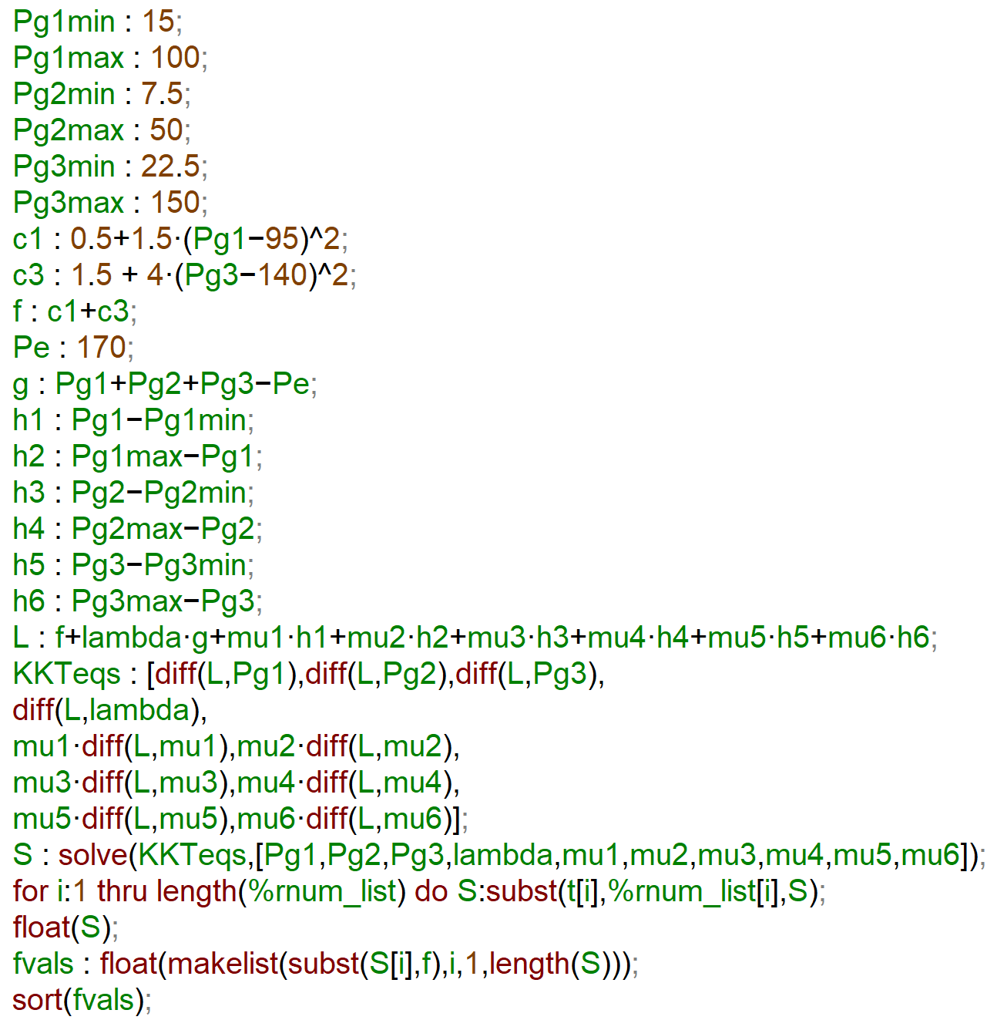
Optimzation problem (in KKT formulation)
f = 0.5 + 1.5*(P_{g1}-95)²+ 1.5 +4*(P_{g3}-140)² (neglect c₂ on the cost function, as we pointed out)
g = P_{g1} + P_{g2} + P_{g3} – P_{e}
h₁=P_{g1} - Pg1,min MAXIMA:
h₂=P_{g1,max} - P_{g1}
h₃=P_{g2} - P_{g2,min}
h₄=P_{g2,max} - P_{g2}
h₅=P_{g3} - P_{g3,min}
h₆=P_{g3,max} - P_{g3}
L= f + λ*g + μ*h (Lagrangian)
(blue parts only if G3 is active, green one when G1 is active)

Slide 14
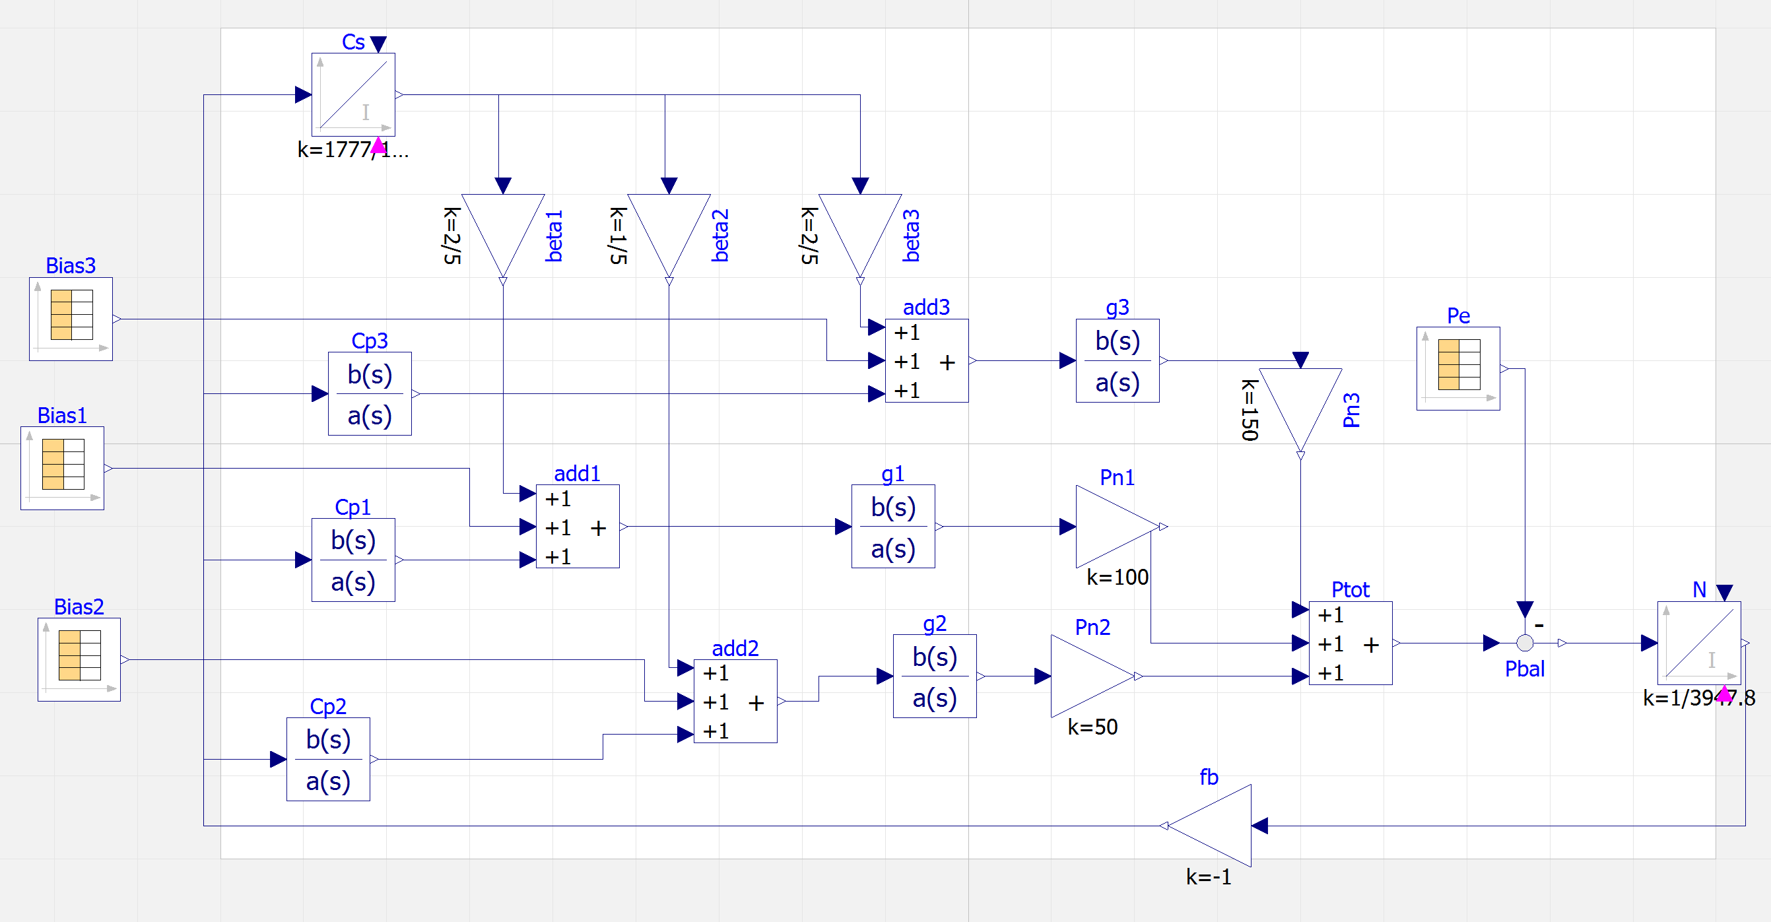
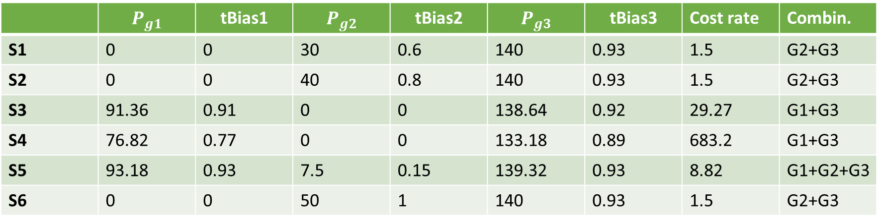
Summing up the optimization results:
 | $$P_{g1}$$ | $$\text{tBias}\text{1}$$ | $$P_{g2}$$ | $$\text{tBias}\text{2}$$ | $$P_{g3}$$ | $$\text{tBias}\text{3}$$ | Cost rate | Combin.
S1 | 0 | 0 | 30 | 0.6 | 140 | 0.93 | 1.5 | G2+G3
S2 | 0 | 0 | 40 | 0.8 | 140 | 0.93 | 1.5 | G2+G3
S3 | 91.36 | 0.91 | 0 | 0 | 138.64 | 0.92 | 29.27 | G1+G3
S4 | 76.82 | 0.77 | 0 | 0 | 133.18 | 0.89 | 683.2 | G1+G3
S5 | 93.18 | 0.93 | 7.5 | 0.15 | 139.32 | 0.93 | 8.82 | G1+G2+G3
S6 | 0 | 0 | 50 | 1 | 140 | 0.93 | 1.5 | G2+G3
Once computed the tertiary bias, using the control tuned previously, we can simulate our optimal tertiary bias as done before.

Slide 15
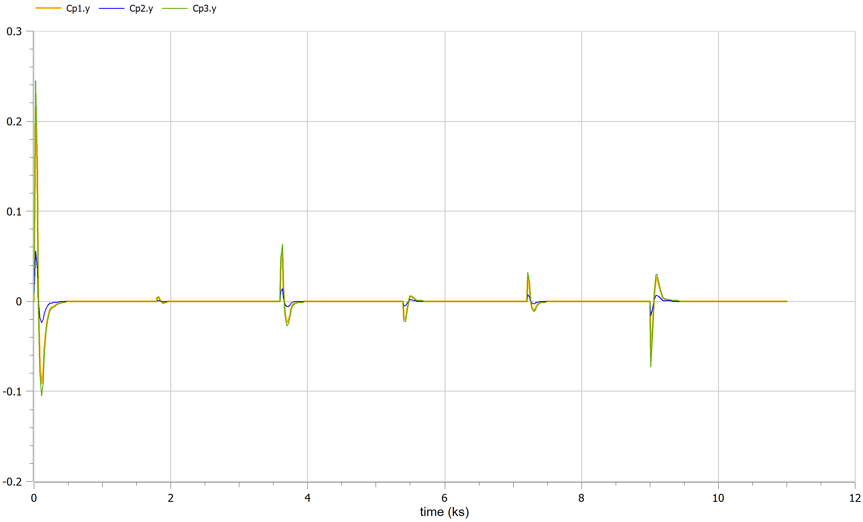
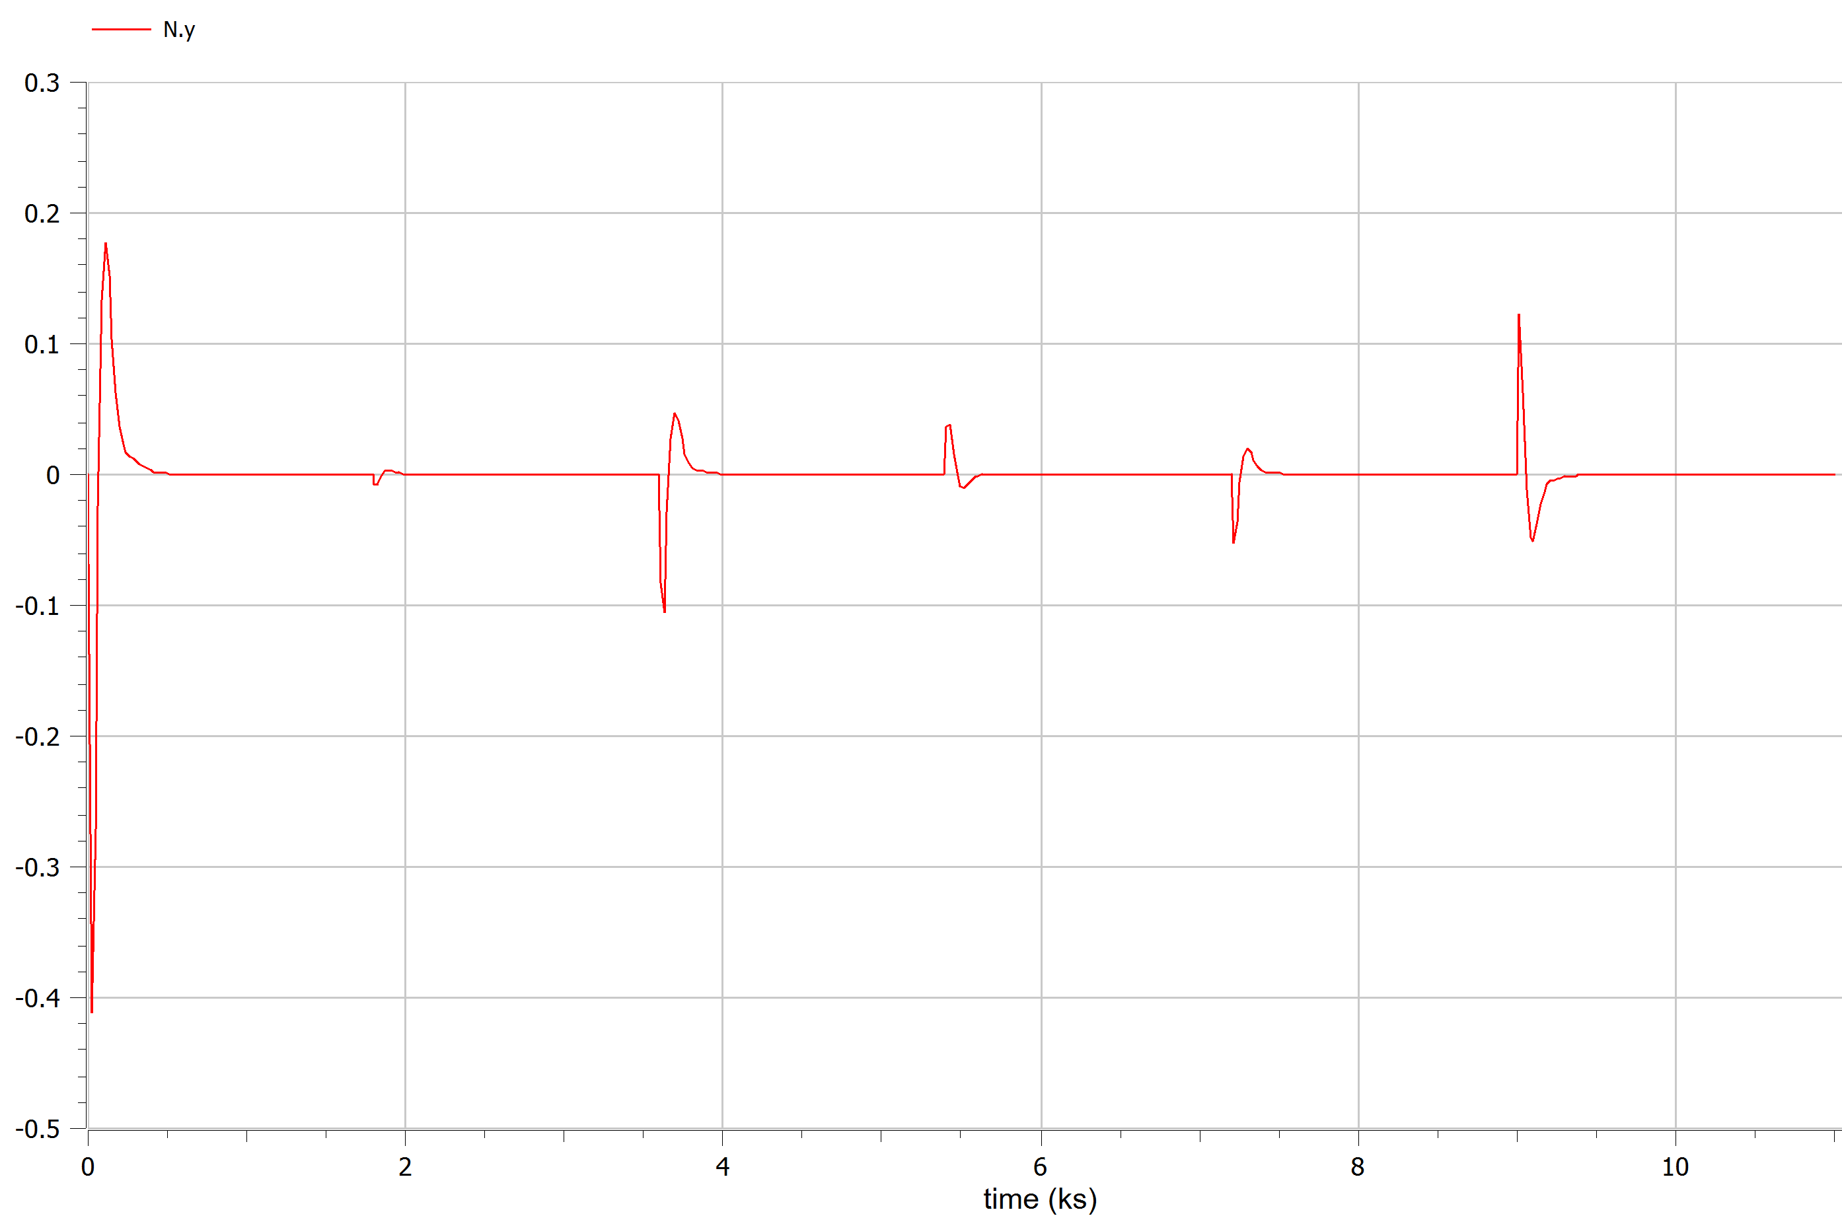
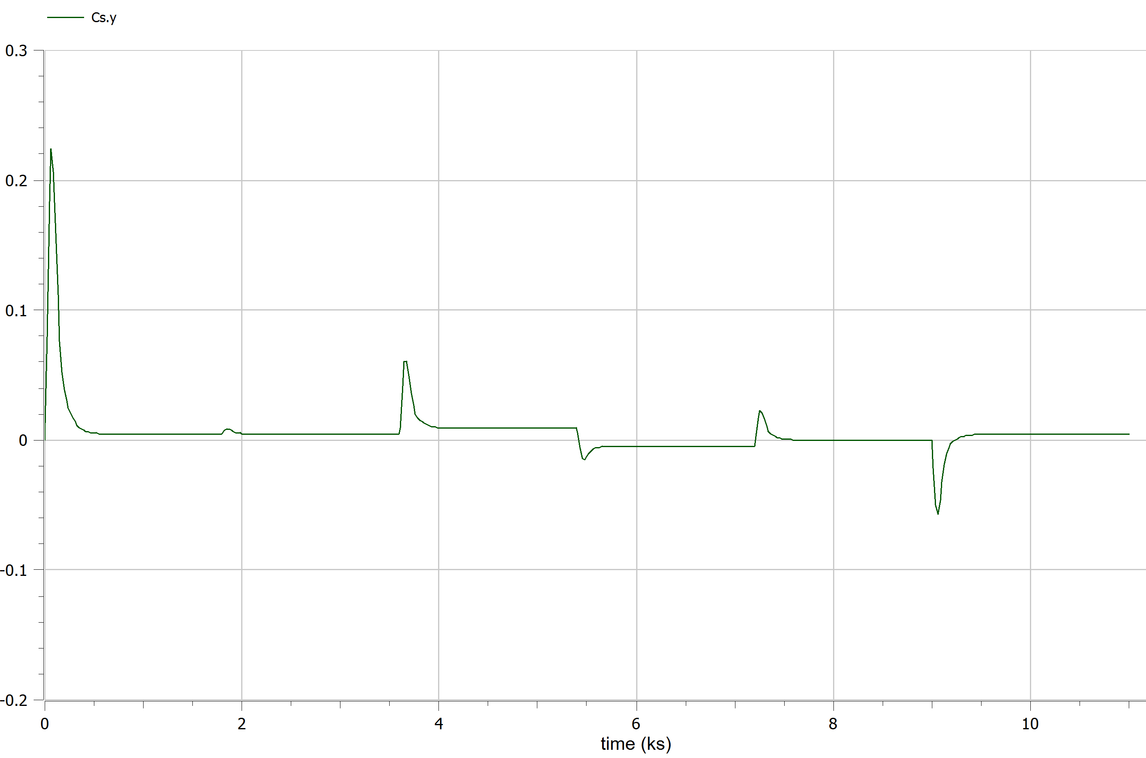
Primary control
Frequency error
Secondary control

Slide 16

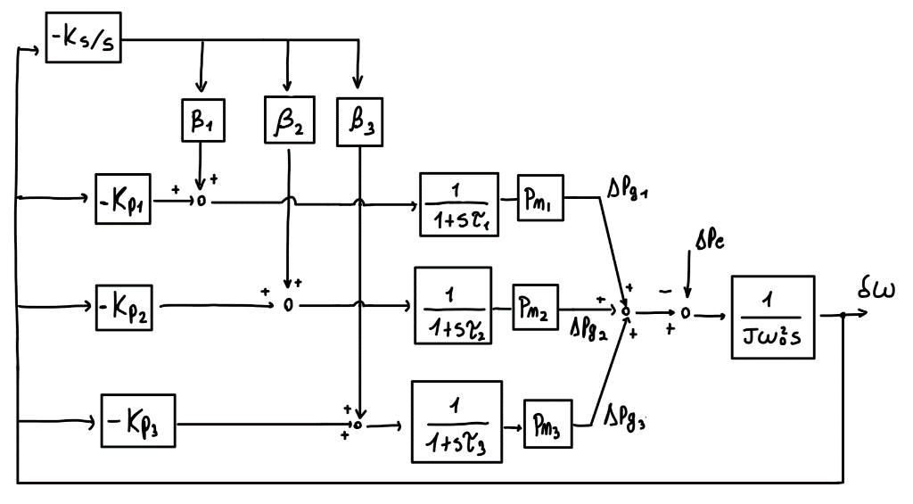
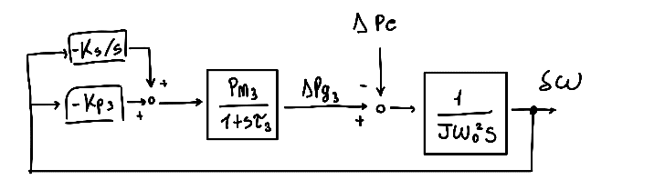
Switch configuration A/B:
(A)
(B)
The transition between the two configuration is a complex task which requires proper coordination and control strategies.

Slide 17
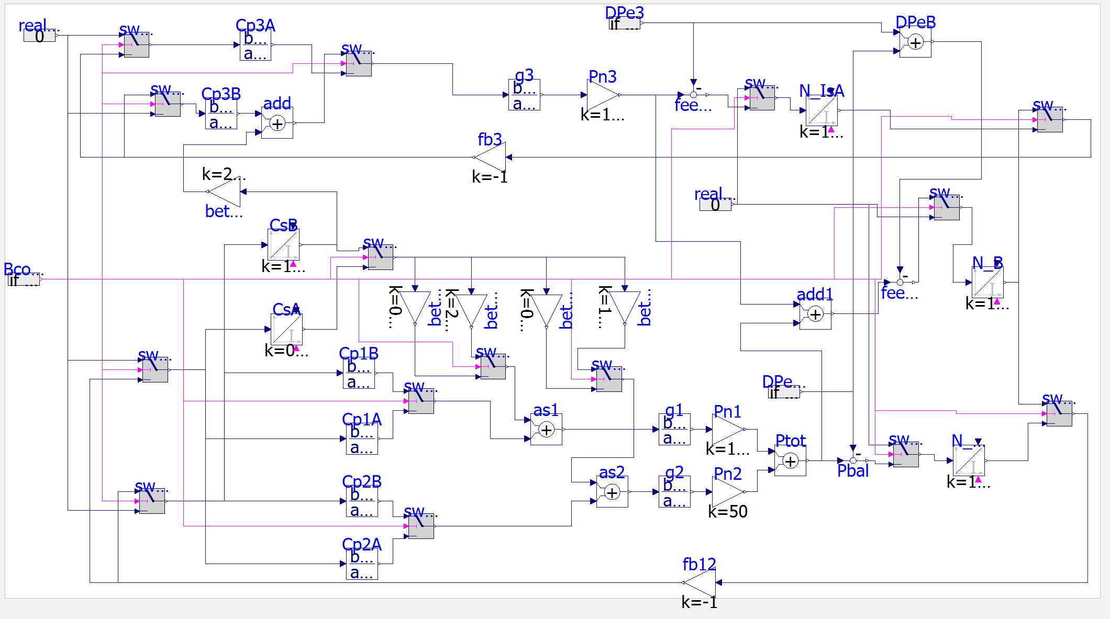
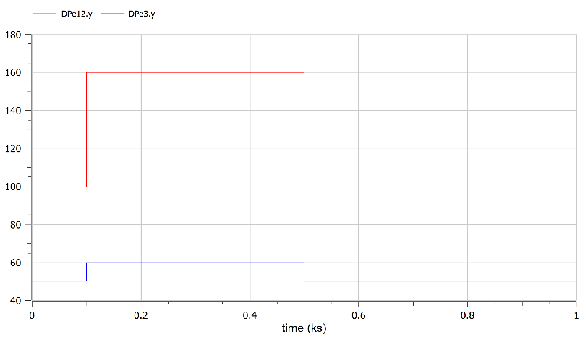
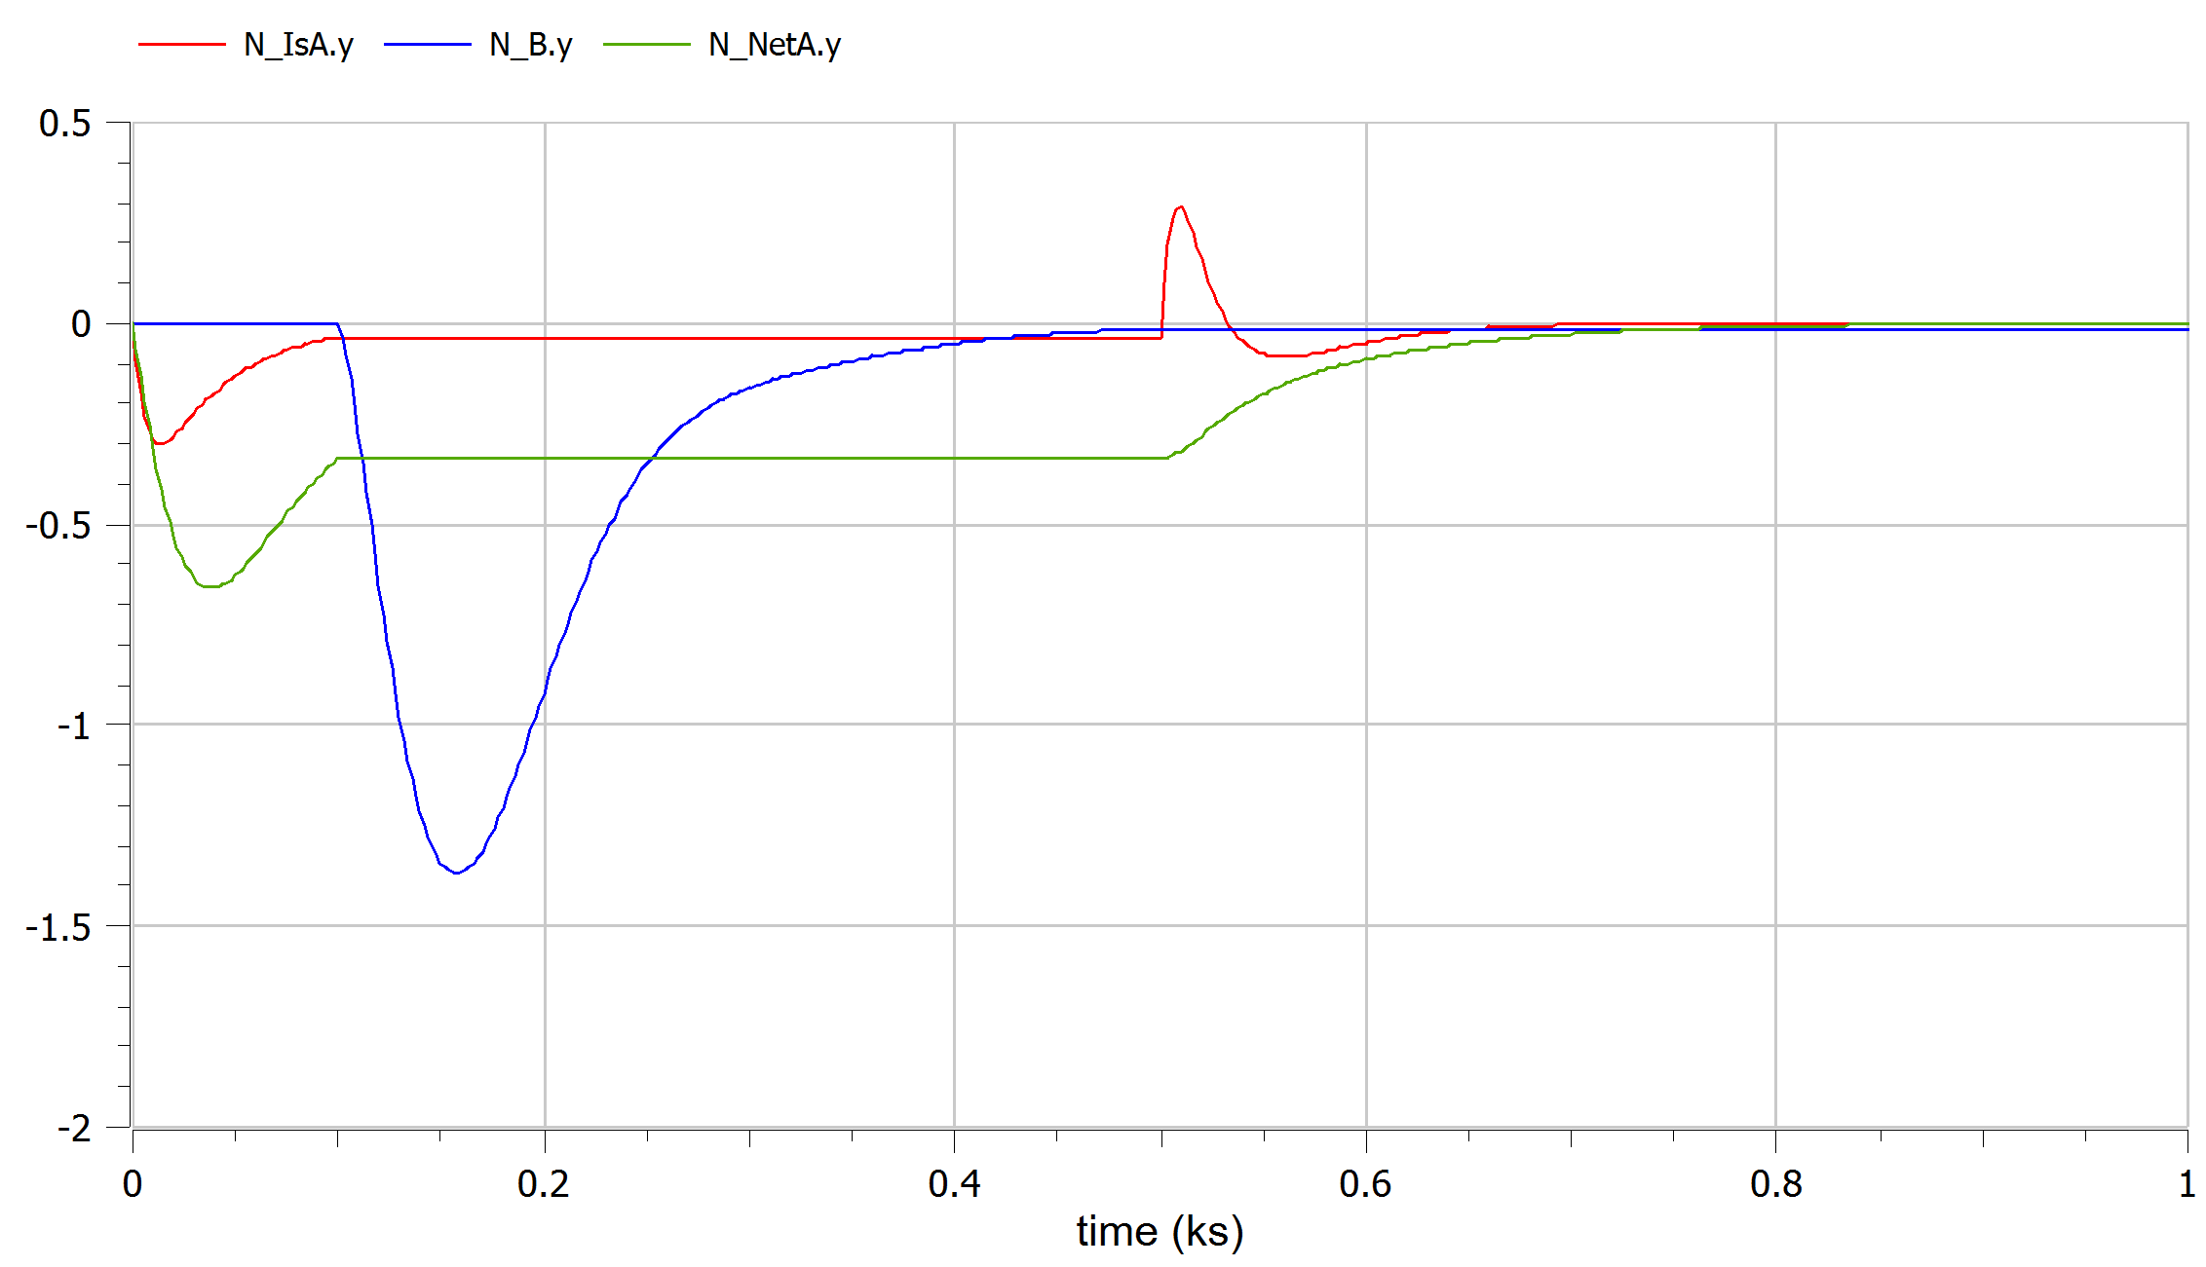
IDEA1: SWITCHES
There are lot’s of probelms on this implementation..

Slide 18
HINTS:
From previous “solution” and some try we find out that we need:
Proper connection/switching between 2 separate sub grids to one single grid
Change of the controller parameters, not only on Kp, Ks but also on the βs of secondary control.
Centralized network inertia.
Load distribution.
Synchronization of the frequency error and on control action.
Adapt optimization: Tertiary control bias changes.
Determine when is convenient to switch, in fact is not an easy choice.

Slide 19
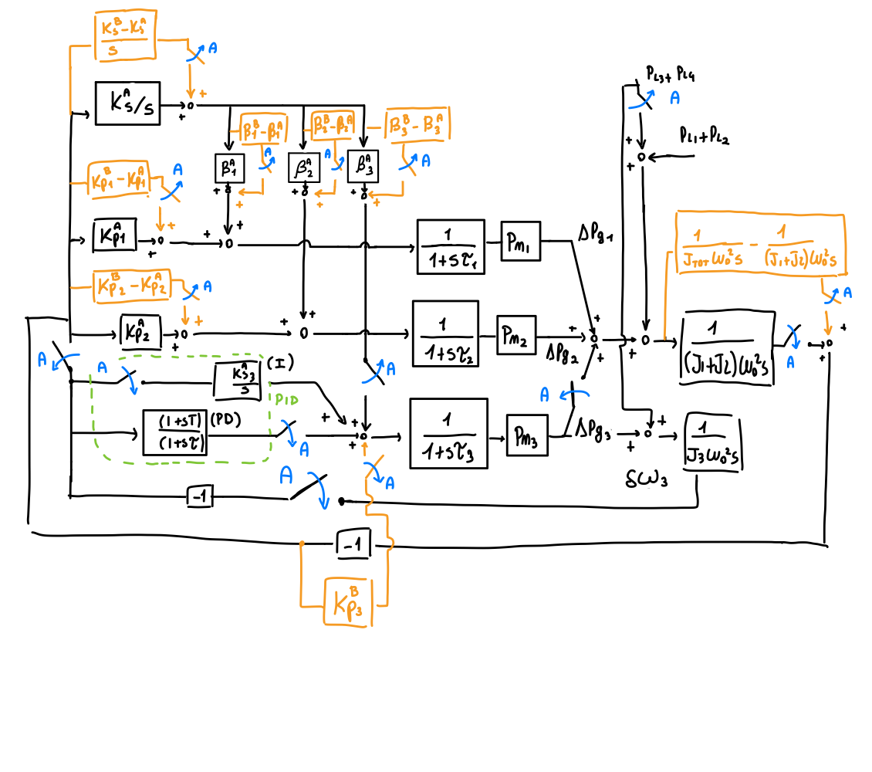
IDEA 2, Switches and variable gains
Other idea: we can use a scheme similar to this one, but with a proper variable gain TF block, to avoid some strange behaviors
CONCLUSIONS
Generalizing, a control scheme able to switch maybe between more than two configurations may need adaptive control. Use process data to update its parameter and control action, with an autonomous switching system and also some safety. So it need a complex infrastructure with a central control and some local controllers, plus optimization algorithms on top and proper exchange of information and communication.
(Hard to simulate in Modelica)

