Slide 1
Campus Sidewalk Optimization
Presented by Davis Wing
and Alex Williams

Slide 2
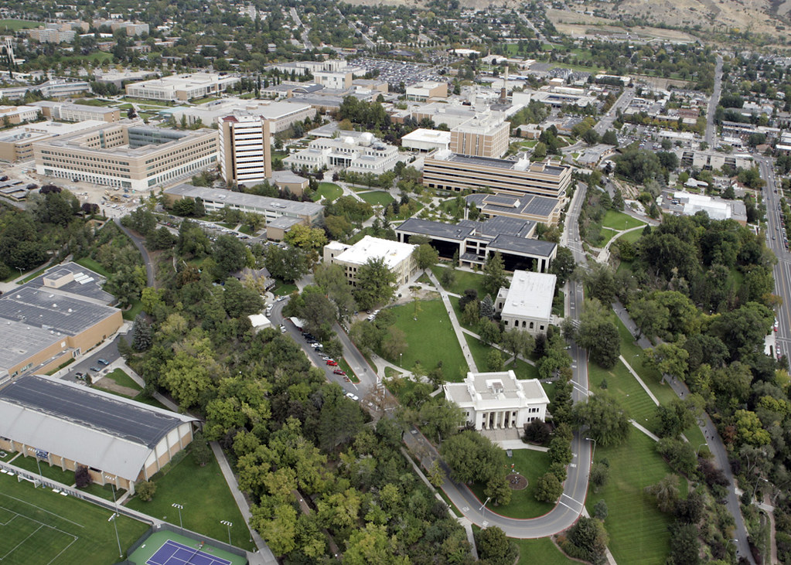
The Problem
from up here it doesn’t look so bad

Slide 3
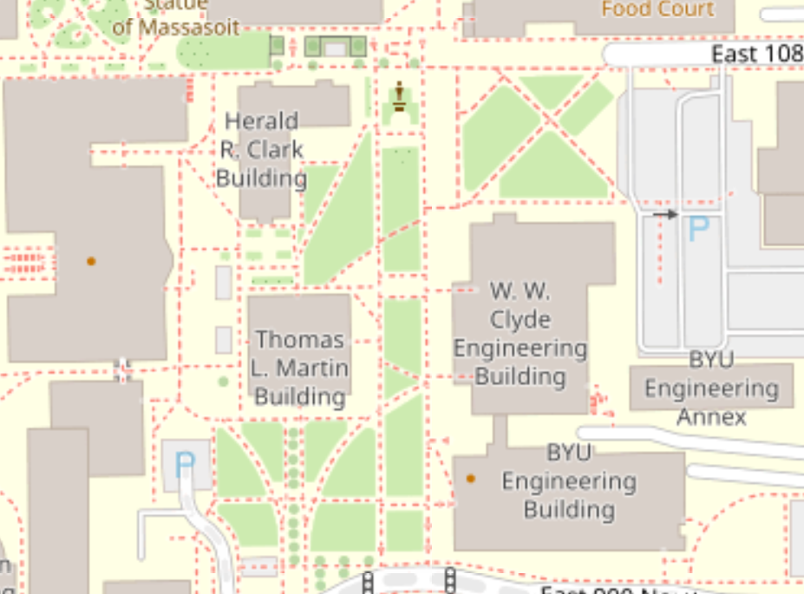
Southern Campus
Southern Campus Sidewalks They can be a mess. Especially to engineering students who want to travel in the straightest of lines.
Goals
Connect all destinations to one another (this one is non-negotiable)
Minimize the amount of sidewalk used to do so
Maximize path usage (minimize desire paths)

Slide 4
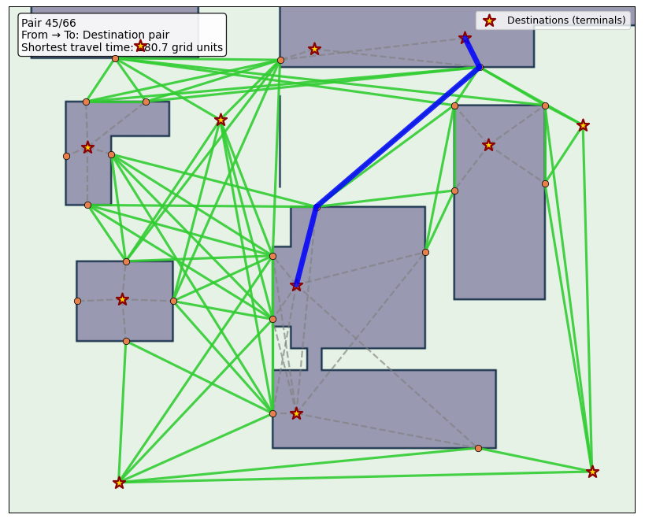
Modeling and Definitions
Finite Grid Baseline
To start, we defined an integer grid for the locations of buildings, points, and paths. This grid could be upscaled to any desired resolution, and all coordinates would still be accurate.
Network
Our network is built from the points on the grid, and encodes connections between doors of the same building, as well as connections between doors of different buildings.
The network class also allows for the addition of other points and paths, as the optimizer adds and removes them.

Slide 5
Modeling and Definitions
Algorithms
Once paths are laid out in the network, the shortest route between destinations is found with Dijkstra’s algorithm.
Evaluation and Assumptions
The network of paths does not attempt to be aesthetic or model the broader flow of campus traffic in any way.
Every pair of destinations has the same traffic volume as any other

Slide 6
optimization
ours was more complicated than this

Slide 7
Simulated Annealing
Annealing Definition To use simulated annealing on this project, we had to redefine the loss function to fit our project specification.
Loss For the updated loss function, we wanted to reduce distances while also reducing pavement. We took the sum length of all routes between destinations as our primary objective, and the total amount of paved pathway used to do so as our secondary objective.
We balanced these two objectives with a simple weighted sum (i.e. 1.5x more sensitive to time than paving cost).
credit jedrazb on github

Slide 8
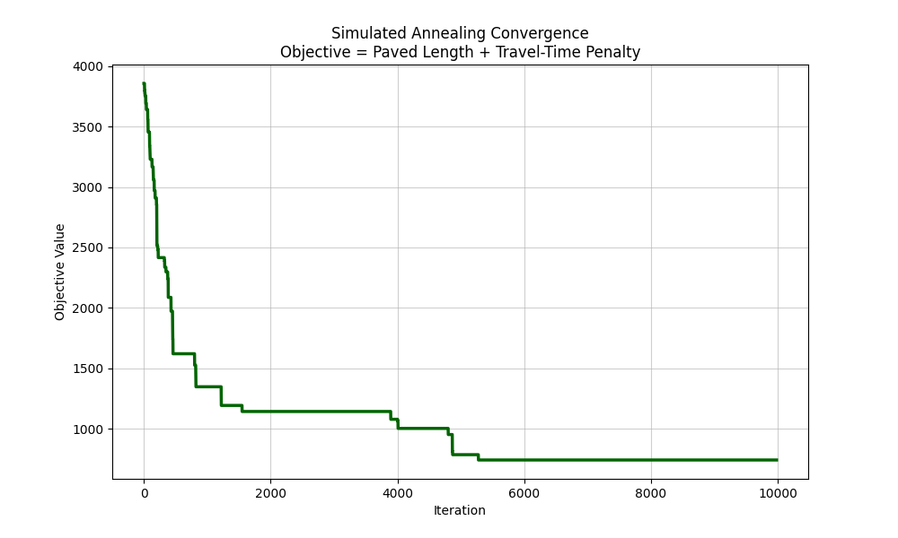
Simulated Annealing
Annealing Definition We also had to redefine the definition of a “neighbor” for our simulated annealing.
Adding/Removing Paths To get a “neighboring” network for connecting campus, we allowed the optimizer to add or remove any connection between two points, so long as they had line of sight. Nodes The optimizer could also, at random points on the grid, add a “node” which connected to two random nodes or doors in its vicinity. These nodes allowed for the optimizer to, at random, discover means of reducing redundant paths. The optimizer could also randomly move nodes around, potentially finding better placements.

Slide 9
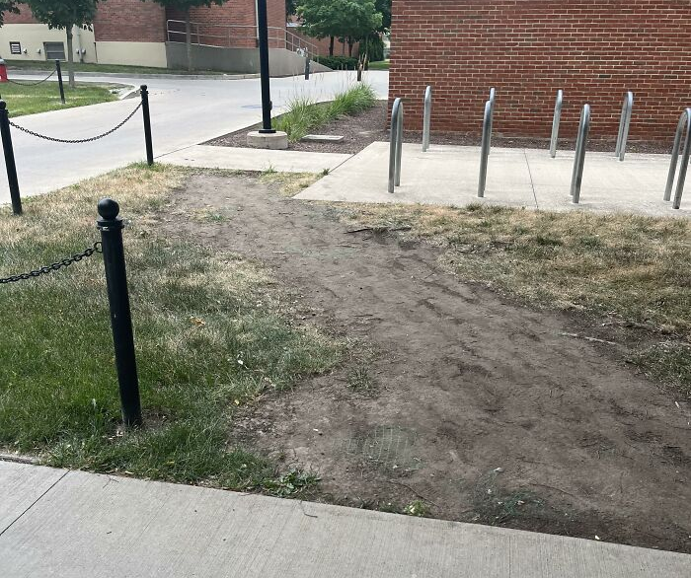
Results
the goal is to never have any more of these

Slide 10
Results
Optimizer Exploitations Walkways inside buildings cost nothing to build, so our results tended to favor ‘building hopping’ when targeting low-budget layouts.
Optimizer Limitations Destinations beyond this small map were not included, and traffic flow between each destination pair was considered equal.
Annealing also struggled to make large enough steps required to properly explore the space and make improvements. It is difficult to blindly make a better network with sequential neighbors. Optimistic Outcome Despite the map’s low fidelity, our optimization for low-budget used 5.5x less pavement while only increasing travel time by 1.18x.

Slide 11
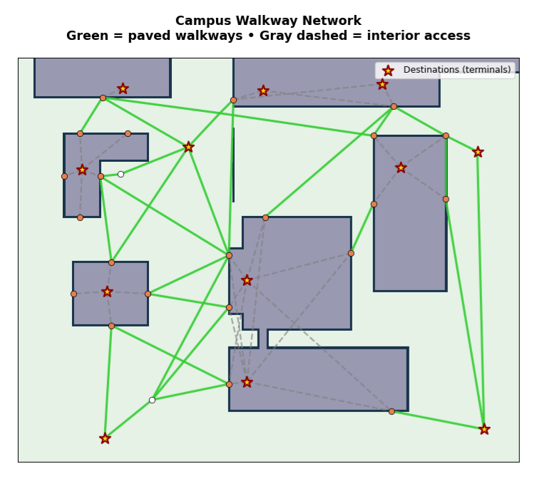
results
Takeaways Though the simulation of campus walkways lacked the full fidelity to be useful in real application, setting up and exploring the problem in optimization yielded excellent experience for future work in the field.
Building the entire changeable map and network of points and paths was a more time-consuming endeavor than anticipated.
Performance The algorithm ran remarkably fast (about 3 seconds for 500 iterations), thanks to well-planned data structures and code formatting.

