Slide 1

ESCAPE THE MATRIX
Alessia Urzi - Garima Sharma - K.Bana - Houleye Anne

Slide 2
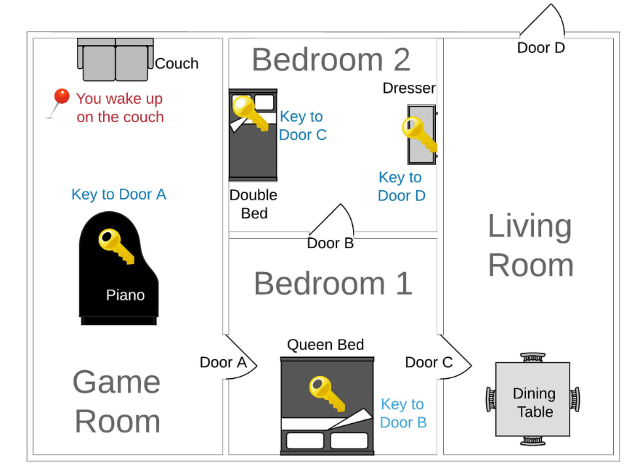
PROJECT OVERVIEW
GAME STRUCTURE We use dictionaries to define every objects such as rooms, furniture, doors and keys. Then we stored all the objects in lists. Finally, we defined the objects relation. Dictionaries:
Furniture
Doors
Keys
Rooms
Object relations
Lists:
all rooms
all doors

Slide 3
PROJECT OVERVIEW
FUNCTIONS
get_started: It gives the player all the informations to start the game
playroom : It’s the core loop of the game. If the player is in target room, he won. If not it will take input from the user to explore or examine the room.
Depending from the user choice “playroom” function will call the functions:
explore: this function lists all the item in the current room.
examine: this function examines each item of the room to find the key and move to the next room.
get_to_the_next_door: this function allows the player to move to the next room.

Slide 4
TECHNICAL CHALLENGE
OUR MOST IMPORTANT TECHNICAL CHALLENGE - Defining the functions and how they work (especially assigning the correct variable!)
- Create the correct data structure of the game, understanding how items correlate with each other
OVERCOMING THAT CHALLENGE We tried to dissect the code with the collaboration of all team members and the help of AI.

Slide 5
BIG MISTAKE
We tried to use nested dictionaries to structure the game and realized it was too complicated to implement in the functions.
OUR BIGGEST LEARNING:
It’s better to start with a simple but clean code and build from it!

Slide 6
DEMO

Slide 7
THANK YOU !
Alessia Urzi - Garima Sharma - K.Bana - Houleye Anne

