Slide 1
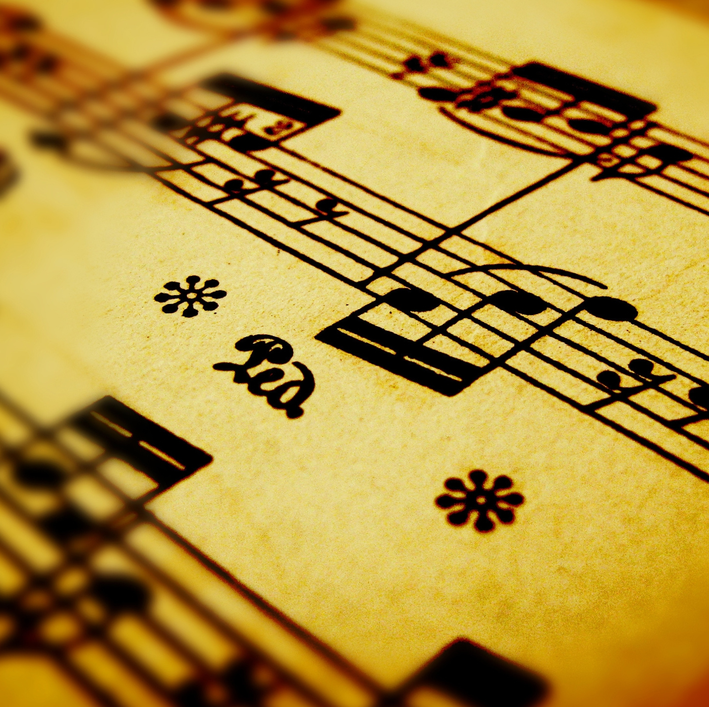
Creation of music through Neural Network

Slide 2
The goal
Create music thanks to an NN
Use of Midi files
Has to sound well at the end
Use of an Autoencoder NN (LSTM RNN, CNN doesn’t work very well)

Slide 3
Data
Midi files (scraping)
Formating midi to np.array
lengths.npy
samples.npy

Slide 4
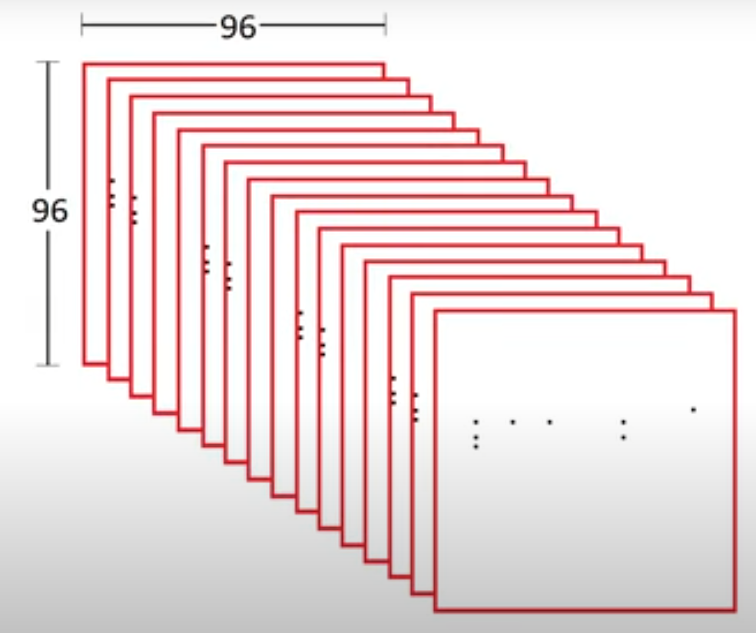
Input
Conversion of np.array to samples
A succession of np.arrays representing the midi
[(16)time,
96(time),
96(notes)]
The output is in the same shape as the input

Slide 5
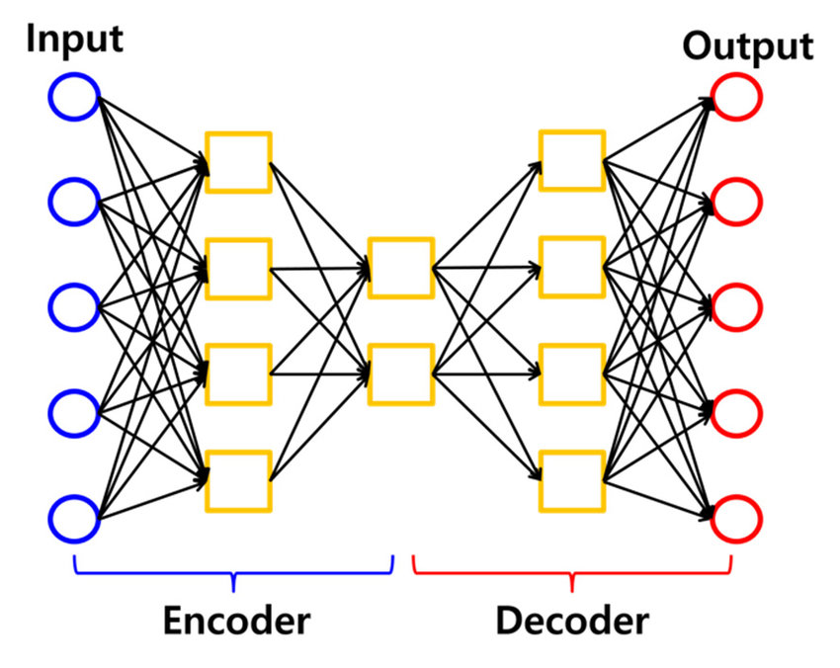
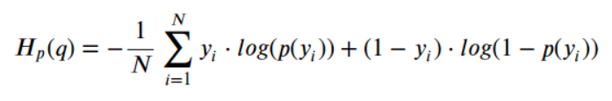
Auto Encoder
Encoder
Latent space
Decoder
__________________________
Output is compared with input
Loss : binary_crossentropy

Slide 6
Encoder
self.encoder = Sequential([
Input(shape=input_shape),
Reshape((input_shape[0], -1)),
TimeDistributed(Dense(2000, activation='relu')),
TimeDistributed(Dense(200, activation='relu')),
Flatten(),
Dense(1600, activation='relu'),
Dense(latent_space_size),
BatchNormalization(momentum=batchnorm_momentum, name='encoder')
])

Slide 7
Decoder
self.decoder = Sequential([
Dense(1600, name='decoder'),
BatchNormalization(momentum=batchnorm_momentum),
Activation('relu'),
Dropout(dropout_rate),
Dense(max_windows * 200),
Reshape((max_windows, 200)),
TimeDistributed(BatchNormalization(momentum=batchnorm_momentum)),
Activation('relu'),
Dropout(dropout_rate),
TimeDistributed(Dense(2000)),
TimeDistributed(BatchNormalization(momentum=batchnorm_momentum)),
Activation('relu'),
Dropout(dropout_rate),
TimeDistributed(Dense(input_shape[1] * input_shape[2], activation='sigmoid')),
Reshape((input_shape[0], input_shape[1], input_shape[2])),
])

Slide 8
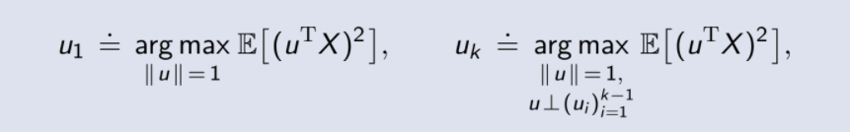
Role of PCA
Used for adjusting parameters in a good manner in the latent space

Slide 9
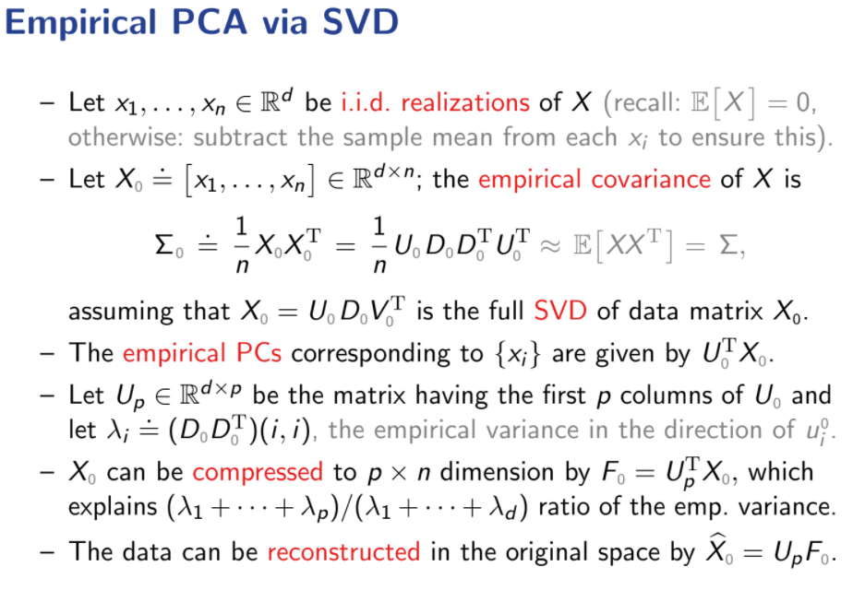
How to create the PCA
We use the Singular Value Decomposition to do so

Slide 10
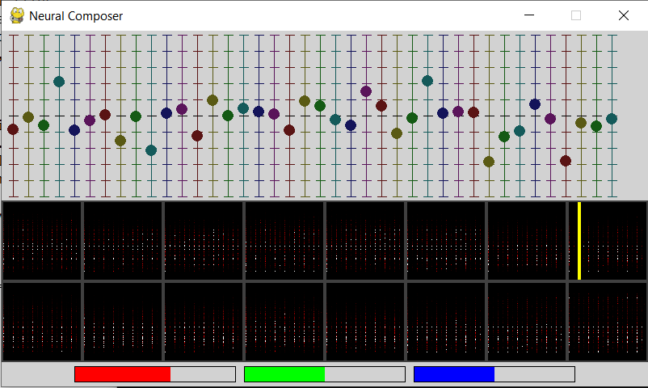
Compose the music
Prediction of songs through decoder with parameters in the latent space
Sample to Midi
Midi to song

Slide 11
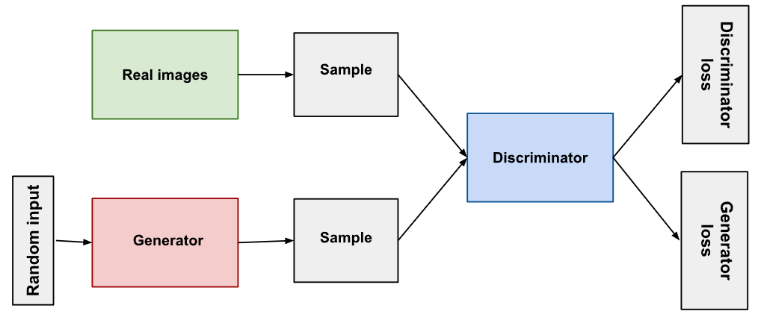
How to do better ?
Change the architecture
The goal would also be to make the AI learn the best parameters in the latent space. Use of a discriminator
Creation of a GAN (generative adversarial network)
Parallelization

Slide 12
References
https://www.youtube.com/watch?v=UWxfnNXlVy8
https://github.com/HackerPoet/Composer

