Slide 1
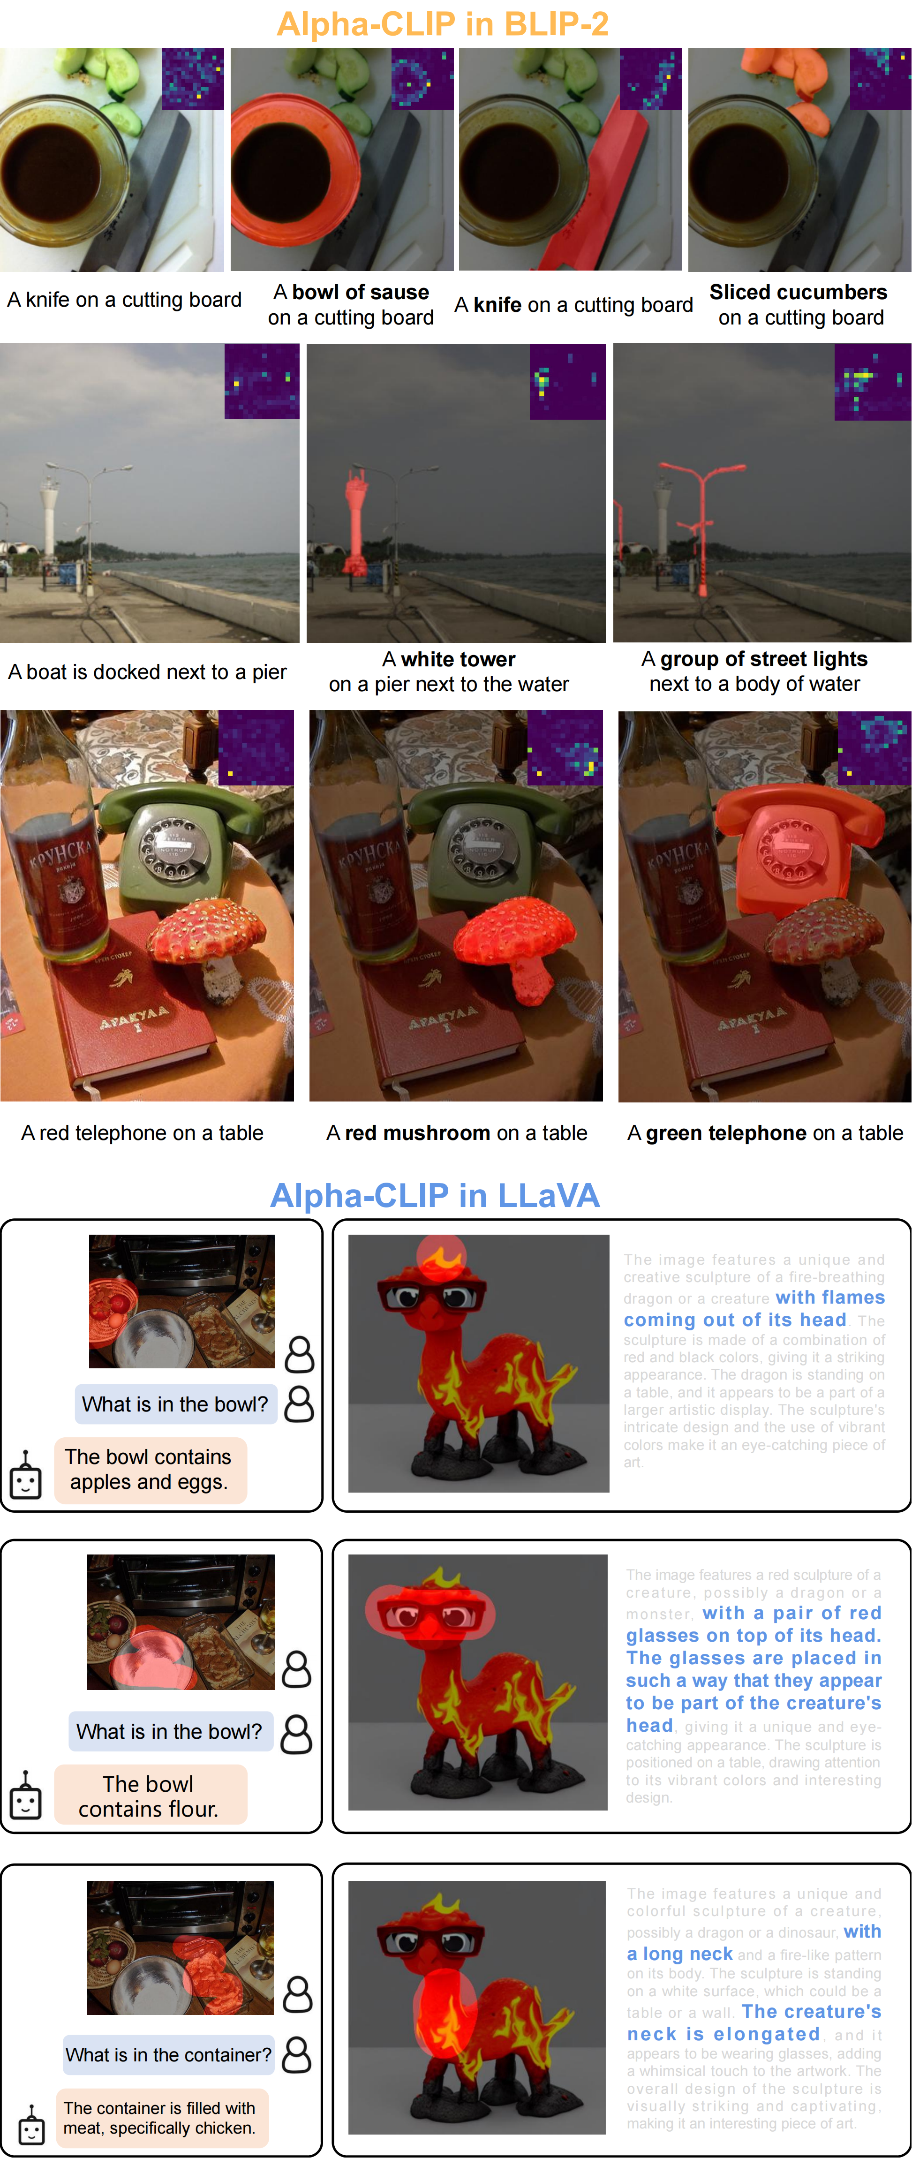
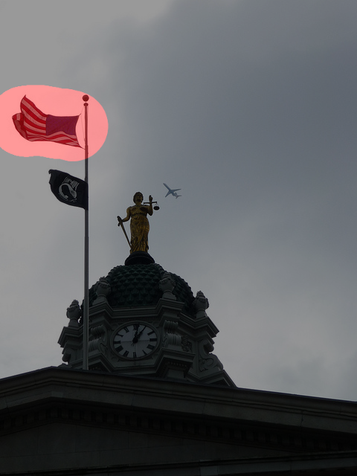
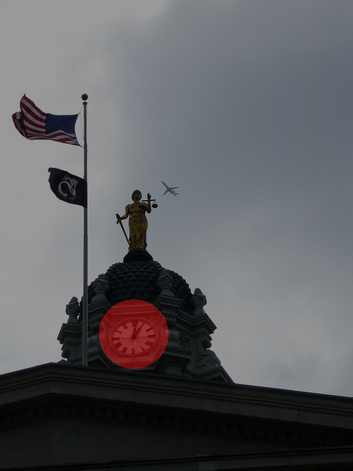
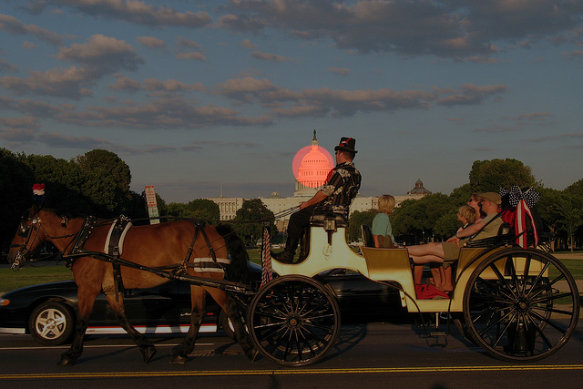
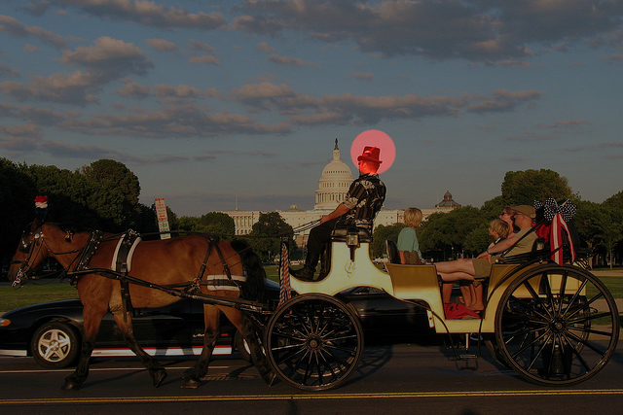
Alpha-CLIP in BLIP2
Alpha-CLIP in LLaVa
The image features a statue of a woman holding scales, which is situated on top of a building. The statue is positioned in front of a large American flag, which is flying high on a pole. In the background, there is an airplane flying overhead, adding a sense of motion and activity to the scene. The combination of the statue, the flag, and the airplane creates a dynamic and visually interesting composition.
The image features a large clock mounted on the side of a building, with a statue of a woman holding scales nearby. The clock is prominently displayed, and it appears to be a central feature of the building. In the background, there is an airplane flying, adding a sense of motion and activity to the scene. The combination of the clock, statue, and airplane creates an interesting and dynamic visual composition.
The image depicts a group of people riding in a horse-drawn carriage on a street in front of the U.S. Capitol building. The carriage is being pulled by two horses, and there are several people visible in the scene, including a man riding the carriage and others standing nearby.
The image features a horse-drawn carriage with a man wearing a top hat driving the carriage. There are several people in the scene, including a man sitting on the carriage, a woman sitting on the back of the carriage, and other individuals standing nearby. The carriage is moving down a street, and the people appear to be enjoying the ride.

Slide 2
Alpha-CLIP in BLIP2
Alpha-CLIP in LLaVa
The image features a statue of a woman holding scales, which is situated on top of a building. The statue is positioned in front of a large American flag, which is flying high on a pole. In the background, there is an airplane flying overhead, adding a sense of motion and activity to the scene. The combination of the statue, the flag, and the airplane creates a dynamic and visually interesting composition.
The image features a large clock mounted on the side of a building, with a statue of a woman holding scales nearby. The clock is prominently displayed, and it appears to be a central feature of the building. In the background, there is an airplane flying, adding a sense of motion and activity to the scene. The combination of the clock, statue, and airplane creates an interesting and dynamic visual composition.
The image depicts a group of people riding in a horse-drawn carriage on a street in front of the U.S. Capitol building. The carriage is being pulled by two horses, and there are several people visible in the scene, including a man riding the carriage and others standing nearby.
The image features a horse-drawn carriage with a man wearing a top hat driving the carriage. There are several people in the scene, including a man sitting on the carriage, a woman sitting on the back of the carriage, and other individuals standing nearby. The carriage is moving down a street, and the people appear to be enjoying the ride.

Slide 3
Alpha-CLIP in BLIP2
Alpha-CLIP in LLaVa
The image features a statue of a woman holding scales, which is situated on top of a building. The statue is positioned in front of a large American flag, which is flying high on a pole. In the background, there is an airplane flying overhead, adding a sense of motion and activity to the scene. The combination of the statue, the flag, and the airplane creates a dynamic and visually interesting composition.
The image features a large clock mounted on the side of a building, with a statue of a woman holding scales nearby. The clock is prominently displayed, and it appears to be a central feature of the building. In the background, there is an airplane flying, adding a sense of motion and activity to the scene. The combination of the clock, statue, and airplane creates an interesting and dynamic visual composition.
The image depicts a group of people riding in a horse-drawn carriage on a street in front of the U.S. Capitol building. The carriage is being pulled by two horses, and there are several people visible in the scene, including a man riding the carriage and others standing nearby.
The image features a horse-drawn carriage with a man wearing a top hat driving the carriage. There are several people in the scene, including a man sitting on the carriage, a woman sitting on the back of the carriage, and other individuals standing nearby. The carriage is moving down a street, and the people appear to be enjoying the ride.

Slide 4
Alpha-CLIP in BLIP2
Alpha-CLIP in LLaVa
Alpha-CLIP in LLaVa
The image features a statue of a woman holding scales, which is situated on top of a building. The statue is positioned in front of a large American flag, which is flying high on a pole. In the background, there is an airplane flying overhead, adding a sense of motion and activity to the scene. The combination of the statue, the flag, and the airplane creates a dynamic and visually interesting composition.
The image features a large clock mounted on the side of a building, with a statue of a woman holding scales nearby. The clock is prominently displayed, and it appears to be a central feature of the building. In the background, there is an airplane flying, adding a sense of motion and activity to the scene. The combination of the clock, statue, and airplane creates an interesting and dynamic visual composition.
The image depicts a group of people riding in a horse-drawn carriage on a street in front of the U.S. Capitol building. The carriage is being pulled by two horses, and there are several people visible in the scene, including a man riding the carriage and others standing nearby.
The image features a horse-drawn carriage with a man wearing a top hat driving the carriage. There are several people in the scene, including a man sitting on the carriage, a woman sitting on the back of the carriage, and other individuals standing nearby. The carriage is moving down a street, and the people appear to be enjoying the ride.

Slide 5
Alpha-CLIP in BLIP2
Alpha-CLIP in LLaVA
The image features a statue of a woman holding scales, which is situated on top of a building. The statue is positioned in front of a large American flag, which is flying high on a pole. In the background, there is an airplane flying overhead, adding a sense of motion and activity to the scene. The combination of the statue, the flag, and the airplane creates a dynamic and visually interesting composition.
The image features a large clock mounted on the side of a building, with a statue of a woman holding scales nearby. The clock is prominently displayed, and it appears to be a central feature of the building. In the background, there is an airplane flying, adding a sense of motion and activity to the scene. The combination of the clock, statue, and airplane creates an interesting and dynamic visual composition.
The image depicts a group of people riding in a horse-drawn carriage on a street in front of the U.S. Capitol building. The carriage is being pulled by two horses, and there are several people visible in the scene, including a man riding the carriage and others standing nearby.
The image features a horse-drawn carriage with a man wearing a top hat driving the carriage. There are several people in the scene, including a man sitting on the carriage, a woman sitting on the back of the carriage, and other individuals standing nearby. The carriage is moving down a street, and the people appear to be enjoying the ride.

Slide 6
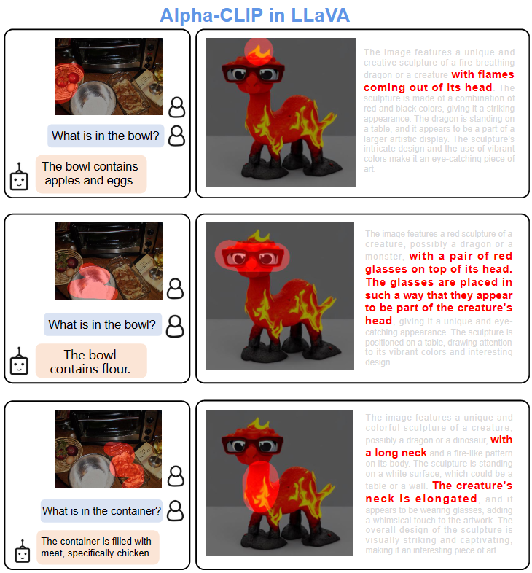
Alpha-CLIP in BLIP2
Alpha-CLIP in LLaVA
The image features a statue of a woman holding scales, which is situated on top of a building. The statue is positioned in front of a large American flag, which is flying high on a pole. In the background, there is an airplane flying overhead, adding a sense of motion and activity to the scene. The combination of the statue, the flag, and the airplane creates a dynamic and visually interesting composition.
The image features a large clock mounted on the side of a building, with a statue of a woman holding scales nearby. The clock is prominently displayed, and it appears to be a central feature of the building. In the background, there is an airplane flying, adding a sense of motion and activity to the scene. The combination of the clock, statue, and airplane creates an interesting and dynamic visual composition.
The image depicts a group of people riding in a horse-drawn carriage on a street in front of the U.S. Capitol building. The carriage is being pulled by two horses, and there are several people visible in the scene, including a man riding the carriage and others standing nearby.
The image features a horse-drawn carriage with a man wearing a top hat driving the carriage. There are several people in the scene, including a man sitting on the carriage, a woman sitting on the back of the carriage, and other individuals standing nearby. The carriage is moving down a street, and the people appear to be enjoying the ride.

Slide 7
Alpha-CLIP in BLIP2
Alpha-CLIP in LLaVa
The image features a statue of a woman holding scales, which is situated on top of a building. The statue is positioned in front of a large American flag, which is flying high on a pole. In the background, there is an airplane flying overhead, adding a sense of motion and activity to the scene. The combination of the statue, the flag, and the airplane creates a dynamic and visually interesting composition.
The image features a large clock mounted on the side of a building, with a statue of a woman holding scales nearby. The clock is prominently displayed, and it appears to be a central feature of the building. In the background, there is an airplane flying, adding a sense of motion and activity to the scene. The combination of the clock, statue, and airplane creates an interesting and dynamic visual composition.
The image depicts a group of people riding in a horse-drawn carriage on a street in front of the U.S. Capitol building. The carriage is being pulled by two horses, and there are several people visible in the scene, including a man riding the carriage and others standing nearby.
The image features a horse-drawn carriage with a man wearing a top hat driving the carriage. There are several people in the scene, including a man sitting on the carriage, a woman sitting on the back of the carriage, and other individuals standing nearby. The carriage is moving down a street, and the people appear to be enjoying the ride.

Slide 8
Alpha-CLIP in BLIP2
Alpha-CLIP in LLaVa
The image features a statue of a woman holding scales, which is situated on top of a building. The statue is positioned in front of a large American flag, which is flying high on a pole. In the background, there is an airplane flying overhead, adding a sense of motion and activity to the scene. The combination of the statue, the flag, and the airplane creates a dynamic and visually interesting composition.
The image features a large clock mounted on the side of a building, with a statue of a woman holding scales nearby. The clock is prominently displayed, and it appears to be a central feature of the building. In the background, there is an airplane flying, adding a sense of motion and activity to the scene. The combination of the clock, statue, and airplane creates an interesting and dynamic visual composition.
The image depicts a group of people riding in a horse-drawn carriage on a street in front of the U.S. Capitol building. The carriage is being pulled by two horses, and there are several people visible in the scene, including a man riding the carriage and others standing nearby.
The image features a horse-drawn carriage with a man wearing a top hat driving the carriage. There are several people in the scene, including a man sitting on the carriage, a woman sitting on the back of the carriage, and other individuals standing nearby. The carriage is moving down a street, and the people appear to be enjoying the ride.

Slide 9
Alpha-CLIP in BLIP2
Alpha-CLIP in LLaVa
The image features a statue of a woman holding scales, which is situated on top of a building. The statue is positioned in front of a large American flag, which is flying high on a pole. In the background, there is an airplane flying overhead, adding a sense of motion and activity to the scene. The combination of the statue, the flag, and the airplane creates a dynamic and visually interesting composition.
The image features a large clock mounted on the side of a building, with a statue of a woman holding scales nearby. The clock is prominently displayed, and it appears to be a central feature of the building. In the background, there is an airplane flying, adding a sense of motion and activity to the scene. The combination of the clock, statue, and airplane creates an interesting and dynamic visual composition.
The image depicts a group of people riding in a horse-drawn carriage on a street in front of the U.S. Capitol building. The carriage is being pulled by two horses, and there are several people visible in the scene, including a man riding the carriage and others standing nearby.
The image features a horse-drawn carriage with a man wearing a top hat driving the carriage. There are several people in the scene, including a man sitting on the carriage, a woman sitting on the back of the carriage, and other individuals standing nearby. The carriage is moving down a street, and the people appear to be enjoying the ride.

Slide 10
Alpha-CLIP in BLIP2
Alpha-CLIP in LLaVa
The image features a statue of a woman holding scales, which is situated on top of a building. The statue is positioned in front of a large American flag, which is flying high on a pole. In the background, there is an airplane flying overhead, adding a sense of motion and activity to the scene. The combination of the statue, the flag, and the airplane creates a dynamic and visually interesting composition.
The image features a large clock mounted on the side of a building, with a statue of a woman holding scales nearby. The clock is prominently displayed, and it appears to be a central feature of the building. In the background, there is an airplane flying, adding a sense of motion and activity to the scene. The combination of the clock, statue, and airplane creates an interesting and dynamic visual composition.
The image depicts a group of people riding in a horse-drawn carriage on a street in front of the U.S. Capitol building. The carriage is being pulled by two horses, and there are several people visible in the scene, including a man riding the carriage and others standing nearby.
The image features a horse-drawn carriage with a man wearing a top hat driving the carriage. There are several people in the scene, including a man sitting on the carriage, a woman sitting on the back of the carriage, and other individuals standing nearby. The carriage is moving down a street, and the people appear to be enjoying the ride.

