Slide 1
Flight Satisfaction Survey
Alec Schneider

Slide 2
Background
Airlines have been pioneers in the analytics community regarding pricing and route optimization, however they have long struggled with understanding customer satisfaction. It is possible they have struggled with this due to company bias, and lack of customer data from other airlines. To tackle this problem an industry funded customer survey gathered ~130,000 responses each with 25 attributes, to create 3.25 million data points that can be used to assist their understanding. I was tasked with analyzing this data thoroughly enough to provide actionable insights for the businesses to implement in their company strategies.
After cleaning and exploring the survey data, creating informative visualizations to assist in understanding the data, and applying machine learning algorithms to it, airlines are now closer to fully understanding what their customers value most, thus improving customer satisfaction. This will be a win for the airlines, as increased satisfaction is believed to increase demand of air travel, and the consumers who choose to travel on their aircrafts.

Slide 3
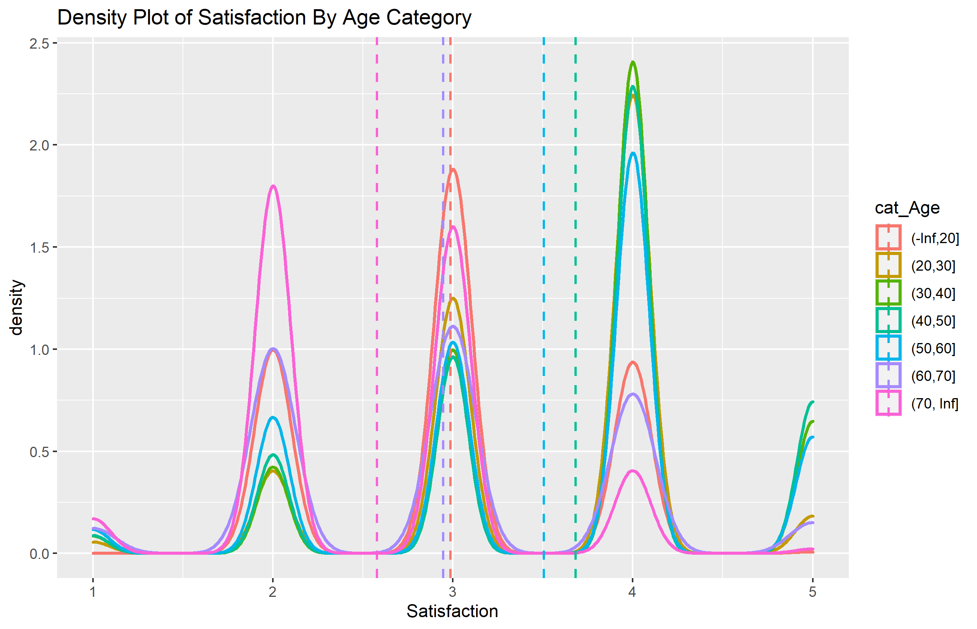
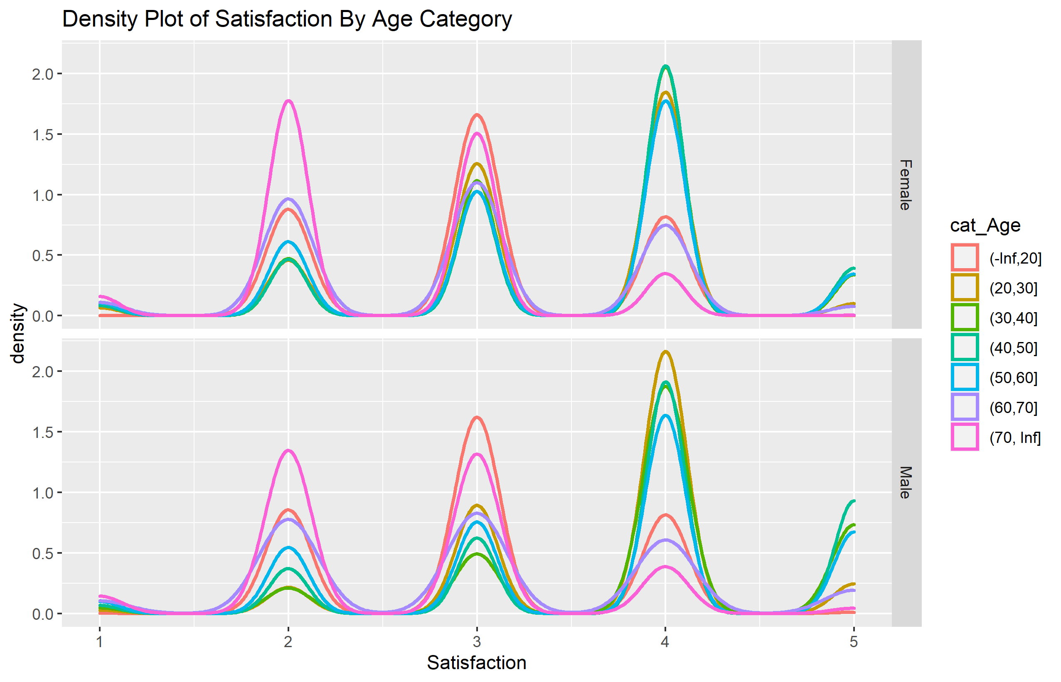
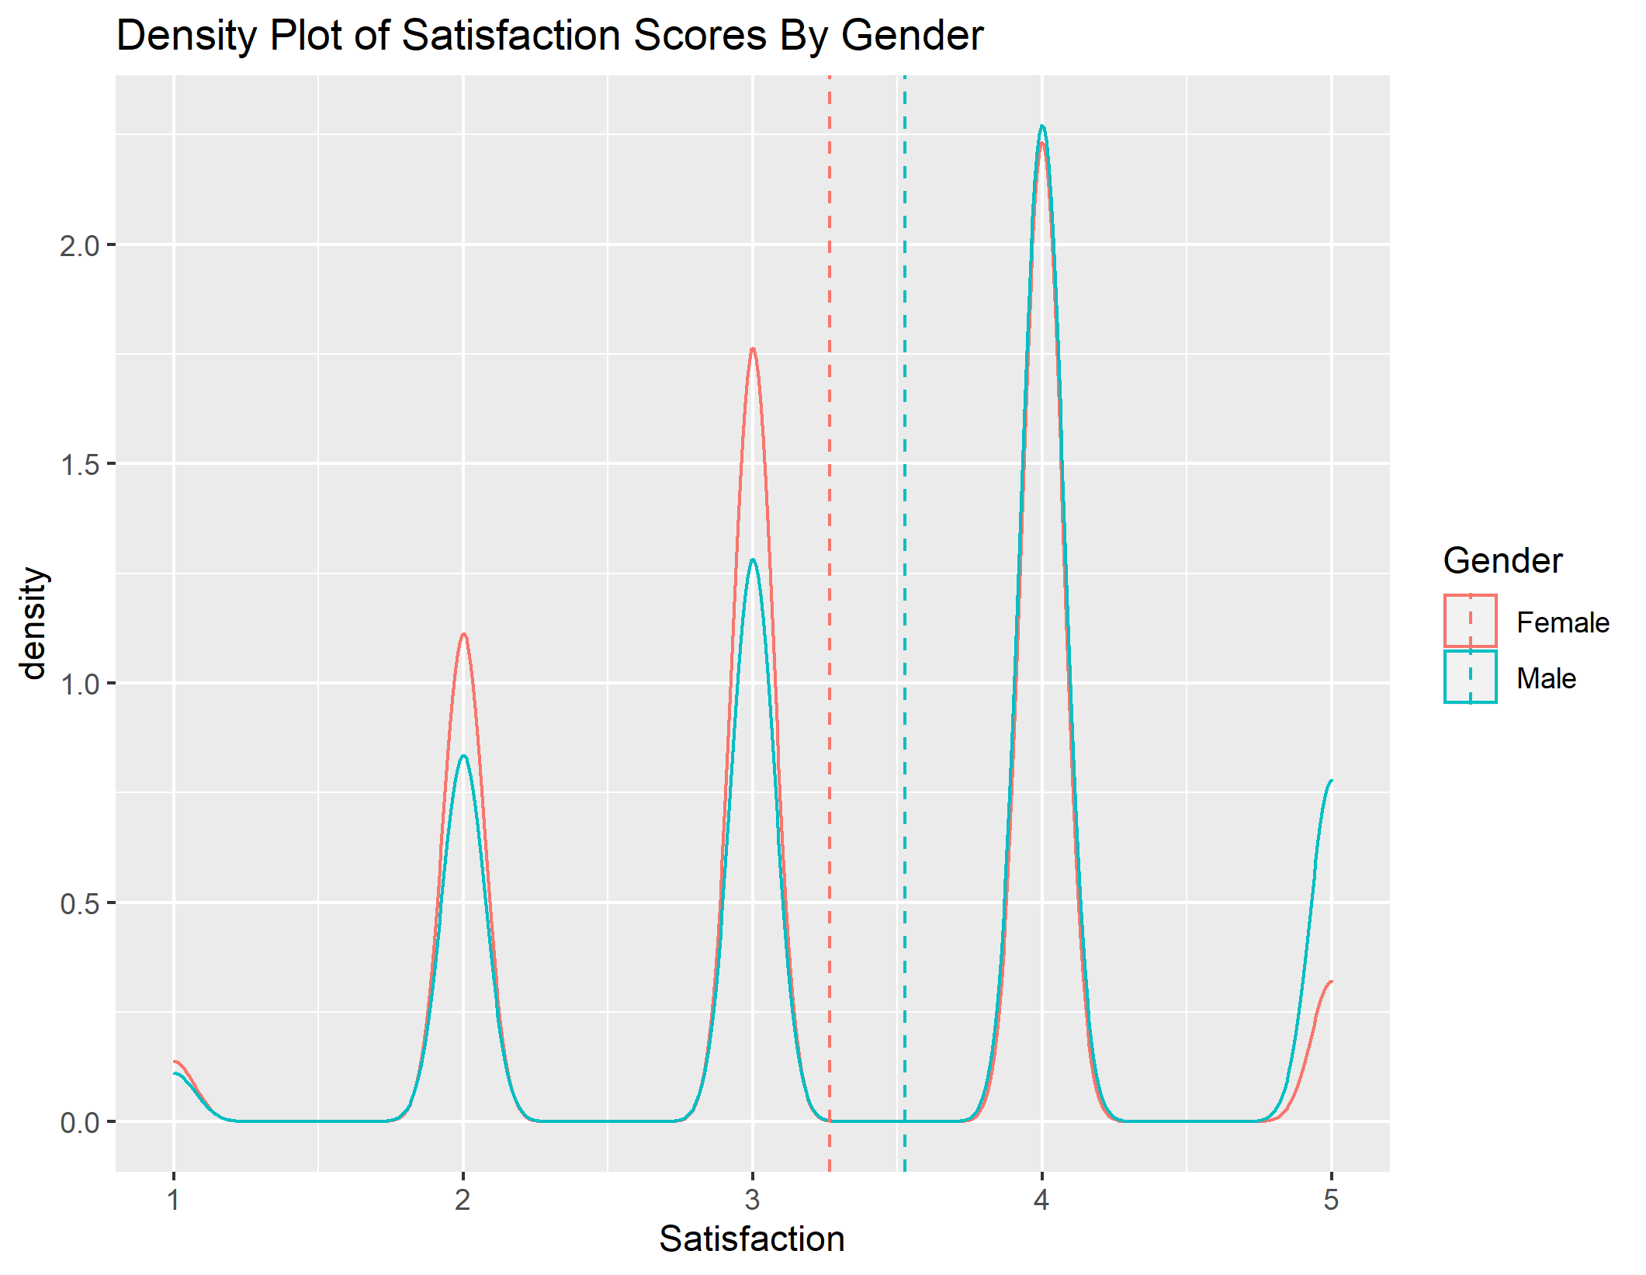
Demographics - Satisfaction

Slide 4
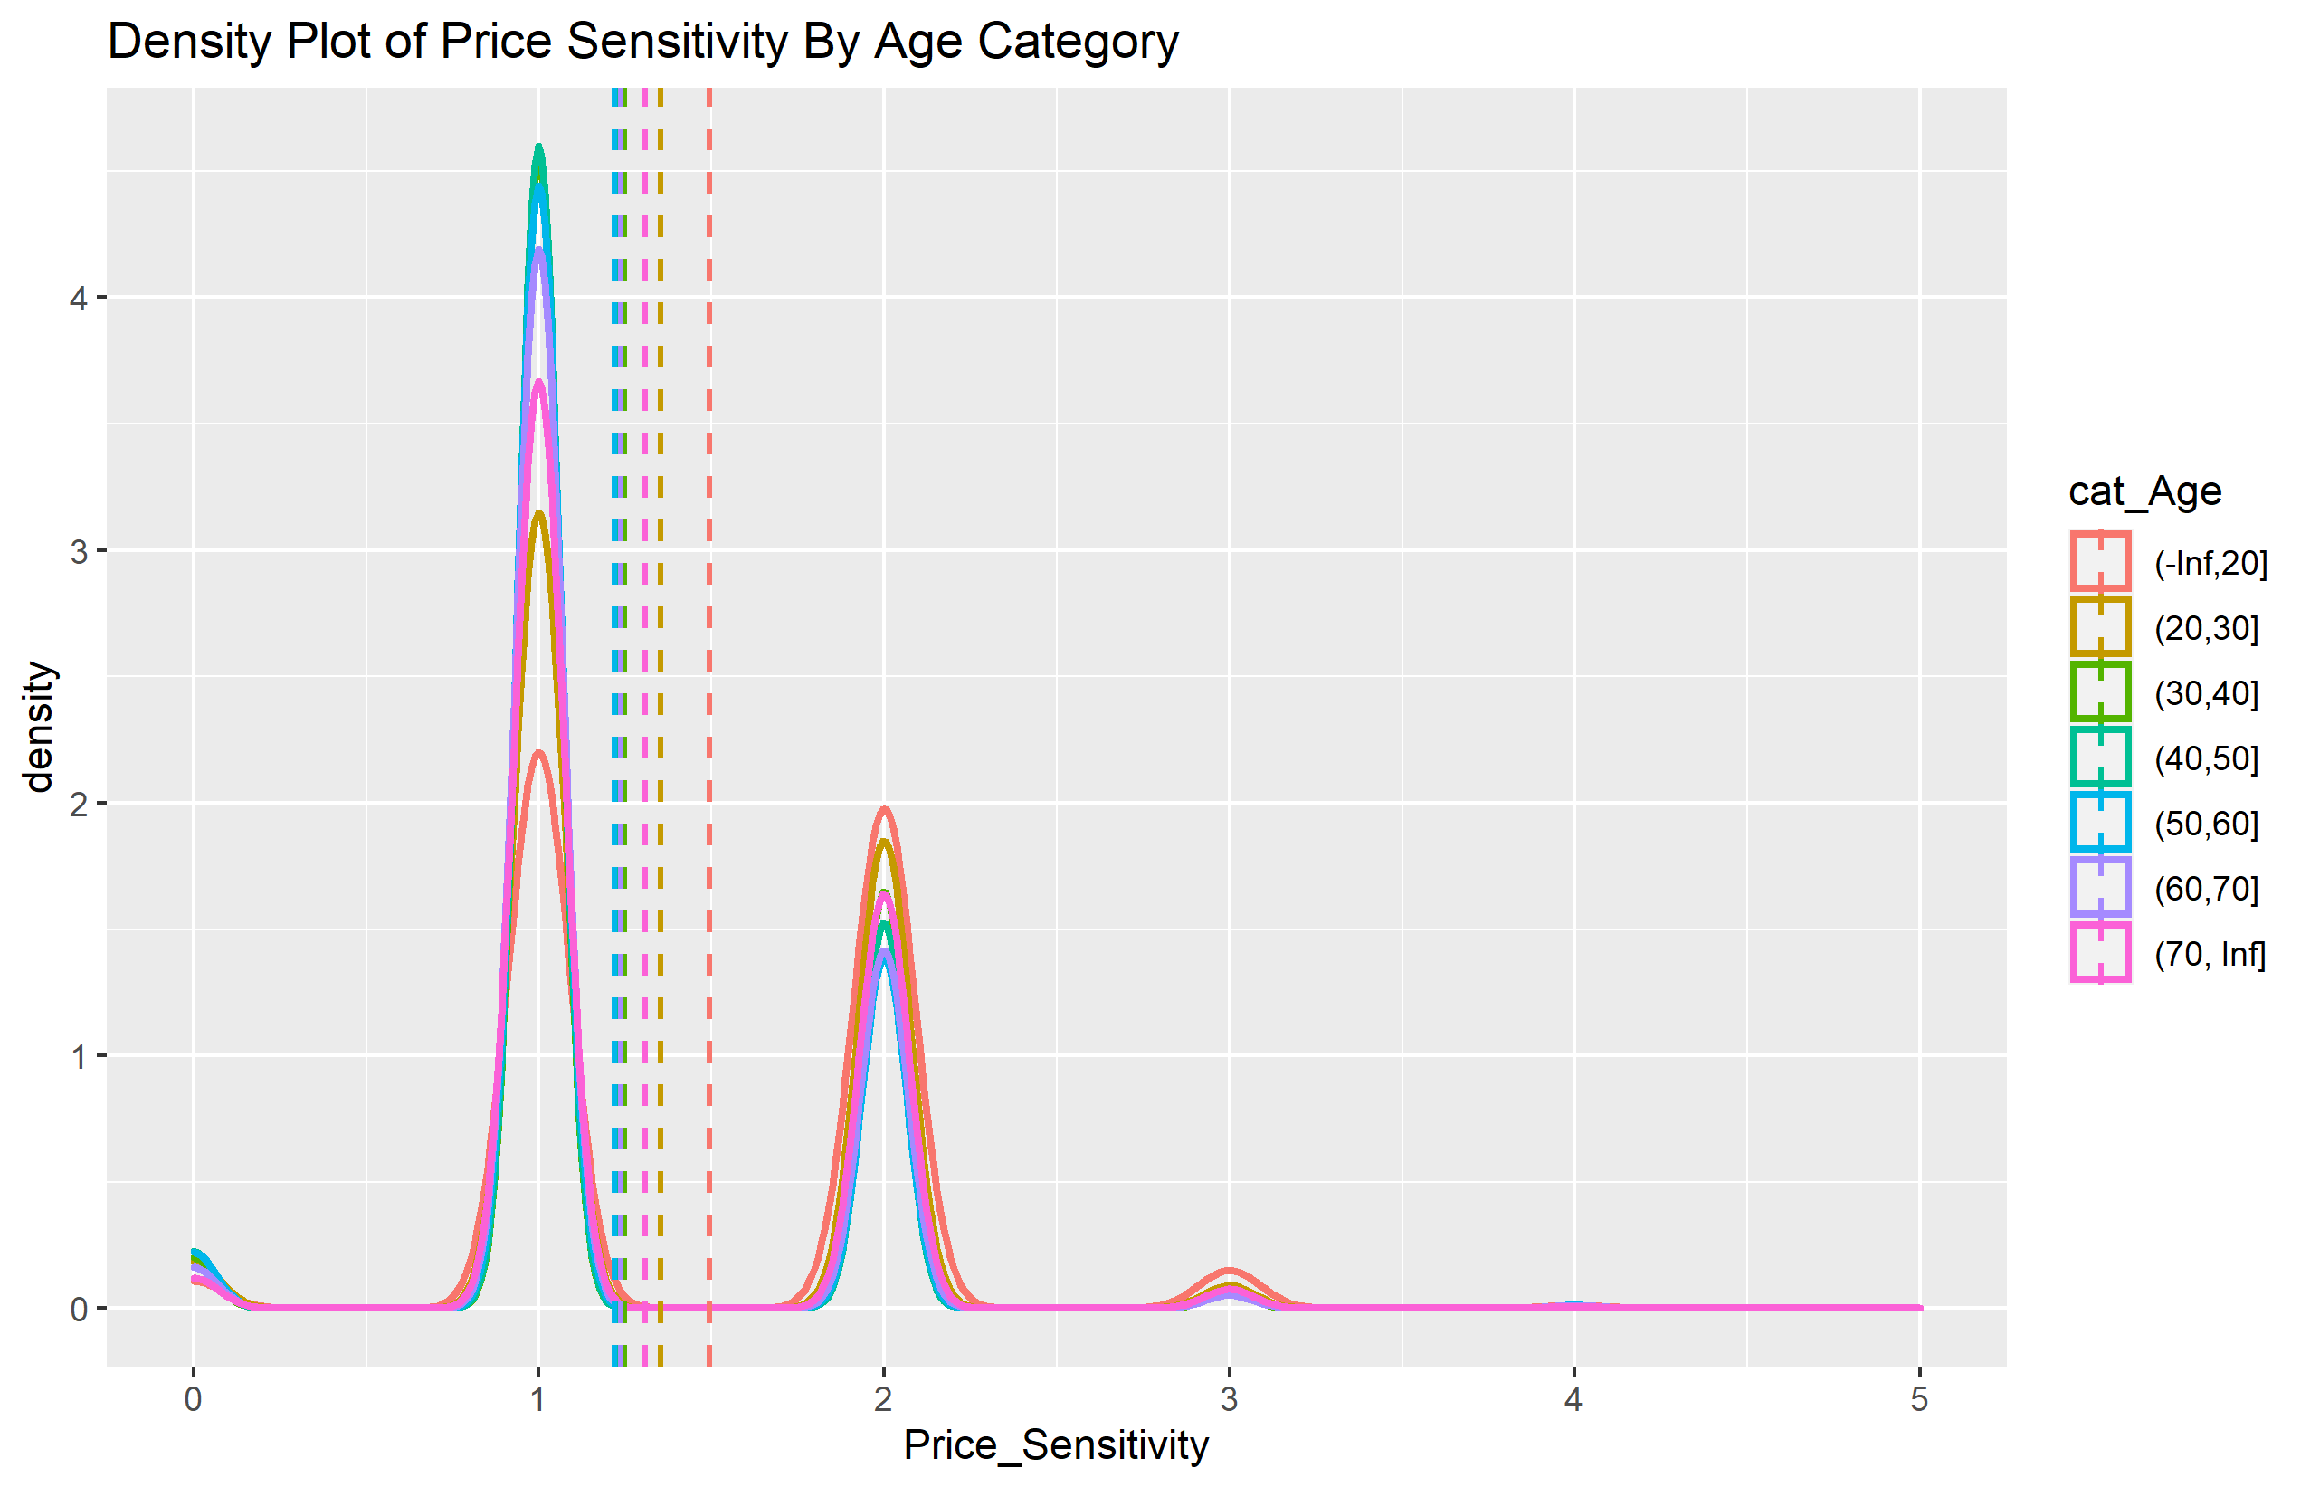
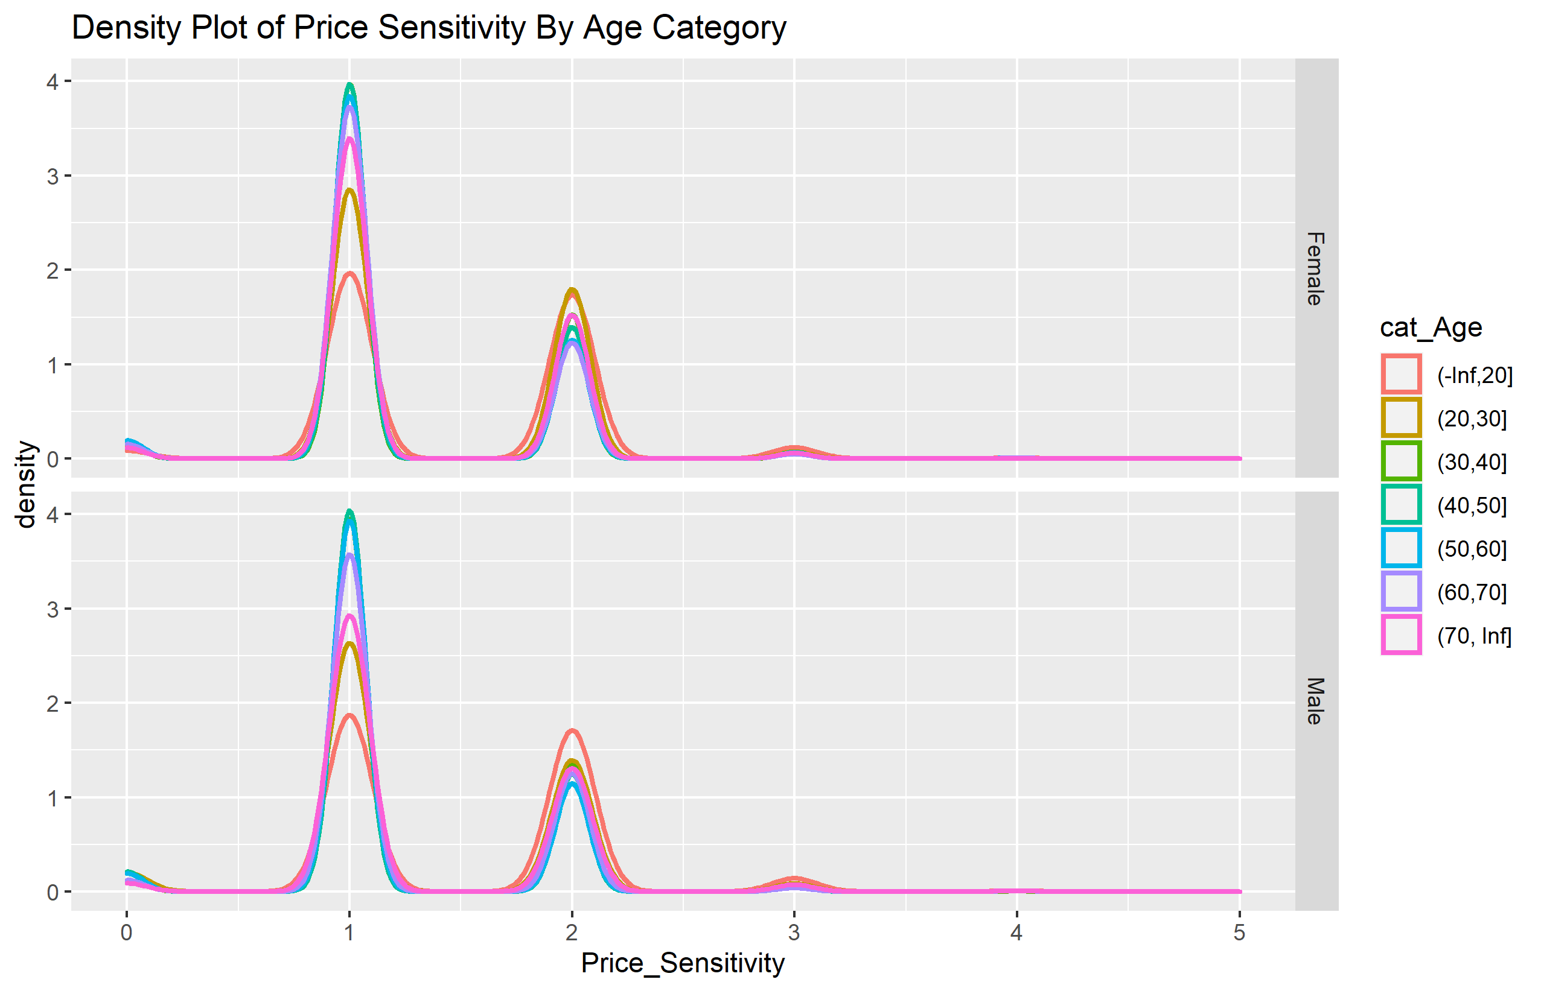
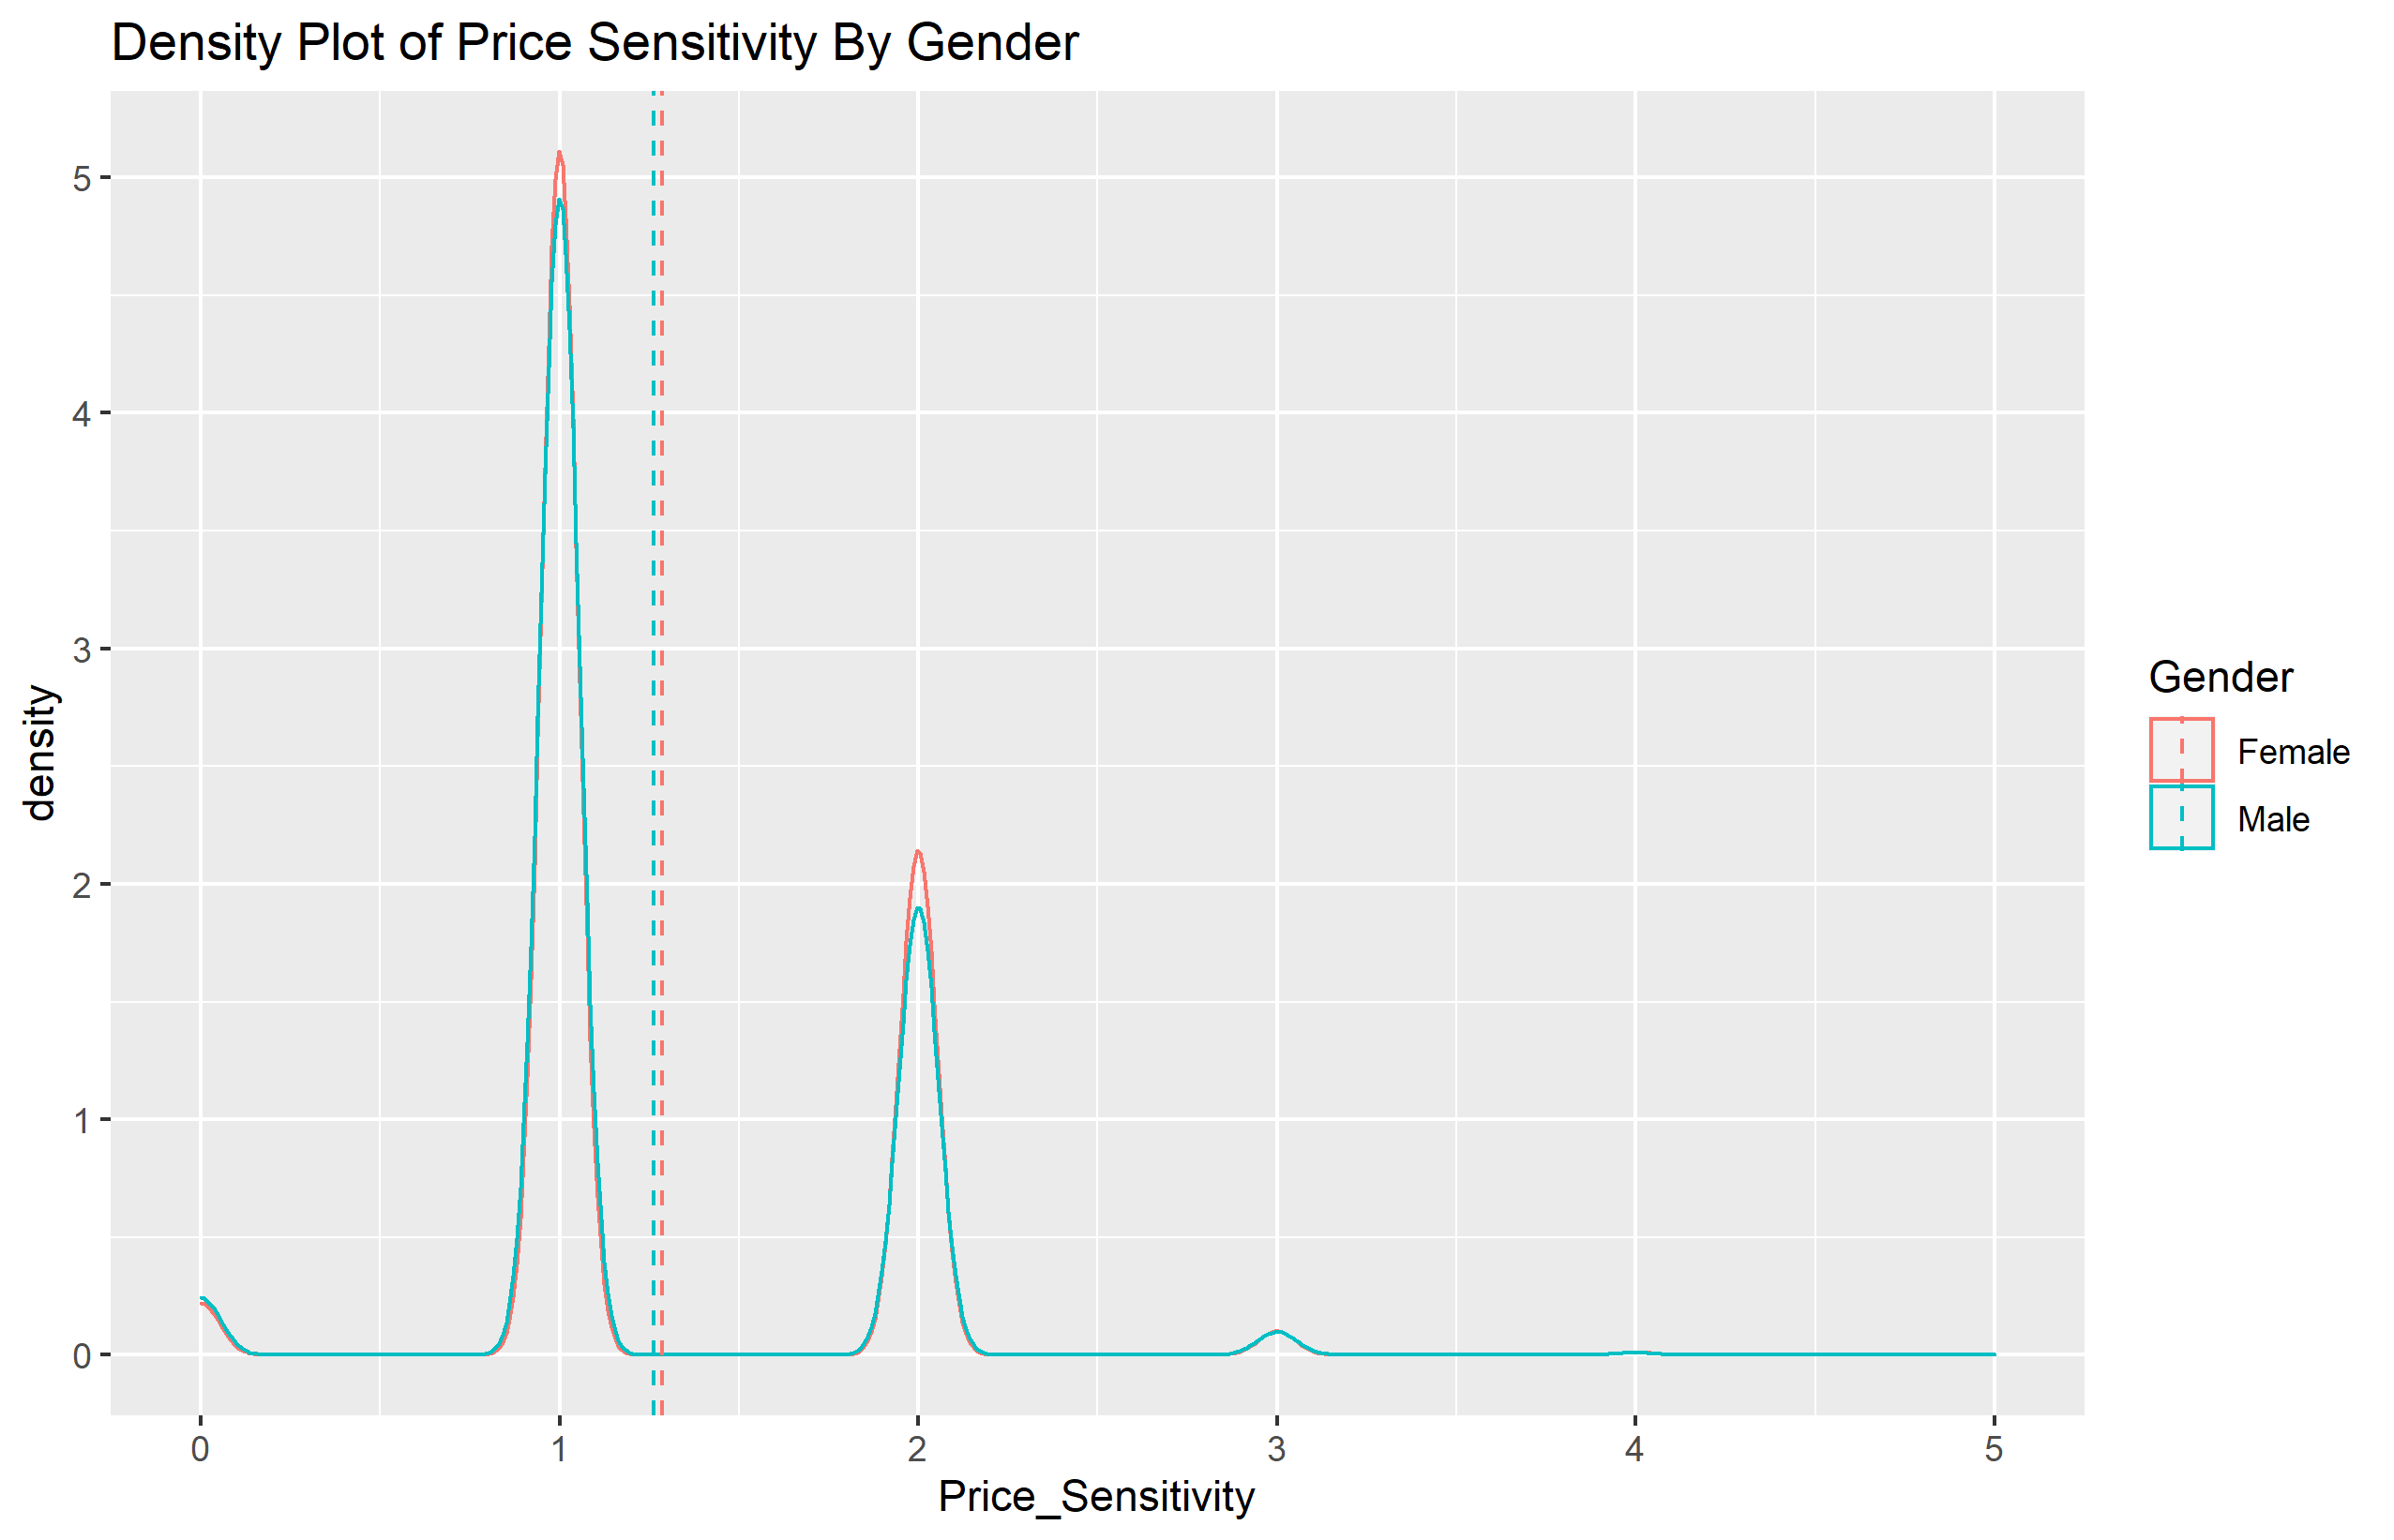
Demographics – Price Sensitivity

Slide 5
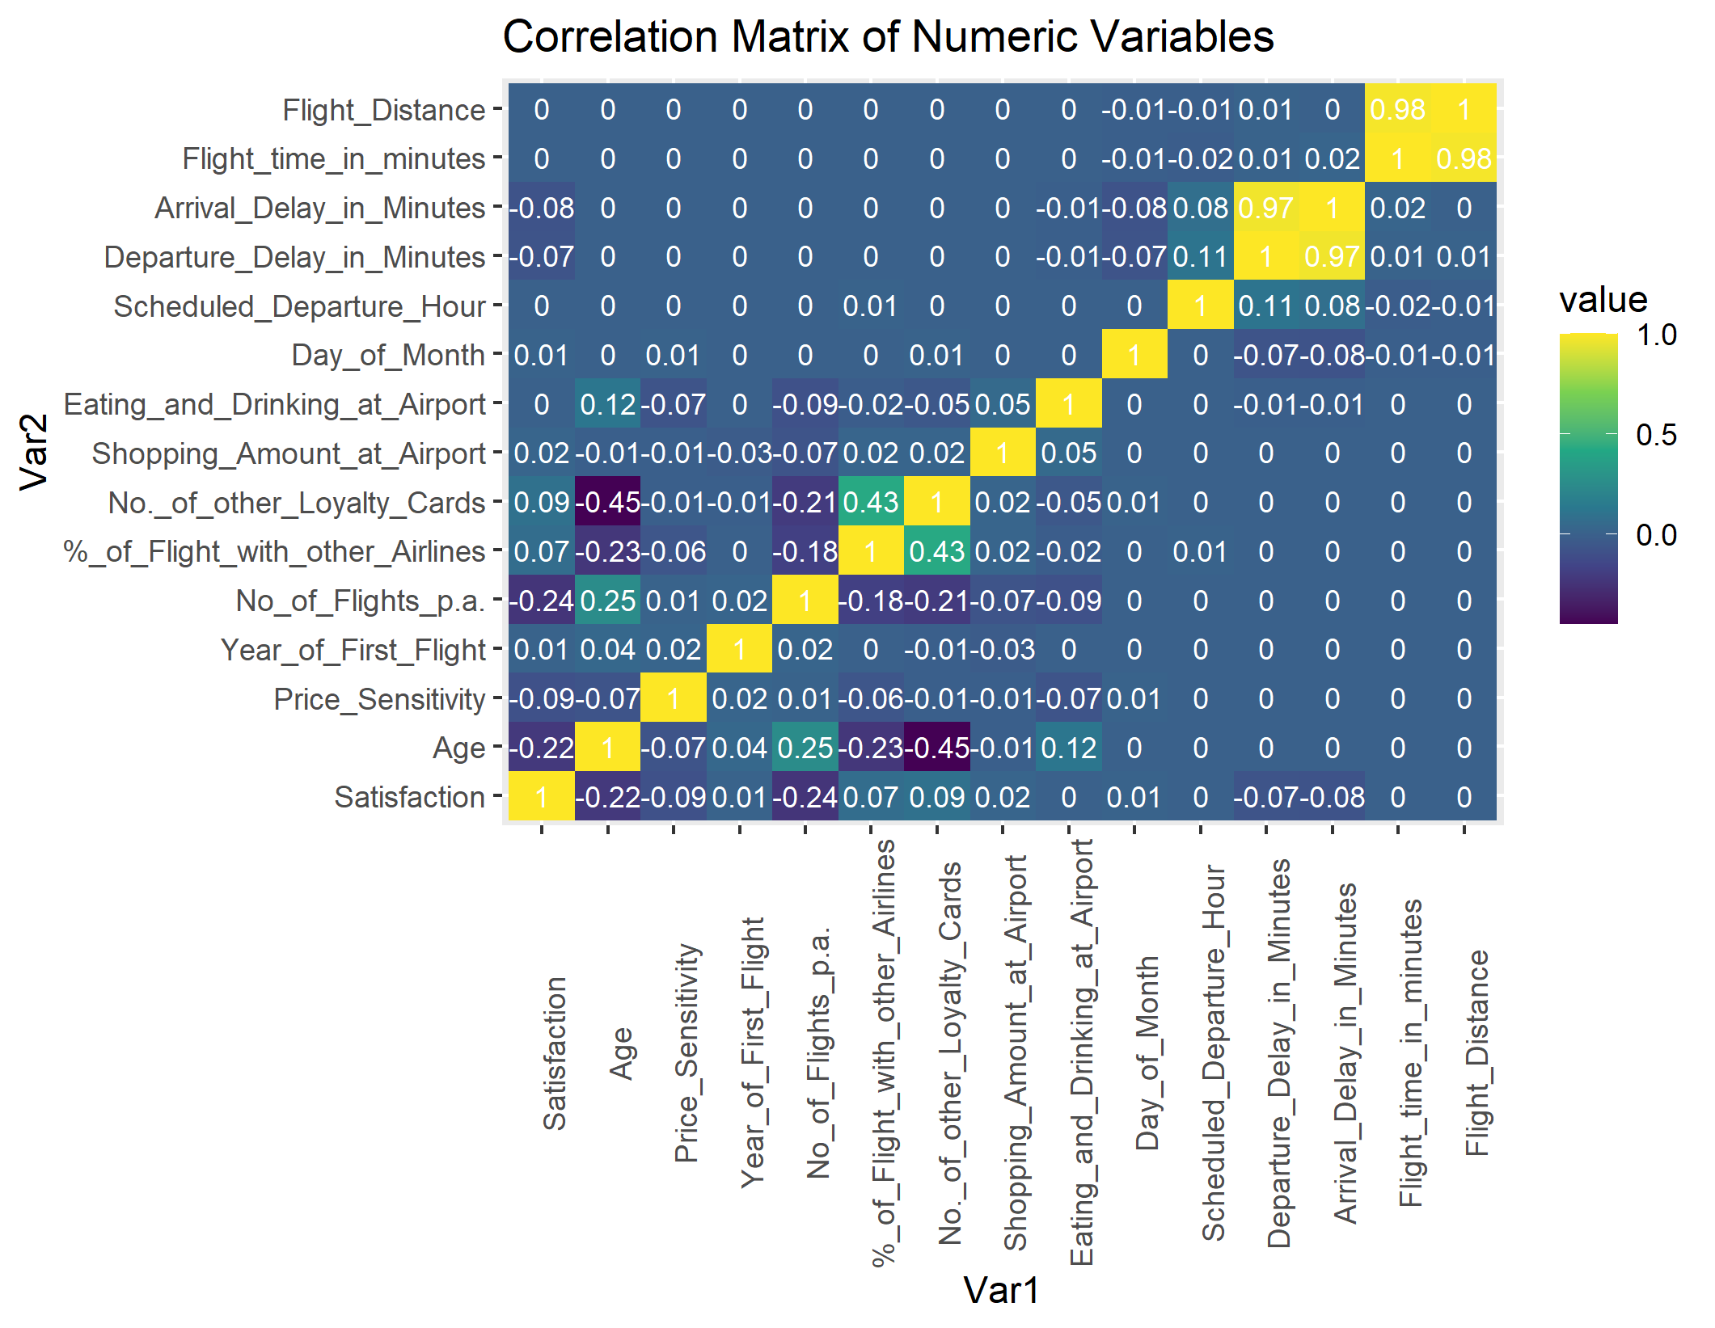
Correlations

Slide 6
Linear Regression
Top Feature across models:
Type_of_TravelPersonal.Travel – by far the most important feature across all models
Airline_StatusSilver
Age
DepDelayRatio
Flight_Distance
Flight_time_in_minutes
Gender
Airline_StatusPlatinum
Scheduled_Departure_Hour
Shopping_Amount_at_Airport
Airline_StatusGold
Price Sensitivity
Day_of_Month
Type_of_TravelMileage.Tickets

Slide 7
Gradient Boosting
Top Feature across models:
Type_of_TravelPersonal.Travel – by far the most important feature across all models
Airline_StatusSilver
Age
DepDelayRatio
Flight_Distance
Flight_time_in_minutes
Gender
Airline_StatusPlatinum
Scheduled_Departure_Hour
Shopping_Amount_at_Airport
Airline_StatusGold
Price Sensitivity
Day_of_Month
Type_of_TravelMileage.Tickets

Slide 8
Support Vector Machines
Top Feature across models:
Type_of_TravelPersonal.Travel – by far the most important feature across all models
Airline_StatusSilver
Age
DepDelayRatio
Flight_Distance
Flight_time_in_minutes
Gender
Airline_StatusPlatinum
Scheduled_Departure_Hour
Shopping_Amount_at_Airport
Airline_StatusGold
Price Sensitivity
Day_of_Month
Type_of_TravelMileage.Tickets

Slide 9
Final Recommendations
Target customers from the ages of 35 to 45 for personal travel.
Reduce the proportion of cancellations and departure delays by collaborating with airports to improve runways.
Accommodate elderly passengers with early plane entry/departure and additional assistance around the airport and into/out of the plane.
Offer special price incentives and food/drink specials onboard to the age 21-30 age group.
Attempt to corner the crushed business traveling customers.
Target younger customers to buy loyalty cards.

