Slide 1
The Cost of Doing Business
A Supermarket Services Story
Analysis Preformed by
Alec Schneider
&
Ross Conway

Slide 2
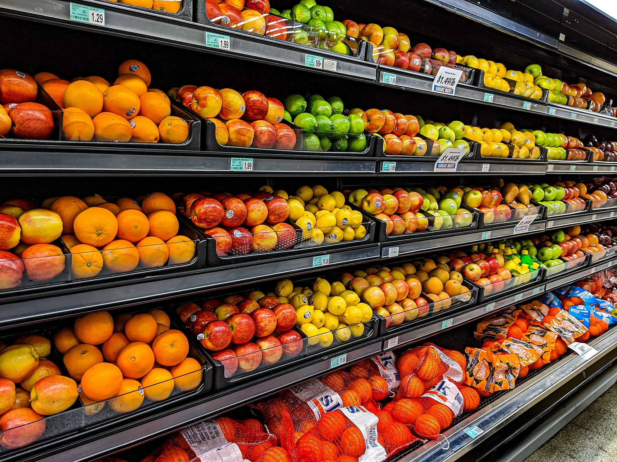
It’s More than Just the Food
Your average full-size supermarket spends $65,000 annually on operational cost not related to goods, insurance, rent or payroll. This is a story about modeling and managing those costs.

Slide 3
What happened?
In 2011 Cushman & Wakefield Services is awarded all maintenance contracts for the Ahold Corporation.
It would take a full year to transition all service lines, but by January 2012 all the Ahold Corporation’s maintenance services were managed through Cushman & Wakefield Services.
This would mark the first time that all work order data for all maintenance costs would reside in a single system of record providing never realized opportunities for data modeling and exploration.

Slide 4
Our Data Source and its Subsequent Cleaning
Our data comes from a now sun-set “WOM” or work order management system known as Corrigo. This system was built with few controls restricting users' inputs for a variety of fields leading to a data set that at best can be called challenging.
Gaps in the data pertaining to geographic and service-related fields were manually munged using a combination of general operational knowledge of the program or by being merged with the nearest geographical location.
Gaps in the cost data such as the allocation to labor vs materials were substituted using flat percentages based off the specialty and the total cost of the work performed.

Slide 5
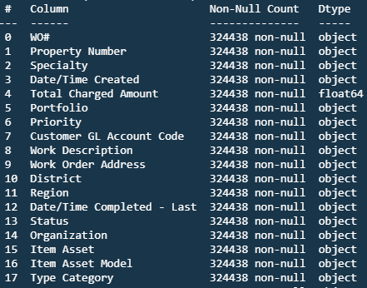
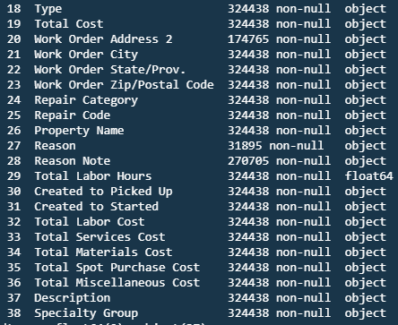
Our Data A Deeper Look
Key Terminology
Specialty: What trade does the service fall under? E.g. Landscaping, Plumbing, HVAC…
Portfolio: What brand does the supermarket operate under? E.g. Stop & Shop or Giant Food
Region: Smaller geographic regions divided by the municipalities tax codes. Provides a more granular break down than the portfolio level.
Total Cost: Is the total cost to complete the service.
Total Charged Amount: Is the amount Billed to the Ahold Corporation (typically this is a flat 9% but can vary based on regional and municipal tax codes)

Slide 6
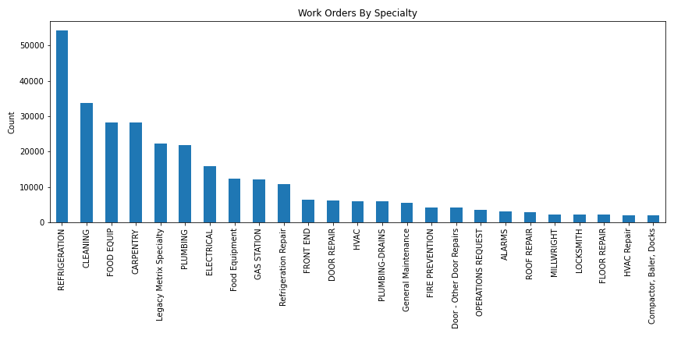
Data Exploration
The all-important 3rd step of the OSEMiN method.
Once the data was cleaned, a series of bar charts and scatterplots were produced to help visualize the data in its early stage. This early exploration brought to our attention a couple of issues when looking at the cost and volume data by specialty.
The cost data for refrigeration work orders was being housed in JD Edwards, not through the Corrigo system, and would have to be populated and reran
Defunct Specialty codes were found when doing histograms of the volumetric data

Slide 7
Preparing our Models
How did we set them up?
Forecasted monthly costs for multiple segmentations, creating Prophet and Vector Auto Regression (VAR) time series models
Work order counts and total labor hours were used as input features with total cost (the target variable)
What did we encounter and try and work around while modeling the data?
With data being limited and dirty before 2012, segments could not be modeled and would better be forecasted using historical rates
How did we do this?
Data was split by the different segmentations and passed to user defined functions to use the models to train, forecast, save, score, and plot

Slide 8
Results and Interpretation
Overall, multi-variable Prophet additive models and VAR models struggled to model the underlying trends in the data.
This is mainly due to the limitations in data management and processing of the Corrigo WOM system
Root Mean Squared Error and its % of the average monthly cost was very high after multiple rounds of tuning and additional training iterations

Slide 9
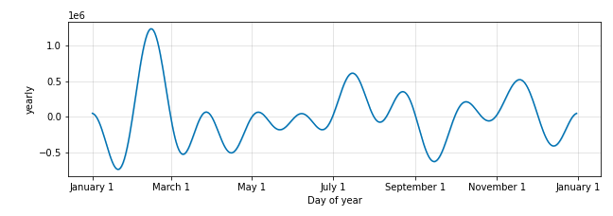
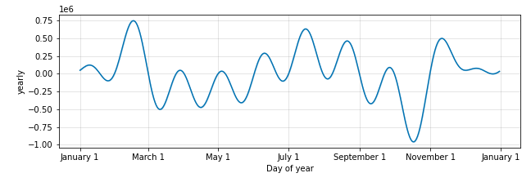
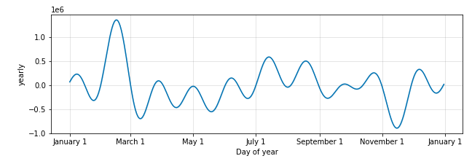
Prophet Seasonality
Stop & Shop
North
Strong seasonality was detected in the data set which at first seemed counter intuitive. Why would we be seeing seasonal variance in work order volume and cost?
Highlighted in red are spikes that seem to occur at uniform places across brands and regions with a major spike in February and again in July.
Highlighted in yellow, we can see that following the July spending there always is as dramatic reduction in spending until just before the end of the year holidays.
Central
South

Slide 10
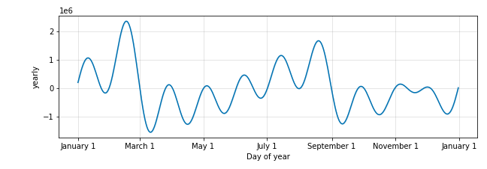
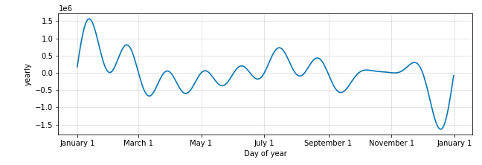
Prophet Seasonality Continued
The Giant Company
These trends held true for the Giant brands
The spikes occur before the major holidays. As discussed in class with the candy sales, we are seeing that store managers are putting in an increased volume of tickets to prepare for the influx of holiday shoppers
The higher average prices during the summer months shown in the stop and shop brand are most readily accounted for by the influx in HVAC and Refrigeration work orders from the increased loads placed on the systems by the higher temperatures. This effect is less marked in the Giant brands, as they are in more southern geographically areas.
Giant Food
Giant Martins

Slide 11
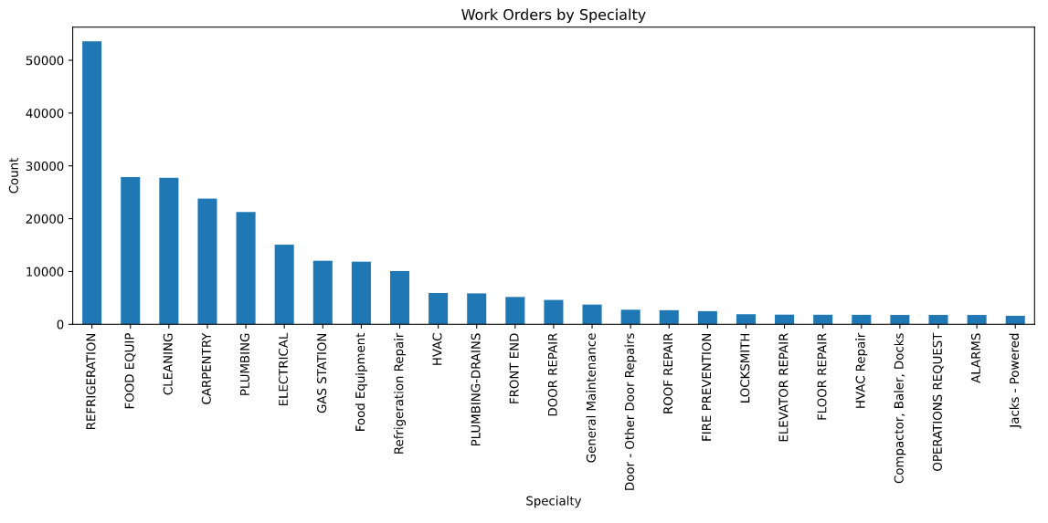
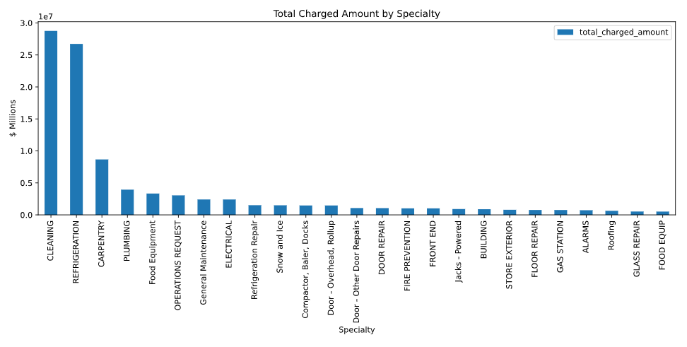
Digging into Work Order Specialty
Our initial data exploration provided us with some insight as to where to most effectively direct our attentions.
When looking at costs Floor Cleaning, Carpentry, Plumbing and Food Equipment repairs are the main cost drivers with Floor Cleaning leading by a large margin.
In terms of volume, Refrigeration, Floor Cleaning, Food Equipment, Carpentry and Plumbing act as the main drivers.

Slide 12
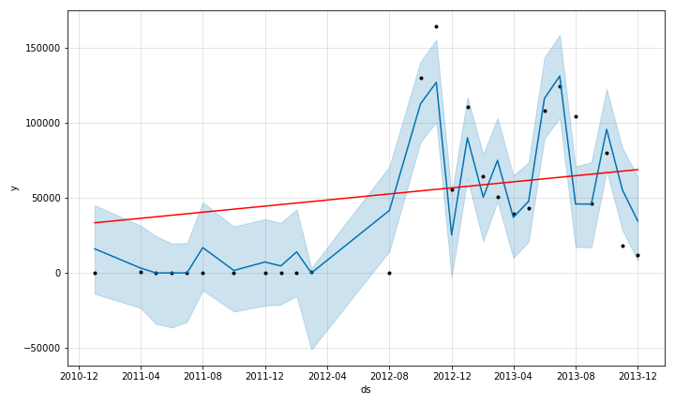
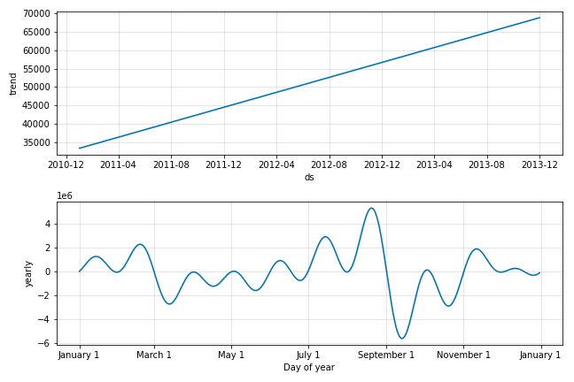
Cleaning
The daily cleanings and weekly waxing of a location with an interior area of nearly a football pitch makes this the largest cost driver and second largest volume driver
Floor cleaning coming fully online in Q2 2012 has lead to an artificially inflated slope on its trend line, our model performed relatively well considering the effect of the 2011 data.

Slide 13
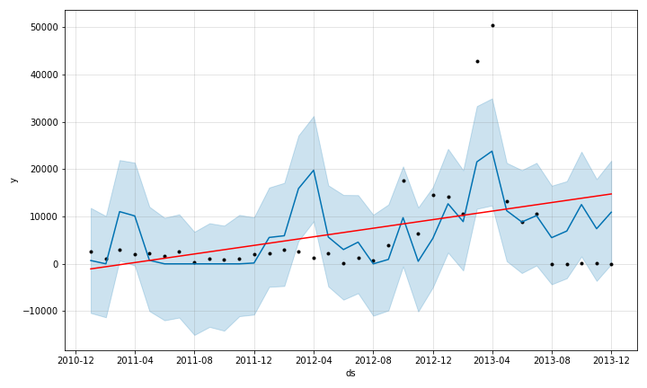
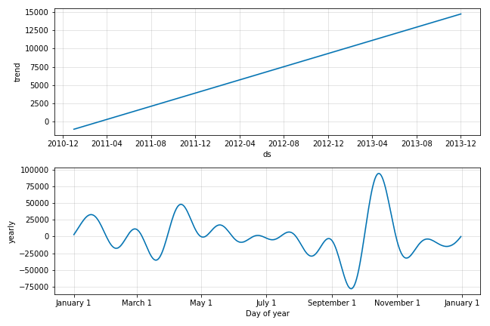
Plumbing
Plumbing repairs can occur in many places beyond the bathrooms in a supermarket, much of these costs are associated with Jetting work orders for floor drains and grease traps.
Our model displays a significant upward trending maintenance cost. In reality this issue lead to the implementation of a “One Rate Program” in a couple of markets starting in 2015.

Slide 14
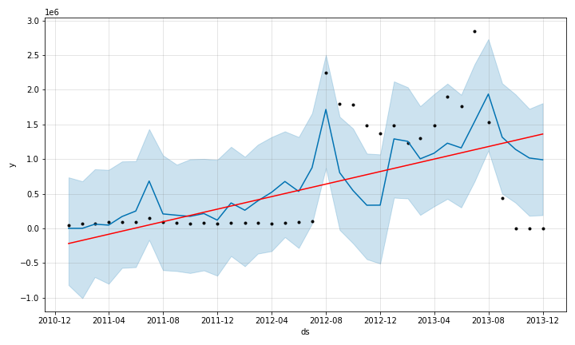
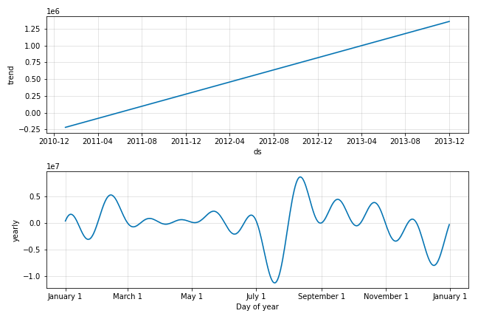
Refrigeration
There is a lot of food that you need to keep cold even though everyone insists on leaving the fridge door open all the time
Condensation is a killer and its not easy to keep those clear freezer door, clear
Eventually C&W Services bought freezer doors in bulk by the 1,000s and stored them in one of three centralized warehouses to try and mitigate the replacement costs and lag time for orders and shipment.

Slide 15
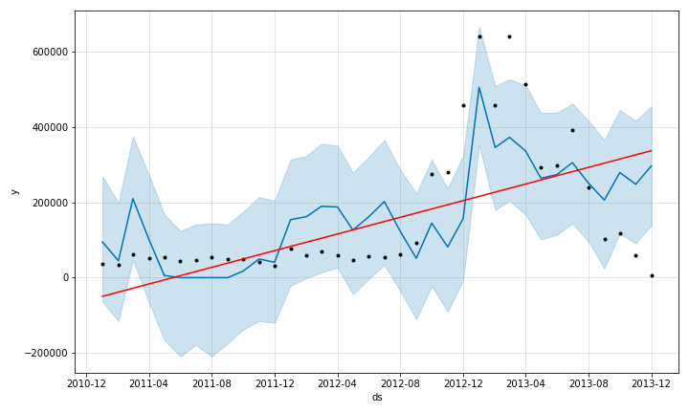
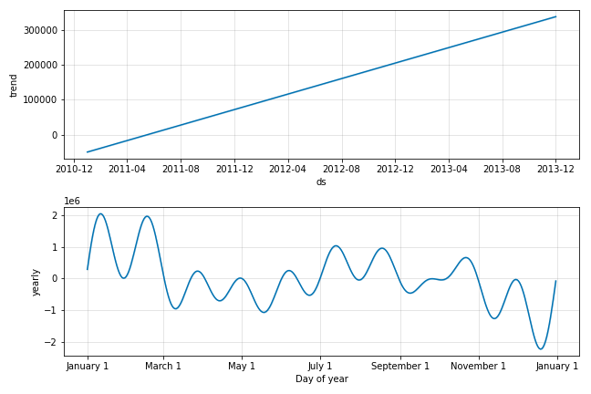
Carpentry
How much woodwork is really being done in a Supermarket? Not a lot
Store managers soon realized it was faster to just select carpentry from the general building root menu than it was working through the systems “decision tree” to the proper department repair code and specialty
Making it a catch all bucket and illustrating why good input controls are so important for accurate reporting “Garbage in Garbage Out”

Slide 16
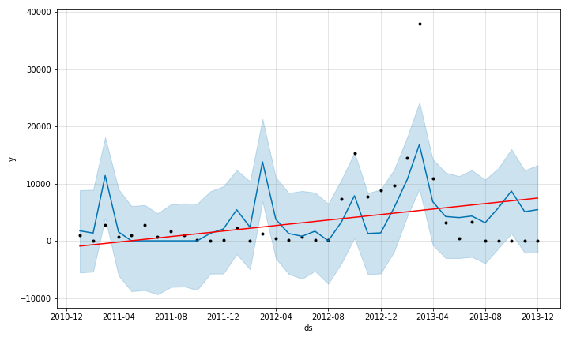
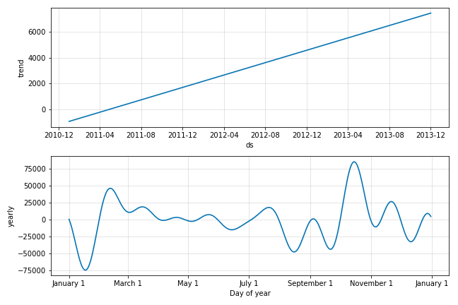
Food Equipment
How can food equipment have the second highest volume of tickets for repairs to complex specialized machinery but the lowest total cost?
The data tells an interesting story here if we drill in we can see that the vast majority of these work orders are resolved with no associated or relatively low costs. This is because food equipment is typically covered by warranty, so if it breaks there are rarely associated repair costs. If it is outside of warranty often the specialized replacement part cost nearly as much as an entire new unit so you often only see low cost parts orders approved.

Slide 17
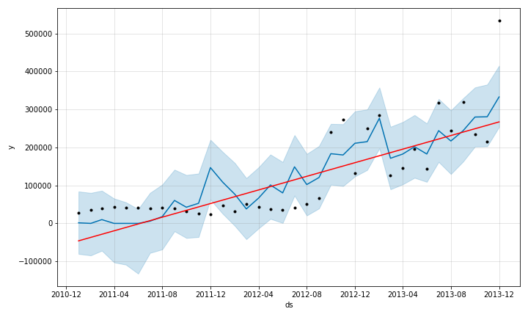
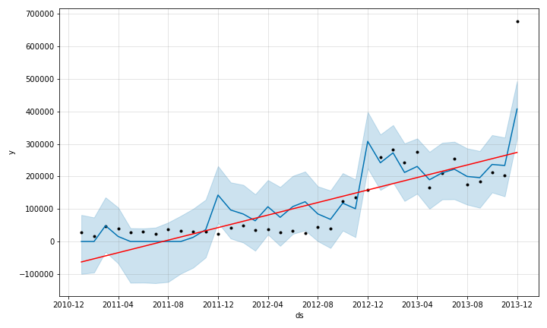
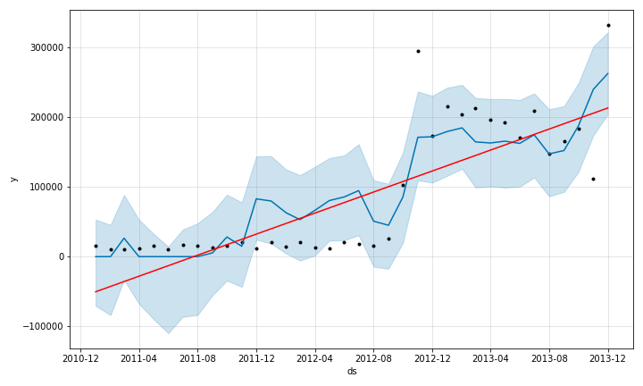
Stop & Shop
Forecast Plot with Change Points
Though we should expect an upward trend with our data, our model has predicted too steep of a trend line to be accurate. This is most readily explained by the issues previously mentioned in our narrative. The first and the most significant is that it includes an initial onboarding period that skews the predictions.
North
Central
South

Slide 18
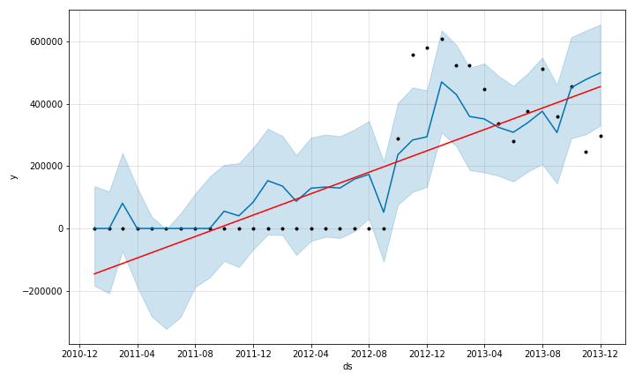
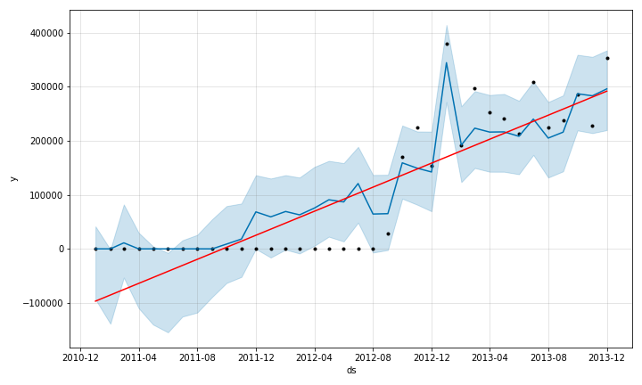
The Giant Company
The second issue is missing or miss-entered data. The system was not designed and implemented from its onset with the input controls, such as required, entry restricted fields. Catch-all “buckets” such as carpentry and general maintenance functionally lead to reduced granularity and visibility.
Giant Food
Giant Martins

Slide 19
Conclusion
Summary
Better data entry, management, and engineering is needed to collect work order data. Should be technology’s main priority in order to allow modelers to reasonably forecast important costs and work orders
Modeling discovered seasonality that was much more difficult to find at an aggregated level. This can assist the business in pre-planning maintenance across all locations in order to keep store quality high and lock in key specialists ahead of time

Slide 20
Appendix

Slide 21
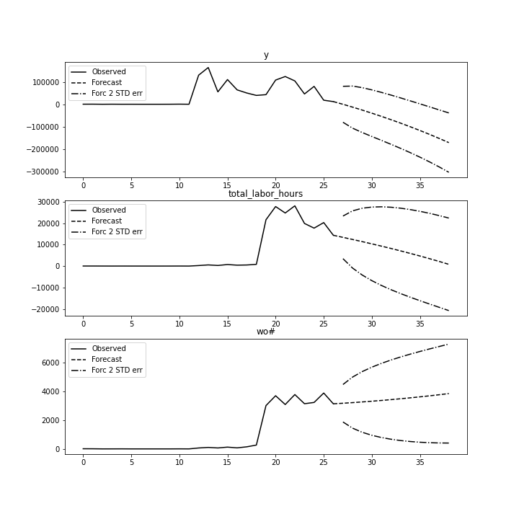
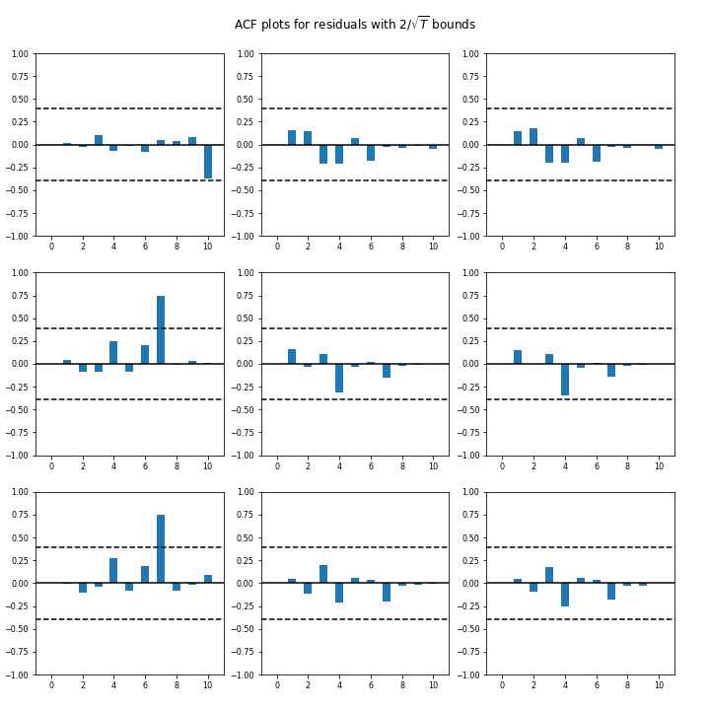
Cleaning – VAR
VAR struggles and begins to forecast negative costs

Slide 22
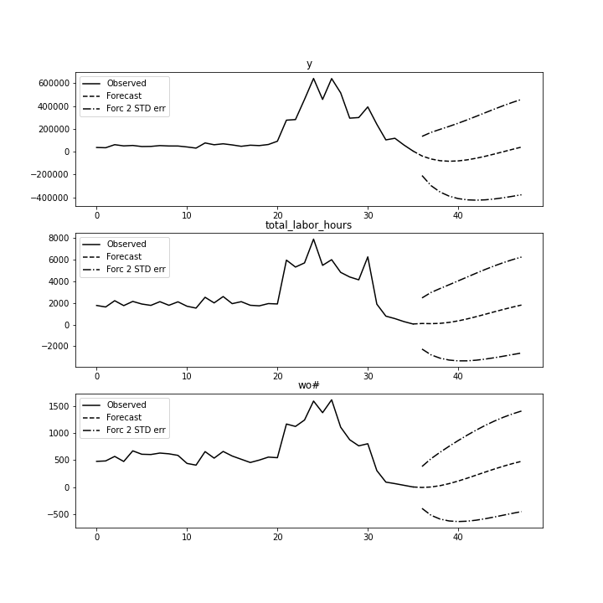
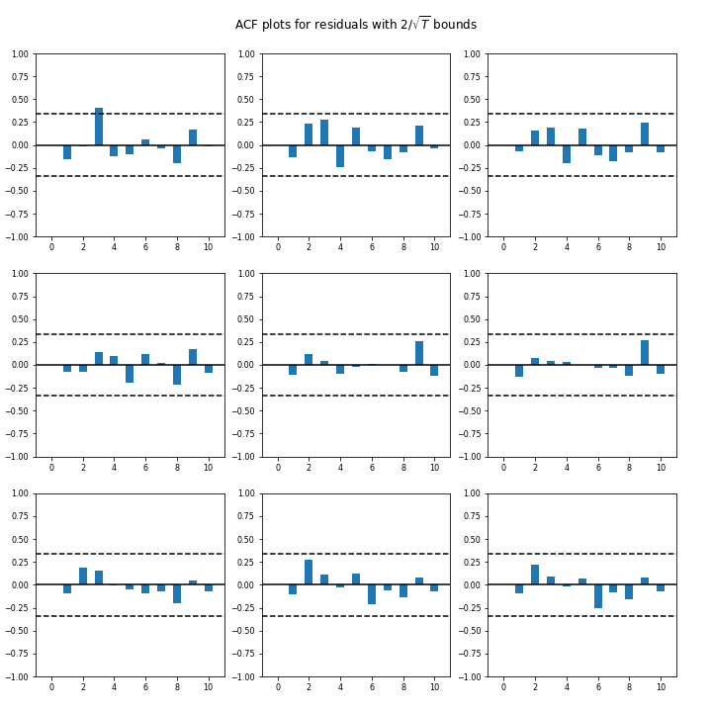
Carpentry - VAR
Again we see a struggle in trend finding

Slide 23
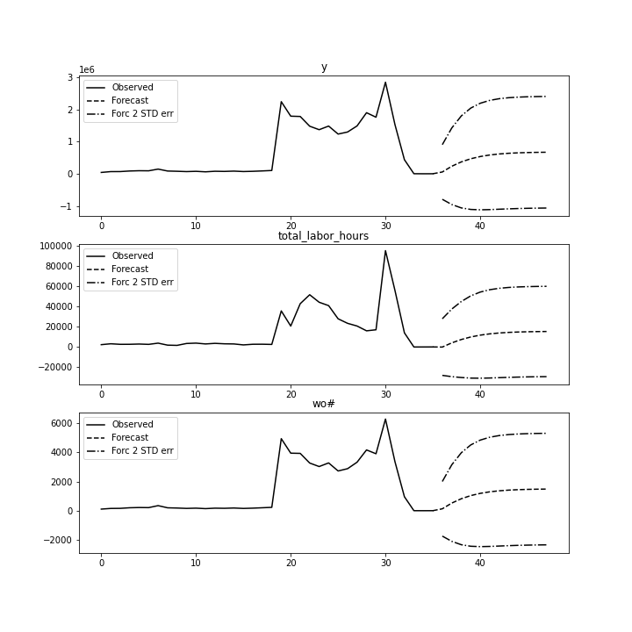
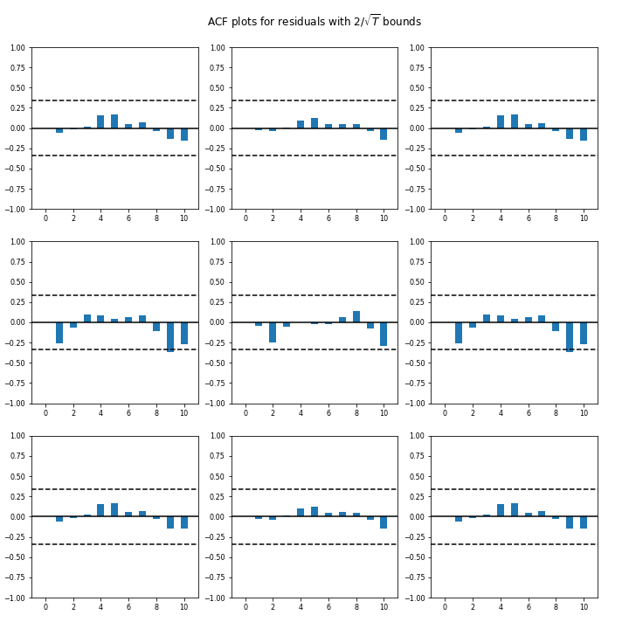
Refrigeration - VAR
Very wide 2 STD error with a struggle to adapt to recent trend

