Slide 1
University of Warsaw
Classification and Regression Tasks
Abdukholik Tukhtamishev
Ismatillaev Lochin

Slide 2
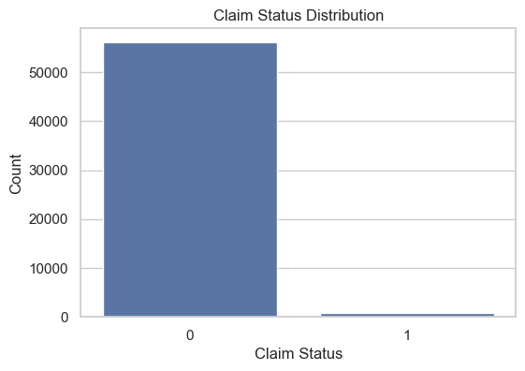
University of Warsaw
Data Preparation and Exploration
During data preparation, several columns such as person_gender, agent_id, and entity_a were removed because they did not contribute to the predictive task. The cleaned dataset retained only variables relevant for classification. Categorical variables were encoded to numerical values, and all features were standardized to ensure comparability. This careful preprocessing ensured the model would learn from meaningful patterns rather than noise or redundant information.
Upon further exploring, it has been found out that there is class imbalance in target variable with majority being 0 and very few 1

Slide 3
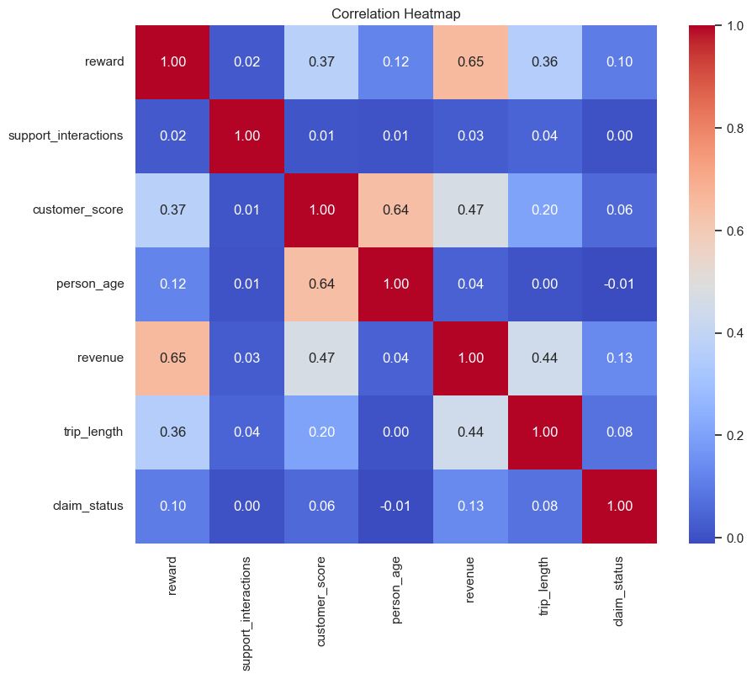
University of Warsaw
Correlation Heatmap
The features show weak correlation with `claim_status`, with the highest being `revenue` at 0.13. There is a moderate correlation between `reward` and `revenue` (0.65), and between `customer_score` and both `person_age` (0.64) and `revenue` (0.47). `Support_interactions` shows no meaningful correlation with any variable.

Slide 4

University of Warsaw
Algorithms Used
Flow of Methods
For the classification of insurance claims, several machine learning algorithms were considered: Logistic Regression, K-Nearest Neighbors (KNN), Lasso (via Logistic Regression with L1 penalty), and Ridge Classifier. The choice of these methods was driven by their complementary strengths and suitability for the problem.

Slide 5
University of Warsaw
Model Description
Logistic Regression was selected as a primary model due to its interpretability and effectiveness in binary classification tasks. It provides probabilistic outputs and allows for understanding feature importance, which is crucial in insurance contexts.
Ridge and Lasso regression variants were included to address potential multicollinearity among features and to perform feature selection. Ridge helps by shrinking coefficients of correlated variables, while Lasso can zero out less important features, improving model simplicity and generalization.
K-Nearest Neighbors (KNN) was chosen as a non-parametric method to capture possible non-linear relationships in the data and to serve as a performance benchmark against parametric models.

Slide 6
University of Warsaw
Model Evaluation
The classification models were trained using a carefully preprocessed dataset, where categorical features were encoded and all variables were standardized for consistency. Model selection included Logistic Regression, Ridge Classifier, Lasso (via Logistic Regression with L1 penalty), and K-Nearest Neighbors (KNN). Hyperparameters for each model were tuned using GridSearchCV to optimize performance.
Balanced accuracy was chosen as the primary evaluation metric to address class imbalance in the dataset, and classification reports were generated to assess precision, recall, and F1-score. Among all models, Logistic Regression with class weights set to 'balanced' and regularization parameter C=0.01C=0.01 achieved the best balanced accuracy. This model provided a strong balance between interpretability and predictive performance, making it suitable for real-world insurance claim classification tasks.

Slide 7
University of Warsaw
Main Findings
The classification project demonstrated that Logistic Regression with balanced class weights and strong regularization (C=0.01) delivered the best performance among the tested models.
This approach effectively addressed class imbalance and provided reliable, interpretable predictions for insurance claim status. The most influential features for prediction included customer score, reward, person age, and revenue, highlighting their importance in assessing claim likelihood.
These results suggest that machine learning, particularly logistic regression, can streamline claims processing, reduce manual effort, and help identify potential fraud, ultimately enhancing operational efficiency and decision-making in the insurance sector.

Slide 8

Thynk Unlimited
Home
About
Content
Others
Testing and Debugging
Testing and debugging are crucial steps in programming. Testing verifies that code functions as expected, while debugging identifies and resolves errors. By carefully testing and refining code, programmers ensure their applications are reliable, user-friendly, and free of bugs, enhancing the end-user experience.
Working Together in Code

Slide 9
Project Objective: Apartment Price Analytics
The real estate market is one of the most dynamic and influential sectors of the economy. Understanding the factors that determine apartment prices is essential for property investors, developers, and homebuyers alike. In this project, we explore a dataset of apartment listings to uncover the key variables that drive pricing.
Our primary goal is to prepare this data for predictive modeling by performing comprehensive data cleaning, feature engineering, and exploratory data analysis (EDA). This involves:
Handling missing values and irrelevant features
Understanding spatial and infrastructural variables
Identifying patterns and relationships in the data
The project serves as both a technical exercise in data preprocessing and a domain-oriented analysis of real estate pricing behavior. Ultimately, the insights gained will contribute to building a robust model for apartment price prediction.

Slide 10
Environment Setup
Environment Setup
Libraries Used:
pandas, numpy: data manipulation
plotly: for interactive visualizations
statsmodels: to calculate Variance Inflation Factor (VIF) for multicollinearity
scikit-learn: to build machine learning predective model

Slide 11
Missing Values Analysis
Missing Values Analysis
Checked missing values per column and calculated percentages.
Three categories of missingness:
>70% missing: Dropped (cond_class)
10–50% missing: Variables like build_mat, obj_type, floor_no, year_built, infrastructure_quality — considered for imputation or transformation
<5% missing: Minor gaps in key infrastructure distance features (dist_uni, dist_clinic, etc.)

Slide 12
Feature Understanding and Initial Cleaning
cond_class: Dropped due to 70%+ missingness; not useful for modeling.
Important feature types noted:
Boolean: has_lift
Distance metrics: dist_uni, dist_clinic, dist_pharma, etc.
Construction details: year_built, build_mat
Categorical data requires encoding before modeling.
Boolean fields need to be converted to 0/1 format.
Future steps will likely include one-hot encoding or label encoding.
One-Hot Encoding
Applied to categorical variables to make them suitable for machine learning models.
Converts nominal variables into binary vectors without implying ordinal relationships.

Slide 13
Feature Understanding and Initial Cleaning
Modeling Workflow:
Train/Test Split for evaluating performance.
Modeling Algorithms:
Linear Regression
Ridge and Lasso
XGboost

Slide 14
Linear Regression
Mean Absolute Error: 71601.19
Mean Squared Error: 9252667733.46
Root Mean Squared Error: 96190.79
R-squared: 0.95
After checking for ViF and dropping variables which has high collinearity:
Mean Absolute Error: 73374.18
Mean Squared Error: 9625293452.00
Root Mean Squared Error: 98108.58
R-squared: 0.95

Slide 15
Ridge regressions
Mean Absolute Error: 71611.00
Mean Squared Error: 9254117181.75
Root Mean Squared Error: 96198.32
R-squared: 0.95
Results after tuning for the best alpha:
Best alpha: 12.61856883066021
Mean Absolute Error: 71597.17
Mean Squared Error: 9252849176.40
Root Mean Squared Error: 96191.73
R-squared: 0.95

Slide 16
Lasso regressions
Best alpha: 17.47528400007683
Mean Absolute Error: 71601.51
Mean Squared Error: 9252667917.66
Root Mean Squared Error: 96190.79
R-squared: 0.95

Slide 17
XGboost
After the first hyperparameter tuning:
Mean Absolute Error: 69382.93
Mean Squared Error: 8896247392.02
Root Mean Squared Error: 94319.92
After the second hyperparameter tuning:
Mean Absolute Error: 69373.73
Mean Squared Error: 8883205830.27
Root Mean Squared Error: 94250.76
After removing features that contribute nothing or almost nothing to model performance.
Mean Absolute Error: 69284.66
Mean Squared Error: 8861477210.60
Root Mean Squared Error: 94135.42

Slide 18
XGboost
In the task of predicting house prices, several models were evaluated based on their Root Mean Squared Error (RMSE). The baseline linear regression model achieved an RMSE of 96,190.79. Removing multicollinear features using VIF slightly worsened performance, increasing RMSE to 98,108.58.
Regularization techniques showed marginal differences: Ridge regression (after tuning) resulted in an RMSE of 96,191.73, while Lasso regression produced an RMSE of 96,190.79, nearly identical to the baseline.
XGBoost, after extensive hyperparameter tuning and removal of low-importance features, delivered the best performance with a significantly lower RMSE of 94,135.42, indicating its superior predictive power compared to linear and regularized models.

Slide 19
Thank You

