Slide 1
Fashion-MNIST
Carl Edwards
Alec Yen
ECE 471: Intro to Pattern Recognition
Final Project

Slide 2
About the Dataset
The original MNIST (1998) is a popular 10 category dataset of images of 70,000 handwritten digits
Fashion-MNIST was introduced by Han Xiao, Kashif Rasul, and Roland Vollgraf in 2017 aiming to provide a more challenging classification problem: classify the fashion articles
Deep neural networks could attain 99.7% on the original MNIST
Fashion-MNIST consists of 28x28 grayscale images, 60000 training and 10000 testing
Our Motivation: Evaluate classifiers from class on a challenging high-dimensional benchmark image classification dataset and improve understanding of computer vision.
Challenges
High dimensionality (784 features)
The non-Gaussian nature of the data
Higher variation within classes than MNIST
Similar classes (e.g. coats and t-shirts)
State of the Art
The current leader, Andrew Brock, has achieved a remarkable accuracy of 96.7% using wide residual networks (WRN) in PyTorch and 8,900,000 parameters
He uses a novel technique of training networks in which he progressively freezes layers, thereby accelerating training

Slide 3
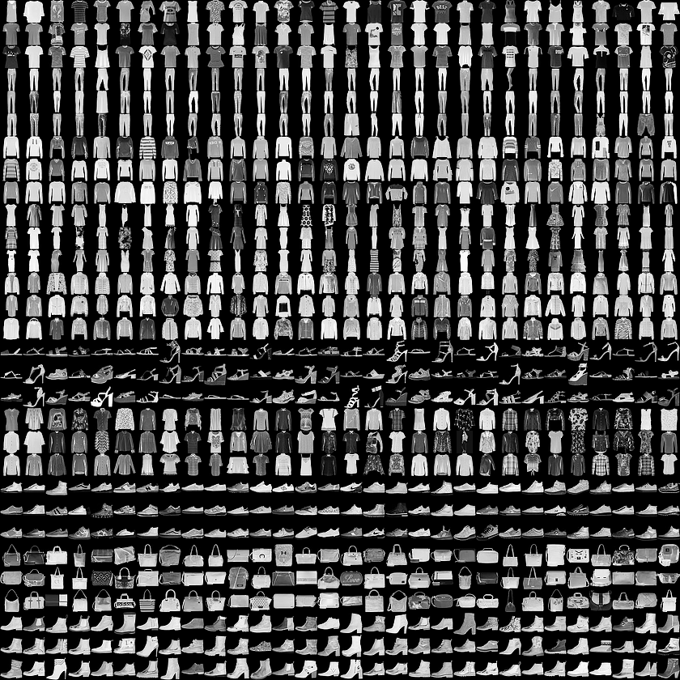
About the Dataset
The categories were as follows
0 - T-shirt/Top
1 - Trouser
2 - Pullover
3 - Dress
4 - Coat
5 - Sandal
6 - Shirt
7 - Sneaker
8 - Bag
9 - Ankle Boot
There were the same number of items in each category in the training as well as in the testing set
https://github.com/zalandoresearch/fashion-mnist/blob/master/doc/img/fashion-mnist-sprite.png

Slide 4
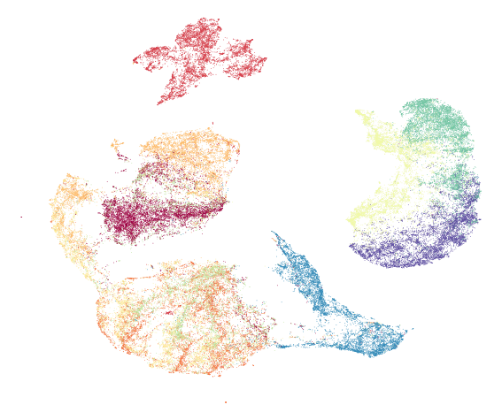
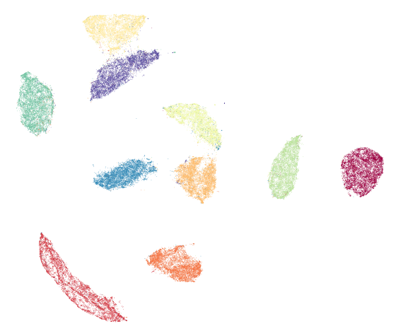
Visualizing Fashion-MNIST and MNIST
Uniform Manifold Approximation and Projection
On the left is Fashion-MNIST. On the right is the original MNIST.
Fashion-MNIST has more mixing between the classes.
https://github.com/zalandoresearch/fashion-mnist

Slide 5
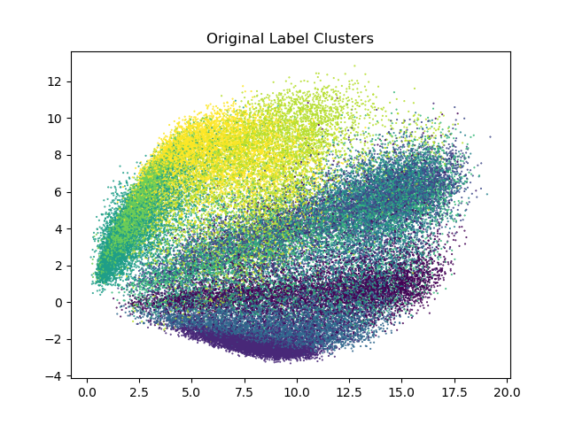
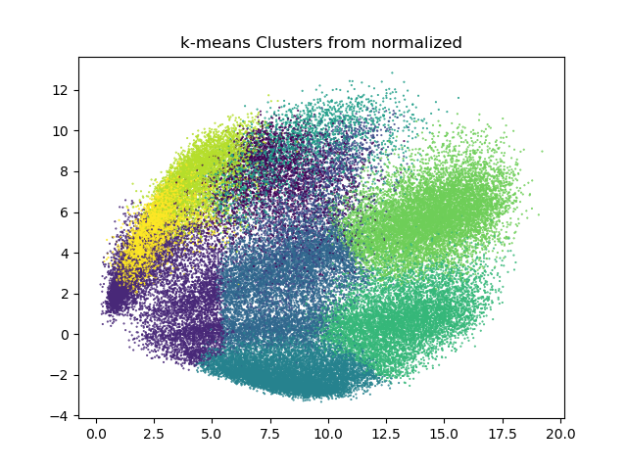
Clustering Visualization with PCA (d=2)
The number of dimensions was reduced to 2 using PCA
k-means and winner-takes-all were tested

Slide 6
Algorithm Summary
Dimensionality Reduction
PCA
FLD
Supervised Classification
Case 1 - Minimum Euclidean distance
Case 2 - Minimum Mahalanobis distance
Case 3 - Nonlinear decision boundary
k-Nearest Neighbors
Different k’s (k=5,10,20,50,100,250)
Different Minkowski distances (p=1,2,3,infinity)
Decision Trees
Backpropagation Neural Network (BPNN)
Different numbers of hidden nodes
Convolutional Neural Network
Unsupervised Classification
k-Means
Winner-takes-all
Classifier Fusion
M-Fold Cross Validation

Slide 7
Experimental Design
The data was normalized and dimensionality reduction was employed
Testing was done on the (1) normalized, (2) normalized + PCA, (3) normalized + FLD
Data was normalized by dividing by 255 (the max pixel value) and had 784 features
PCA allowed for 0.1 error, reduced dimensions to 85 features
FLD reduced dimensions to 9 features
Case I, II, and III Discriminant Functions and kNN
Accuracy was evaluated on the testing set
10-Fold cross validation
kNN was tested with different Minkowski distances (p = 1, 2, 3, and inf)
kNN was tested with different k’s (k = 5, 10, 20, 50, 100, 250)
Clustering - k-means and winner-takes-all
The algorithms separated the testing set into 10 clusters
After clustering, the most common label in each cluster was assigned to the entire cluster
Accuracy was then evaluated

Slide 8
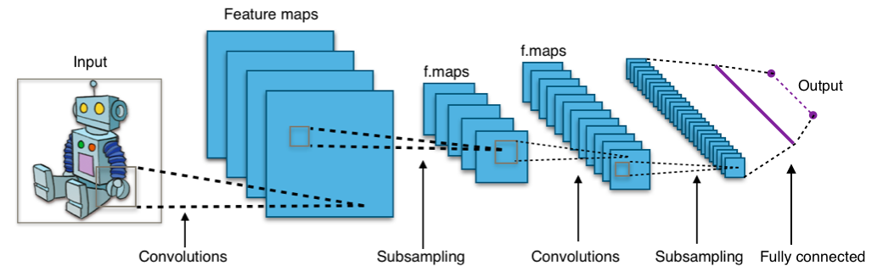
Experimental Design - Neural Networks
BPNN and CNN (convolutional neural networks) were both implemented in Keras using a Tensorflow GPU backend.
Early stopping was used with a validation split of 10% of the training data.
BPNN Testing was conducted on normalized data, PCA, and FLD.
3 layers were used. 5, 8, 10, and 15 hidden nodes were evaluated.
10-fold cross validation also used for normalized data
CNN was evaluated on normalized data.
Uses two convolutional layers, a max pooling layer, and two dense layers.
First conv. layer uses 32 filters then second uses 64 before max pooling.
Dropout is 25% after the max pooling and 50% after first dense layer.
CNN Visualization from Wikipedia
https://upload.wikimedia.org/wikipedia/commons/6/63/Typical_cnn.png

Slide 9
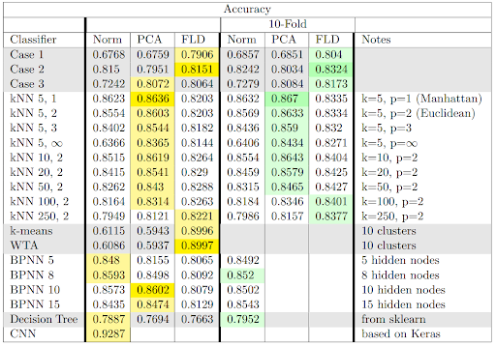
Testing Accuracies and 10-Fold Cross Validation
Norm - 784 features
PCA - 85 features
FLD - 9 features
PCA reduced the number of dimensions to 85, allowing for a maximum error of 0.1

Slide 10
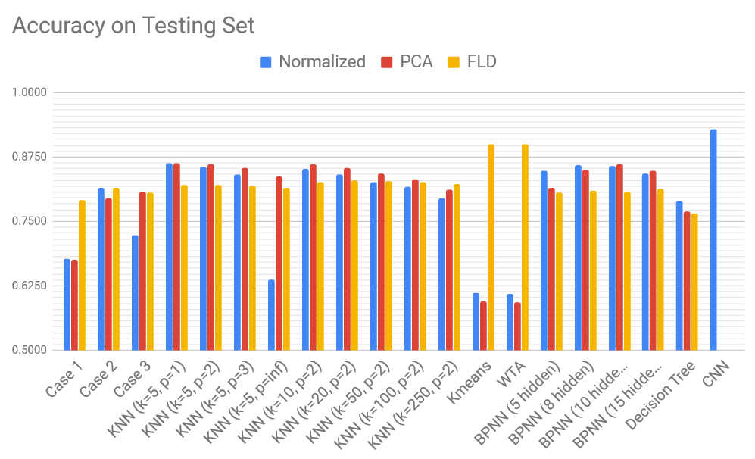
Testing Accuracies

Slide 11
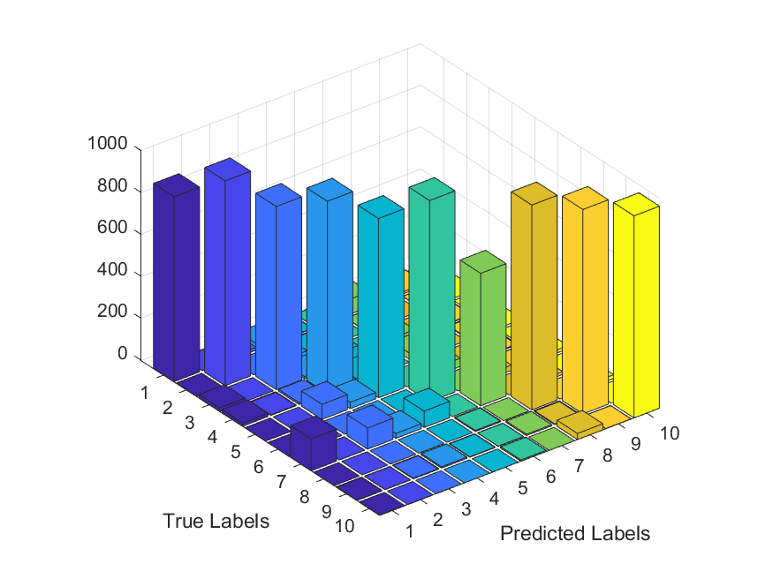
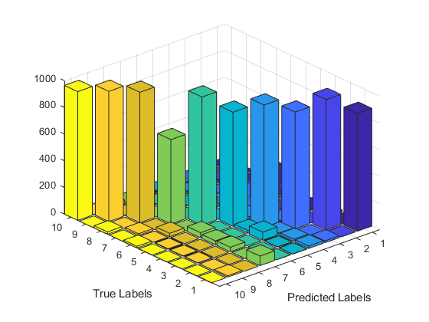
Classifier Fusion
The categories were as follows
1 - T-shirt/Top
2 - Trouser
3 - Pullover
4 - Dress
5 - Coat
6 - Sandal
7 - Shirt
8 - Sneaker
9 - Bag
10 - Ankle Boot
Classifier fusion using 3 classifiers
Using Naive Bayes Approach
Convolutional Neural Network (CNN)
Backpropagation Neural Network (BPNN) with 8 hidden nodes (using normalized)
k-Nearest Neighbors (KNN) with k=5 and Euclidean distance with PCA
Accuracy of 90.14%
Front and back of confusion matrix

Slide 12
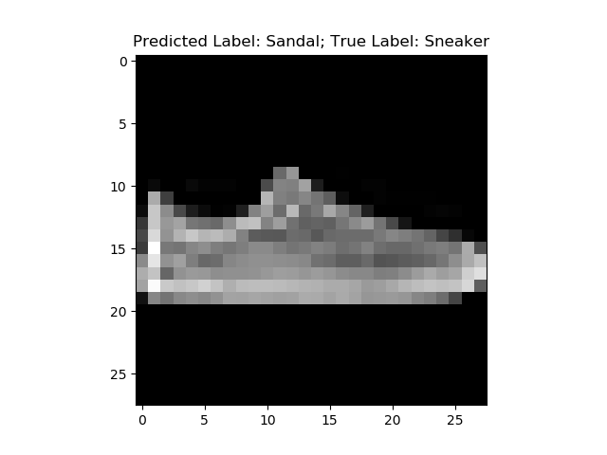
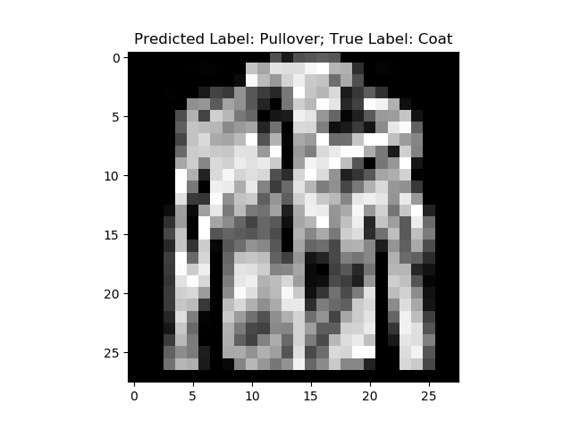
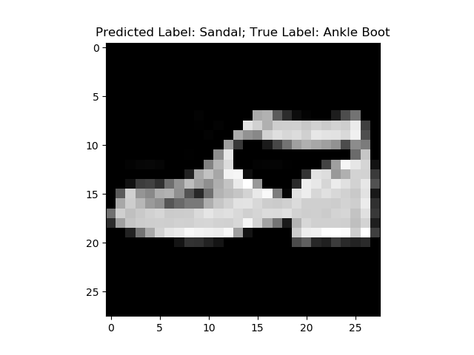
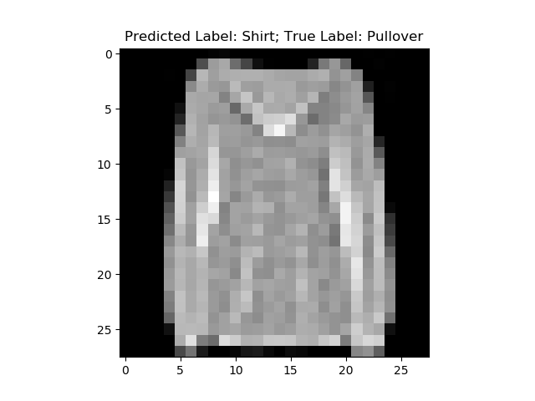
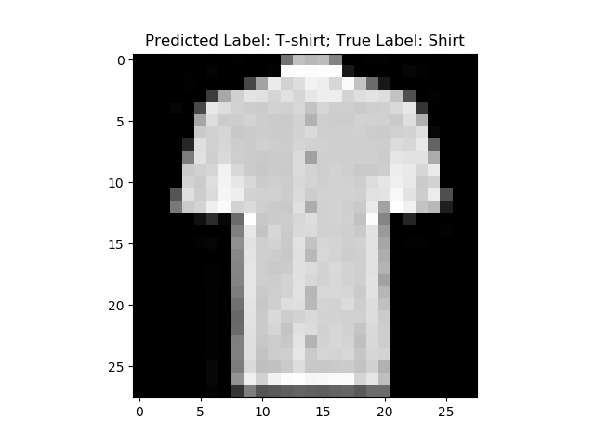
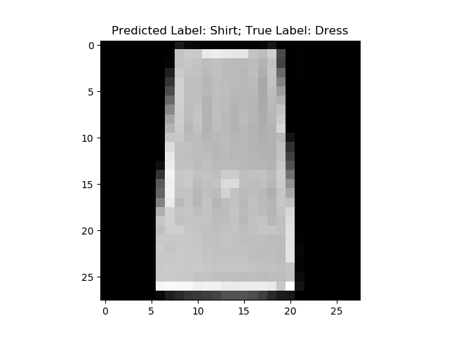
Examples of Misclassified Garments

Slide 13
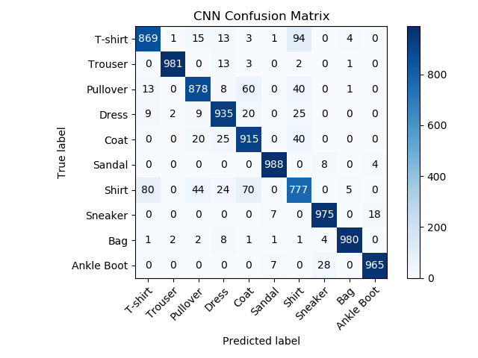
Performance Comparison
State of the Art using Wide Residual Networks | 96.7%
CNN with Normalized | 92.9%
Winner-Takes-All with FLD | 90.0%
kNN with PCA using k=5 and city block distance | 86.4%
BPNN with PCA using 10 hidden nodes | 86.0%
Case II with FLD | 81.5%

