Slide 1

AI Foundry Local
Building, Running, and Governing AI Locally
User Group Session (30–40 minutes)

Slide 2
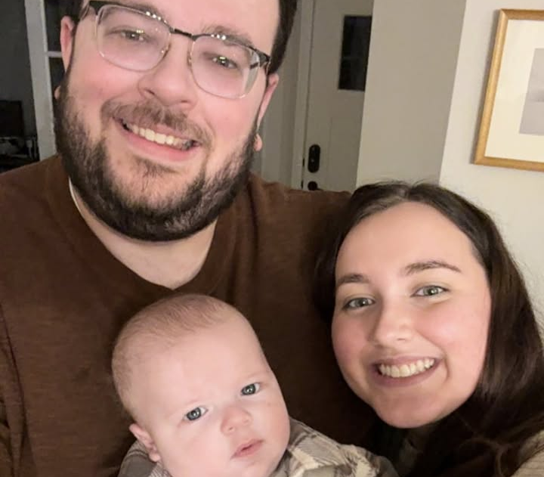

About Me
Podcast Host
Microsoft MVP in AI
Gen AI Staff Engineer
New Dad

Slide 3
Agenda
Why AI Foundry Local
What AI Foundry Local Is
Architecture Overview
Core Capabilities
Use Cases
Demo / Walkthrough
Operational & Governance Considerations
Getting Started

Slide 4
Why Run AI Locally?
Data residency and compliance requirements
Latency-sensitive workloads
Cost control for high-volume inference
Offline or edge scenarios
Security and IP protection

Slide 5
What Is AI Foundry Local?
A local deployment of AI Foundry capabilities
Run models, tools, and workflows on your own infrastructure
Consistent experience with cloud-based AI Foundry
Designed for enterprise and regulated environments

Slide 6
Core Components
Model hosting and inference runtime
Prompt and workflow orchestration
Evaluation and monitoring
Security and access controls
Integration with existing apps and data

Slide 7
High-Level Architecture
Local compute (VMs, Kubernetes, or on‑prem servers)
Model registry and artifact storage
API layer for apps and services
Observability and logging
Optional cloud connectivity

Slide 8
Model Support
Open-source models (e.g., LLMs, embeddings)
Fine-tuned or custom models
Versioning and lifecycle management
Bring-your-own-model flexibility

Slide 9
Prompt & Workflow Management
Centralized prompt templates
Reusable chains and tools
Environment-specific configurations
Version control for prompts

Slide 10
Evaluation & Quality
Offline and online evaluation
Regression testing for prompts and models
Human-in-the-loop review
Metrics for accuracy and relevance

Slide 11
Monitoring & Observability
Inference latency and throughput
Token usage and cost estimation ($0.00)

Slide 12
Security & Governance
Local data control
Role-based access control
Audit logging

Slide 13
Common Use Cases
Internal copilots and assistants
Document processing and summarization
Code analysis and generation
Edge or disconnected environments
Regulated industry workloads

Slide 14
Example Workflow
User request hits internal app
App calls AI Foundry Local API
Model processes data locally
Response returned

Slide 15
Demo (Optional)
Deploy
Deploy a local model
Create
Create a prompt
Run
Run an inference
Review
Review logs and metrics

Slide 16
Operational Considerations
Hardware sizing and GPU selection
Scaling strategies
Upgrade and patching process
Backup and recovery

Slide 17
Local vs Cloud AI Foundry
Local: control, compliance, low latency
Cloud: elasticity, managed services
Hybrid approaches are common
Choose per workload

Slide 18
Getting Started
Identify target use case
Select hardware and runtime
Deploy AI Foundry Local
Pilot with a small team
Iterate and scale

Slide 19
Best Practices
Start with evaluation early
Treat prompts as code
Monitor usage continuously
Plan for governance from day one

Slide 20
Common Questions
https://learn.microsoft.com/en-us/azure/ai-foundry/foundry-local/what-is-foundry-local?view=foundry-classic&viewFallbackFrom=foundry

Slide 21
Roadmap & Future
Expanded model support
Improved tooling and automation (prompty)
Deeper hybrid integrations
Community and ecosystem growth

Slide 22
Q&A
Questions
Discussion
Share experiences

