Slide 1




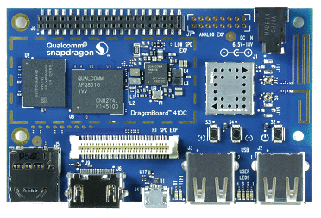
POST
Invoke
UPDATE
SUBSCRIBE
PUBLISH
GET
Invoke
GET

