Slide 1



Point of Care: Modernizing Bedside Charting for Rural Hospitals with HL7v2 Interoperability
Software Requirements Specification
Nick Fauber, Kayla Granger, Alec Howard, Saph Mabalot

Slide 2
Introduction
Purpose: Defines the requirements for DataBridge, a browser-based bedside documentation system for rural hospitals on legacy MEDITECH platforms.
Audience: Development team, Project Mentor and Course Evaluators
Scope:Nurses enter vitals and notes on a tablet instead of paper. Each entry is converted into an HL7v2 message and sent to a simulated EHR receiver. Goal is to reduce delays and errors from double documentation.

Slide 3
Overall Description
Product Perspective: A lightweight layer between the nurse and the hospital’s existing EHR. Made up of a table frontend, a backed that validates and converts data and a receiver.
User Classes:
  Nurse: Primary user, documents vitals for assigned patients
  Charge Nurse: Views the full unit census
  Administrator: Manages users and reviews audit logs.
Operating Environment: Web browser on iPad or desktop. Backend in Python with FastAPI
Constraints: No live hospital access, synthetic data only, HL7v2 used because legacy MEDITECH uses it.
Assumptions: Relies on open-source HL7v2 libraries, Synthea for synthetic data, and free tier hosting.
User Documentation: Short user guide for nurses and an administrator guide.

Slide 4
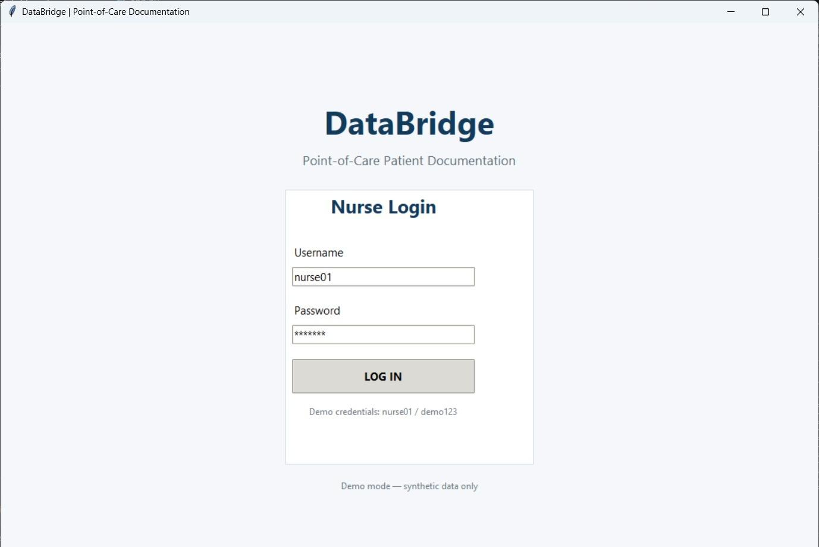
External Interface Requirements

Slide 5
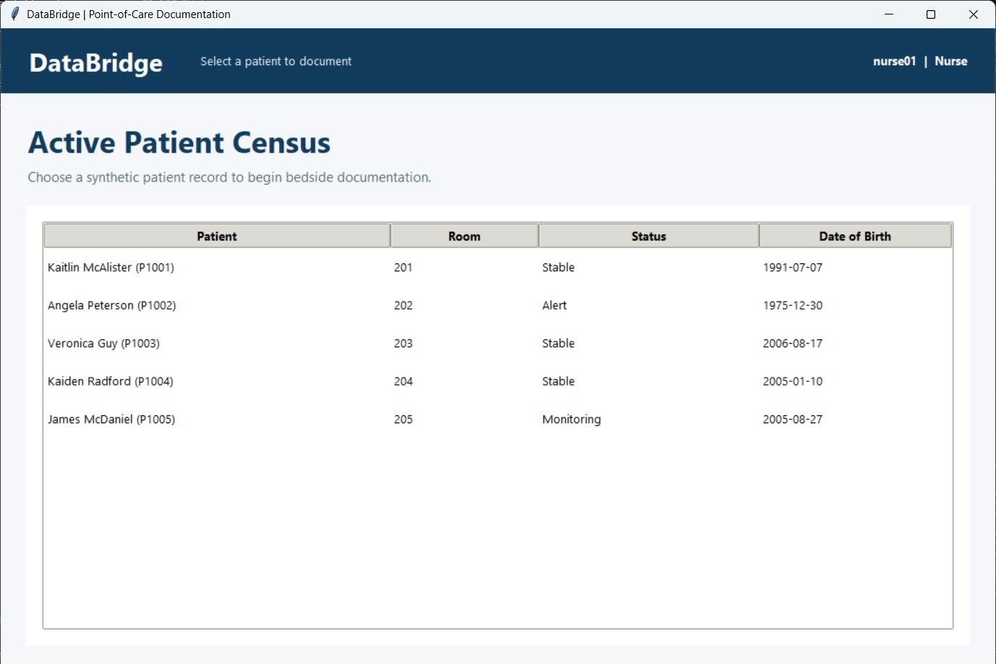

Slide 6
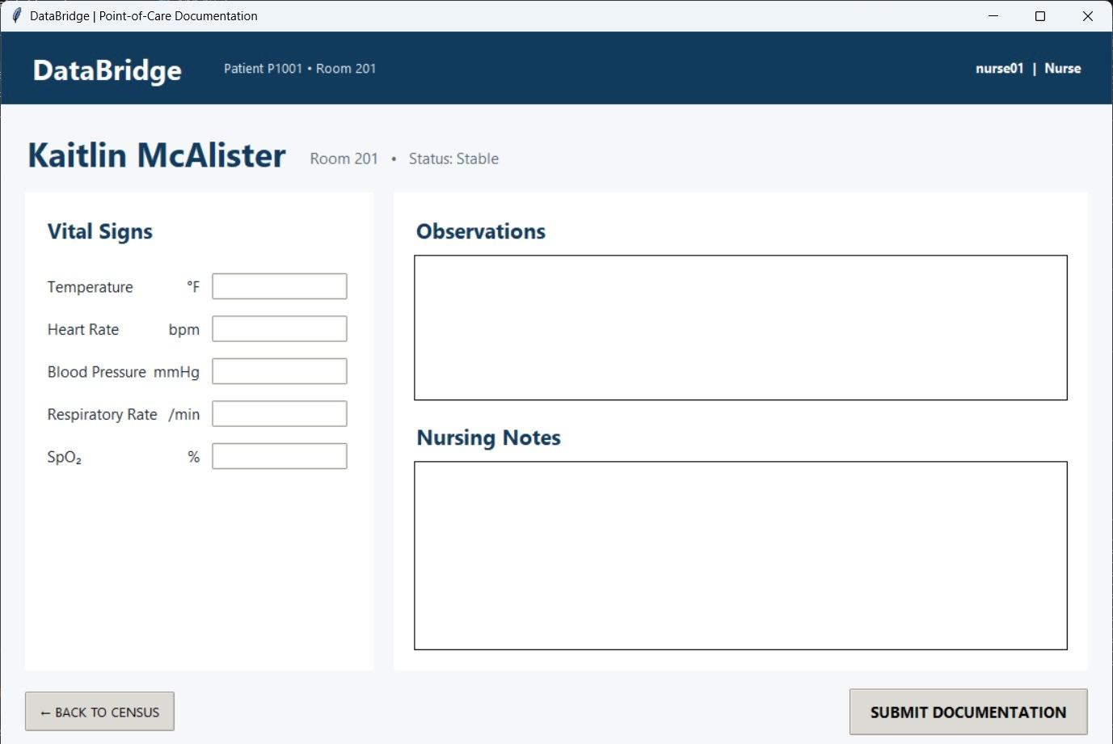

Slide 7
System Features
High Priority:
  User Authentication
  Role-Based Access Control
  Bedside Documentation
  Backend Validation and Processing
  HL7v2 Message Generation
  Simulated EHR Receiver
Medium Priority:
  Audit Logging
  Document Upload, Classification, and OCR
  Secure Document Transfer

Slide 8
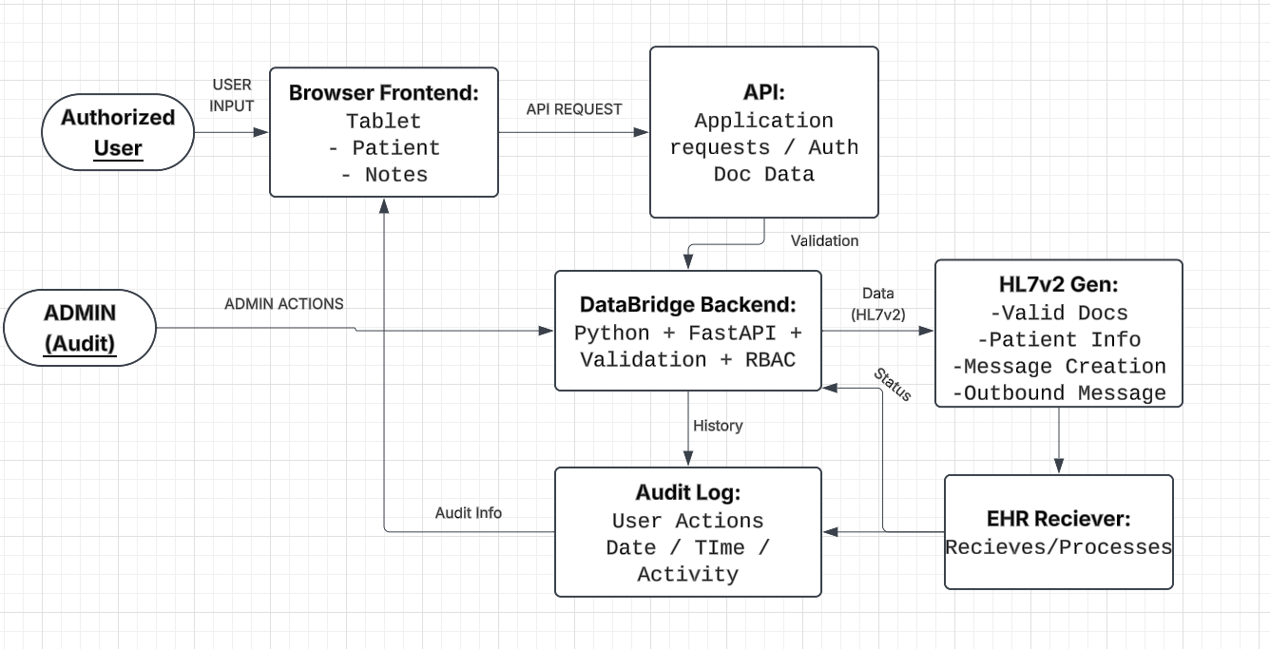

Slide 9
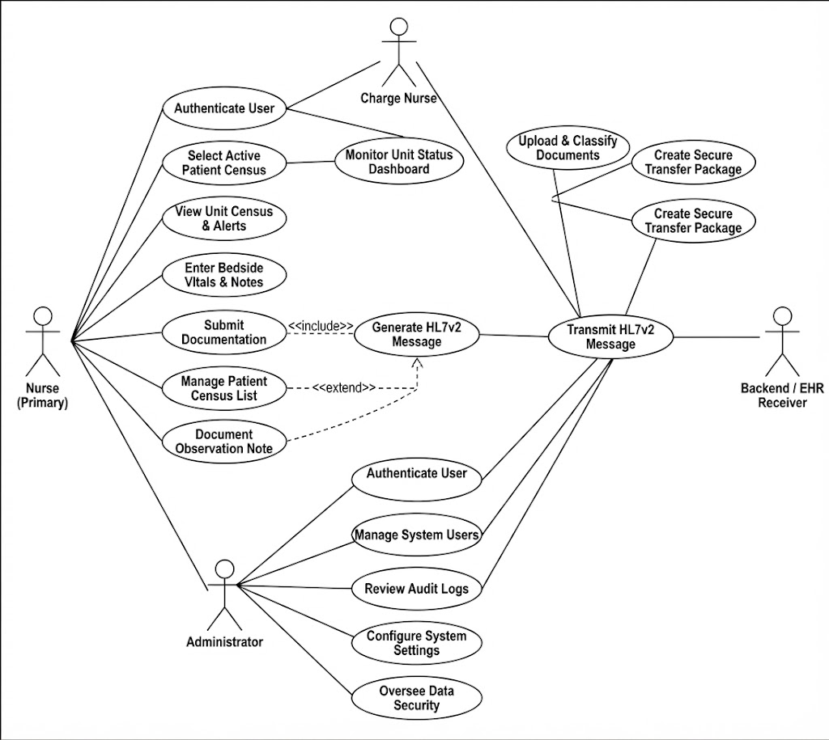
Use-Case Main Structure

Slide 10
Other Nonfunctional Requirements
Performance: Responsive interface: feedback after submission, full workflow runs without manual steps.
Safety: No diagnoses or treatment recommendations. Invalid data is blocked. Synthetic Data only.
Security: Password plus MFA, role-based access with least privileged, encryption in transit and at rest, audit logging, expiring securing sharing links. HIPAA-aligned but not HIPAA-certified.
Quality Attributes: Easy to use on a tablet, reliable error handling, HL7v2 interoperability, separated components, testable with synthetic data.
Business Rules: Users must log in, every user has a role, users only access what their role allows, documentation is tied to the user and patient, simulated receiver used instead of live EHR

Slide 11

Thank you for listening!
GITHUB:

