Slide 1
CSCE 576
Android Application APARTMENT MATE

Slide 2
PROJECT MODULES
Modules Involved In The Project Are :
ADMIN
MANAGER
RESIDENT

Slide 3
ADMIN MODULE
Tasks Include :
Renders the application to the administration of an apartments.
Creates manager accounts by creating ausername and password.

Slide 4
MANAGER MODULE
Represents the administration of the apartments.
Creates Resident accounts.
Receives complaints, posts reminders, updates calendar with events etc.

Slide 5
RESIDENT MODULE
Can login into the application by providing the username and password given to him by the manager.
Resident can lodge complaints, receive reminders, can look at calendar events etc.

Slide 6
FUNCTIONALITY OF RESIDENT MODULE
Post in the blog
Make Parking Requests
Look up the calendar events
Receive response for the complaints

Slide 7
FUNCTIONALITY OF RESIDENT MODULE
Receive notifications(reminders) from the manager
Lodge complaints

Slide 8
ADMIN ACTIVITIES
Admin can add new managers.
Assign them user name and passwords
View and manage managers already registered.

Slide 9
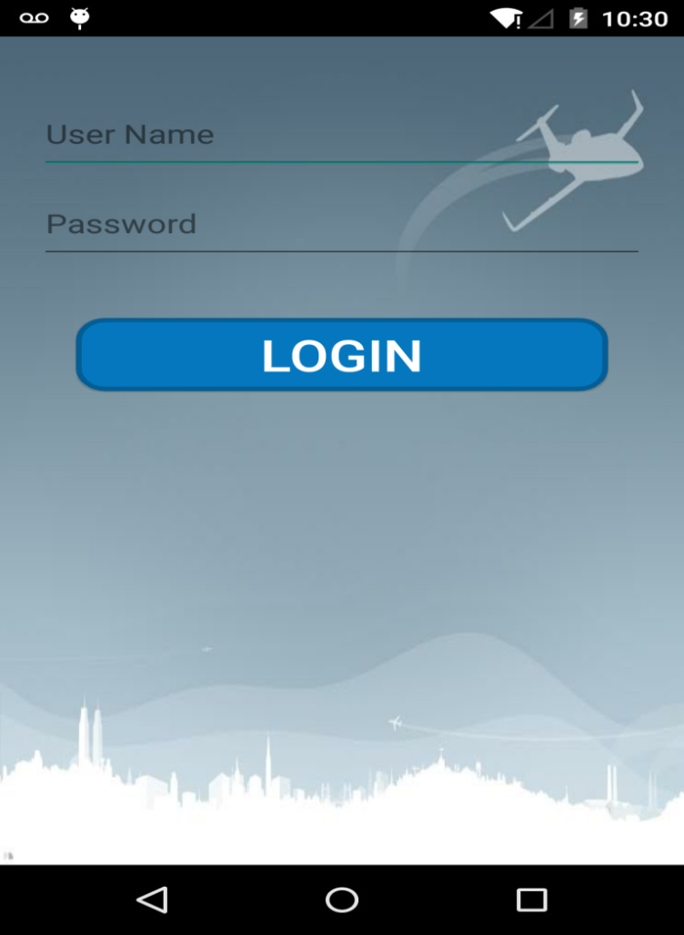
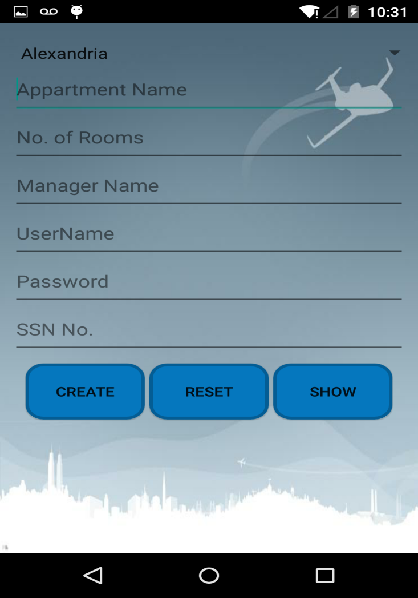
COMMON LOGIN FORM
ADMIN LOGIN
MANAGER REGISTRATION

Slide 10
MANAGER ACTIVITES
Add residents and assign them username and passwords.
Post important information on blog for social conversation and opinion purposes.
Allocate parking slots to residents.
Make calander entry of events .
Receive compliants from residents and respond to them.
Set reminders.

Slide 11
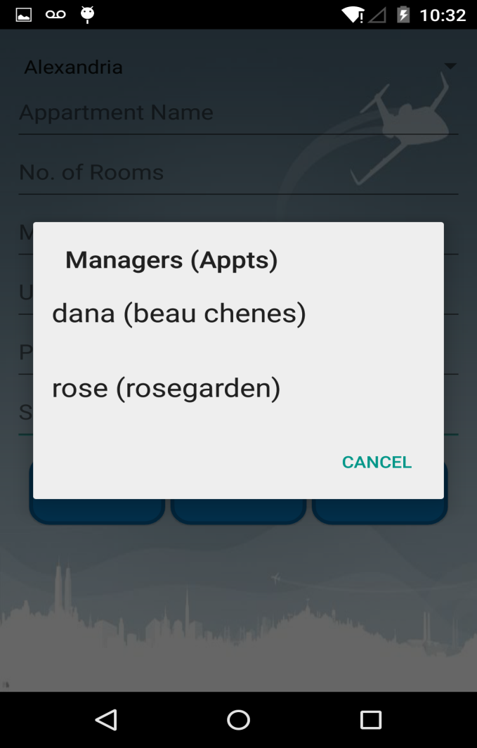
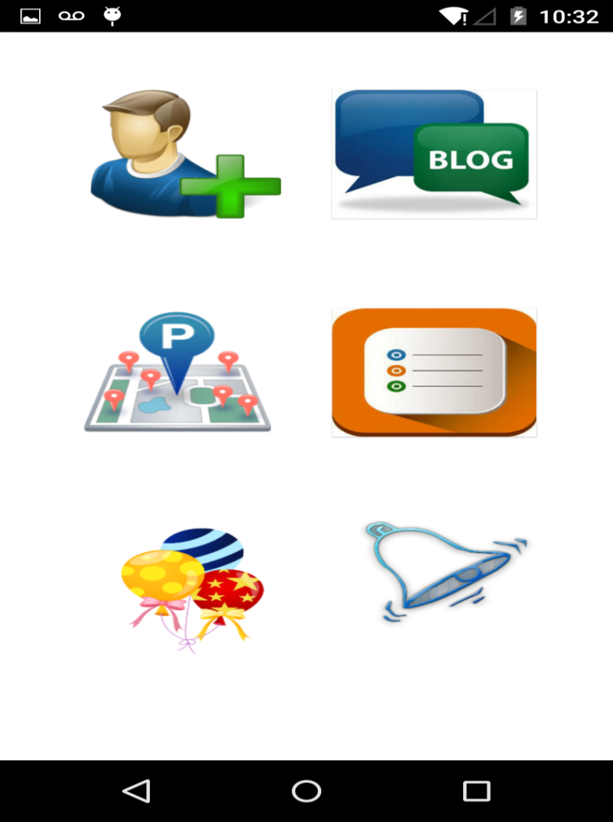
MANAGER USER INTERFACE
LIST OF MANAGERS
MANAGER MODULE

Slide 12

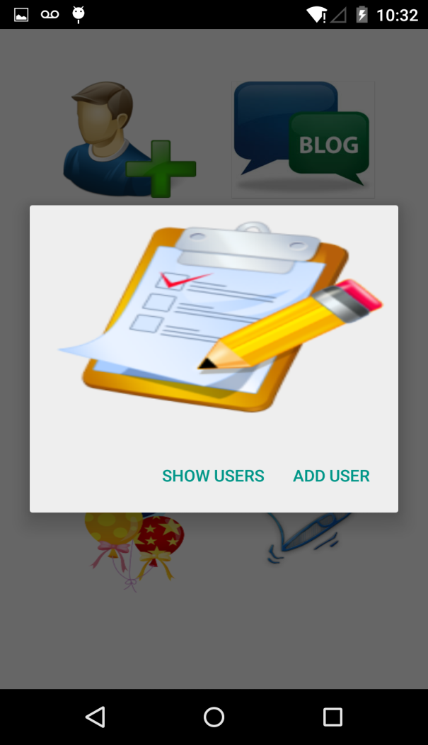
ASSIGNING USERNAMES AND PASSWORDS FOR RESIDENTS IN APPARTMENT BY MANAGER
MANAGER MODULE ACTIVITIES
ADDING USERS

Slide 13
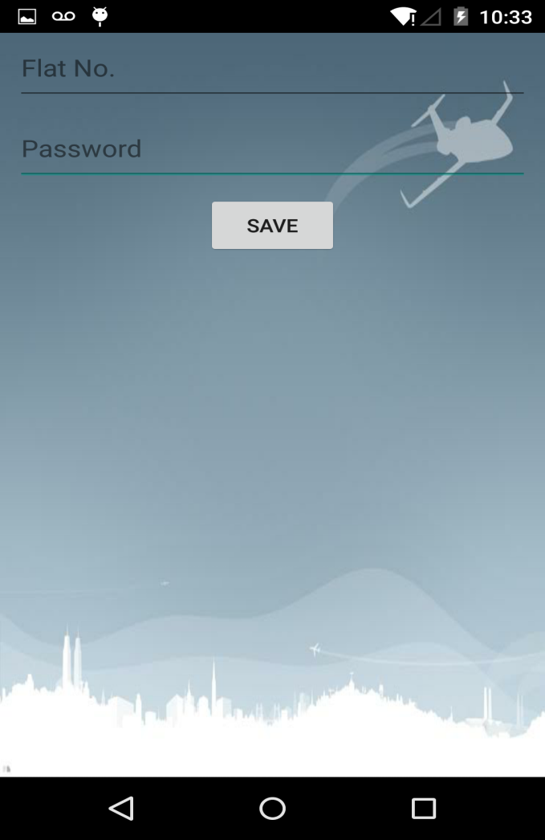

ASSIGNING RESIDENTS USERNAME AND PASSWORDS
ASSIGNING USER NAME AND PASSWORD
USER LOGIN MODULE

Slide 14
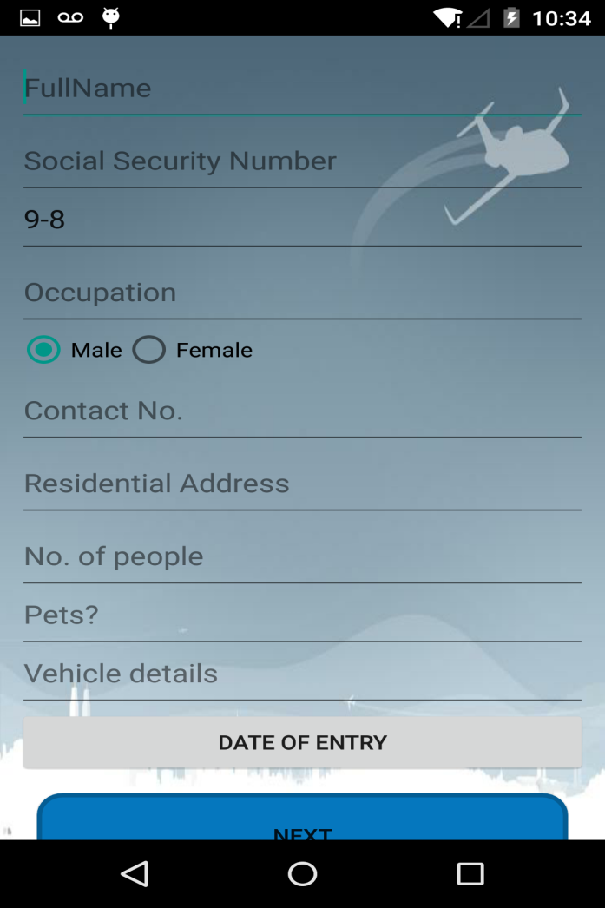
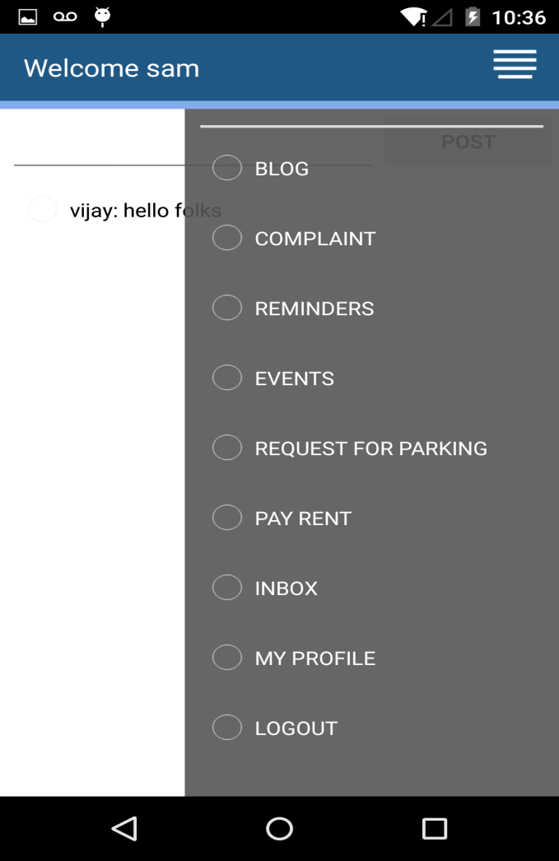
USER MODULE
USER INFORMATION ENTRY
USER MODULE

Slide 15
BLOG ENTRY
Blog entry can be two way
A manager can post any useful information on the blog which can be viewed by all the residents of the appartments.
Any resident can respond to that information and it can be used for social conversation.

Slide 16
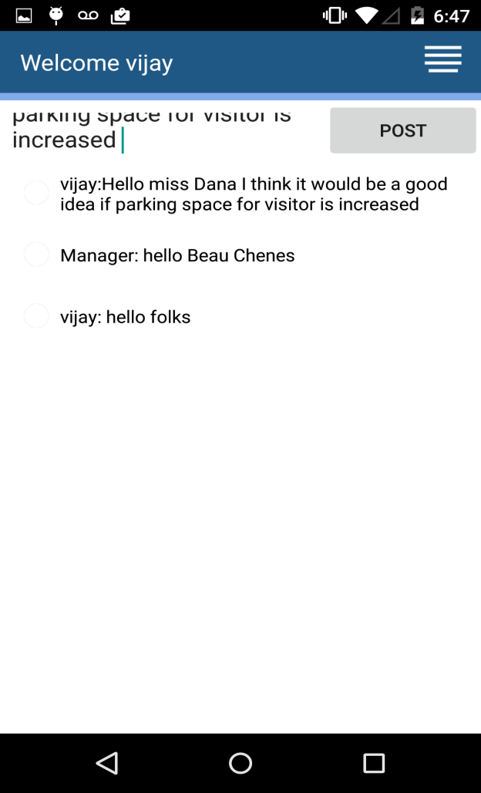
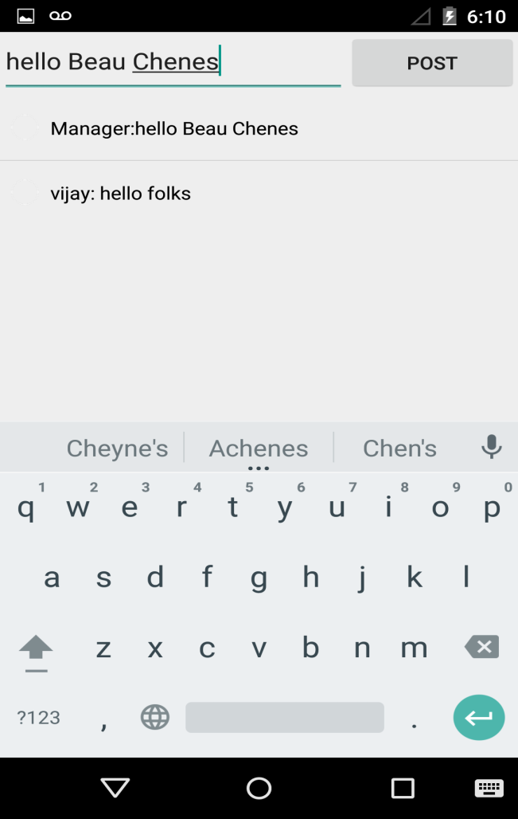
BLOG ENTRY
BLOG POSTINGS

Slide 17
PARKING REQUEST
Resident can request for parking space and this task consists of two phases
Resident requests for parking space by entering their vehicle details.
Manager responds to those requests by verifying the authenticity of the request.

Slide 18
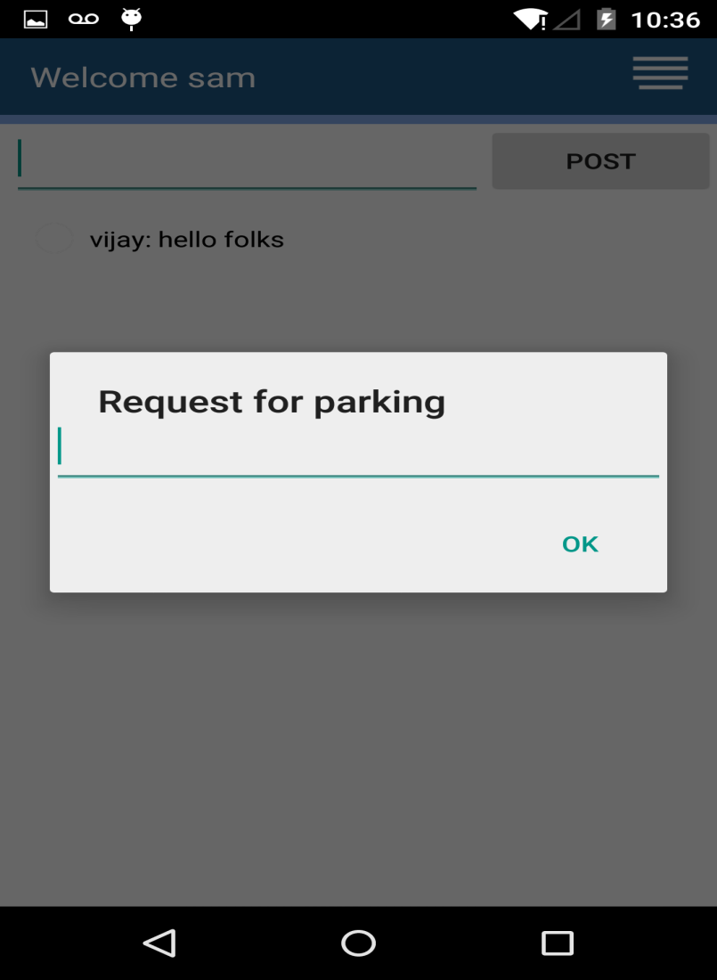
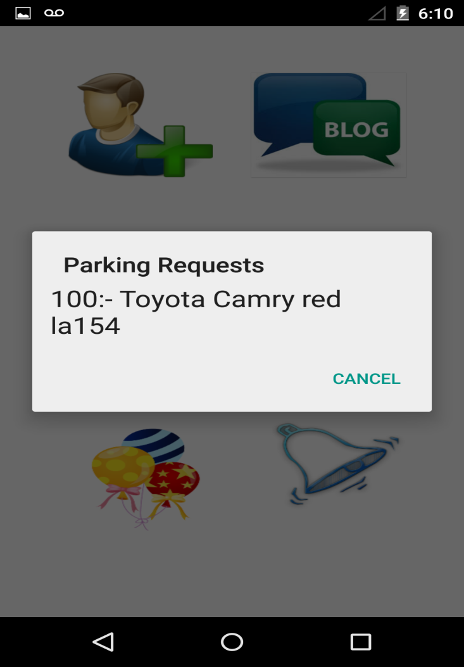
PARKING REQUEST
USER REQUESTING FOR PARKING SLOT
MANAGER SIDE VIEW OF PARKING REQUESTS

Slide 19
COMPLIANT REGISTRATION
Compliant registration consists of two tasks
Registering a compliant on the user side.
Handling the compliants on the manger side.

Slide 20
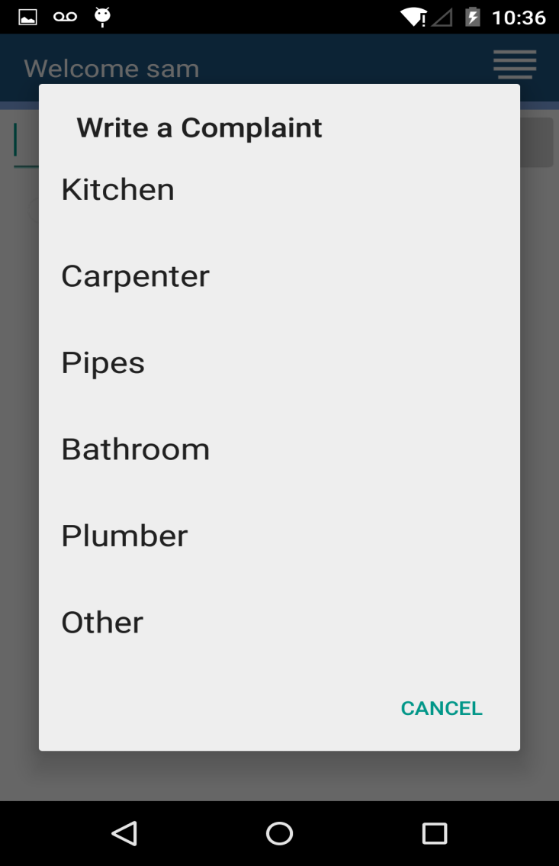
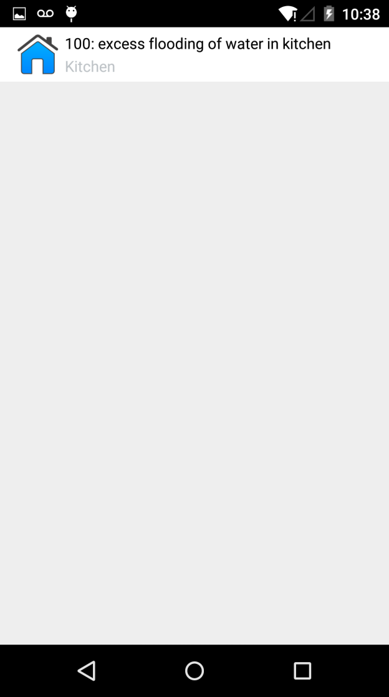
COMPLIANT REGISTRATION
COMPLAINT FILING ON USER SIDE
HANDLING COMPLIANTS BY MANAGER

Slide 21
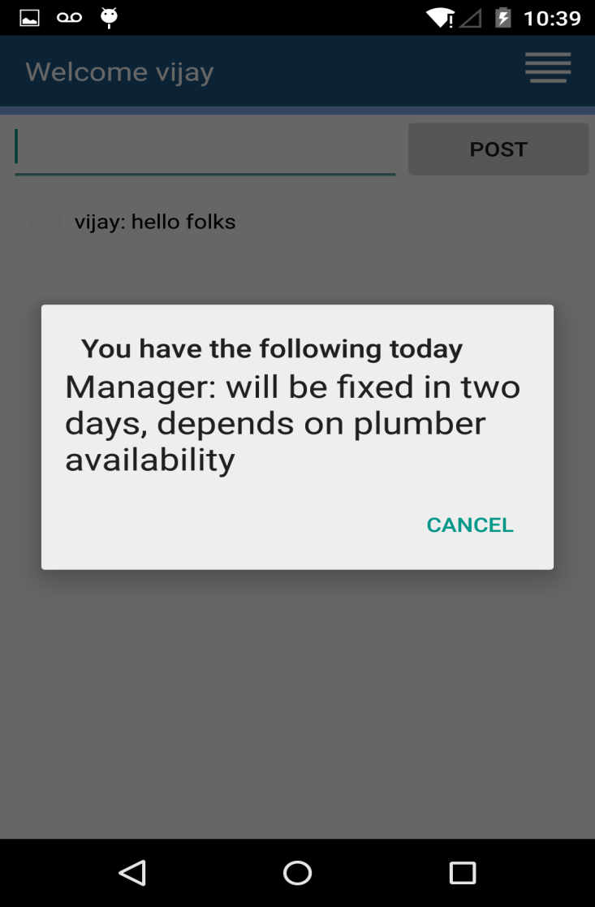
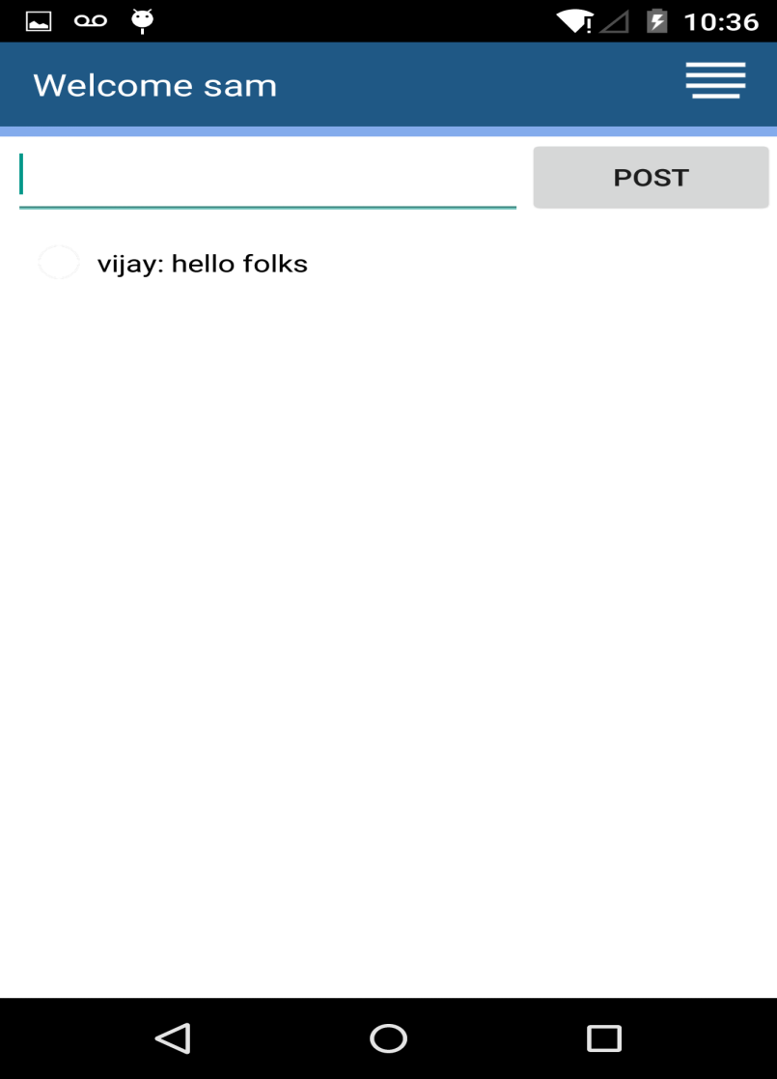
RESPONSE FOR THE COMPLIANTS FILED

Slide 22
EVENT ENTRIES ON CALENDER
Event entry mechanism is handled by the manager
Manager clicks the calendar and select the date to which he want to make a entry.
User can see the entry for that particular date when he clicks that particular date.

Slide 23
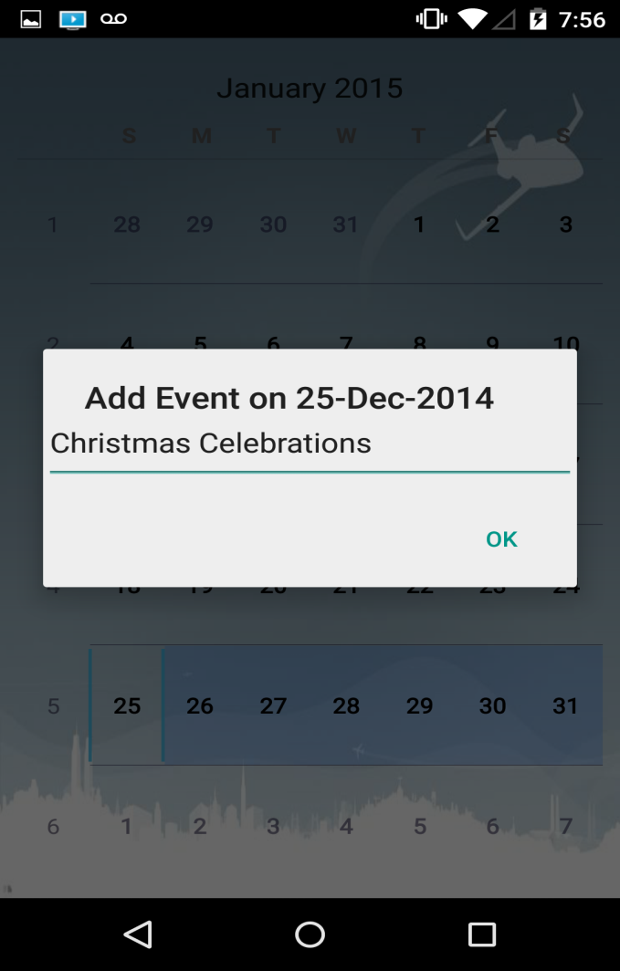
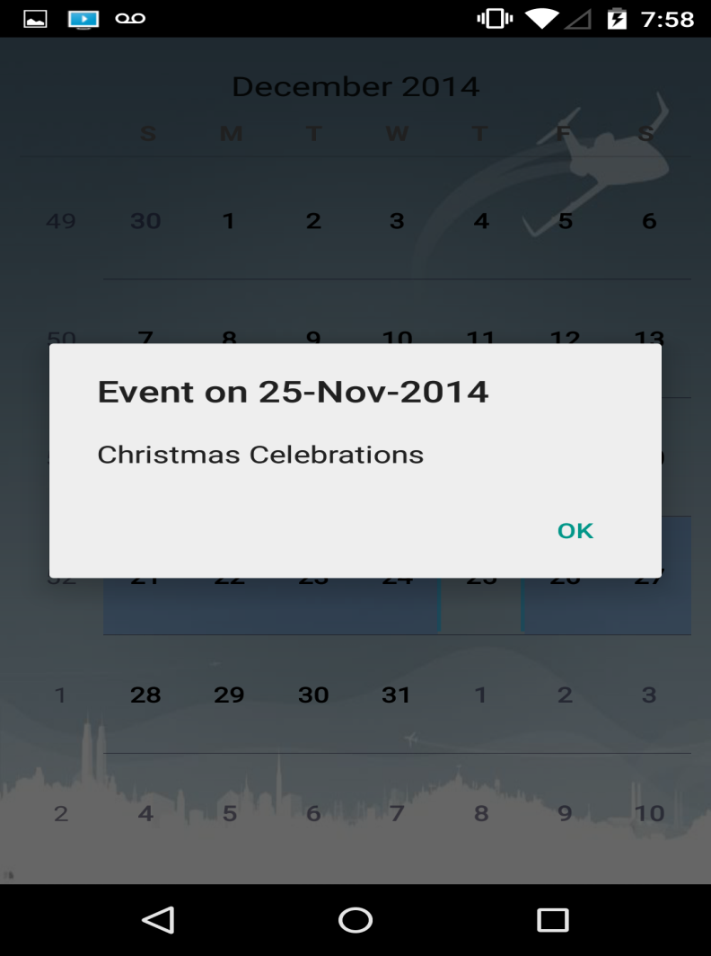
EVENT ENTRY
EVENT ENTRY BY MANAGER
RESIDENT SIDE VIEW OF EVENTS

Slide 24
FUTURE SCOPE
Can be generalized and extended to all the apartments in a city.
Can include many other features like lease renewal, creation of personal events etc.
Each module consists of several components , functionality and description of each component is given in the below slides

