Slide 1
PMS Quotation
2021

Slide 2
Quotation Sheet
Basic Information
contact
validity
Quotation Items
composition
extra fee
tax fee
specification
unit price
quantity
raw material
powder
vhp
machine
bonding
analysis

Slide 3
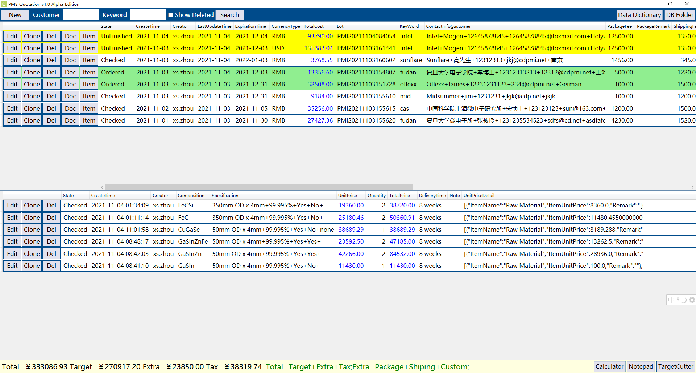

Slide 4
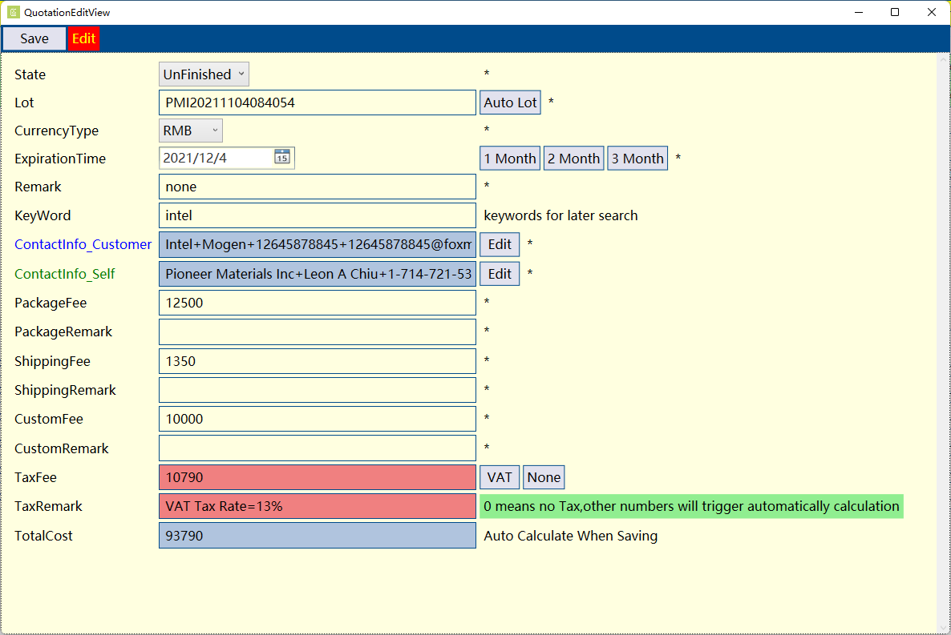

Slide 5
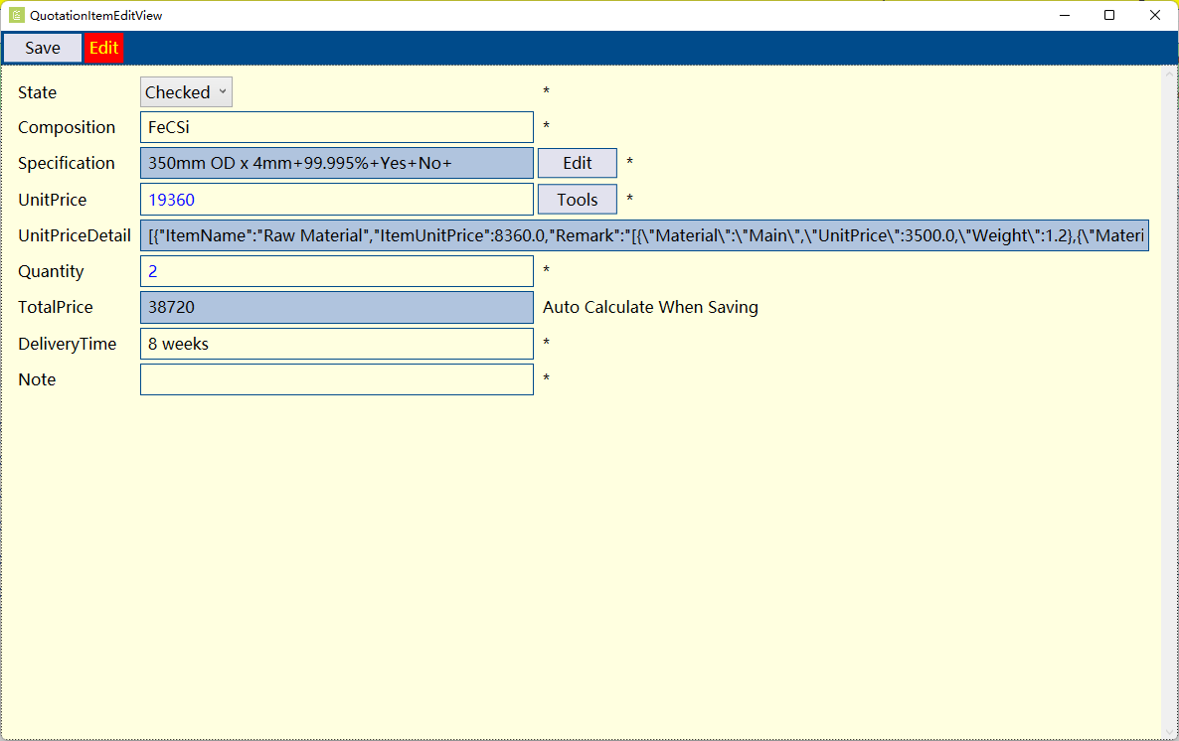

Slide 6
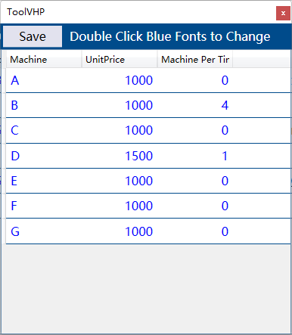
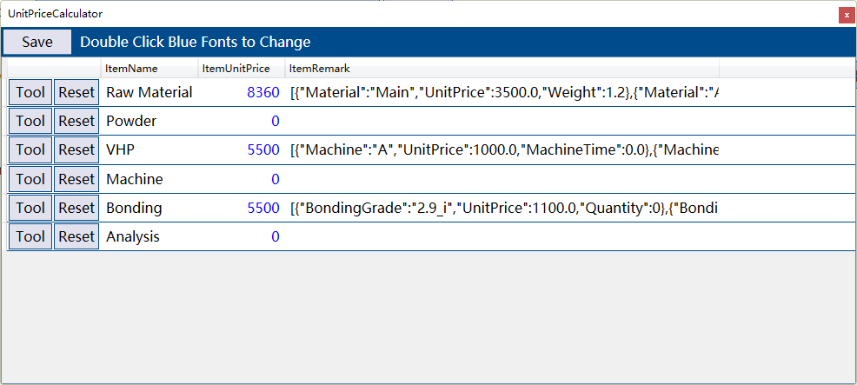
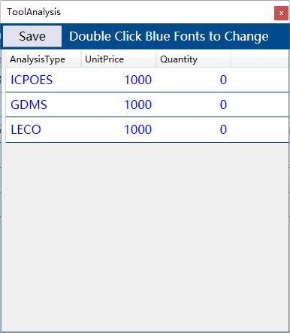

Slide 7
