Slide 1
The laser guide
By: Alec Vosika & Jacob Poppitz

Slide 2
Project Description
The main focus of this project will be to build a setup that views a whiteboard with a start point, end point, and obstacles on it. The setup will then direct a laser from the start point to the end point using the shortest path possible. The Raspberry Pi will be using the Breadth First Search algorithm to find the fastest route possible.

Slide 3
BFS (Breadth First Search) Algorithm
BFS is an algorithm for traversing tree or graph data structures
The algorithm works by starting at a single point and moving to the next point starting at a distance of one and then two and so on. This is without going back to any of the points. From all the different pathways you can determine the quickest path possible.

Slide 4
Other Algorithm options
Depth first search : continues through a path until it reaches an endpoint, continues until best path found
Dijkstra's algorithm calculates the shortest path by finding the shortest path for every vertice from a single point

Slide 5
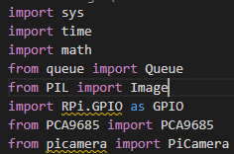
Software & Hardware
Raspberry Pi operating system
Raspberry Pi 4 Model B
Laser dot module
Raspberry Pi Servo Motor Controller
Auto Focus Pi Camera
Raspbian

Slide 6
How it works
The setup takes a picture of maze or image and processes that image using the breadth first search algorithm to search for the quickest route possible. Once the image has been processed the laser will move to the start point and move throughout the maze to the end point in the quickest route possible.

Slide 8

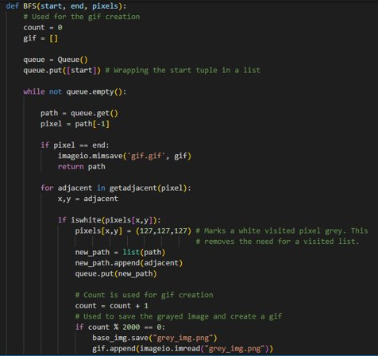
BFs FUnction Code

Slide 9
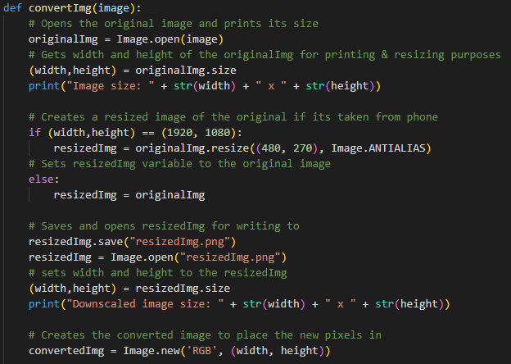
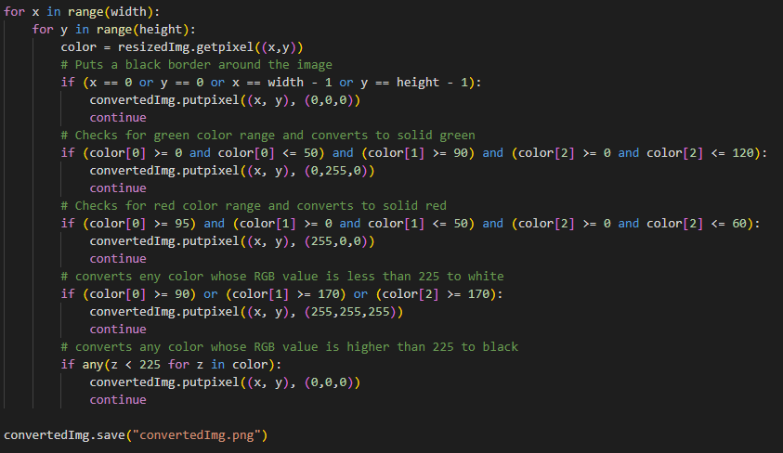
Image Processing Code

Slide 10
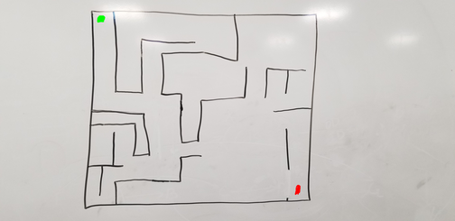
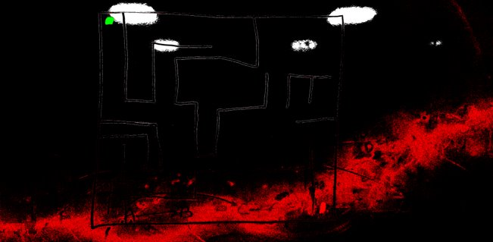
Image Processing progression 1

Slide 11
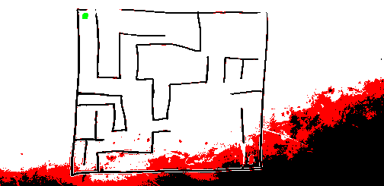
Image Processing progression 2

Slide 12
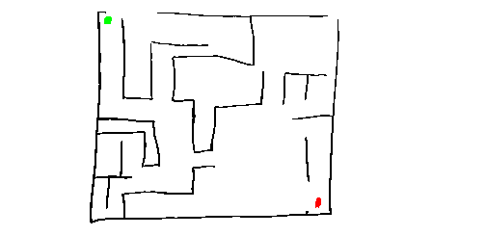
Image Processing progression 3

Slide 13
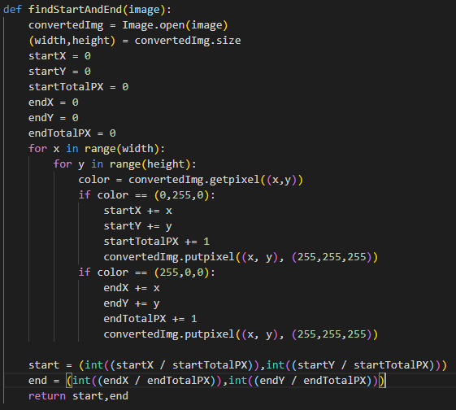
Finding the start and end coordinates

Slide 14
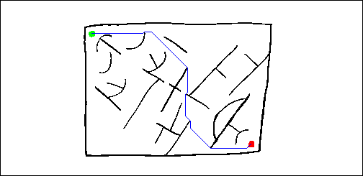
Results/conclusions

Slide 15
Questions?

