Slide 1
Towards Adaptive/Incremental Data for F#
Georg Haaser @krauthaufen
Harald Steinlechner @haraldsteinlechner
Don Syme @dsyme
+ Aardvark contributors

Slide 2
FSharp.Data.Adaptive a classic “fsprojects” project
github.com/fsprojects/FSharp.Data.Adaptive/

Slide 3
What is adaptive/incremental data?
We all love the immutable data structures
Lists, maps, sets, records, unions, DOM trees
Immutable Inputs → Immutable Outputs
But what happens when inputs change, incrementally?
Why not allow incremental adjustments to functional inputs?
Value changes
Insertions/deletions
Distinguish adaptive functional data from regular data
“adaptive { … }”
aval<int>, aset<int>, amap<int,string>, alist<int> etc.

Slide 4
What is adaptive/incremental data used for?
Dependency graphs in financial applications (e.g. new market signals)
Model-View-Update UIs (Jane St Capital – “incremental, data-driven UIs”)
Excel-like calculation engines
High performance 3D scene-graph graphics (Aardvark)
Likely many other uses (discuss)

Slide 5
What are the assumptions
Assumes a stateful thing (e.g. an app, a game) mediates the adaption.
Aim is to make implementing these stateful adaptions easy

Slide 6
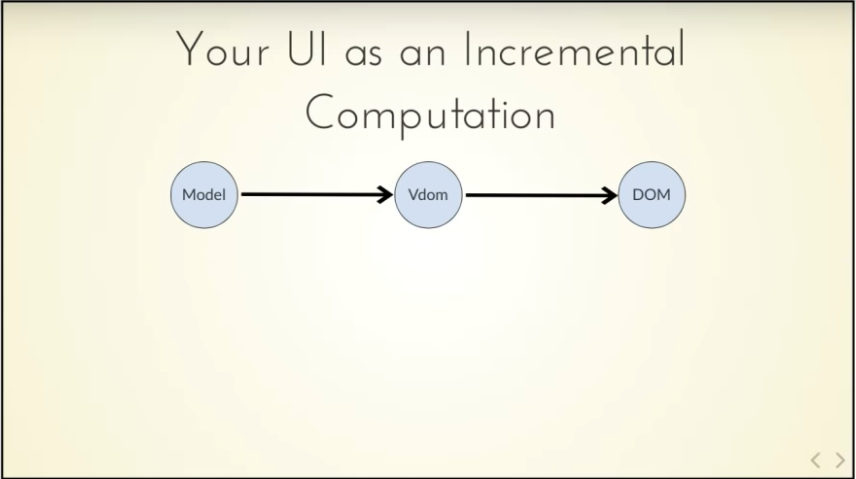


Slide 7
type Model =
{ IsPressed: bool }
type Msg =
| Pressed
let init() =
{ IsPressed=false }
let update (msg: Msg) (model: Model) =
match msg with
| Pressed -> { model with IsPressed = true }
let view (model: Model) dispatch =
if model.IsPressed then
View.Label(text="I was pressed!")
else
View.Button(text="Press Me!", command=(fun () -> dispatch Pressed))
The model from which
the view is generated
Messages which cause
updates to the model
Initial state
Update the model
Compute the view

Slide 8
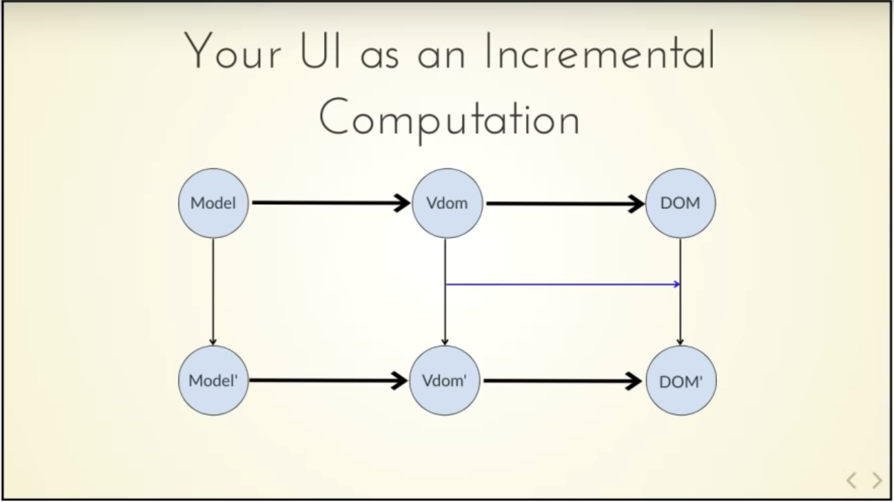
Δ

Slide 9
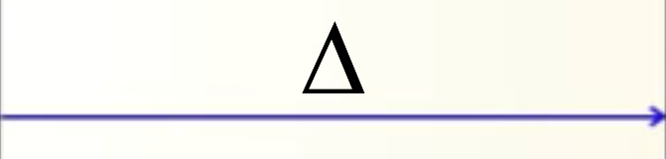
Δ
Δ

Slide 10
FSharp.Data.Adaptive
github.com/fsprojects/FSharp.Data.Adaptive/

Slide 11
Demo
github.com/fsprojects/FSharp.Data.Adaptive/

Slide 12
github.com/fsprojects

