Slide 1
The adPredict Competition
Start of competition: 2nd February 2007
Start of training phase: 18th May 2007
End of training phase: 11th June 2007
Number of Teams: 9
Task:
Predict the probability of click of 3 days of real data from 4 weeks of training data (logged page views)
Resources:
4 (2 x 2) CPU machine with 16 GB of RAM/200 GB HD
Potentially grid computing available

Slide 2
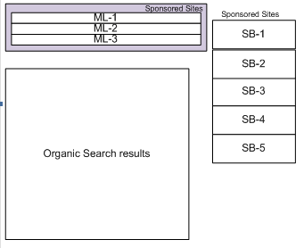
Why Predicting Click Probability?
2nd price auction with quality discounts
Assignment rule: bid × CTR
Charging rule: bid_{next} × CTR_{next} /CTR_{this}
Dangers of poor CTR estimates:
Opportunity cost
Reputation loss
Discount for badly performing advertisers
Overcharge advertisers with truly good ads

Slide 3
The Scale of Things
4 weeks of data in training:
4 wks × 7 days × 250,000,000 impressions = 7,000,000,000 impressions
2 weeks of CPU time during training:
2 wks × 7 days × 86,400 sec/day =
1,209,600 seconds
Learning algorithm speed requirement:
5,787 impression updates / sec
172.8 μs per impression update

Slide 4
Overview
adPredict Competition
Tool Chain
Exploratory Data Analysis
Model and Algorithm
Architecture
Results

Slide 5
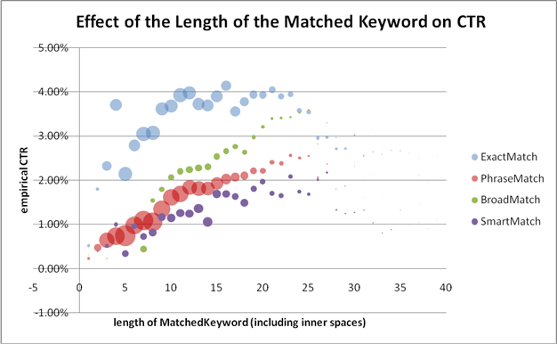
Tool Chain: Existing Tools
Excel 2007
Scientific Visualisation
Small Scale Simulations
SQL Server 2005
1.6 TB of “active” data (for 2 weeks of data + indices)
Ad-Hoc Queries and Stored Procedures
Visual Studio 2005
54 projects solution (many small tools)
F# 1.9.1.8
FSI for rapid development and code testing
Strong typing as a surrogate for correctness

Slide 6
Strong Typing: An Example
/// A single page-view
type PageView =
{
ClientDateTime : DateTime
GmtSeconds : int
TargetDomainId : int16
Medium : MediumType option
StartPosition : int
PageNum : byte
[<SqlStringLengthAttribute(256)>]
Query : string
Gender : Gender option
AgeBucket : AgeGroup option
ReturnedAdCnt : byte
AbTestingType : byte option
AlgorithmId : int option
ANID : int128 option
GUID : int128 option
[<SqlStringLengthAttribute(15)>]
PassportZipCode : string option
[<SqlStringLengthAttribute(2)>]
PassportCountry : string option
PassportRegion : int
[<SqlStringLengthAttribute(2)>]
PassportOccupation : char
LocationCountry : int
LocationState : int
LocationMetroArea : int
CategoryId : int16
SubCategoryId : int16
FormCode : int16
ReturnedAds : Advertisement array
}
/// Different types of media
type MediumType =
| PaidSearch
| ContextualSearch
/// A single displayed advertisement
type Advertisement =
{
AdId : int
OrderItemId : int
CampDayId : int16
CampHourNum : byte
ProductId : ProductType
MatchType : MatchType
AdLayoutId : AdLayout
RelativePosition : byte
DeliveryEngineRank : int16
ActualBid : int
ProbabilityOfClick : int16
MatchScore : int
ImpressionCnt : int
ClickCnt : int
ConversionCnt : int
TotalCost : int
}

Slide 7
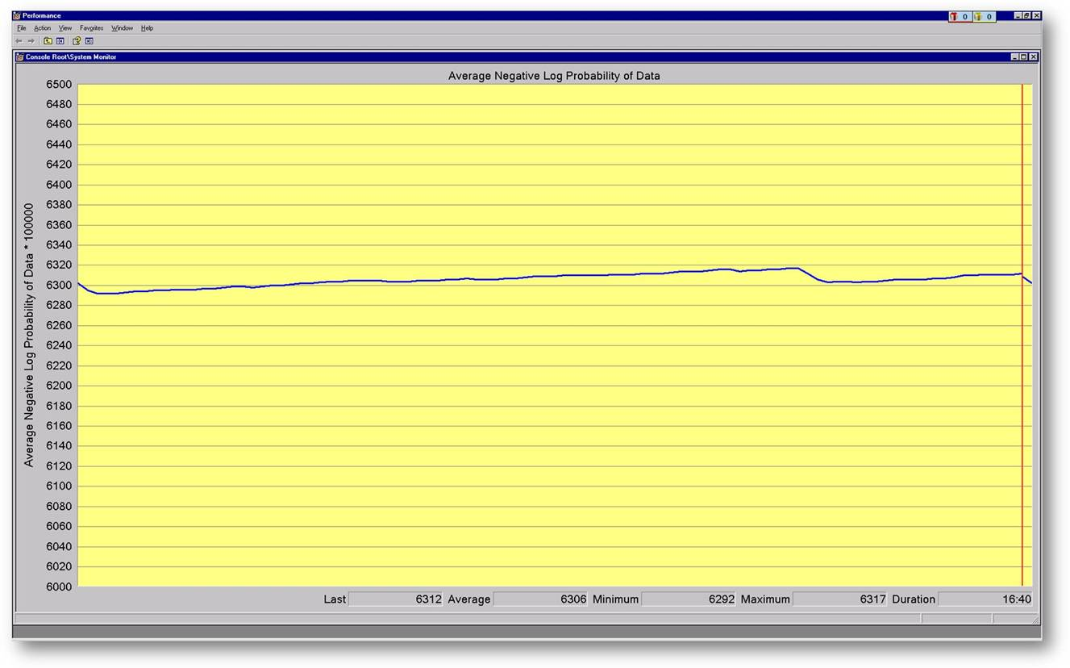
ToolChain: New Tools Developed
SQL Schema Generator & Serialisers
Motto: Code defines the schema! (unlike LINQ)
High-performance insertion via computed bulk-insertion with automated key propagation
Live Monitoring Tools
Programmatically generated PerfMon
TelNet Listener (monitor and supervise a DLL)
Event Log and Tracing

Slide 8
Strong Typing and SQL Datastores
/// A single page-view
type PageView =
{
ClientDateTime : DateTime
GmtSeconds : int
TargetDomainId : int16
Medium : MediumType option
StartPosition : int
PageNum : byte
[<SqlStringLengthAttribute(256)>]
Query : string
Gender : Gender option
AgeBucket : AgeGroup option
ReturnedAdCnt : byte
AbTestingType : byte option
AlgorithmId : int option
ANID : int128 option
GUID : int128 option
[<SqlStringLengthAttribute(15)>]
PassportZipCode : string option
[<SqlStringLengthAttribute(2)>]
PassportCountry : string option
PassportRegion : int
[<SqlStringLengthAttribute(2)>]
PassportOccupation : char
LocationCountry : int
LocationState : int
LocationMetroArea : int
CategoryId : int16
SubCategoryId : int16
FormCode : int16
ReturnedAds : Advertisement array
}
/// Different types of media
type MediumType =
| PaidSearch
| ContextualSearch
/// A single displayed advertisement
type Advertisement =
{
AdId : int
OrderItemId : int
CampDayId : int16
CampHourNum : byte
ProductId : ProductType
MatchType : MatchType
AdLayoutId : AdLayout
RelativePosition : byte
DeliveryEngineRank : int16
ActualBid : int
ProbabilityOfClick : int16
MatchScore : int
ImpressionCnt : int
ClickCnt : int
ConversionCnt : int
TotalCost : int
}
/// Create the SQL schema
let schema = bulkBuild ("cpidssdm18", “Cambridge", “June10")
/// Try to open the CSV file and read it pageview by pageview
File.OpenTextReader “HourlyRelevanceFeed.csv"
|> Seq.map (fun s -> s.Split [|','|])
|> Seq.chunkBy (fun xs -> xs.[0])
|> Seq.iteri (fun i (rguid,xss) ->
/// Write the current in-memory bulk to the Sql database
if i % 10000 = 0 then
schema.Flush ()
/// Get the strongly typed object from the list of CSV file lines
let pageView = PageView.Parse xss
/// Insert it
pageView |> schema.Insert
)
/// One final flush
schema.Flush ()

Slide 9
Overview
adPredict Competition
Tool Chain
Exploratory Data Analysis
Model and Algorithm
Architecture
Results

Slide 10
Exploratory Data Analysis
We use SQL
Very fast response time
Very rapid hypothesis testing: is this feature useful?
We use Excel’s interface to SQL

Slide 11
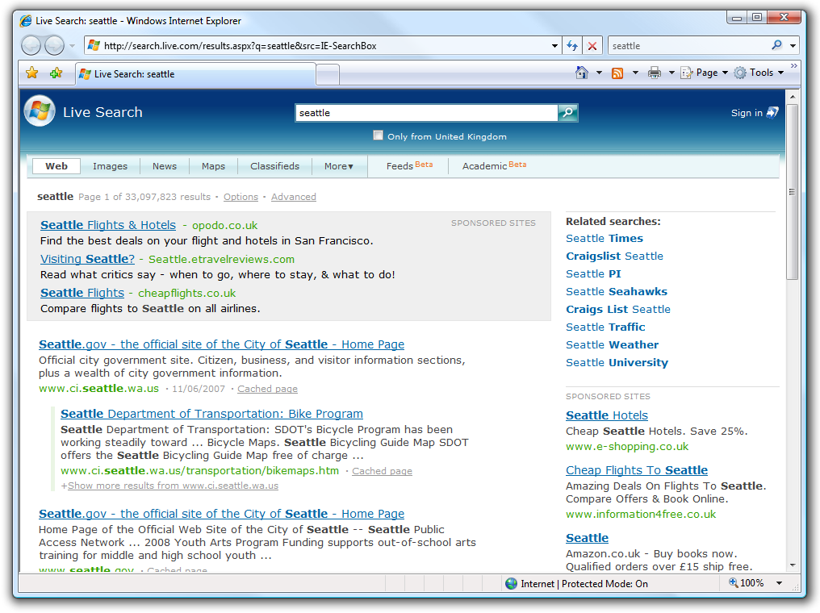
SQL Schema
One table for the Page Views
User-related information
One table for the Returned Ads
Advertisement-related information
A set of auxiliary dimension tables

Slide 13
All the tables are automatically generated
by our import tool-chain

Slide 14
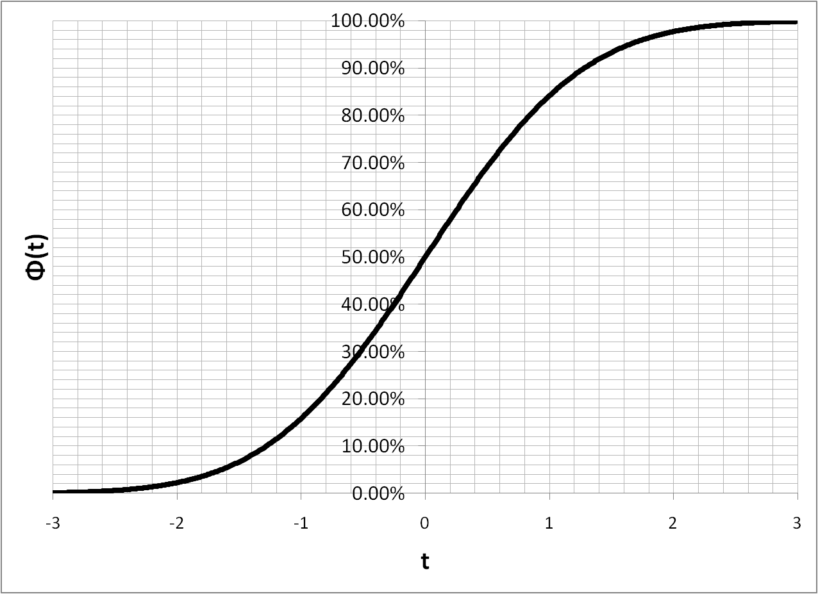
Sparse Bayesian Probit Regression
ClientIP
HasPassport?
MatchType
...
...
IsClicked?

Slide 15
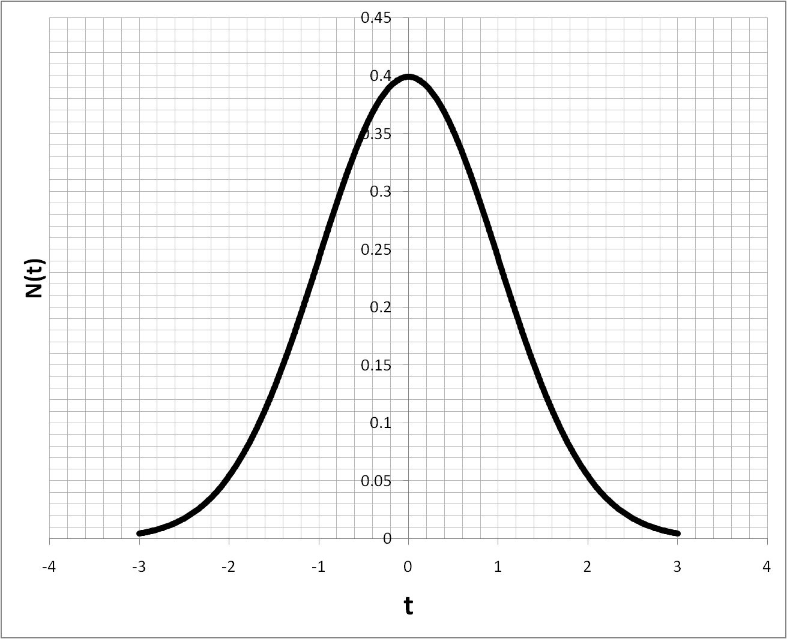
Bayesian Inference and Beliefs
We track a (Gaussian) belief over weights
Learning means updating its parameters µ and σ
µ represents the system’s best guess at the strength of the effect
σ represents the system’s uncertainty
Frequent variables: Small σ
Infrequent variables: Large σ
σ acts as a “learning” rate: large updates early on and small updates after many examples

Slide 16
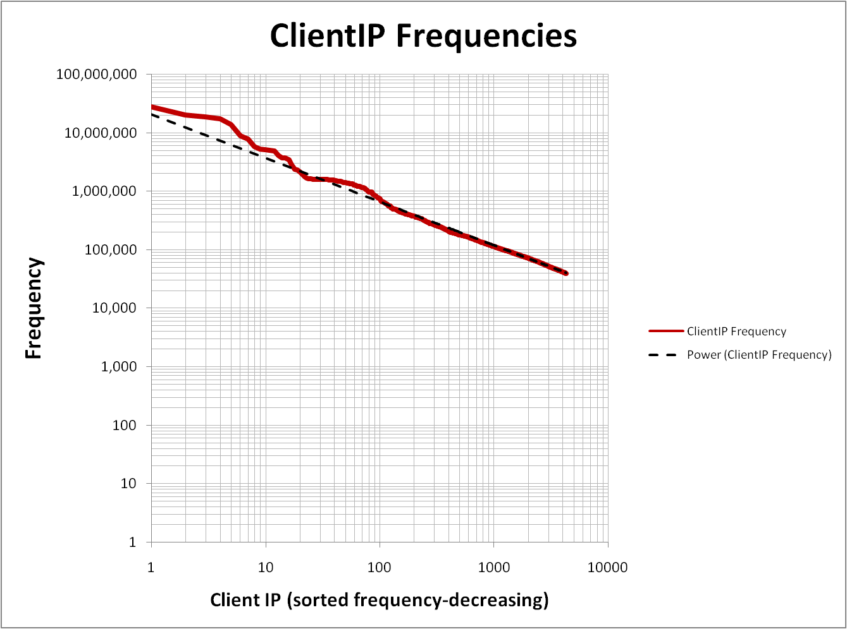
Dealing with Millions of Variables
Observation 1: Large variable bags follow a power-law w.r.t. frequency of items
Observation 2: Weight posteriors of rare items are close to their prior
Idea:
Initially, the belief of each new items is compactly represented by one (and the same) prior
After observing an item for the first time, the posterior is allocated
At regular intervals, all weight posteriors with a small deviation from the prior are removed

Slide 17
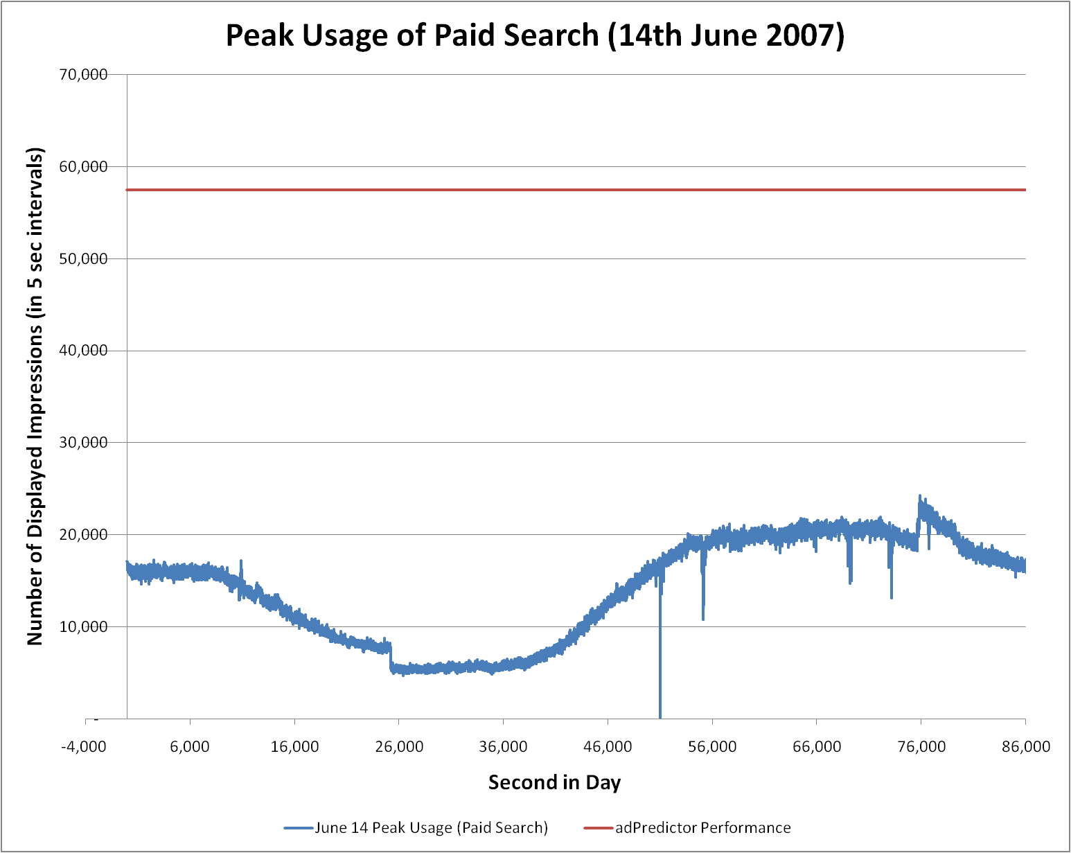
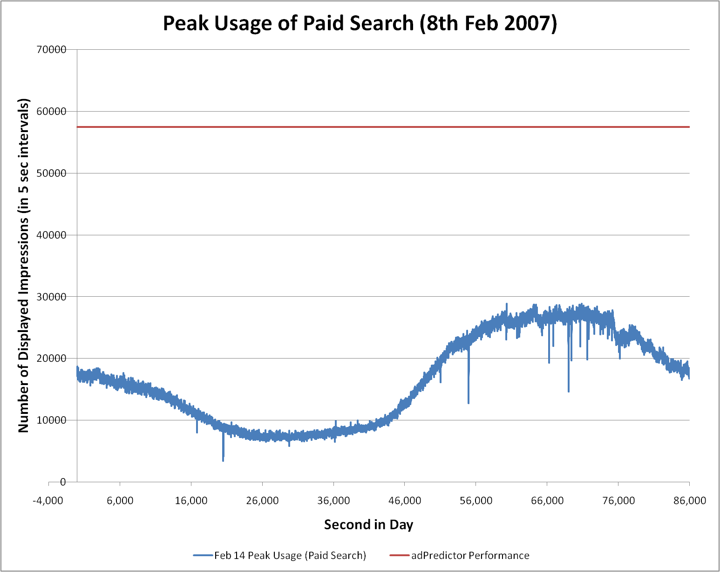
Sparsity Leads to Efficiency
Total number of parameters (“weights”)
≈100,000,000 Gaussian beliefs (mean & variance)
Number of “active” parameters per impression
n = 20
Complexity of weight belief update
4 n additions + 6 n multiplications
2 erf functions
Speed on a single threaded Pentium IV:
1,000,000,000 updates/24 hours = 11,500 updates/second

Slide 18
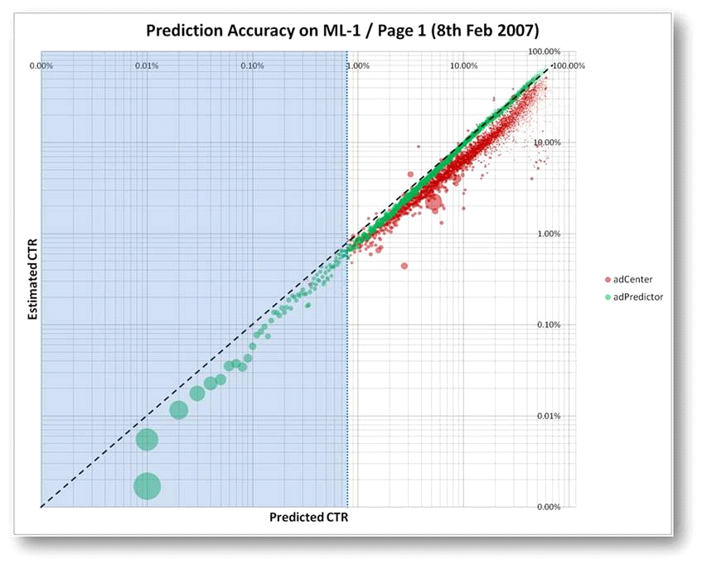
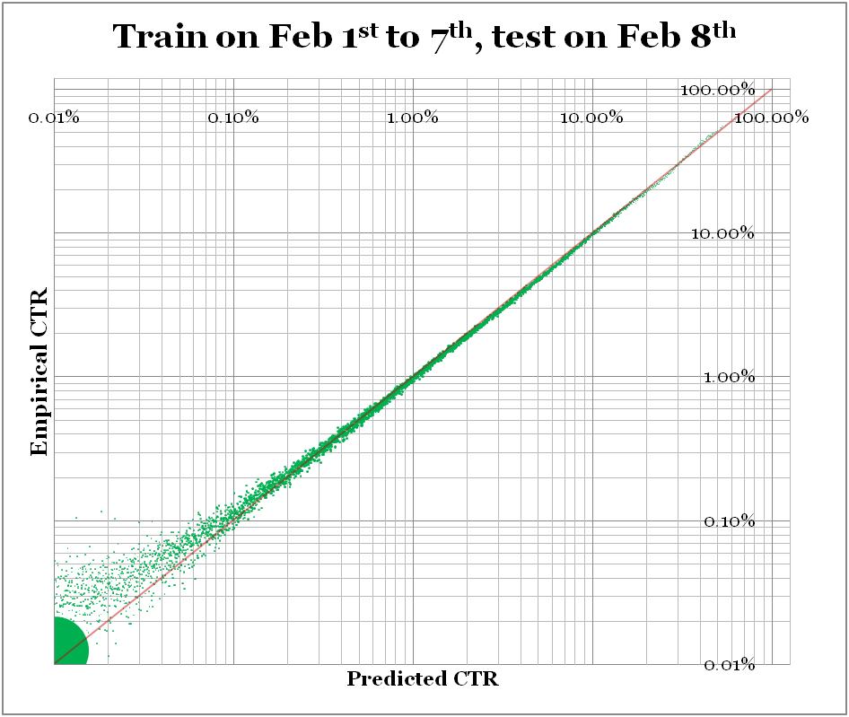
Performance of adPredictor

