Slide 1
Introducing F#
James Margetson
F# Team
Don Syme, James Margetson
Can Erten, Tomas Petricek, Jurgen Van Gael (interns)

Slide 2
F# overview
Functional “Style”
Strong Typing
Type Inference
OO Style
Builds on .NET
Visual Studio
Tools
Concurrency
.NET OO Model
Interoperable
Compact type-inferred classes
LINQ, Meta-programming
Libraries
F# Compiler
Lex and Yacc
F# Interactive
F# Tools
Data types and Patterns
1st Class Functions
“Imperative” Allows state
Visual Studio Integration

Slide 3
F# application areas?

Slide 4
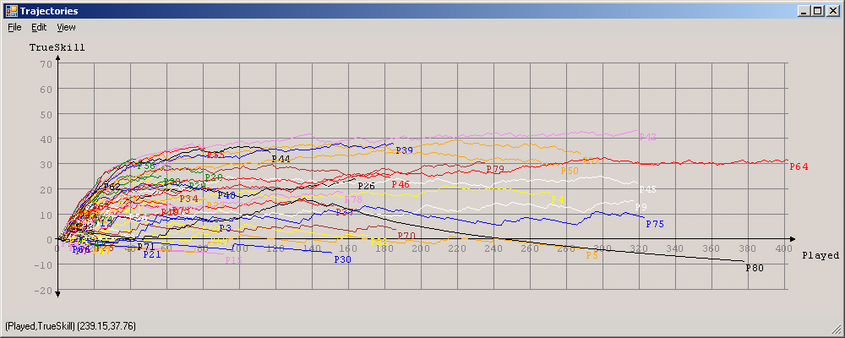

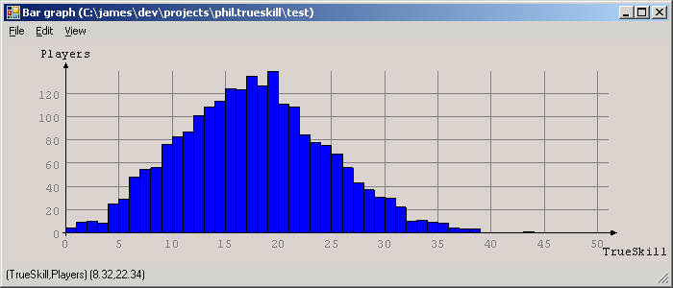
F# for Machine Learning
Applied Games Group, MSR Cambridge
Ralf, Thore, Phil, Onno, Joaquin, interns
Algorithms, Numerics, GUI, Interactive, 1TB+ datasets, Clusters
Factor Graph Library
Xbox Live Log Viewer (Xbox Live and games companies)
Match making tool (Halo)
TrueSkill Web App (XBox Live Production Servers in Jan)
AdPredict (Click Through Rates for selection and fraud detection)

Slide 5
F# for Software Verification
Static Driver Verifier (Windows Core Team, Redmond)
50K LOC OCaml verification application from MSR, shipped in 2004, cross-compiled and fully tested
Not shipped in F#, but new functionality being written in F#
JakobL: "Did I say that this is the worlds best ML editor? With or without the bug mentioned above…… I LOVE it"
Nestra (MSR India, RSE: Rigorous Software Engineering)
Analysis of ACLs (Prasad Naldurg) ~2K LOC symbolic analysis
Undergoing tech-transfer to SWI (Secure Windows Initiative)
Yogi (MSR India, RSE: Rigorous Software Engineering)
Software property checking tool

Slide 6
F# for Multi-core
Dave Wecker (Multi-Core Incubation Group, Redmond)
F# + Software Transactional Memory implementations of various machine learning algorithms
Also F# + STM implementations of parallel stochastic simulation algorithms

Slide 7

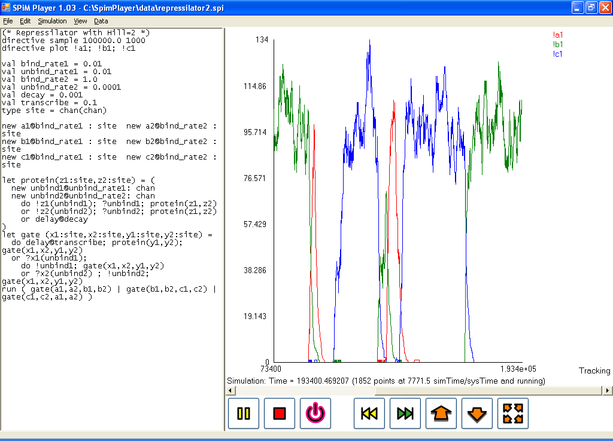
F# for Biological Modelling
SPiM Player (Andrew Phillips, Luca Cardeli, ERO Cambridge)
F# simulation of stochastic pi-calculus
Models biological reactions in silica
Biological modelling meets programming languages

Slide 8
F# for Specification and Verification
Samoa, (Karthik, Cedric, Andy). MSR Cambridge.
Securing Web Services.
"Concrete F#" as real implementation
"Model F#" as formal model, converted to ProVerif

Slide 9

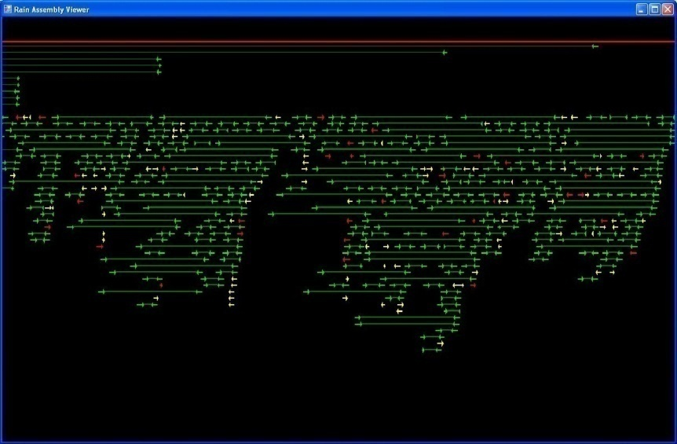
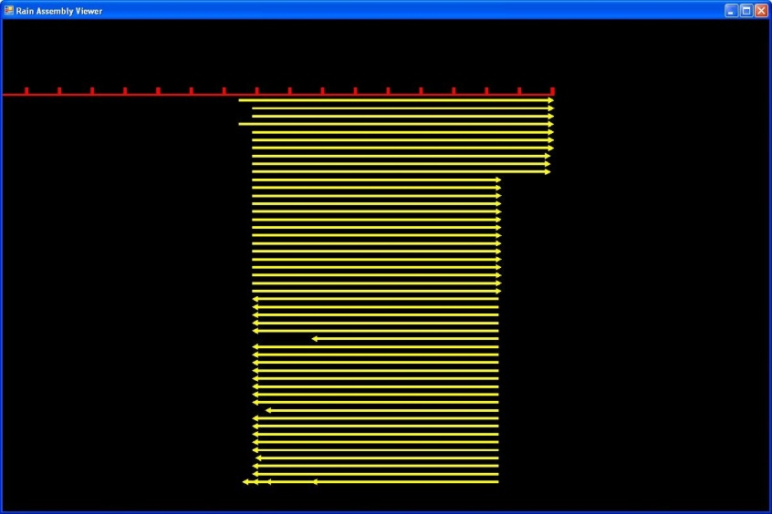
F# for Bioinformatics
"Rain" Genome Assembly Viewer
Implemented by Darren Platt: Head of Bioinformatics, DOE JGI
They sequence 20% of world's DNA
Co-author on Neanderthal DNA sequencing paper.
Experienced, trained programmer
F# /.NET/C++ v. Perl/C++ v. Python/C++
“It's the fastest genome assembly viewer I've ever seen and only 500 lines of F#.
My current tool for doing is a python CGI script that produces nice images but which is completely non-interactive and very slow....
The more I think about our field and current best practice (perl/java ...), rapid protyping, mathematical problems, the more enthusiastic I get about this path.”

Slide 10
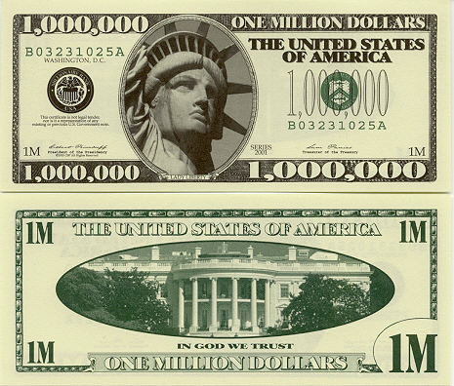
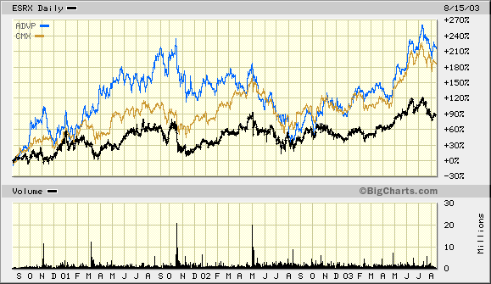
F# for Financial Modelling
Credit Suisse Global Analysis Group (requesting support)
2000+ machine compute farms
Excel scripting and interop works very well here
Haskell Enthusiasts convert them to functional style.
They want .NET
F# largely fits the bill… but they want guarantees
Also:
Lexifi (contract description language (OCaml and F#)
Derivatives One (online financial software)
Jane St (Ocaml and F#)

Slide 11
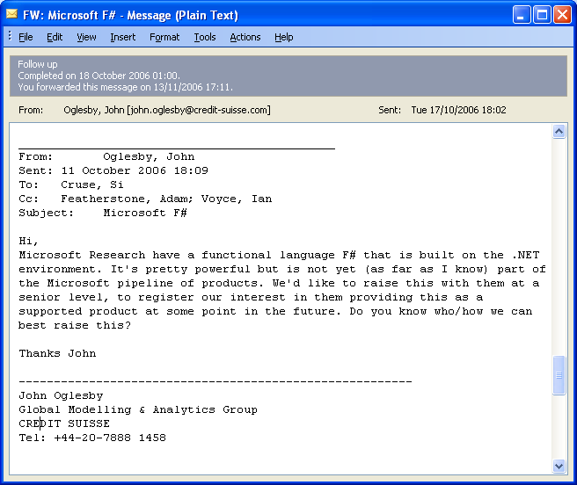
F# support requests from CSFB

Slide 12
F# for Systems Data Analysis
Constellation Project, MSR Cambridge.
Richard Mortier, Richard Black and Systems group
Packet parsing and analysis of TBs of packet captures
Core packet process is written in F# (Richard Mortier).

Slide 13
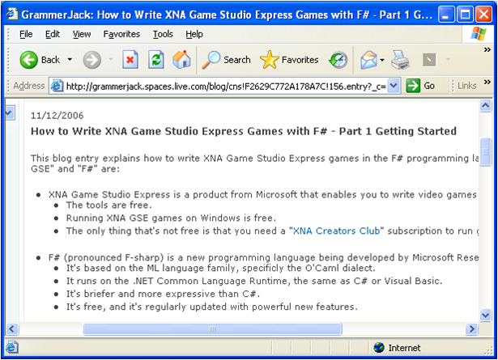
F# for XNA
Jack Palevich
F# on XBox 360 via XNA Framework
Jack’s blog has a tutorial

Slide 14
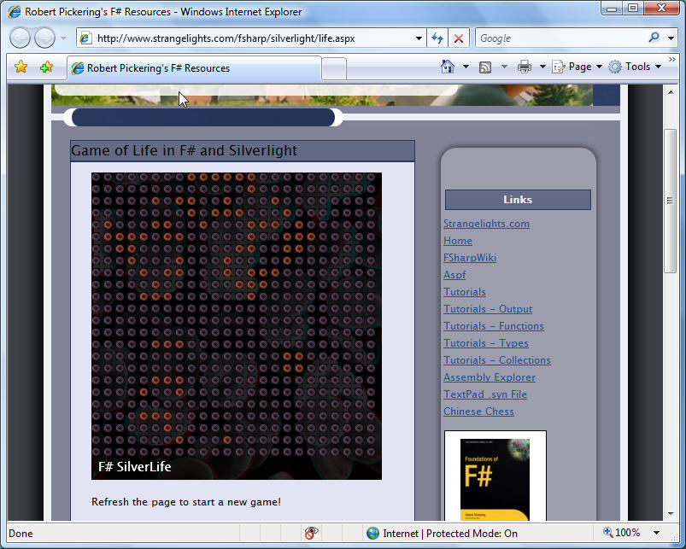
F# for SilverLight
Rob Pickering (Author of the first F# book in print)
http://www.strangelights.com/fsharp/silverlight/life.aspx

Slide 15
F# CASE STUDY: AD PREDICT

Slide 16
AdPredict: The Competition
Task:
Predict the probability of click of 3 days of real data from 4 weeks of training data (logged page views)
Resources:
4 (2 x 2) CPU with 16 GB of RAM/200 GB HD
Potentially grid computing available

Slide 17
AdPredict: Scale of Things
4 weeks of data in training:
4 wks × 7 days × 250,000,000 impressions = 7,000,000,000 impressions
2 weeks of CPU time during training:
2 wks × 7 days × 86,400 sec/day =
1,209,600 seconds
Learning algorithm speed requirement:
5,787 impression updates / sec
172.8 μs per impression update

Slide 18
AdPredict: Strong Typing.
/// A single page-view
type PageView =
{
ClientDateTime : DateTime
GmtSeconds : int
TargetDomainId : int16
Medium : MediumType option
StartPosition : int
PageNum : byte
[<SqlStringLengthAttribute(256)>]
Query : string
Gender : Gender option
AgeBucket : AgeGroup option
ReturnedAdCnt : byte
AbTestingType : byte option
AlgorithmId : int option
ANID : int128 option
GUID : int128 option
[<SqlStringLengthAttribute(15)>]
PassportZipCode : string option
[<SqlStringLengthAttribute(2)>]
PassportCountry : string option
PassportRegion : int
[<SqlStringLengthAttribute(2)>]
PassportOccupation : char
LocationCountry : int
LocationState : int
LocationMetroArea : int
CategoryId : int16
SubCategoryId : int16
FormCode : int16
ReturnedAds : Advertisement array
}
/// Different types of media
type MediumType =
| PaidSearch
| ContextualSearch
/// A single displayed advertisement
type Advertisement =
{
AdId : int
OrderItemId : int
CampDayId : int16
CampHourNum : byte
ProductId : ProductType
MatchType : MatchType
AdLayoutId : AdLayout
RelativePosition : byte
DeliveryEngineRank : int16
ActualBid : int
ProbabilityOfClick : int16
MatchScore : int
ImpressionCnt : int
ClickCnt : int
ConversionCnt : int
TotalCost : int
}

Slide 19
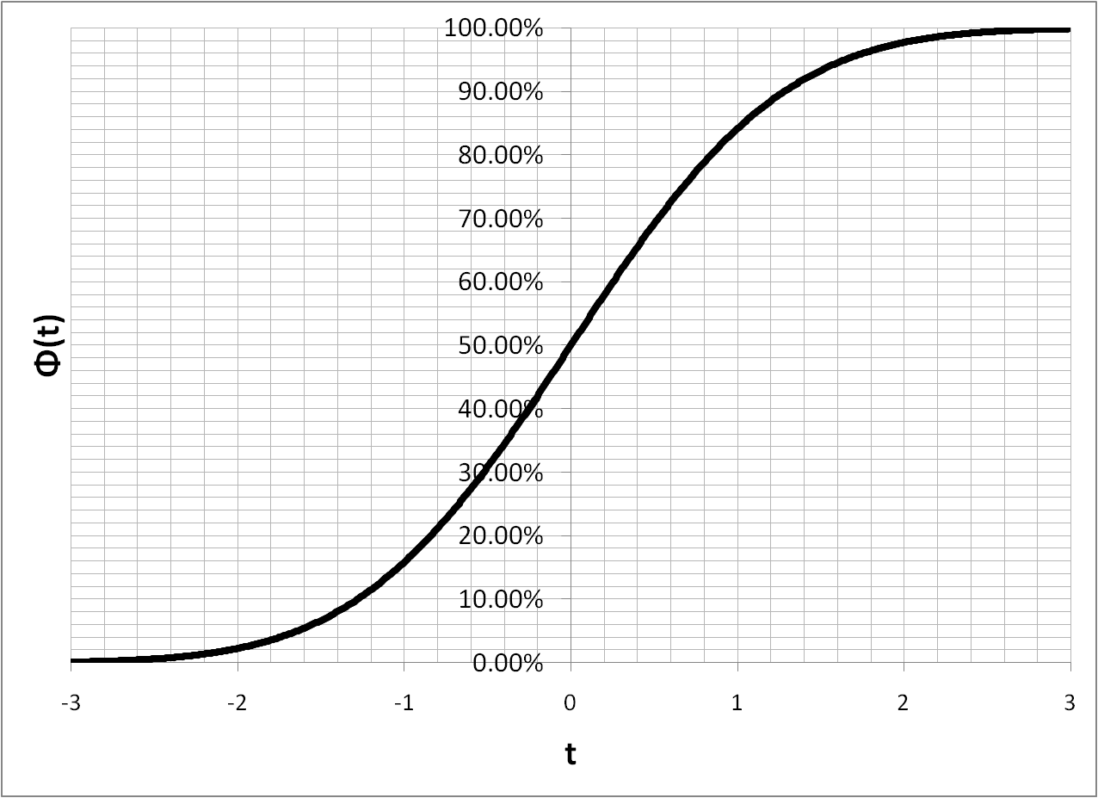
AdPredict: Sparse Bayesian Probit Regression
ClientIP
HasPassport?
MatchType
...
...
IsClicked?

Slide 20
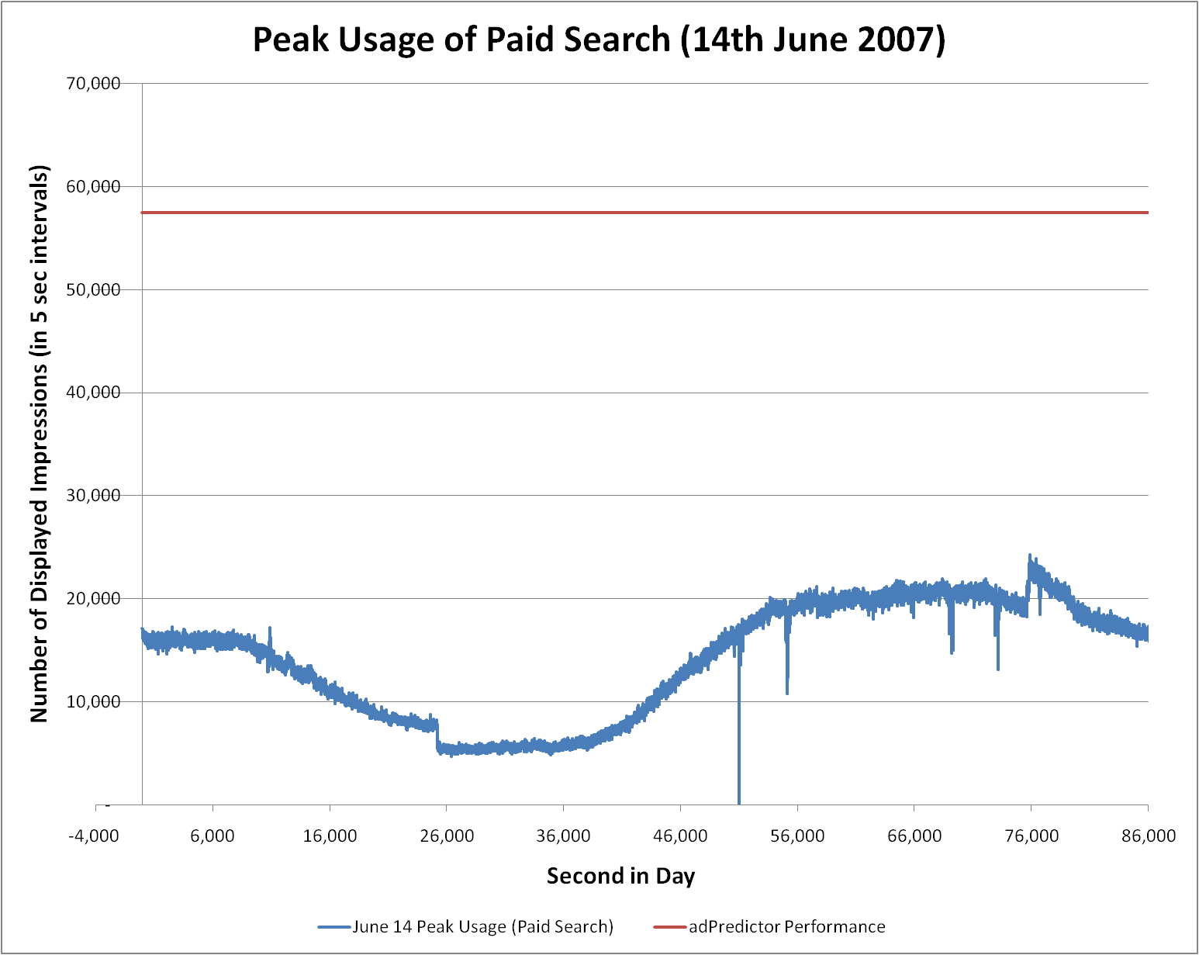
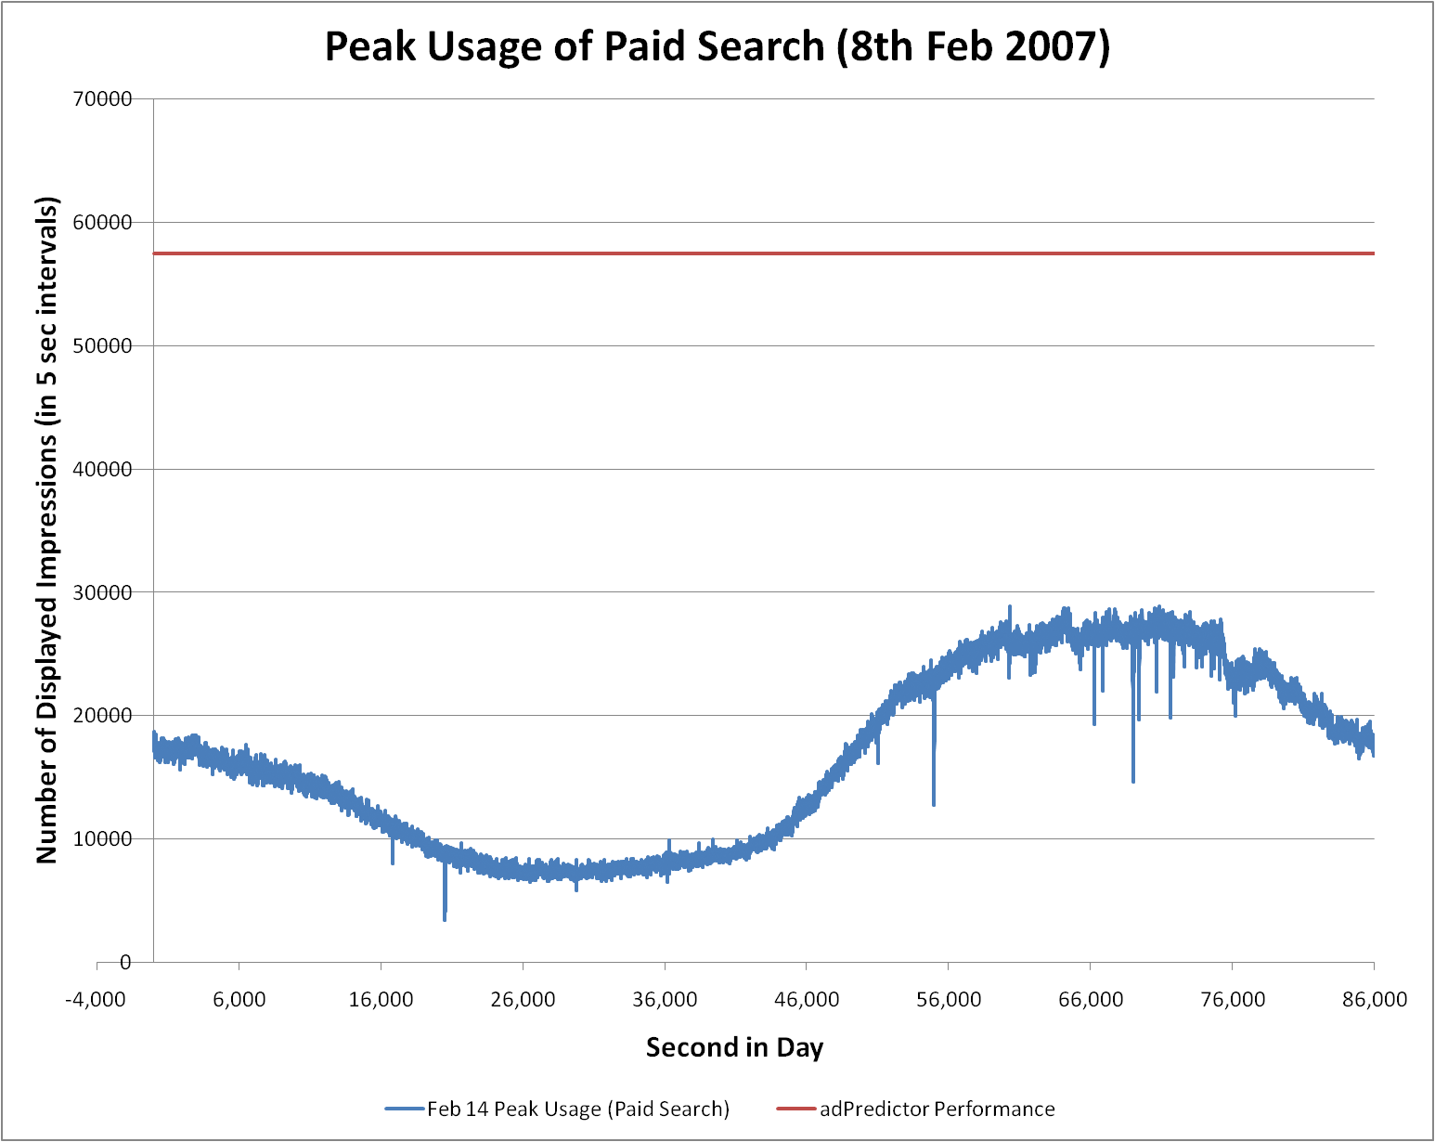
AdPredict: Real time learning
Total number of parameters (“weights”)
≈100,000,000 Gaussian beliefs (mean & variance)
Number of “active” parameters per impression
n = 20
Complexity of weight belief update
4 n additions + 6 n multiplications
2 erf functions
Speed on a single threaded Pentium IV:
1,000,000,000 updates/24 hours = 11,500 updates/second

Slide 21
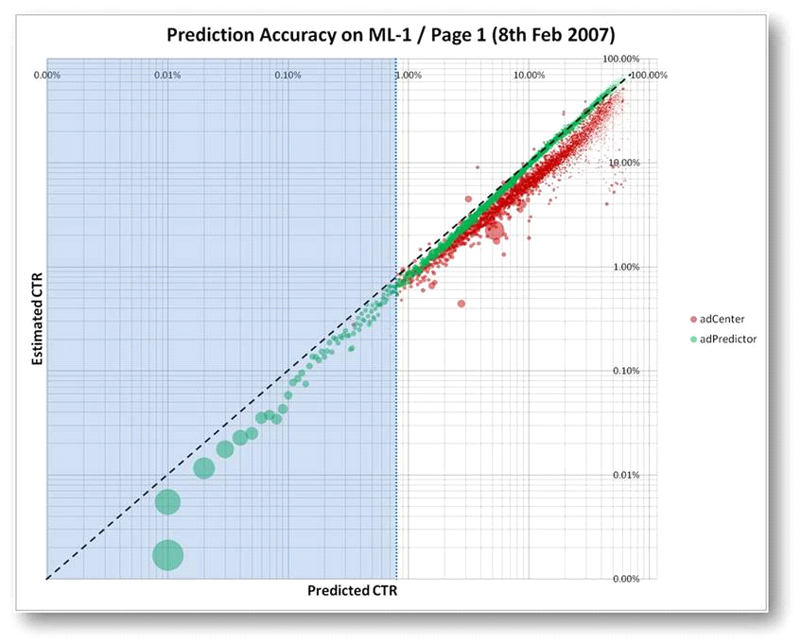
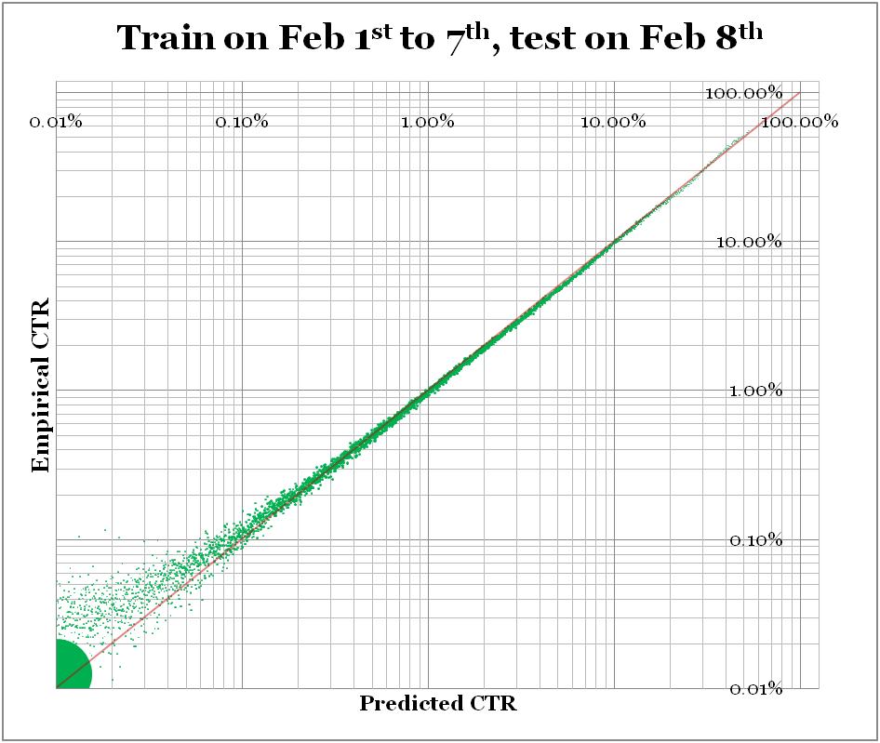
AdPredict: Model Accuracy?

Slide 22
AdPredict: Success?
Competition?
Results due…
Already going into the CTR fraud detector
Applied Games Group use of F#
Rapid prototyping
Programmatic data mining
Agility to explore alternative models
Successful model for CTR prediction
Clarity of code

Slide 23
F# Community

Slide 24
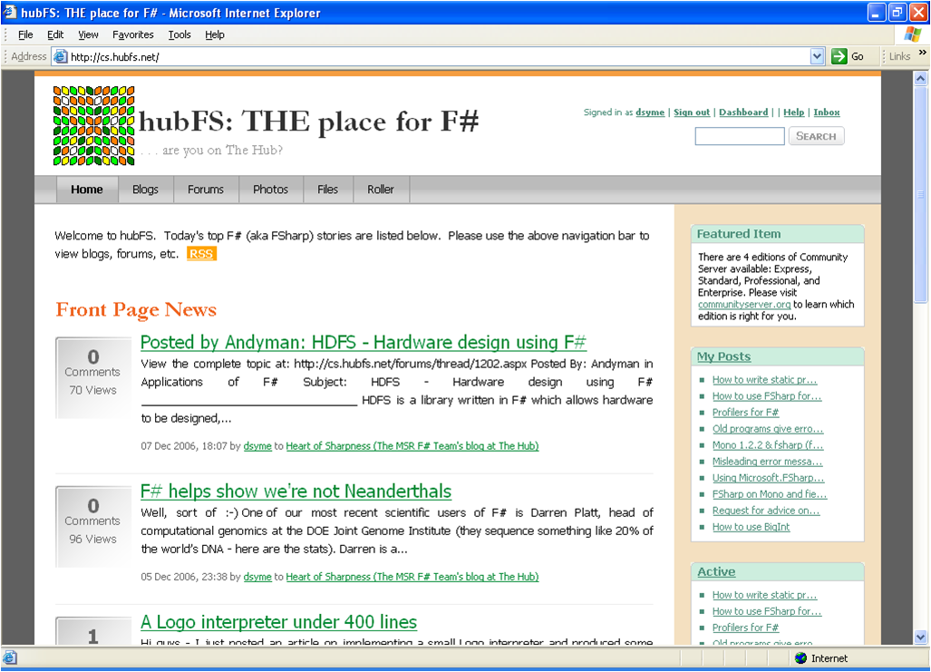
F# Community, http://hubFS.net

Slide 25
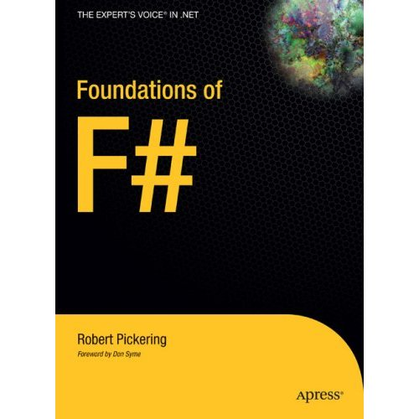
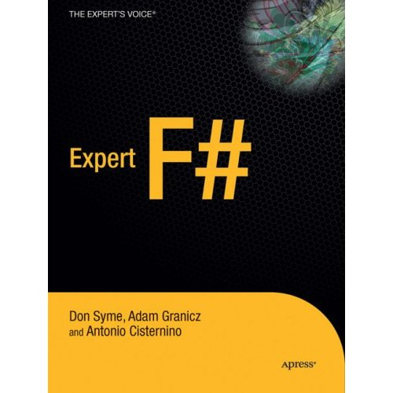


F# Books and Third Party Add Ons

