Slide 1
F# Eye for the C# guy
Leon Bambrick, secretGeek.net
Notes:
What’s this F# thing anyway?

Slide 2
WTF#?
Notes:
What’s this F# thing anyway?

Slide 3
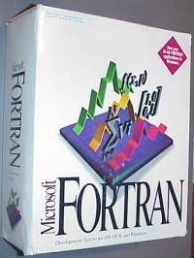
F#
…it’s Fortran.net
Notes:
No, it’s not fortran.net

Slide 4

F#!@ YOU GUYS!
Notes:
It’s not cartoon characters swearing

Slide 5
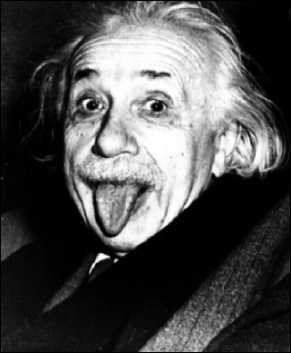
F#
An Academic
Language
Reserved
For
Scienticians
Notes:
And it’s not targeted at academia

Slide 6
General Purpose Language
Ideal for Real World Development
Notes:
It’s a general purpose language, ideal for real world development. Built in .Net. Officially supported.

Slide 7

F# is big.
Really big.

Slide 8
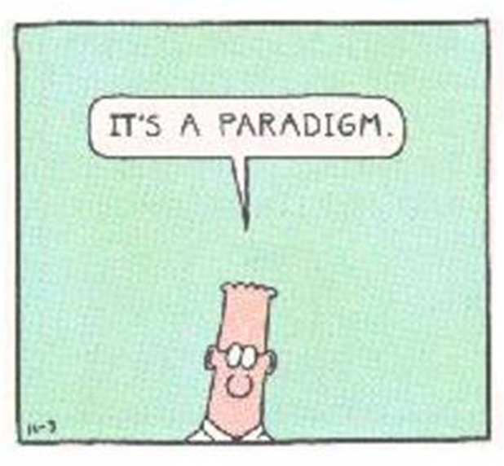
A Multi-Paradigm Language!
a what?
Notes:
It happens to be a multi-paradigm language. This makes it somewhat unique in .net land.

Slide 9
functional
procedural
object-oriented
F#
Notes:
Seamlessly combines procedural functional and object oriented styles (let’s leave language oriented for another day)

Slide 10
30 second review:
3
Big
Paradigms

Slide 11
procedural
Assembly language, Fortran, C, Pascal
Do this, then that, then that
Useful abstraction over machine code

Slide 12
object oriented
C++, VB.net, C#, J#
Define types, methods, members
Inheritance, polymorphism, overloading
Useful abstraction over procedural

Slide 13
procedural
object oriented
imperative
Notes:
Those two styles together are examples of imperative programming. The only people who ever use the term imperative programming are those who don’t like it. People who follow a different paradigm… functional

Slide 14

Functional = The Other Side

Slide 15

functional
No common ancestor with C
no matter how far back you go!

Slide 16
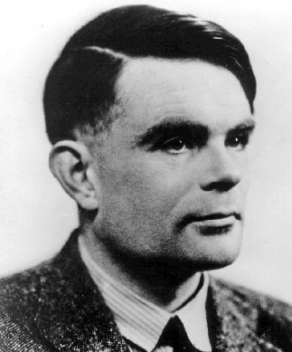
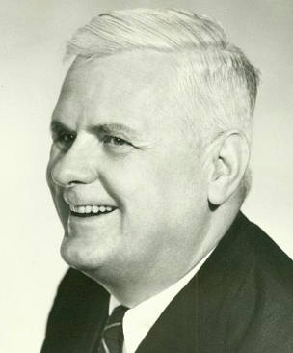
Alan Turing v Alonzo Church
Cage Match of Death
Notes:
Imperative programming stems from machine language – grounded in the universal Turing machine. Functional programming stems from the Lambda Calculus developed by Alonzo Church. Initially it was thought that to fully express Church’s concepts, new computers would need to be built from scratch. Actually the two approaches achieve the same results – no more no less – as shown in the “Church-Turing” thesis. Or so I’m told.

Slide 17
functional
Lisp, Scheme, Haskell, ML, Erlang
Decompose problem into ‘functions’
Focus on results not process

Slide 18
functional?
Visual Basic has functions...

Slide 19
functional?
Visual Basic has functions...
does that make it 'functional' ?

Slide 20
functional?
FUNCTION ≠ "method that returns a value"

Slide 21
functional?
FUNCTION ≠ "method that returns a value"
Think:
"mathematical function“
"formula"
"equation "

Slide 22

Purely functional…
Avoid
Side-
Effects!
Notes:
Side-effects are things like input, output… writing to the screen, writing to disk, printing… impure, non mathematical activities. Okay so pure functional languages can create IO by doing very deliberate acts called monads. (And some like Erlang use messaging for IO. Beats me how they do it, but good for them)

Slide 23

Purely functional…
Avoid
Mutation!
Notes:
In OO we’ll define a variable and make changes to its state. Such types are mutable. This is “mutation” or rather mutability. Immutable objects never change – though pure functions may create altered copies of their content.

Slide 24
Purely functional…
No Variables!
Only Functions!
Notes:
Functions are also known as ‘symbols’ or sometimes ‘values’

Slide 25
Purely functional…
Same input ->
Same output!
Notes:
Pure functions are deterministic. Like the times table. This is called ‘referential transparency’

Slide 26

Purely functional…
No Shared State

Slide 27
Why bother?
Pure functions can be executed in parallel without interfering with one another
Notes:
Allows for greater modularity (just as OO improves procedural and procedural improves machine code)

Slide 28
Why bother?
Pure functions can be executed in parallel without interfering with one another
Pure functions can be “perfectly” cached
Notes:
Known as memoization. Consider the sort of cache-filling you did in primary school. You learnt that 7*7 is 49. You need never perform that calc manually again – the cache will never go stale – never needs to be recalculated. Such is not true of referentially opaque questions like “Who is the prime minister”, as this relies on I/O.

Slide 29
Why bother?
Pure functions can be executed in parallel without interfering with one another
Pure functions can be “perfectly” cached
Pure functions can be “partially” applied
Notes:
We’ll see this later on.

Slide 30
Why bother?
Pure functions can be executed in parallel without interfering with one another
Pure functions can be “perfectly” cached
Pure functions can be “partially” applied
Functions can receive and return functions, for which all of the above hold true
Notes:
You can reason about the code in a way that is impossible for messy imperative code. This affords optimisations of every kind.

Slide 31
Why bother?
Pure functions can be executed in parallel without interfering with one another
Pure functions can be “perfectly” cached
Pure functions can be “partially” applied
Pure functions can return functions, for which all of the above still hold true
Allows for greater “modularity”
Notes:
Allows for greater modularity through higher functions. (just as OO improves procedural and procedural improves machine code)

Slide 32
What’s the catch?
“Hello world” is a side effect
Custom runtimes a-plenty
Notes:
We’re not going into Monads right here. Custom runtimes built with the aim of getting to higher level abstractions don’t involve a broad enough audience along the way. Better to wait for runtimes to mature and then apply higher level capabilities over the top.

Slide 33
What’s the catch?
“Hello world” is a side effect
Custom runtimes a-plenty
Smug Lisp weenies
Notes:
And you get people with deep experience in functional languages who are disdainful of those with only imperative experience. Such is life.

Slide 34
Functional is the new OO
Some stuff is now cheap!
Ram
Disk
Cores
Some stuff remains expensive!
Time
Concurrency
Locking

Slide 35
Functional is the new OO
Some stuff is now cheap!
Ram
Disk
Cores
Some stuff remains expensive!
Time
Concurrency
Locking

Slide 36
Functional is the new OO
Some stuff is now cheap!
Ram
Disk
Cores
Some stuff remains expensive!
Time
Concurrency
Locking

Slide 37
Functional is the new OO
Some stuff is now cheap!
Ram
Disk
Cores
Some stuff remains expensive!
Time
Concurrency
Locking

Slide 38

This tips the balance toward higher abstractions

Slide 39
WTF#?
Theorem proving and ISWIM begat:
ML “Meta Language”, which begat:
CAML, which in turn begat
OCaml, which in turn begat
F#... A sort of caml.net
Notes:
So where does F# fit in? It’s developed from ML

Slide 40
WTF#?
First official functional language on .net
Deep support thanks to Generics
Notes:
So where does F# fit in? It’s developed from ML

Slide 41

WTF#?
First official functional language on .net
Deep support thanks to Generics
Recently assimilated by dev-div
Notes:
So where does F# fit in? It’s developed from ML

Slide 42
Code!
//F#
let a = 2

Slide 43
Code!
//F#
let a = 2
//C#
int a = 2
≠

Slide 44
Code!
//F#
let a = 2
//C#
//a function!
static int a()
{
return 2;
}
More like

Slide 45
More Code!
//F#
#light
open System
let a = 2
Console.WriteLine a
//C#
using System;
namespace ConsoleApplication1
{
class Program
{
static int a()
{
return 2;
}
static void Main(string[] args)
{
Console.WriteLine(a);
}
}
}
Notes:
We see that C# makes a right fist of it and crams a 4 line program into 8 lines of code and 8 lines of bracket, with 3 semi colons, 3 sets of round brackets and one set of square brackets.

Slide 46
More Code!
//F#
#light
open System
let a = 2
Console.WriteLine a
//C#
using System;
namespace ConsoleApplication1
{
class Program
{
static int a()
{
return 2;
}
static void Main(string[] args)
{
Console.WriteLine (a);
}
}
}
More Noise
Than Signal!
Notes:
We see that C# makes a right fist of it and crams a 4 line program into 8 lines of code and 8 lines of bracket, with 3 semi colons, 3 sets of round brackets and one set of square brackets.

Slide 47
More Code!
//F#
#light
open System
let a = 2
Console.WriteLine a
//C#
using System;
namespace ConsoleApplication1
{
class Program
{
static int a()
{
return 2;
}
static void Main(string[] args)
{
Console.WriteLine(a);
}
}
}
Looks Weakly typed?
Maybe Dynamic?
Notes:
But why does F# omit any type information? Is it not type safe? Is it coercive maybe? Or weakly typed? Maybe this is one of those dynamic languages I read about at 37 signals?

Slide 48
Strict?
Dynamic?
Static?
Weak?
F#?
Notes:
So where does F# sit in the world of type systems?

Slide 49
Strict
Dynamic
Static
Weak
F#
Notes:
It’s strict and static.

Slide 50
Strict
Dynamic
Static
Weak
F#
Yet rich, expressive
Yet versatile
Notes:
But it has some features to make this a little more comfortable. We’ll see a bit of that later.

Slide 51
More Code!
//F#
#light
open System
let a = 2
Console.WriteLine a
//C#
using System;
namespace ConsoleApplication1
{
class Program
{
static int a()
{
return 2;
}
static void Main(string[] args)
{
Console.WriteLine(a);
}
}
}
Type Inference
Notes:
Rather than the programmer explicitly adding type annotations again and again… F# has type inference. And once a type is determined in one place, that inference is pushed through to other places where it’s used. And when it’s not sure of the type, it assumes a generic type – exactly like the generic types we have in .net 2.0. (This is where they came from). When it finds ambiguity – it raises a compile time error.

Slide 52
Immutable by default
let a = 2
let a = 3
error: FS0037: Duplicate definition of value 'a'

Slide 53
Discriminated union types
type NullableInt =
| Value of int
| Nothing of unit
Notes:
Able to say this type is really any one of these other types. Can behave completely differently to each other. Consider “nullable int” in C# - a long winded way to say this could be of type int, or in some special cases it could be null. In F# this “OR”ing of types is fundamental. (Unit is a null return type. Functions with no return value return “unit”. Similar to void in c#.)

Slide 54
Discriminated unions example
type Weapon =
| Knife
| Gun
| Bomb
Notes:
Able to say this type is really any one of these other types. Can behave completely differently to each other.

Slide 55
Pattern Matching
type Weapon =
| Knife
| Gun
| Bomb
//block any weapon!
let block w =
match w with
| Knife
| Gun -> disarm w
| _ -> difuse w
block Gun
block Knife
block Bomb

Slide 56
Pattern Matching
type Weapon =
| Knife
| Gun
| Bomb
//block any weapon
let block w =
match w with
| Knife
| Gun -> disarm w
| _ -> difuse w
block Gun
block Knife
block Bomb

Slide 57
Lazy is a virtue (demo)
let lazy_square x =
lazy ( print_endline “thinking...“
x * x )
let lazy_square_ten = lazy_square 10
//first time: “thinking…”
Lazy.force (lazy_square_ten)
//second time: no thinking, just result
Lazy.force (lazy_square_ten)

Slide 58
Why learn F#?

Slide 59
Why learn F#?
See where C# and VB.net are headed

Slide 60
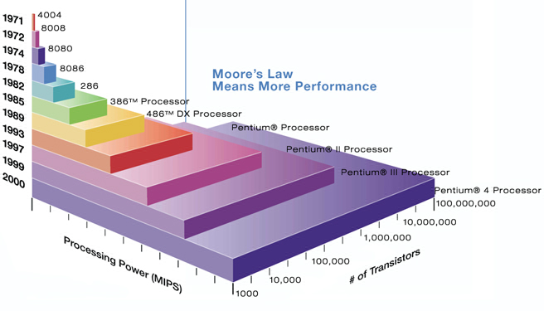
Why learn F#?
Moore’s Law Ran Out!

Slide 61
Why learn F#?
Moore’s Law Ran Out!
(again, maybe)

Slide 62
Data Grows Quickly
Amount of Possible Dimensions Grows much faster!
Amount of semi structured data outgrowing structured
Entropy Increasing

Slide 63
“Software gets slower faster than hardware gets faster”
--Wirth’s Law

Slide 64
Lisp F# is worth learning for the profound enlightenment experience you will have when you finally get it; that experience will make you a better programmer for the rest of your days, even if you never actually use Lisp F# itself a lot."
- Eric Raymond (lb)

Slide 65
Some Applications of F#
Map/Reduce over internets
Financial Analysis
In process SQL Data Mining
XNA Games Development
Web tools, Compile F# to Javascript

Slide 66
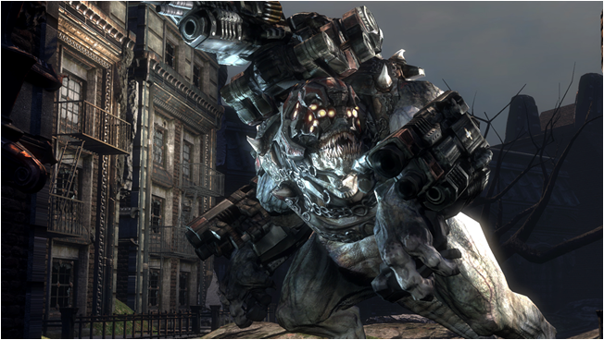
Game Programming

Slide 67
Game Programming
3D Animation
Rendering
Shading
Simulation (e.g. physics)
Collision Detection
AI Opponents
Notes:
Everything about

Slide 68
8 Ways to Learn
FSI.exe
Samples Included
Go to definition
Lutz’ Reflector
http://cs.hubfs.net
Codeplex Fsharp Samples
Books
ML

Slide 69
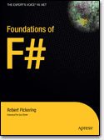
Acknowledgements
Cartman
Einstein
Dilbert
Alan Turing
Alonzo Church
Godzilla
Gears of war
John Hughes, Why Functional Programming Matters, http://www.math.chalmers.se/~rjmh/Papers/whyfp.html
Robert Pickering, Foundations of F#, http://www.apress.com/book/view/1590597575
Slava Akhmechet, Functional Programming For The Rest of Us, http://www.defmacro.org/ramblings/fp.html
Steve Yegge, Execution In the Kingdom of Nouns, http://steve-yegge.blogspot.com/2006/03/execution-in-kingdom-of-nouns.html
P. J. Landin, The Next 700 Programming Languages http://www.cs.utah.edu/~wilson/compilers/old/papers/p157-landin.pdf
Tim Sweeney, The Next Mainstream Programming Language, http://www.st.cs.uni-sb.de/edu/seminare/2005/advanced-fp/docs/sweeny.pdf
Tomas Petricek, F# Web Tools, Ajax Made Simple, http://www.codeplex.com/fswebtools
Don Syme, http://blogs.msdn.com/dsyme

