Slide 1
Language Oriented Programming and F#
Don Syme and the F# Team
Microsoft Research, Cambridge

Slide 2
Overview
What is F#?
F# includes a few, very general LOP mechanisms
Standard FP Core + Standard OO Core
Generic Programming over Types
Generic Programming over Expressions
Computation Expressions to “Build Semantically Rich F# Programs”

Slide 3
Overview
What is F#?
F# includes a few, very general LOP mechanisms
Standard FP + Standard OO Core
Generic Programming over Types
Generic Programming over Expressions
Computation Expressions to “Build Semantically Rich F# Programs”

Slide 4
The .NET Context
Visual Studio
Debuggers,
Profilers
.NET Common
Language
Runtime
C#
XML
Libraries
GUI Libraries,
etc.
Visual Basic
F#
ML
Graphics
Libraries
System.I/O
System.Net
etc.
Database
Connection
Libraries

Slide 5
What is F# about?
Or: Why is Microsoft investing in functional programming anyway?

Slide 6
Simplicity

Slide 7
Economics

Slide 8
Fun! Fun! And More Fun!

Slide 9
Simplicity

Slide 10
Code!
//F#
open System
let a = 2
Console.WriteLine a
//C#
using System;
namespace ConsoleApplication1
{
class Program
{
static int a()
{
return 2;
}
static void Main(string[] args)
{
Console.WriteLine(a);
}
}
}
More Noise
Than Signal!

Slide 11
Pleasure
Pain
type Command = Command of (Rover -> unit)
let BreakCommand =
Command(fun rover -> rover.Accelerate(-1.0))
let TurnLeftCommand =
Command(fun rover -> rover.Rotate(-5.0<degs>))
abstract class Command
{
public virtual void Execute();
}
abstract class MarsRoverCommand : Command
{
protected MarsRover Rover { get; private set; }
public MarsRoverCommand(MarsRover rover)
{
this.Rover = rover;
}
}
class BreakCommand : MarsRoverCommand
{
public BreakCommand(MarsRover rover)
: base(rover)
{
}
public override void Execute()
{
Rover.Rotate(-5.0);
}
}
class TurnLeftCommand : MarsRoverCommand
{
public TurnLeftCommand(MarsRover rover)
: base(rover)
{
}
public override void Execute()
{
Rover.Rotate(-5.0);
}
}

Slide 12
Pleasure
Pain
type Expr =
| True
| And of Expr * Expr
| Nand of Expr * Expr
| Or of Expr * Expr
| Xor of Expr * Expr
| Not of Expr
public abstract class Expr { }
public abstract class UnaryOp :Expr
{
public Expr First { get; private set; }
public UnaryOp(Expr first)
{
this.First = first;
}
}
public abstract class BinExpr : Expr
{
public Expr First { get; private set; }
public Expr Second { get; private set; }
public BinExpr(Expr first, Expr second)
{
this.First = first;
this.Second = second;
}
}
public class TrueExpr : Expr { }
public class And : BinExpr
{
public And(Expr first, Expr second) : base(first, second) { }
}
public class Nand : BinExpr
{
public Nand(Expr first, Expr second) : base(first, second) { }
}
public class Or : BinExpr
{
public Or(Expr first, Expr second) : base(first, second) { }
}
public class Xor : BinExpr
{
public Xor(Expr first, Expr second) : base(first, second) { }
}
public class Not : UnaryOp
{
public Not(Expr first) : base(first) { }
}
http://stepheneasey.wordpress.com/tag/c/

Slide 13
Pleasure
Pain
let rotate (x,y,z) = (z,x,y)
let reduce f (x,y,z) =
f x + f y + f z
Tuple<V,T,U> Rotate(Tuple<T,U,V> t)
{
return new Tuple<V,T,U>(t.Item3,t.Item1,t.Item2);
}
int Reduce(Func<T,int> f,Tuple<T,T,T> t)
{
return f(t.Item1) + f(t.Item2) + f (t.Item3);
}

Slide 14
Economics

Slide 15
You
Can
Interoperate
With
Everything

Slide 16
Everything
Can
Interoperate
With
You

Slide 17
F#: Influences
OCaml
C#/.NET
F#
Similar core
language
Similar object
model

Slide 18
Demo

Slide 19
Functional Core
Objects
Units of Measure
Imperative Mutation & I/O
Computation Expressions
Meta Programming
Functional Data

Slide 20
Overview
F# includes a few, very general LOP mechanisms
Standard FP + Standard OO Core
Generic Programming over Types
Generic Programming over Expressions
Computation Expressions to “Build Semantically Rich F# Programs”

Slide 21
Objects
Class Types
type ObjectType(args) =
let internalValue = expr
let internalFunction args = expr
let mutable internalState = expr
member x.Prop1 = expr
member x.Meth2 args = expr
Interface Types
type IObject =
interface ISimpleObject
abstract Prop1 : type
abstract Meth2 : type -> type
Constructing Objects
new FileInfo(@"c:\misc\test.fs")

Slide 22
F# - Objects + Functional
type Vector2D(dx:double,dy:double) =
member v.DX = dx
member v.DY = dy
member v.Length = sqrt(dx*dx+dy*dy)
member v.Scale(k) = Vector2D(dx*k,dy*k)
Inputs to object construction
Exported properties
Exported method

Slide 23
F# - Objects + Functional
type Vector2D(dx:double,dy:double) =
let norm2 = dx*dx+dy*dy
member v.DX = dx
member v.DY = dy
member v.Length = sqrt(norm2)
member v.Norm2 = norm2
Internal (pre-computed) values and functions

Slide 24
F# - Objects + Functional
Immutable inputs
type HuffmanEncoding(freq:seq<char*int>) =
...
< 50 lines of beautiful functional code>
...
member x.Encode(input: seq<char>) =
encode(input)
member x.Decode(input: seq<char>) =
decode(input)
Internal tables
Publish access

Slide 25
F# - Objects + Functional
type Vector2D(dx:double,dy:double) =
let mutable currDX = dx
let mutable currDX = dy
member v.DX = currDX
member v.DY = currDY
member v.Move(x,y) =
currDX <- currDX+x
currDY <- currDY+y
Internal state
Publish internal state
Mutate internal state

Slide 26
F# - Imperative
Using .NET collections
open System.Collections.Generic
let dict = new Dictionary<int,string>(1000)
dict.[17] <- "Seventeen"
dict.[1000] <- "One Grand"
for (KeyValue(k,v)) in dict do
printfn "key = %d, value = %s" k v

Slide 27
F# - Imperative
“use” =
C# “using”
open System.IO
open System.Collections.Generic
let readAllLines(file) =
use inp = File.OpenText file
let res = new List<_>()
while not(inp.EndOfStream) do
res.Add(inp.ReadLine())
res.ToArray()

Slide 28
F# - Imperative
open System.IO
open System.Collections.Generic
let readAllLines(file) =
let inp = File.OpenText file
try
let res = new List<_>()
while not(inp.EndOfStream) do
res.Add(inp.ReadLine())
res.ToArray()
finally inp.Close()

Slide 29
Language Oriented Programming in F#

Slide 30
Overview
F# includes a few, very general LOP mechanisms
Standard FP + Standard OO Core
Generic Programming over Types
Generic Programming over Expressions
Computation Expressions to “Build Semantically Rich F# Programs”

Slide 31
Sample LOP “Design Elements”
Strings
Regular Expressions
Parse Trees
XML Object Model
Minimal Abstract Syntax of Propositional Logic
Discriminated Unions
Combinator Library
Attributes
Expression Trees
Monads
Attribute Grammars
Binary Rewriting
...

Slide 32
The Balancing Act
A GPPL needs
A small number of very widely applicable techniques
Good integration of these techniques to maximize their value together

Slide 33
LOP Taxonomy
XML, CSV, Text, Strings, JSON
The language
is in the data
Concrete Representations
Abstract Representations
Integrated Representations
Parse Trees
The language
is in the code
Almost-Implicit
Parallelism
Queries
Exception Handling
Workflows

Slide 34
LOP Techniques
XML Libraries
RegExp Libraries
Lex/Yacc
...
Concrete Representations
Abstract Representations
Integrated Representations
Discriminated Unions
Pattern Matching
F# Computation Expressions
Expression Trees

Slide 35
Kinds of languages
There can be many of these languages
No Structure
Syntactic Structure
Minimal Syntactic Structure + Some Semantic Properties
Lots of Semantic and Computational Structure
Typed AST
Very Generic (XML Object Model)
Monadic Languages
Strings
BDDs
Very Specific (Models one problem)
RegExp
Combinator API
Much FP Research Focuses Here
Many real world gains are here

Slide 36
Overview
F# includes a few, very general LOP mechanisms
Standard FP + Standard OO Core
Generic Programming over Types
Generic Programming over Expressions
Computation Expressions to “Build Semantically Rich F# Programs”

Slide 37
Technique #1: Programming Over Types, the F# Way

Slide 38
Getting in
Data lives outside
e.g. Log File
Excel Spreadsheet
Getting data in
is too hard!!!!
No Structure
Syntactic Structure
Minimal Syntactic Structure + Some Semantic Properties
Lots of Semantic and Computational Structure
Typed AST
Very Generic (XML Object Model)
Monadic Languages
Strings
BDDs
Very Specific (Models one problem)
RegExp
Combinator APIs
???
???
???
???

Slide 39
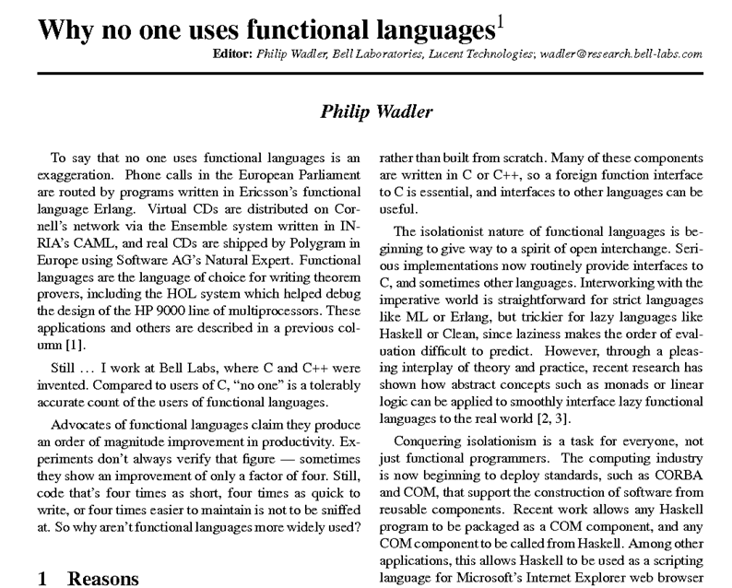

Slide 40
The end of isolation...
We need this “impossible” function
(for any ‘T of the “right” shape)
Without incurring enormous type system complexity
Without breaking runtime memory safety
ReadStandardLogFile<'T> : file:string -> 'T seq

Slide 41
Example
Steve, 12/03/2007, Cheddar
Sally, 18/02/2007, Brie
Simple Task, Surprisingly Hard
type CheeseClub =
{ Name : string
FavouriteCheese : string
LastAttendance : System.DateTime }
Getting and keeping things under the type discipline is critical to productivity
Database

Slide 42
The Role of Types
In applied typed FP and OO programming, type declarations are not just for in-memory data
They must also serve as general, interoperable schema representations
That is, the language of type declarations must rich enough to indicate
What the data looks like
How the data is transformed to and from its dominant standard formats
And much more...
The software architect must be able to take and use this information in interesting ways

Slide 43
The Role of Types
The F# and .NET solution to this is
Provide the fundamentals to allow semi-safe, generic programming over attributed type declarations
Spiritually akin to “research” generic programming, but tuned very, very differently

Slide 44
Example (Python-esque)
let reader = new SchemaReader()
reader.ReadFile("members.txt") : obj list

Slide 45
Example (F#-esque)
type CheeseClub =
{ [<Column(0)>] Name : string
[<Column(2)>] FavouriteCheese : string
[<Column(1)>] LastAttendance : System.DateTime }
let reader = new SchemaReader<CheeseClub>()
reader.ReadFile("members.txt") : CheeseClub list

Slide 46
Example
A generic component for mediating between the untyped and typed world
(for a specific class of attributed type definitions)
type SchemaReader<'T>() =
member ReadFile : string -> 'T seq
member WriteFile : 'T seq * string -> unit
Depends on types being implicitly or explicitly self-describing

Slide 47
Foundations
.NET Generics Reified Type Parameters
typeof<‘T> : System.Type
.NET Reflection on Definitional Structure
ty.IsUnion/IsRecord/GetUnionCases/GetMethods/GetProperties
.NET Reflection - Constructing Values
Reflection.FSharpValue.MakeRecord(ty,objs)
box : ‘T -> obj
Runtime Checked “Proofs” That It All Adds Up
unbox : obj -> ‘T

Slide 48
Example
DVD Player, 17/02/2009, MyDvD#1, Click
York Hotel, 18/02/2009, CheapHotels#2, NoClick
....
for 7 billion lines
type PageView =
{ SearchTerm : string
Date : System.DateTime
Advertisement : Advertisement
Result : bool }
Database

Slide 49
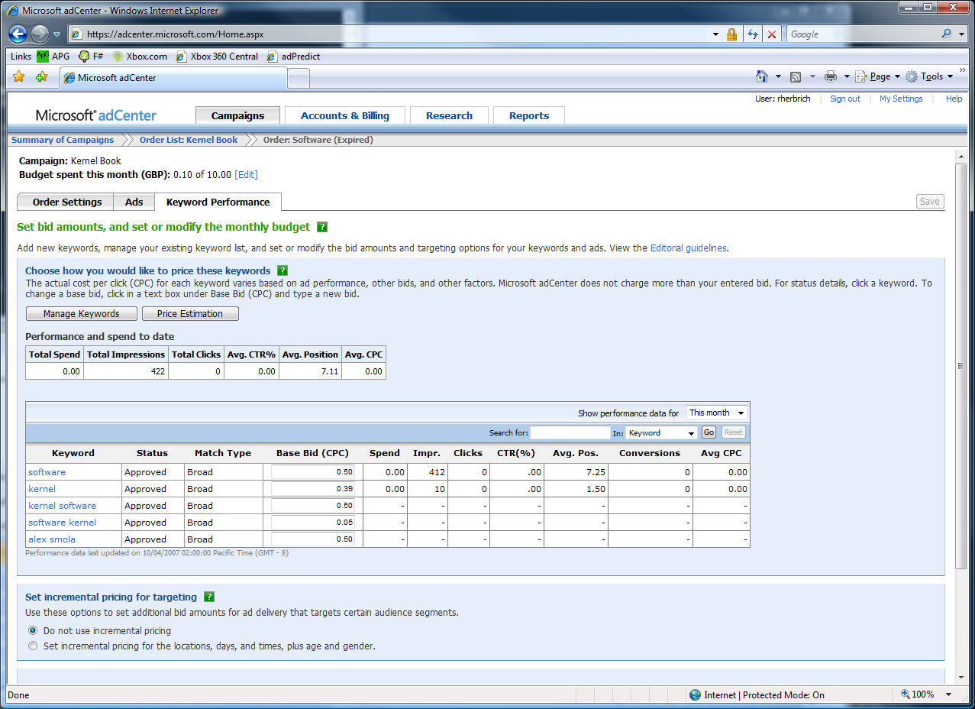

The adCenter Problem

Slide 50
The Scale of Things
Weeks of data in training:
7,000,000,000 impressions, 6TB data
2 weeks of CPU time during training:
2 wks × 7 days × 86,400 sec/day =
1,209,600 seconds
Learning algorithm speed requirement:
5,787 impression updates / sec
172.8 μs per impression update

Slide 51
F# and adCenter
4 week project, 4 machine learning experts
100million probabilistic variables
Processes 6TB of training data
Real time processing

Slide 52
Technique #2: Programming Over Expressions, the F# Way

Slide 53
Overview
F# includes a few, very general LOP mechanisms
Standard FP + Standard OO Core
Generic Programming over Types
Generic Programming over Expressions
Computation Expressions to “Build Semantically Rich F# Programs”

Slide 54
Getting out
No Structure
Syntactic Structure
Minimal Syntactic Structure + Some Semantic Properties
Lots of Semantic and Computational Structure
Typed AST
Very Generic (XML Object Model)
Monadic Languages
Strings
BDDs
Very Specific (Models one problem)
RegExp
Combinator APIs
???
Traditionally far too hard to get entities modelled using computational techniques “out” of the computational framework

Slide 55
<@ ... @>
Makes the expression available as a typed AST
let t = <@ 1 + 1 @>
[<ReflectedDefinition>]
let f x = x + 3
Makes the definition available as both code and as a typed TAST

Slide 56

Getting Out
SQL <@ [ for customer in db.Customers do
for employee in db.Employees do
if customer.Name = employee.Name then
yield (customer.Name, employee.Address) ] @>
SQL : Expr<seq<'a>> -> seq<'a>
LINQ
SQL Database

Slide 57
Getting Out
Javascript <@ ...@>
F#-to-Javascript
Browser Client

Slide 58
Getting Out
Differentiate <@ ...@>
Automatic Differentiation Engine
Execute

Slide 59
Overview
F# includes a few, very general LOP mechanisms
Standard FP + Standard OO Core
Generic Programming over Types
Generic Programming over Expressions
Computation Expressions to “Build Semantically Rich F# Programs”

Slide 60
Overview
F# includes a few, very general LOP mechanisms
Standard FP + Standard OO Core
Generic Programming over Types
Generic Programming over Expressions
Computation Expressions to “Build Semantically Rich F# Programs”

Slide 61
F# Computation Expressions

Slide 62
Kinds of languages
No Structure
Syntactic Structure
Minimal Syntactic Structure + Some Semantic Properties
Lots of Semantic and Computational Structure
Typed AST
Very Generic (XML Object Model)
Monadic Languages
Strings
BDDs
Very Specific (Models one problem)
RegExp
Combinator API
Attributes on
Declarations
Computation
Expressions

Slide 63
Computation Expressions
F# has five primary syntactic categories
Expressions
Declarations
Types
Patterns
Computation Expressions (= Workflows = Monadic Syntax)

Slide 64
Computation Expressions
Monadic syntax added to F# aimed at:
List/Sequence/Array comprehensions
Database queries
Asynchronous/Reactive Programming
Probabilistic modelling
Modalities (client/server)
≈≈ "monads", but rebranded, partly on advice
seq { ... }
async { ... }
option { ... }
seq<'a>
= IEnumerable<'a>
Async<'a>
≈ ('a -> unit) -> unit
Optional<'a>
= unit -> 'a option
server { ... }
client { ... }
dist { ... }
Server<'a>
= unit -> 'a
Client<'a>
= unit -> 'a
Distribution<'a>

Slide 65
Computation Expressions
async { let! image = readAsync "cat.jpg"
let image2 = f image
do! writeAsync image2 "dog.jpg"
do printfn "done!"
return image2 }
Async<'a>
{ for x in 0 .. 10 -> (x,x*x) }
[ for x in 0 .. 10 -> (x,x*x) ]
seq<'a> = IEnumerable<'a>
[| for x in 0 .. 10 -> (x,x*x) |]
<@ seq { for c in db.Customers do
for e in db.Employees do
if c.Name = e.Name then
yield (c.Name,c.Address,e.Address) } @>
seq<'a> + meta-program
member x.OnClick(EventArgs) =
client { let! x = ...
do! ... }
member x.OnPageLoad() =
server { ... }
member OnClick : EventArgs -> Client<'a>
member OnPageLoad : unit -> Server<'a>

Slide 66
Computation Expressions
async { let! image = readAsync "cat.jpg"
let image2 = f image
do! writeAsync image2 "dog.jpg"
do printfn "done!"
return image2 }
Asynchronous "non-blocking" action
Continuation/
Event callback
You're actually writing this (approximately):
async.Delay(fun () ->
async.Bind(readAsync "cat.jpg", (fun image ->
async.Bind(async.Return(f image),(fun image2
async.Bind(writeAsync "dog.jpg",(fun () ->
async.Bind(async.Return(printfn "done!"),(fun () ->
async.Return())))))))))

Slide 67
async { ... }
A Building Block for Async/Parallel/Reactive Design Patterns
async { ... }
For users:
You can run it, but it may take a while
Or, your builder says...
OK, I can do the job, but I might have to talk to someone else about it. I’ll get back to you when I’m done

Slide 68
An Important Assumption...
.NET threads map to O/S threads
O/S threads are relatively expensive
async { ... } is a way of making more efficient use of O/S threads for “event” and “task”-based programming

Slide 69
Demo

Slide 70
Taming Asynchronous I/O
Open the file, synchronously
Equivalent F# code
(same perf)
Read from the file,
asynchronously
let ProcessImageAsync(i) =
async { use inStream = File.OpenRead(sprintf "source%d.jpg" i)
let! pixels = inStream.ReadAsync(numPixels)
let pixels' = TransformImage(pixels,i)
use outStream = File.OpenWrite(sprintf "result%d.jpg" i)
do! outStream.WriteAsync(pixels')
do Console.WriteLine "done!" }
let ProcessImagesAsync() =
Async.Run (Async.Parallel
[ for i in 1 .. numImages -> ProcessImageAsync(i) ])
This object coordinates
Write the result, asynchronously
“!”
= “asynchronous”
Generate the tasks and queue them in parallel

Slide 71
async { ... }
A Building Block for Async/Parallel/Reactive Design Patterns
async { ... }
More specifically:
User level tasks implemented using the continuation monad
try/catch, try/finally, start included
I/O primitives execute asynchronously (do not block O/S threads)
Explicit parallelism (StartChild, SwitchToNewThread)
Cooperative cancellation

Slide 72
Computation Expressions
Give the outer control structure of this syntactic expression different computational interpretation
expr = ident { expr }
cexpr; cexpr
let pat = expr in cexpr
use id = expr in cexpr
match expr with pat -> cexpr
if .. then cexpr else cexpr
try cexpr with pat -> cexpr
try cexpr finally cexpr
while ... do cexpr
for pat in ... do cexpr

Slide 73
Computation Expressions
Add extra expression forms for monadic actions
expr = ident { expr }
| return expr
| let! pat = expr
cexpr; cexpr
let pat = expr in cexpr
use id = expr in cexpr
match expr with pat -> cexpr
if .. then cexpr else cexpr
try cexpr with pat -> cexpr
try cexpr finally cexpr
while ... do cexpr
for pat in ... do cexpr

Slide 74
type MonadBuilder() with
member Return : 'a -> M<'a>
member Delay : (unit -> M<'a>) -> M<'a>
member Bind: M<'a> * ('a -> M<'b>) -> M<'b>
let monad = MonadBuilder()

Slide 75
type AsyncBuilder() with
member Return : 'a -> Async<'a>
member Delay : (unit -> Async<'a>) -> Async<'a>
member Bind: Async<'a> * ('a -> Async<'b>) -> Async<'b>
let async = AsyncBuilder()

Slide 76
type MonadBuilder() with
member Return : 'a -> M<'a>
member Delay : (unit -> M<'a>) -> M<'a>
member Bind: M<'a> * ('a -> M<'b>) -> M<'b>
member Combine: M<unit> * M<'a> -> M<'a>
member TryFinally : M<'a> * (unit -> unit) -> M<'a>
member TryWith : M<'a> * (exn -> M<'a>) -> M<'a>
let monad = MonadBuilder()

Slide 77
Computation Expression Syntax & Translation
expr = ...
| expr { cexpr } -- let v = expr in v.Delay(fun () -> «cexpr»)
| { cexpr }
| [| cexpr |]
| [ cexpr ]
cexpr = let! pat = expr in cexpr -- v.Bind(expr,(fun pat -> «cexpr»))
| use pat = expr in cexpr -- v.Using(expr,(fun pat -> «cexpr»))
| do! cexpr1 in cexpr2 -- «let! () = cexpr1 in cexpr2»
| do expr in cexpr -- «let () = cexpr1 in cexpr2»
| for pat in expr do cexpr -- v.For(expr,(fun pat -> «cexpr»))
| while expr do cexpr -- v.While((fun () -> expr),
v.Delay(fun () -> «cexpr»))
| if expr then cexpr else cexpr -- if expr then «cexpr1» else «cexpr2»
| if expr then cexpr -- if expr then «cexpr1» else v.Zero()
| cexpr; cexpr -- v.Combine(«cexpr1», v.Delay(fun () -> «cexpr2»))
| return expr -- v.Return(expr)
| yield expr -- v.Yield(expr)
| match expr with [pat -> cexpr]+ -- ...
| try cexpr finally cexpr -- ...
| try cexpr with pat -> cexpr -- ...

Slide 78
Aims
Very Smooth Transitions to/from Monadic Code
For
Sequences
Database Queries
Asynchronous (non-blocking) Programming
“Put async { ... } around it and add let! where needed”

Slide 79
Wrap Up

Slide 80
Overview
F# includes a few, very general LOP mechanisms
Standard FP + Standard OO Core
Generic Programming over Types
Generic Programming over Expressions
Computation Expressions
Cross the typed/untyped divide, generically
Run F# Programs in other ways, other places
Combine F# Program fragments in other ways, monadically

Slide 81
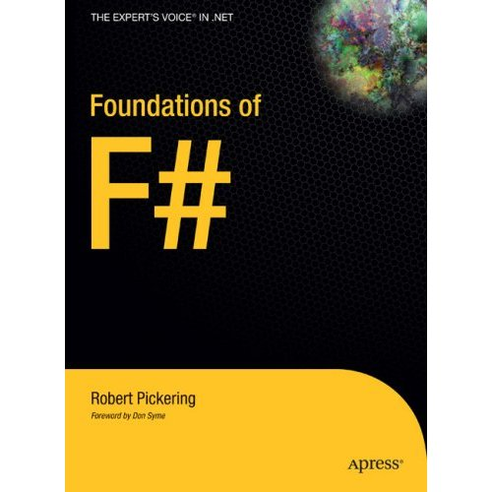
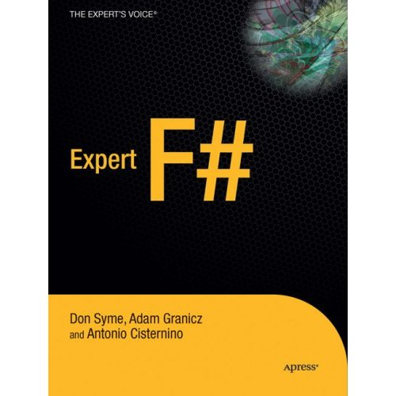
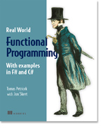

Books about F#
Visit www.fsharp.net

Slide 82
Questions & Discussion

Slide 83

1985
Mirror on underside of shuttle
SDI experiment: The plan
Big mountain in Hawaii

Slide 84
1985
SDI experiment:
The reality

Slide 85
1985
The reality

Slide 86
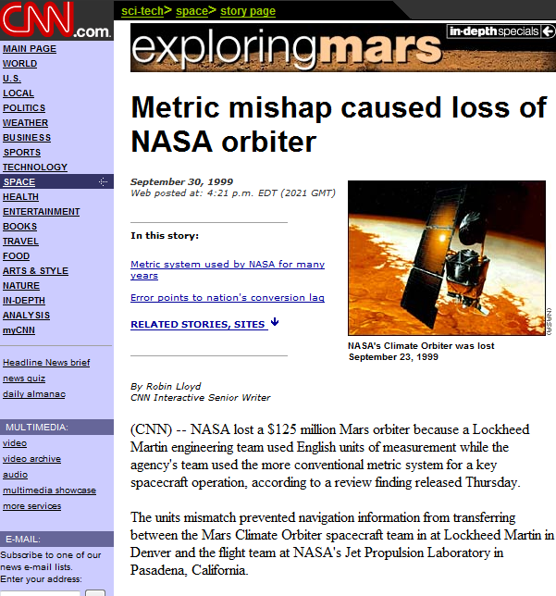
NASA Mars Climate Orbiter, 1999

Slide 87
NASA Mars Climate Orbiter, 1999

Slide 88
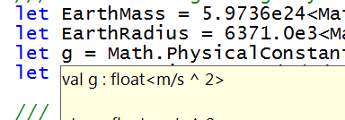
let EarthMass = 5.9736e24<kg>
// Average between pole and equator radii
let EarthRadius = 6371.0e3<m>
// Gravitational acceleration on surface of Earth
let g = PhysicalConstants.G * EarthMass / (EarthRadius * EarthRadius)

Slide 89
AdPredict: What We Observed
F#’s powerful type inference means less typing, more thinking
Type-inferred code is easily refactored
Quick Coding
Agile Coding
Scripting
Performance
Memory-Faithful
Succinct
Symbolic
.NET Integration
“Hands-on” exploration.
Immediate scaling to massive data sets
mega-data structures, 16GB machines
Live in the domain, not the language
Schema compilation and “Schedules”
Especially Excel, SQL Server

Slide 90
Methodology? Communication?
So we all intuitively know what LOP is
But we communicate this in muddy terms
How is “The Language” represented? Why?
How does it relate to the host language? Its syntax? Its semantics? Its operational properties?
What techniques are available?
What methodology is used to make these decisions?

Slide 91
F#: Combining Paradigms
I've been coding in F# lately, for a production task. F# allows you to move smoothly in your programming style... I start with pure functional code, shift slightly towards an object-oriented style, and in production code, I sometimes have to do some imperative programming.
I can start with a pure idea, and still finish my project with realistic code. You're never disappointed in any phase of the project!
Julien Laugel, Chief Software Architect, www.eurostocks.com

