Slide 1

F# 3.0 Information Rich Programming
Don Syme + Visual Studio F# Team, FPDay 2011

Slide 2
What is Functional Programming Anyway?

Slide 3
Background: Principles of Typed Functional Programming
Compositionality
Immutability, Purity
Definition before use
Strong typing
Algebraic transformation and reasoning
Separation and isolation of side effects
Lazy computational structures
Identity through intension not extension
Rich Parameterization
Inference and Automatic Generalization
Unbreakable data hiding techniques
(phase1 >> phase2)
(op1 `orElse` op2)
event |> E.filter ... |> E.map ...
All typed functional languages encourage these techniques
Different languages enforce them to different degrees
"let A be a group"
"let x be a member of A"
These encourage compositionality
let x = (1,2)
…
fst x
≈
1
Types help you think, maintain, compose, interoperate, reason, communicate, run fast
Many techniques:
Explicit:
let gcd ((+),(>),zero) n m =
...
Inferred:
gcd :: Num a => a -> a -> a
gcd n m = ...
Generics, Functors, etc. etc.
Goodbye (most) null pointers
Ensure coherent initialization
Note: Lambda Syntax Not Mentioned
inp |> map id
≈
inp
inp |> map f |> map g |> filter p
≈
inp |> filter (f >> g >> p)
"do they do the same thing?"
not "do they have the same address"

Slide 4
Background: OO through this Lens
"OO is fine, but the defaults are all wrong" (Greg Morrisett)
Side effects everywhere
Needless over focus on object identity
Few program transformations turn out to be valid
Weak parameterization techniques
Use before definition possible all over the place
No asynchronous programming, sequence programming, query programming

Slide 5
However, there’s also a simpler way to explain it…

Slide 6
Functional Programming = Simple Code to Solve Complex Problems

Slide 7
Pleasure
Pain
let swap (x, y) = (y, x)
let rotations (x, y, z) =
[ (x, y, z);
(z, x, y);
(y, z, x) ]
let reduce f (x, y, z) =
f x + f y + f z
Tuple<U,T> Swap<T,U>(Tuple<T,U> t)
{
return new Tuple<U,T>(t.Item2, t.Item1)
}
ReadOnlyCollection<Tuple<T,T,T>> Rotations<T>(Tuple<T,T,T> t)
{
new ReadOnlyCollection<int>
(new Tuple<T,T,T>[]
{new Tuple<T,T,T>(t.Item1,t.Item2,t.Item3);
new Tuple<T,T,T>(t.Item3,t.Item1,t.Item2);
new Tuple<T,T,T>(t.Item2,t.Item3,t.Item1); });
}
int Reduce<T>(Func<T,int> f,Tuple<T,T,T> t)
{
return f(t.Item1)+f(t.Item2)+f(t.Item3);
}

Slide 8
Some sample F#...

Slide 9
Whitespace Matters
let computeDerivative f x =
let p1 = f (x - 0.05)
let p2 = f (x + 0.05)
(p2 – p1) / 0.1

Slide 10
Objects + Functional
type Vector2D (dx:double, dy:double) =
let d2 = dx*dx+dy*dy
member v.DX = dx
member v.DY = dy
member v.Length = sqrt d2
member v.Scale(k) = Vector2D (dx*k,dy*k)
Inputs to object
construction
Object internals
Exported properties
Exported method

Slide 11
[ … ]
Task: return all the files under a directory, as a list
let rec allFiles dir =
[ for file in Directory.GetFiles dir do
yield file
for sub in Directory.GetDirectories dir do
yield! allFiles sub ]
allFiles @"C:\LogFiles"

Slide 12
seq { … }
On-demand
Task: return all the files under a directory, on demand
let rec allFiles dir =
seq { for file in Directory.GetFiles dir do
yield file
for sub in Directory.GetDirectories dir do
yield! allFiles sub }
allFiles @"C:\LogFiles"
|> Seq.take 100
|> show
Pipelines

Slide 13
F# is…
...a productive, supported, interoperable, functional language that allows you to write simple code to solve complex problems.

Slide 14
Understanding F#
C# (designers)
F# (code)
WebSharper (HTML5)
Javascript…
F# 3.0
F# 2.0
Transformation,
Analysis,
Algorithms,
Code,
Parallel
Access
Data,
Information,
Services
Presentation,
Publication,
Experience

Slide 15



Example F# 2.0 Adoptions
Eon PowerGen
an F# engine balances the UK power generation schedule
Credit Suisse
120 quants use F# for all new models
WebSharper Platform
Simple, beautiful HTML5 programming, all in F#
Trayport, London (commodities trading software)
F# + C# for trading front-ends and algorithms
Thompson Reuters
Web services in F#
Amyris Biotech
Analysis and algorithms for algae biofuels

Slide 16
Example: Biotech
...F# rocks - building algorithms for DNA processing and it's like a drug. 12-15 at Amyris use F#...
F# has been phenomenally useful. I would be writing a lot of this in Python otherwise and F# is more robust, 20x - 100x faster to run and faster to develop.
Darren Platt, Amyris BioTechnologies

Slide 17
Now, F# 3.0…

Slide 18
Proposition 1 The world is information-rich

Slide 19
Proposition 2 Modern applications are information-rich

Slide 20
Proposition 3 Our languages are information-sparse

Slide 21
Proposition 4 This is a problem

Slide 22
Proposition 4 For typed languages, this is a big problem

Slide 23
Type Providers + LINQ = Language Integrated Data and Services

Slide 24
A Coding Challenge A Chemical Elements Library… Then a Biology Library… Then libraries for all of human knowledge…

Slide 25
Language Integrated Web Data
demo

Slide 26
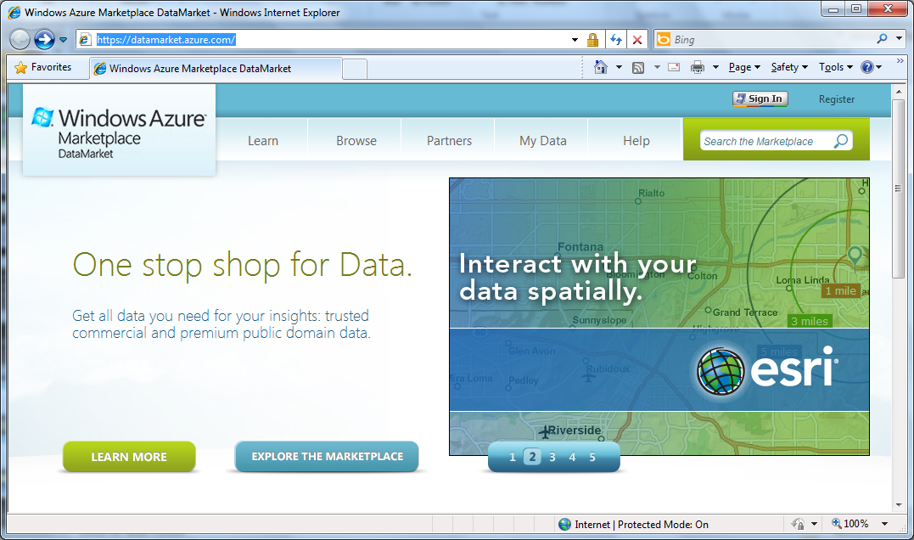

Slide 27
Language Integrated Data Market Directory
demo

Slide 28
A Type Provider is…
A design-time component that provides a computed space of types
A compiler/IDE extension…
The static counterpart to dynamic languages…
Intellisense for data
Extensible and open
Breaking down walls

Slide 29
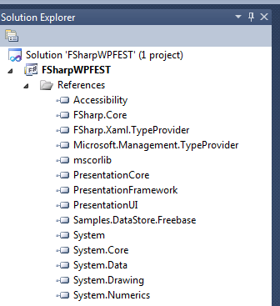


Slide 30
The key issues are… code-focused strong types simplicity consistency scale liveness open and extensible

Slide 31
// Freebase.fsx
// Example of reading from freebase.com in F#
// by Jomo Fisher
#r "System.Runtime.Serialization"
#r "System.ServiceModel.Web"
#r "System.Web"
#r "System.Xml"
open System
open System.IO
open System.Net
open System.Text
open System.Web
open System.Security.Authentication
open System.Runtime.Serialization
[<DataContract>]
type Result<'TResult> = {
[<field: DataMember(Name="code") >]
Code:string
[<field: DataMember(Name="result") >]
Result:'TResult
[<field: DataMember(Name="message") >]
Message:string
}
[<DataContract>]
type ChemicalElement = {
[<field: DataMember(Name="name") >]
Name:string
[<field: DataMember(Name="boiling_point") >]
BoilingPoint:string
[<field: DataMember(Name="atomic_mass") >]
AtomicMass:string
}
How would we do this today?
let Query<'T>(query:string) : 'T =
let query = query.Replace("'","\"")
let queryUrl = sprintf "http://api.freebase.com/api/service/mqlread?query=%s" "{\"query\":"+query+"}"
let request : HttpWebRequest = downcast WebRequest.Create(queryUrl)
request.Method <- "GET"
request.ContentType <- "application/x-www-form-urlencoded"
let response = request.GetResponse()
let result =
try
use reader = new StreamReader(response.GetResponseStream())
reader.ReadToEnd();
finally
response.Close()
let data = Encoding.Unicode.GetBytes(result);
let stream = new MemoryStream()
stream.Write(data, 0, data.Length);
stream.Position <- 0L
let ser = Json.DataContractJsonSerializer(typeof<Result<'T>>)
let result = ser.ReadObject(stream) :?> Result<'T>
if result.Code<>"/api/status/ok" then
raise (InvalidOperationException(result.Message))
else
result.Result
let elements = Query<ChemicalElement array>("[{'type':'/chemistry/chemical_element','name':null,'boiling_point':null,'atomic_mass':null}]")
elements |> Array.iter(fun element->printfn "%A" element)

Slide 32
How do we mediate today?
Untyped,
non-navigable
UI designs
WCF services
WebRequest
XmlReader
ReadJSON
SqlReader
...
Resources
objects
strings
bytes
program
Web services
Databases

Slide 33
How do we mediate today? Codegen, Codegen, Codegen!!
Ok, but…
there are problems ☺
UI designs
xaml designer
WCF services
svcutil.exe
types
+
code
Resources
resgen.exe
program
Web Services
datasvcutil.exe
Databases
edmgen.exe
...
yacg.exe

Slide 34
Note: F# still contains no data Open architecture You can write your own type provider

Slide 35
A type provider (one type, one property, one ctor)
[<TypeProvider>]
type SampleTypeProvider(config: TypeProviderConfig) as this =
inherit TypeProviderForNamespaces()
let t = ProvidedTypeDefinition(namespaceName,"OneType",Some typeof<obj>)
let ctor = ProvidedConstructor([ProvidedParameter("Name",typeof<string>)],
InvokeCode = (fun args -> <@@ box<string> (%%args.[0]) @@>))
t.AddMember ctor
let prop = ProvidedProperty("Name", typeof<string>,
GetterCode= (fun args -> <@@ unbox<string> (%%args.[0]) @@>))
t.AddMember prop
do this.AddNamespace("Samples.TypeSpace", [ t ])
[<assembly:TypeProviderAssembly>]
do()

Slide 36
OData
type Netflix = ODataService<"http://odata.netflix.com">
Fluent, Typed Access To OData

Slide 37
SQL
type SQL = SqlDataConnection<"Server='.\\SQLEXPRESS'..">
Fluent, Typed Access To SQL

Slide 38
SharePoint
type EmeaSite = SharePointSite<"http://myemea/">
Fluent, Typed Access To SharePoint Lists

Slide 39
F# 3.0: Queries
let avatarTitles =
query { for t in netflix.Titles do
where (t.Name.Contains "Avatar")
select t }

Slide 40
F# 3.0: Queries
let avatarTitles =
query { for t in netflix.Titles do
where (t.Name.Contains "Avatar")
sortBy t.Name
select t }

Slide 41
F# 3.0: Queries
let avatarTitles =
query { for t in netflix.Titles do
where (t.Name.Contains "Avatar")
sortBy t.Name
select t
take 100 }

Slide 42
Applications
…web data
…data markets
…WMI & active directory
…a spreadsheet
…web services
…CRM data
…social data
…SQL data
…XML data
...
strongly typed
without explicit codegen
extensible, open

Slide 43
Summary The world is information rich Our typed language architectures need to be adjusted for the information-rich world Consume anything! Directly! Strongly typed! No walls!

Slide 44
In Summary
F# 3.0
Ready for use in VS 11
Code-focused analytical programming
An amazing data-rich future ahead
Simple, expressive, productive, interoperable language

Slide 45

F# in Visual Studio 2010…

