Slide 1

Reconsidering Strongly Typed Programming in the Information Rich World
Don Syme, Principal Researcher,
Microsoft Research, UK

Slide 2
F# and Open Source
F# 2.0 compiler+library open source drop
Apache 2.0 license
Runs on Linux, Mac, Windows, Browser

Slide 3
F# for the Browser & Web
www.tryfsharp.org
(F# Console + Tutorials)
pitfw.posterous.com
(F# to JS/HTML5, Community)
websharper.com
(F# to JS/HTML5, Product)

Slide 4
Today’s talk is very simple

Slide 5
Proposition 1 The world is information-rich

Slide 6
Proposition 2 Modern applications are information-rich

Slide 7
Proposition 3 Our languages are information-sparse

Slide 8
Proposition 4 This is a problem (especially for strongly typed programming)

Slide 9
With F# we want to help fix this… The mechanism we’re adding to F# is called Type Providers

Slide 10
LINQ = Language Integrated Queries

Slide 11
LINQ + Type Providers = Language Integrated Data and Services

Slide 12
Two aims today Demonstrate what we’re doing in F# 3.0 Explore the ramifications of information-richness for languages, engineering and tooling

Slide 13
But first… What is F#?

Slide 14
F# is…
...a practical, strongly-typed , functional-first , supported language that allows you to write simple code to solve complex problems.

Slide 15
Typed Functional Core
Functional Data
Units of Measure
Imperative Mutation & I/O
Computation Expressions
(monads, async, comprehensions)
Meta Programming
(quote)
Objects
(Nominal)
Type Providers
(lazy type macros)

Slide 16
Simplicity: Functions as Values
abstract class Command
{
public virtual void Execute();
}
abstract class RoverCommand : Command
{
protected Rover Rover { get; private set; }
public RoverCommand(MarsRover rover)
{
this.Rover = rover;
}
}
class BreakCommand : RoverCommand
{
public BreakCommand(Rover rover) : base(rover)
{
}
public override void Execute()
{
Rover.Rotate(-5.0);
}
}
class TurnLeftCommand : RoverCommand
{
public TurnLeftCommand(Rover rover) : base(rover)
{
}
public override void Execute()
{
Rover.Rotate(-5.0);
}
}
OO
F#
type Command = Command of (Rover -> unit)
let BreakCommand =
Command(fun rover -> rover.Accelerate(-1.0))
let TurnLeftCommand =
Command(fun rover -> rover.Rotate(-5.0<degs>))

Slide 17
Simplicity: Functional Data
C#
Tuple<U,T> Swap<T,U>(Tuple<T,U> t)
{
return new Tuple<U,T>(t.Item2, t.Item1)
}
ReadOnlyCollection<Tuple<T,T,T>> Rotations<T>(Tuple<T,T,T> t)
{
new ReadOnlyCollection<int>
(new Tuple<T,T,T>[]
{ new Tuple<T,T,T>(t.Item1,t.Item2,t.Item3);
new Tuple<T,T,T>(t.Item3,t.Item1,t.Item2);
new Tuple<T,T,T>(t.Item2,t.Item3,t.Item1); });
}
int Reduce<T>(Func<T,int> f,Tuple<T,T,T> t)
{
return f(t.Item1) + f(t.Item2) + f (t.Item3);
}
let swap (x, y) = (y, x)
let rotations (x, y, z) =
[ (x, y, z);
(z, x, y);
(y, z, x) ]
let reduce f (x, y, z) =
f x + f y + f z
F#

Slide 18
The Big Trends
WEB
MULTICORE
DATA

Slide 19
Part 2 F# 3.0 Information Rich Programming

Slide 20
A Challenge Task #1: A Chemistry Elements Class Library Task #2: Biology… Task #3: Repeat for all Sciences, Businesses, …

Slide 21
Language Integrated Web Data
demo

Slide 22
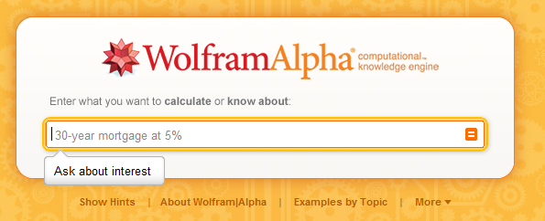
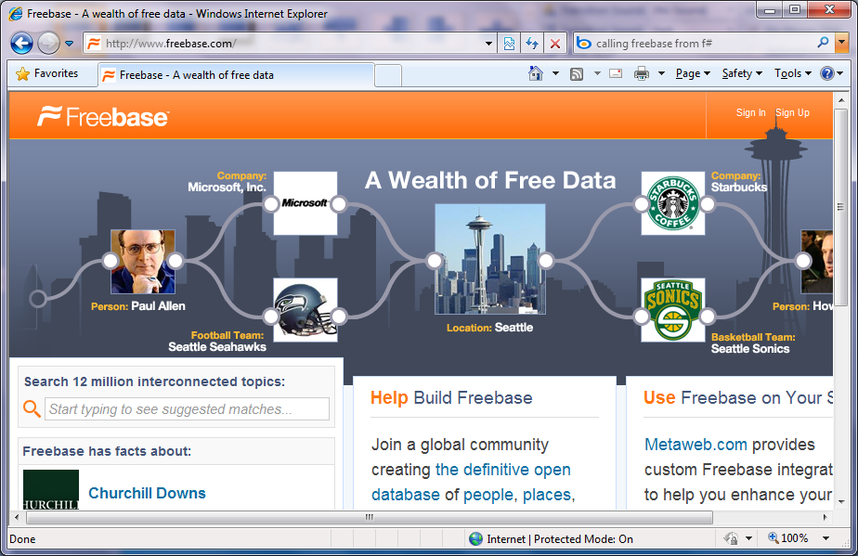
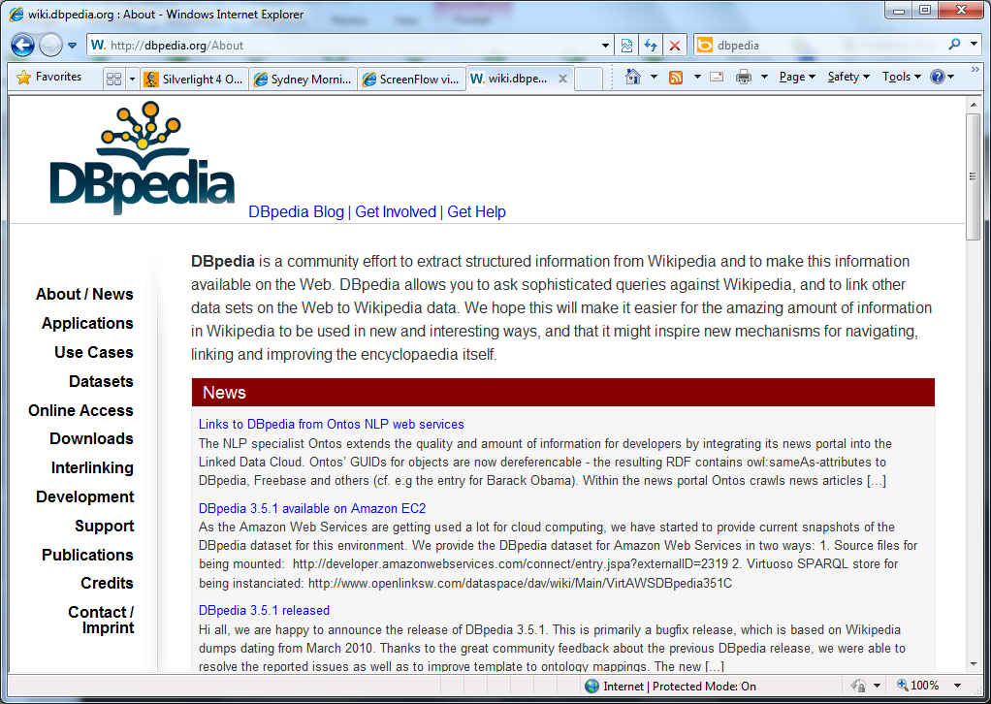
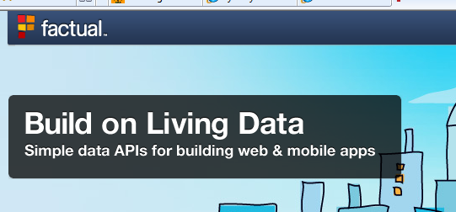
The Data Deluge
Organized Data
Enormous number of “types”
Very interlinked, internally and externally
Includes semantic webs, ontologies, web data services, traditional DBs…

Slide 23
A Type Provider is…. “A compile-time component that provides a computed space of types and methods on-demand …” “A compiler plug-in…” “An adaptor between data/services and the .NET type system…”

Slide 24
// Freebase.fsx
// Example of reading from freebase.com in F#
// by Jomo Fisher
#r "System.Runtime.Serialization"
#r "System.ServiceModel.Web"
#r "System.Web"
#r "System.Xml"
open System
open System.IO
open System.Net
open System.Text
open System.Web
open System.Security.Authentication
open System.Runtime.Serialization
[<DataContract>]
type Result<'TResult> = {
[<field: DataMember(Name="code") >]
Code:string
[<field: DataMember(Name="result") >]
Result:'TResult
[<field: DataMember(Name="message") >]
Message:string
}
[<DataContract>]
type ChemicalElement = {
[<field: DataMember(Name="name") >]
Name:string
[<field: DataMember(Name="boiling_point") >]
BoilingPoint:string
[<field: DataMember(Name="atomic_mass") >]
AtomicMass:string
}
let Query<'T>(query:string) : 'T =
let query = query.Replace("'","\"")
let queryUrl = sprintf "http://api.freebase.com/api/service/mqlread?query=%s" "{\"query\":"+query+"}"
let request : HttpWebRequest = downcast WebRequest.Create(queryUrl)
request.Method <- "GET"
request.ContentType <- "application/x-www-form-urlencoded"
let response = request.GetResponse()
let result =
try
use reader = new StreamReader(response.GetResponseStream())
reader.ReadToEnd();
finally
response.Close()
let data = Encoding.Unicode.GetBytes(result);
let stream = new MemoryStream()
stream.Write(data, 0, data.Length);
stream.Position <- 0L
let ser = Json.DataContractJsonSerializer(typeof<Result<'T>>)
let result = ser.ReadObject(stream) :?> Result<'T>
if result.Code<>"/api/status/ok" then
raise (InvalidOperationException(result.Message))
else
result.Result
let elements = Query<ChemicalElement array>("[{'type':'/chemistry/chemical_element','name':null,'boiling_point':null,'atomic_mass':null}]")
elements |> Array.iter(fun element->printfn "%A" element)
How would we do this previously?

Slide 25
Note: F# itself still contains no data Open architecture You can write your own type provider

Slide 26
How do we mediate today?
Untyped,
non-navigable
UI designs
WCF services
WebRequest
XmlReader
ReadJSON
SqlReader
...
Resources
objects
strings
bytes
program
Web services
Databases

Slide 27
How do we mediate today? Codegen, Codegen, Codegen!!
Does not scale, very clumsy
UI designs
xaml designer
WCF services
svcutil.exe
types
+
code
Resources
resgen.exe
program
OData
datasvcutil.exe
Databases
edmgen.exe
...
yacg.exe

Slide 28
Language Integrated Data Market Directory
demo

Slide 29
OData
demo

Slide 30
Part 3 How F# Type Providers have changed my view of programming languages

Slide 31
Observation 1 Huge Information Spaces can be Software Components

Slide 32
Observation 2 Type-provider architectures allow languages to avoid l.c.d. effects Rich type systems, importing rich metadata where it exists

Slide 33
Observation 3 Languages should also be measured by their effectiveness for working with external information spaces “Programs manipulate in-memory objects” → “Programs manipulate external information spaces” Example: queries, JSON, XML, type providers, async…

Slide 34
Observation 4 Programming Type Systems v. Information Space Metadata Examples: Types, Schema, Constraints, Units of Measure, Security Information, Documentation, Definition Locations, Help , Provenance, Privacy, Ratings, Rankings, Search…

Slide 35
An invitation to partner with Microsoft Research
MSR want to partner with experts to fuse functional programming + databases + semantic web + …
We’re looking for people who want to be creative in using and extending languages like F#
Help bring data-rich functional programming to '000s of programmers
Experiments can be browser-hosted and delivered, including code editing

Slide 36
Summary The world is information rich Our programming needs to be information-rich too Information-richness changes how we think about programming languages

Slide 37
Thank You! Questions? Contacts: dsyme@microsoft.com www.fsharp.net, http://blogs.msdn.com/b/fsharpteam Twitter: @dsyme, #fsharp

Slide 38
What Changes?
Traditionally:
Γ├ e : τ
Γ₀ = M ₁ : Σ ₁, … M _{n} : Σ _{n}
The “initial environment” for a compilation includes a set of providers. Typically each of these are related to one or more external data/service/library stores of the same kind, e.g.
Γ₀ = (D₀,…, D_{n}, D → Σ), …

Slide 39
SQL
type SQL = SqlDataConnection<"Server='.\\SQLEXPRESS'..">
Fluent, Typed Access To SQL

Slide 40
SharePoint
type EmeaSite = SharePointSite<"http://myemea/">
Fluent, Typed Access To SharePoint Lists

Slide 41
Type Providers: Applications
…web data
…data markets
…network management
…a spreadsheet
…web services
…CRM data
…social data
…SQL data
…XML data
...
strongly typed
without explicit codegen
extensible, open

Slide 42

Whitespace Matters
let computeDerivative f x =
let p1 = f (x - 0.05)
let p2 = f (x + 0.05)
(p2 – p1) / 0.1

Slide 43
Objects + Functional
type Vector2D (dx:double, dy:double) =
let d2 = dx*dx+dy*dy
member v.DX = dx
member v.DY = dy
member v.Length = sqrt d2
member v.Scale(k) = Vector2D (dx*k,dy*k)

Slide 44
Example #1 (Power Company)
I have written an application to balance the national power generation schedule … for an energy company.
...the calculation engine was written in F#.
The use of F# to address the complexity at the heart of this application clearly demonstrates a sweet spot for the language … algorithmic analysis of large data sets.
Simon Cousins (Eon Powergen)

Slide 45
What Changes?
Type soundness becomes relative to
the stability of schema → type mappings as data sources change
the soundness of the erasure functions of the providers
A program that checks today may not check tomorrow
Depending on the data store, access rights, …
This is true today anyway, because libraries change
It is also true for any external interop based on code generation
Practically speaking, its also true for external interop based on dynamic techniques
Formally, very reminiscent of binary and source compatibility analyses
Memory safety and IL-type safety are unaffected

Slide 46
Ramification 0 Software Component v. Information Space Component

Slide 47
Ramification 1 Software Engineering v. Information Space Engineering Examples: Soundness, Stability, Performance, Reliability

Slide 48
Ramification 3 Software Component Markets v. Information Space Markets Example: Windows Azure Marketplace

