Slide 1
F# drilldown
Don Syme
F# Team
James Margetson
Can Erten, Tomas Petricek, Jurgen Van Gael (interns)

Slide 2
Today
Your choice:
F# Language Overview
F# Tools/Libs/Binaries/Doc Overview
Some applications of F#
F# Community, Customers, Partners
Whatever else you want

Slide 3
F# overview
Functional
Strong Typing
Succinct
Objects
Builds on .NET
Visual Studio
Tools
Concurrency
.NET OO Model
Interoperable
Compact type-inferred classes
LINQ
Libraries
F# Compiler
Lex and Yacc
F# Interactive
F# Tools
Data types and Patterns
1st Class Functions
Visual Studio Integration
Type Inference
Functional Data Structures
Extensible Plotting
Meta-Programming

Slide 4
Language Overview

Slide 5
Quick Overview
Comments
// comment
(* comment *)
/// XML doc comment
let x = 1
Attaching Attributes
[<Obsolete("Deprecated at 1.2")>]
type Type =
…
[<Conditional("DEBUG")>]
let Function(x) =
[<assembly: Note("argument")>]
do ()

Slide 6
Quick Overview: Types
Basic Types and Literals
sbyte = System.SByte 76y
byte = System.Byte 76uy
int16 = System.Int16 76s
uint16 = System.UInt16 76us
int32 = System.Int32 76
uint32 = System.UInt32 76u
int64 = System.Int64 76L
uint64 = System.UInt64 76UL
string = System.String "abc", @"c:\etc"
single = System.Single 3.14f
double = System.Double 3.14, 3.2e5
char = System.Char '7'
nativeint = System.IntPtr 76n
unativeint = System.UIntPtr 76un
bool = System.Boolean true, false
unit = Microsoft.FSharp.Core.Unit ()
Basic Type Abbreviations
int8 = sbyte
uint8 = byte
int = int32
float32 = single
float = double
Types
ident Named type
ident<type,...,type> Type instantiation
type * ... * type Tuple type
type[] Array type
#type Flexible type (any subtype)
'ident Variable type
type -> type Function type
Type instantiations can be postfix:int list

Slide 7
Quick Overview: Functions
Functions
fun pat … pat -> expr Function value
function Match function
| pat -> expr
…
| pat -> expr
Application and Pipelining
f x Application
x |> g Forward pipe
f >> g Function composition

Slide 8
F# - Control Flow
Control Flow
expr Sequencing
expr
do expr Sequencing
expr
for id = expr to expr do Loop (1)
expr
for pat in expr do Loop (2)
expr
while expr do While loop
expr
Binding and Scoping
let pat = expr Value
let id args = expr Function
let rec id args = expr Recursive
use pat = expr Dispose

Slide 9
F# - Operators
Generic Comparison and Hashing
hash x Generic hashing
x = y Generic equality
x <> y Generic inequality
compare x y Generic comparison
x >= y, x <= y,
x > y, x < y,
min x y, max x y
Note: Records, tuples, arrays and unions
automatically implement structural equality
and hashing
Overloaded Math Operators
abs, acos, atan, atan2,
ceil, cos, cosh, exp,
floor, log, log10, pow,
pown, sqrt, sin, sinh,
tan, tanh
Overloaded Arithmetic
x + y Addition
x - y Subtraction
x * y Multiplication
x / y Division
x % y Remainder/modulus
-x Unary negation
Overloaded Conversion Operators
byte, sbyte, int16, uint16,
int, int32, uint32, int64,
uint64, float32, float, single, double, nativeint, unativeint
Mutable Locals
let mutable v = expr declare
v read
v <- expr update
Mutable Reference Cells (Chapter 4)
ref x allocate
!cell read
cell.Value read
cell := x assign
Indexed Lookup
expr.[idx] Lookup
expr.[idx] <- expr Assignment
expr.[idx..idx] Slice
expr.[idx..] Right slice
expr.[..idx] Left slice
Also multidimensional operators
Booleans
not expr Boolean negation
expr && expr Boolean “and”
expr || expr Boolean “or”

Slide 10
What is Pattern Matching
F# has four primary syntactic categories
Expressions
Declarations
Types
Patterns

Slide 11
Patterns are Everywhere
let pat = expr
Binding
try expr
with
| pat -> expr
| pat -> expr
Exception
Handling
fun pat -> expr
Function Values
Sequence
expressions
let f pat ... pat = expr
seq { for pat in expr
for pat in expr
let pat = expr
...
-> expr }
Function
binding
match expr with
| pat -> expr
| pat -> expr
| pat -> expr
Match
expressions

Slide 12
F#: Patterns
Patterns
_ Wildcard pattern
literal Constant pattern
ident Variable pattern
(pat, …, pat) Tuple pattern
[ pat; …; pat ] List pattern
[| pat; …; pat |] Array pattern
{ id=pat; …; id=pat } Record pattern
id(pat, …, pat) Union case pattern
pat | pat “Or” pattern
pat as id Named pattern
:? type Type test pattern
:? type as id Type cast pattern
null Null pattern
Matching
match expr with
| pat -> expr
…
| pat -> expr
Note: Rules of a match may use
| pat when expr -> expr

Slide 13
Objects
Constructed Class Types
type ObjectType(args) =
let internalValue = expr
let internalFunction args = expr
let mutable internalState = expr
member x.Prop1 = expr
member x.Meth2 args = expr
Object Expressions
{ new IObject with
member x.Prop1 = expr
member x.Meth1 args = expr }
{ new Object() with
member x.Prop1 = expr
interface IObject with
member x.Meth1 args = expr
interface IWidget with
member x.Meth1 args = expr }
Object Interface Types
type IObject =
interface ISimpleObject
abstract Prop1 : type
abstract Meth2 : type -> type

Slide 14
Other things
Loops
Expression trees (“quotations”)
Records, Unions
Operator overloading (essentially C#-style)
Namespace/module declarations
Sequence expressions
Module Signatures

Slide 15
F# libraries, TOOLS, IDE

Slide 16
Binaries
FSharp.Compiler.dll
fsc.exe
fsi.exe
FSharp.Core.dll
FSharp.VisualStudio.Session.dll
fsprj.dll, fslangservice.dll, fslangserviceparser.dll (**)
FSharp.Compatibiliy.dll (**)
FSharp.Math.dll (**)
FSharp.Plot.dll (**)

Slide 17
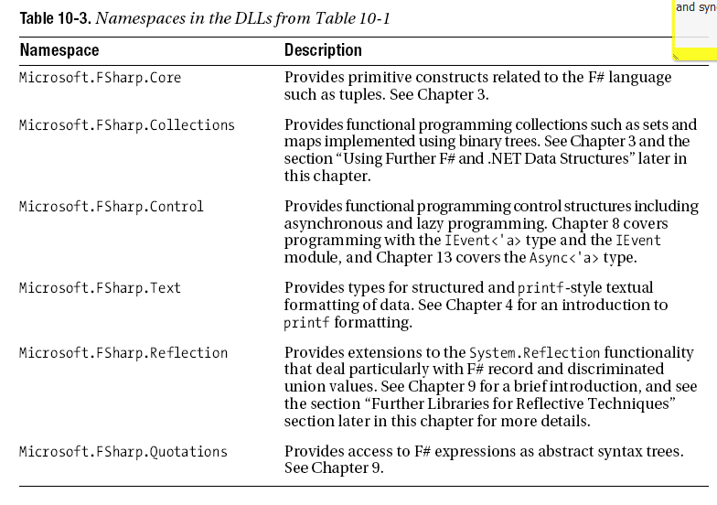
Libraries

Slide 18
IDE Experience
F# Interactive
Color highlighting
Interactive parsing
Interactive typechecking
Type inference hints
Intellisense (Declarations, Methods, Parameters)
Project system

Slide 19
Tool Kits: FSharp.Parsing
FSharp.Parsing (lex, yacc)
FSharp.Math
FSharp.Plot
CodePlex: FSharp.WebTools (rough!)
CodePlex: FSharp.MathTools (small!)

Slide 20
Spec, Doc, UE
Prototype Language Spec
QuickTour etc.
Books
Library documented “a few lines per function”

Slide 21
What have I/we found hard?
Being Dev/Architect/Evangelist/QA/PM at once
Getting a truly complete .NET OO experience while keeping the language “sweet”
Intellisense and other regressions
Poor Project System based on MyC C++ sample
Compiler Perf & cleanliness

Slide 22
SOME APPLICATIONS OF F#
MSR Applied Games Group
Ralf Herbrich, Thore Graepel, Onno Zoeter, Joaquin Quiñonero Candela

Slide 23
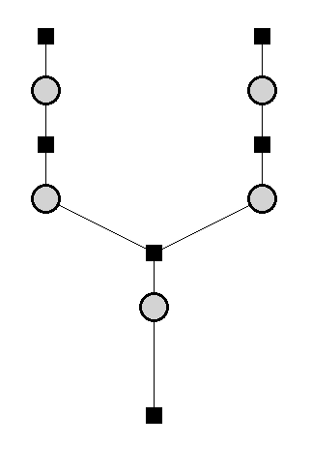
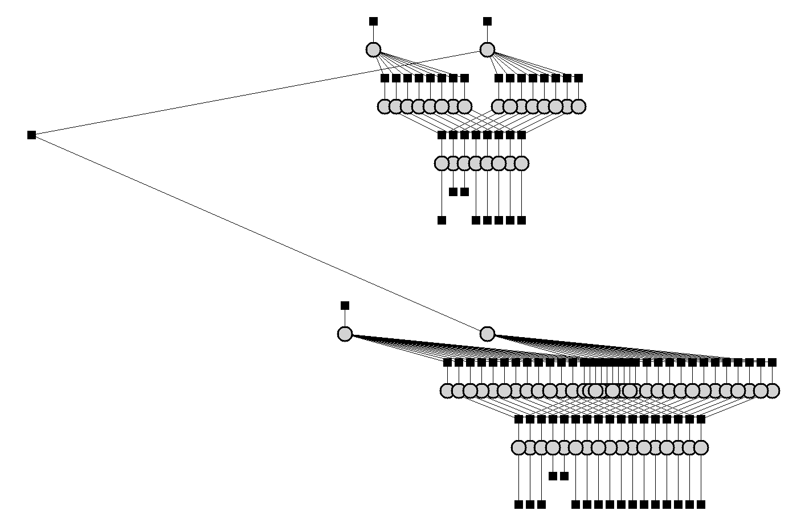
APG Machine Learning
Model time-series of skills by smoothing across time
Analyse history of chess based on 3.5M game outcomes
1857
s₁
s₂
Dynamics noise
Performance noise
p₁
p₂
d = p₁ - p₂
d > ε
1858
Single Game Outcome

Slide 24
APG Machine Learning
Use F# for major adCenter competition
4 week project, 4 machine learning experts
100million probabilistic variables
Processes 6TB of training data
Real time processing

Slide 25
APG Machine Learning
F#’s type inference means less typing, more thinking
Observations
Quick Coding
Agile Coding
Scripting
Performance
Memory-Faithful
Succinct
Symbolic
.NET Integration
Type-inferred functional/ OO code is easily factored and re-used
Interactive “hands-on” exploration of algorithms and data over smaller data sets. Used in combination with Excel
Immediate scaling to massive data sets
mega-data structures, 16GB machines
Live in the domain, not the language
Schema compilation and efficient “Schedule” representations key to success
Especially Excel, SQL Server

Slide 26
The Team’s Summary
“F# was absolutely integral to our success”
“We delivered a robust, high-performance solution on-time.”
“We couldn’t have achieved this with any other tool given the constraints of the task”
“F# programming is fun – I feel like I learn more about programming every day”

Slide 27
Some Code Highlights
Expressing “Approximation Schedules” was crucial to this work.
/// A schedule of computation in a factor graph
/// (i.e., a series of update functions
/// and variables that should be updated)
type Schedule =
| ScheduleStep of (IFactor * int)
| ScheduleSeq of Schedule[]
| ScheduleLoop of Schedule * double
/// Runs a schedule
member schedule.Run() =
match schedule with
| ScheduleStep (fac,idx) ->
fac.UpdateMessage idx
| ScheduleSeq sseq ->
sseq |> Seq.maxOn (fun s -> s.Run())
| ScheduleLoop (s,maxDelta) ->
let delta = s.Run()
if delta > maxDelta then schedule.Run() else delta
F# “embedded languages” made this beautiful

Slide 28

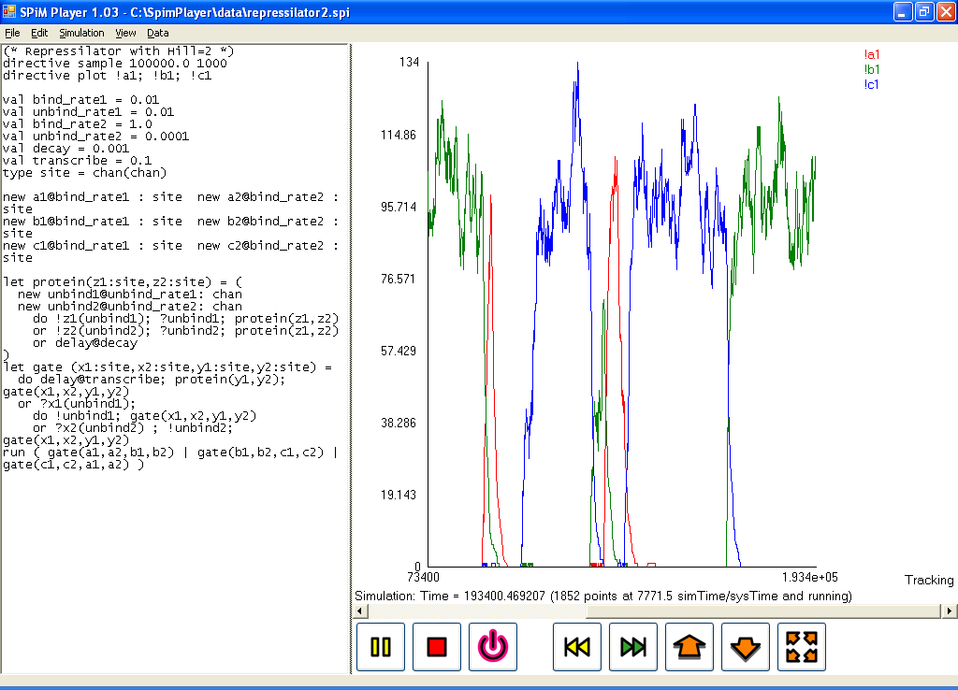
F# for Biological Modelling
SPiM Player (Phillips, Cardelli, MSR Cambridge)
F# simulation of stochastic pi-calculus
Models biological reactions in silica
Biological modelling meets programming languages
http://research.microsoft.com/~aphillip/spim

Slide 29

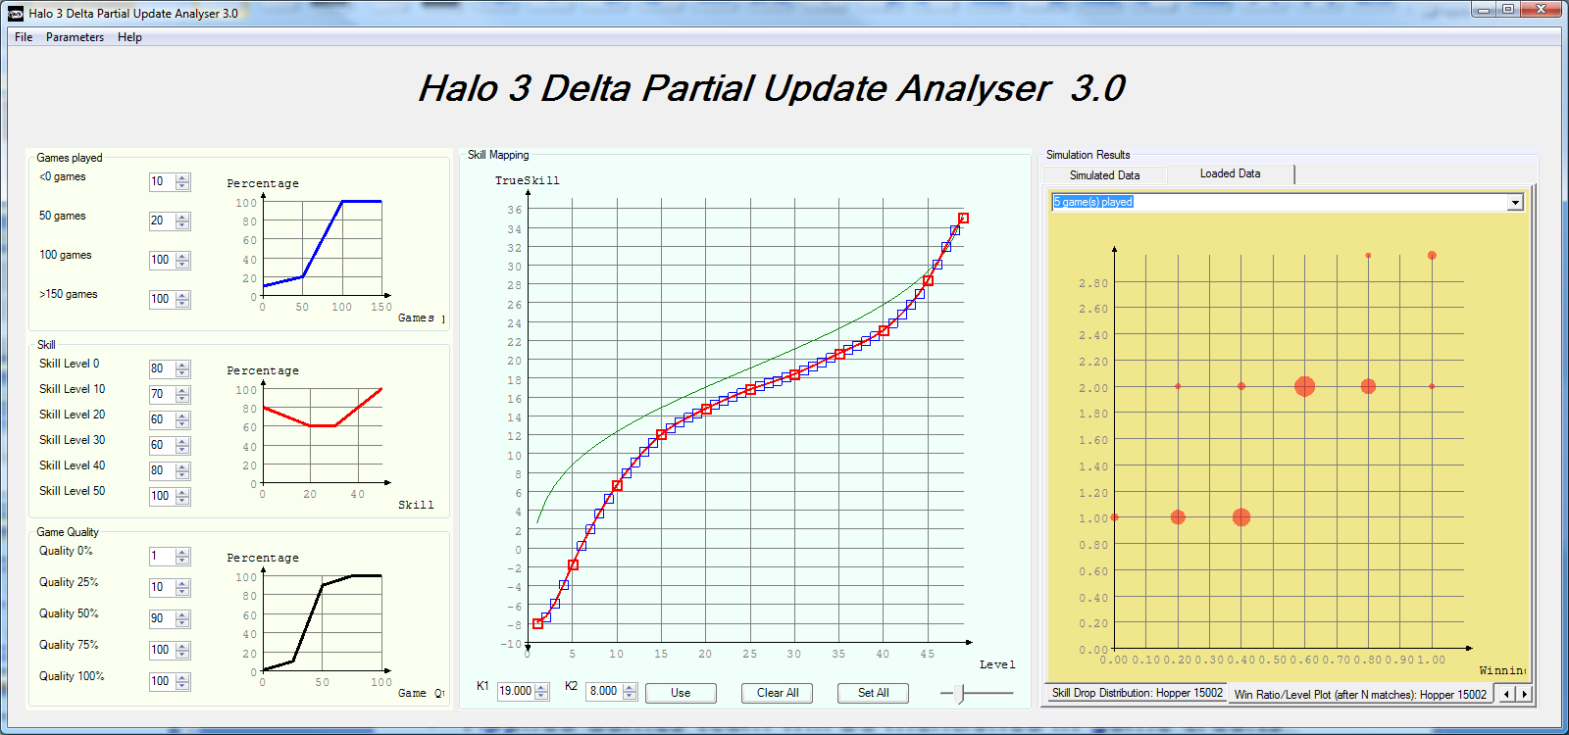
TrueSkill in Halo 3
TrueSkill extensions developed and deployed
Partial updates: Progressive Hill-climbing experience
Skill transformation: Linking skill- and experience-based ranking (monotonically increasing smooth splines)
Public beta-test 2007
Simulation of level distribution (2006) matched almost exactly findings during the beta test (2007).
From a consumer entertainment standpoint, comparable to Spiderman 3 or Harry Potter (Shane Kim).
Applied Games team will be mentioned in game credits

Slide 30

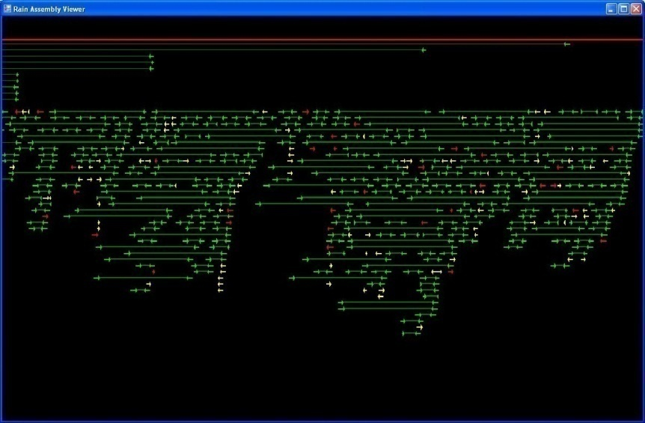
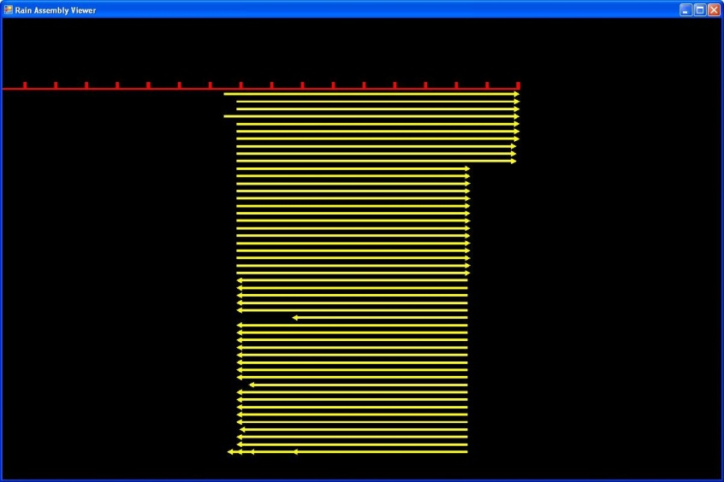
F# for Bioinformatics
"Rain" Genome Assembly Viewer
Implemented by Darren Platt: Head of Bioinformatics, DOE JGI
They sequence 20% of world's DNA
Co-author on Neanderthal DNA sequencing paper.
Experienced, trained programmer
F# /.NET/C++ v. Perl/C++ v. Python/C++
“It's the fastest genome assembly viewer I've ever seen and only 500 lines of F#.
My current tool for doing is a python CGI script that produces nice images but which is completely non-interactive and very slow....
The more I think about our field and current best practice (perl/java ...), rapid protyping, mathematical problems, the more enthusiastic I get about this path.”

Slide 31
Feature/QA Drilldown

Slide 32
Language
Feature | Designed | Implemented | Tested | Expected Adjustments?
Type Inference |  |  | 
Generalization |  |  | 
#light |  |  |  | Make it the default
Basic expressions |  |  | 
Object expressions |  |  | 
Records/Unions |  |  |  | Continue to align with OO features
Sequence expressions |  |  |  | Complete some cases, e.g try/catch
Computation expressions |  |  |  | Complete some cases, e.g try/catch

Slide 33
Language
Feature | Designed | Implemented | Tested | Expected Adjustments?
Compare/Hash |  |  |  | Opt in/out on objects/records
Tuples, Functions |  |  | 
Explicit Object Type Syntax |  |  |  | Leverage C# tests here to catch corner cases
Implicit Object Type Syntax |  |  |  | Mutual recursion unimplemented
Structs |  |  |  | Mutual recursion checks unimplemented
Named/ Optional Args |  |  |  | Error messages a bit weak
Nested Types | ★ |  |  | Needed for CodeDom

Slide 34
Language
Feature | Designed | Implemented | Tested | Expected Adjustments?
Extension Members |  | ★ | ★ | C# compat NYI
Overloaded Operators |  |  |  | Match C# more precisely?
Privacy |  | ★ | ★
Language Spec | n/a |  | n/a | Work to do

Slide 35
Compiler
Feature | Owner | Complexity | Bug Rate | LOC | Notes
Lex | dsyme |  |  | 1K | Uses FsLex
#light | dsyme |   |  | 1.5K
Parse | dsyme |   |  | 4K | Uses FsYacc (LALR)
Import | dsyme |  |  | 12K | Abstract IL library
Name Res | dsyme |  |  | 1.5K
Typecheck | dsyme |   |  | 12K
Internal tree | dsyme |   |  | 8K
Represent | jamarg |   |  | 2K
Optimize | jamarg |  |  | 2K
ILX gen | dsyme |  |  | 5K
Erase | dsyme |  |  | 2K | Remnants of ILX
Write | dsyme |  |  | 4K | Abstract IL Library
VS Service | dsyme |  |  | 2.5K

Slide 36
Exploration
Feature | Designed | Implemented | Quality | Tested | Expected Adjustments?
F# Interactive |  |  |  |  | Foresee user requests here
Visual FSI |  |  |  |  | Foresee user requests here
Intellisense |  |  |  | ★ | Automated testing weak here
Hover Types |  |  |  | ★ | Automated testing weak here
Interactive Parse/Check |  |  |  | ★ | Automated testing weak here
Color Hilight |  |  |  | ★ | Automated testing weak here, but not needed

Slide 37
Tools
Feature | Designed | Implemented | Quality | Tested | Expected Adjustments?
CodeDom |  |  |  | 
Lex |  Move to CodePlex? Unicode NYI
Yacc |  Move to CodePlex?

Slide 38
Library
Feature | Designed | Implemented | Quality | Tested | Expected Adjustments?
Core |  |  |  |  | Move some to CodePlex
Control |  |  |  |  | Review w.r.t. PFX
Collections |  |  |  | 
Math |  Strategic decisions needed here
Quotations |  |  |  |  | Review w.r.t. LINQ
Reflection |  |  |  | 
Text |  |  |  |  | StructuredFormat?
Plot |  Strategic decisions needed here
NativeInterop |  Move to CodePlex
Compat |  Move to CodePlex

Slide 39
CUSTOMERS, COMMUNITY, PARTNERS

Slide 40
Internal Customers
MSR Cambridge Applied Games Group
Potential: adCenter, Xbox Live
Various Research Groups (MSR India, Cambridge)
Potential: Much of MSR, hence tech transfer
Potential: Static Driver Verifier (Windows Core)

Slide 41
External Customers
Lots of individual users
Many potentially significant decision makers and opinion leaders (e.g. Darren Platt, JGI)
Potential: Morgan Stanley, Credit Suisse
E.g. HDFS – hardware design in F#
Potential: A powerful, programmatic hardware design & test stack

Slide 42
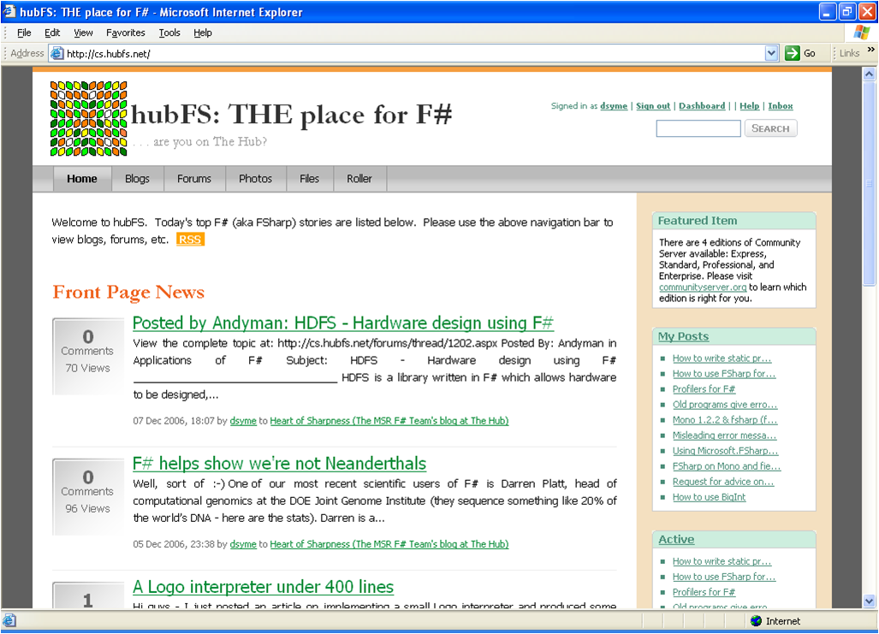
F# Community, http://hubFS.net

Slide 43
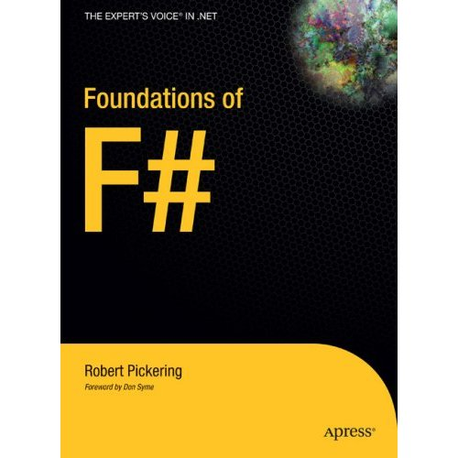
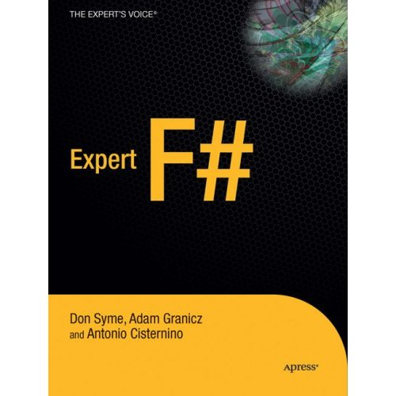

F# Books

Slide 44
DEEPER INTO THE LANGUAGE

Slide 45
The Quick Summary
Simpler Object-Oriented Programming
Simpler Syntax (#light)
Meta-programming
Extensible “Active” Pattern Matching
Generic “Workflow” Syntax
Asynchronous Workflows
Interactive Charting and Plotting
Many, many small improvements
Paper “Extensible Pattern Matching through a Lightweight Language Extension”, ICFP 2007

Slide 46
The Quick Summary
Simpler Object-Oriented Programming
Simpler Syntax (#light)
Meta-programming
Extensible “Active” Pattern Matching
Generic “Workflow” Syntax
Asynchronous Workflows
Interactive Charting and Plotting
Many, many small improvements

Slide 47
Taming Asynchronous I/O
The Targets:
Asynchronous I/O
Thread Pool
“Anything with a callback or where a process suspends”
Aim: Compositionality
The Technique: “Asynchronous Workflows”
Making it feasible to write continuation-passing programs

Slide 48
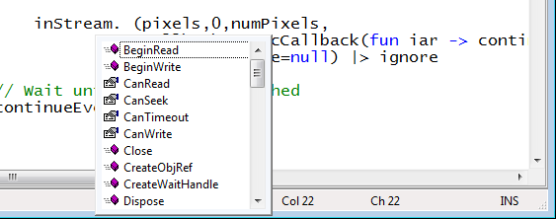
Taming Asynchronous I/O
Target: make it easy to use Begin/End operations
Stream.BeginRead : ...
Stream.EndRead : IAsyncResult * ...

Slide 49
Taming Asynchronous I/O
Typical Control Flow
One aim is to encapsulate portions of thread-hopping control flow
BeginRead
EndRead
Rest of Task

Slide 50
Taming Asynchronous I/O
One aim is to encapsulate portions of thread-hopping control flow
ReadAsync
Rest of Task

Slide 51
Taming Asynchronous I/O
Current MSDN “best practice” for processing 200 images in parallel
using System;
using System.IO;
using System.Threading;
public class BulkImageProcAsync
{
public const String ImageBaseName = "tmpImage-";
public const int numImages = 200;
public const int numPixels = 512 * 512;
// ProcessImage has a simple O(N) loop, and you can vary the number
// of times you repeat that loop to make the application more CPU-
// bound or more IO-bound.
public static int processImageRepeats = 20;
// Threads must decrement NumImagesToFinish, and protect
// their access to it through a mutex.
public static int NumImagesToFinish = numImages;
public static Object[] NumImagesMutex = new Object[0];
// WaitObject is signalled when all image processing is done.
public static Object[] WaitObject = new Object[0];
public class ImageStateObject
{
public byte[] pixels;
public int imageNum;
public FileStream fs;
}
public static void ReadInImageCallback(IAsyncResult asyncResult)
{
ImageStateObject state = (ImageStateObject)asyncResult.AsyncState;
Stream stream = state.fs;
int bytesRead = stream.EndRead(asyncResult);
if (bytesRead != numPixels)
throw new Exception(String.Format
("In ReadInImageCallback, got the wrong number of " +
"bytes from the image: {0}.", bytesRead));
ProcessImage(state.pixels, state.imageNum);
stream.Close();
// Now write out the image.
// Using asynchronous I/O here appears not to be best practice.
// It ends up swamping the threadpool, because the threadpool
// threads are blocked on I/O requests that were just queued to
// the threadpool.
FileStream fs = new FileStream(ImageBaseName + state.imageNum +
".done", FileMode.Create, FileAccess.Write, FileShare.None,
4096, false);
fs.Write(state.pixels, 0, numPixels);
fs.Close();
// This application model uses too much memory.
// Releasing memory as soon as possible is a good idea,
// especially global state.
state.pixels = null;
fs = null;
// Record that an image is finished now.
lock (NumImagesMutex)
{
NumImagesToFinish--;
if (NumImagesToFinish == 0)
{
Monitor.Enter(WaitObject);
Monitor.Pulse(WaitObject);
Monitor.Exit(WaitObject);
}
}
}
public static void ProcessImagesInBulk()
{
Console.WriteLine("Processing images... ");
long t0 = Environment.TickCount;
NumImagesToFinish = numImages;
AsyncCallback readImageCallback = new
AsyncCallback(ReadInImageCallback);
for (int i = 0; i < numImages; i++)
{
ImageStateObject state = new ImageStateObject();
state.pixels = new byte[numPixels];
state.imageNum = i;
// Very large items are read only once, so you can make the
// buffer on the FileStream very small to save memory.
FileStream fs = new FileStream(ImageBaseName + i + ".tmp",
FileMode.Open, FileAccess.Read, FileShare.Read, 1, true);
state.fs = fs;
fs.BeginRead(state.pixels, 0, numPixels, readImageCallback,
state);
}
// Determine whether all images are done being processed.
// If not, block until all are finished.
bool mustBlock = false;
lock (NumImagesMutex)
{
if (NumImagesToFinish > 0)
mustBlock = true;
}
if (mustBlock)
{
Console.WriteLine("All worker threads are queued. " +
" Blocking until they complete. numLeft: {0}",
NumImagesToFinish);
Monitor.Enter(WaitObject);
Monitor.Wait(WaitObject);
Monitor.Exit(WaitObject);
}
long t1 = Environment.TickCount;
Console.WriteLine("Total time processing images: {0}ms",
(t1 - t0));
}
}
let ProcessImageAsync () =
async { let inStream = File.OpenRead(sprintf "Image%d.tmp" i)
let! pixels = inStream.ReadAsync(numPixels)
let pixels' = TransformImage(pixels,i)
let outStream = File.OpenWrite(sprintf "Image%d.done" i)
do! outStream.WriteAsync(pixels')
do Console.WriteLine "done!" }
let ProcessImagesAsyncWorkflow() =
Async.Run (Async.Parallel
[ for i in 1 .. numImages -> ProcessImageAsync i ])

Slide 52
Taming Asynchronous I/O
Open the file, synchronously
Equivalent F# code
(same perf)
Read from the file,
asynchronously
let ProcessImageAsync () =
async { let inStream = File.OpenRead(sprintf "source%d.jpg" i)
let! pixels = inStream.ReadAsync(numPixels)
let pixels' = TransformImage(pixels,i)
let outStream = File.OpenWrite(sprintf "result%d.jpg" i)
do! outStream.WriteAsync(pixels')
do Console.WriteLine "done!" }
let ProcessImagesAsync() =
Async.Run (Async.Parallel
[ for i in 1 .. numImages -> ProcessImageAsync i ])
This object coordinates everything.
Write the result, asynchronously
“!”
= “asynchronous”
Generate the tasks and queue them in parallel

Slide 53
Taming Asynchronous I/O
using System;
using System.IO;
using System.Threading;
public class BulkImageProcAsync
{
public const String ImageBaseName = "tmpImage-";
public const int numImages = 200;
public const int numPixels = 512 * 512;
// ProcessImage has a simple O(N) loop, and you can vary the number
// of times you repeat that loop to make the application more CPU-
// bound or more IO-bound.
public static int processImageRepeats = 20;
// Threads must decrement NumImagesToFinish, and protect
// their access to it through a mutex.
public static int NumImagesToFinish = numImages;
public static Object[] NumImagesMutex = new Object[0];
// WaitObject is signalled when all image processing is done.
public static Object[] WaitObject = new Object[0];
public class ImageStateObject
{
public byte[] pixels;
public int imageNum;
public FileStream fs;
}
public static void ReadInImageCallback(IAsyncResult asyncResult)
{
ImageStateObject state = (ImageStateObject)asyncResult.AsyncState;
Stream stream = state.fs;
int bytesRead = stream.EndRead(asyncResult);
if (bytesRead != numPixels)
throw new Exception(String.Format
("In ReadInImageCallback, got the wrong number of " +
"bytes from the image: {0}.", bytesRead));
ProcessImage(state.pixels, state.imageNum);
stream.Close();
// Now write out the image.
// Using asynchronous I/O here appears not to be best practice.
// It ends up swamping the threadpool, because the threadpool
// threads are blocked on I/O requests that were just queued to
// the threadpool.
FileStream fs = new FileStream(ImageBaseName + state.imageNum +
".done", FileMode.Create, FileAccess.Write, FileShare.None,
4096, false);
fs.Write(state.pixels, 0, numPixels);
fs.Close();
// This application model uses too much memory.
// Releasing memory as soon as possible is a good idea,
// especially global state.
state.pixels = null;
fs = null;
// Record that an image is finished now.
lock (NumImagesMutex)
{
NumImagesToFinish--;
if (NumImagesToFinish == 0)
{
Monitor.Enter(WaitObject);
Monitor.Pulse(WaitObject);
Monitor.Exit(WaitObject);
}
}
}
public static void ProcessImagesInBulk()
{
Console.WriteLine("Processing images... ");
long t0 = Environment.TickCount;
NumImagesToFinish = numImages;
AsyncCallback readImageCallback = new
AsyncCallback(ReadInImageCallback);
for (int i = 0; i < numImages; i++)
{
ImageStateObject state = new ImageStateObject();
state.pixels = new byte[numPixels];
state.imageNum = i;
// Very large items are read only once, so you can make the
// buffer on the FileStream very small to save memory.
FileStream fs = new FileStream(ImageBaseName + i + ".tmp",
FileMode.Open, FileAccess.Read, FileShare.Read, 1, true);
state.fs = fs;
fs.BeginRead(state.pixels, 0, numPixels, readImageCallback,
state);
}
// Determine whether all images are done being processed.
// If not, block until all are finished.
bool mustBlock = false;
lock (NumImagesMutex)
{
if (NumImagesToFinish > 0)
mustBlock = true;
}
if (mustBlock)
{
Console.WriteLine("All worker threads are queued. " +
" Blocking until they complete. numLeft: {0}",
NumImagesToFinish);
Monitor.Enter(WaitObject);
Monitor.Wait(WaitObject);
Monitor.Exit(WaitObject);
}
long t1 = Environment.TickCount;
Console.WriteLine("Total time processing images: {0}ms",
(t1 - t0));
}
}
Create 10, 000s of “asynchronous tasks”
Mostly queued, suspended and executed in the thread pool
Use your own thread pool if needed
let ProcessImageAsync () =
async { let inStream = File.OpenRead(sprintf "Image%d.tmp" i)
let! pixels = inStream.ReadAsync(numPixels)
let pixels' = TransformImage(pixels,i)
let outStream = File.OpenWrite(sprintf "Image%d.done" i)
do! outStream.WriteAsync(pixels')
do Console.WriteLine "done!" }
let ProcessImagesAsyncWorkflow() =
Async.Run (Async.Parallel
[ for i in 1 .. numImages -> ProcessImageAsync i ])
Exceptions can be handled properly
Cancellation checks inserted automatically
Resources can be disposed properly on failure
CPU threads are not blocked

Slide 54
Taming Asynchronous I/O
let ProcessImageAsync () =
async { let inStream = File.OpenRead(sprintf "source%d.jpg" i)
let! pixels = inStream.ReadAsync(numPixels)
let pixels' = TransformImage(pixels,i)
let outStream = File.OpenWrite(sprintf "result%d.jpg" i)
do! outStream.WriteAsync(pixels')
do Console.WriteLine "done!" }
let ProcessImagesAsync() =
Async.Run (Async.Parallel
[ for i in 1 .. numImages -> ProcessImageAsync i ])

Slide 55
Taming Asynchronous I/O
let ProcessImageAsync () =
async { use inStream = File.OpenRead(sprintf "source%d.jpg" i)
let! pixels = inStream.ReadAsync(numPixels)
let pixels' = TransformImage(pixels,i)
use outStream = File.OpenWrite(sprintf "result%d.jpg" i)
do! outStream.WriteAsync(pixels')
do Console.WriteLine "done!" }
let ProcessImagesAsync() =
Async.Run (Async.Parallel
[ for i in 1 .. numImages -> ProcessImageAsync i ])

Slide 56
More Examples
Compute 22 and 7 in parallel
Async.Parallel [ async { -> 2*2 + 3*6 };
async { -> 3 + 5 - 1 } ]
Get these three web pages and wait until all have come back
Async.Parallel [WebRequest.Async "http://www.live.com";
WebRequest.Async "http://www.yahoo.com";
WebRequest.Async "http://www.google.com" ]
let parArrMap f (arr: _[]) =
Async.Run (Async.Parallel [| for x in arr -> async { -> f x } |])
Parallel Array Map

Slide 57
How does it work?
Based on a way to make writing continuation-passing programs simpler and compositional
Similar to techniques used in Haskell
Related to “Futures”
Nothing in the language, it’s all in the library, Microsoft.FSharp.Control.Async
Execution request
Async<T>
Success continuation
Exception continuation
Typed
Functional Programming
Gives
Declarative
Control

Slide 58
BACKUP

Slide 59
F# as a Language
and more
Functional
Programming
Functional
Programming
Similar core
language
“OCaml-Objects”
and other extensions
Modules-as-
values, functors
.NET API
Access
.NET
Objects
+ tools
+ tools
OCaml
F#

Slide 60
The Combination
Statically typed
Succinct
Safe
Efficient
Libraries
Explorative
Interoperable
Great Platform

Slide 61
Quick start: let
Type inference. The safety of C# with the succinctness of a scripting language
Bind a static value
let data = (1,2,3)
let f(a,b,c) =
let sum = a + b + c
let g(x) = sum + x*x
g(a), g(b), g(c)
Bind a static function
Bind a local value
Bind a local function
Let “let” simplify your life…

Slide 62
Quick Start: Structured Data
Lists, tuples and options:
let people = [ ("Adam", None);
("Eve" , None);
("Cain", Some("Adam","Eve"));
("Abel", Some("Adam","Eve")) ]
let showParents (nm,parents) =
match parents with
| Some(dad,mum) -> printfn "%s, dad %s, mum %s" nm dad mum
| None -> printfb "%s has no parents!" nm

Slide 63
Quick Start: .NET Collections
open System.Collections.Generic
let capitals = new Dictionary<_,_>()
capitals.["Great Britain"] <- "London"
capitals.["France"] <- "Paris"
capitals.ContainsKey("France")
capitals.ContainsKey("Sweden")
capitals.["France"]
capitals.Keys |> show
e.g. using dictionaries…

