Slide 1
F# for Parallel and Asynchronous Programming
Don Syme
Principal Researcher
Microsoft
DEV306

Slide 2
F# Orientation!
F# Eye for the Parallel Guy
Immutability, Async and Agents

Slide 3
Parallel Computing at TechEd
Tools
Managed Languages
Visual Studio 2010
Visual F#
Parallel
Debugger Windows
Managed Libraries
Native Libraries
Parallel LINQ
Parallel Pattern Library
Async
Agents Library
Profiler Concurrency
Analysis
Task Parallel Library
Data Structures
Data Structures
Native Concurrency Runtime
Task Scheduler
Managed Concurrency Runtime
ThreadPool
Resource Manager
HPC Server
Threads
UMS Threads
Operating System
Operating System
Key:
Visual Studio 2010 / .NET 4
Windows 7 / Server 2008 R2

Slide 4
Why is Microsoft Investing in F# Anyway?

Slide 5
Simplicity

Slide 6
Economics

Slide 7
Parallel

Slide 8
Simplicity

Slide 9
Code!
Pleasure
Pain
//C#
using System;
namespace ConsoleApplication1
{
class Program
{
static int a()
{
return 2;
}
static void Main(string[] args)
{
Console.WriteLine(a);
}
}
}
//F#
open System
let a = 2
Console.WriteLine(a)
More noise
than signal!

Slide 10
Pleasure
Pain
type Command = Command of (Rover -> unit)
let BreakCommand =
Command(fun rover -> rover.Accelerate(-1.0))
let TurnLeftCommand =
Command(fun rover -> rover.Rotate(-5.0<degs>))
abstract class Command
{
public virtual void Execute();
}
abstract class MarsRoverCommand : Command
{
protected MarsRover Rover { get; private set; }
public MarsRoverCommand(MarsRover rover)
{
this.Rover = rover;
}
}
class BreakCommand : MarsRoverCommand
{
public BreakCommand(MarsRover rover)
: base(rover)
{
}
public override void Execute()
{
Rover.Rotate(-5.0);
}
}
class TurnLeftCommand : MarsRoverCommand
{
public TurnLeftCommand(MarsRover rover)
: base(rover)
{
}
public override void Execute()
{
Rover.Rotate(-5.0);
}
}

Slide 11
Pleasure
Pain
Tuple<U,T> Swap<T,U>(Tuple<T,U> t)
{
return new Tuple<U,T>(t.Item2, t.Item1)
}
ReadOnlyCollection<Tuple<T,T,T>> Rotations<T>(Tuple<T,T,T> t)
{
new ReadOnlyCollection<int>
(new Tuple<T,T,T>[]
{new Tuple<T,T,T>(t.Item1,t.Item2,t.Item3);
new Tuple<T,T,T>(t.Item3,t.Item1,t.Item2);
new Tuple<T,T,T>(t.Item2,t.Item3,t.Item1); });
}
int Reduce<T>(Func<T,int> f,Tuple<T,T,T> t)
{
return f(t.Item1)+f(t.Item2)+f(t.Item3);
}
let swap (x, y) = (y, x)
let rotations (x, y, z) =
[ (x, y, z);
(z, x, y);
(y, z, x) ]
let reduce f (x, y, z) =
f x + f y + f z

Slide 12
Pleasure
Pain
public abstract class Expr { }
public abstract class UnaryOp :Expr
{
public Expr First { get; private set; }
public UnaryOp(Expr first)
{
this.First = first;
}
}
public abstract class BinExpr : Expr
{
public Expr First { get; private set; }
public Expr Second { get; private set; }
public BinExpr(Expr first, Expr second)
{
this.First = first;
this.Second = second;
}
}
public class TrueExpr : Expr { }
public class And : BinExpr
{
public And(Expr first, Expr second) : base(first, second) { }
}
public class Nand : BinExpr
{
public Nand(Expr first, Expr second) : base(first, second) { }
}
public class Or : BinExpr
{
public Or(Expr first, Expr second) : base(first, second) { }
}
public class Xor : BinExpr
{
public Xor(Expr first, Expr second) : base(first, second) { }
}
public class Not : UnaryOp
{
public Not(Expr first) : base(first) { }
}
type Expr =
| True
| And of Expr * Expr
| Nand of Expr * Expr
| Or of Expr * Expr
| Xor of Expr * Expr
| Not of Expr

Slide 13
F#: Influences
OCaml
C#/.NET
F#
Similar core
language
Similar object
model

Slide 14
Parallel

Slide 15
F# and the Concurrency Challenges
Shared State
F# Immutability
Inversion of Control
F# Async
I/O Parallelism
F# Async
Messaging and Scaling
F# Agents
+ Web/Azure/MSQ/etc.
Notes:
We all know it’s not always as easy as adding .Parallel !!
Shared state
Making applications reactive means inverting control - “do this when you are done with this”
In practice, performance bottlenecks are more often about I/O than CPU – and there is abundant I/O paralleism (can have hundreds of pending web requests, disks know how to inteligently schedule concurrent reads, etc.) - using .Parallel doesn’t take advantage of this parallelism
And if you really just want pure speed or scalability, a single machine is likely not enough. So easy to get ahold of compute resources now, need development approaches which scale.
Shared State
Inversion of Control (asynchronous)
I/O bottlenecks (network, disk)
Scaling off a single machine

Slide 16
Fundamentals - Whitespace Matters
let computeDerivative f x =
let p1 = f (x - 0.05)
let p2 = f (x + 0.05)
(p2 – p1) / 0.1
Offside (bad indentation)

Slide 17
Fundamentals - Whitespace Matters
let computeDerivative f x =
let p1 = f (x - 0.05)
let p2 = f (x + 0.05)
(p2 – p1) / 0.1

Slide 18
Functional– Pipelines
x |> f1
|> f2
|> f3
Successive stages
in a pipeline

Slide 19
F# - Objects + Functional
type Vector2D (dx:double, dy:double) =
let d2 = dx*dx+dy*dy
member v.DX = dx
member v.DY = dy
member v.Length = sqrt d2
member v.Scale(k) = Vector2D (dx*k,dy*k)
Inputs to object
construction
Object internals
Exported properties
Exported method

Slide 20
Let’s Web Crawl…
demo
Name
Title
Company
Notes:
If you would like to host your demo on the Virtual Server, please use the myVPC demo slide, not this slide.

Slide 21
Four Big Concurrency Challenges
Shared State
Inversion of Control
I/O Parallelism
Messaging and Scaling
Notes:
We all know it’s not always as easy as adding .Parallel !!
Shared state
Making applications reactive means inverting control - “do this when you are done with this”
In practice, performance bottlenecks are more often about I/O than CPU – and there is abundant I/O paralleism (can have hundreds of pending web requests, disks know how to inteligently schedule concurrent reads, etc.) - using .Parallel doesn’t take advantage of this parallelism
And if you really just want pure speed or scalability, a single machine is likely not enough. So easy to get ahold of compute resources now, need development approaches which scale.
Shared State
Inversion of Control (asynchronous)
I/O bottlenecks (network, disk)
Scaling off a single machine

Slide 22
Concurrency Challenges
Shared State
Difficult to maintain and test
Very difficult to parallelize!
Locking is fundamentally error prone:
Must guess where parallelism will be needed
All consumers need to participate
Inversion of Control
I/O Parallelism
Messaging and Scaling
Notes:
We all know it’s not always as easy as adding .Parallel !!
Shared state
Making applications reactive means inverting control - “do this when you are done with this”
In practice, performance bottlenecks are more often about I/O than CPU – and there is abundant I/O paralleism (can have hundreds of pending web requests, disks know how to inteligently schedule concurrent reads, etc.) - using .Parallel doesn’t take advantage of this parallelism
And if you really just want pure speed or scalability, a single machine is likely not enough. So easy to get ahold of compute resources now, need development approaches which scale.
Shared State
Inversion of Control (asynchronous)
I/O bottlenecks (network, disk)
Scaling off a single machine

Slide 23
Shared State: The Problem
“Shared state is the new spaghetti code”
Difficult to maintain
Difficult to test
Very difficult to parallelize!
Locking is fundamentally error prone
Have to guess where thing might one day be used concurrently
Necessary invariants for locking correctness are not recorded in the code
Notes:
Note: Slide will be simplified, currently collecting talking points.

Slide 24
Concurrency Challenges
Shared State
Inversion of Control
We’re used to writing code linearly
Async requires decoupling Begin from End
Very difficult to:
Combine multiple asynchronous operations
Deal with exceptions and cancellation
I/O Parallelism
Messaging and Scaling
Notes:
Synchronous code is linear
Asynchronous code requires de-coupling Begin action from End action
Makes code hard to write, and even harder to read
Especially difficult to compose multiple operations
But…reactivity requires asynchronous code
Silverlight doesn’t even provide synchronous versions of common I/O operations

Slide 25
Concurrency Challenges
Shared State
Inversion of Control
I/O Parallelism
Software is often I/O-bound
Leveraging web services
Working with data on disk
Network and disk speeds increasing slower
I/O resources are inherently parallel
Huge opportunity for performance
Messaging and Scaling
Notes:
Multicore means your apps can run 4, 8,16x faster
I/O is almost always the perf bottleneck in the “real world”
Can get 10, 50, 100x performance improvement
Disk and network speeds growing much slower than CPU
Applications are working with more and more web services and more and more data on disk

Slide 26
Concurrency Challenges
Shared State
Inversion of Control
I/O Parallelism
Messaging and Scaling
Multi-machine resources becoming common:
Roll-you-own clusters with cheap hardware
On-demand cloud compute with Azure
Programs must be written with this in mind
This means structuring with messaging and agents
Notes:
If you really want processing power, you’ve got to scale to multi machines
But…
Shared memory doesn’t scale
This is becoming common place:
Roll-your-own clusters with cheap hardware
Azure provides compute in the cloud

Slide 27
F# and the Concurrency Challenges
Shared State
F# Immutability
+ .NET 4.0 Concurrent Collections
+ .NET 4.0 PLINQ Queries
Inversion of Control
F# Async
+ .NET 4.0 Parallel Loops
I/O Parallelism
F# Async
Messaging and Scaling
F# Agents
+ Web, Azure, MSQ etc.
Notes:
We all know it’s not always as easy as adding .Parallel !!
Shared state
Making applications reactive means inverting control - “do this when you are done with this”
In practice, performance bottlenecks are more often about I/O than CPU – and there is abundant I/O paralleism (can have hundreds of pending web requests, disks know how to inteligently schedule concurrent reads, etc.) - using .Parallel doesn’t take advantage of this parallelism
And if you really just want pure speed or scalability, a single machine is likely not enough. So easy to get ahold of compute resources now, need development approaches which scale.
Shared State
Inversion of Control (asynchronous)
I/O bottlenecks (network, disk)
Scaling off a single machine

Slide 28
Immutability

Slide 29
= “Persistence”

Slide 30
= Value/Object Doesn’t Change Over Time

Slide 31
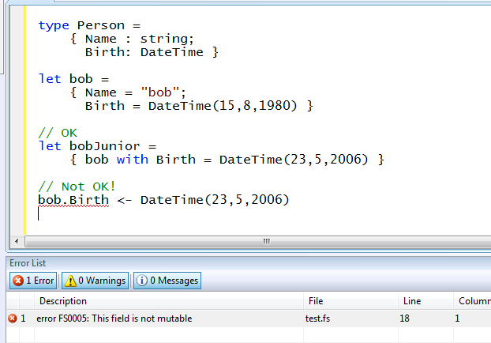
Immutability the norm…
Types immutable by default
✓ Copy & Update
✗ Not Mutate

Slide 32
Immutability the norm...
Immutable Tuples!
Immutable Dictionaries!
Immutable Unions!
+ lots of language features to encourage immutability
Immutable Lists!
Immutable Records!
Immutable Sets!
Immutable Objects!

Slide 33
In Praise of Immutability
Immutable objects can transfer between threads
Immutable objects never have race conditions

Slide 34
F# and the Concurrency Challenges
Shared State
Inversion of Control
F# Async
I/O Parallelism
F# Async
Messaging and Scaling
Notes:
We all know it’s not always as easy as adding .Parallel !!
Shared state
Making applications reactive means inverting control - “do this when you are done with this”
In practice, performance bottlenecks are more often about I/O than CPU – and there is abundant I/O paralleism (can have hundreds of pending web requests, disks know how to inteligently schedule concurrent reads, etc.) - using .Parallel doesn’t take advantage of this parallelism
And if you really just want pure speed or scalability, a single machine is likely not enough. So easy to get ahold of compute resources now, need development approaches which scale.
Shared State
Inversion of Control (asynchronous)
I/O bottlenecks (network, disk)
Scaling off a single machine

Slide 35
F# is a Parallel Language
(Multiple active computations)
F# is a Reactive Language
(Multiple pending reactions)
GUI Event
Page Load
Timer Callback
Query Response
HTTP Response
Web Service Response
Disk I/O Completion
Agent Gets Message

Slide 36
async { ... }
A Building Block for
Writing Reactive Code
async { ... }
You can run it, but it may take a while
Or, your builder says...
OK, I can do the job, but I might have to talk to someone else about it. Tell me what to do when I’m done

Slide 37
async { ... }
React!
async { let! res = <async-event>
... }
React to a GUI Event
React to a Timer Callback
React to a Query Response
React to a HTTP Response
React to a Web Service Response
React to a Disk I/O Completion
Agent reacts to Message

Slide 38
async { ... }
async { let! image = ReadAsync "cat.jpg"
let image2 = f image
do! WriteAsync image2 "dog.jpg"
do printfn "done!"
return image2 }
Asynchronous action
Continuation/
Event callback
You're actually writing this (approximately):
async.Delay(fun () ->
async.Bind(ReadAsync "cat.jpg", (fun image ->
let image2 = f image
async.Bind(writeAsync "dog.jpg",(fun () ->
printfn "done!"
async.Return())))))

Slide 39
The many uses of async { ... }
Sequencing I/O requests
Sequencing CPU computations and I/O requests
async { let! lang = detectLanguageAsync text
let! text2 = translateAsync (lang,"da",text)
return text2 }
async { let! lang = detectLanguageAsync text
let! text2 = translateAsync (lang,"da",text)
let text3 = postProcess text2
return text3 }

Slide 40
The many uses of async { ... }
Parallel CPU computations
Parallel I/O requests
Async.Parallel [ async { return (fib 39) };
async { return (fib 40) }; ]
Async.Parallel
[ for target in langs ->
translateAsync (lang,target,text) ]

Slide 41
Async Basics + Web Translation
demo

Slide 42
F# In-Memory Agents

Slide 43
F# and the Concurrency Challenges
Shared State
Inversion of Control
I/O Parallelism
Messaging and Scaling
F# Agents
Notes:
We all know it’s not always as easy as adding .Parallel !!
Shared state
Making applications reactive means inverting control - “do this when you are done with this”
In practice, performance bottlenecks are more often about I/O than CPU – and there is abundant I/O paralleism (can have hundreds of pending web requests, disks know how to inteligently schedule concurrent reads, etc.) - using .Parallel doesn’t take advantage of this parallelism
And if you really just want pure speed or scalability, a single machine is likely not enough. So easy to get ahold of compute resources now, need development approaches which scale.
Shared State
Inversion of Control (asynchronous)
I/O bottlenecks (network, disk)
Scaling off a single machine

Slide 44
Your First Agent
let agent =
Agent.Start(fun inbox ->
async { while true do
let! msg = inbox.Receive()
printfn "got message %s" msg } )
agent.Post "three"
agent.Post "four"
Note:
type Agent<'T> = MailboxProcessor<'T>

Slide 45
Your First 100,000 Agents
let agents =
[ for i in 0 .. 100000 ->
Agent.Start(fun inbox ->
async { while true do
let! msg = inbox.Receive()
printfn "%d got message %s" i msg })]
for agent in agents do
agent.Post "hello"
Note:
type Agent<'T> = MailboxProcessor<'T>

Slide 46
Your First State Isolated Agent
Isolated, Mutable
State in a Reactive Agent
let agents =
Agent.Start(fun inbox ->
async { let state = Dictionary<int,string>()
while true do
let! key,value = inbox.Receive()
state.[key] <- value } )
for i in 0..10000 do
agent.Post (i, string i)
Note:
type Agent<'T> = MailboxProcessor<'T>

Slide 47
Agents Galore
demo

Slide 48
In Summary
F#
Parallelism and asynchrony, for today and tomorrow
F# + .NET 4.0 greatly simplify parallelism
F# is ready for use in production with VS2010
Simple, powerful, and productive
Notes:
Contents are wrong – should be a summary of key F# takeaways

Slide 49
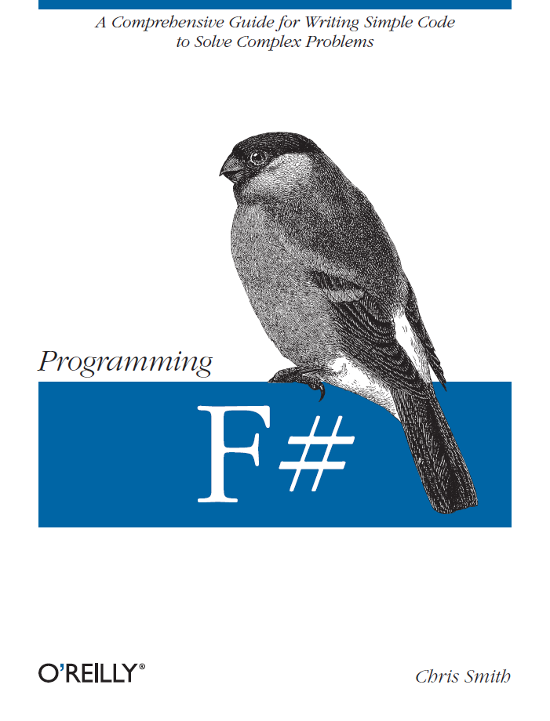
Latest Book about F#
Visit www.fsharp.net

Slide 50
question & answer

Slide 51
F#: Combining Paradigms
I've been coding in F# lately, for a production task. F# allows you to move smoothly in your programming style... I start with pure functional code, shift slightly towards an object-oriented style, and in production code, I sometimes have to do some imperative programming.
I can start with a pure idea, and still finish my project with realistic code. You're never disappointed in any phase of the project!
Julien Laugel, Chief Software Architect, www.eurostocks.com

Slide 52
Your First 100,000 Chatty Agents
let agents =
[ for i in 0 .. 100000 ->
Agent.Start(fun inbox ->
async { while true do
let! a,b,reply = inbox.Receive()
msg <-- (a+b) })]
Async.Parallel
[ for agent in agents ->
agent.PostAndAsyncReply (fun r -> (10,10,r)) ]
Response
Promise
Note:
type Agent<'T> = MailboxProcessor<'T>
let (<--) (a:AsyncReplyChannel<'T>) b = a.Reply(b)

