Slide 1
Taking Functional Programming into the Mainstream
Don Syme,
Principal Researcher
Microsoft Research, Cambridge

Slide 2
Agenda
Why is Microsoft Investing in Functional Programming?
A Deeper Look into F#
Some F# Coding and Demonstrations

Slide 3
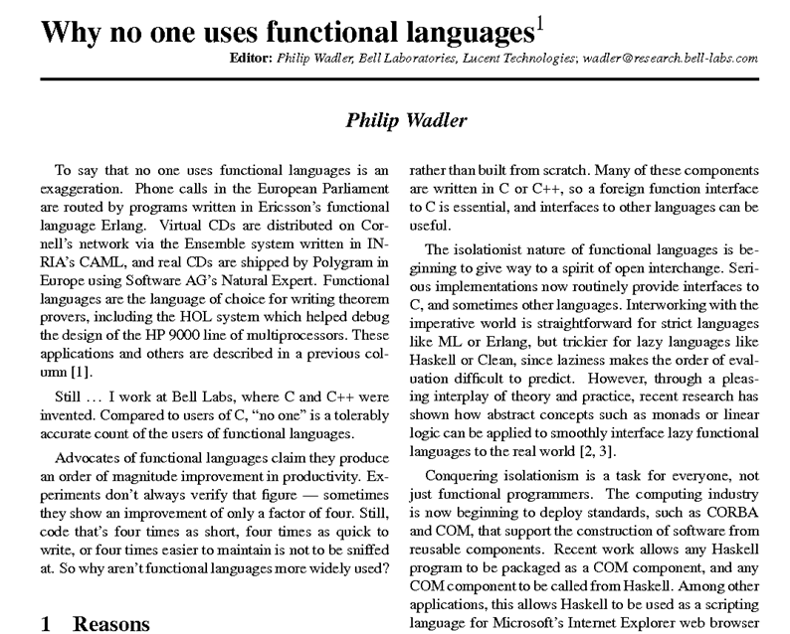

Slide 4
The Simple Story
1998
Reshape an Industrial Execution Environment
Add a Core Functional Language
Prove it Works
Add Extensions that multiply its power
Objects Parallel
Async/monads Units-of-measure
Release it at Product-Equality
2003
2005
2007
2009

Slide 5

Industry is another country...
Academia
“Industry”
These are different ecosystems. Different ideas survive.
An idea that has evolved to look beautiful over
here…
…may need to change to look different over here…
Or else…
“It’s an academic feature...”
“This is great science, but …”

Slide 6
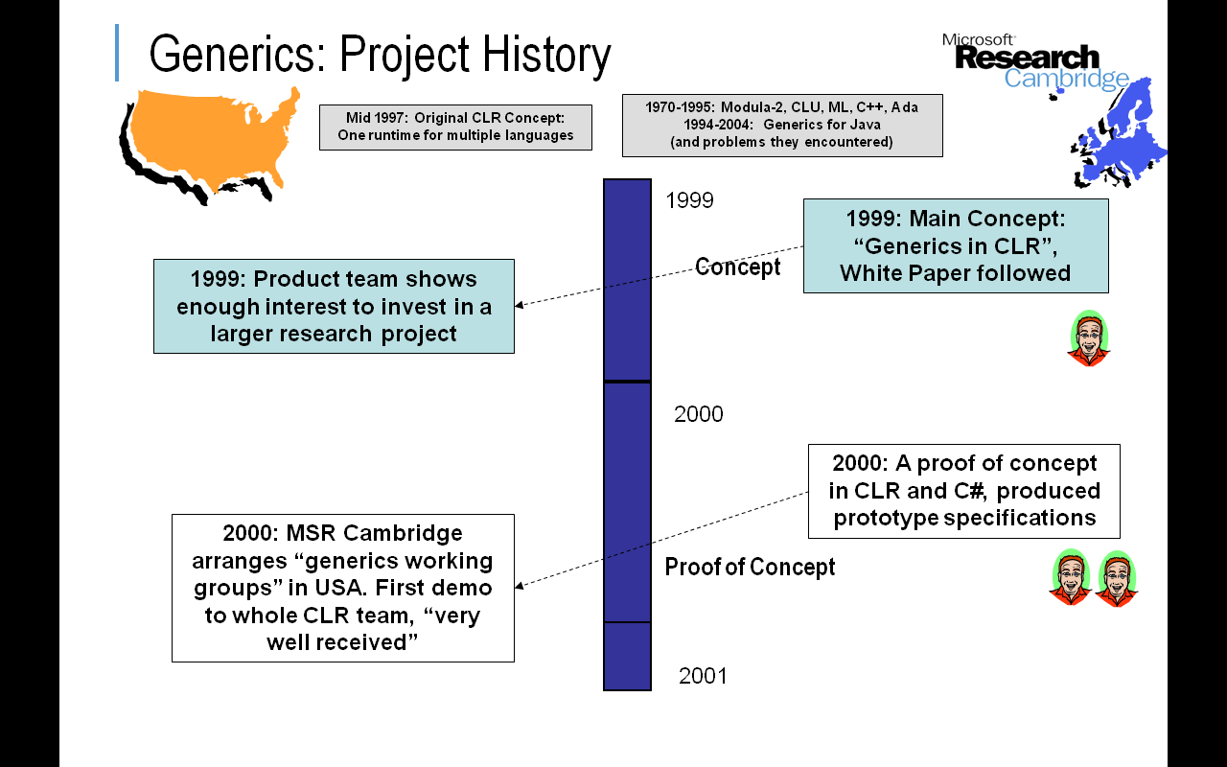

Slide 7
Why is Microsoft Investing in Functional Programming Anyway?

Slide 8
Simplicity

Slide 9
Economics

Slide 10
Parallel

Slide 11
Simplicity

Slide 12
Code!
Pleasure
Pain
//C#
using System;
namespace ConsoleApplication1
{
class Program
{
static int a()
{
return 2;
}
static void Main(string[] args)
{
Console.WriteLine(a);
}
}
}
//F#
open System
let a = 2
Console.WriteLine(a)
More noise
than signal!

Slide 13


Slide 14
Pleasure
Pain
type Command =
Command of (Rover -> unit)
let BreakCommand =
Command(fun rover ->
rover.Accelerate(-1.0))
let TurnLeftCommand =
Command(fun rover ->
rover.Rotate(-5.0<degs>))
abstract class Command
{
public virtual void Execute();
}
abstract class MarsRoverCommand : Command
{
protected MarsRover Rover
{ get; private set; }
public MarsRoverCommand(MarsRover rover)
{
this.Rover = rover;
}
}
class BreakCommand : MarsRoverCommand
{
public BreakCommand(MarsRover rover)
: base(rover)
{
}
public override void Execute()
{
Rover.Rotate(-5.0);
}
}
class TurnLeftCommand : MarsRoverCommand
{
public TurnLeftCommand(MarsRover rover)
: base(rover)
{
}
public override void Execute()
{
Rover.Rotate(-5.0);
}
}

Slide 15
Pleasure
Pain
Tuple<U,T> Swap<T,U>(Tuple<T,U> t)
{
return new Tuple<U,T>(t.Item2, t.Item1)
}
ReadOnlyCollection<Tuple<T,T,T>> Rotations<T>(Tuple<T,T,T> t)
{
new ReadOnlyCollection<int>
(new Tuple<T,T,T>[]
{new Tuple<T,T,T>(t.Item1,t.Item2,t.Item3);
new Tuple<T,T,T>(t.Item3,t.Item1,t.Item2);
new Tuple<T,T,T>(t.Item2,t.Item3,t.Item1); });
}
int Reduce<T>(Func<T,int> f,Tuple<T,T,T> t)
{
return f(t.Item1)+f(t.Item2)+f(t.Item3);
}
let swap (x, y) = (y, x)
let rotations (x, y, z) =
[ (x, y, z);
(z, x, y);
(y, z, x) ]
let reduce f (x, y, z) =
f x + f y + f z

Slide 16
Pleasure
Pain
public abstract class Expr { }
public abstract class UnaryOp :Expr
{
public Expr First { get; private set; }
public UnaryOp(Expr first)
{
this.First = first;
}
}
public abstract class BinExpr : Expr
{
public Expr First { get; private set; }
public Expr Second { get; private set; }
public BinExpr(Expr first, Expr second)
{
this.First = first;
this.Second = second;
}
}
public class TrueExpr : Expr { }
public class And : BinExpr
{
public And(Expr first, Expr second) : base(first, second) { }
}
public class Nand : BinExpr
{
public Nand(Expr first, Expr second) : base(first, second) { }
}
public class Or : BinExpr
{
public Or(Expr first, Expr second) : base(first, second) { }
}
public class Xor : BinExpr
{
public Xor(Expr first, Expr second) : base(first, second) { }
}
public class Not : UnaryOp
{
public Not(Expr first) : base(first) { }
}
type Expr =
| True
| And of Expr * Expr
| Nand of Expr * Expr
| Or of Expr * Expr
| Xor of Expr * Expr
| Not of Expr

Slide 17
Pleasure
Pain
public abstract class Event { }
public abstract class PriceEvent : Event
{
public Price Price { get; private set; }
public PriceEvent(Price price)
{
this.Price = price;
}
}
public abstract class SplitEvent : Event
{
public double Factor { get; private set; }
public SplitEvent(double factor)
{
this.Factor = factor;
}
}
public class DividendEvent : Event { }
...
type Event =
| Price of float<money>
| Split of float
| Dividend of float<money>

Slide 18
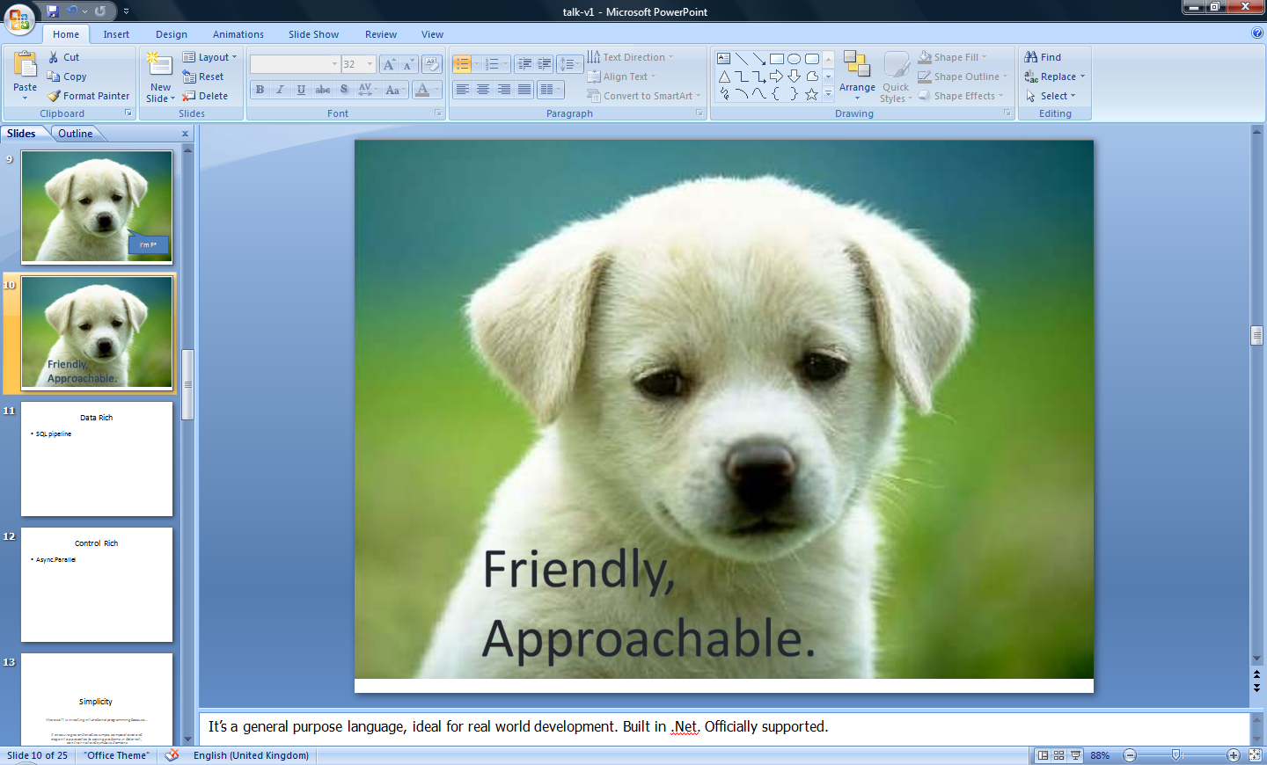


Slide 19
You
Can
Interoperate
With
Everything

Slide 20
Everything
Can
Interoperate
With
You

Slide 21
F#: Influences
OCaml
C#/.NET
F#
Similar core
language
Similar object
model

Slide 22
Combining Paradigms
I've been coding in F# lately, for a production task. F# allows you to move smoothly in your programming style... I start with pure functional code, shift slightly towards an object-oriented style, and in production code, I sometimes have to do some imperative programming.
I can start with a pure idea, and still finish my project with realistic code. You're never disappointed in any phase of the project!
Julien Laugel, Chief Software Architect, www.eurostocks.com

Slide 23
Parallel

Slide 24
F# and the Concurrency Challenges
Shared State
F# Immutability
Inversion of Control
F# Async
I/O Parallelism
F# Async
Messaging and Scaling
F# Agents
+ Web/Cloud/MSQ/
HPC/Cluster etc.

Slide 25
Let’s Web Crawl…
some basic F#
Notes:
If you would like to host your demo on the Virtual Server, please use the myVPC demo slide, not this slide.

Slide 26
Let’s Web Crawl…
quick tour

Slide 27
Functional Core
Objects
Units of Measure
Imperative Mutation & I/O
Async/Parallel/Monads
Meta Programming
e.g. Queries
Functional Data

Slide 28
Whitespace Matters
let computeDerivative f x =
let p1 = f (x - 0.05)
let p2 = f (x + 0.05)
(p2 – p1) / 0.1
Offside (bad indentation)

Slide 29
Whitespace Matters
let computeDerivative f x =
let p1 = f (x - 0.05)
let p2 = f (x + 0.05)
(p2 – p1) / 0.1

Slide 30
Objects
Class Types
type ObjectType(args) =
let internalValue = expr
let internalFunction args = expr
let mutable internalState = expr
member x.Prop1 = expr
member x.Meth2 args = expr
Interface Types
type IObject =
interface ISimpleObject
abstract Prop1 : type
abstract Meth2 : type -> type
Constructing Objects
new FileInfo(@"c:\misc\test.fs")

Slide 31
Objects + Functional
type Vector2D (dx:double, dy:double) =
let d2 = dx*dx+dy*dy
member v.DX = dx
member v.DY = dy
member v.Length = sqrt d2
member v.Scale(k) = Vector2D (dx*k,dy*k)
Inputs to object
construction
Object internals
Exported properties
Exported method

Slide 32
Objects + Functional
Immutable inputs
type HuffmanEncoding(freq:seq<char*int>) =
...
< 50 lines of beautiful functional code>
...
member x.Encode(input: seq<char>) =
encode(input)
member x.Decode(input: seq<char>) =
decode(input)
Internal tables
Publish access

Slide 33
Embedding Computations (monads)
Strict lists
[ … ]
seq { … }
async { … }
eventStream { … }
resumable { … }
stm { … }
myMonad { … }
On-demand sequences
Tasks/Reactions (emit one result)
User defined monads/monoids

Slide 34
[ … ]
let kindergartenActivities() =
[ "PlayingInGarden.fs"
"SayingGoodbye.fs" ]

Slide 35
[ … ]
Sequential composition of programs that yield lists of results
let kindergartenActivities() =
[ yield "PlayingInGarden.fs"
yield "SayingGoodbye.fs" ]

Slide 36
[ … ]
Conditionals too
let kindergartenActivities() =
[ yield "PlayingInGarden.fs"
if DateTime.Now.DayOfWeek = Monday then
yield "Baking.fs"
yield "SayingGoodbye.fs" ]

Slide 37
[ … ]
Match too
let kindergartenActivities() =
[ yield "PlayingInGarden.fs"
match DateTime.Now.DayOfWeek with
| Monday -> yield "Baking.fs"
| Tuesday -> yield "Building.fs"
| _ ->
yield "Singing.fs"
yield "StoryTelling.fs"
yield "SayingGoodbye.fs" ]

Slide 38
[ … ]
Yield many
let weekDay() =
[ yield! kindergartenActivities()
yield! afternoonActivities()
yield "GoToBed.fs" ]

Slide 39
[ … ]
For loops
let squares (n, m) =
[ for x in n .. m do
yield (x,x*x) ]
let activities children =
[ for child in children do
yield "WakeUp.fs"
yield! morningActivies child ]

Slide 40
[ … ]
We can do I/O here
This is F#, not Haskell
let rec allFiles dir =
[ for file in Directory.GetFiles dir do
yield file
for sub in Directory.GetDirectories dir do
yield! allFiles sub ]
allFiles @"C:\LogFiles"

Slide 41
seq { … }
Same syntax, but generated on demand
let someFilesOnDemand =
seq { yield "File1.fs"
yield "File3.fs" }

Slide 42
seq { … }
e.g. With side effects
let someFilesOnDemand =
seq { printfn "about to yield #1"
yield "File1.fs"
printfn "about to yield #2"
yield "File3.fs"
printfn "finishing..." }

Slide 43
seq { … }
let rec allFiles dir =
seq { for file in Directory.GetFiles dir do
yield file
for sub in Directory.GetDirectories dir do
yield! allFiles sub }
allFiles @"C:\LogFiles"
|> Seq.take 100
|> show
Pipelines

Slide 44
seq { … }
Because it's on-demand, things can now be infinite
let rec randomWalk x =
seq { yield x
yield! randomWalk (x+rnd()) }

Slide 45
queries
<@ ... @> = quotation
query
<@ seq { for i in db.Customers do
for j in db.Employees do
if i.Country = j.Country then
yield (i.FirstName, j.FirstName) } @>
(runs as SQL on database)

Slide 46
Case Study : adPredict on bing

Slide 47

The adCenter Problem

Slide 48
The adCenter Problem
Ads for“web space” at www.bing.com and www.msn.com.
Prices by auctions
Internal competition for “Click Prediction”

Slide 49
The Scale of Things
Weeks of data in training:
7,000,000,000 impressions, 6TB data
2 weeks of CPU time during training:
2 wks × 7 days × 86,400 sec/day =
1,209,600 seconds
Learning algorithm speed requirement:
5,787 impression updates / sec
172.8 μs per impression update

Slide 50
F# and adCenter
4 week project, 4 machine learning experts
100million probabilistic variables
Processes 6TB of training data
Real time processing

Slide 51
AdPredict: What We Observed
Type inference means less typing, more thinking
Less Typing
Agile Coding
Scripting
Performance
Memory-Faithful
Succinct
Symbolic
.NET Integration
Type-inferred code is easily refactored
“Hands-on” exploration.
Scaling to massive data sets
mega-data structures, 16GB machines
Live in the domain, not the language
Schema compilation and “Schedules”
Especially Excel, SQL Server

Slide 52
Let’s Web Crawl…
parallel & reactive
Notes:
If you would like to host your demo on the Virtual Server, please use the myVPC demo slide, not this slide.

Slide 53
F# and the Concurrency Challenges
Shared State
F# Immutability
Inversion of Control
F# Async
I/O Parallelism
F# Async
Messaging and Scaling
F# Agents
+ Web/Cloud/MSQ/
HPC/Cluster etc.

Slide 54
Four Big Concurrency Challenges
Shared State
F# Immutability
Inversion of Control
I/O Parallelism
Messaging and Scaling

Slide 55
Immutability the norm...
Immutable Tuples
Immutable Maps
Immutable Unions
+ lots of language features to encourage immutability
Immutable Lists
Immutable Records
Immutable Sets
Immutable Objects

Slide 56
F# and the Concurrency Challenges
Shared State
Inversion of Control
F# Async
I/O Parallelism
F# Async
Messaging and Scaling
Notes:
We all know it’s not always as easy as adding .Parallel !!
Shared state
Making applications reactive means inverting control - “do this when you are done with this”
In practice, performance bottlenecks are more often about I/O than CPU – and there is abundant I/O paralleism (can have hundreds of pending web requests, disks know how to inteligently schedule concurrent reads, etc.) - using .Parallel doesn’t take advantage of this parallelism
And if you really just want pure speed or scalability, a single machine is likely not enough. So easy to get ahold of compute resources now, need development approaches which scale.
Shared State
Inversion of Control (asynchronous)
I/O bottlenecks (network, disk)
Scaling off a single machine

Slide 57
F# is a Parallel Language
(Multiple active computations)
F# is a Reactive Language
(Multiple pending reactions)
GUI Event
Page Load
Timer Callback
Query Response
HTTP Response
Web Service Response
Disk I/O Completion
Agent Gets Message

Slide 58
async { ... }
A Building Block for
Writing Reactive Code
async { ... }
You can run it, but it may take a while
Or, your builder says...
OK, I can do the job, but I might have to talk to someone else about it. Tell me what to do when I’m done

Slide 59
async { ... }
A Building Block for
Writing Reactive Code
async { ... }
Continuation monad
(one shot = resumptions)
result/exception/cancellation continuations

Slide 60
async { ... }
React!
async { let! res = <async-event>
... }
React to a GUI Event
React to a Timer Callback
React to a Query Response
React to a HTTP Response
React to a Web Service Response
React to a Disk I/O Completion
Agent reacts to Message

Slide 61
Async Basics + Web Translation
demo

Slide 62
F# and the Concurrency Challenges
Shared State
Inversion of Control
I/O Parallelism
Messaging and Scaling
F# Agents
Notes:
We all know it’s not always as easy as adding .Parallel !!
Shared state
Making applications reactive means inverting control - “do this when you are done with this”
In practice, performance bottlenecks are more often about I/O than CPU – and there is abundant I/O paralleism (can have hundreds of pending web requests, disks know how to inteligently schedule concurrent reads, etc.) - using .Parallel doesn’t take advantage of this parallelism
And if you really just want pure speed or scalability, a single machine is likely not enough. So easy to get ahold of compute resources now, need development approaches which scale.
Shared State
Inversion of Control (asynchronous)
I/O bottlenecks (network, disk)
Scaling off a single machine

Slide 63
Your First Agent
let agent =
Agent.Start(fun inbox ->
async { while true do
let! msg = inbox.Receive()
printfn "got message %s" msg } )
agent.Post "three"
agent.Post "four"
Note:
type Agent<'T> = MailboxProcessor<'T>

Slide 64
Your First 100,000 Agents
let agents =
[ for i in 0 .. 100000 ->
Agent.Start(fun inbox ->
async { while true do
let! msg = inbox.Receive()
printfn "%d got message %s" i msg })]
for agent in agents do
agent.Post "hello"
Note:
type Agent<'T> = MailboxProcessor<'T>

Slide 65
Agents Galore
summary

Slide 66
Recap
F# is a general purpose, efficient, succinct, “functional-first” .NET programming language
F# has a simple, script-like initial experience, but is strongly typed and .NET friendly
F# has some nice features for objects, async, agents, parallel and units of measure
F# is highly interoperable, and can build vanilla .NET components

Slide 67
Research Contributions (not all published)
Active Patterns
Monadic/query programming in a strict language
Runtime meta-programming in a typed language
Lightweight reactive agents on .NET or JVM
Nominal objects in a type-inferred language
Units of measure
Notes:
Contents are wrong – should be a summary of key F# takeaways

Slide 68
Related Work
A vast amount....
C#
SML (SML.NET)
OCaml
Scala
Haskell
Kennedy ‘97 – Units of Measure
Use of resumptions for async/parallel programming has many precursors
Notes:
Contents are wrong – should be a summary of key F# takeaways

Slide 69
Some Micro Trends
HTTP, HTML, XML, JSON, Haskell, F#, Scala, Clojure, Erlang,...
Communication With Immutable Data
Programming With Queries
Programming With Lambdas
Programming With Pattern Matching
Languages with a Lighter Syntax
Isolation
Taming Side Effects
C#, VB, F#, SQL, Kx....
C#, F#, Javascript, Scala, Clojure, ...
F#, Scala, ...
Python, Ruby, F#, ...
Erlang, ...
Haskell, ...

Slide 70
The Huge Trends
THE WEB
MULTICORE

Slide 71
In Summary
Notes:
Contents are wrong – should be a summary of key F# takeaways

Slide 72
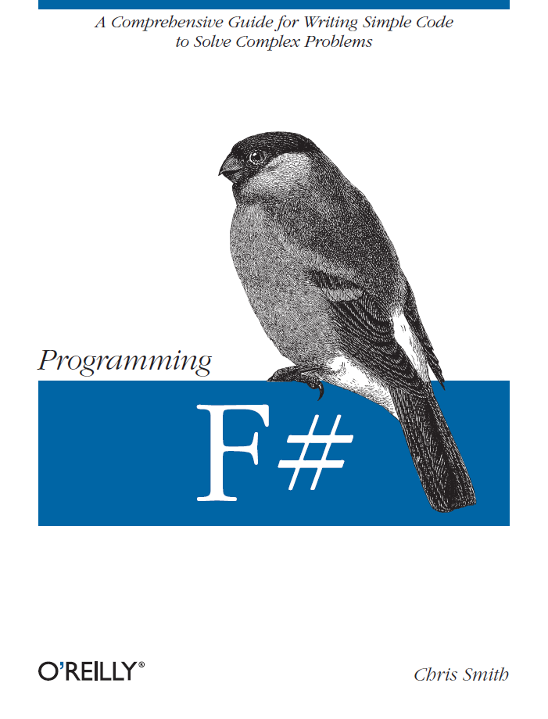
Latest Book about F#
Visit www.fsharp.net

Slide 73
question & answer

Slide 74
Typical F# Reactive Architecture
async { ... }
Async.Parallel [ ... ]
...
Single Threaded GUI
Or
Single Threaded Page Handler
Or
Command Line Driver
new Agent<_>(async { ... })
new WebCrawler<_>()
Internally: new Agent<_>(...) ...
event x.Started
event x.CrawledPage
event x.Finished

Slide 75
Functional– Pipelines
x |> f
The pipeline operator

Slide 76
The many uses of async { ... }
Representing Agents (approximate)
let queue = new Queue()
let rec loop count =
async { let! msg = queue.ReadMessage()
printfn "got a message"
return! loop (count + msg) }
Async.Start (loop 0)
queue.Enqueue 3
queue.Enqueue 4

Slide 77
Your First 100,000 Chatty Agents
let agents =
[ for i in 0 .. 100000 ->
Agent.Start(fun inbox ->
async { while true do
let! a,b,reply = inbox.Receive()
msg <-- (a+b) })]
Async.Parallel
[ for agent in agents ->
agent.PostAndAsyncReply (fun r -> (10,10,r)) ]
Response
Promise
Note:
type Agent<'T> = MailboxProcessor<'T>
let (<--) (a:AsyncReplyChannel<'T>) b = a.Reply(b)

Slide 78
The many uses of async { ... }
Repeating tasks with mutable state
Repeating tasks with immutable state
async { let state = ...
while true do
let! msg = queue.ReadMessage()
<process message> }
let rec loop count =
async { let! msg = queue.ReadMessage()
printfn "got a message"
return! loop (count + msg) }
loop 0

Slide 79
Concurrency Challenges
Shared State
Difficult to maintain and test
Very difficult to parallelize!
Locking is fundamentally error prone:
Must guess where parallelism will be needed
All consumers need to participate
Inversion of Control
I/O Parallelism
Messaging and Scaling
Notes:
We all know it’s not always as easy as adding .Parallel !!
Shared state
Making applications reactive means inverting control - “do this when you are done with this”
In practice, performance bottlenecks are more often about I/O than CPU – and there is abundant I/O paralleism (can have hundreds of pending web requests, disks know how to inteligently schedule concurrent reads, etc.) - using .Parallel doesn’t take advantage of this parallelism
And if you really just want pure speed or scalability, a single machine is likely not enough. So easy to get ahold of compute resources now, need development approaches which scale.
Shared State
Inversion of Control (asynchronous)
I/O bottlenecks (network, disk)
Scaling off a single machine

Slide 80
Shared State: The Problem
“Shared state is the new spaghetti code”
Difficult to maintain
Difficult to test
Difficult to parallelize!

Slide 81
Concurrency Challenges
Shared State
Inversion of Control
We’re used to writing code linearly
Async requires decoupling Begin from End
Very difficult to:
Combine multiple asynchronous operations
Deal with exceptions and cancellation
I/O Parallelism
Messaging and Scaling
Notes:
Synchronous code is linear
Asynchronous code requires de-coupling Begin action from End action
Makes code hard to write, and even harder to read
Especially difficult to compose multiple operations
But…reactivity requires asynchronous code
Silverlight doesn’t even provide synchronous versions of common I/O operations

Slide 82
Concurrency Challenges
Shared State
Inversion of Control
I/O Parallelism
Software is often I/O-bound
Leveraging web services
Working with data on disk
Network and disk speeds increasing slower
I/O resources are inherently parallel
Huge opportunity for performance
Messaging and Scaling
Notes:
Multicore means your apps can run 4, 8,16x faster
I/O is almost always the perf bottleneck in the “real world”
Can get 10, 50, 100x performance improvement
Disk and network speeds growing much slower than CPU
Applications are working with more and more web services and more and more data on disk

Slide 83
Concurrency Challenges
Shared State
Inversion of Control
I/O Parallelism
Messaging and Scaling
Multi-machine resources becoming common:
Roll-you-own clusters with cheap hardware
On-demand cloud compute with Azure
Programs must be written with this in mind
This means structuring with messaging and agents
Notes:
If you really want processing power, you’ve got to scale to multi machines
But…
Shared memory doesn’t scale
This is becoming common place:
Roll-your-own clusters with cheap hardware
Azure provides compute in the cloud

Slide 84
LOP Taxonomy
XML, CSV, Text, Strings, JSON
The language
is in the data
Concrete Representations
Abstract Representations
Integrated Representations
Parse Trees
The language
is in the code
Almost-Implicit
Parallelism
Queries
Exception Handling
Workflows

Slide 85
LOP Techniques
XML Libraries
RegExp Libraries
Lex/Yacc
...
Concrete Representations
Abstract Representations
Integrated Representations
Discriminated Unions
Pattern Matching
F# Computation Expressions
Expression Trees

Slide 86
Kinds of languages
There can be many of these languages
No Structure
Syntactic Structure
Minimal Syntactic Structure + Some Semantic Properties
Lots of Semantic and Computational Structure
Typed AST
Very Generic (XML Object Model)
Monadic Languages
Strings
BDDs
Very Specific (Models one problem)
RegExp
Combinator API
Much FP Research Focuses Here
Many real world gains are here

Slide 87
What is Functional Programming?
“Anything but imperative programming”???
“Working with immutable data”
“A language with queries”
“A language with lambdas”
“A language with pattern matching”
“A language with a lighter syntax”
“Laziness”
“Taming side effects”
“Type classes”

Slide 88
async { ... }
async { let! image = ReadAsync "cat.jpg"
let image2 = f image
do! WriteAsync image2 "dog.jpg"
do printfn "done!"
return image2 }
Asynchronous action
Continuation/
Event callback
You're actually writing this (approximately):
async.Delay(fun () ->
async.Bind(ReadAsync "cat.jpg", (fun image ->
let image2 = f image
async.Bind(writeAsync "dog.jpg",(fun () ->
printfn "done!"
async.Return())))))

Slide 89
The many uses of async { ... }
Sequencing I/O requests
Sequencing CPU computations and I/O requests
async { let! lang = detectLanguageAsync text
let! text2 = translateAsync (lang,"da",text)
return text2 }
async { let! lang = detectLanguageAsync text
let! text2 = translateAsync (lang,"da",text)
let text3 = postProcess text2
return text3 }

Slide 90
The many uses of async { ... }
Parallel CPU computations
Parallel I/O requests
Async.Parallel [ async { return (fib 39) };
async { return (fib 40) }; ]
Async.Parallel
[ for target in langs ->
translateAsync (lang,target,text) ]

