Slide 1
F# - Overview + Parallel/Asynchronous
Don Syme,
Principal Researcher
Microsoft Research, Cambridge

Slide 2
Agenda
Why are we investing in Functional Programming?
Some F# Coding and Demonstrations
The F# Contributions to Parallelism and Async Programming

Slide 3
Why are we investing in Functional Programming Anyway?

Slide 4
Simplicity

Slide 5
Economics

Slide 6
Parallel

Slide 7
Simplicity

Slide 8
Code!
Pleasure
Pain
//C#
using System;
namespace ConsoleApplication1
{
class Program
{
static int a()
{
return 2;
}
static void Main(string[] args)
{
Console.WriteLine(a);
}
}
}
//F#
open System
let a = 2
Console.WriteLine(a)
More noise
than signal!

Slide 9
Pleasure
Pain
type Command =
Command of (Rover -> unit)
let BreakCommand =
Command(fun rover ->
rover.Accelerate(-1.0))
let TurnLeftCommand =
Command(fun rover ->
rover.Rotate(-5.0<degs>))
abstract class Command
{
public virtual void Execute();
}
abstract class MarsRoverCommand : Command
{
protected MarsRover Rover
{ get; private set; }
public MarsRoverCommand(MarsRover rover)
{
this.Rover = rover;
}
}
class BreakCommand : MarsRoverCommand
{
public BreakCommand(MarsRover rover)
: base(rover)
{
}
public override void Execute()
{
Rover.Rotate(-5.0);
}
}
class TurnLeftCommand : MarsRoverCommand
{
public TurnLeftCommand(MarsRover rover)
: base(rover)
{
}
public override void Execute()
{
Rover.Rotate(-5.0);
}
}

Slide 10
Pleasure
Pain
Tuple<U,T> Swap<T,U>(Tuple<T,U> t)
{
return new Tuple<U,T>(t.Item2, t.Item1)
}
ReadOnlyCollection<Tuple<T,T,T>> Rotations<T>(Tuple<T,T,T> t)
{
new ReadOnlyCollection<int>
(new Tuple<T,T,T>[]
{new Tuple<T,T,T>(t.Item1,t.Item2,t.Item3);
new Tuple<T,T,T>(t.Item3,t.Item1,t.Item2);
new Tuple<T,T,T>(t.Item2,t.Item3,t.Item1); });
}
int Reduce<T>(Func<T,int> f,Tuple<T,T,T> t)
{
return f(t.Item1)+f(t.Item2)+f(t.Item3);
}
let swap (x, y) = (y, x)
let rotations (x, y, z) =
[ (x, y, z);
(z, x, y);
(y, z, x) ]
let reduce f (x, y, z) =
f x + f y + f z

Slide 11
Pleasure
Pain
public abstract class Expr { }
public abstract class UnaryOp :Expr
{
public Expr First { get; private set; }
public UnaryOp(Expr first)
{
this.First = first;
}
}
public abstract class BinExpr : Expr
{
public Expr First { get; private set; }
public Expr Second { get; private set; }
public BinExpr(Expr first, Expr second)
{
this.First = first;
this.Second = second;
}
}
public class TrueExpr : Expr { }
public class And : BinExpr
{
public And(Expr first, Expr second) : base(first, second) { }
}
public class Nand : BinExpr
{
public Nand(Expr first, Expr second) : base(first, second) { }
}
public class Or : BinExpr
{
public Or(Expr first, Expr second) : base(first, second) { }
}
public class Xor : BinExpr
{
public Xor(Expr first, Expr second) : base(first, second) { }
}
public class Not : UnaryOp
{
public Not(Expr first) : base(first) { }
}
type Expr =
| True
| And of Expr * Expr
| Nand of Expr * Expr
| Or of Expr * Expr
| Xor of Expr * Expr
| Not of Expr

Slide 12
Pleasure
Pain
public abstract class Event { }
public abstract class PriceEvent : Event
{
public Price Price { get; private set; }
public PriceEvent(Price price)
{
this.Price = price;
}
}
public abstract class SplitEvent : Event
{
public double Factor { get; private set; }
public SplitEvent(double factor)
{
this.Factor = factor;
}
}
public class DividendEvent : Event { }
...
type Event =
| Price of float<money>
| Split of float
| Dividend of float<money>

Slide 13
Async.Parallel [ getPage "www.google.com"; getPage "www.bing.com"; getPage "www.yahoo.com"; ]
Pleasure

Slide 14
Async.Parallel [ for i in 0 .. 200 -> computeTask i ]
Pleasure
|> Async.RunSynchronously

Slide 15
Async.Parallel [ getPage "www.google.com"; getPage "www.bing.com"; getPage "www.yahoo.com"; ]

Slide 16
F#: Influences
OCaml
C#/.NET
F#
Similar core
language
Similar object
model

Slide 17
Combining Paradigms
I've been coding in F# lately, for a production task. F# allows you to move smoothly in your programming style... I start with pure functional code, shift slightly towards an object-oriented style, and in production code, I sometimes have to do some imperative programming.
I can start with a pure idea, and still finish my project with realistic code.
Julien Laugel, Chief Software Architect, www.eurostocks.com

Slide 18
Let’s Web Crawl…
quick tour

Slide 19
Whitespace Matters
let computeDerivative f x =
let p1 = f (x - 0.05)
let p2 = f (x + 0.05)
(p2 – p1) / 0.1
Offside (bad indentation)

Slide 20
Whitespace Matters
let computeDerivative f x =
let p1 = f (x - 0.05)
let p2 = f (x + 0.05)
(p2 – p1) / 0.1

Slide 21
Functional– Pipelines
x |> f
=
f x
The pipeline operator

Slide 22
Let’s Web Crawl…
some basic F#
Notes:
If you would like to host your demo on the Virtual Server, please use the myVPC demo slide, not this slide.

Slide 23
Functional Core
Objects
Units of Measure
Imperative Mutation & I/O
Async/Parallel/Monads
Meta Programming
e.g. Queries
Functional Data

Slide 24
Objects + Functional
type Vector2D (dx:double, dy:double) =
let d2 = dx*dx+dy*dy
member v.DX = dx
member v.DY = dy
member v.Length = sqrt d2
member v.Scale(k) = Vector2D (dx*k,dy*k)
Inputs to object
construction
Object internals
Exported properties
Exported method

Slide 25
Objects + Functional
Immutable inputs
type HuffmanEncoding(freq:seq<char*int>) =
...
< 50 lines of beautiful functional code>
...
member x.Encode(input: seq<char>) =
encode(input)
member x.Decode(input: seq<char>) =
decode(input)
Internal tables
Publish access

Slide 26
[ … ]
Generated data
let squares (n, m) =
[ for x in n .. m do
yield (x,x*x) ]
let activities children =
[ for child in children do
yield "WakeUp.fs"
yield! morningActivies child ]

Slide 27
[ … ]
We can do I/O here
This is F#, not Haskell
let rec allFiles dir =
[ for file in Directory.GetFiles dir do
yield file
for sub in Directory.GetDirectories dir do
yield! allFiles sub ]
allFiles @"C:\LogFiles"

Slide 28
seq { … }
On-demand
let rec allFiles dir =
seq { for file in Directory.GetFiles dir do
yield file
for sub in Directory.GetDirectories dir do
yield! allFiles sub }
allFiles @"C:\LogFiles"
|> Seq.take 100
|> show
Pipelines

Slide 29
seq { … }
Because it's on-demand, things can now be infinite
let rec randomWalk x =
seq { yield x
yield! randomWalk (x+rnd()) }

Slide 30
queries
<@ ... @> = quotation
query
<@ seq { for i in db.Customers do
for j in db.Employees do
if i.Country = j.Country then
yield (i.FirstName, j.FirstName) } @>
(runs as SQL on database)

Slide 31
Let’s Web Crawl…
parallel & reactive
Notes:
If you would like to host your demo on the Virtual Server, please use the myVPC demo slide, not this slide.

Slide 32
What is Functional Programming?
“Working with immutable data”
“A language with queries”
“A language with lambdas”
“A language with pattern matching”
“A language with a lighter syntax”
“Taming side effects”
“Anything but imperative programming”???

Slide 33
Some Micro Trends
REST, HTML, XML, JSON, Haskell, F#, Scala, Clojure, Erlang,...
Communication With Immutable Data
Programming With Queries
Programming With Lambdas
Programming With Pattern Matching
Languages with a Lighter Syntax
Taming Side Effects
C#, VB, F#, SQL, Kx....
C#, F#, Javascript, Scala, Clojure, ...
F#, Scala, ...
Python, Ruby, F#, ...
Erlang, Scala, F#, Haskell, ...

Slide 34
The Huge Trends
THE WEB
MULTICORE

Slide 35
Typed Functional
Programming
Make
parallelism
sane
“Minimize Mutable
State”
Make I/O and task
parallelism more
compositional
“Purity”
Less
Mutable
State
“Transactional
State”
“Isolated
State”
Integrate declarative
engine-based parallelism
into language
e.g. Queries,
Array/matrix programs,
Constraint programs
“Immutable
Data”
Embedded
Computational
Languages
Embedded
Declarative
Languages
“combinators”
“monads”
“meta-programs”
“DSLs”
“LINQ”
task { ... }
async { ... }
PSeq.map
Async.Parallel
“monoids”
Types
“generics”
query
<@ seq { for i in db.Customers do
for j in db.Employees do
if i.Country = j.Country then
yield (i.FirstName, j.FirstName) } @>
Make
programming
sane

Slide 36
F# and Parallel Challenges
Shared State
Immutability
Inversion of Control
Async
I/O, Task, Agent Parallelism
Async
Engine Access +
Embedded
Languages
Implicit Parallelism
Distribution
Web/Cloud/MSQ/
Cluster etc.

Slide 37
Four Big Concurrency Challenges
Shared State
F# Immutability
Inversion of Control
I/O, Task, Agent Parallelism

Slide 38
Immutability the norm...
Immutable Tuples
Immutable Maps
Immutable Unions
+ lots of language features to encourage immutability
Immutable Lists
Immutable Records
Immutable Sets
Immutable Objects

Slide 39
F# and the Concurrency Challenges
Shared State
Inversion of Control
F# Async
I/O, Task, Agent Parallelism
F# Async
Notes:
We all know it’s not always as easy as adding .Parallel !!
Shared state
Making applications reactive means inverting control - “do this when you are done with this”
In practice, performance bottlenecks are more often about I/O than CPU – and there is abundant I/O paralleism (can have hundreds of pending web requests, disks know how to inteligently schedule concurrent reads, etc.) - using .Parallel doesn’t take advantage of this parallelism
And if you really just want pure speed or scalability, a single machine is likely not enough. So easy to get ahold of compute resources now, need development approaches which scale.
Shared State
Inversion of Control (asynchronous)
I/O bottlenecks (network, disk)
Scaling off a single machine

Slide 40
F# is a Parallel Language
(Multiple active computations)
F# is a Reactive Language
(Multiple pending reactions)
GUI Event
Page Load
Timer Callback
Query Response
HTTP Response
Web Service Response
Disk I/O Completion
Agent Gets Message

Slide 41
async { ... }
A Building Block for
Writing Reactive Code
async { ... }
You can run it, but it may take a while
Or, your builder says...
OK, I can do the job, but I might have to talk to someone else about it. Tell me what to do when I’m done

Slide 42
async { ... }
React!
async { let! res = <async-event>
... }
React to a GUI Event
React to a Timer Callback
React to a Query Response
React to a HTTP Response
React to a Web Service Response
React to a Disk I/O Completion
Agent reacts to Message

Slide 43
async { ... }
A Building Block for
Writing Reactive Code
async { ... }
Continuation monad
(one shot = resumptions)
result/exception/cancellation continuations
+ delimited exceptions and resources
+ combinators to put them together
+ monadic syntax
+ start-task, fork-join operators

Slide 44
async { ... }
async { let! image = ReadAsync "cat.jpg"
let image2 = f image
do! WriteAsync image2 "dog.jpg"
do printfn "done!"
return image2 }
Asynchronous action
Continuation/
Event callback
You're actually writing this (approximately):
async.Delay(fun () ->
async.Bind(ReadAsync "cat.jpg", (fun image ->
let image2 = f image
async.Bind(writeAsync "dog.jpg",(fun () ->
printfn "done!"
async.Return())))))

Slide 45
The many uses of async { ... }
Sequencing I/O requests
Sequencing CPU computations and I/O requests
async { let! lang = detectLanguageAsync text
let! text2 = translateAsync (lang,"da",text)
return text2 }
async { let! lang = detectLanguageAsync text
let! text2 = translateAsync (lang,"da",text)
let text3 = postProcess text2
return text3 }

Slide 46
The many uses of async { ... }
Parallel CPU computations
Parallel I/O requests
Async.Parallel [ async { return (fib 39) };
async { return (fib 40) }; ]
Async.Parallel
[ for target in langs ->
translateAsync (lang,target,text) ]

Slide 47
The many uses of async { ... }
Repeating tasks with mutable state
Repeating tasks with immutable state
async { let state = ...
while true do
let! msg = queue.ReadMessage()
<process message> }
let rec loop count =
async { let! msg = queue.ReadMessage()
printfn "got a message"
return! loop (count + msg) }
loop 0

Slide 48
The many uses of async { ... }
Representing Agents (approximate)
let queue = new Queue()
let rec loop count =
async { let! msg = queue.ReadMessage()
printfn "got a message"
return! loop (count + msg) }
Async.Start (loop 0)
queue.Enqueue 3
queue.Enqueue 4

Slide 49
A First Agent
let agent =
Agent.Start(fun inbox ->
async { while true do
let! msg = inbox.Receive()
printfn "got message %s" msg } )
agent.Post "three"
agent.Post "four"
Note:
type Agent<'T> = MailboxProcessor<'T>

Slide 50
First 100,000 Agents
let agents =
[ for i in 0 .. 100000 ->
Agent.Start(fun inbox ->
async { while true do
let! msg = inbox.Receive()
printfn "%d got message %s" i msg })]
for agent in agents do
agent.Post "hello"
Note:
type Agent<'T> = MailboxProcessor<'T>

Slide 51
First 100,000 Chatty Agents
let agents =
[ for i in 0 .. 100000 ->
Agent.Start(fun inbox ->
async { while true do
let! a,b,reply = inbox.Receive()
msg <-- (a+b) })]
Async.Parallel
[ for agent in agents ->
agent.PostAndAsyncReply (fun r -> (10,10,r)) ]
Response
Promise
Note:
type Agent<'T> = MailboxProcessor<'T>
let (<--) (a:AsyncReplyChannel<'T>) b = a.Reply(b)

Slide 52
Async Basics + Web Translation
demo

Slide 53
Typical F# Reactive Architecture
async { ... }
Async.Parallel [ ... ]
...
Single Threaded GUI
Or
Single Threaded Page Handler
Or
Command Line Driver
new Agent<_>(async { ... })
new WebCrawler<_>()
Internally: new Agent<_>(...) ...
event x.Started
event x.CrawledPage
event x.Finished

Slide 54
Agents Galore
summary

Slide 55
Recap
F# is a general purpose, efficient, succinct, “functional-first” .NET programming language
F# has a simple, script-like initial experience, but is strongly typed and .NET friendly
F# has some nice features for objects, async, agents, parallel and units of measure
F# is highly interoperable, and can build vanilla .NET components

Slide 56
F# - Research Contributions
Active Patterns ICFP 07
Meta-programming in a typed language ML 06
Units of measure CEFP 09, Kennedy
Lightweight reactive agents on VM Expert F#
Nominal objects in a type-inferred language
Monadic programming in a strict language
Notes:
Contents are wrong – should be a summary of key F# takeaways

Slide 57
Related Work
A vast amount....
C#
SML (SML.NET)
OCaml
Scala
Haskell
Kennedy ‘97 – Units of Measure
Use of resumptions for async/parallel programming has many precursors
Notes:
Contents are wrong – should be a summary of key F# takeaways

Slide 58
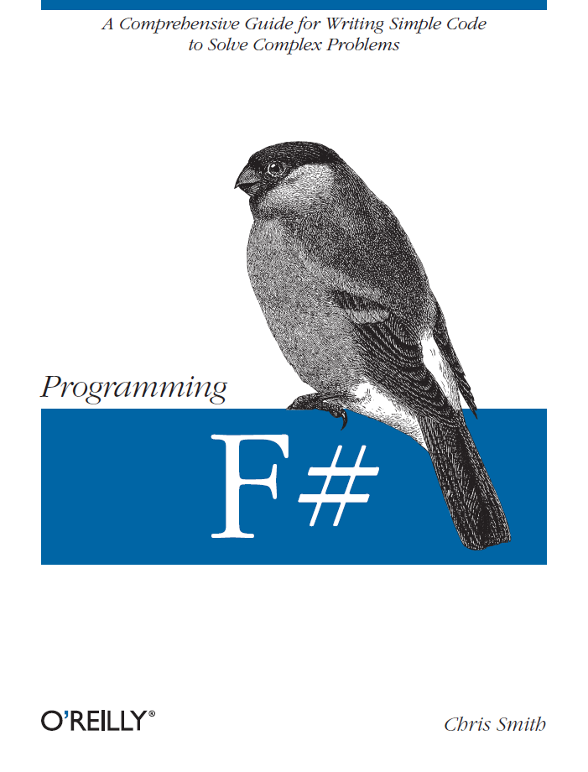
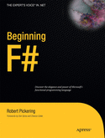
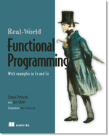

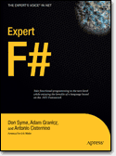
Latest Books about F#
Visit www.fsharp.net

Slide 59
question & answer

