Slide 1
Taking Functional Programming into the Mainstream
Don Syme
Principal Researcher
Microsoft Research, Cambridge
Many thanks to the F# team and community

Slide 2
Agenda
Making Functional Programming Mainstream
Some F# Coding and Demonstrations
A Look at F# Async/Parallel

Slide 3
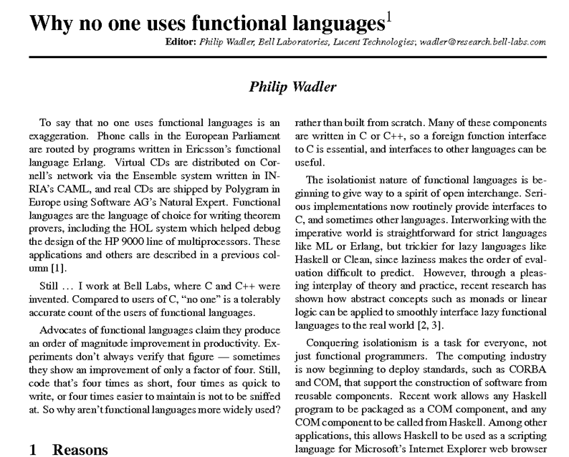

Slide 4
The Simple Story
1998
Reshape a Widely Used Execution Environment
Add a Core Functional Language
Prove it Works
Add Extensions that multiply its power
Objects Parallel
Async/monads Units-of-measure
Release it at Product-Equality
2003
2005
2007
2010

Slide 5
Why are we investing in Functional Programming Anyway?

Slide 6
Simplicity

Slide 7
Code!
//C#
using System;
namespace ConsoleApplication1
{
class Program
{
static int a()
{
return 2;
}
static void Main(string[] args)
{
Console.WriteLine(a);
}
}
}
//F#
open System
let a = 2
Console.WriteLine(a)
More noise
than signal!

Slide 8
Pleasure
Pain
type Command =
Command of (Rover -> unit)
let BreakCommand =
Command(fun rover ->
rover.Accelerate(-1.0))
let TurnLeftCommand =
Command(fun rover ->
rover.Rotate(-5.0<degs>))
abstract class Command
{
public virtual void Execute();
}
abstract class MarsRoverCommand : Command
{
protected MarsRover Rover
{ get; private set; }
public MarsRoverCommand(MarsRover rover)
{
this.Rover = rover;
}
}
class BreakCommand : MarsRoverCommand
{
public BreakCommand(MarsRover rover)
: base(rover)
{
}
public override void Execute()
{
Rover.Rotate(-5.0);
}
}
class TurnLeftCommand : MarsRoverCommand
{
public TurnLeftCommand(MarsRover rover)
: base(rover)
{
}
public override void Execute()
{
Rover.Rotate(-5.0);
}
}

Slide 9
Pleasure
Pain
let swap (x, y) = (y, x)
let rotations (x, y, z) =
[ (x, y, z);
(z, x, y);
(y, z, x) ]
let reduce f (x, y, z) =
f x + f y + f z
Tuple<U,T> Swap<T,U>(Tuple<T,U> t)
{
return new Tuple<U,T>(t.Item2, t.Item1)
}
ReadOnlyCollection<Tuple<T,T,T>> Rotations<T>(Tuple<T,T,T> t)
{
new ReadOnlyCollection<int>
(new Tuple<T,T,T>[]
{new Tuple<T,T,T>(t.Item1,t.Item2,t.Item3);
new Tuple<T,T,T>(t.Item3,t.Item1,t.Item2);
new Tuple<T,T,T>(t.Item2,t.Item3,t.Item1); });
}
int Reduce<T>(Func<T,int> f,Tuple<T,T,T> t)
{
return f(t.Item1)+f(t.Item2)+f(t.Item3);
}

Slide 10
Pleasure
Pain
public abstract class Expr { }
public abstract class UnaryOp :Expr
{
public Expr First { get; private set; }
public UnaryOp(Expr first)
{
this.First = first;
}
}
public abstract class BinExpr : Expr
{
public Expr First { get; private set; }
public Expr Second { get; private set; }
public BinExpr(Expr first, Expr second)
{
this.First = first;
this.Second = second;
}
}
public class TrueExpr : Expr { }
public class And : BinExpr
{
public And(Expr first, Expr second) : base(first, second) { }
}
public class Nand : BinExpr
{
public Nand(Expr first, Expr second) : base(first, second) { }
}
public class Or : BinExpr
{
public Or(Expr first, Expr second) : base(first, second) { }
}
public class Xor : BinExpr
{
public Xor(Expr first, Expr second) : base(first, second) { }
}
public class Not : UnaryOp
{
public Not(Expr first) : base(first) { }
}
type Expr =
| True
| And of Expr * Expr
| Nand of Expr * Expr
| Or of Expr * Expr
| Xor of Expr * Expr
| Not of Expr

Slide 11
Pleasure
Pain
public abstract class Event { }
public abstract class PriceEvent : Event
{
public Price Price { get; private set; }
public PriceEvent(Price price)
{
this.Price = price;
}
}
public abstract class SplitEvent : Event
{
public double Factor { get; private set; }
public SplitEvent(double factor)
{
this.Factor = factor;
}
}
public class DividendEvent : Event { }
...
type Event =
| Price of float<money>
| Split of float
| Dividend of float<money>

Slide 12
Parallel

Slide 13
Async.Parallel [ getPage "www.google.com"; getPage "www.bing.com"; getPage "www.yahoo.com"; ]
Pleasure

Slide 14
Async.Parallel [ for i in 0 .. 200 -> computeTask i ]
Pleasure
|> Async.RunSynchronously

Slide 15
F#: Influences
OCaml
C#/.NET
F#
Similar core
language
Similar object
model

Slide 16
Combining Paradigms
I've been coding in F# lately, for a production task. F# allows you to move smoothly in your programming style... I start with pure functional code, shift slightly towards an object-oriented style, and in production code, I sometimes have to do some imperative programming.
I can start with a pure idea, and still finish my project with realistic code.
Julien Laugel, Chief Software Architect, www.eurostocks.com

Slide 17
Functional Core
Objects
Units of Measure
Imperative Mutation & I/O
Async/Parallel/Monads
Meta Programming
e.g. SQL Queries,
GPU Programs
Functional Data

Slide 18
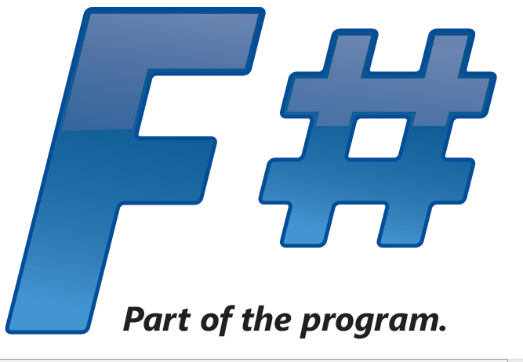
.NET CLR
Windows
Silverlight
Browser (native)
Mono
Cloud/Cluster
Web-Sharper
Javascript
Azure
EC2
Mac OSX
Linux
Windows
iPhone

Slide 19
Let’s Web Crawl…
some basic F#
Notes:
If you would like to host your demo on the Virtual Server, please use the myVPC demo slide, not this slide.

Slide 20
Whitespace Matters
let computeDerivative f x =
let p1 = f (x - 0.05)
let p2 = f (x + 0.05)
(p2 – p1) / 0.1
Offside (bad indentation)

Slide 21
Whitespace Matters
let computeDerivative f x =
let p1 = f (x - 0.05)
let p2 = f (x + 0.05)
(p2 – p1) / 0.1

Slide 22
Functional– Pipelines
x |> f
=
f x
The pipeline operator

Slide 23
Objects + Functional
type Vector2D (dx:double, dy:double) =
let d2 = dx*dx+dy*dy
member v.DX = dx
member v.DY = dy
member v.Length = sqrt d2
member v.Scale(k) = Vector2D (dx*k,dy*k)
Inputs to object
construction
Object internals
Exported properties
Exported method

Slide 24
Objects + Functional
Immutable inputs
type HuffmanEncoding(freq:seq<char*int>) =
...
< 50 lines of beautiful functional code>
...
member x.Encode(input: seq<char>) =
encode(input)
member x.Decode(input: seq<char>) =
decode(input)
Internal tables
Publish access

Slide 25
[ … ]
Generated data
let squares (n, m) =
[ for x in n .. m do
yield (x,x*x) ]
let activities children =
[ for child in children do
yield "WakeUp.fs"
yield! morningActivies child ]

Slide 26
[ … ]
We can do I/O here
This is F#, not Haskell
let rec allFiles dir =
[ for file in Directory.GetFiles dir do
yield file
for sub in Directory.GetDirectories dir do
yield! allFiles sub ]
allFiles @"C:\LogFiles"

Slide 27
seq { … }
On-demand
let rec allFiles dir =
seq { for file in Directory.GetFiles dir do
yield file
for sub in Directory.GetDirectories dir do
yield! allFiles sub }
allFiles @"C:\LogFiles"
|> Seq.take 100
|> show
Pipelines

Slide 28
seq { … }
Because it's on-demand, things can now be infinite
let rec randomWalk x =
seq { yield x
yield! randomWalk (x+rnd()) }

Slide 29
queries
seq { for i in db.Customers do
for j in db.Employees do
if i.Country = j.Country then
yield (i.FirstName, j.FirstName) }
(runs in-memory)

Slide 30
queries
<@ ... @> = quotation
query
<@ seq { for i in db.Customers do
for j in db.Employees do
if i.Country = j.Country then
yield (i.FirstName, j.FirstName) } @>
(runs as SQL on database)

Slide 31
Let’s Web Crawl…
parallel & reactive
Notes:
If you would like to host your demo on the Virtual Server, please use the myVPC demo slide, not this slide.

Slide 32
Some Micro Trends
REST, HTML, XML, JSON, Haskell, F#, Scala, Clojure, Erlang,...
Communication With Immutable Data
Programming With Queries
Programming With Lambdas
Programming With Pattern Matching
Languages with a Lighter Syntax
Taming Side Effects
C#, VB, F#, SQL, Kx....
C#, F#, Javascript, Scala, Clojure, ...
F#, Scala, ...
Python, Ruby, F#, ...
Erlang, Scala, F#, Haskell, ...

Slide 33
The Huge Trends
THE WEB
MULTICORE

Slide 34
Typed Functional
Programming
Make
parallelism
sane
“Minimize Mutable
State”
Make I/O and task
parallelism more
compositional
“Purity”
Less
Mutable
State
“Transactional
State”
“Isolated
State”
Integrate declarative
engine-based parallelism
into language
e.g. Queries,
Array/matrix programs,
Constraint programs
“Immutable
Data”
Embedded
Computational
Languages
Embedded
Declarative
Languages
“combinators”
“monads”
“meta-programs”
“DSLs”
“LINQ”
task { ... }
async { ... }
PSeq.map
Async.Parallel
“monoids”
Types
“generics”
query
<@ seq { for i in db.Customers do
for j in db.Employees do
if i.Country = j.Country then
yield (i.FirstName, j.FirstName) } @>
Make
programming
sane

Slide 35
F# and Parallel Challenges
Shared State
Immutability
Inversion of Control
Async
I/O, Task, Agent Parallelism
Async
Engine Access +
Embedded
Languages
Implicit Parallelism
Distribution
Web/Cloud/MSQ/
Cluster etc.

Slide 36
F# and Parallel Challenges
Shared State
Immutability
Inversion of Control
I/O, Task, Agent Parallelism
Implicit Parallelism
Distribution

Slide 37
Immutability the norm...
Immutable Tuples
Immutable Maps
Immutable Unions
+ lots of language features to encourage immutability
Immutable Lists
Immutable Records
Immutable Sets
Immutable Objects

Slide 38
F# and Parallel Challenges
Shared State
Inversion of Control
Async
I/O, Task, Agent Parallelism
Async
Implicit Parallelism
Distribution

Slide 39
F# is a Parallel Language
(Multiple active computations)
F# is a Reactive Language
(Multiple pending reactions)
GUI Event
Page Load
Timer Callback
Query Response
HTTP Response
Web Service Response
Disk I/O Completion
Agent Gets Message

Slide 40
async { ... }
A Building Block for
Writing Reactive Code
async { ... }
You can run it, but it may take a while
Or, your builder says...
OK, I can do the job, but I might have to talk to someone else about it. Tell me what to do when I’m done

Slide 41
async { ... }
React!
async { let! res = <async-event>
... }
React to a GUI Event
React to a Timer Callback
React to a Query Response
React to a HTTP Response
React to a Web Service Response
React to a Disk I/O Completion
Agent reacts to Message

Slide 42
async { ... }
async { ... }
Resumption monad
(one shot continuations)
w/- result/exception/cancellation continuations
+ delimited exceptions and resources
+ combinators to put them together
+ monadic syntax
+ start-task, fork-join operators

Slide 43
async { ... }
async { let! image = ReadAsync "cat.jpg"
let image2 = f image
do! WriteAsync image2 "dog.jpg"
do printfn "done!"
return image2 }
Asynchronous action
Continuation/
Event callback
You're actually writing this (approximately):
async.Delay(fun () ->
async.Bind(ReadAsync "cat.jpg", (fun image ->
let image2 = f image
async.Bind(writeAsync "dog.jpg",(fun () ->
printfn "done!"
async.Return())))))

Slide 44
The many uses of async { ... }
Sequencing I/O requests
Sequencing CPU computations and I/O requests
async { let! lang = detectLanguageAsync text
let! text2 = translateAsync (lang,"da",text)
return text2 }
async { let! lang = detectLanguageAsync text
let! text2 = translateAsync (lang,"da",text)
let text3 = postProcess text2
return text3 }

Slide 45
The many uses of async { ... }
Parallel CPU computations
Parallel I/O requests
Async.Parallel [ async { return (fib 39) };
async { return (fib 40) }; ]
Async.Parallel
[ for target in langs ->
translateAsync (lang,target,text) ]

Slide 46
The many uses of async { ... }
Repeating tasks with mutable state
Repeating tasks with immutable state
async { let state = ...
while true do
let! msg = queue.ReadMessage()
<process message> }
let rec loop count =
async { let! msg = queue.ReadMessage()
printfn "got a message"
return! loop (count + msg) }
loop 0

Slide 47
The many uses of async { ... }
Representing Agents (approximate)
let queue = new Queue()
let rec loop count =
async { let! msg = queue.ReadMessage()
printfn "got a message"
return! loop (count + msg) }
Async.Start (loop 0)
queue.Enqueue 3
queue.Enqueue 4

Slide 48
A First Agent
let agent =
Agent.Start(fun inbox ->
async { while true do
let! msg = inbox.Receive()
printfn "got message %s" msg } )
agent.Post "three"
agent.Post "four"
Note:
type Agent<'T> = MailboxProcessor<'T>

Slide 49
First 100,000 Agents
let agents =
[ for i in 0 .. 100000 ->
Agent.Start(fun inbox ->
async { while true do
let! msg = inbox.Receive()
printfn "%d got message %s" i msg })]
for agent in agents do
agent.Post "hello"
Note:
type Agent<'T> = MailboxProcessor<'T>

Slide 50
Async Basics + Web Translation
demo

Slide 51
Agents Galore
summary

Slide 52
Recap
F# is a general purpose, efficient, succinct, “functional-first” .NET programming language
F# has a simple, script-like initial experience, but is strongly typed and .NET friendly
F# has some nice features for objects, queries, async, agents, parallel and units of measure
F# is highly interoperable, and can build vanilla .NET components

Slide 53
F# - Research Contributions
Active Patterns ICFP 07
Meta-programming in a typed language ML 06
Units of measure CEFP 09, Kennedy
Lightweight reactive agents on VM Expert F#
Nominal objects in a type-inferred language
Monadic programming in a strict language
Notes:
Contents are wrong – should be a summary of key F# takeaways

Slide 54
Related Work
A vast amount....
C#
SML (SML.NET)
OCaml
Scala
Haskell
Kennedy ‘97 – Units of Measure
Use of resumptions for async/parallel programming has many precursors
Notes:
Contents are wrong – should be a summary of key F# takeaways

Slide 55
Source
F# Compiler Source in MSI/ZIP
In Every Release
Reference source, commercial use for binaries
Aiming for more permissive release
F# PowerPack on CodePlex
Released Feb 2010
OSS approved licence

Slide 56
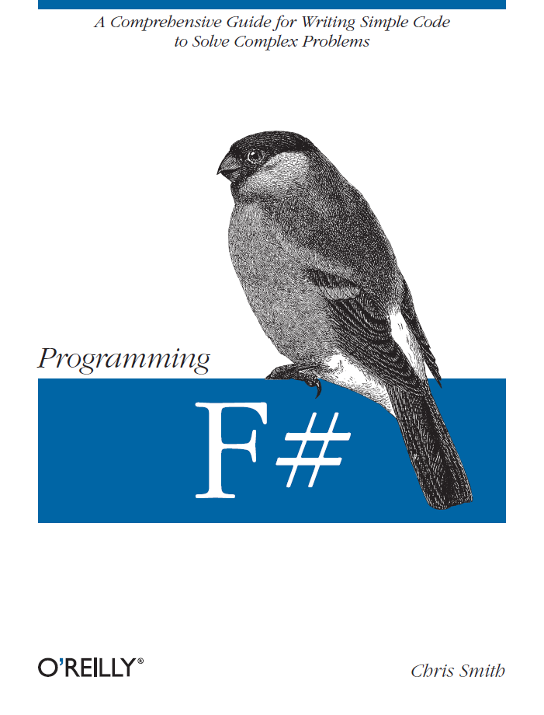
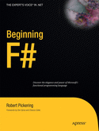
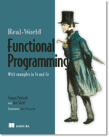

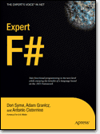
Latest Books about F#
Visit www.fsharp.net

Slide 57
question & answer

