Slide 1
Exploring...
Functional
Parallel
Don Syme
Principal Researcher
Microsoft Research, Cambridge

Slide 2
Disclaimer
I’m a Microsoft Guy. I’m a .NET Fan. I will be using F# and Visual Studio in this talk.
This talk is offered in a spirit of cooperation and idea exchange. Please accept it as such ☺
I assume “running on JVM/.NET is important”. This places some technical limitations (e.g. threads are not cheap)

Slide 3
Themes
Theme: Simplicity
Theme: Immutability
Theme: Reaction v. Action
Theme: Actors and Agents

Slide 4
Where Parallelism?
Instruction Level (CPU)
Multi-core Parallelism (CPUs)
Multi-device Parallelism (CPUs+Disk)
Multi-machine I/O Parallelism (AJAX, Client-Server)
Multi-machine CPU Parallelism (Cluster)
Mega-machine Parallelism (Google, Bing)
The whole world.... (The Web!)

Slide 5
Parallel
Reactive
Concurrent
Distributed

Slide 6
some basic F#

Slide 7
Whitespace Matters
let computeDerivative f x =
let p1 = f (x - 0.05)
let p2 = f (x + 0.05)
(p2 – p1) / 0.1
Offside (bad indentation)

Slide 8
Whitespace Matters
let computeDerivative f x =
let p1 = f (x - 0.05)
let p2 = f (x + 0.05)
(p2 – p1) / 0.1

Slide 9
Functional– Pipelines
x |> f
The pipeline operator

Slide 10
Objects + Functional
type Vector2D (dx:double, dy:double) =
let d2 = dx*dx+dy*dy
member v.DX = dx
member v.DY = dy
member v.Length = sqrt d2
member v.Scale(k) = Vector2D (dx*k,dy*k)
Inputs to object
construction
Object internals
Exported properties
Exported method

Slide 11
Let’s Web Crawl…
theme: functional simplicity
Notes:
If you would like to host your demo on the Virtual Server, please use the myVPC demo slide, not this slide.

Slide 12
Code!
//C#
using System;
namespace ConsoleApplication1
{
class Program
{
static int a()
{
return 2;
}
static void Main(string[] args)
{
Console.WriteLine(a);
}
}
}
//F#
open System
let a = 2
Console.WriteLine(a)
More noise
than signal!

Slide 13
Pleasure
Pain
abstract class Command
{
public virtual void Execute();
}
abstract class MarsRoverCommand : Command
{
protected MarsRover Rover
{ get; private set; }
public MarsRoverCommand(MarsRover rover)
{
this.Rover = rover;
}
}
class BreakCommand : MarsRoverCommand
{
public BreakCommand(MarsRover rover)
: base(rover)
{
}
public override void Execute()
{
Rover.Rotate(-5.0);
}
}
class TurnLeftCommand : MarsRoverCommand
{
public TurnLeftCommand(MarsRover rover)
: base(rover)
{
}
public override void Execute()
{
Rover.Rotate(-5.0);
}
}
type Command = Command of (Rover -> unit)
let BreakCommand =
Command(fun rover -> rover.Accelerate(-1.0))
let TurnLeftCommand =
Command(fun rover -> rover.Rotate(-5.0<degs>))

Slide 14
Pleasure
Pain
let swap (x, y) = (y, x)
let rotations (x, y, z) =
[ (x, y, z);
(z, x, y);
(y, z, x) ]
let reduce f (x, y, z) =
f x + f y + f z
Tuple<U,T> Swap<T,U>(Tuple<T,U> t)
{
return new Tuple<U,T>(t.Item2, t.Item1)
}
ReadOnlyCollection<Tuple<T,T,T>> Rotations<T>(Tuple<T,T,T> t)
{
new ReadOnlyCollection<int>
(new Tuple<T,T,T>[]
{new Tuple<T,T,T>(t.Item1,t.Item2,t.Item3);
new Tuple<T,T,T>(t.Item3,t.Item1,t.Item2);
new Tuple<T,T,T>(t.Item2,t.Item3,t.Item1); });
}
int Reduce<T>(Func<T,int> f,Tuple<T,T,T> t)
{
return f(t.Item1)+f(t.Item2)+f(t.Item3);
}

Slide 15
Pleasure
Pain
public abstract class Expr { }
public abstract class UnaryOp :Expr
{
public Expr First { get; private set; }
public UnaryOp(Expr first)
{
this.First = first;
}
}
public abstract class BinExpr : Expr
{
public Expr First { get; private set; }
public Expr Second { get; private set; }
public BinExpr(Expr first, Expr second)
{
this.First = first;
this.Second = second;
}
}
public class TrueExpr : Expr { }
public class And : BinExpr
{
public And(Expr first, Expr second) : base(first, second) { }
}
public class Nand : BinExpr
{
public Nand(Expr first, Expr second) : base(first, second) { }
}
public class Or : BinExpr
{
public Or(Expr first, Expr second) : base(first, second) { }
}
public class Xor : BinExpr
{
public Xor(Expr first, Expr second) : base(first, second) { }
}
public class Not : UnaryOp
{
public Not(Expr first) : base(first) { }
}
type Expr =
| True
| And of Expr * Expr
| Nand of Expr * Expr
| Or of Expr * Expr
| Xor of Expr * Expr
| Not of Expr

Slide 16
Pleasure
Pain
public abstract class Event { }
public class PriceEvent : Event
{
public Price Price { get; private set; }
public PriceEvent(Price price)
{
this.Price = price;
}
}
public class SplitEvent : Event
{
public double Factor { get; private set; }
public SplitEvent(double factor)
{
this.Factor = factor;
}
}
public class DividendEvent : Event
{
...
}
type Event =
| Price of float<money>
| Split of float
| Dividend of float<money>

Slide 17
Async.Parallel [ http "www.google.com"; http "www.bing.com"; http "www.yahoo.com"; ]
|> Async.RunSynchronously

Slide 18
Async.Parallel [ for i in 0 .. 200 -> computeTask i ]
|> Async.RunSynchronously

Slide 19
Taming Asynchronous I/O
using System;
using System.IO;
using System.Threading;
public class BulkImageProcAsync
{
public const String ImageBaseName = "tmpImage-";
public const int numImages = 200;
public const int numPixels = 512 * 512;
// ProcessImage has a simple O(N) loop, and you can vary the number
// of times you repeat that loop to make the application more CPU-
// bound or more IO-bound.
public static int processImageRepeats = 20;
// Threads must decrement NumImagesToFinish, and protect
// their access to it through a mutex.
public static int NumImagesToFinish = numImages;
public static Object[] NumImagesMutex = new Object[0];
// WaitObject is signalled when all image processing is done.
public static Object[] WaitObject = new Object[0];
public class ImageStateObject
{
public byte[] pixels;
public int imageNum;
public FileStream fs;
}
public static void ReadInImageCallback(IAsyncResult asyncResult)
{
ImageStateObject state = (ImageStateObject)asyncResult.AsyncState;
Stream stream = state.fs;
int bytesRead = stream.EndRead(asyncResult);
if (bytesRead != numPixels)
throw new Exception(String.Format
("In ReadInImageCallback, got the wrong number of " +
"bytes from the image: {0}.", bytesRead));
ProcessImage(state.pixels, state.imageNum);
stream.Close();
// Now write out the image.
// Using asynchronous I/O here appears not to be best practice.
// It ends up swamping the threadpool, because the threadpool
// threads are blocked on I/O requests that were just queued to
// the threadpool.
FileStream fs = new FileStream(ImageBaseName + state.imageNum +
".done", FileMode.Create, FileAccess.Write, FileShare.None,
4096, false);
fs.Write(state.pixels, 0, numPixels);
fs.Close();
// This application model uses too much memory.
// Releasing memory as soon as possible is a good idea,
// especially global state.
state.pixels = null;
fs = null;
// Record that an image is finished now.
lock (NumImagesMutex)
{
NumImagesToFinish--;
if (NumImagesToFinish == 0)
{
Monitor.Enter(WaitObject);
Monitor.Pulse(WaitObject);
Monitor.Exit(WaitObject);
}
}
}
public static void ProcessImagesInBulk()
{
Console.WriteLine("Processing images... ");
long t0 = Environment.TickCount;
NumImagesToFinish = numImages;
AsyncCallback readImageCallback = new
AsyncCallback(ReadInImageCallback);
for (int i = 0; i < numImages; i++)
{
ImageStateObject state = new ImageStateObject();
state.pixels = new byte[numPixels];
state.imageNum = i;
// Very large items are read only once, so you can make the
// buffer on the FileStream very small to save memory.
FileStream fs = new FileStream(ImageBaseName + i + ".tmp",
FileMode.Open, FileAccess.Read, FileShare.Read, 1, true);
state.fs = fs;
fs.BeginRead(state.pixels, 0, numPixels, readImageCallback,
state);
}
// Determine whether all images are done being processed.
// If not, block until all are finished.
bool mustBlock = false;
lock (NumImagesMutex)
{
if (NumImagesToFinish > 0)
mustBlock = true;
}
if (mustBlock)
{
Console.WriteLine("All worker threads are queued. " +
" Blocking until they complete. numLeft: {0}",
NumImagesToFinish);
Monitor.Enter(WaitObject);
Monitor.Wait(WaitObject);
Monitor.Exit(WaitObject);
}
long t1 = Environment.TickCount;
Console.WriteLine("Total time processing images: {0}ms",
(t1 - t0));
}
}
let ProcessImageAsync () =
async { let inStream = File.OpenRead(sprintf "Image%d.tmp" i)
let! pixels = inStream.ReadAsync(numPixels)
let pixels' = TransformImage(pixels,i)
let outStream = File.OpenWrite(sprintf "Image%d.done" i)
do! outStream.WriteAsync(pixels') }
let ProcessImagesAsyncWorkflow() =
Async.Run (Async.Parallel
[ for i in 1 .. numImages -> ProcessImageAsync i ])
Processing 200 images in parallel
Equivalent F#, more robust

Slide 20
Let’s Web Crawl…
theme: language
Notes:
If you would like to host your demo on the Virtual Server, please use the myVPC demo slide, not this slide.

Slide 21
Some Micro Trends
REST, HTML, XML, JSON, Haskell, F#, Scala, Clojure, Erlang,...
Communication With Immutable Data
Programming With Queries
Programming With Lambdas
Programming With Pattern Matching
Languages with a Lighter Syntax
Taming Side Effects
C#, VB, F#, SQL, Kx....
C#, F#, Javascript, Scala, Clojure, ...
F#, Scala, ...
Python, Ruby, F#, ...
Erlang, Scala, F#, Haskell, ...

Slide 22
The Huge Trends
THE WEB
MULTICORE

Slide 23
Myths and Fallacies
✗ It changes what the web and cloud haven’t changed already
“Multi-core changes everything”
“Parallelism is all about CPU computations”
“Functional Parallelism is Implicit Parallelism”
✗ I/O Parallelism is hugely important
✗ A lofty goal, far from reality

Slide 24
What does Typed Functional
Programming Bring to Parallelism?
Make
parallelism
sane
“Minimize Mutable
State”
Make I/O and task
parallelism more
compositional
“Purity”
Less
Mutable
State
“Transactional
State”
“Isolated
State”
Integrate declarative
engine-based parallelism
into language
e.g. Queries,
Array/matrix programs,
Constraint programs
“Immutable
Data”
Computational
Sub-Languages
Declarative
Sub-Languages
“combinators”
“meta-programs”
“DSLs”
“LINQ”
“monads”
“comprehensions”
task { ... }
async { ... }
PSeq.map
Async.Parallel
Types
“generics”
query
<@ seq { for i in db.Customers do
for j in db.Employees do
if i.Country = j.Country then
yield (i.FirstName, j.FirstName) } @>
Make
programming
sane

Slide 25
Let’s Web Crawl…
theme: immutability
Notes:
If you would like to host your demo on the Virtual Server, please use the myVPC demo slide, not this slide.

Slide 26
Immutability the norm...
Immutable Tuples
Immutable Maps
Immutable Unions
+ lots of language features to encourage immutability
Immutable Lists
Immutable Records
Immutable Sets
Immutable Objects

Slide 27
immutability
demo

Slide 28
Let’s Web Crawl…
theme: react, not act

Slide 29
Example: F#
F# is a Parallel Language
(Multiple active computations)
F# is a Reactive Language
(Multiple pending reactions)
GUI Event
Page Load
Timer Callback
Query Response
HTTP Response
Web Service Response
Disk I/O Completion
Agent Gets Message

Slide 30
(the same applies to Java, C#, VB, Scala, Erlang, ...) and we’re still working through the ramifications of this!

Slide 31
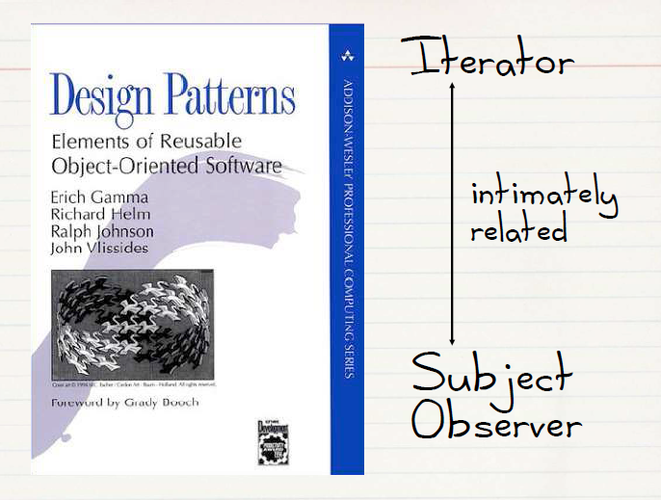
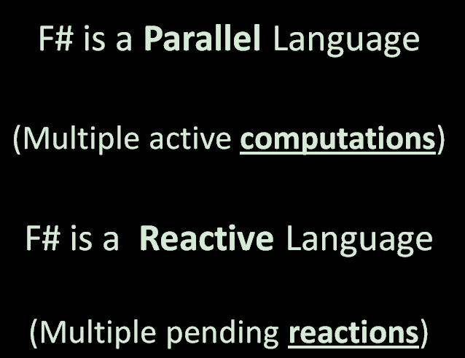
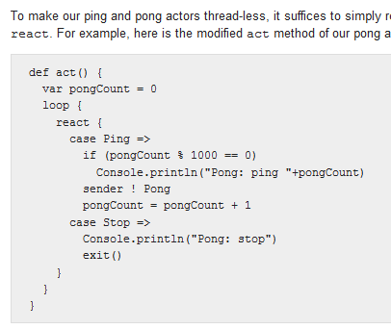
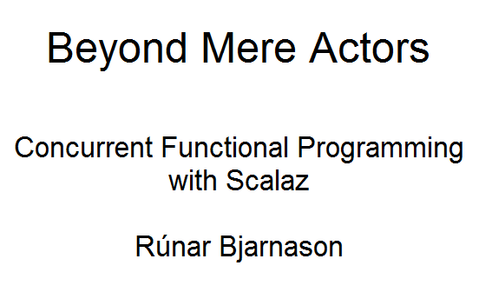

Slide 32
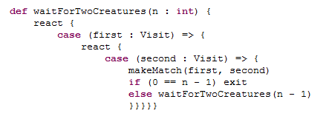
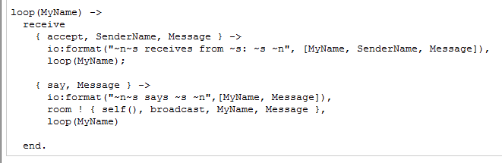
Scala
Erlang
async { let! image = ReadAsync "cat.jpg"
let image2 = f image
do! WriteAsync image2 "dog.jpg"
do printfn "done!"
return image2 }
F#

Slide 33
F# async { ... }
A Building Block for
Writing Reactive Code
async { ... }
async == Resumptions == One shot continuations

Slide 34
Example: F# async { ... }
React!
async { let! res = httpAsync "www.google.com"
... }
React to a GUI Event
React to a Timer Callback
React to a Query Response
React to a HTTP Response
React to a Web Service Response
React to a Disk I/O Completion
Agent reacts to Message

Slide 35
Example: F# async { ... }
async { let! image = ReadAsync "cat.jpg"
let image2 = f image
do! WriteAsync image2 "dog.jpg"
do printfn "done!"
return image2 }
Asynchronous action
Continuation/
Event callback
You're actually writing this (approximately):
async.Delay(fun () ->
async.Bind(ReadAsync "cat.jpg", (fun image ->
let image2 = f image
async.Bind(writeAsync "dog.jpg",(fun () ->
printfn "done!"
async.Return())))))

Slide 36
The many uses of F# async { ... }
Sequencing I/O requests
Sequencing CPU computations and I/O requests
async { let! lang = detectLanguageAsync text
let! text2 = translateAsync (lang,"da",text)
return text2 }
async { let! lang = detectLanguageAsync text
let! text2 = translateAsync (lang,"da",text)
let text3 = postProcess text2
return text3 }

Slide 37
The many uses of F# async { ... }
Parallel CPU computations
Parallel I/O requests
Async.Parallel [ async { return (fib 39) };
async { return (fib 40) }; ]
Async.Parallel
[ for target in langs ->
translateAsync (lang,target,text) ]

Slide 38
Async Basics + Web Translation
demo

Slide 39
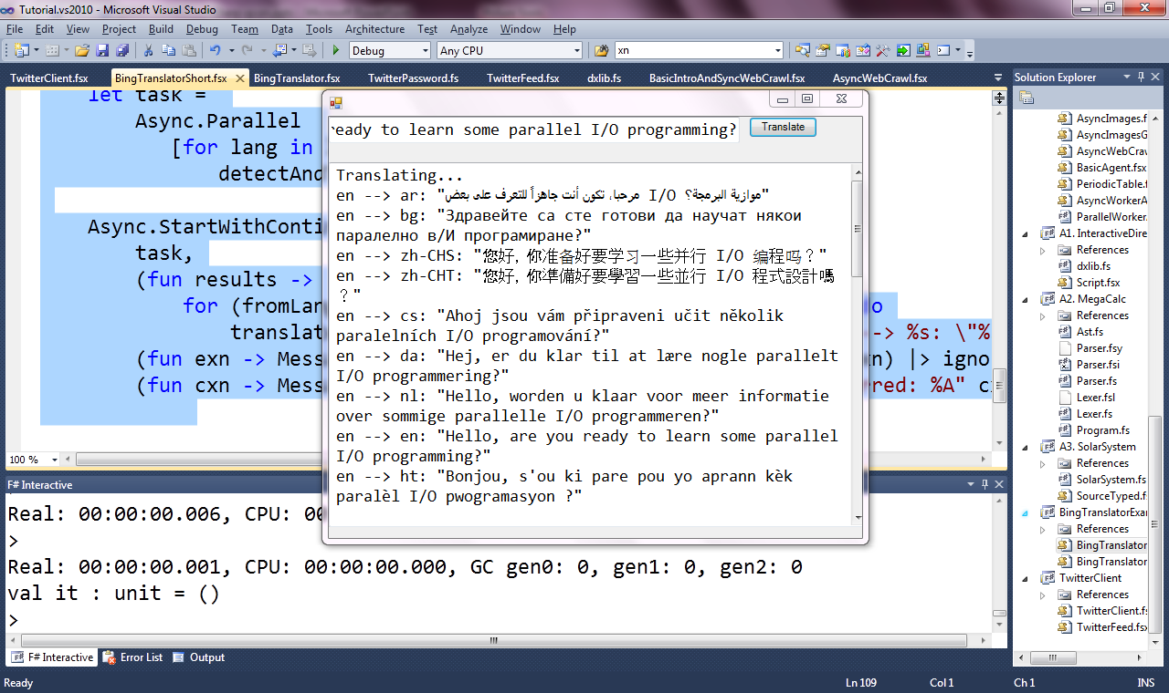

Slide 40
Lightweight Reactions
Lightweight Parallel Tasks
Lightweight Parallel Request Handlers
Lightweight Parallel Agents

Slide 41
Lightweight Reactions
Lightweight Parallel Tasks
Lightweight Parallel Request Handlers
Lightweight Parallel Agents

Slide 42
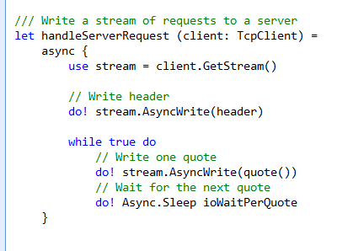
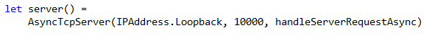
F# example: Serving 5,000+ simultaneous TCP connections with ~10 threads
React!
React!
React!

Slide 43
Let’s Web Crawl…
theme: agents/actors
Notes:
If you would like to host your demo on the Virtual Server, please use the myVPC demo slide, not this slide.

Slide 44
Lightweight Reactions
Lightweight Parallel Tasks
Lightweight Parallel Request Handlers
Lightweight Parallel Agents

Slide 45
Lightweight Reactions
Lightweight Parallel Tasks
Lightweight Parallel Request Handlers
Lightweight Parallel Agents

Slide 46
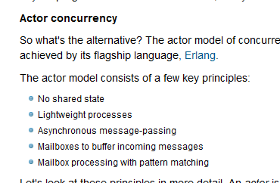

Slide 47
The many uses of F# async { ... }
Repeating tasks
Repeating tasks with immutable state
async { let state = ...
while true do
let! msg = queue.ReadMessage()
<process message> }
let rec loop count =
async { let! msg = queue.ReadMessage()
printfn "got a message"
return! loop (count + msg) }
loop 0

Slide 48
A First Agent
let agent =
Agent.Start(fun inbox ->
async { while true do
let! msg = inbox.Receive()
printfn "got message %s" msg } )
agent.Post "three"
agent.Post "four"
Note:
type Agent<'T> = MailboxProcessor<'T>

Slide 49
First 100,000 Agents
let agents =
[ for i in 0 .. 100000 ->
Agent.Start(fun inbox ->
async { while true do
let! msg = inbox.Receive()
printfn "%d got message %s" i msg })]
for agent in agents do
agent.Post "hello"
Note:
type Agent<'T> = MailboxProcessor<'T>

Slide 50
A Chatty Agent
let agent =
Agent.Start(fun inbox ->
async { while true do
let! a,b,resp = inbox.Receive()
resp.Reply (a+b) })
agent.PostAndAsyncReply (fun resp -> (10,10,resp))
Response
Request

Slide 51
Async Basics + Web Translation
demo

Slide 52
Let’s Web Crawl…
theme: data parallelism
Notes:
If you would like to host your demo on the Virtual Server, please use the myVPC demo slide, not this slide.

Slide 53
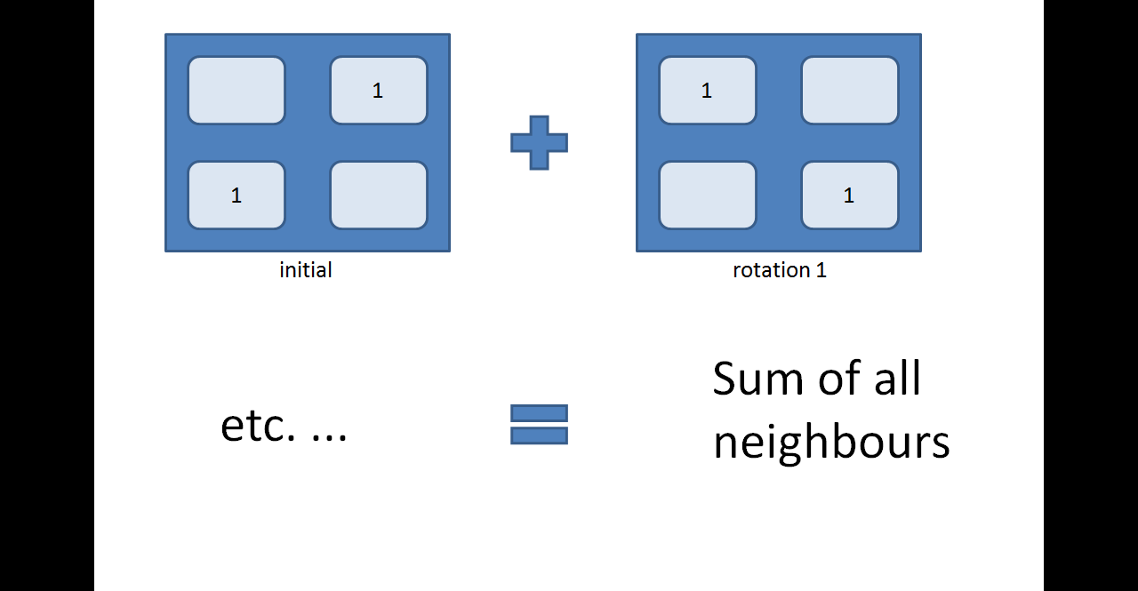

Slide 54
Data Parallelism: Philosophies
Functional is beautiful for declarative data parallelism
Just write the equations
But how to run it?
Smart, dedicated compiler (e.g. Sisal)
Embedded Expression-based DSL (e.g. C#/F#)
Compile-time Meta-programming (e.g. Haskell)
Run-time Meta-programming (e.g. C#/F#)

Slide 55
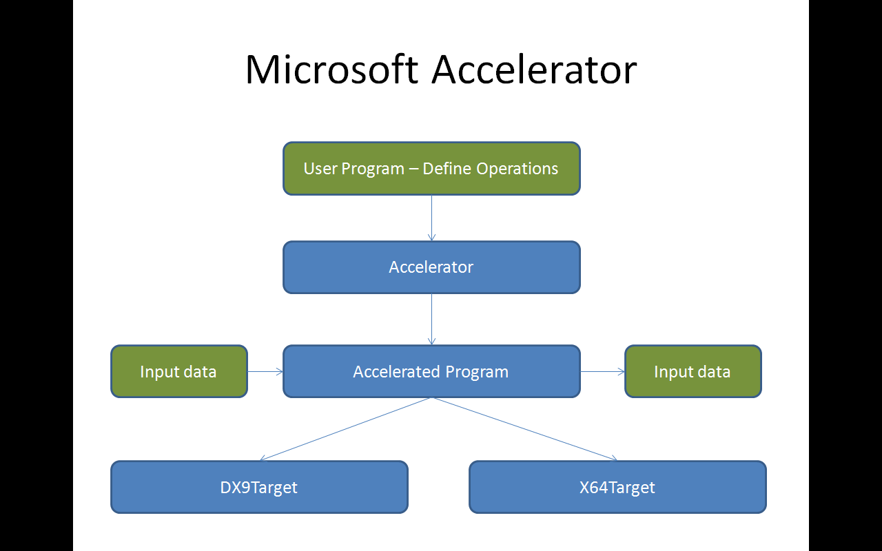
Microsoft Accelerator
User Program – Define Operations
Accelerator
Input data
Accelerated Program
Input data
DX9Target
X64Target

Slide 56
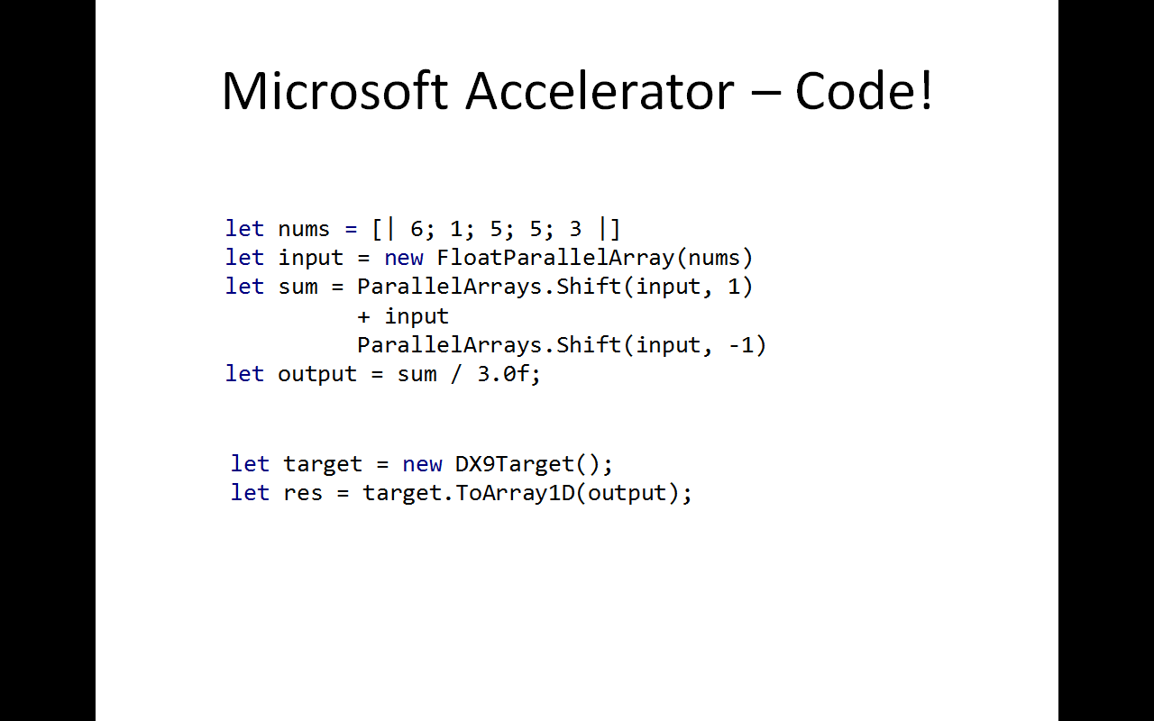

Slide 57
Example: F# Game of Life
/// Evaluate next generation of the life game state
let nextGeneration (grid: Matrix<float32>) =
// Shift in each direction, to count the neighbours
let sum = shiftAndSum grid offsets
// Check to see if we're born or remain alive
(sum =. threeAlive) ||. ((sum =. twoAlive) &&. grid)
CPU
GPU

Slide 58
Example: F# Game of Life
/// Evaluate next generation of the life game state
[<ReflectedDefinition>]
let nextGeneration (grid: Matrix<float32>) =
// Shift in each direction, to count the neighbours
let sum = shiftAndSum grid offsets
// Check to see if we're born or remain alive
(sum =. threeAlive) ||. ((sum =. twoAlive) &&. grid)
CPU
GPU

Slide 59
Agents Galore
summary

Slide 60
Key Themes
Simplicity of Expression
Composability
Immutability
Lightweight Reaction (tasks, agents, actors, promises, futures)
Transactions
Data Parallelism

Slide 61
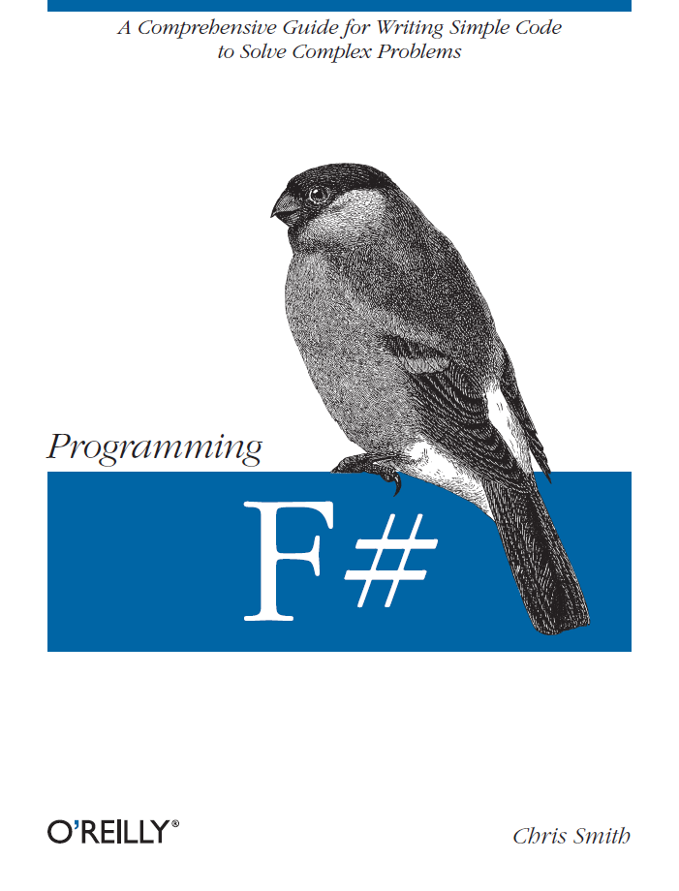




Latest Books about F#
Visit www.fsharp.net

Slide 62
question & answer

