Slide 1
F#
Async
Parallel
Don Syme
Principal Researcher
Microsoft Research, Cambridge

Slide 2
Themes
Theme: Simplicity
Theme: Immutability
Theme: Reaction v. Action
Theme: Actors and Agents

Slide 3
Where Parallelism?
Instruction Level (CPU)
Multi-core Parallelism (CPUs)
Multi-device Parallelism (CPUs+Disk)
Multi-machine I/O Parallelism (AJAX, Client-Server)
Multi-machine CPU Parallelism (Cluster)
Mega-machine Parallelism (Google, Bing)
The whole world.... (The Web!)

Slide 4
Parallel
Reactive
Concurrent
Distributed

Slide 5
some basic F#

Slide 6
Whitespace Matters
let computeDerivative f x =
let p1 = f (x - 0.05)
let p2 = f (x + 0.05)
(p2 – p1) / 0.1
Offside (bad indentation)

Slide 7
Whitespace Matters
let computeDerivative f x =
let p1 = f (x - 0.05)
let p2 = f (x + 0.05)
(p2 – p1) / 0.1

Slide 8
Functional– Pipelines
x |> f
The pipeline operator

Slide 9
Objects + Functional
type Vector2D (dx:double, dy:double) =
let d2 = dx*dx+dy*dy
member v.DX = dx
member v.DY = dy
member v.Length = sqrt d2
member v.Scale(k) = Vector2D (dx*k,dy*k)
Inputs to object
construction
Object internals
Exported properties
Exported method

Slide 10
Objects + Functional
Immutable inputs
type HuffmanEncoding(freq:seq<char*int>) =
...
< 50 lines of beautiful functional code>
...
member x.Encode(input: seq<char>) =
encode(input)
member x.Decode(input: seq<char>) =
decode(input)
Internal tables
Publish access

Slide 11
[ … ]
Generated data
let squares (n, m) =
[ for x in n .. m do
yield (x,x*x) ]
let activities children =
[ for child in children do
yield "WakeUp.fs"
yield! morningActivies child ]

Slide 12
[ … ]
We can do I/O here
This is F#, not Haskell
let rec allFiles dir =
[ for file in Directory.GetFiles dir do
yield file
for sub in Directory.GetDirectories dir do
yield! allFiles sub ]
allFiles @"C:\LogFiles"

Slide 13
seq { … }
On-demand
let rec allFiles dir =
seq { for file in Directory.GetFiles dir do
yield file
for sub in Directory.GetDirectories dir do
yield! allFiles sub }
allFiles @"C:\LogFiles"
|> Seq.take 100
|> show
Pipelines

Slide 14
Let’s Web Crawl…
theme: functional simplicity
Notes:
If you would like to host your demo on the Virtual Server, please use the myVPC demo slide, not this slide.

Slide 15
Pleasure
Pain
abstract class Command
{
public virtual void Execute();
}
abstract class MarsRoverCommand : Command
{
protected MarsRover Rover
{ get; private set; }
public MarsRoverCommand(MarsRover rover)
{
this.Rover = rover;
}
}
class BreakCommand : MarsRoverCommand
{
public BreakCommand(MarsRover rover)
: base(rover)
{
}
public override void Execute()
{
Rover.Rotate(-5.0);
}
}
class TurnLeftCommand : MarsRoverCommand
{
public TurnLeftCommand(MarsRover rover)
: base(rover)
{
}
public override void Execute()
{
Rover.Rotate(-5.0);
}
}
type Command = Command of (Rover -> unit)
let BreakCommand =
Command(fun rover -> rover.Accelerate(-1.0))
let TurnLeftCommand =
Command(fun rover -> rover.Rotate(-5.0<degs>))

Slide 16
Pleasure
Pain
let swap (x, y) = (y, x)
let rotations (x, y, z) =
[ (x, y, z);
(z, x, y);
(y, z, x) ]
let reduce f (x, y, z) =
f x + f y + f z
Tuple<U,T> Swap<T,U>(Tuple<T,U> t)
{
return new Tuple<U,T>(t.Item2, t.Item1)
}
ReadOnlyCollection<Tuple<T,T,T>> Rotations<T>(Tuple<T,T,T> t)
{
new ReadOnlyCollection<int>
(new Tuple<T,T,T>[]
{new Tuple<T,T,T>(t.Item1,t.Item2,t.Item3);
new Tuple<T,T,T>(t.Item3,t.Item1,t.Item2);
new Tuple<T,T,T>(t.Item2,t.Item3,t.Item1); });
}
int Reduce<T>(Func<T,int> f,Tuple<T,T,T> t)
{
return f(t.Item1)+f(t.Item2)+f(t.Item3);
}

Slide 17
Pleasure
Pain
public abstract class Event { }
public class PriceEvent : Event
{
public Price Price { get; private set; }
public PriceEvent(Price price)
{
this.Price = price;
}
}
public class SplitEvent : Event
{
public double Factor { get; private set; }
public SplitEvent(double factor)
{
this.Factor = factor;
}
}
public class DividendEvent : Event
{
...
}
type Event =
| Price of float<money>
| Split of float
| Dividend of float<money>

Slide 18
Async.Parallel [ http "www.google.com"; http "www.bing.com"; http "www.yahoo.com"; ]
|> Async.RunSynchronously

Slide 19
Async.Parallel [ for i in 0 .. 200 -> computeTask i ]
|> Async.RunSynchronously

Slide 20
Let’s Web Crawl…
theme: language
Notes:
If you would like to host your demo on the Virtual Server, please use the myVPC demo slide, not this slide.

Slide 21
Some Micro Trends
REST, HTML, XML, JSON, Haskell, F#, Scala, Clojure, Erlang,...
Communication With Immutable Data
Programming With Queries
Programming With Lambdas
Programming With Pattern Matching
Languages with a Lighter Syntax
Taming Side Effects
C#, VB, F#, SQL, Kx....
C#, F#, Javascript, Scala, Clojure, ...
F#, Scala, ...
Python, Ruby, F#, ...
Erlang, Scala, F#, Haskell, ...

Slide 22
The Huge Trends
THE WEB
MULTICORE

Slide 23
Myths and Fallacies
✗ It changes what the web and cloud haven’t changed already
“Multi-core changes everything”
“Parallelism is all about CPU computations”
“Functional Parallelism is Implicit Parallelism”
✗ I/O Parallelism is hugely important
✗ A lofty goal, far from reality

Slide 24
demo

Slide 25
What does Typed Functional
Programming Bring to Parallelism?
Make
parallelism
sane
“Minimize Mutable
State”
Make I/O and task
parallelism more
compositional
“Purity”
Less
Mutable
State
“Transactional
State”
“Isolated
State”
Integrate declarative
engine-based parallelism
into language
e.g. Queries,
Array/matrix programs,
Constraint programs
“Immutable
Data”
Computational
Sub-Languages
Declarative
Sub-Languages
“combinators”
“meta-programs”
“DSLs”
“LINQ”
“monads”
“comprehensions”
async { ... }
Async.Parallel
Types
“generics”
query
<@ seq { for i in db.Customers do
for j in db.Employees do
if i.Country = j.Country then
yield (i.FirstName, j.FirstName) } @>
Make
programming
sane

Slide 26
Let’s Web Crawl…
theme: immutability
Notes:
If you would like to host your demo on the Virtual Server, please use the myVPC demo slide, not this slide.

Slide 27
Immutability the norm...
Immutable Tuples
Immutable Maps
Immutable Unions
+ lots of language features to encourage immutability
Immutable Lists
Immutable Records
Immutable Sets
Immutable Objects

Slide 28
Let’s Web Crawl…
theme: react, not act

Slide 29
Example: F#
F# is a Parallel Language
(Multiple active computations)
F# is a Reactive Language
(Multiple pending reactions)
GUI Event
Page Load
Timer Callback
Query Response
HTTP Response
Web Service Response
Disk I/O Completion
Agent Gets Message

Slide 30
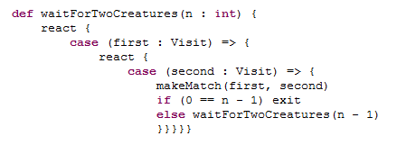
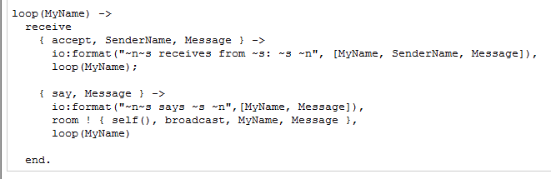
Scala
Erlang
async { let! image = ReadAsync "cat.jpg"
let image2 = f image
do! WriteAsync image2 "dog.jpg"
do printfn "done!"
return image2 }
F#

Slide 31
F# async { ... }
A Building Block for
Writing Reactive Code
async { ... }
async == Resumptions == One shot continuations

Slide 32
Example: F# async { ... }
React!
async { let! res = httpAsync "www.google.com"
... }
React to a GUI Event
React to a Timer Callback
React to a Query Response
React to a HTTP Response
React to a Web Service Response
React to a Disk I/O Completion
Agent reacts to Message

Slide 33
Example: F# async { ... }
async { let! image = ReadAsync "cat.jpg"
let image2 = f image
do! WriteAsync image2 "dog.jpg"
do printfn "done!"
return image2 }
Asynchronous action
Continuation/
Event callback
You're actually writing this (approximately):
async.Delay(fun () ->
async.Bind(ReadAsync "cat.jpg", (fun image ->
let image2 = f image
async.Bind(writeAsync "dog.jpg",(fun () ->
printfn "done!"
async.Return())))))

Slide 34
The many uses of F# async { ... }
Sequencing I/O requests
Sequencing CPU computations and I/O requests
async { let! lang = detectLanguageAsync text
let! text2 = translateAsync (lang,"da",text)
return text2 }
async { let! lang = detectLanguageAsync text
let! text2 = translateAsync (lang,"da",text)
let text3 = postProcess text2
return text3 }

Slide 35
The many uses of F# async { ... }
Parallel CPU computations
Parallel I/O requests
Async.Parallel [ async { return (fib 39) };
async { return (fib 40) }; ]
Async.Parallel
[ for target in langs ->
translateAsync (lang,target,text) ]

Slide 36
Async Basics + Web Translation
demo

Slide 37
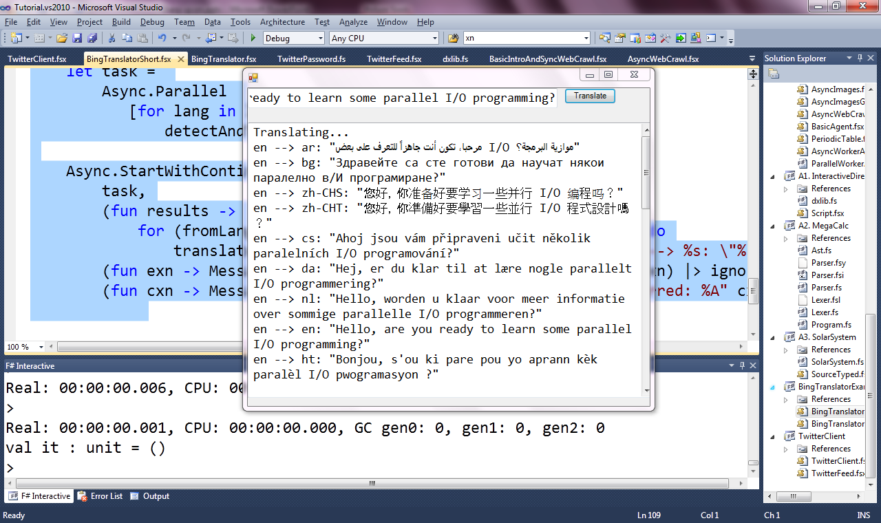

Slide 38
Lightweight Reactions
Lightweight Parallel Tasks
Lightweight Parallel Request Handlers
Lightweight Parallel Agents

Slide 39
Lightweight Reactions
Lightweight Parallel Tasks
Lightweight Parallel Request Handlers
Lightweight Parallel Agents

Slide 40
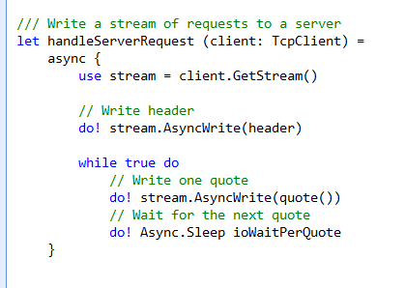
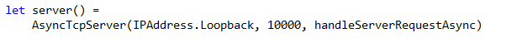
F# example: Serving 5,000+ simultaneous TCP connections with ~10 threads
React!
React!
React!

Slide 41
Let’s Web Crawl…
theme: agents/actors
Notes:
If you would like to host your demo on the Virtual Server, please use the myVPC demo slide, not this slide.

Slide 42
Lightweight Reactions
Lightweight Parallel Tasks
Lightweight Parallel Request Handlers
Lightweight Parallel Agents

Slide 43
Lightweight Reactions
Lightweight Parallel Tasks
Lightweight Parallel Request Handlers
Lightweight Parallel Agents

Slide 44
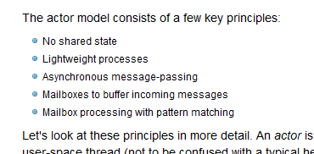

Slide 45
The many uses of F# async { ... }
Repeating tasks
Repeating tasks with immutable state
async { let state = ...
while true do
let! msg = queue.ReadMessage()
<process message> }
let rec loop count =
async { let! msg = queue.ReadMessage()
printfn "got a message"
return! loop (count + msg) }
loop 0

Slide 46
A First Agent
let agent =
Agent.Start(fun inbox ->
async { while true do
let! msg = inbox.Receive()
printfn "got message %s" msg } )
agent.Post "three"
agent.Post "four"
Note:
type Agent<'T> = MailboxProcessor<'T>

Slide 47
First 100,000 Agents
let agents =
[ for i in 0 .. 100000 ->
Agent.Start(fun inbox ->
async { while true do
let! msg = inbox.Receive()
printfn "%d got message %s" i msg })]
for agent in agents do
agent.Post "hello"
Note:
type Agent<'T> = MailboxProcessor<'T>

Slide 48
A Chatty Agent
let agent =
Agent.Start(fun inbox ->
async { while true do
let! a,b,resp = inbox.Receive()
resp.Reply (a+b) })
agent.PostAndAsyncReply (fun resp -> (10,10,resp))
Response
Request

Slide 49
Async Basics + Web Translation
demo

Slide 50
Let’s Web Crawl…
theme: data parallelism
Notes:
If you would like to host your demo on the Virtual Server, please use the myVPC demo slide, not this slide.

Slide 51
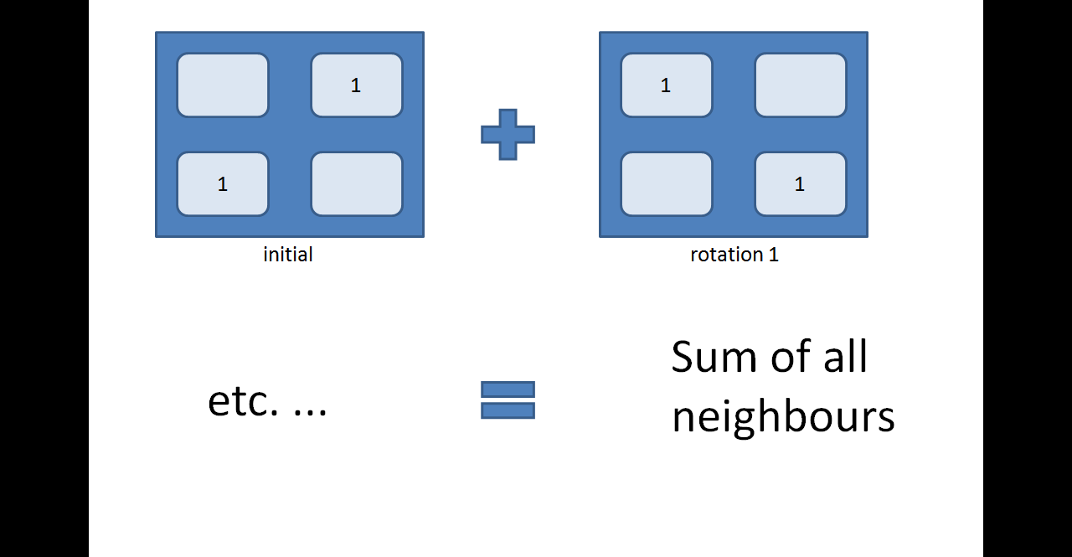

Slide 52
Data Parallelism: Philosophies
Functional is beautiful for declarative data parallelism
Just write the equations
But how to run it?
Smart, dedicated compiler (e.g. Sisal)
Embedded Expression-based DSL (e.g. C#/F#)
Compile-time Meta-programming (e.g. Haskell)
Run-time Meta-programming (e.g. C#/F#)

Slide 53
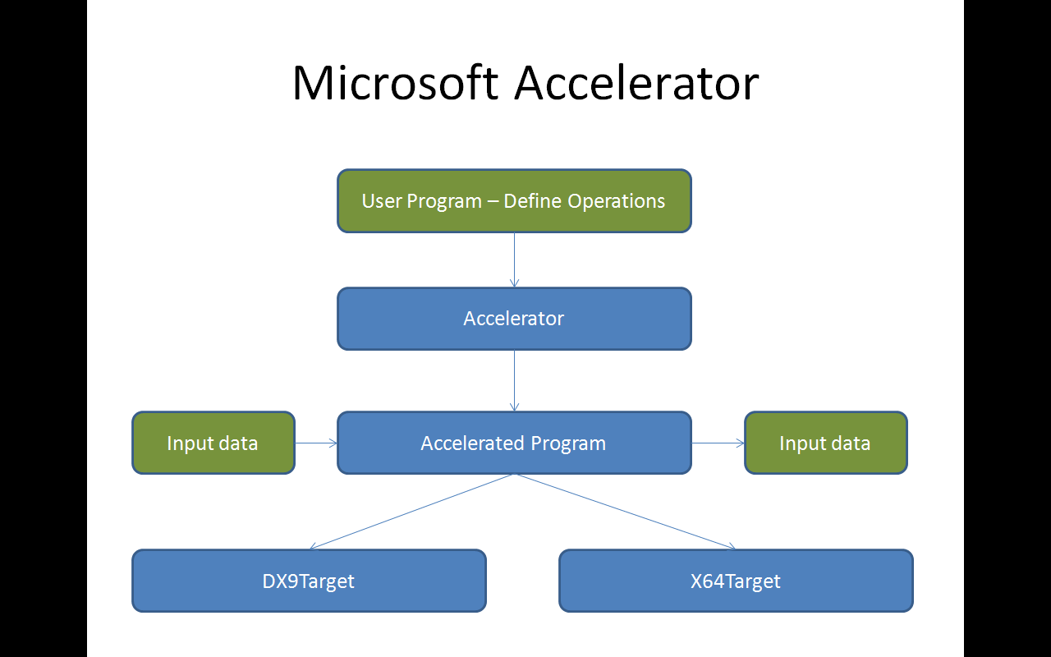
Microsoft Accelerator
User Program – Define Operations
Accelerator
Input data
Accelerated Program
Input data
DX9Target
X64Target

Slide 54
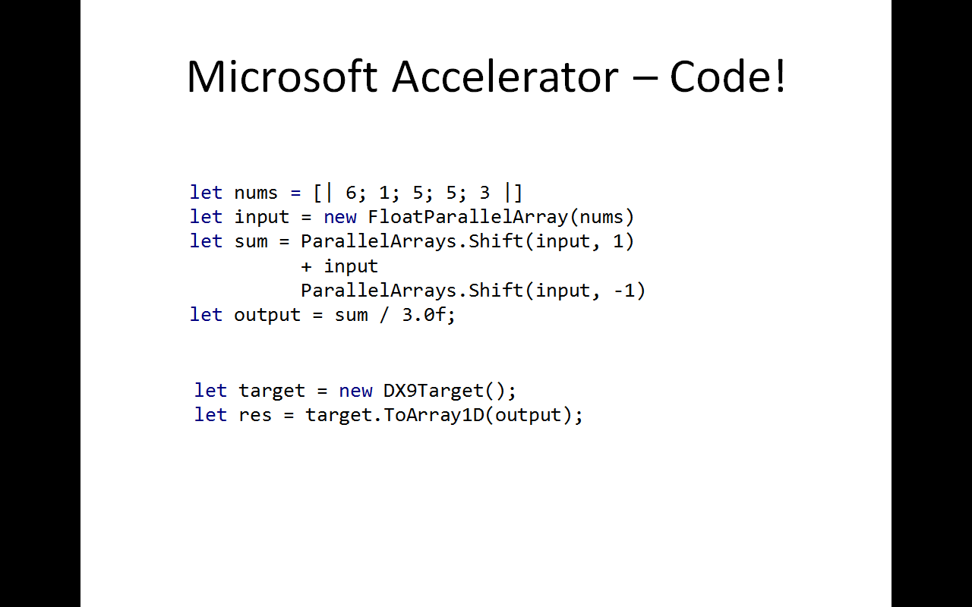

Slide 55
Example: F# Game of Life
/// Evaluate next generation of the life game state
let nextGeneration (grid: Matrix<float32>) =
// Shift in each direction, to count the neighbours
let sum = shiftAndSum grid offsets
// Check to see if we're born or remain alive
(sum =. threeAlive) ||. ((sum =. twoAlive) &&. grid)
CPU
GPU

Slide 56
Example: F# Game of Life
/// Evaluate next generation of the life game state
[<ReflectedDefinition>]
let nextGeneration (grid: Matrix<float32>) =
// Shift in each direction, to count the neighbours
let sum = shiftAndSum grid offsets
// Check to see if we're born or remain alive
(sum =. threeAlive) ||. ((sum =. twoAlive) &&. grid)
CPU
GPU

Slide 57
Agents Galore
summary

Slide 58
Key Themes
Theme: Simplicity
Theme: Immutability
Theme: Reaction v. Action
Theme: Actors and Agents

Slide 59
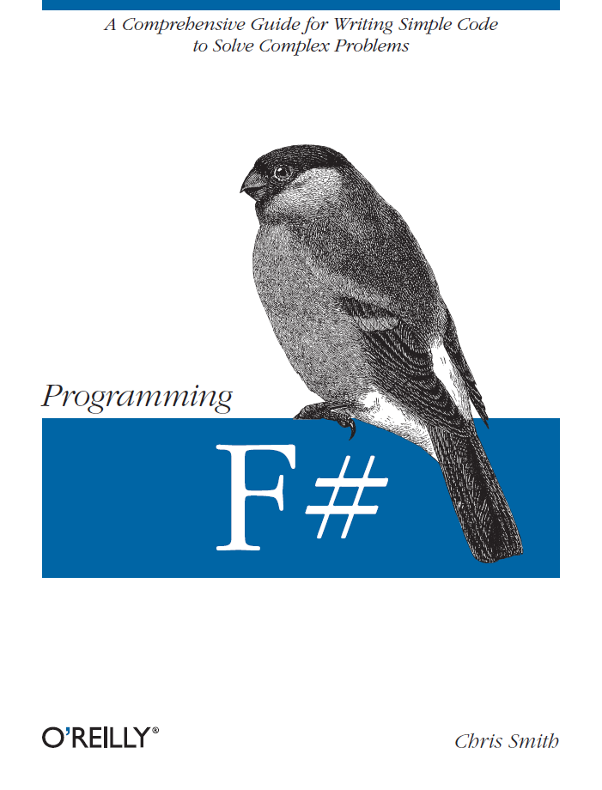
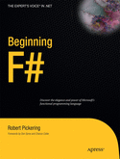
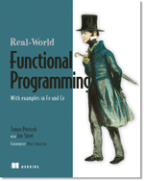

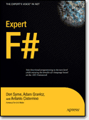
Latest Books about F#
Visit www.fsharp.net

Slide 60
question & answer

Slide 61
Typical F# Reactive Architecture
async { ... }
Single Threaded GUI
Or
Single Threaded Page Handler
Or
Command Line Driver
Async.Parallel [ ... ]
new Agent<_>(async { ... })
new WebCrawler<_>()
Internally: new Agent<_>(...) ...
event x.Started
event x.CrawledPage
event x.Finished

Slide 62
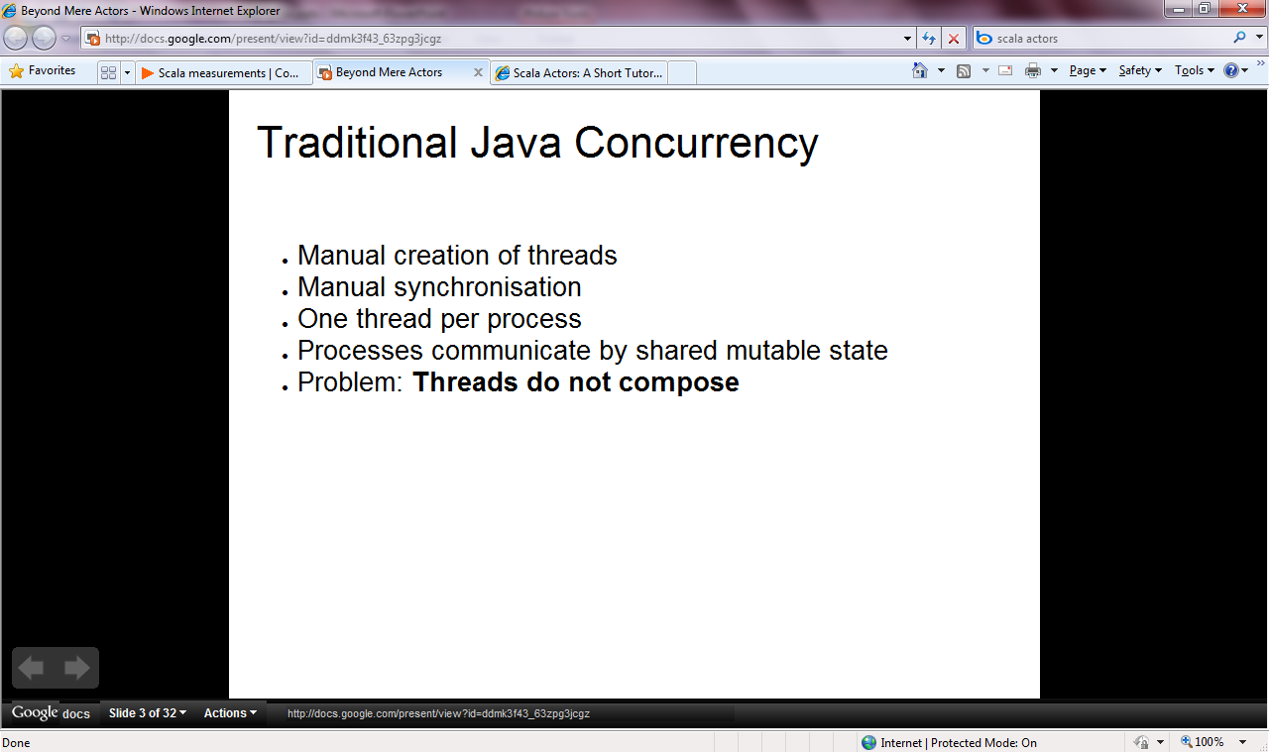

Slide 63
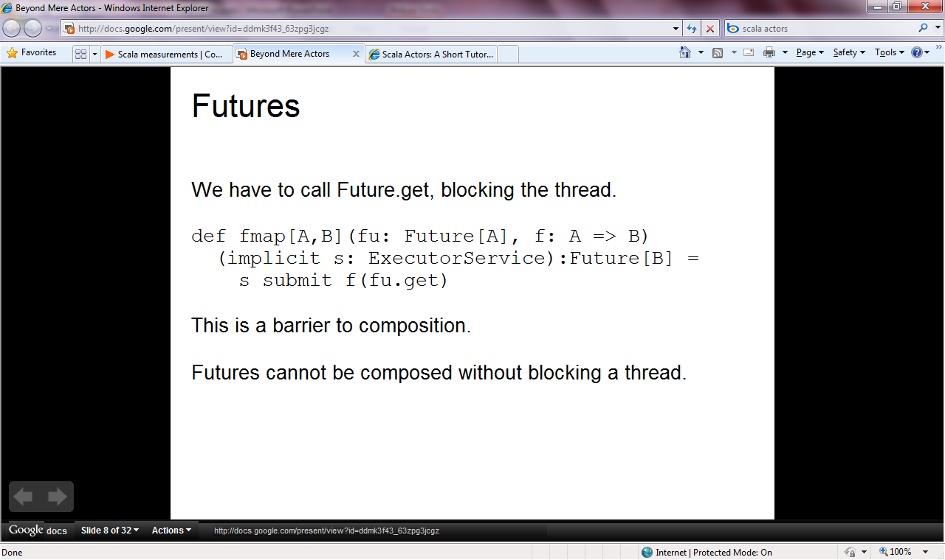

Slide 64
Objects + Functional
Immutable inputs
type HuffmanEncoding(freq:seq<char*int>) =
...
< 50 lines of beautiful functional code>
...
member x.Encode(input: seq<char>) =
encode(input)
member x.Decode(input: seq<char>) =
decode(input)
Internal tables
Publish access

Slide 65
[ … ]
Generated data
let squares (n, m) =
[ for x in n .. m do
yield (x,x*x) ]
let activities children =
[ for child in children do
yield "WakeUp.fs"
yield! morningActivies child ]

Slide 66
[ … ]
We can do I/O here
This is F#, not Haskell
let rec allFiles dir =
[ for file in Directory.GetFiles dir do
yield file
for sub in Directory.GetDirectories dir do
yield! allFiles sub ]
allFiles @"C:\LogFiles"

Slide 67
seq { … }
On-demand
let rec allFiles dir =
seq { for file in Directory.GetFiles dir do
yield file
for sub in Directory.GetDirectories dir do
yield! allFiles sub }
allFiles @"C:\LogFiles"
|> Seq.take 100
|> show
Pipelines

Slide 68
seq { … }
Because it's on-demand, things can now be infinite
let rec randomWalk x =
seq { yield x
yield! randomWalk (x+rnd()) }

Slide 69
queries
seq { for i in db.Customers do
for j in db.Employees do
if i.Country = j.Country then
yield (i.FirstName, j.FirstName) }
(runs in-memory)

Slide 70
queries
<@ ... @> = quotation
query
<@ seq { for i in db.Customers do
for j in db.Employees do
if i.Country = j.Country then
yield (i.FirstName, j.FirstName) } @>
(runs as SQL on database)

Slide 71
F#: Influences
OCaml
C#/.NET
F#
Similar core
language
Similar object
model

Slide 72
Combining Paradigms
I've been coding in F# lately, for a production task. F# allows you to move smoothly in your programming style... I start with pure functional code, shift slightly towards an object-oriented style, and in production code, I sometimes have to do some imperative programming.
I can start with a pure idea, and still finish my project with realistic code.
Julien Laugel, Chief Software Architect, www.eurostocks.com

Slide 73
Functional Core
Objects
Units of Measure
Imperative Mutation & I/O
Async/Parallel/Monads
Meta Programming
e.g. SQL Queries,
GPU Programs
Functional Data

Slide 74
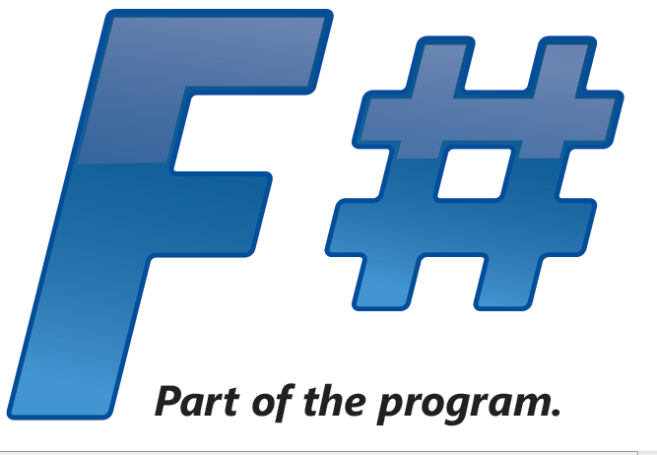
.NET CLR
Windows
Silverlight
Browser (native)
Mono
Cloud/Cluster
Web-Sharper
Javascript
Azure
EC2
Mac OSX
Linux
Windows
iPhone

Slide 75
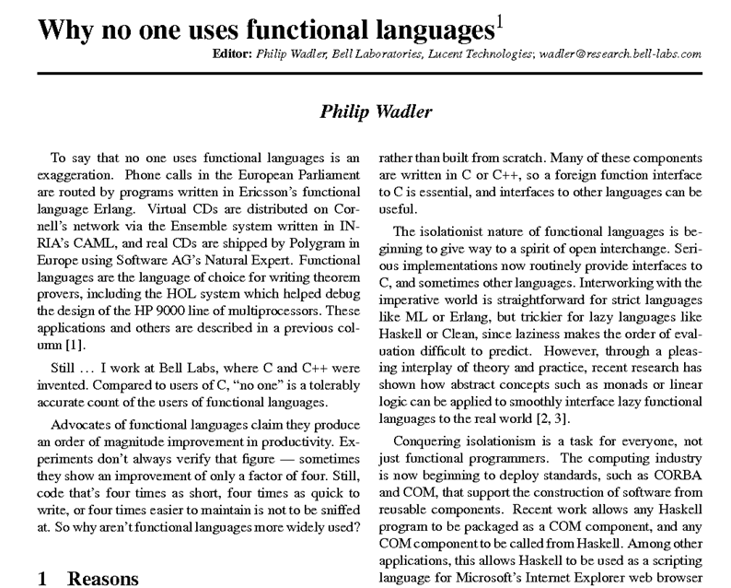

Slide 76
Recap
F# is a general purpose, efficient, succinct, “functional-first” .NET programming language
F# has a simple, script-like initial experience, but is strongly typed and .NET friendly
F# has some nice features for objects, queries, async, agents, parallel and units of measure
F# is highly interoperable, and can build vanilla .NET components

Slide 77
F# - Research Contributions
Active Patterns ICFP 07
Meta-programming in a typed language ML 06
Units of measure CEFP 09, Kennedy
Lightweight reactive agents on VM Expert F#
Nominal objects in a type-inferred language
Monadic programming in a strict language
Notes:
Contents are wrong – should be a summary of key F# takeaways

Slide 78
Related Work
A vast amount....
C#
SML (SML.NET)
OCaml
Scala
Haskell
Kennedy ‘97 – Units of Measure
Use of resumptions for async/parallel programming has many precursors
Notes:
Contents are wrong – should be a summary of key F# takeaways

Slide 79
Source
F# Compiler Source in MSI/ZIP
In Every Release
Reference source, commercial use for binaries
Aiming for more permissive release
F# PowerPack on CodePlex
Released Feb 2010
OSS approved licence

Slide 80
async { ... }
async { ... }
Resumption monad
(one shot continuations)
w/- result/exception/cancellation continuations
+ delimited exceptions and resources
+ combinators to put them together
+ monadic syntax
+ start-task, fork-join operators

Slide 81
Techniques
immutability
isolation
light weight threading
async methods
agents
tasks
thread pools
transactional memory
data parallel

Slide 82
F# and Parallel Challenges
Shared State
Inversion of Control
Async
I/O, Task, Agent Parallelism
Async
Implicit Parallelism
Distribution

Slide 83
F# and Parallel Challenges
Shared State
Immutability
Inversion of Control
Async
I/O, Task, Agent Parallelism
Async
Engine Access +
Embedded
Languages
Implicit Parallelism
Distribution
Web/Cloud/MSQ/
Cluster etc.

Slide 84
F# and Parallel Challenges
Shared State
Immutability
Inversion of Control
I/O, Task, Agent Parallelism
Implicit Parallelism
Distribution

Slide 85
Pleasure
Pain
public abstract class Expr { }
public abstract class UnaryOp :Expr
{
public Expr First { get; private set; }
public UnaryOp(Expr first)
{
this.First = first;
}
}
public abstract class BinExpr : Expr
{
public Expr First { get; private set; }
public Expr Second { get; private set; }
public BinExpr(Expr first, Expr second)
{
this.First = first;
this.Second = second;
}
}
public class TrueExpr : Expr { }
public class And : BinExpr
{
public And(Expr first, Expr second) : base(first, second) { }
}
public class Nand : BinExpr
{
public Nand(Expr first, Expr second) : base(first, second) { }
}
public class Or : BinExpr
{
public Or(Expr first, Expr second) : base(first, second) { }
}
public class Xor : BinExpr
{
public Xor(Expr first, Expr second) : base(first, second) { }
}
public class Not : UnaryOp
{
public Not(Expr first) : base(first) { }
}
type Expr =
| True
| And of Expr * Expr
| Nand of Expr * Expr
| Or of Expr * Expr
| Xor of Expr * Expr
| Not of Expr

