Slide 1
Some F# for the Erlang programmer
Don Syme, F# Team, Microsoft, http://fsharp.net

Slide 2

We’ve been busy ☺

Slide 3
F# Topics for the Erlang Programmer
A little about F#
Basics
Syntax
Types
Pattern Matching
Objects
In-memory Agent Programming

Slide 4
Simplicity: Scripting
C#
F#
open System
let greeting = "hello"
Console.WriteLine(greeting)
using System;
namespace ConsoleApplication1
{
class Program
{
static string greeting()
{
return "hello";
}
static void Main(string[] args)
{
Console.WriteLine(greeting);
}
}
}

Slide 5
Simplicity: Functional Data
C#
let swap (x, y) = (y, x)
let rotations (x, y, z) =
[ (x, y, z);
(z, x, y);
(y, z, x) ]
let reduce f (x, y, z) =
f x + f y + f z
Tuple<U,T> Swap<T,U>(Tuple<T,U> t)
{
return new Tuple<U,T>(t.Item2, t.Item1)
}
ReadOnlyCollection<Tuple<T,T,T>> Rotations<T>(Tuple<T,T,T> t)
{
new ReadOnlyCollection<int>
(new Tuple<T,T,T>[]
{ new Tuple<T,T,T>(t.Item1,t.Item2,t.Item3);
new Tuple<T,T,T>(t.Item3,t.Item1,t.Item2);
new Tuple<T,T,T>(t.Item2,t.Item3,t.Item1); });
}
int Reduce<T>(Func<T,int> f,Tuple<T,T,T> t)
{
return f(t.Item1) + f(t.Item2) + f (t.Item3);
}
F#

Slide 6
Simplicity: Functional Data
C#
public abstract class Event { }
public abstract class PriceEvent : Event
{
public Price Price { get; private set; }
public PriceEvent(Price price)
{
this.Price = price;
}
}
public abstract class SplitExpr : Event
{
public double Factor { get; private set; }
public SplitExpr(double factor)
{
this.Factor = factor;
}
}
public class DividendEvent : Event { }
...
type Event =
| Price of float
| Split of float
| Dividend of float<money>
F#

Slide 7
Async.Parallel [ http "www.google.com"; http "www.bing.com"; http "www.yahoo.com"; ]
Simplicity: Functional Parallel
|> Async.RunSynchronously

Slide 8
F#: Influences
OCaml
C#/.NET
F#
Similar core
language
Similar object
model

Slide 9
F#: Combining Paradigms
I've been coding in F# lately, for a production task. F# allows you to move smoothly in your programming style... I start with pure functional code, shift slightly towards an object-oriented style, and in production code, I sometimes have to do some imperative programming.
I can start with a pure idea, and still finish my project with realistic code. You're never disappointed in any phase of the project!
Julien Laugel, Chief Software Architect, www.eurostocks.com

Slide 10
Erlang & F# - Overview

Slide 11
Erlang/F# - Aims are Different
F# : Practical Typed Functional Programming
“Interop, interop, interop”
“Objects are the foundation of .NET libraries. They are very effective. Embrace them.”
“Parallel, multi-core, asynchronous”
“Nice, practical functional features”
Native-code, C# performance, often near C++
Erlang: Practical Concurrent Actors
Telephony, now general I/O parallel programming

Slide 12
F# & Erlang - The Familiar
Technically, both are
Functional core
Strict
Single Assignment
Pattern Matching
Strong emphasis on Tuples , Lists, Recursion
Or... the two main practical languages where it’s important to know what a tailcall is ☺

Slide 13
F# & Erlang - The Familiar
Methodologically, both use
Design by prototyping
Exploration & experimentation
Good for smart, programmmer/architects
Historically
There is a lot of overlap, shared vocabulary and knowledge

Slide 14
However...
F# is not a functional-only language
Imperative state, arrays
Objects
Meta-programming
.NET libraries
F# does things differently
Syntax
Types
Libraries
Concurrency via an “async { ... }” modality
+ much inherited from .NET

Slide 15
F# Topics

Slide 16
F# Topics for the Erlang Programmer
Basics
Syntax
Types
Pattern Matching
Objects
In-memory Agent Programming

Slide 17
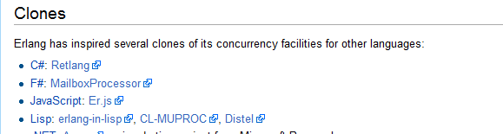

Slide 18
Tutorial: Fundamentals

Slide 19
Fundamentals - Whitespace Matters
let computeDerivative f x =
let p1 = f (x - 0.05)
let p2 = f (x + 0.05)
(p2 – p1) / 0.1
Offside (bad indentation)

Slide 20
Whitespace Matters
let computeDerivative f x =
let p1 = f (x - 0.05)
let p2 = f (x + 0.05)
(p2 – p1) / 0.1

Slide 21
Basics
F#
Erlang
-module(fact).
-export([fac/1]).
fac(0) -> 1
fac(N) -> N * fac(N-1).
module Fact
let rec fac x =
match x with
| 0 -> 1
| n -> n * fac (n-1)

Slide 22
Basics
F#
Erlang
-module(fact).
-export([fac/1]).
fac(0) -> 1
fac(N) -> N * fac(N-1).
module Fact
let rec fac = function
| 0 -> 1
| n -> n * fac (n-1)

Slide 23
Basics
Erlang
F#
quicksort([]) -> [];
quicksort([Pivot|Rest]) ->
quicksort([Front || Front <- Rest, Front < Pivot])
++ [Pivot] ++
quicksort([Back || Back <- Rest, Back >= Pivot]).
let rec quicksort = function
| [] -> []
| pivot::rest ->
quicksort (List.filter (fun x -> x < pivot) rest) @
[pivot] @
quicksort (List.filter (fun x -> x >= pivot) rest)

Slide 24
Basics
Erlang
F#
quicksort([]) -> [];
quicksort([Pivot|Rest]) ->
quicksort([Front || Front <- Rest, Front < Pivot])
++ [Pivot] ++
quicksort([Back || Back <- Rest, Back >= Pivot]).
let rec quicksort = function
| [] -> []
| pivot::rest ->
quicksort (rest |> List.filter (fun x -> x < pivot)) @
[pivot] @
quicksort (rest |> List.filter (fun x -> x >= pivot))

Slide 25
Basics
Erlang
F#
quicksort([]) -> [];
quicksort([Pivot|Rest]) ->
quicksort([Front || Front <- Rest, Front < Pivot])
++ [Pivot] ++
quicksort([Back || Back <- Rest, Back >= Pivot]).
let rec quicksort = function
| [] -> []
| pivot::rest ->
let lo,hi = rest |> List.partition (fun x -> x < pivot)
quicksort lo @ [rest] @ quicksort hi

Slide 26
Functional– Pipelines
x |> f
The pipeline operator

Slide 27
Functional– Pipelines
x |> f1
|> f2
|> f3
Successive stages
in a pipeline

Slide 28
[ … ]
Generated data
let squares (n, m) =
[ for x in n .. m do
yield (x,x*x) ]
let activities children =
[ for child in children do
yield "WakeUp.fs"
yield! morningActivies child ]

Slide 29
[ … ]
We can do I/O here
This is F#, not Haskell
let rec allFiles dir =
[ for file in Directory.GetFiles dir do
yield file
for sub in Directory.GetDirectories dir do
yield! allFiles sub ]
allFiles @"C:\LogFiles"

Slide 30
seq { … }
On-demand
let rec allFiles dir =
seq { for file in Directory.GetFiles dir do
yield file
for sub in Directory.GetDirectories dir do
yield! allFiles sub }
allFiles @"C:\LogFiles"
|> Seq.take 100
|> show
Pipelines

Slide 31
Generating Data with seq { … }
On-demand, infinite
let rec randomWalk x =
seq { yield x
yield! randomWalk (x+rnd()) }

Slide 32
Generating Data with seq { … }
Range
Expressions
[ 0..1000 ]
[ for x in 0..1000 -> (x, x * x) ]
[| for x in 0..1000 -> (x, x * x) |]
seq { for x in 0..1000 -> (x, x * x) }
List via query
Array via query
Sequence
via query

Slide 33
Generating Structured Data
type Suit =
| Heart
| Diamond
| Spade
| Club
type PlayingCard =
| Ace of Suit
| King of Suit
| Queen of Suit
| Jack of Suit
| ValueCard of int * Suit
Union type
(no data = enum)
Union type
with data

Slide 34
Generating Structured Data (2)
let suits = [ Heart; Diamond; Spade; Club ]
let deckOfCards =
[ for suit in suits do
yield Ace suit
yield King suit
yield Queen suit
yield Jack suit
for value in 2 .. 10 do
yield ValueCard (value, suit) ]
Generate a deck
of cards

Slide 35
Tutorial: Actors & Async

Slide 36
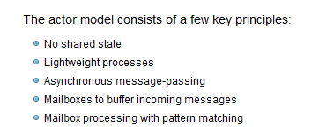

Slide 37
Actors
Erlang
F#
start() ->
spawn(echo, loop, []).
loop() ->
receive {From, Message} -> From ! Message, loop()
end.
let (<--) (a:Agent<_>) x = a.Post x
let agent =
Agent.Start(fun inbox ->
async { while true do
let! (from, msg) = inbox.Receive()
from <-- msg }

Slide 38
Actors
Erlang
F#
start() ->
spawn(echo, loop, []).
loop() ->
receive {From, Message} -> From ! Message, loop()
end.
let (<--) (a:Agent<_>) x = a.Post x
let rec loop (inbox:Agent<_>) =
async { let! (from, msg) = inbox.Receive()
from.Post msg
return! loop inbox }
let agent = Agent.Start(loop)

Slide 39
So what is async { ... }?

Slide 40
F# is a Parallel Language
(Multiple active computations)
F# is a Reactive Language
(Multiple pending reactions)
e.g.
GUI Event
Page Load
Timer Callback
Query Response
HTTP Response
Web Service Response
Disk I/O Completion
Agent Gets Message

Slide 41
Computational Model Example
✰ (e.g. Click)
Single Threaded GUI
Pending
Reactions
!
✰
(e.g. I/O
response)
...
!
!
!
...
Handlers (callbacks)

Slide 42
React!
async { let! res = <async-event>
... }
React to a GUI Event
React to a Timer Callback
React to a Query Response
React to a HTTP Response
React to a Web Service Response
React to a Disk I/O Completion
Agent reacts to Message

Slide 43
async { ... }
Asynchronous "non-blocking" action
async { let! image = ReadAsync "cat.jpg"
let image2 = f image
do! WriteAsync image2 "dog.jpg"
do printfn "done!"
return image2 }
Continuation/
Event callback

Slide 44
The many uses of F# async { ... }
Sequencing I/O requests
Sequencing CPU computations and I/O requests
async { let! lang = detectLanguageAsync text
let! text2 = translateAsync (lang,"da",text)
return text2 }
async { let! lang = detectLanguageAsync text
let! text2 = translateAsync (lang,"da",text)
let text3 = postProcess text2
return text3 }

Slide 45
The many uses of F# async { ... }
Parallel CPU computations
Parallel I/O requests
Async.Parallel [ async { return (fib 39) };
async { return (fib 40) }; ]
Async.Parallel
[ for target in langs ->
translateAsync (lang,target,text) ]

Slide 46
Demo: Web Crawling

Slide 47
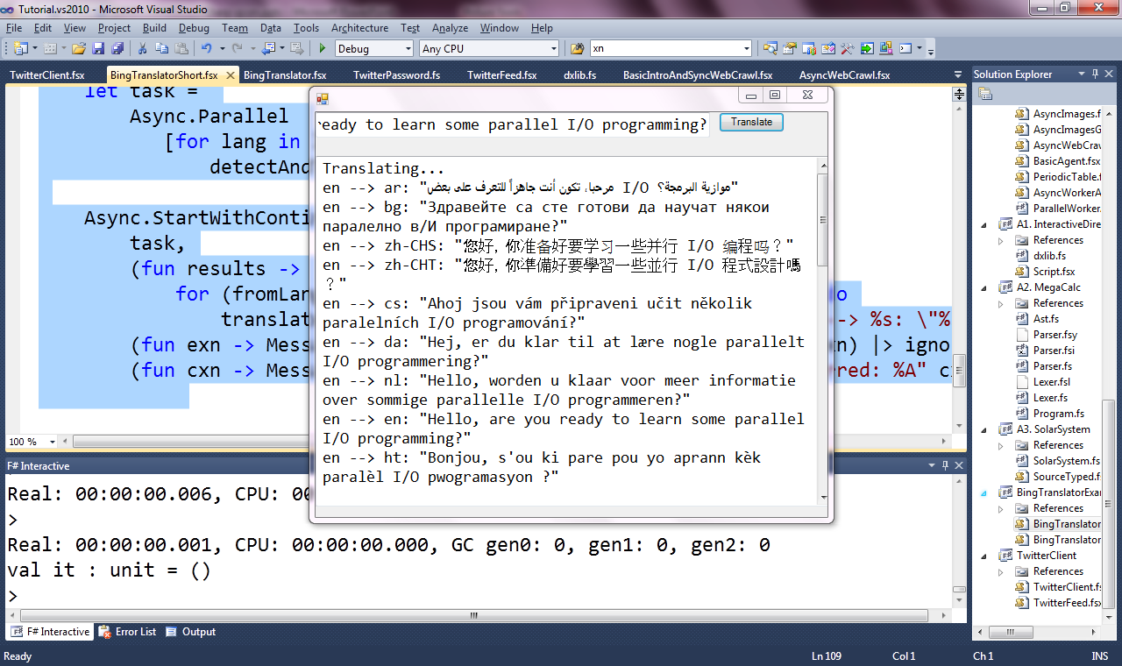

Slide 48
F# async
Parallel
Lightweight Parallel Request Handlers
Lightweight Parallel Agents

Slide 49
F# async
Parallel
Server
Lightweight Parallel Agents

Slide 50
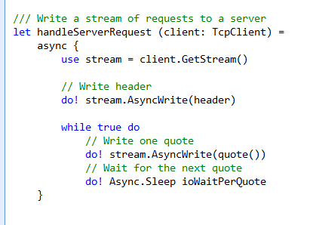
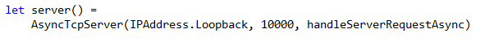
F# example: Serving 5,000+ simultaneous TCP connections with ~10 threads
React!
React!
React!

Slide 51
F# async
Parallel
Server
Lightweight Parallel Agents

Slide 52
F# async
Parallel
Server
Agents

Slide 53
One Agent
let agent =
Agent.Start(fun inbox ->
async { while true do
let! msg = inbox.Receive()
printfn "got message %s" msg } )
agent.Post "three"
agent.Post "four"
Note:
type Agent<'T> = MailboxProcessor<'T>

Slide 54
100,000 Agents
let agents =
[ for i in 1 .. 100000 ->
Agent.Start(fun inbox ->
async { while true do
let! msg = inbox.Receive()
printfn "%d got message %s" i msg })]
for agent in agents do
agent.Post "hello"

Slide 55
Agents – Typed messages
type Message =
| Message1
| Message2 of int * string
let agent =
Agent.Start(fun inbox ->
async { while true do
let! msg = inbox.Receive()
match msg with
| Message1 -> ...
| Message2 (x,y) -> ... })
agent.Post Message1
agent.Post (Message2(3,"t“))

Slide 56
Agents – Untyped messages
type Message = obj
let agent =
Agent.Start(fun inbox ->
async { while true do
let! msg = inbox.Receive()
match msg with
| :? string as s -> ...
| :? int as d -> ...
| _ -> ... })
agent.Post 3
agent.Post "three"

Slide 57
Agents – State Isolation
Isolated, Mutable
State in a Reactive Agent
let agents =
Agent.Start(fun inbox ->
async { let state = Dictionary<int,string>()
while true do
let! key,value = inbox.Receive()
state.[key] <- value } )
for i in 0..10000 do
agent.Post (i, string i)

Slide 58
Agents - PostAndAsyncReply
let agents =
[ for i in 0 .. 100000 ->
Agent.Start(fun inbox ->
async { while true do
let! a,b,reply = inbox.Receive()
msg <-- (a+b) })]
Async.Parallel
[ for agent in agents ->
agent.PostAndAsyncReply (fun r -> (10,10,r)) ]
Response
Message

Slide 59
Miscellaneous Actor Topics
Error Orchestration
Add listener to “Error” event on agents
Isolation
Isolated state in agents is easy
Scanning
Inbox.Scan
Timeouts
timeout=10, inbox.TryReceive, inbox.TryScan, inbox.DefaultTimeout
Scheduling
Rarely tweeked. Set the global “Synchronization Context” or give high-priority agents their own thread.

Slide 60
Tutorial: Objects

Slide 61
Objects
Class Types
type ObjectType(args) =
let internalValue = expr
let internalFunction args = expr
let mutable internalState = expr
member x.Prop1 = expr
member x.Meth2 args = expr
Interface Types
type IObject =
interface ISimpleObject
abstract Prop1 : type
abstract Meth2 : type -> type
Constructing Objects
new FileInfo(@"c:\misc\test.fs")

Slide 62
F# - Objects + Functional
type Vector2D (dx:double, dy:double) =
let d2 = dx*dx+dy*dy
member v.DX = dx
member v.DY = dy
member v.Length = sqrt d2
member v.Scale(k) = Vector2D (dx*k,dy*k)
Inputs to object
construction
Object internals
Exported properties
Exported method

Slide 63
Objects + Functional
Immutable inputs
type HuffmanEncoding(freq:seq<char*int>) =
...
< 50 lines of beautiful functional code>
...
member x.Encode(input: seq<char>) =
encode(input)
member x.Decode(input: seq<char>) =
decode(input)
Internal tables
Publish access

Slide 64
F# - Objects + Imperative
type MutableVector2D (dx:double, dy:double) =
let mutable currDX = dx
let mutable currDY = dy
member v.DX = currDX
member v.DY = currDY
member v.MoveX x = currDX <- currDX + x
member v.MoveY y = currDY <- currDY + y
Internal state

Slide 65
OO: F#/C# comparisons
Source: F# Object-Oriented Quick Guide

Slide 66
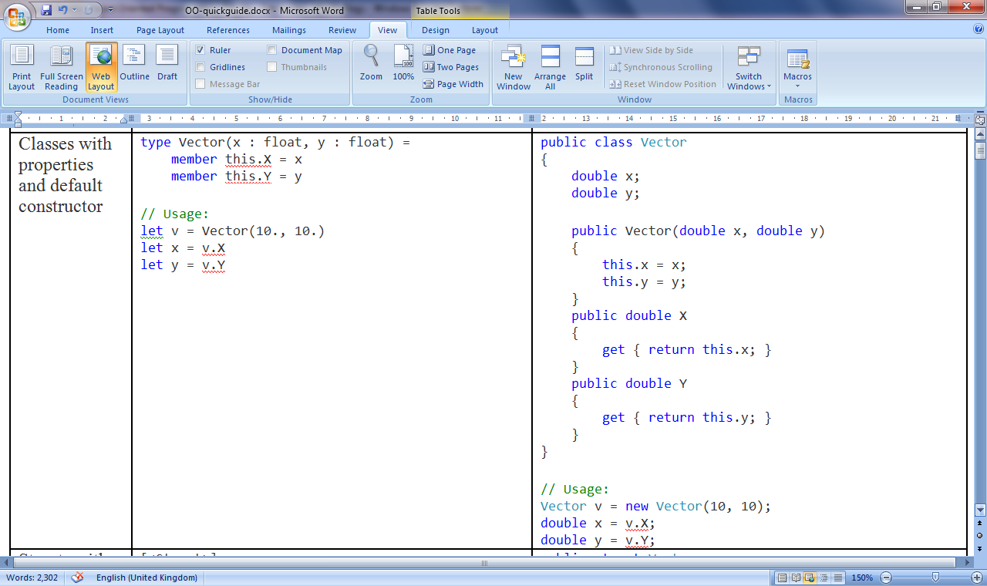
Class with Properties

Slide 67
Wrapping Up

Slide 68
In Summary
F#
A powerful addition to .NET/Visual Studio
F# + .NET 4.0 greatly simplify parallelism
F# is ready for use in production with VS2010
Simple, powerful, and productive

Slide 69
Not Covered
Many minor topics
Distribution
F# uses .NET for distributed computing
Strong emphasis on SOA (Web/REST Services)
“Windows Communication Foundation”
Cloud (Azure 2010)
Hot swapping
.NET does not support “hot code swapping” in normal use. Some can be architected in.

Slide 70
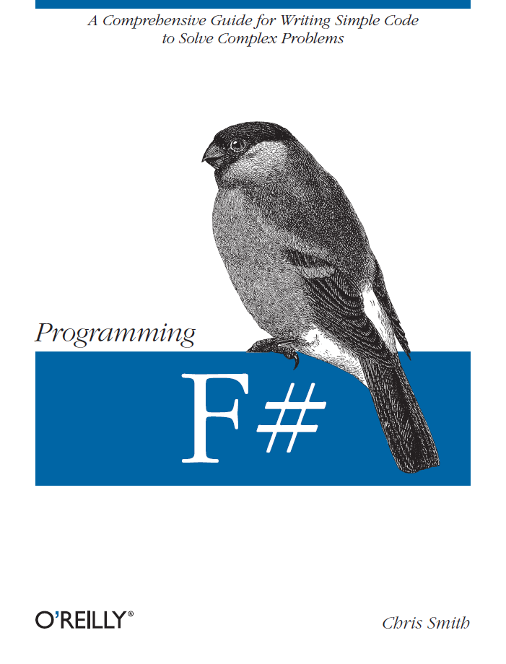
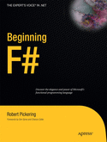
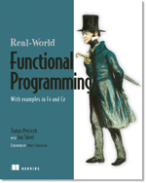

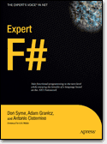
Latest Books about F#
Visit www.fsharp.net

Slide 71
Questions & Discussion http://fsharp.net http://blogs.msdn.com/dsyme http://meetup.com/FSharpLondon

