Slide 1
F# Programming meets Domain Specialists
Dr. Don Syme,
Principal Researcher
Microsoft Research, Cambridge

Slide 2
What is F#?
...a programming language

Slide 3
What is F#?
...a productive functional language that enables users to write simple code to solve complex problems.

Slide 4
Why is F# appealing in finance?
Functional programming is a great fit with much financial work
“Programmatic modelling”
A typed, efficient scripting language gets you a long way
Plays differently for different roles:
Enable quants to contribute to component development
Enables architects to explore hard problems fluently
Enables developers to tackle parallel and asynchronous programming

Slide 5
Crossing boundaries
Performance +
Professional Development
“Programming”
“Financial engineering”
C++
C#
Java
F#
“QF modelling”
Python
Math-
ematica
Programming
Expressivity for
Mathematical tasks

Slide 6
F# Fundamentals
Succinct, Expressive, Functional Language
Parallel, Explorative, Data-rich, Algorithmic
Industry/Platform-Leading
Note: F# is not a replacement for C#/VB/C++
Augments and builds on .NET as multi-lang platform

Slide 7
Simplicity: Scripting
C#
F#
open System
let greeting = "hello"
Console.WriteLine(greeting)
using System;
namespace ConsoleApplication1
{
class Program
{
static string greeting()
{
return "hello";
}
static void Main(string[] args)
{
Console.WriteLine(greeting);
}
}
}

Slide 8
Simplicity: Simulation
abstract class Command
{
public virtual void Execute();
}
abstract class RoverCommand : Command
{
protected Rover Rover { get; private set; }
public RoverCommand(MarsRover rover)
{
this.Rover = rover;
}
}
class BreakCommand : RoverCommand
{
public BreakCommand(Rover rover)
: base(rover)
{
}
public override void Execute()
{
Rover.Rotate(-5.0);
}
}
class TurnLeftCommand : RoverCommand
{
public TurnLeftCommand(Rover rover)
: base(rover)
{
}
public override void Execute()
{
Rover.Rotate(-5.0);
}
}
C#-OO
F#
type Command = Command of (Rover -> unit)
let BreakCommand =
Command(fun rover -> rover.Accelerate(-1.0))
let TurnLeftCommand =
Command(fun rover -> rover.Rotate(-5.0<degs>))

Slide 9
Simplicity: Data
C#
let swap (x, y) = (y, x)
let rotations (x, y, z) =
[ (x, y, z);
(z, x, y);
(y, z, x) ]
let reduce f (x, y, z) =
f x + f y + f z
Tuple<U,T> Swap<T,U>(Tuple<T,U> t)
{
return new Tuple<U,T>(t.Item2, t.Item1)
}
ReadOnlyCollection<Tuple<T,T,T>> Rotations<T>(Tuple<T,T,T> t)
{
new ReadOnlyCollection<int>
(new Tuple<T,T,T>[]
{ new Tuple<T,T,T>(t.Item1,t.Item2,t.Item3);
new Tuple<T,T,T>(t.Item3,t.Item1,t.Item2);
new Tuple<T,T,T>(t.Item2,t.Item3,t.Item1); });
}
int Reduce<T>(Func<T,int> f,Tuple<T,T,T> t)
{
return f(t.Item1) + f(t.Item2) + f (t.Item3);
}
F#

Slide 10
Simplicity: Data
C#
public abstract class Event { }
public abstract class PriceEvent : Event
{
public Price Price { get; private set; }
public PriceEvent(Price price)
{
this.Price = price;
}
}
public abstract class SplitExpr : Event
{
public double Factor { get; private set; }
public SplitExpr(double factor)
{
this.Factor = factor;
}
}
public class DividendEvent : Event { }
...
type Event =
| Price of float
| Split of float
| Dividend of float<money>
F#

Slide 11
F# - Scalable, Realistic Programming
I've been coding in F# lately, for a production task. F# allows you to move smoothly in your programming style... I start with pure functional code, shift slightly towards an object-oriented style, and in production code, I sometimes have to do some imperative programming.
I can start with a pure idea, and still finish my project with realistic code. You're never disappointed in any phase of the project!
Julien Laugel, Chief Software Architect, www.eurostocks.com

Slide 12

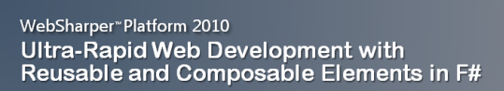


4 Examples of F# Usage
Amyris Biotechnologies
Biotechnology research for engineered renewable fuels
F# for in-house gene sequencing and analytics software tools
Intellifactory WebSharper Platform
Productive Web development leveraging F#
3rd party filling in experience holes
Microsoft ‘Path of Go’ Xbox Live Arcade Game
Paid Xbox Live Arcade Game
XNA with C#/F#
Leveraging advanced Go AI implemented by MSR in F#
Credit Suisse – Global Modelling and Analytics Group
Large group using F# (60+)
Financial modeling, mission critical components

Slide 13
Case Study: Calculation Engine
I have written an application to balance the national power generation schedule for a portfolio of power stations to a trading position for an energy company. ...the calculation engine was written in F#.
The use of F# to address the complexity at the heart of this application clearly demonstrates a sweet spot for the language within enterprise software, namely algorithmically complex analysis of large data sets.
Simon Cousins, Eon PowerGen

Slide 14
Typical Case Study (Source: Simon Cousins, Eon PowerGen)
Units of measure The industry I work in is littered with units....Having the type system verify the correctness of the units is a huge time saver...it eradicates a whole class of errors that previous systems were prone to.
Exploratory programming Working with F# Interactive allowed me to explore the solution space more effectively before committing to an implementation ... a very natural way for a programmer to build their understanding of the problem and the design tensions in play.
Unit testing Code written using non-side effecting functions and immutable data structures is a joy to test. There are no complex time-dependent interactions to screw things up or large sets of dependencies to be mocked.
Parallelism The functional purity ... makes it ripe for exploiting the inherent parallelism in processing vectors of data.
Interoperation ... The calculation engine could be injected into any C# module that needed to use it without any concerns at all about interoperability. Seamless. The C# programmer need never know.
Code reduction Much of the data fed into the calculation engine was in the form of vectors and matrices. Higher order functions eat these for breakfast with minimal fuss, minimal code. Beautiful.
Lack of bugs Functional programming can feel strange. .. once the type checker is satisfied that’s it, it works.

Slide 15
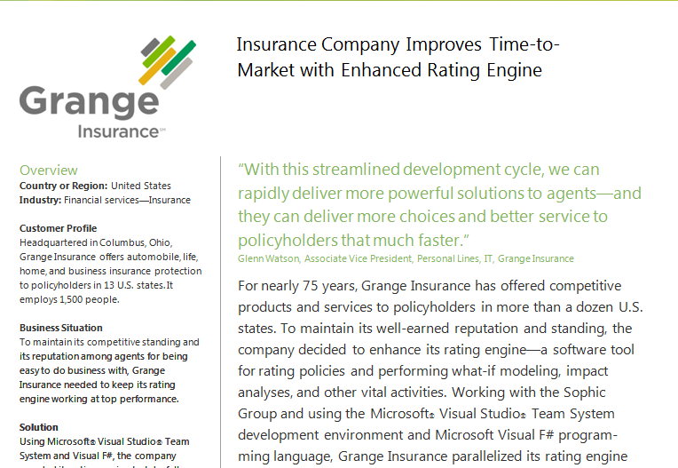
Case Study: Grange Insurance

Slide 16
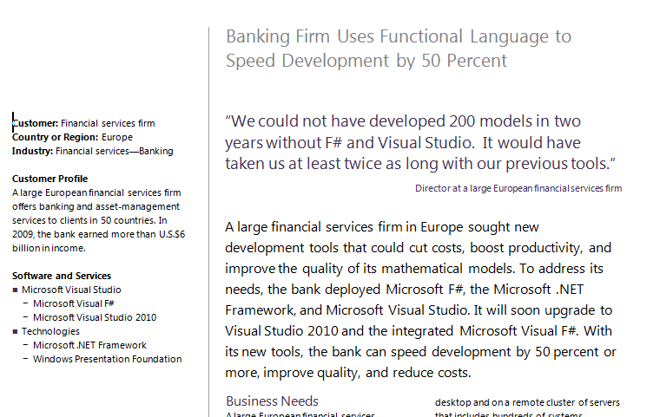
Case Study: “Finance Company”
Source: http://whitepapers.techrepublic.com

Slide 17
Let’s Web Crawl…
Demo: Event Processing
Notes:
If you would like to host your demo on the Virtual Server, please use the myVPC demo slide, not this slide.

Slide 18
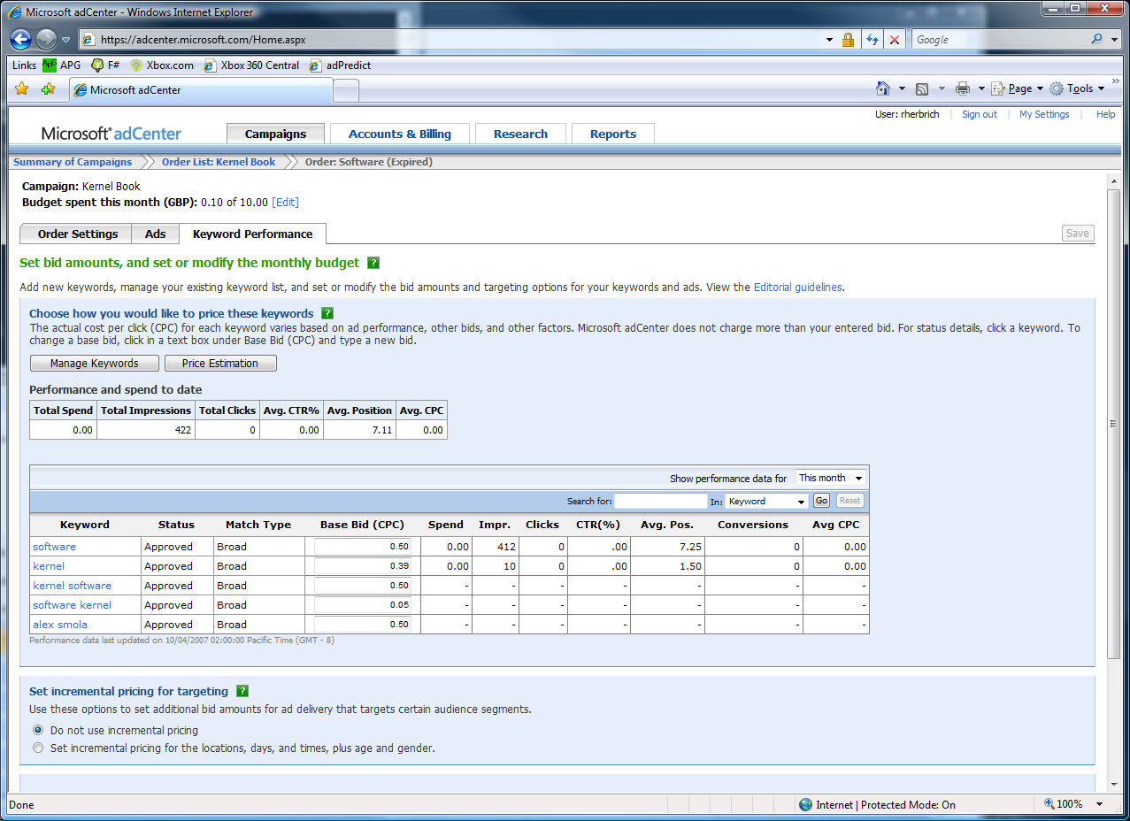
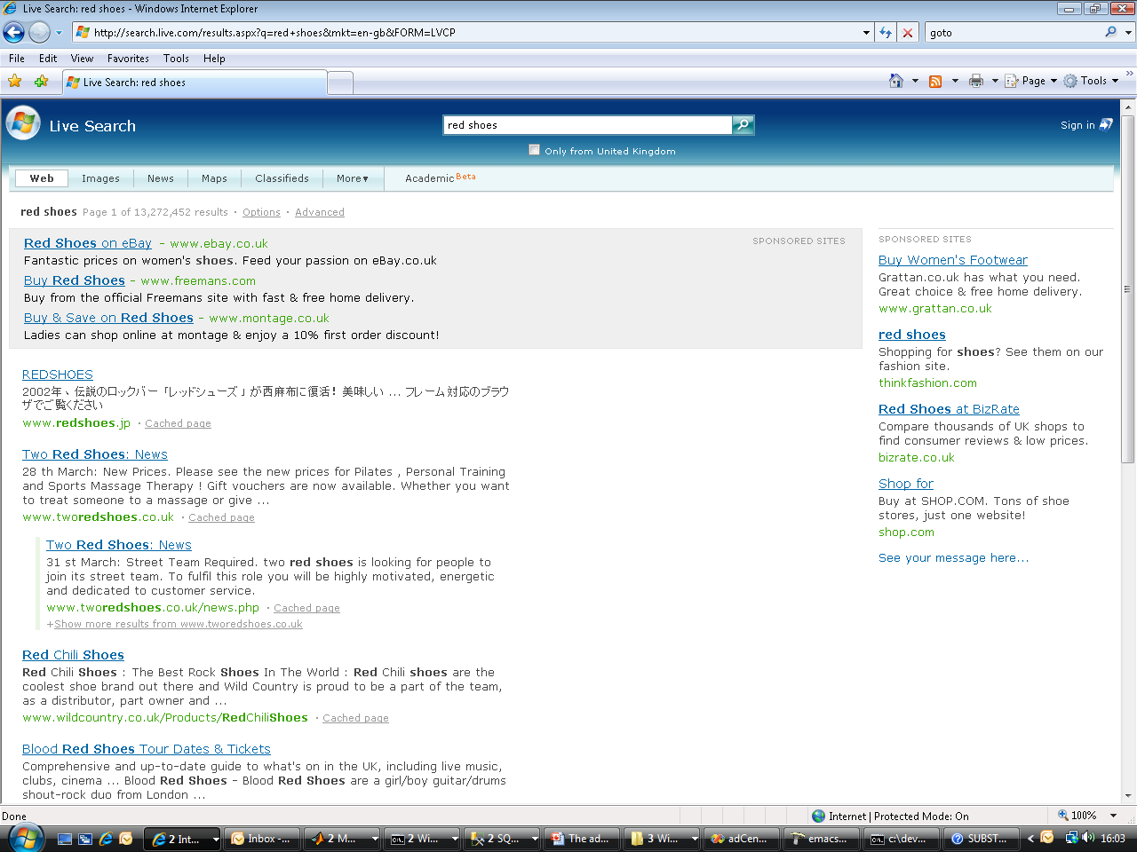
Case Study: adCenter

Slide 19
Case Study: adCenter
Weeks of data in training:
N,000,000,000 impressions, 6TB data
2 weeks of CPU time during training:
2 wks × 7 days × 86,400 sec/day =
1,209,600 seconds
Learning algorithm speed requirement:
N,000 impression updates / sec
N00.0 μs per impression update

Slide 20
Case Study: adCenter
4 week project, 4 machine learning experts
100million probabilistic variables
Processes 6TB of training data
Real time processing

Slide 21
AdPredict: What We Observed
F#’s powerful type inference means less typing, more thinking
Quick Coding
Agile Coding
Scripting
Performance
Memory-Faithful
Succinct
Symbolic
.NET Integration
Type-inferred code is easily refactored
“Hands-on” exploration.
Immediate scaling to massive data sets
mega-data structures, 16GB machines
Live in the domain, not the language
Schema compilation and “Schedules”
Especially Excel, SQL Server

Slide 22
Topic: Units of Measure

Slide 23
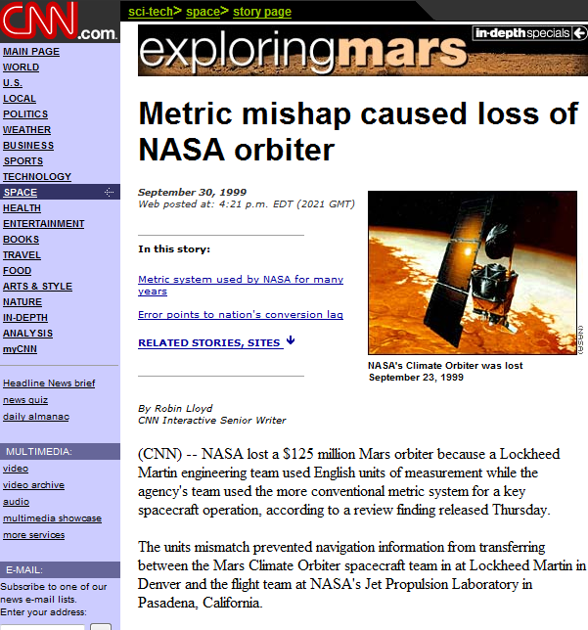
NASA Mars Climate Orbiter, 1999

Slide 24
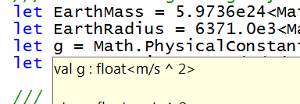
let EarthMass = 5.9736e24<kg>
// Average between pole and equator radii
let EarthRadius = 6371.0e3<m>
// Gravitational acceleration on surface of Earth
let g = PhysicalConstants.G * EarthMass / (EarthRadius * EarthRadius)

Slide 25
Units of Measure – Typical Example
[<Measure>] type money
[<Measure>] type shares
[<Measure>] type volume
[<Measure>] type rateOfReturn
let rateOfReturn (f:float) = f * 1.<rateOfReturn>
type Price = { Open: float<money>;
High: float<money>;
Low: float<money>;
Close: float<money>;
Volume: float<volume> }

Slide 26
Demo: Units of Measure

Slide 27
Parallel

Slide 28
Async.Parallel [ http "www.google.com"; http "www.bing.com"; http "www.yahoo.com"; ]
|> Async.RunSynchronously

Slide 29
Async.Parallel [ for i in 0 .. 200 -> computeTask i ]
|> Async.RunSynchronously

Slide 30
F#
Parallel
Server
Agents

Slide 31
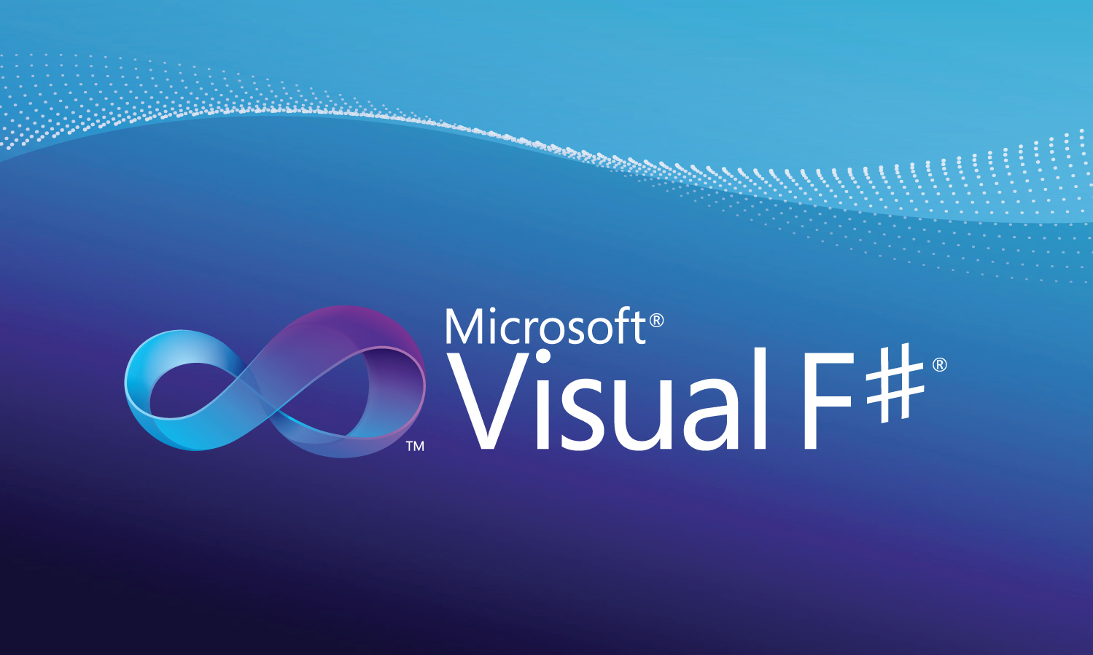
Professional Tools

Slide 32
In Summary
F#
A powerful addition to Base Financial Tools
F# + .NET 4.0 greatly simplify parallelism
F# is ready for use in production with VS2010
Simple, powerful, and productive

Slide 33
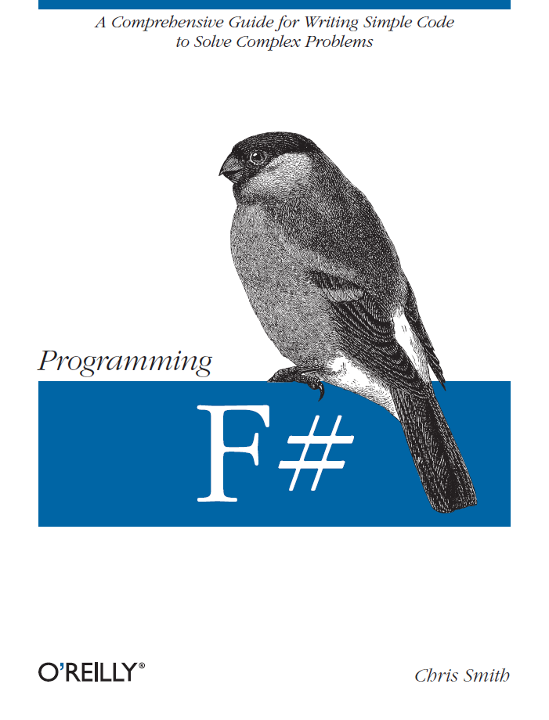
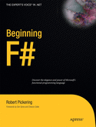
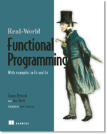

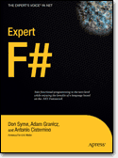
Latest Books about F#
Visit www.fsharp.net

Slide 34
Questions http://fsharp.net http://blogs.msdn.com/dsyme http://meetup.com/FSharpLondon
June 23
Wednesday Night!
A great place to meet F# users, trainers, architects, consultants, guys, gals, …

Slide 35
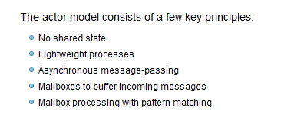

Slide 36

© 2009 Microsoft Corporation. All rights reserved. Microsoft, Windows, Windows Vista and other product names are or may be registered trademarks and/or trademarks in the U.S. and/or other countries.
The information herein is for informational purposes only and represents the current view of Microsoft Corporation as of the date of this presentation. Because Microsoft must respond to changing market conditions, it should not be interpreted to be a commitment on the part of Microsoft, and Microsoft cannot guarantee the accuracy of any information provided after the date of this presentation. MICROSOFT MAKES NO WARRANTIES, EXPRESS, IMPLIED OR STATUTORY, AS TO THE INFORMATION IN THIS PRESENTATION.

Slide 37
F#: Influences
Python,OCaml
Haskell
C#/.NET
F#
Similar core
ideas
Practical, real world programming

Slide 38
Fundamentals - Whitespace Matters
let computeDerivative f x =
let p1 = f (x - 0.05)
let p2 = f (x + 0.05)
(p2 – p1) / 0.1
Offside (bad indentation)

Slide 39
Fundamentals - Whitespace Matters
let computeDerivative f x =
let p1 = f (x - 0.05)
let p2 = f (x + 0.05)
(p2 – p1) / 0.1

Slide 40
Your First F# Application
printfn "Hello World"
C:\test> fsc test.fs
C:\test> test.exe
Hello World
C:\test>

Slide 41
Your Second F# Application
open System.Windows.Form
let form = new Form (Visible=true)
form.Click.Add (fun _ -> printfn "click")
Application.Run form

Slide 42
Functional– Pipelines
x |> f
The pipeline operator

Slide 43
Functional– Pipelines
x |> f1
|> f2
|> f3
Successive stages
in a pipeline

Slide 44
F# - Objects + Functional
type Vector2D (dx:double, dy:double) =
let d2 = dx*dx+dy*dy
member v.DX = dx
member v.DY = dy
member v.Length = sqrt d2
member v.Scale(k) = Vector2D (dx*k,dy*k)
Inputs to object
construction
Object internals
Exported properties
Exported method

Slide 45
Fundamentals: Let
Let “let” simplify your life…
Type inference. The safety of C# with the succinctness of a scripting language
Bind a static value
let data = (1, 2, 3)
let f (a, b, c) =
let sum = a + b + c
let g x = sum + x*x
(g a, g b, g c)
Bind a static function
Bind a local value
Bind a local function

Slide 46
Your First Agent
let agent =
Agent.Start(fun inbox ->
async { while true do
let! msg = inbox.Receive()
printfn "got message %s" msg } )
agent.Post "three"
agent.Post "four"
Note:
type Agent<'T> = MailboxProcessor<'T>

Slide 47
Your First 100,000 Agents
let agents =
[ for i in 0 .. 100000 ->
Agent.Start(fun inbox ->
async { while true do
let! msg = inbox.Receive()
printfn "%d got message %s" i msg })]
for agent in agents do
agent.Post "hello"
Note:
type Agent<'T> = MailboxProcessor<'T>

Slide 48
Your First State Isolated Agent
Isolated, Mutable
State in a Reactive Agent
let agents =
Agent.Start(fun inbox ->
async { let state = Dictionary<int,string>()
while true do
let! key,value = inbox.Receive()
state.[key] <- value } )
for i in 0..10000 do
agent.Post (i, string i)
Note:
type Agent<'T> = MailboxProcessor<'T>

