Slide 1
A Taste of F# Today
Don Syme,
Principal Researcher
Microsoft Research, Cambridge

Slide 2
Which talk?
F# Today?
F# Advanced?
F# Tomorrow?

Slide 3
Which talk?
F# Today!
F# Advanced?
F# Tomorrow?

Slide 4
Which talk?
F# Today!

Slide 5
Agenda
F# Intro
Some F# Case Studies
Some F# Features + Resources

Slide 6
F# is…
a programming language…

Slide 7
F# is…
...a programming language that allows you to write simple code to solve complex problems.

Slide 8
F# is…
...a productive, supported, functional programming language that allows you to write simple code to solve complex problems.

Slide 9
Why is F# appealing in …

Slide 10
Why is F# appealing in finance?

Slide 11
Why is F# appealing in finance?
A great fit for much financial work
“Programmatic modelling”
A typed, efficient scripting language goes a long way
Plays differently for different roles:
Enables quants to contribute components
Enables architects to explore hard problems
Enables developers to tackle parallel and async

Slide 12
Crossing boundaries
Performance +
Professional Development
“Programming”
“Financial engineering”
C++
C#
Java
F#
“QF modelling”
Dynamic
Domain Specific
Programming
Expressivity for
Mathematical tasks

Slide 13
F# Fundamentals
Succinct, Expressive, Functional Language
Parallel, Explorative, Data-rich, Algorithmic
Industry/Platform-Leading
Note: F# is not a replacement for C#/VB/C++
Augments and builds on .NET as multi-lang platform

Slide 14
Why Functional?

Slide 15
Simplicity

Slide 16
Parallel

Slide 17
Simplicity

Slide 18
Simplicity: Scripting
C#
F#
open System
let greeting = "hello"
Console.WriteLine(greeting)
using System;
namespace ConsoleApplication1
{
class Program
{
static string greeting = "hello"
static void Main(string[] args)
{
Console.WriteLine(greeting);
}
}
}

Slide 19
Simplicity: Functions as Values
abstract class Command
{
public virtual void Execute();
}
abstract class RoverCommand : Command
{
protected Rover Rover { get; private set; }
public RoverCommand(MarsRover rover)
{
this.Rover = rover;
}
}
class BreakCommand : RoverCommand
{
public BreakCommand(Rover rover)
: base(rover)
{
}
public override void Execute()
{
Rover.Rotate(-5.0);
}
}
class TurnLeftCommand : RoverCommand
{
public TurnLeftCommand(Rover rover)
: base(rover)
{
}
public override void Execute()
{
Rover.Rotate(-5.0);
}
}
C#-OO
F#
type Command = Command of (Rover -> unit)
let BreakCommand =
Command(fun rover -> rover.Accelerate(-1.0))
let TurnLeftCommand =
Command(fun rover -> rover.Rotate(-5.0<degs>))

Slide 20
Simplicity: Functional Data
C#
let swap (x, y) = (y, x)
let rotations (x, y, z) =
[ (x, y, z);
(z, x, y);
(y, z, x) ]
let reduce f (x, y, z) =
f x + f y + f z
Tuple<U,T> Swap<T,U>(Tuple<T,U> t)
{
return new Tuple<U,T>(t.Item2, t.Item1)
}
ReadOnlyCollection<Tuple<T,T,T>> Rotations<T>(Tuple<T,T,T> t)
{
new ReadOnlyCollection<int>
(new Tuple<T,T,T>[]
{ new Tuple<T,T,T>(t.Item1,t.Item2,t.Item3);
new Tuple<T,T,T>(t.Item3,t.Item1,t.Item2);
new Tuple<T,T,T>(t.Item2,t.Item3,t.Item1); });
}
int Reduce<T>(Func<T,int> f,Tuple<T,T,T> t)
{
return f(t.Item1) + f(t.Item2) + f (t.Item3);
}
F#

Slide 21
Simplicity: Functional Data
C#
public abstract class Expr { }
public abstract class UnaryOp :Expr {
public Expr First { get; private set; }
public UnaryOp(Expr first) { this.First = first; }
}
public abstract class BinExpr : Expr
{
public Expr First { get; private set; }
public Expr Second { get; private set; }
public BinExpr(Expr first, Expr second) {
this.First = first;
this.Second = second;
}
}
public class TrueExpr : Expr { }
public class And : BinExpr {
public And(Expr first, Expr second) : base(first, second) { }
}
public class Nand : BinExpr {
public Nand(Expr first, Expr second) : base(first, second{ }
}
public class Or : BinExpr {
public Or(Expr first, Expr second) : base(first, second) { }
}
public class Xor : BinExpr {
public Xor(Expr first, Expr second) : base(first, second) { }
}
public class Not : UnaryOp {
public Not(Expr first) : base(first) { }
}
F#
type Expr =
| True
| And of Expr * Expr
| Nand of Expr * Expr
| Or of Expr * Expr
| Xor of Expr * Expr
| Not of Expr

Slide 22
Simplicity: Functional Data
C#
public abstract class Event { }
public abstract class PriceEvent : Event
{
public Price Price { get; private set; }
public PriceEvent(Price price)
{
this.Price = price;
}
}
public abstract class SplitExpr : Event
{
public double Factor { get; private set; }
public SplitExpr(double factor)
{
this.Factor = factor;
}
}
public class DividendEvent : Event { }
...
type Event =
| Price of float
| Split of float
| Dividend of float<money>
F#

Slide 23
Parallel

Slide 24
Async.Parallel [ http "www.google.com"; http "www.bing.com"; http "www.yahoo.com"; ]
|> Async.RunSynchronously

Slide 25
Async.Parallel [ for i in 0 .. 200 -> computeTask i ]
|> Async.RunSynchronously

Slide 26
F#: Influences
OCaml
C#/.NET
F#
Similar core
language
Similar object
model

Slide 27
Let’s Web Crawl…
Demo: Event Processing
Notes:
If you would like to host your demo on the Virtual Server, please use the myVPC demo slide, not this slide.

Slide 28
Example #1 : Methodology
I've been coding in F# lately, for a production task. F# allows you to move smoothly in your programming style... I start with pure functional code, shift slightly towards an object-oriented style, and in production code, I sometimes have to do some imperative programming.
I can start with a pure idea, and still finish my project with realistic code. You're never disappointed in any phase of the project!
Julien Laugel, Chief Software Architect, www.eurostocks.com

Slide 29
Example #2 (power company)
I have written an application to balance the national power generation schedule for a portfolio of power stations to a trading position for an energy company. ...the calculation engine was written in F#.
The use of F# to address the complexity at the heart of this application clearly demonstrates a sweet spot for the language within enterprise software, namely algorithmically complex analysis of large data sets.
Simon Cousins (power company)

Slide 30
Example #2 (power company)
Units of measure The industry I work in is littered with units....Having the type system verify the correctness of the units is a huge time saver...it eradicates a whole class of errors that previous systems were prone to.
Exploratory programming Working with F# Interactive allowed me to explore the solution space more effectively before committing to an implementation ... a very natural way for a programmer to build their understanding of the problem and the design tensions in play.
Unit testing Code written using non-side effecting functions and immutable data structures is a joy to test. There are no complex time-dependent interactions to screw things up or large sets of dependencies to be mocked.
Parallelism The functional purity ... makes it ripe for exploiting the inherent parallelism in processing vectors of data.
Interoperation ... The calculation engine could be injected into any C# module that needed to use it without any concerns at all about interoperability. Seamless. The C# programmer need never know.
Code reduction Much of the data fed into the calculation engine was in the form of vectors and matrices. Higher order functions eat these for breakfast with minimal fuss, minimal code. Beautiful.
Lack of bugs Functional programming can feel strange. .. once the type checker is satisfied that’s it, it works.

Slide 31
Case Study #2 (power company)
Units of measure The industry I work in is littered with units....Having the type system verify the correctness of the units is a huge time saver...it eradicates a whole class of errors that previous systems were prone to.
Exploratory programming Working with F# Interactive allowed me to explore the solution space more effectively before committing to an implementation ... a very natural way for a programmer to build their understanding of the problem and the design tensions in play.
Unit testing Code written using non-side effecting functions and immutable data structures is a joy to test. There are no complex time-dependent interactions to screw things up or large sets of dependencies to be mocked.
Parallelism The functional purity ... makes it ripe for exploiting the inherent parallelism in processing vectors of data.
Interoperation ... The calculation engine could be injected into any C# module that needed to use it without any concerns at all about interoperability. Seamless. The C# programmer need never know.
Code reduction Much of the data fed into the calculation engine was in the form of vectors and matrices. Higher order functions eat these for breakfast with minimal fuss, minimal code. Beautiful.
Lack of bugs Functional programming can feel strange. .. once the type checker is satisfied that’s it, it works.

Slide 32
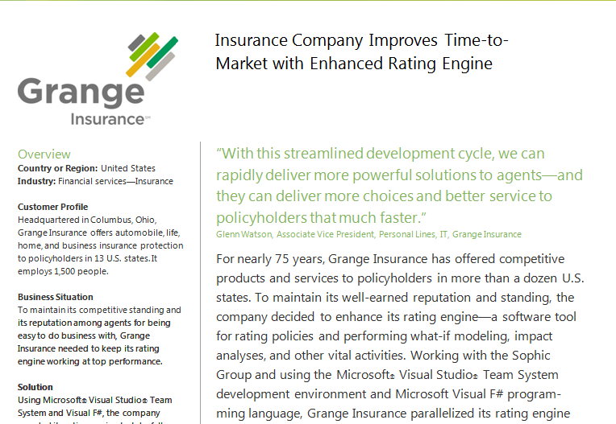
Case Study #1: Grange Insurance

Slide 33
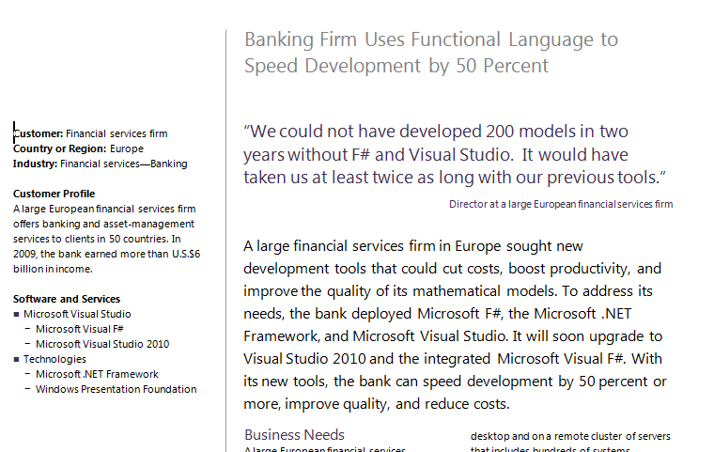
Case Study #2: “Finance Company”
Source: http://whitepapers.techrepublic.com

Slide 34
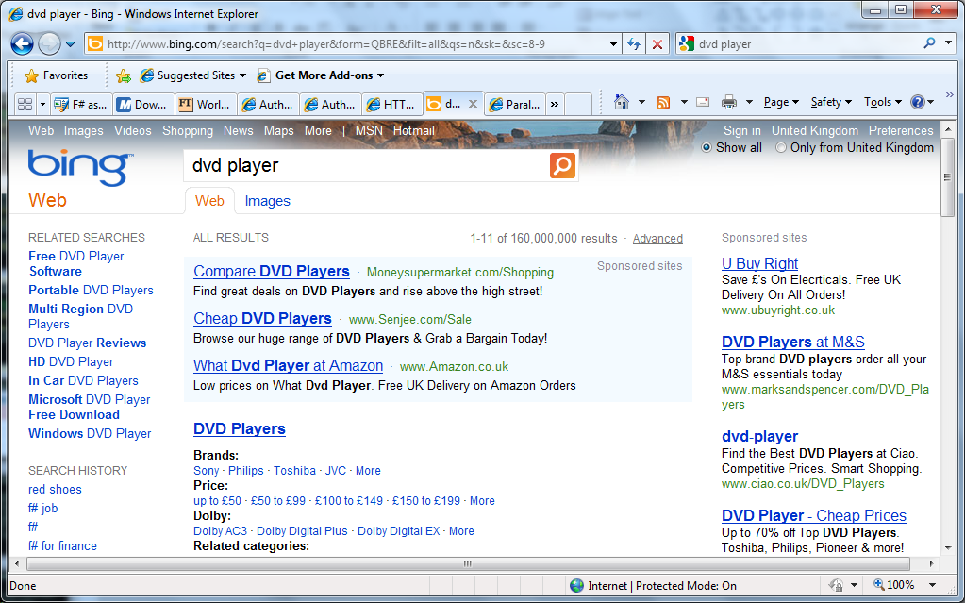
The adCenter Problem

Slide 35
AdPredict: What We Observed
F#’s powerful type inference means less typing, more thinking
Quick Coding
Agile Coding
Scripting
Performance
Memory-Faithful
Succinct
Symbolic
.NET Integration
Type-inferred code is easily refactored
“Hands-on” exploration.
Immediate scaling to massive data sets
mega-data structures, 16GB machines
Live in the domain, not the language
Schema compilation and “Schedules”
Especially Excel, SQL Server

Slide 36
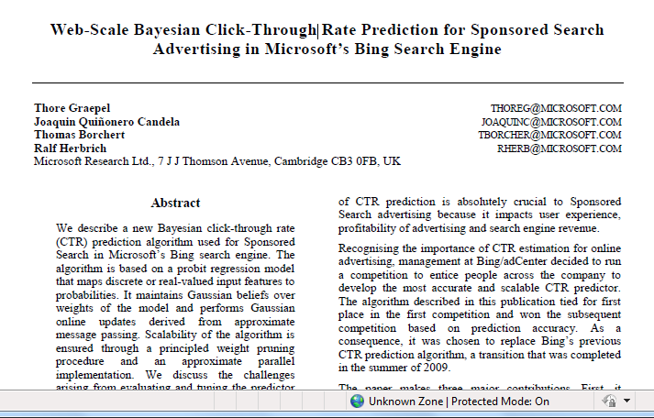

Slide 37
Let’s Web Crawl…
Topic: Some Basics
Notes:
If you would like to host your demo on the Virtual Server, please use the myVPC demo slide, not this slide.

Slide 38
Fundamentals - Whitespace Matters
let computeDerivative f x =
let p1 = f (x - 0.05)
let p2 = f (x + 0.05)
(p2 – p1) / 0.1
Offside (bad indentation)

Slide 39
Fundamentals - Whitespace Matters
let computeDerivative f x =
let p1 = f (x - 0.05)
let p2 = f (x + 0.05)
(p2 – p1) / 0.1

Slide 40
Your First F# Application
printfn "Hello World"
C:\test> fsc test.fs
C:\test> test.exe
Hello World
C:\test>

Slide 41
Your Second F# Application
open System.Windows.Form
let form = new Form (Visible=true)
form.Click.Add (fun _ -> printfn "click")
Application.Run form

Slide 42
Fundamentals: Let
Let “let” simplify your life…
Type inference. The safety of C# with the succinctness of a scripting language
Bind a static value
let data = (1, 2, 3)
let f (a, b, c) =
let sum = a + b + c
let g x = sum + x*x
(g a, g b, g c)
Bind a static function
Bind a local value
Bind a local function

Slide 43
Functional– Pipelines
x |> f
The pipeline operator

Slide 44
Functional– Pipelines
x |> f1
|> f2
|> f3
Successive stages
in a pipeline

Slide 45
F# - Objects + Functional
type Vector2D (dx:double, dy:double) =
let d2 = dx*dx+dy*dy
member v.DX = dx
member v.DY = dy
member v.Length = sqrt d2
member v.Scale(k) = Vector2D (dx*k,dy*k)
Inputs to object
construction
Object internals
Exported properties
Exported method

Slide 46
Let’s Web Crawl…
Demo: 3d Simulation
Notes:
If you would like to host your demo on the Virtual Server, please use the myVPC demo slide, not this slide.

Slide 47
Resource: F# Object Oriented Quick Guide
Source: F# Object-Oriented Quick Guide

Slide 48
Objects
Class Types
type ObjectType(args) =
let internalValue = expr
let internalFunction args = expr
let mutable internalState = expr
member x.Prop1 = expr
member x.Meth2 args = expr
Interface Types
type IObject =
interface ISimpleObject
abstract Prop1 : type
abstract Meth2 : type -> type
Constructing Objects
new FileInfo(@"c:\misc\test.fs")

Slide 49
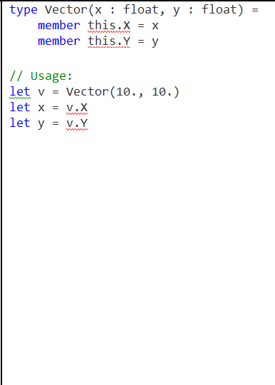
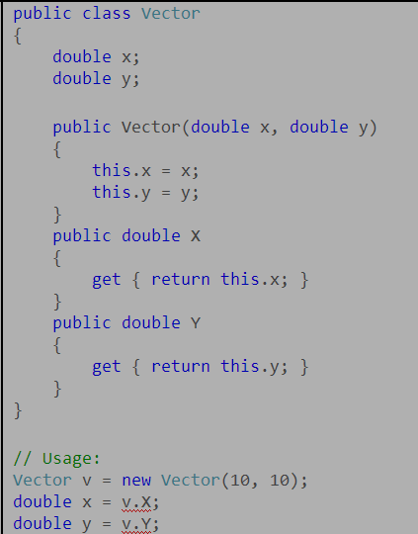
Class with Properties

Slide 50
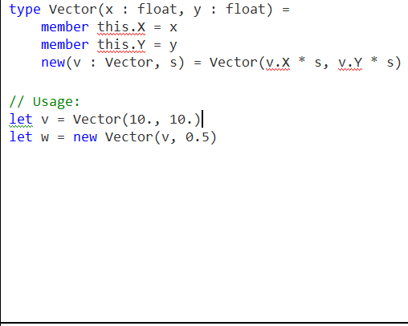
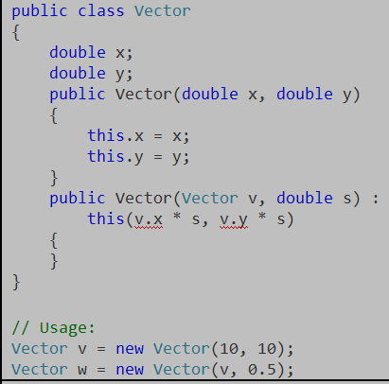
Class with Multiple Constructors

Slide 51
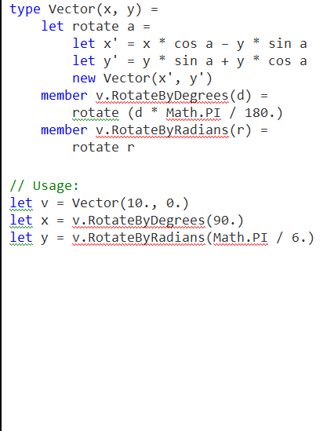
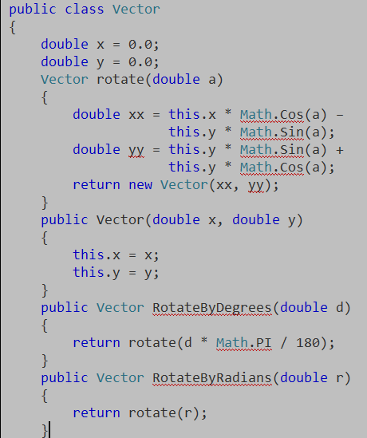
Class with Members + Private

Slide 52
+quick guide has more....
Structs with properties
Member functions
Operators
Static members and properties
Class properties that use let value computations in the constructor
Overloading members
Mutable fields in a class with get/set properties
Generic classes and function arguments
Extension methods
Extension properties
Indexers
Indexed Properties
Abstract classes
Derive from a base class and overriding base methods with generics
Calling a base class method
Implementing an interface
Implementing an interface with object expressions
Events
Explicit class constructor
Explicit public fields
Explicit struct definition

Slide 53
Topic: Units of Measure

Slide 54
Units of Measure – Typical Example
[<Measure>] type money
[<Measure>] type shares
[<Measure>] type volume
[<Measure>] type rateOfReturn
let rateOfReturn (f:float) = f * 1.<rateOfReturn>
type Price = { Open: float<money>;
High: float<money>;
Low: float<money>;
Close: float<money>;
Volume: float<volume> }

Slide 55
Let’s Web Crawl…
Topic: async/parallel
Notes:
If you would like to host your demo on the Virtual Server, please use the myVPC demo slide, not this slide.

Slide 56
React!
async { let! res = <async-event>
... }
React to a GUI Event
React to a Timer Callback
React to a Query Response
React to a HTTP Response
React to a Web Service Response
React to a Disk I/O Completion
Agent reacts to Message

Slide 57
F# async + immutable
Parallel
Server
Agents

Slide 58
F# async + immutable
Parallel
Server
Agents

Slide 59
The many uses of async { ... }
Sequencing I/O requests
Sequencing CPU computations and I/O requests
async { let! lang = detectLanguageAsync text
let! text2 = translateAsync (lang,"da",text)
return text2 }
async { let! lang = detectLanguageAsync text
let! text2 = translateAsync (lang,"da",text)
let text3 = postProcess text2
return text3 }

Slide 60
The many uses of async { ... }
Parallel CPU computations
Parallel I/O requests
Async.Parallel [ async { return (fib 39) };
async { return (fib 40) }; ]
Async.Parallel
[ for target in langs ->
translateAsync (lang,target,text) ]

Slide 61
F# async + immutable
Parallel
Server
Agents

Slide 62
F# async + immutable
Parallel
Server
Agents

Slide 63
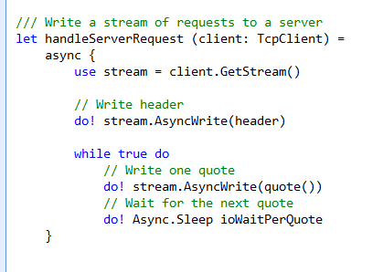
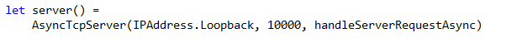
F# example: Serving 5,000+ simultaneous TCP connections with ~10 threads
React!
React!
React!

Slide 64
F# async + immutable
Parallel
Server
Agents

Slide 65
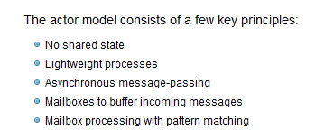
Agents/Actors

Slide 66
Your First Agent
let agent =
Agent.Start(fun inbox ->
async { while true do
let! msg = inbox.Receive()
printfn "got message %s" msg } )
agent.Post "three"
agent.Post "four"
Note:
type Agent<'T> = MailboxProcessor<'T>

Slide 67
Your First 100,000 Agents
let agents =
[ for i in 0 .. 100000 ->
Agent.Start(fun inbox ->
async { while true do
let! msg = inbox.Receive()
printfn "%d got message %s" i msg })]
for agent in agents do
agent.Post "hello"
Note:
type Agent<'T> = MailboxProcessor<'T>

Slide 68
Agents Galore
demo

Slide 69
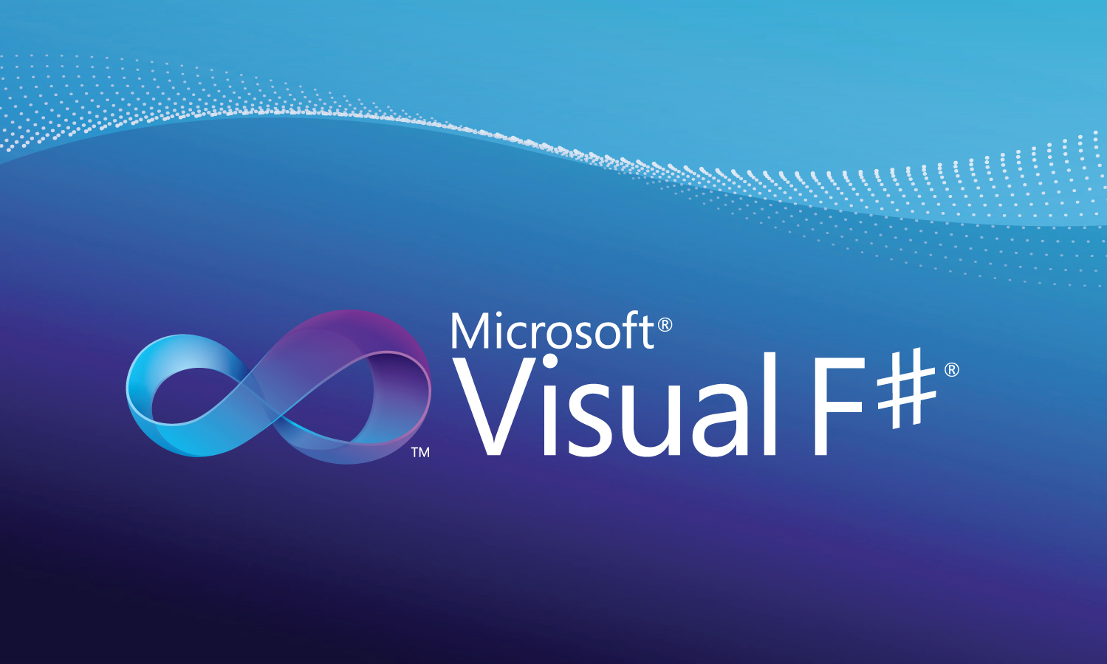
Professional Tools

Slide 70
In Summary
F#
A powerful addition to base .NET tools
F# greatly simplifies parallelism
F# is cross-platform, and ready for supported use in VS2010
Simple, powerful, and productive

Slide 71
We’ve been busy ☺

Slide 72
Plus…
July 2010: Community Templates
August 2010: Windows Phone Templates
August 2010: Mono/Linux/Mac/.NET 4.0 + Visual Studio 2010 Shell Free Tools Release
November 5: F# in Education Workshop, Boston

Slide 73
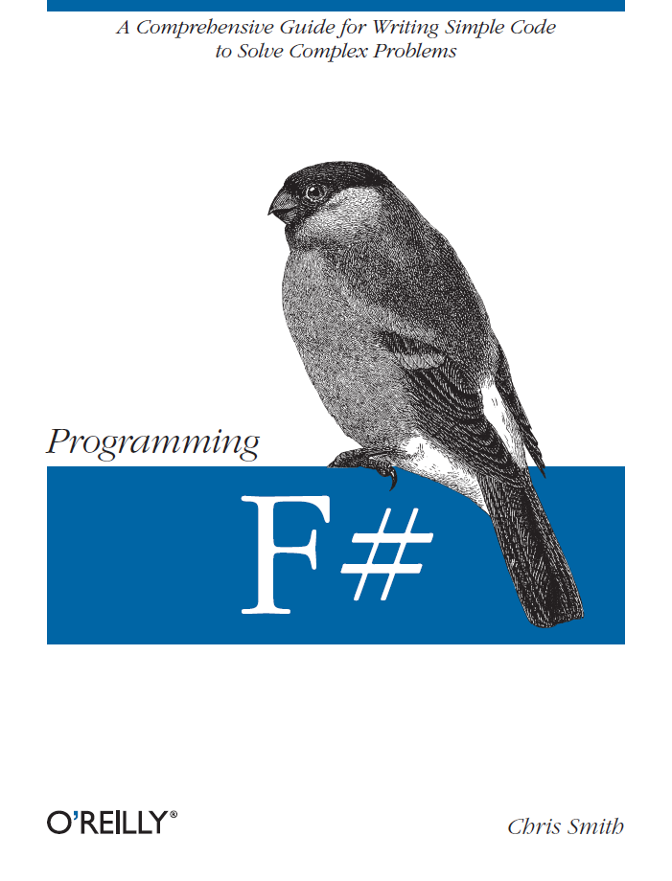
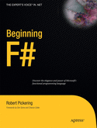
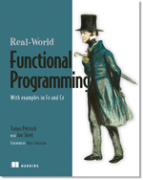

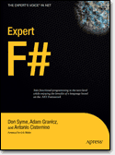
Latest Books about F#
Visit www.fsharp.net

Slide 74
Questions http://fsharp.net http://blogs.msdn.com/dsyme http://meetup.com/FSharpLondon

Slide 75

© 2009 Microsoft Corporation. All rights reserved. Microsoft, Windows, Windows Vista and other product names are or may be registered trademarks and/or trademarks in the U.S. and/or other countries.
The information herein is for informational purposes only and represents the current view of Microsoft Corporation as of the date of this presentation. Because Microsoft must respond to changing market conditions, it should not be interpreted to be a commitment on the part of Microsoft, and Microsoft cannot guarantee the accuracy of any information provided after the date of this presentation. MICROSOFT MAKES NO WARRANTIES, EXPRESS, IMPLIED OR STATUTORY, AS TO THE INFORMATION IN THIS PRESENTATION.

Slide 76
F# and the Concurrency Challenges
Shared State
F# Immutability
Inversion of Control
F# Async
I/O Parallelism
F# Async
Messaging and Scaling
F# Agents
+ Web/Azure/MSQ/
HPC/Cluster etc.

Slide 77
Immutability the norm...
Immutable Tuples
Immutable Dictionaries
Immutable Unions
+ lots of language features to encourage immutability
Immutable Lists
Immutable Records
Immutable Sets
Immutable Objects

Slide 78
In Praise of Immutability
Immutable objects can transfer between threads
Immutable objects never have race conditions

Slide 79
Parallel Async Stock Tickers
let loadTickerAsync ticker span =
async { let prices = loadPricesAsync ticker span
let divs = loadDivsAsync ticker span
let splits = loadSplitsAsync ticker span
let! (prices, divs, splits) =
Async.Parallel3 (prices, divs, splits)
return prices @ divs @ splits }
let loadTickersAsync tickerSpanTuples =
Async.Parallel
[ for (ticker, span) in tickerSpanTuples ->
async { let! obs = loadTickerAsync ticker span
return (ticker, span, obs) } ]

Slide 80
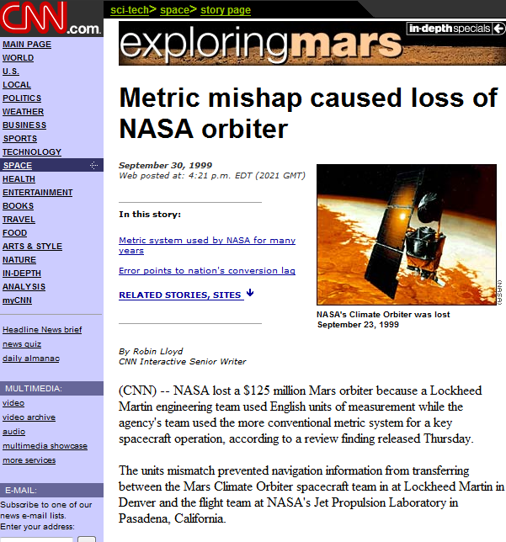
NASA Mars Climate Orbiter, 1999

Slide 81
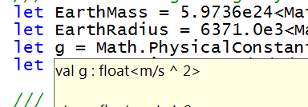
let EarthMass = 5.9736e24<kg>
// Average between pole and equator radii
let EarthRadius = 6371.0e3<m>
// Gravitational acceleration on surface of Earth
let g = PhysicalConstants.G * EarthMass / (EarthRadius * EarthRadius)

