Slide 1
F# History, Today, Tomorrow
Invited talk, SPLASH/ILC 2010
Don Syme,
Principal Researcher
Microsoft Research, Cambridge

Slide 2
Agenda
Overview
Demos
Language Taster
Pragmatics
F# History
F# Today
F# Tomorrow!
1998-2010
A teaser

Slide 3
F# : The Road Behind

Slide 4
My F# Journey to 2010
The Ship
The Destination
Microsoft Research & .NET
The Origin
1998: Java, Ocaml, Scheme, Lisp, Haskell, COM, TclTk, Pizza, GJ, MLj
2010: C# 4.0-5.0, F# 2.0

Slide 5


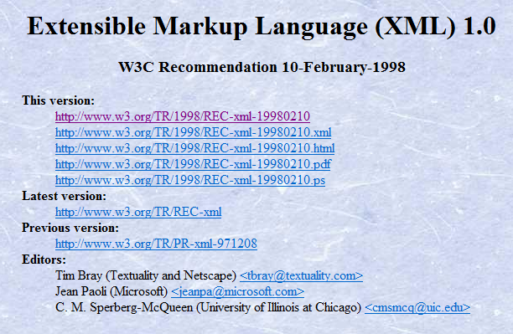
Take your mind back…
The Year is 1998….

Slide 6
1998: The State of Play
Java
Object, objects, objects rule the world
Java? Great language, great meme, but so, so much of what I loved about programming was missing...
Microsoft & MSR
Innovation? Surely we can do better than “The Digital Dashboard”
Functional
I experienced FP as “great” every day with OCaml, but why couldn’t we make it work “in real”?

Slide 7
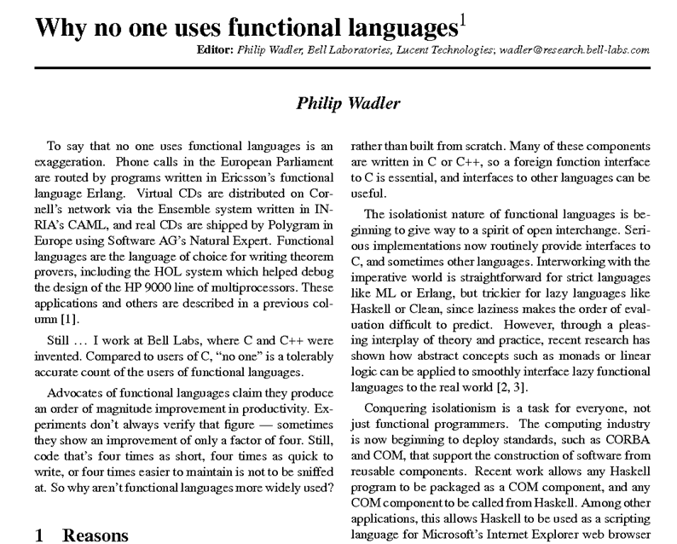

Slide 8
Roll Forward…
1998
…
2010

Slide 9
The year is 2010…
C# LINQ
'05-'08
F# Metaprog
'06-'10
.NET Generics
'98-'05
C#/VB Generics
'98-'05
.NET
2.0-4.0
C#/VB
1.0-4.0
F#
2.0
F# Core Lang
'03-'10
F# Units of
Measure
'07-'10
.NET 4.0 Tasks
'07-'10
F# Language
Integrated Async/Parallel
'07-'10
With no disrespect to the great history+advances in Lisp, Scheme, Java, Python, Scala, Erlang, Ruby, Haskell, Ocaml, Objective C, Javascript, …
Notes:
.NET 2.0-4.0, C# 2.0-4.0: .NET Generics: deep innovation, heavily inspired by functional programming design & implementation, deeply empowering for C#/VB programmers. Generic programming, with total simplicity, with debugging, with runtime types, with unboxed efficiency, with precompilation. Assert this has put Microsoft 10-20 years ahead in this aspect of VM implementation: there is still no sign of JVM or other implementations or designs that rival the CLR on this design point. IMHO anyone who builds a typed VM language on anything less is building on sand.
C# 3.0-4.0: Lambda Expressions, LINQ. I had less to do with this, but it is fundamentally enabled by .NET generics. It is a wonderful and ground-breaking embedding of queries into languages
F# 2.0: Strongly typed functional programming for .NET, built on .NET Generics
F# 2.0: Units of Measure with effective type inference. Again, it feels Microsoft is 10-20 years ahead of the competition for this feature. Take that as a challenge, if you like.
F# 2.0: Asynchronous + parallel + agent programming. Smoothly integrated asynchronous programming and agents on a VM through local CPS rewriting. Similar to Kilim, predates it a little (2007).
C# 5.0: Look for a sneak preview next week!

Slide 10
The year is 2010…
C# LINQ
SIGMOD2006
C# 3.0 Spec
F# Metaprog
ML 2006
F# 2.0 Spec
.NET Generics
PLDI 2001
POPL 2004
C#/VB Generics
PLDI 2001
C# 2.0 Spec
.NET
2.0-4.0
C#/VB
1.0-4.0
F#
2.0
F# Core Lang
ML 2004
F# 2.0 Spec
F# Async/Parallel/
Agents
Expert F# 2007
PADL 2010
F# 2.0 Spec
.NET 4.0 Tasks
OOPSLA ‘09
Towards
C# async…
F# Units of
Measure
POPL 2009
F# 2.0 Spec
Notes:
.NET 2.0-4.0, C# 2.0-4.0: .NET Generics: deep innovation, heavily inspired by functional programming design & implementation, deeply empowering for C#/VB programmers. Generic programming, with total simplicity, with debugging, with runtime types, with unboxed efficiency, with precompilation. Assert this has put Microsoft 10-20 years ahead in this aspect of VM implementation: there is still no sign of JVM or other implementations or designs that rival the CLR on this design point. IMHO anyone who builds a typed VM language on anything less is building on sand.
C# 3.0-4.0: Lambda Expressions, LINQ. I had less to do with this, but it is fundamentally enabled by .NET generics. It is a wonderful and ground-breaking embedding of queries into languages
F# 2.0: Strongly typed functional programming for .NET, built on .NET Generics
F# 2.0: Units of Measure with effective type inference. Again, it feels Microsoft is 10-20 years ahead of the competition for this feature. Take that as a challenge, if you like.
F# 2.0: Asynchronous + parallel + agent programming. Smoothly integrated asynchronous programming and agents on a VM through local CPS rewriting. Similar to Kilim, predates it a little (2007).
C# 5.0: Look for a sneak preview next week!

Slide 11
2010? A world of difference!
There’s much more to typed programming…
Java
Microsoft
Functional
Data Access
Parallel
MSR at the heart of innovation for .NET
FP is now viable and merging
Language-integrated queries (LINQ) a critical advance
Language-integrated async a critical advance

Slide 12
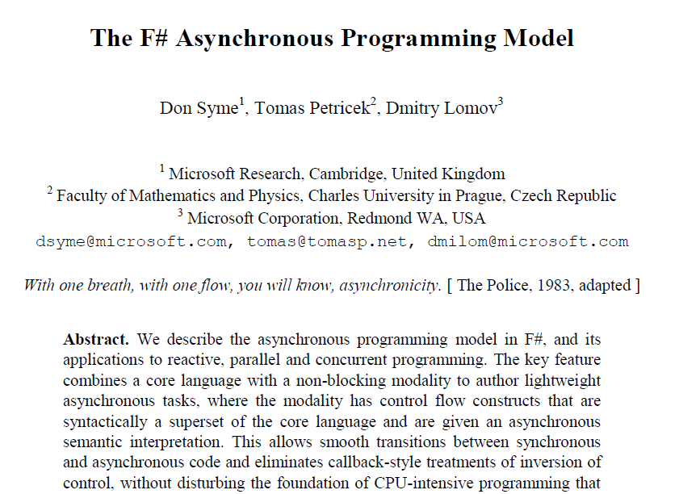
Interested in async/parallel?
Expert F# 2007
Look for it in PADL 2010!

Slide 13
Agenda
Overview
Demo
Language Taster
Source
Cross-platform
F# History
F# Today
F# Tomorrow!

Slide 14
F# is…
a programming language…

Slide 15
F# is…
...a programming language that allows you to write simple code to solve complex problems.

Slide 16
F# is…
...a productive, supported, functional programming language that allows you to write simple code to solve complex problems.

Slide 17
Simplicity

Slide 18
Simplicity: Functions as Values
abstract class Command
{
public virtual void Execute();
}
abstract class RoverCommand : Command
{
protected Rover Rover { get; private set; }
public RoverCommand(MarsRover rover)
{
this.Rover = rover;
}
}
class BreakCommand : RoverCommand
{
public BreakCommand(Rover rover)
: base(rover)
{
}
public override void Execute()
{
Rover.Rotate(-5.0);
}
}
class TurnLeftCommand : RoverCommand
{
public TurnLeftCommand(Rover rover)
: base(rover)
{
}
public override void Execute()
{
Rover.Rotate(-5.0);
}
}
C#-OO
F#
type Command = Command of (Rover -> unit)
let BreakCommand =
Command(fun rover -> rover.Accelerate(-1.0))
let TurnLeftCommand =
Command(fun rover -> rover.Rotate(-5.0<degs>))

Slide 19
Simplicity: Functional Data
C#
let swap (x, y) = (y, x)
let rotations (x, y, z) =
[ (x, y, z);
(z, x, y);
(y, z, x) ]
let reduce f (x, y, z) =
f x + f y + f z
Tuple<U,T> Swap<T,U>(Tuple<T,U> t)
{
return new Tuple<U,T>(t.Item2, t.Item1)
}
ReadOnlyCollection<Tuple<T,T,T>> Rotations<T>(Tuple<T,T,T> t)
{
new ReadOnlyCollection<int>
(new Tuple<T,T,T>[]
{ new Tuple<T,T,T>(t.Item1,t.Item2,t.Item3);
new Tuple<T,T,T>(t.Item3,t.Item1,t.Item2);
new Tuple<T,T,T>(t.Item2,t.Item3,t.Item1); });
}
int Reduce<T>(Func<T,int> f,Tuple<T,T,T> t)
{
return f(t.Item1) + f(t.Item2) + f (t.Item3);
}
F#

Slide 20
Simplicity: Functional Data
C#
public abstract class Expr { }
public abstract class UnaryOp :Expr {
public Expr First { get; private set; }
public UnaryOp(Expr first) { this.First = first; }
}
public abstract class BinExpr : Expr
{
public Expr First { get; private set; }
public Expr Second { get; private set; }
public BinExpr(Expr first, Expr second) {
this.First = first;
this.Second = second;
}
}
public class TrueExpr : Expr { }
public class And : BinExpr {
public And(Expr first, Expr second) : base(first, second) { }
}
public class Nand : BinExpr {
public Nand(Expr first, Expr second) : base(first, second{ }
}
public class Or : BinExpr {
public Or(Expr first, Expr second) : base(first, second) { }
}
public class Xor : BinExpr {
public Xor(Expr first, Expr second) : base(first, second) { }
}
public class Not : UnaryOp {
public Not(Expr first) : base(first) { }
}
F#
type Expr =
| True
| And of Expr * Expr
| Nand of Expr * Expr
| Or of Expr * Expr
| Xor of Expr * Expr
| Not of Expr

Slide 21
Simplicity: Functional Data
C#
public abstract class Event { }
public abstract class PriceEvent : Event
{
public Price Price { get; private set; }
public PriceEvent(Price price)
{
this.Price = price;
}
}
public abstract class SplitExpr : Event
{
public double Factor { get; private set; }
public SplitExpr(double factor)
{
this.Factor = factor;
}
}
public class DividendEvent : Event { }
...
type Event =
| Price of float
| Split of float
| Dividend of float<money>
F#

Slide 22
Parallel

Slide 23
Simple Code, Complex Problems

Slide 24
Example (power company)
I have written an application to balance the national power generation schedule for a portfolio of power stations to a trading position for an energy company. ...the calculation engine was written in F#.
The use of F# to address the complexity at the heart of this application clearly demonstrates a sweet spot for the language within enterprise software, namely algorithmically complex analysis of large data sets.
Simon Cousins (power company)

Slide 25
Example (power company)
Units of measure The industry I work in is littered with units....Having the type system verify the correctness of the units is a huge time saver...it eradicates a whole class of errors that previous systems were prone to.
Exploratory programming Working with F# Interactive allowed me to explore the solution space more effectively before committing to an implementation ... a very natural way for a programmer to build their understanding of the problem and the design tensions in play.
Unit testing Code written using non-side effecting functions and immutable data structures is a joy to test. There are no complex time-dependent interactions to screw things up or large sets of dependencies to be mocked.
Parallelism The functional purity ... makes it ripe for exploiting the inherent parallelism in processing vectors of data.
Interoperation ... The calculation engine could be injected into any C# module that needed to use it without any concerns at all about interoperability. Seamless. The C# programmer need never know.
Code reduction Much of the data fed into the calculation engine was in the form of vectors and matrices. Higher order functions eat these for breakfast with minimal fuss, minimal code. Beautiful.
Lack of bugs Functional programming can feel strange. .. once the type checker is satisfied that’s it, it works.

Slide 26
Example (power company)
Units of measure The industry I work in is littered with units....Having the type system verify the correctness of the units is a huge time saver...it eradicates a whole class of errors that previous systems were prone to.
Exploratory programming Working with F# Interactive allowed me to explore the solution space more effectively before committing to an implementation ... a very natural way for a programmer to build their understanding of the problem and the design tensions in play.
Unit testing Code written using non-side effecting functions and immutable data structures is a joy to test. There are no complex time-dependent interactions to screw things up or large sets of dependencies to be mocked.
Parallelism The functional purity ... makes it ripe for exploiting the inherent parallelism in processing vectors of data.
Interoperation ... The calculation engine could be injected into any C# module that needed to use it without any concerns at all about interoperability. Seamless. The C# programmer need never know.
Code reduction Much of the data fed into the calculation engine was in the form of vectors and matrices. Higher order functions eat these for breakfast with minimal fuss, minimal code. Beautiful.
Lack of bugs Functional programming can feel strange. .. once the type checker is satisfied that’s it, it works.

Slide 27
Let’s Web Crawl…
taster: demo
Notes:
If you would like to host your demo on the Virtual Server, please use the myVPC demo slide, not this slide.

Slide 28
Let’s Web Crawl…
taster: overview
Notes:
If you would like to host your demo on the Virtual Server, please use the myVPC demo slide, not this slide.

Slide 29
F# Overview
Functional Core
Objects
Units of Measure
Imperative Mutation & I/O
Language Integrated Async/Parallel
Meta Programming
e.g. SQL Queries
GPU Programs
Functional Data

Slide 30
F# Core Language: Influences
OCaml
C#/.NET
F#
Similar core
language
Similar object
model

Slide 31
Functional-First
I've been coding in F# lately, for a production task. F# allows you to move smoothly in your programming style... I start with pure functional code, shift slightly towards an object-oriented style, and in production code, I sometimes have to do some imperative programming.
I can start with a pure idea, and still finish my project with realistic code. You're never disappointed in any phase of the project!
Julien Laugel, Chief Software Architect, www.eurostocks.com

Slide 32
Let’s Web Crawl…
taster: syntax
Notes:
If you would like to host your demo on the Virtual Server, please use the myVPC demo slide, not this slide.

Slide 33
Fundamentals - Whitespace Matters
let computeDerivative f x =
let p1 = f (x - 0.05)
let p2 = f (x + 0.05)
(p2 – p1) / 0.1
Offside (bad indentation)

Slide 34
Fundamentals - Whitespace Matters
let computeDerivative f x =
let p1 = f (x - 0.05)
let p2 = f (x + 0.05)
(p2 – p1) / 0.1

Slide 35
Let’s Web Crawl…
taster: objects
Notes:
If you would like to host your demo on the Virtual Server, please use the myVPC demo slide, not this slide.

Slide 36
F# - Objects + Functional
type Vector2D (dx:double, dy:double) =
let d2 = dx*dx+dy*dy
member v.DX = dx
member v.DY = dy
member v.Length = sqrt d2
member v.Scale(k) = Vector2D (dx*k,dy*k)
Inputs to object
construction
Object internals
Exported properties
Exported method

Slide 37
Let’s Web Crawl…
taster: units of measure
Notes:
If you would like to host your demo on the Virtual Server, please use the myVPC demo slide, not this slide.

Slide 38
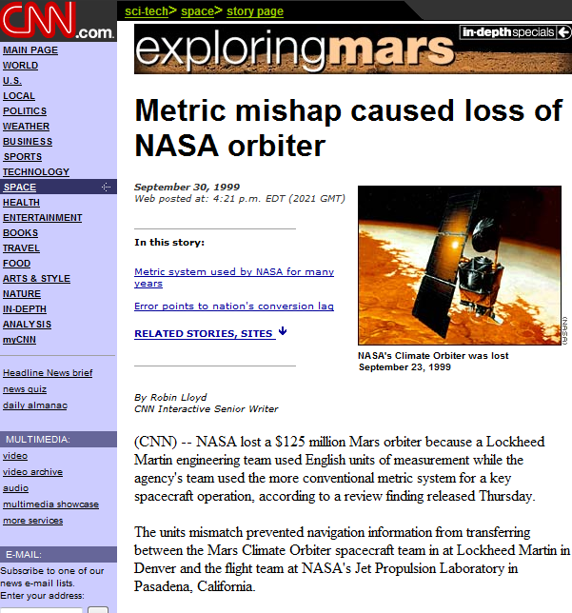
NASA Mars Climate Orbiter, 1999

Slide 39
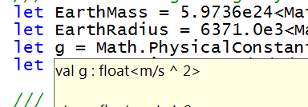
let EarthMass = 5.9736e24<kg>
// Average between pole and equator radii
let EarthRadius = 6371.0e3<m>
// Gravitational acceleration on surface of Earth
let g = PhysicalConstants.G * EarthMass / (EarthRadius * EarthRadius)

Slide 40
Let’s Web Crawl…
taster: async/parallel
Notes:
If you would like to host your demo on the Virtual Server, please use the myVPC demo slide, not this slide.

Slide 41
React!
async { let! res = <async-event>
... }
React to a GUI Event
React to a Timer Callback
React to a Query Response
React to a HTTP Response
React to a Web Service Response
React to a Disk I/O Completion
Agent reacts to Message

Slide 42
The many uses of async { ... }
Sequencing I/O requests
Sequencing CPU computations and I/O requests
async { let! lang = detectLanguageAsync text
let! text2 = translateAsync (lang,"da",text)
return text2 }
async { let! lang = detectLanguageAsync text
let! text2 = translateAsync (lang,"da",text)
let text3 = postProcess text2
return text3 }

Slide 43
The many uses of async { ... }
Parallel CPU computations
Parallel I/O requests
Async.Parallel [ async { return (fib 39) };
async { return (fib 40) }; ]
Async.Parallel
[ for target in langs ->
translateAsync (lang,target,text) ]

Slide 44
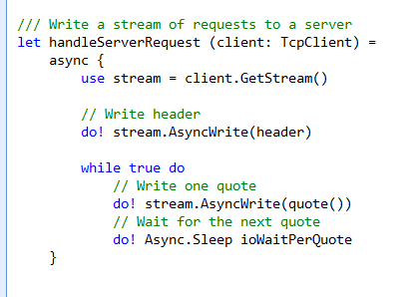
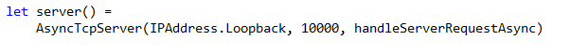
F# example: Serving 50,000+ simultaneous TCP connections with ~10 threads
React!
React!
React!

Slide 45
Let’s Web Crawl…
taster: source
Notes:
If you would like to host your demo on the Virtual Server, please use the myVPC demo slide, not this slide.

Slide 46
F#: Source
Today:
Compiler+Library source is in every “CTP” release (MSR Shared Source license)
Source for “F# Power Pack” on CodePlex
Coming Up: announcements about F# Compiler+Library OSS Release….

Slide 47
Let’s Web Crawl…
taster: cross-platform
Notes:
If you would like to host your demo on the Virtual Server, please use the myVPC demo slide, not this slide.

Slide 48
F#: Cross-platform
Emacs
Mono-Develop,
etc. …
Emacs
Mono-Develop,
etc. …
Visual Studio
tools templates
designers
…
Visual Studio
tools templates
designers
…
Visual Studio
tools++
languages
templates
designers
…
Adv. Tools
fsc.exe
fsi.exe
libraries
fsc.exe
fsi.exe
libraries
fsc.exe
libraries
fsc.exe
fsi.exe
libraries
fsc.exe
fsi.exe
libraries
Basic Tools
Linux
(Mono…)
Mac
(Mono…)
Phone
(Mono,WP7)
Windows,
Silverlight
(free tools)
Windows,
Silverlight
VS 2010

Slide 49
Agenda
F# History
F# Today
F# Tomorrow!
A teaser

Slide 50
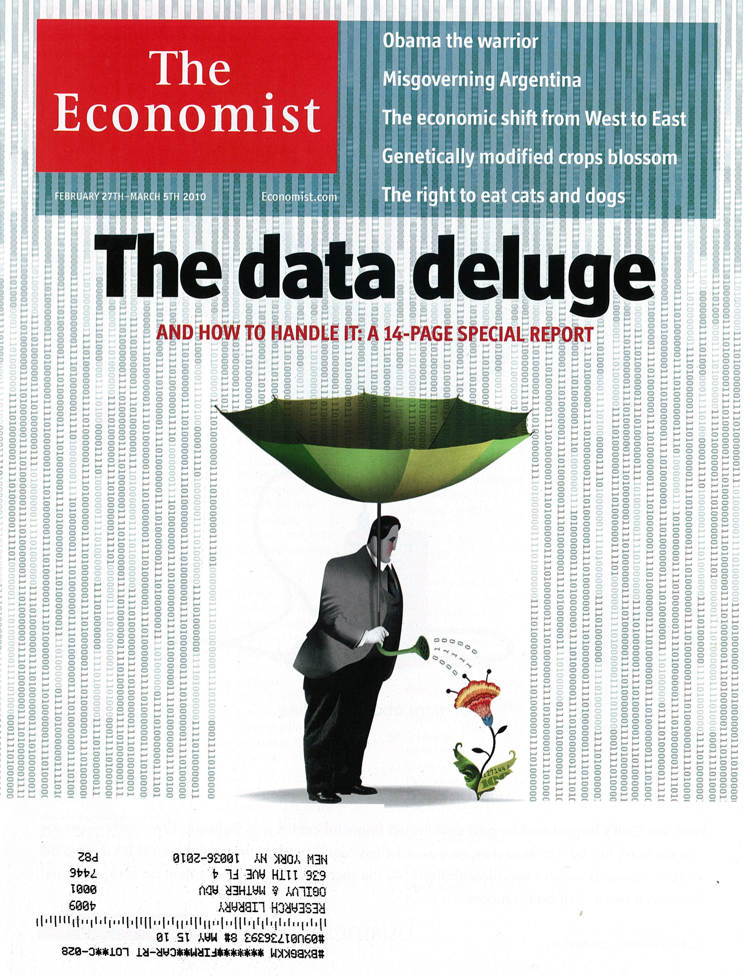

Slide 51
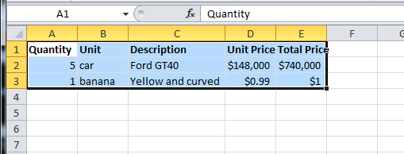
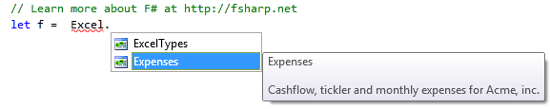
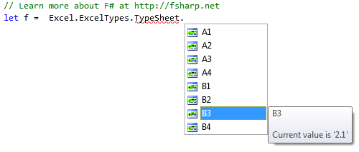
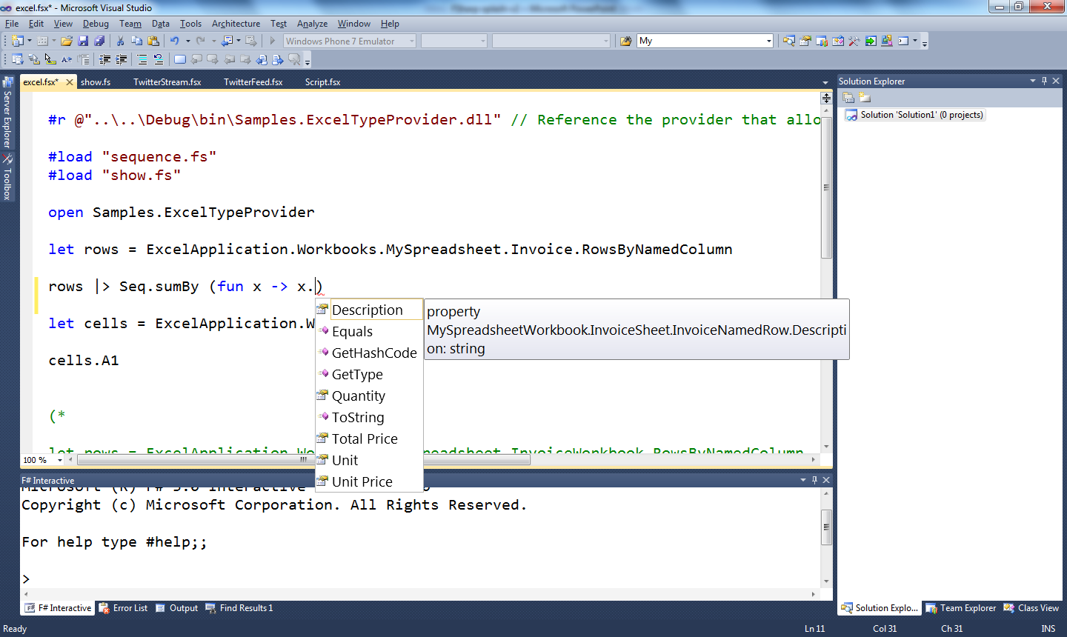
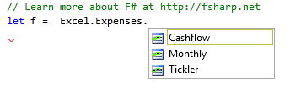
Just imagine if we could… access spreadsheets in a strongly typed way?

Slide 52
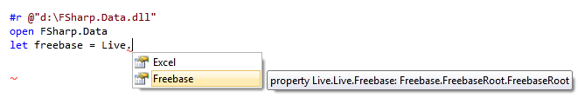
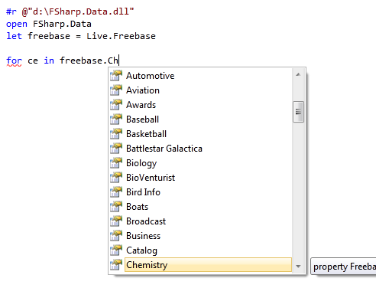
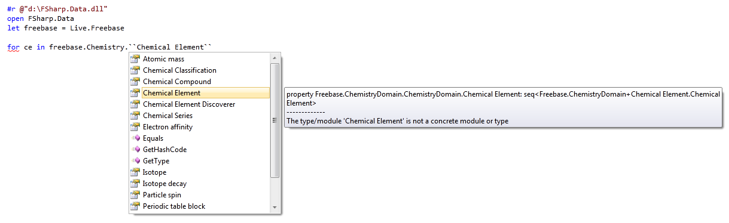
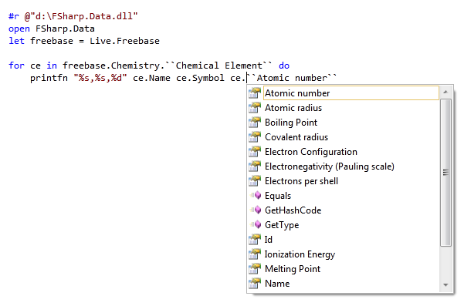
Just imagine if we could… access web data in a strongly typed way?

Slide 53
Just imagine if we could…
Language extensions to access the world’s data and services, strongly typed and navigable
Watch this space!

Slide 54
F# Tomorrow: Language Philosophy... Typed programming in a context of named information and named services You program directly against these www.usgs.gov www.xignite.com www.freebase.com www.google.com/.../api //MyServer/MyDatabase MyExcelFile.xlsx homepage.html MyWindows.xaml
Notes:
So why can’t programmers experience this context, using these names, and their schemas?

Slide 55
Summary
F# Tomorrow?
“What if you had the
world at your fingertips,
strongly typed…??”
1998-2010,
A Journey to C# 5.0
and F# 2.0
F# Today: Simple Code
for Complex Problems
F# History
F# Today
F# Tomorrow!

Slide 56
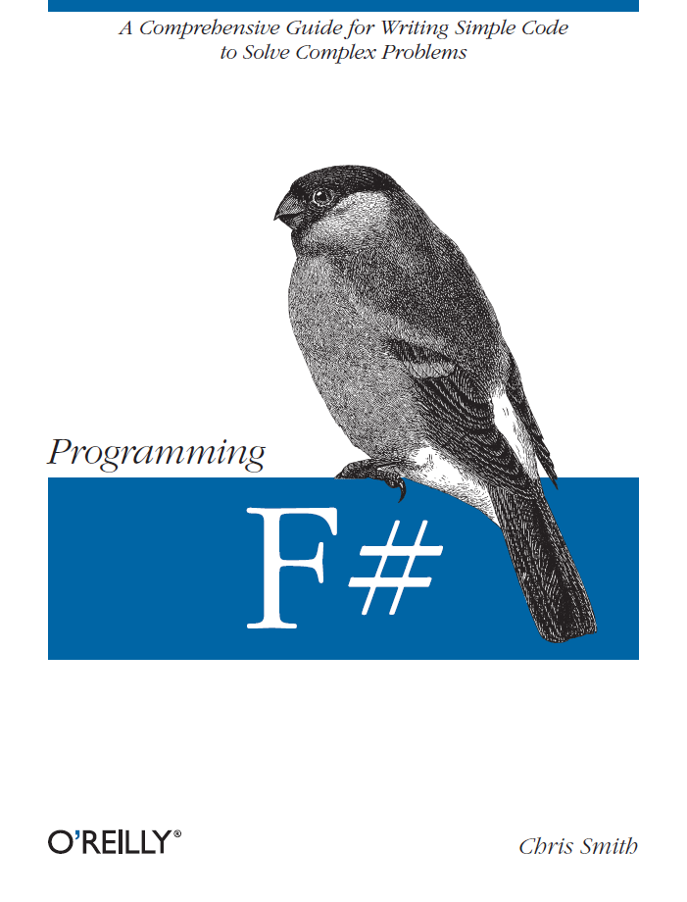
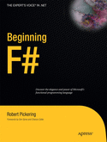
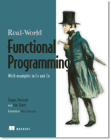

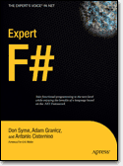
Books about F#
Visit www.fsharp.net

Slide 57
Questions http://fsharp.net http://blogs.msdn.com/dsyme

