Slide 1
The Future of F# Data and Services, At Your Fingertips, Strongly Typed
Don Syme
Principal Researcher
Microsoft Research

Slide 2
Summary The world is information rich Our languages need to be information-rich too The F# Future? Consume it! Directly! Strongly typed! No walls!

Slide 3
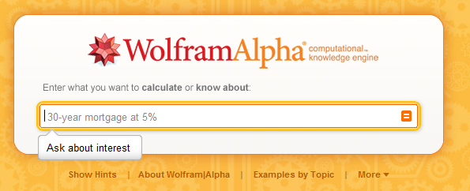
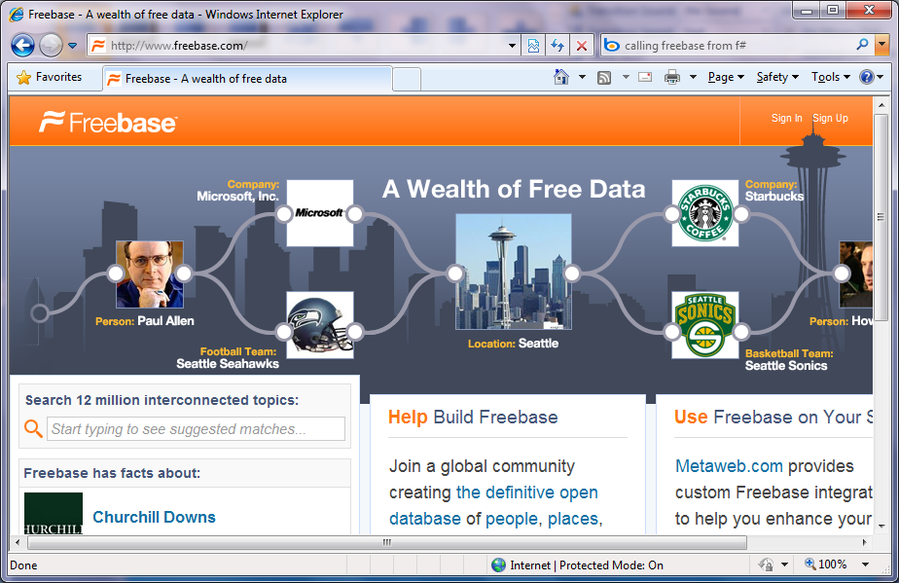
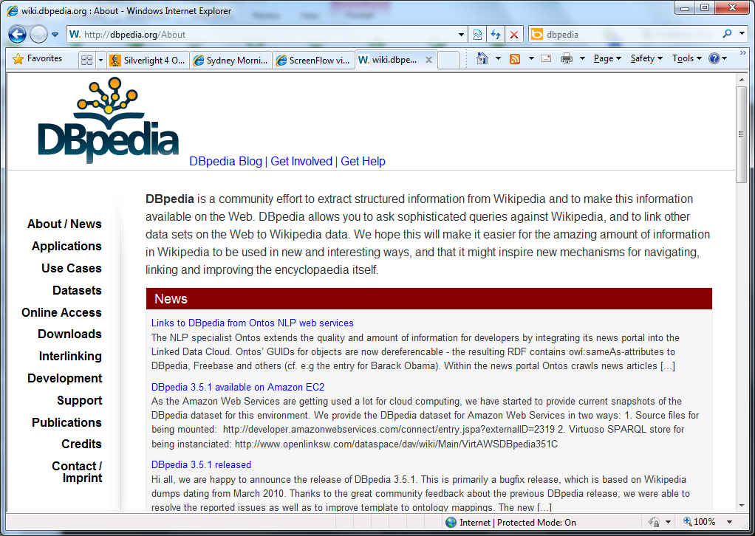
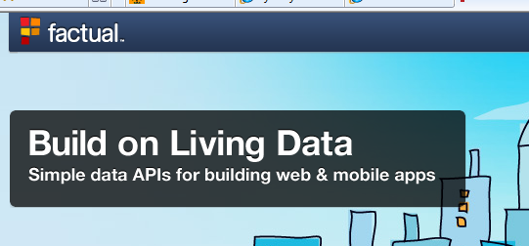
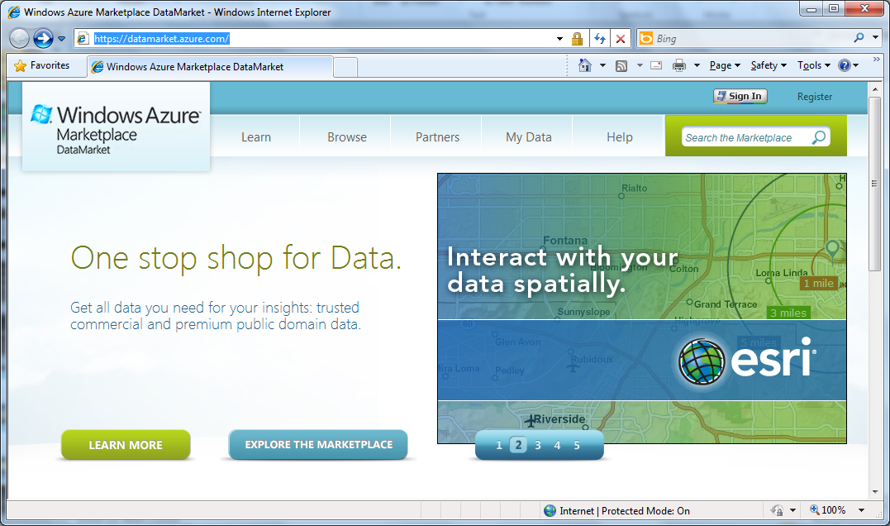
demos x 3
Language Integrated Web Data

Slide 4
Summary: Just imagine if we could access….
…web data
…data markets
…WMI & active directory
…a spreadsheet
…web services
…CRM data
…social data
…SQL data
…XML data
...
strongly typed
without explicit codegen
extensible, open

