Slide 1
F# From Simple & Fun to Parallel and Data Rich
Don Syme, Principal Researcher, Microsoft Research
Nigel Horspool, Professor, University of Victoria, Canada

Slide 2
Purpose of Tutorial
Show F# running on different platforms
Introduce the F# programming language
Describe possibilities for teaching:
introductory programming
concurrent programming
Demonstrate more advanced possibilities

Slide 3
F# and Open Source
F# 2.0 compiler+library open source drop
Apache 2.0 license
www.tryfsharp.org
http://blogs.msdn.com/dsyme

Slide 4
Some Characteristics of F#
Multiparadigm (functional first + OO + parallel)
Strong static type checking + inference
Succinct
Linux, Mac or Windows
Visual Studio, or MonoDevelop on all platforms

Slide 5
F# AS A SIMPLE, Fun, PLAYFUL BUT PRACTICAL LANGUAGE
Notes:
If you would like to host your demo on the Virtual Server, please use the myVPC demo slide, not this slide.

Slide 6
F# is…
a programming language…

Slide 7
F# is…
...a programming language that allows you to write simple code to solve complex problems.

Slide 8
F# is…
...a practical, functional-first programming language that allows you to write simple code to solve complex problems.

Slide 9
Simplicity

Slide 10
Simplicity: Functions as Values
abstract class Command
{
public virtual void Execute();
}
abstract class RoverCommand : Command
{
protected Rover Rover { get; private set; }
public RoverCommand(MarsRover rover)
{
this.Rover = rover;
}
}
class BreakCommand : RoverCommand
{
public BreakCommand(Rover rover)
: base(rover)
{
}
public override void Execute()
{
Rover.Rotate(-5.0);
}
}
class TurnLeftCommand : RoverCommand
{
public TurnLeftCommand(Rover rover)
: base(rover)
{
}
public override void Execute()
{
Rover.Rotate(-5.0);
}
}
OO
F#
type Command = Command of (Rover -> unit)
let BreakCommand =
Command(fun rover -> rover.Accelerate(-1.0))
let TurnLeftCommand =
Command(fun rover -> rover.Rotate(-5.0<degs>))

Slide 11
Simplicity: Functional Data
C#
Tuple<U,T> Swap<T,U>(Tuple<T,U> t)
{
return new Tuple<U,T>(t.Item2, t.Item1)
}
ReadOnlyCollection<Tuple<T,T,T>> Rotations<T>(Tuple<T,T,T> t)
{
new ReadOnlyCollection<int>
(new Tuple<T,T,T>[]
{ new Tuple<T,T,T>(t.Item1,t.Item2,t.Item3);
new Tuple<T,T,T>(t.Item3,t.Item1,t.Item2);
new Tuple<T,T,T>(t.Item2,t.Item3,t.Item1); });
}
int Reduce<T>(Func<T,int> f,Tuple<T,T,T> t)
{
return f(t.Item1) + f(t.Item2) + f (t.Item3);
}
let swap (x, y) = (y, x)
let rotations (x, y, z) =
[ (x, y, z);
(z, x, y);
(y, z, x) ]
let reduce f (x, y, z) =
f x + f y + f z
F#

Slide 12
Simplicity: Functional Data
C#
F#
public abstract class Expr { }
public abstract class UnaryOp :Expr {
public Expr First { get; private set; }
public UnaryOp(Expr first) { this.First = first; }
}
public abstract class BinExpr : Expr
{
public Expr First { get; private set; }
public Expr Second { get; private set; }
public BinExpr(Expr first, Expr second) {
this.First = first;
this.Second = second;
}
}
public class TrueExpr : Expr { }
public class And : BinExpr {
public And(Expr first, Expr second) : base(first, second) { }
}
public class Nand : BinExpr {
public Nand(Expr first, Expr second) : base(first, second{ }
}
public class Or : BinExpr {
public Or(Expr first, Expr second) : base(first, second) { }
}
public class Xor : BinExpr {
public Xor(Expr first, Expr second) : base(first, second) { }
}
public class Not : UnaryOp {
public Not(Expr first) : base(first) { }
}
type Expr =
| True
| And of Expr * Expr
| Nand of Expr * Expr
| Or of Expr * Expr
| Xor of Expr * Expr
| Not of Expr

Slide 13
Simplicity: Functional Data
C#
public abstract class Event { }
public abstract class PriceEvent : Event
{
public Price Price { get; private set; }
public PriceEvent(Price price)
{
this.Price = price;
}
}
public abstract class SplitExpr : Event
{
public double Factor { get; private set; }
public SplitExpr(double factor)
{
this.Factor = factor;
}
}
public class DividendEvent : Event { }
...
type Event =
| Price of float
| Split of float
| Dividend of float<money>
F#

Slide 14
Parallel

Slide 15
The Big Trends
THE WEB
MULTICORE

Slide 16
Async.Parallel [ httpAsync "www.google.com" httpAsync "www.bing.com" httpAsync "www.yahoo.com" ]
Parallel
|> Async.RunSynchronously

Slide 17
Async.Parallel [ for i in 0 .. 200 -> computeTask i ]
Parallel
|> Async.RunSynchronously

Slide 18
Some Basic F#
Notes:
If you would like to host your demo on the Virtual Server, please use the myVPC demo slide, not this slide.

Slide 19
Some ADVANCED F#
Notes:
If you would like to host your demo on the Virtual Server, please use the myVPC demo slide, not this slide.

Slide 20
Objects
Class Types
type ObjectType(args) =
let internalValue = expr
let internalFunction args = expr
let mutable internalState = expr
member x.Prop1 = expr
member x.Meth2 args = expr
Interface Types
type IObject =
interface ISimpleObject
abstract Prop1 : type
abstract Meth2 : type -> type
Constructing Objects
new FileInfo(@"c:\misc\test.fs")

Slide 21
Objects + Functional
type Vector2D (dx:double, dy:double) =
let d2 = dx*dx+dy*dy
member v.DX = dx
member v.DY = dy
member v.Length = sqrt d2
member v.Scale(k) = Vector2D (dx*k,dy*k)
Inputs to object
construction
Object internals
Exported properties
Exported method

Slide 22
Topic: Units of Measure

Slide 23
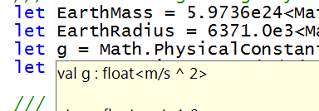
let EarthMass = 5.9736e24<kg>
// Average between pole and equator radii
let EarthRadius = 6371.0e3<m>
// Gravitational acceleration on surface of Earth
let g = PhysicalConstants.G * EarthMass / (EarthRadius * EarthRadius)

Slide 24
Summary
F# is a general purpose, efficient, succinct, “functional-first” programming language
F# has a simple, script-like initial experience, but is strongly typed and friendly
F# has some nice features for objects, queries, async, agents, parallel and units of measure
F# is highly interoperable, and can build vanilla .NET components

Slide 25
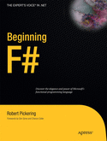
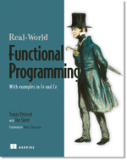
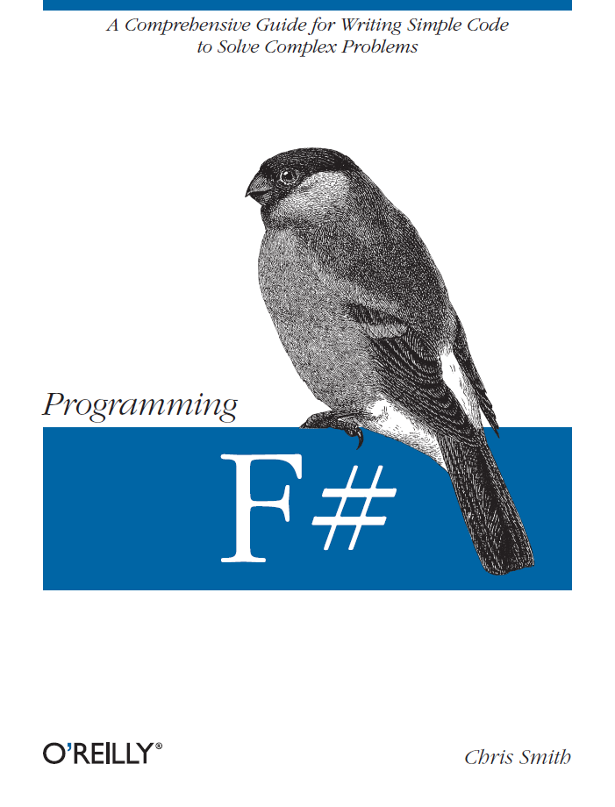

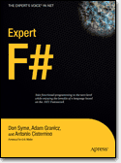
Latest Books about F#
Visit www.fsharp.net

Slide 26
q & a
www.tryfsharp.org
http://blogs.msdn.com/dsyme

