Slide 1
F# 3.0: data, services, Web, cloud, at your fingertips
SAC-904T
Don Syme
Principal Researcher
Microsoft Research

Slide 2
Agenda slide
WHO WILL BENEFIT FROM THIS TALK
TOPICS
WHAT YOU’LL LEAVE WITH
Enterprise Developers
Data Developers
Service Developers
Analytical Programmers
F# 3.0: Making Data Simple
F# 3.0: Making Data Regular
F# 3.0: Making Data Efficient
How to access data with F# 3.0
How to access services with F# 3.0
Using F# 3.0 on servers and devices

Slide 3
Understanding F#
F# 3.0
F# 2.0
C#, VB, HTML5, Javascript
Transformation,
Analysis,
Algorithms,
Code,
Parallel
Access
Data,
Information,
Services
Presentation,
Publication,
Experience

Slide 4
Understanding F#
Our roadmap is for F# 3.0 to support “portable” profile libraries (not in Developer Preview)
You use your F# code on Metro, Desktop etc.
You use a C# or VB front-end project
Just like Silverlight, Phone, ASP.NET etc.

Slide 5
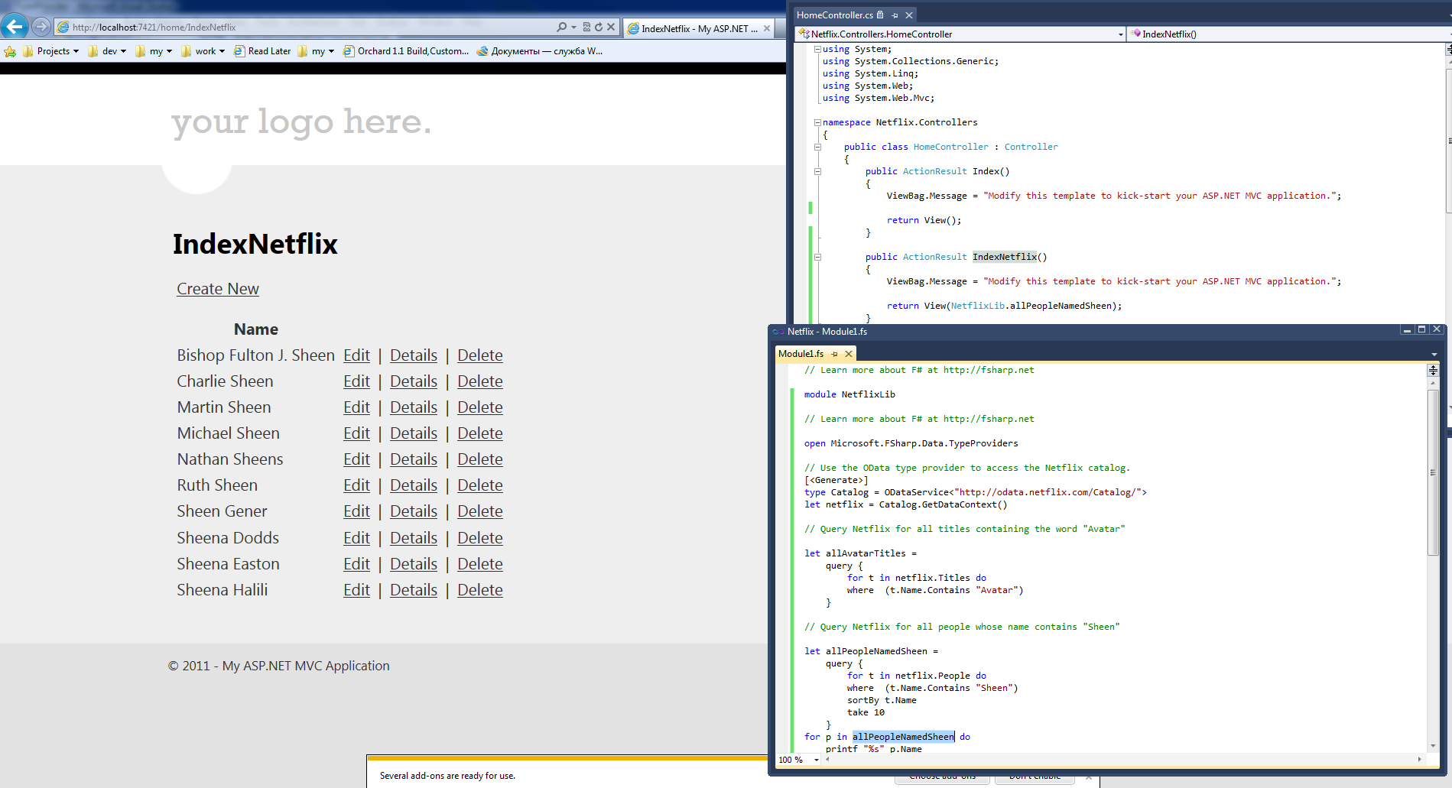
Final ASP.NET application
C# Front End
F# Data Acquisition, Query and
Analysis
http://yfrog.com/z/nupkap

Slide 6
Understanding F# 3.0 is very simple

Slide 7
The world is information rich Very, very information rich

Slide 8
Our languages and frameworks are information-sparse

Slide 9
We need to fix this

Slide 10
F# 3.0 is about fixing this and you can use F# components with C#, VB etc.

Slide 11
But first, a bit about F#...

Slide 12
F# is…
...a productive, supported, interoperable, functional language that allows you to write simple code to solve complex problems.

Slide 13
Some Basic F#
demo

Slide 14
F# can be used for just about everything, but excels at analytical programming

Slide 15
Example (Power Company)
I have written an application to balance the national power generation schedule … for an energy company.
...the calculation engine was written in F#.
The use of F# to address the complexity at the heart of this application clearly demonstrates a sweet spot for the language … algorithmic analysis of large data sets.
Simon Cousins (Eon Powergen)

Slide 16
Language Integrated Web & Cloud Data
demo

Slide 17
A Type Provider is…
A design-time component that provides a computed space of types
A compiler/IDE extension…
The static counterpart to dynamic languages…
Intellisense for data
Extensible and open
Breaking down walls

Slide 18
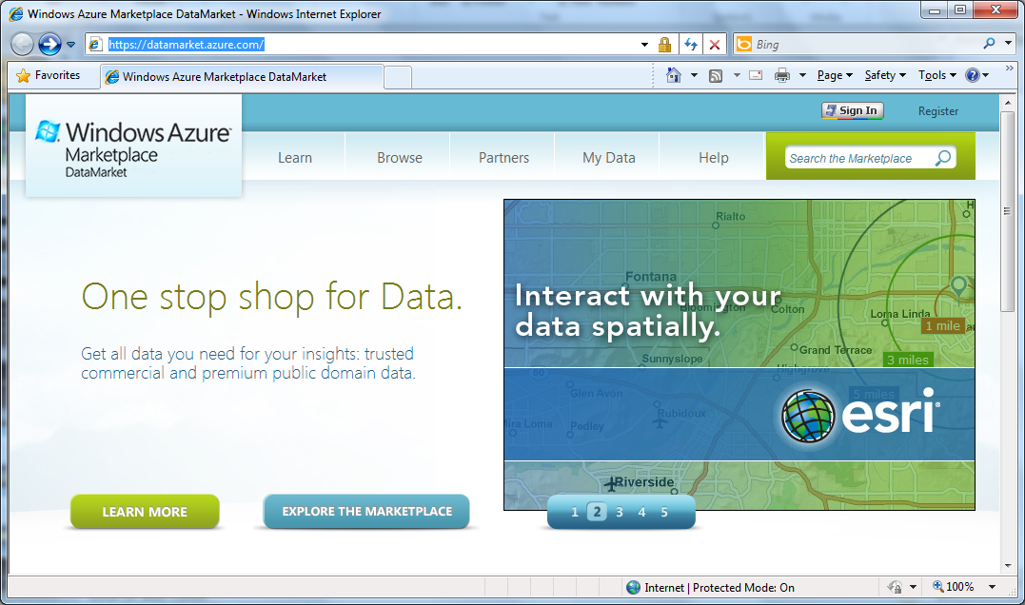

Slide 19
The Enterprise Data Sources You Need
demo

Slide 20
F# 3.0: SQL + Linq2SQL
type SQL = SqlDataConnection<"Server='.\\SQLEXPRESS'...">

Slide 21
F# 3.0: SQL + Linq2SQL
Needed in Developer Preview
[<Generate>]
type SQL = SqlDataConnection<"Server='.\\SQLEXPRESS'...">

Slide 22
F# 3.0: SQL + Linq2SQL
type SQL = SqlDataConnection<"Server='.\\SQLEXPRESS'...">

Slide 23
F# 3.0: SQL Server/Entity Framework
type SQL = SqlEntityConnection<"Server='.\\SQLEXPRESS'">

Slide 24
F# 3.0: OData
type Netflix = ODataService<"http://odata.netflix.com">

Slide 25
F# 3.0: Queries
let avatarTitles =
query { for t in netflix.Titles do
where (t.Name.Contains "Avatar") }

Slide 26
F# 3.0: Queries
let avatarTitles =
query { for t in netflix.Titles do
where (t.Name.Contains "Avatar")
sortBy t.Name
take 100 }

Slide 27
Extensible and Open
demo

Slide 28
F# 3.0: SharePoint (via sample)
type EmeaSite = SharePointSite<"http://myemea/">

Slide 29
F# 3.0 – Details
Much Better Intellisense
Auto-properties
Parameter help when using methods
Many more samples and documentation
Better Nullable Support
F# Type Providers can work with Units of Measure
Standard SI Units of Measure in F# Core Library
Benefit from many improvements in .NET and Visual Studio

Slide 30
F# 2.0 is an accelerator for solving computationally complex problems F# 3.0 is an accelerator for solving data complex problems

Slide 31
Next Steps
Use F# 3.0
here
Use F# 2.0
here
Enjoy C#, VB, HTML5, Javascript here
Transformation,
Analysis,
Algorithms,
Code,
Parallel
Data,
Information,
Services
Access
Presentation,
Publication,
Experience

Slide 32
In Summary
F# 3.0
Ready for use in VS 11
Code-focused analytical programming
An amazing data-rich future ahead
Simple, expressive, productive, interoperable language

Slide 33
“For more information” Slide
RELATED SESSIONS
DOCUMENTATION & ARTICLES
SAC-836T Your devices + OData + Windows Azure = happiness
SAC-824T OData Futures: creating the web of data
TOOL-834T What's new in .NET Framework 4.5
TBD Future of C# and Visual Basic
MSDN F# Developer Center
MSDN F# Sample Kit
MSDN F# Type Providers
CONTACT: dsyme@microsoft.com

Slide 34
thank you
Feedback and questions http://forums.dev.windows.com
Session feedback http://bldw.in/SessionFeedback

Slide 35

© 2011 Microsoft Corporation. All rights reserved. Microsoft, Windows, Windows Vista and other product names are or may be registered trademarks and/or trademarks in the U.S. and/or other countries.
The information herein is for informational purposes only and represents the current view of Microsoft Corporation as of the date of this presentation. Because Microsoft must respond to changing market conditions, it should not be interpreted to be a commitment on the part of Microsoft, and Microsoft cannot guarantee the accuracy of any information provided after the date of this presentation. MICROSOFT MAKES NO WARRANTIES, EXPRESS, IMPLIED OR STATUTORY, AS TO THE INFORMATION IN THIS PRESENTATION.

Slide 36
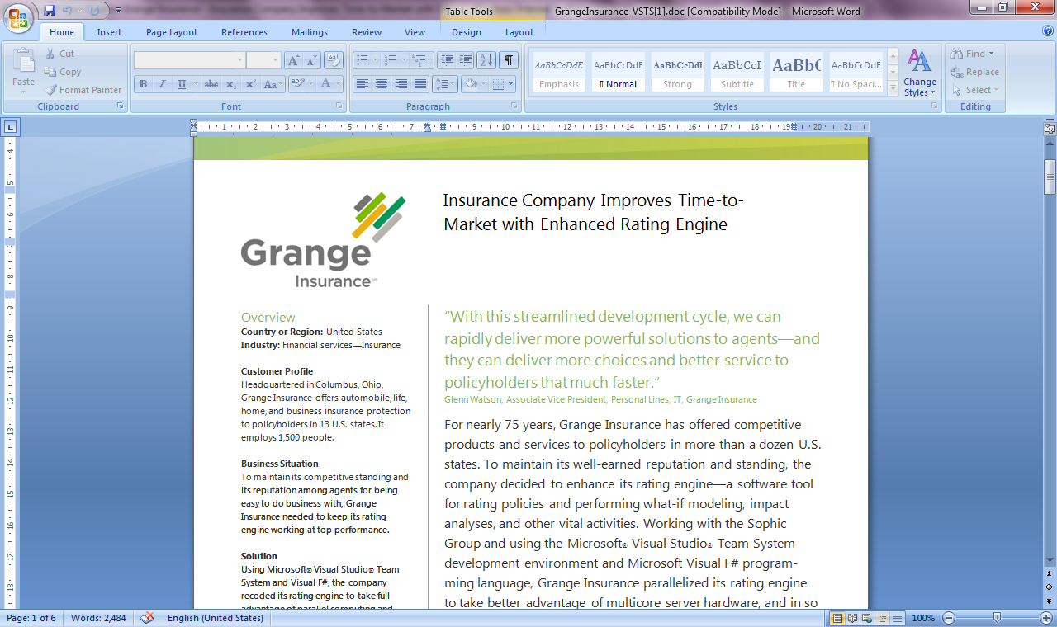
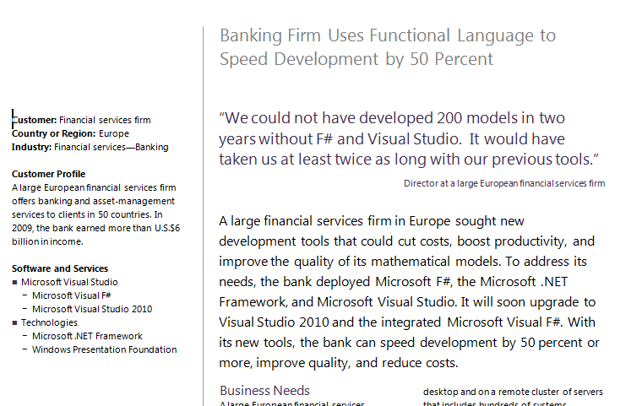
Examples #2/#3: Finance companies

Slide 37
Example #4: Biotech
...F# rocks - building algorithms for DNA processing
and it's like a drug. 12-15 at Amyris use F#...
F# has been phenomenally useful. I would be writing a lot of this in Python otherwise and F# is more robust, 20x - 100x faster to run and faster to develop.
Darren Platt, Amyris BioTechnologies

Slide 38
The magic is made up of: - F# Type Providers - F# LINQ Queries - F# SQL, OData, WSDL, … - Extensible, open information injection architecture

